Slide 1
X-Informatics MapReduce
February 25 2013
Geoffrey Fox
gcf@indiana.edu
http://www.infomall.org/X-InformaticsSpring2013/index.html
Associate Dean for Research and Graduate Studies, School of Informatics and Computing
Indiana University Bloomington
2013

Slide 2
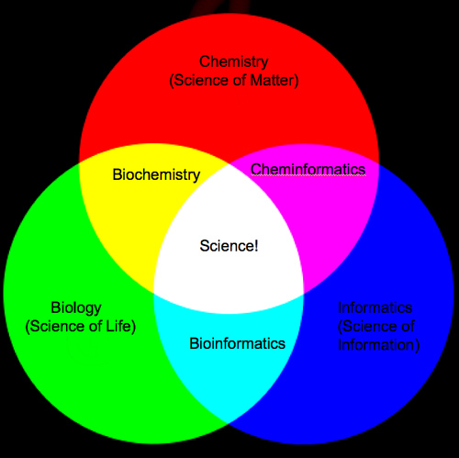
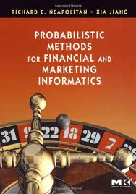
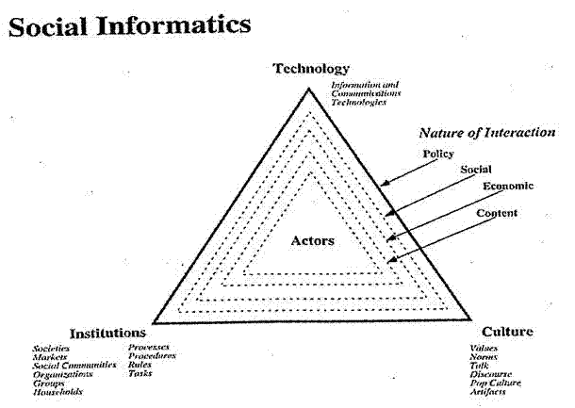

Slide 3
The Course in One Sentence
Study Clouds running Data Analytics processing Big Data to solve problems in X-Informatics

Slide 4
MapReduce

Slide 5
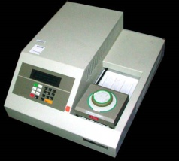
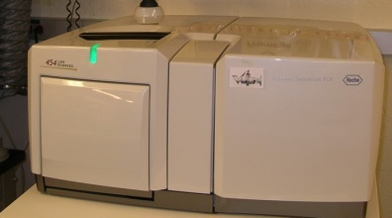
MapReduce “File/Data Repository” Parallelism
Map = (data parallel) computation reading and writing data
Reduce = Collective/Consolidation phase e.g. forming multiple global sums as in histogram
Instruments
MPI and Iterative MapReduce
Map Map Map Map
Reduce Reduce Reduce
Communication
Reduce
Portals /Users
Disks
Map₁
Map₂
Map₃

Slide 6
MapReduce
A parallel Runtime coming from Information Retrieval
Data Partitions
Map(Key, Value)
A hash function maps the results of the map tasks to r reduce tasks
Reduce(Key, List<Value>)
Reduce Outputs
Implementations support:
Splitting of data
Passing the output of map functions to reduce functions
Sorting the inputs to the reduce function based on the intermediate keys
Quality of services

Slide 7
4 Forms of MapReduce
(a) Map Only
(b) Classic MapReduce
(c) Iterative MapReduce
(d) Loosely Synchronous
Input
Input
Iterations
Input
map
map
map
P_{ij}
reduce
reduce
Output
BLAST Analysis
Parametric sweep
Pleasingly Parallel
High Energy Physics (HEP) Histograms
Distributed search
Expectation maximization Clustering e.g. Kmeans
Linear Algebra, Page Rank
Classic MPI
PDE Solvers and particle dynamics
Domain of MapReduce and Iterative Extensions
Science Clouds
MPI
Exascale
MPI is Map followed by Point to Point Communication – as in style d)

Slide 8
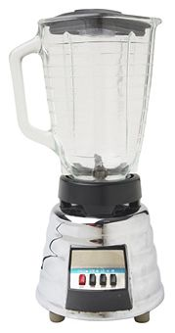
Sam’s Problem http://www.slideshare.net/esaliya/mapreduce-in-simple-terms
Sam thought of “drinking” the apple
He used a to cut the and a to make juice.

Slide 9
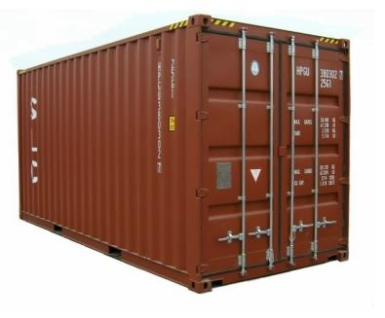
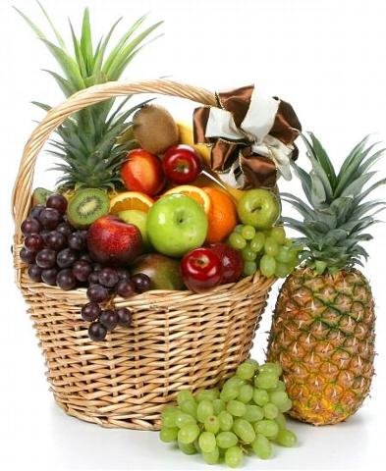
Creative Sam
Implemented a parallel version of his innovation
Fruits
Each input to a map is a list of <key, value> pairs
A list of <key, value> pairs mapped into another list of <key, value> pairs which gets grouped by the key and reduced into a list of values
(<a, > , <o, > , <p, > , …)
Each output of slice is a list of <key, value> pairs
(<a’, > , <o’, > , <p’, > )
Grouped by key
The idea of Map Reduce in Data Intensive Computing
Each input to a reduce is a <key, value-list> (possibly a list of these, depending on the grouping/hashing mechanism)
e.g. <ao, ( …)>
Reduced into a list of values

