Slide 1
X-Informatics Introduction:
What is
Big Data, Data Analytics and X-Informatics? (Continued)
January 14 2013
Geoffrey Fox
gcf@indiana.edu
http://www.infomall.org/X-InformaticsSpring2013/index.html
Associate Dean for Research and Graduate Studies, School of Informatics and Computing
Indiana University Bloomington
2013

Slide 2
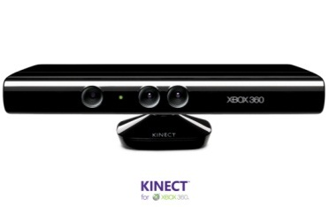

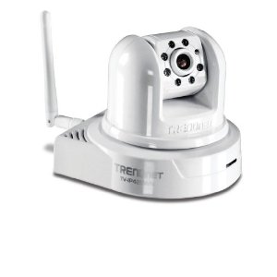
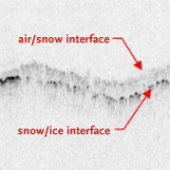
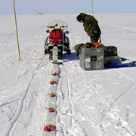

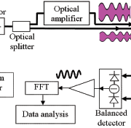

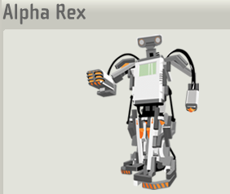
Sensors (Things) as a Service
Output Sensor
Sensors as a Service
Sensor Processing as a Service (could use
MapReduce)
A larger sensor ………
https://sites.google.com/site/opensourceiotcloud/ Open Source Sensor (IoT) Cloud

Slide 3
Clouds

Slide 4
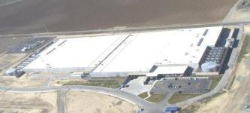

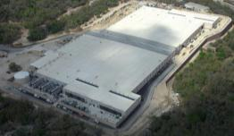
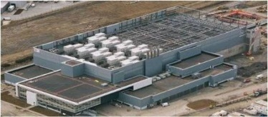
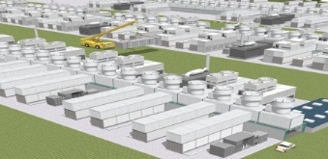
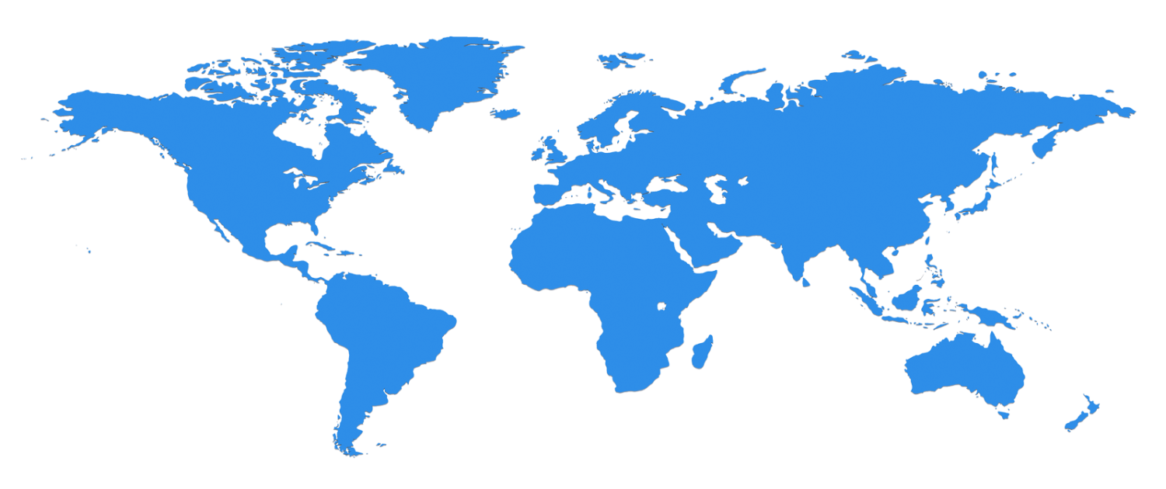


The Microsoft Cloud is Built on Data Centers
~100 Globally Distributed Data Centers
Range in size from “edge” facilities to megascale (100K to 1M servers)
Quincy, WA
Chicago, IL
San Antonio, TX
Dublin, Ireland
Generation 4 DCs
Gannon Talk

Slide 5
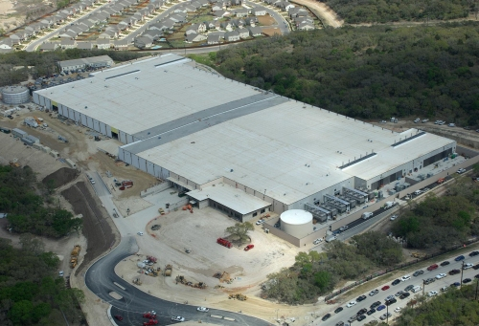
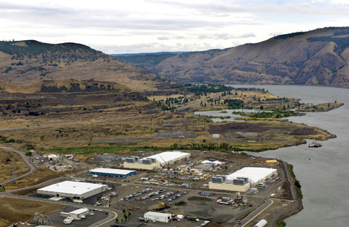
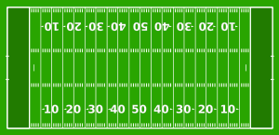
Data Centers Clouds &
Economies of Scale I
Range in size from “edge” facilities to megascale.
Economies of scale
  Approximate costs for a small size center (1K servers) and a larger, 50K server center.
2 Google warehouses of computers on the banks of the Columbia River, in The Dalles, Oregon
Such centers use 20MW-200MW
(Future) each with 150 watts per CPU
Save money from large size, positioning with cheap power and access with Internet
Technology | Cost in small-sized Data Center | Cost in Large Data Center | Ratio
Network | $95 per Mbps/ month | $13 per Mbps/ month | 7.1
Storage | $2.20 per GB/ month | $0.40 per GB/ month | 5.7
Administration | ~140 servers/ Administrator | >1000 Servers/ Administrator | 7.1
Each data center is
11.5 times
the size of a football field

Slide 6
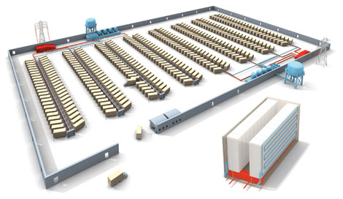
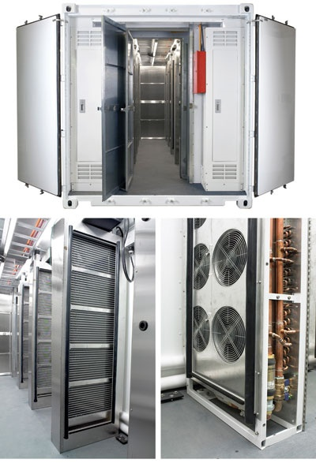
Data Centers, Clouds
& Economies of Scale II
Builds giant data centers with 100,000’s of computers;
~ 200-1000 to a shipping container with Internet access
“Microsoft will cram between 150 and 220 shipping containers filled with data center gear into a new 500,000 square foot Chicago facility. This move marks the most significant, public use of the shipping container systems popularized by the likes of Sun Microsystems and Rackable Systems to date.”

Slide 7

Green Clouds
Cloud Centers optimize life cycle costs and power use
http://www.datacenterknowledge.com/archives/2011/05/10/uptime-institute-the-average-pue-is-1-8/
Average PUE = 1.8 (was nearer 3) ; Good Clouds are 1.1-1.2
4th generation data centers (from Microsoft) make everything modular so data centers can be built incrementally as in modern manufacturing
http://loosebolts.wordpress.com/2008/12/02/our-vision-for-generation-4-modular-data-centers-one-way-of-getting-it-just-right/
Extends container based third generation

Slide 8
Some Sizes in 2010
http://www.mediafire.com/file/zzqna34282frr2f/koomeydatacenterelectuse2011finalversion.pdf
30 million servers worldwide
Google had 900,000 servers (3% total world wide)
Google total power ~200 Megawatts
  < 1% of total power used in data centers (Google more efficient than average – Clouds are Green!)
  ~ 0.01% of total power used on anything world wide
Maybe total clouds are 20% total world server count (a growing fraction)

Slide 9
Some Sizes Cloud v HPC
Top Supercomputer Sequoia Blue Gene Q at LLNL
  16.32 Petaflop/s on the Linpack benchmark using 98,304 CPU compute chips with 1.6 million processor cores and 1.6 Petabyte of memory in 96 racks covering an area of about 3,000 square feet
  7.9 Megawatts power
Largest (cloud) computing data centers
  100,000 servers at ~200 watts per CPU chip
  Up to 30 Megawatts power
  Microsoft says upto million servers
So largest supercomputer is around 1-2% performance of total cloud computing systems with Google ~20% total

Slide 10
Clouds Offer From different points of view
Features from NIST:
  On-demand service (elastic);
  Broad network access;
  Resource pooling;
  Flexible resource allocation;
  Measured service
Economies of scale in performance and electrical power (Green IT)
Powerful new software models
  Platform as a Service is not an alternative to Infrastructure as a Service – it is instead an incredible valued added
  New programming ideas including MapReduce and new storage ideas like NOSQL, Bigtable etc. designed for Big Data as invented by Google and internet companies to solve Cloud applications like information retrieval, e-commerce and Social Media

Slide 11
Features of Data Deluge

Slide 12
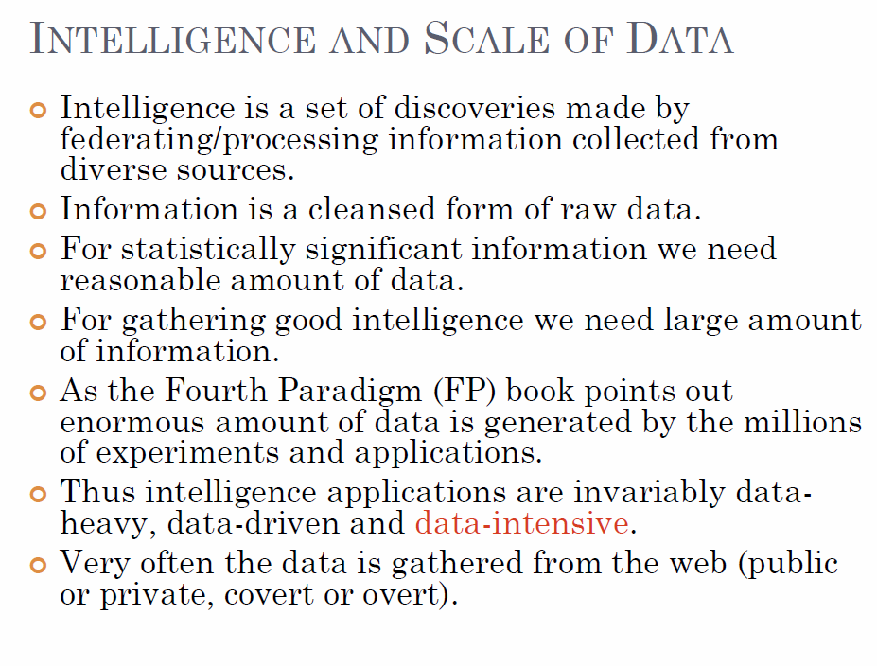
Bina Ramamurthy http://www.cse.buffalo.edu/~bina/cse487/fall2011/

Slide 13
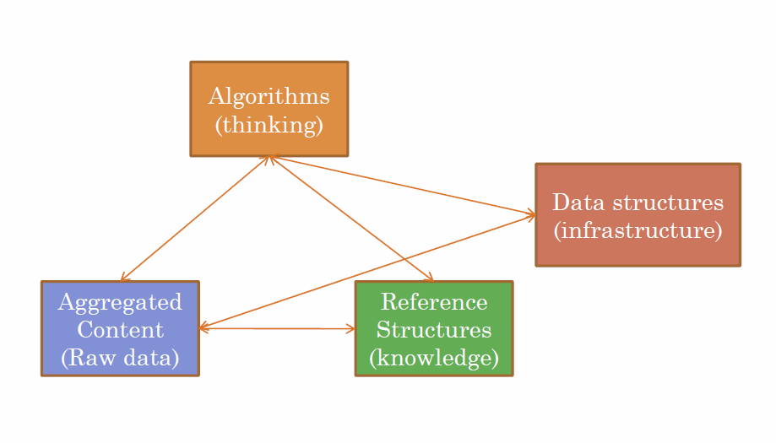
Bina Ramamurthy http://www.cse.buffalo.edu/~bina/cse487/fall2011/

Slide 14
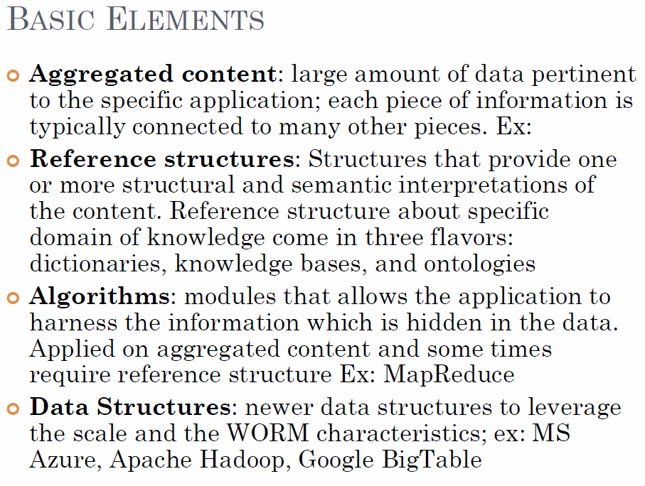
Bina Ramamurthy
http://www.cse.buffalo.edu/~bina/cse487/fall2011/

Slide 15
Semantic Web/Grid v. Big Data
Original vision of Semantic Web was that one would annotate (curate) web pages by extra “meta-data” (data about data) to tell web browser (machine, person) the “real meaning” of page
The success of Google Search is “Big Data” approach; one mines the text on page to find “real meaning”
Obviously combination is powerful but the pure “Big Data” method is more powerful than expected 15 years ago

Slide 16
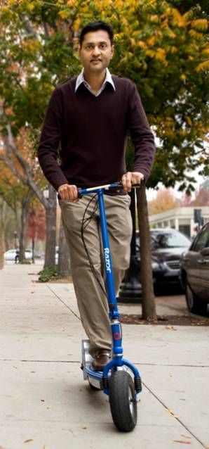
More data usually beats better algorithms
Here's how the competition works. Netflix has provided a large data set that tells you how nearly half a million people have rated about 18,000 movies. Based on these ratings, you are asked to predict the ratings of these users for movies in the set that they have not rated. The first team to beat the accuracy of Netflix's proprietary algorithm by a certain margin wins a prize of $1 million!
Different student teams in my class adopted different approaches to the problem, using both published algorithms and novel ideas. Of these, the results from two of the teams illustrate a broader point. Team A came up with a very sophisticated algorithm using the Netflix data. Team B used a very simple algorithm, but they added in additional data beyond the Netflix set: information about movie genres from the Internet Movie Database(IMDB). Guess which team did better?
Anand Rajaraman is Senior Vice President at Walmart Global eCommerce, where he heads up the newly created @WalmartLabs,
http://anand.typepad.com/datawocky/2008/03/more-data-usual.html
20120117berkeley1.pdf Jeff Hammerbacher

Slide 17
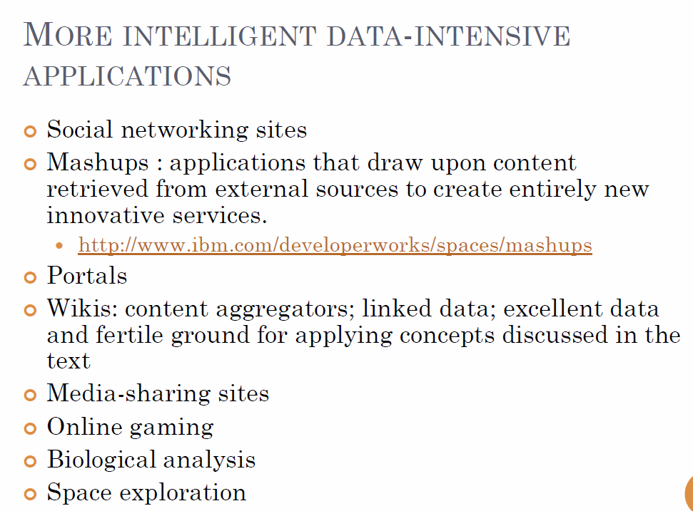
Bina Ramamurthy
http://www.cse.buffalo.edu/~bina/cse487/fall2011/

Slide 18
Types of Data Deluge
Traditional business transaction data from credit cards to stock market
Interaction data as in LinkedIn and Facebook
Information retrieval with topic and language etc. enhancements
Recommender and user customization systems
Marketing information as produced in operation of Walmart
Pervasive sensors in vehicles and people (health)
Scientific Instruments such as satellites, telescopes, Large Hadron Colliders, Gene Sequencers
Military sensors and satellites

Slide 19
Big Data
Processing

Slide 20
20120119berkeley.pdf Jeff Hammerbacher

Slide 21
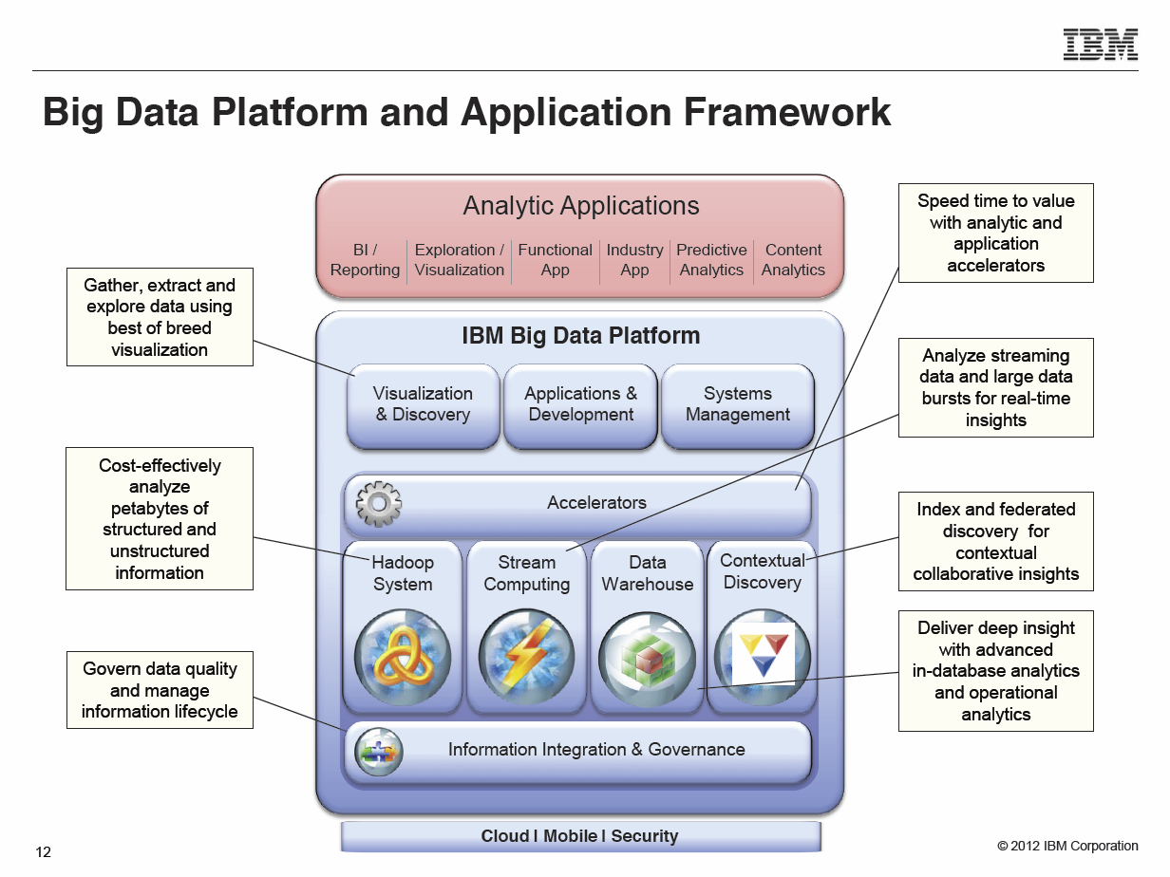
Anjul Bhambhri, VP of Big Data, IBM http://fisheritcenter.haas.berkeley.edu/Big_Data/index.html

Slide 22
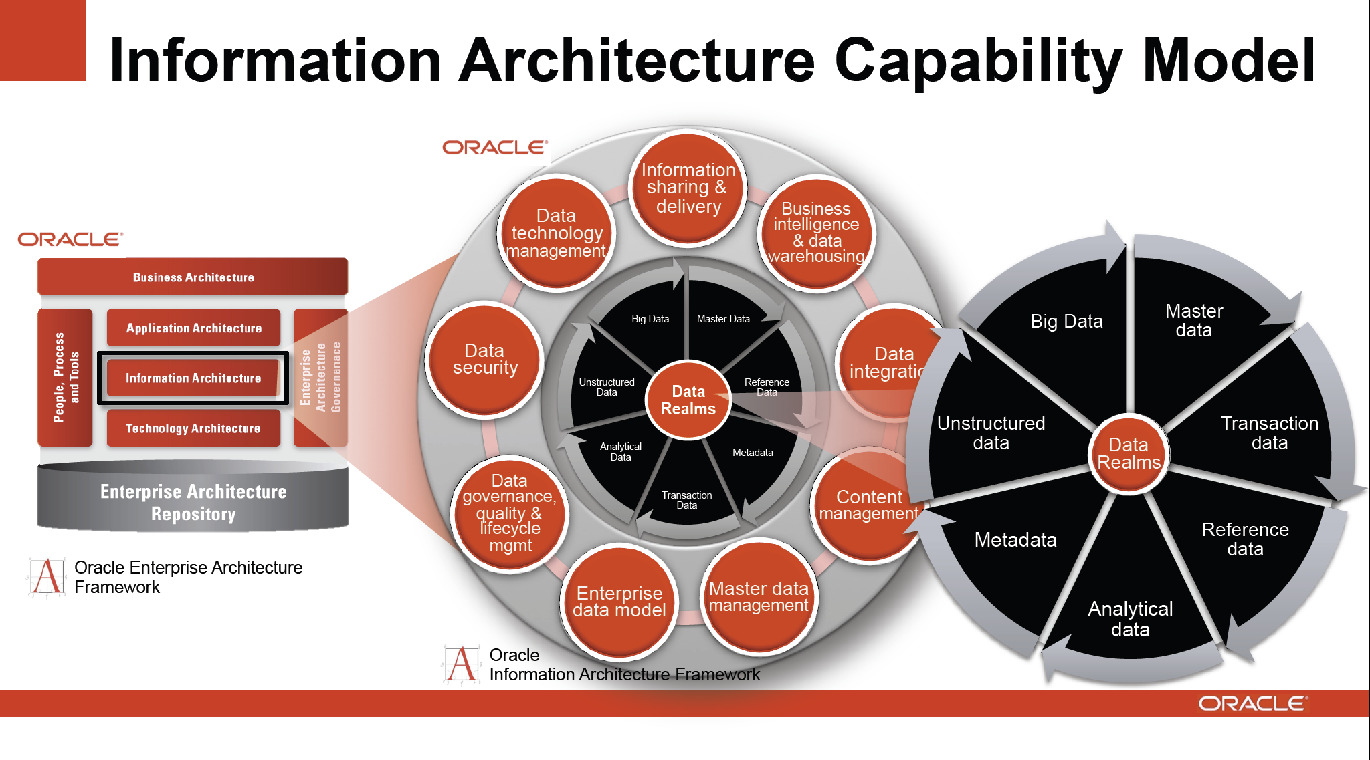
http://cs.metrostate.edu/~sbd/ Oracle

Slide 23
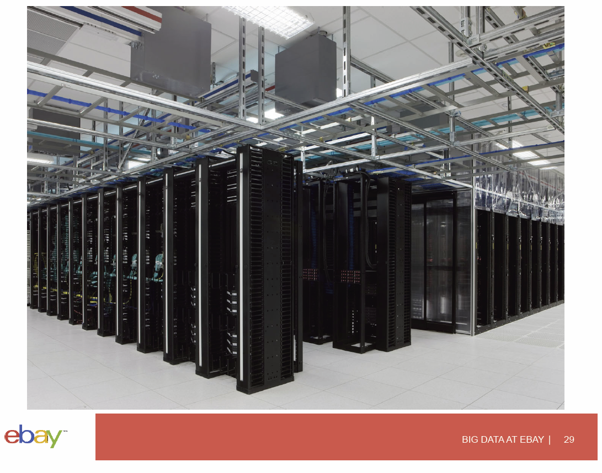

Slide 24
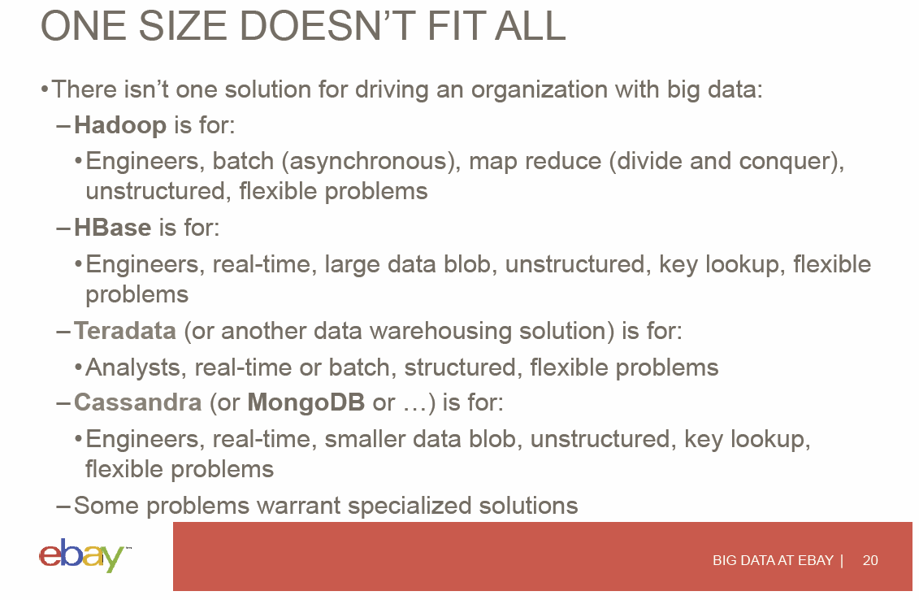

Slide 25
Data Science Process
(Continued)

Slide 26
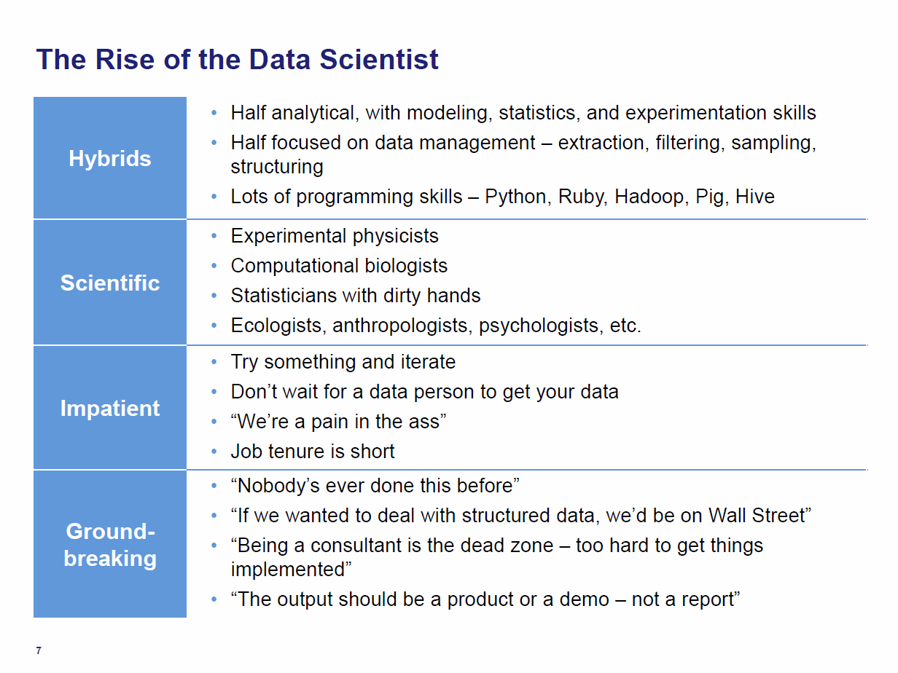
Tom Davenport Harvard Business School http://fisheritcenter.haas.berkeley.edu/Big_Data/index.html Nov 2012

Slide 27
Jeff Hammerbacher’s Process
Identify problem
Instrument data sources
Collect data
Prepare data (integrate, transform, clean, impute, filter, aggregate)
Build model
Evaluate model
Communicate results
20120117berkeley1.pdf Jeff Hammerbacher

Slide 28
Another Jeff Hammerbacher Process
Obtain
Scrub
Explore
Model
Interpret
20120117berkeley1.pdf Jeff Hammerbacher

Slide 29
Statistician Colin Mallows
Identify data to collect and its relevance to your problem
Statistical specification of the problem
Method selection
Analysis of method
Interpret results for non-statisticians
20120117berkeley1.pdf Jeff Hammerbacher

Slide 30
Ben Fry Data Visualization http://en.wikipedia.org/wiki/Benjamin_Fry
Acquire
Parse
Filter
Mine
Represent
Reﬁne
Interact
20120117berkeley1.pdf Jeff Hammerbacher

Slide 31
Peter Huber Statistics (UCB)
Inspection
Error checking
Modiﬁcation
Comparison
Modeling and model ﬁtting
Simulation
What-if analyses
Interpretation
Presentation of conclusions
20120117berkeley1.pdf Jeff Hammerbacher

Slide 32
Jim Gray Microsoft Database/eScience
Capture
Curate
Communicate
Ted Johnson
Assemble an accurate and relevant data set
Choose the appropriate algorithm
20120117berkeley1.pdf Jeff Hammerbacher

Slide 33
Data Analytics

Slide 34
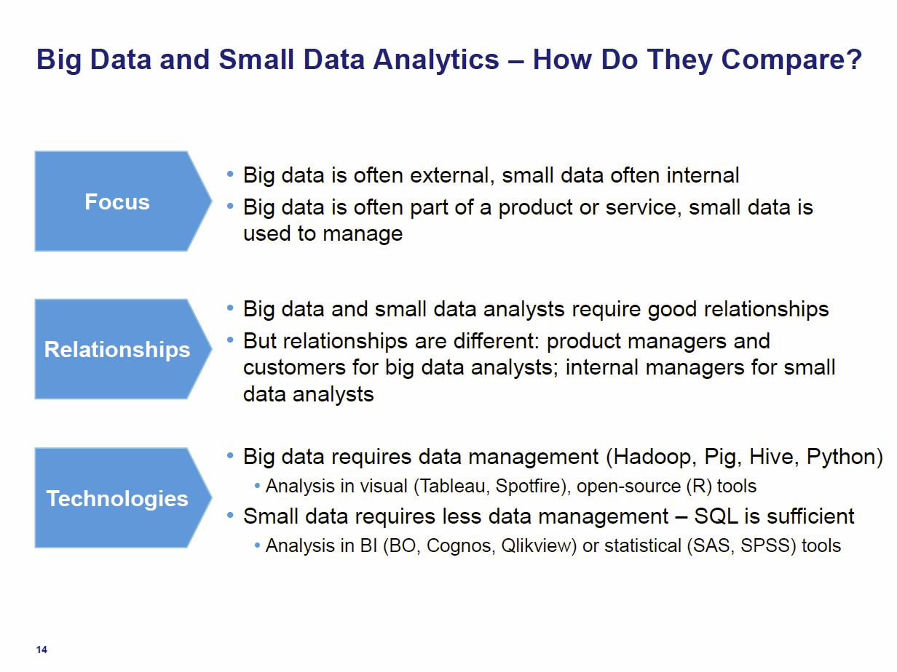
Tom Davenport Harvard Business School http://fisheritcenter.haas.berkeley.edu/Big_Data/index.html Nov 2012

Slide 35
General Remarks I
An immature (exciting) field: No agreement as to what is data analytics and what tools/computers needed
  Databases or NOSQL?
  Shared repositories or bring computing to data
  What is repository architecture?
Sources: Data from observation or simulation
Different terms: Data analysis, Datamining, Data analytics., machine learning, Information visualization
Fields: Computer Science, Informatics, Library and Information Science, Statistics, Application Fields including Business
Approaches: Big data (cell phone interactions) v. Little data (Ethnography, surveys, interviews)
Topics: Security, Provenance, Metadata, Data Management, Curation

Slide 36
General Remarks II
Tools: Regression analysis; biostatistics; neural nets; bayesian nets; support vector machines; classification; clustering; dimension reduction; artificial intelligence; semantic web
One driving force: Patient records growing fast
Another: Abstract graphs from net leads to community detection
Some data in metric spaces; others very high dimension or none
Large Hadron Collider analysis mainly histogramming – all can be done with MapReduce (larger use than MPI)
Commercial: Google, Bing largest data analytics in world
Time Series: Earthquakes, Tweets, Stock Market (Pattern Informatics)
Image Processing from climate simulations to NASA to DoD to Radiology (Radar and Pathology Informatics – same library)
Financial decision support; marketing; fraud detection; automatic preference detection (map users to books, films)

Slide 37
Algorithms for Data Analytics
In simulation area, it is observed that equal contributions to improved performance come from increased computer power and better algorithms
http://cra.org/ccc/docs/nitrdsymposium/pdfs/keyes.pdf
In data intensive area, we haven’t seen this effect so clearly
  Information retrieval revolutionized but
  Still using Blast in Bioinformatics (although Smith Waterman etc. better)
  Still using R library which has many non optimal algorithms
  Parallelism and use of GPU’s often ignored

Slide 38
