Slide 1
Physics-Informatics Looking for Higgs Particle Counting Errors (Continued)
January 23 2013
Geoffrey Fox
gcf@indiana.edu
http://www.infomall.org/X-InformaticsSpring2013/index.html
Associate Dean for Research and Graduate Studies, School of Informatics and Computing
Indiana University Bloomington
2013

Slide 2
Top Topics
TOPICS
Medical/Health (medical records) | 11
Commerce (Target, Amazon) | 7
Internet/Search engine data | 7
Business | 6
Bio-informatics (metagenomics, forestry, disease) | 6
Sensors (music, videogames, 911 calls, traffic, automotive) | 5
Social informatics (social networks, communities) | 5
Environmental science | 4
Music Informatics | 4
Astronomy | 4
Science (LHC, modeling) | 3

Slide 3
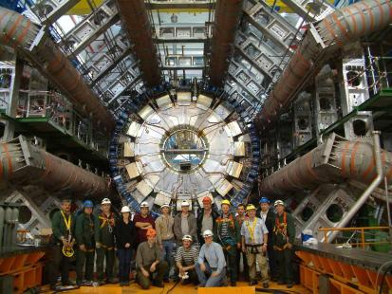
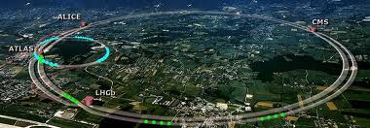
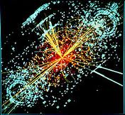
http://grids.ucs.indiana.edu/ptliupages/publications/Where%20does%20all%20the%20data%20come%20from%20v7.pd
This analysis raw data → reconstructed data → AOD and TAGS → Physics is performed on the multi-tier LHC Computing Grid. Note that every event can be analyzed independently so that many events can be processed in parallel with some concentration operations such as those to gather entries in a histogram. This implies that both Grid and Cloud solutions work with this type of data with currently Grids being the only implementation today.
ATLAS Expt
Note LHC lies in a tunnel 27 kilometres (17 mi) in circumference
Higgs Event
The LHC produces some 15 petabytes of data per year of all varieties and with the exact value depending on duty factor of accelerator (which is reduced simply to cut electricity cost but also due to malfunction of one or more of the many complex systems) and experiments. The raw data produced by experiments is processed on the LHC Computing Grid, which has some 200,000 Cores arranged in a three level structure. Tier-0 is CERN itself, Tier 1 are national facilities and Tier 2 are regional systems. For example one LHC experiment (CMS) has 7 Tier-1 and 50 Tier-2 facilities.

Slide 4
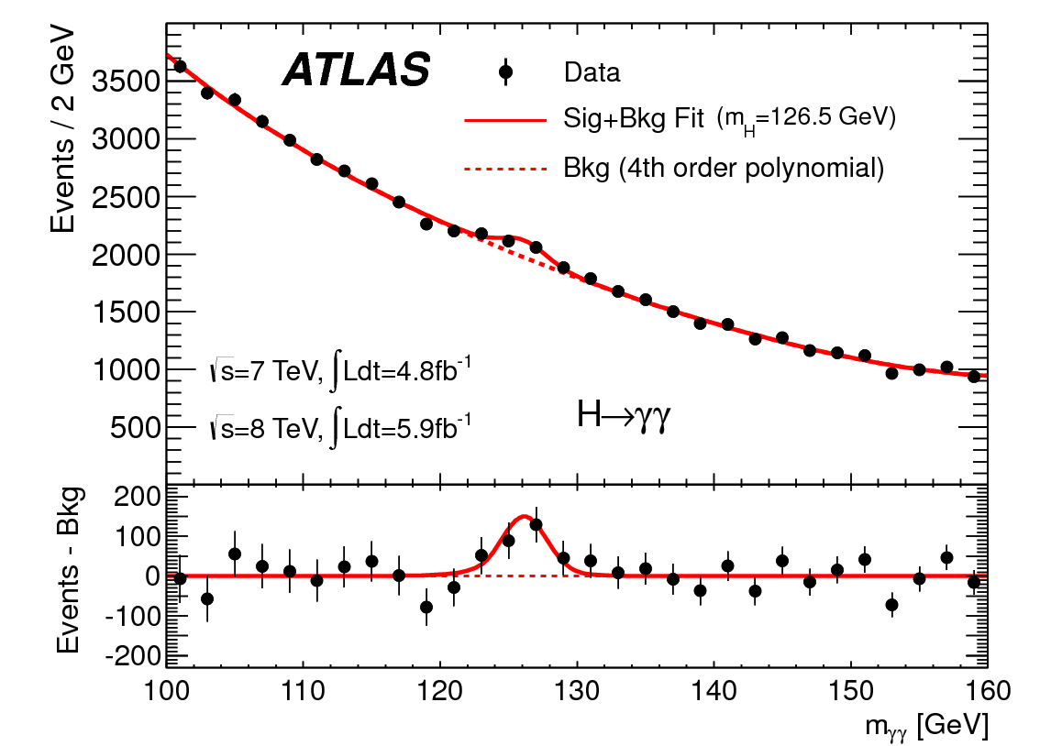
http://www.quantumdiaries.org/2012/09/07/why-particle-detectors-need-a-trigger/atlasmgg/
Model

Slide 6
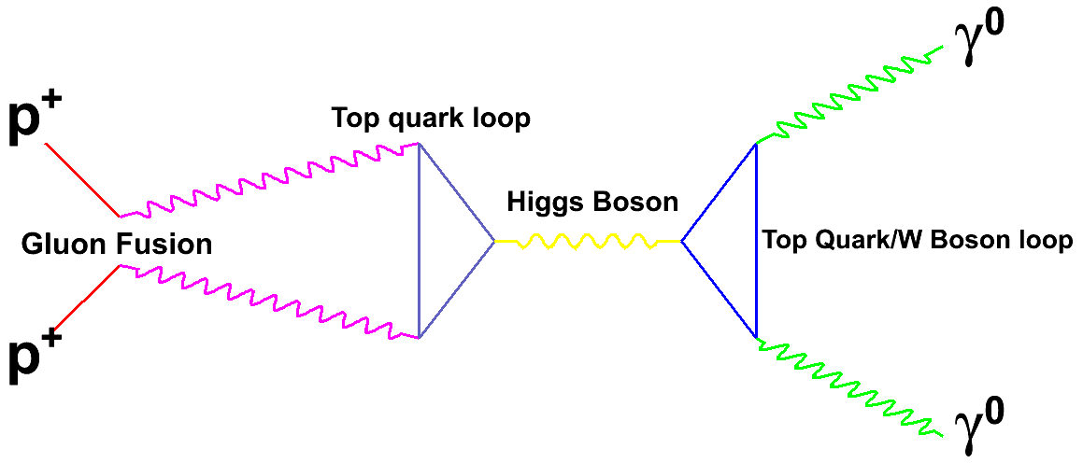
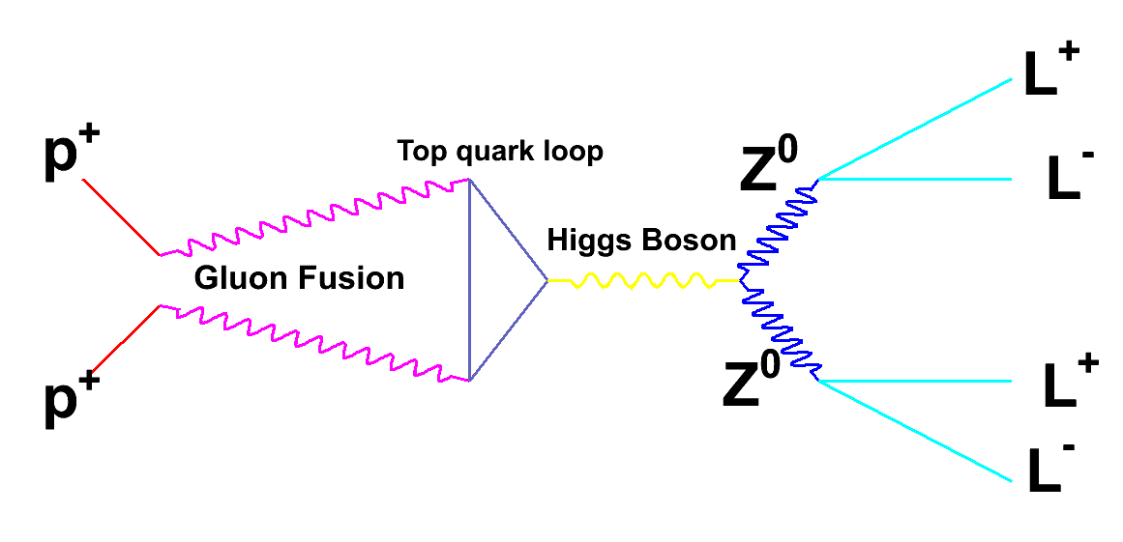
These “Feynman diagrams” define a model. It cannot be calculated exactly but approximate calculations are possible

Slide 7
Event Counting
A lot of data analysis consists of setting up a process that gives “events” as a result
Take a survey of what people feel; event is voting of an individual
Build a software system and categorize each of your data; event is this categorization
Sensor Nets; event is result of a sensor measurement
Often results are yes/no
Did person vote for Candidate X or not?
Did event fall into a certain bin of histogram or not?
Note event might have a result (cost of Hotel stay or Mass of Higgs) which is histogrammed; the decision as to which bin to go into is a yes/no decision

Slide 8
Generate a Physics Experiment with Python
import numpy as np
import matplotlib.pyplot as plt
testrand = np.random.rand(42000)
Base = 110 + 30* np.random.rand(42000)
index = (1.0 - 0.5* (Base-110)/30) > testrand
gauss = 2 * np.random.randn(300) +126
Sloping = Base[index]
NarrowGauss = 0.5 * np.random.randn(300) +126
total = np.concatenate((Sloping, gauss))
NarrowTotal = np.concatenate((Sloping, NarrowGauss))

Slide 9
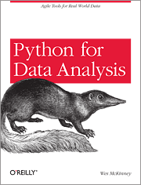
Python Resources
http://www.enthought.com/products/epdgetstart.php Python distribution including NumPy and SciPy with plot package matplotlib
Also pandas and iPython
Python for Data Analysis Agile Tools for Real World Data By Wes McKinney
Publisher: O'Reilly Media
Released: October 2012
Pages: 472

Slide 10
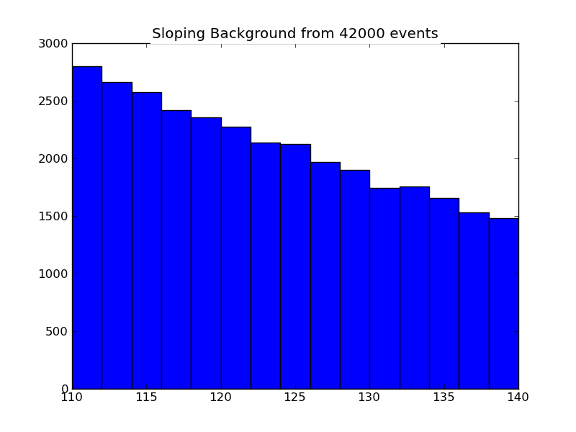
Sloping

Slide 11
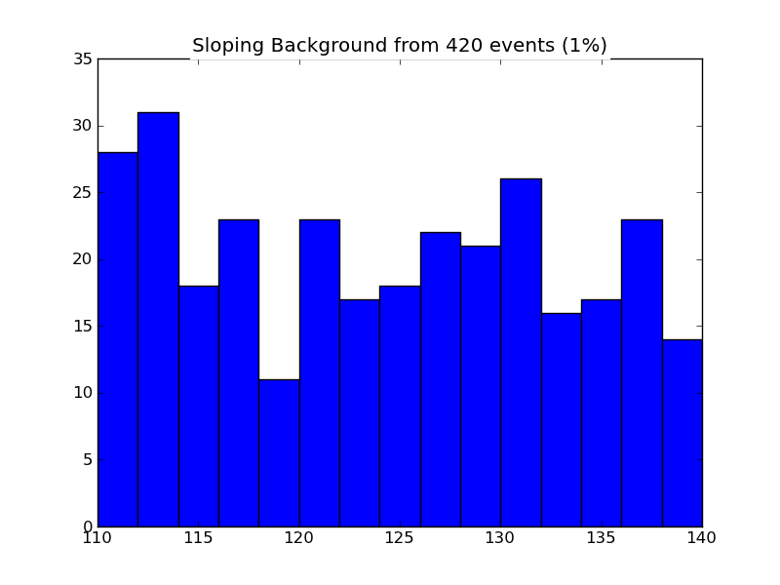
Sloping 1% Data

Slide 12
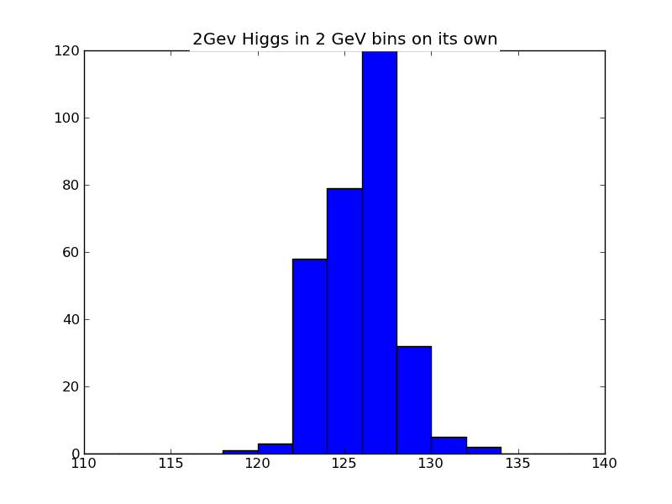
Higgs on its own

Slide 13
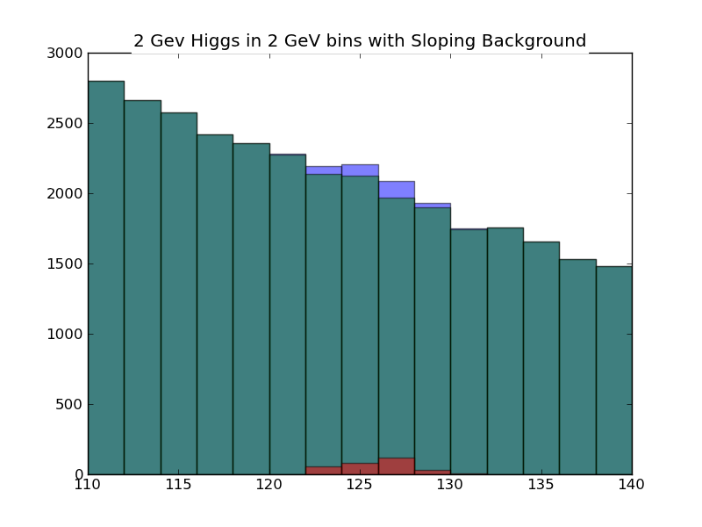
Actual Wide Higgs plus Sloping Background

Slide 14
Actual Wide Higgs plus Sloping Background with errors

Slide 15
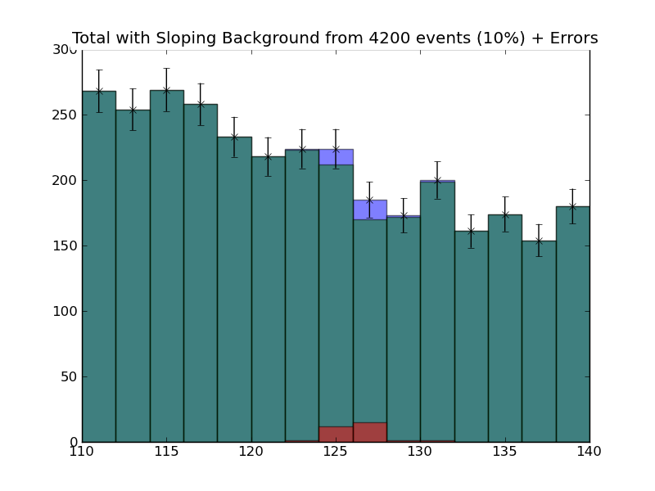
Actual Wide Higgs plus Sloping Background Data Size divided by 10

Slide 16
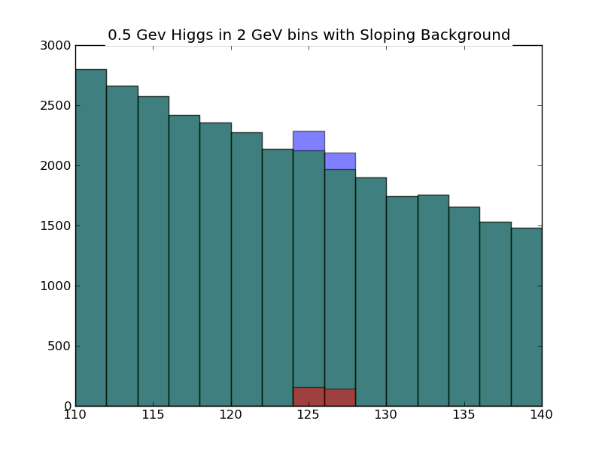
Narrow Higgs plus Sloping Background 2 GeV Bins

Slide 17
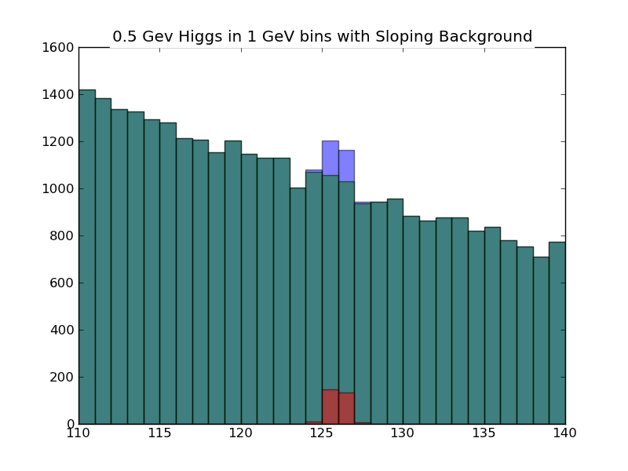
Narrow Higgs plus Sloping Background 1 GeV Bins

Slide 18
Narrow Higgs plus Sloping Background 0.5 GeV Bins

Slide 19
What Happens if more Higgs produced
gaussbig = 2 * np.random.randn(30000) +126
gaussnarrowbig = 0.5 * np.random.randn(30000) +126
totalbig = np.concatenate((Sloping, gaussbig))

Slide 20
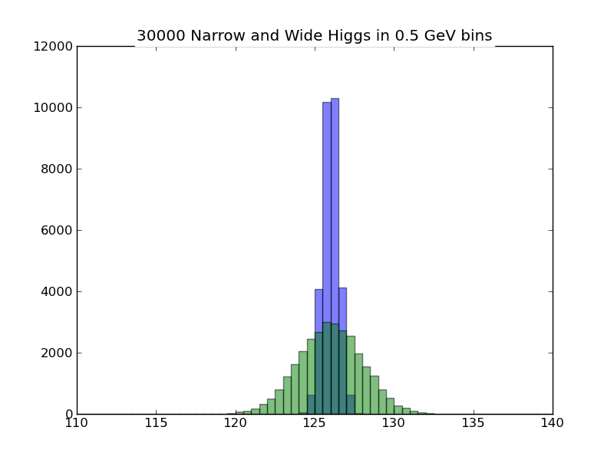
30,000 Higgs (Real Width and Narrow)

Slide 21
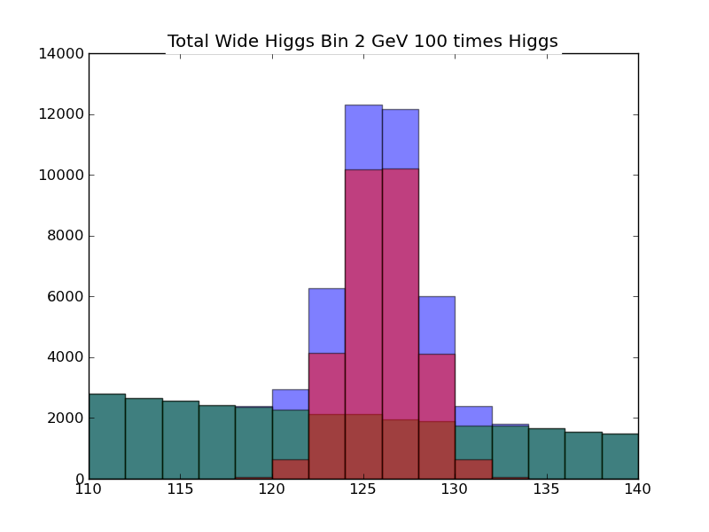
30,000 Higgs (Real Width) + Background

Slide 22
Simplification with flat background
import numpy as np
import matplotlib.pyplot as plt
Base = 110 + 30* np.random.rand(42000)
# Base is set of observations with an expected 2800 background events per bin
# Note we assume here flat but in class I used a "sloping" curve that represented experiment better
gauss = 2 * np.random.randn(300) +126
# Gauss is Number of Higgs particles
simpletotal = np.concatenate((Base, gauss))
# simpletotal is Higgs+Background
plt.figure("Total Wide Higgs Bin 2 GeV")
values, binedges, junk = plt.hist(simpletotal, bins=15, range =(110,140), alpha = 0.5, color="green")
centers = 0.5*(binedges[1:] + binedges[:-1])
# centers is center of each bin
# values is number of events in each bin
# :-1 is same as :Largest Index-1
# binedges[:-1] gets you lower limit of bin
# 1: gives you array starts at second index (labelled 1 as first index 0)
# binedges[1:] is upper limit of each bin
# Note binedges has Number of Bins + 1 entries; centers has Number of Bins entries
errors =sqrt(values)
# errors is expected error for each bin
plt.hist(Base, bins=15, range =(110,140), alpha = 0.5, color="blue")
plt.hist(gauss, bins=15, range =(110,140), alpha = 1.0, color="red")
plt.errorbar(centers, values, yerr = errors, ls='None', marker ='x', color = 'black', markersize= 6.0 )

Slide 23
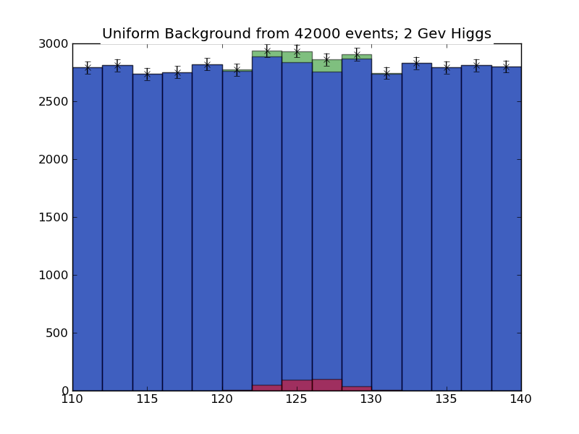
Uniform Background

