Slide 1
Physics-Informatics Looking for Higgs Particle Counting Errors (Continued)
January 28 2013
Geoffrey Fox
gcf@indiana.edu
http://www.infomall.org/X-InformaticsSpring2013/index.html
Associate Dean for Research and Graduate Studies, School of Informatics and Computing
Indiana University Bloomington
2013

Slide 2
Course Schedule
Introduction
Science (LHC) Counting Errors
eCommerce, matching products, movies, jobs with Recommender Systems
Large Scale Search
Cloud Computing
Health Informatics and Bio Informatics
Social Networking; graph analysis
Sensors
1-2 weeks each

Slide 3
Random Variables
The area of probability and statistics underlies the analysis of physics data and in fact historically the first large analyses of this type were done in physics
Now there are more examples and physics is not the largest
The physics experiment observe proton-proton collisions at LHC and look at a “random” subset of possible results. The “theory” (which cannot be calculated) gives a probability that each final state occurs.
The experimental results are sets of collisions (called events) which form a random variable represented by a collection of individual measurements
Events – isolated independent activities are very important e.g. earthquakes, stock and bank transactions are events
The DIKW pipeline transforms this random variable into different forms with final random variable having one component – does this event fall in bin of histogram

Slide 4
Physics DIKW Pipeline
Raw Data: Each event is “vector” of “sensor” measurements such as signals of a charged particle in an ionized chamber or an energy decomposition in a “calorimeter” or light in a “Cherenkov counter” signaling particle type or signature that particle passed through chunk of matter saying it is weakly interacting
Data or just next step: Apply clean up with calibration to get best possible measured data; event is still a vector of measurements
Information: Convert original measurements into a specification – possibly with choices and probabilities of reaction that event represents p p → Reasonably stable particles “charged particles” (with energy measured by magnetic field), “neutral particles” (with energy measured in a calorimeter and a categorization (Baryon, meson, lepton, photon)
Now event is a new random variable with different types of components. Note events are of different vector length as number of particles varies from event to event.
Knowledge: Take list of particles and apply physics motivated selections to select events and calculate “aggregate properties” summed over multiple particles; histogram and scatterplot

Slide 5
Atlas Data Analysis
The detector generates unmanageably large amounts of raw data: about 25 megabytes per event (raw; zero suppression reduces this to 1.6 MB), multiplied by 40 million beam crossings per second in the center of the detector. This produces a total of 1 petabyte of raw data per second.
The trigger system uses simple information to identify, in real time, the most interesting events to retain for detailed analysis. There are three trigger levels. The first is based in electronics on the detector while the other two run primarily on a large computer cluster near the detector. The first-level trigger selects about 100,000 events per second.
Raw Data: After the third-level trigger has been applied, a few hundred events remain to be stored for further analysis. This amount of data still requires over 100 megabytes of disk space per second — at least a petabyte each year.
Information: Offline event reconstruction is performed on all permanently stored events, turning the pattern of signals from the detector into physics objects, such as jets (collections of particles), photons, and leptons.
Grid computing is being extensively used for event reconstruction, allowing the parallel use of university and laboratory computer networks throughout the world for the CPU-intensive task of reducing large quantities of raw data into a form suitable for physics analysis. The software for these tasks has been under development for many years, and will continue to be refined even now that the experiment is collecting data.
Knowledge: Individuals and groups within the collaboration are writing their own code to perform further analysis of these objects, searching the patterns of detected particles for particular physical models or hypothetical particles.

Slide 6
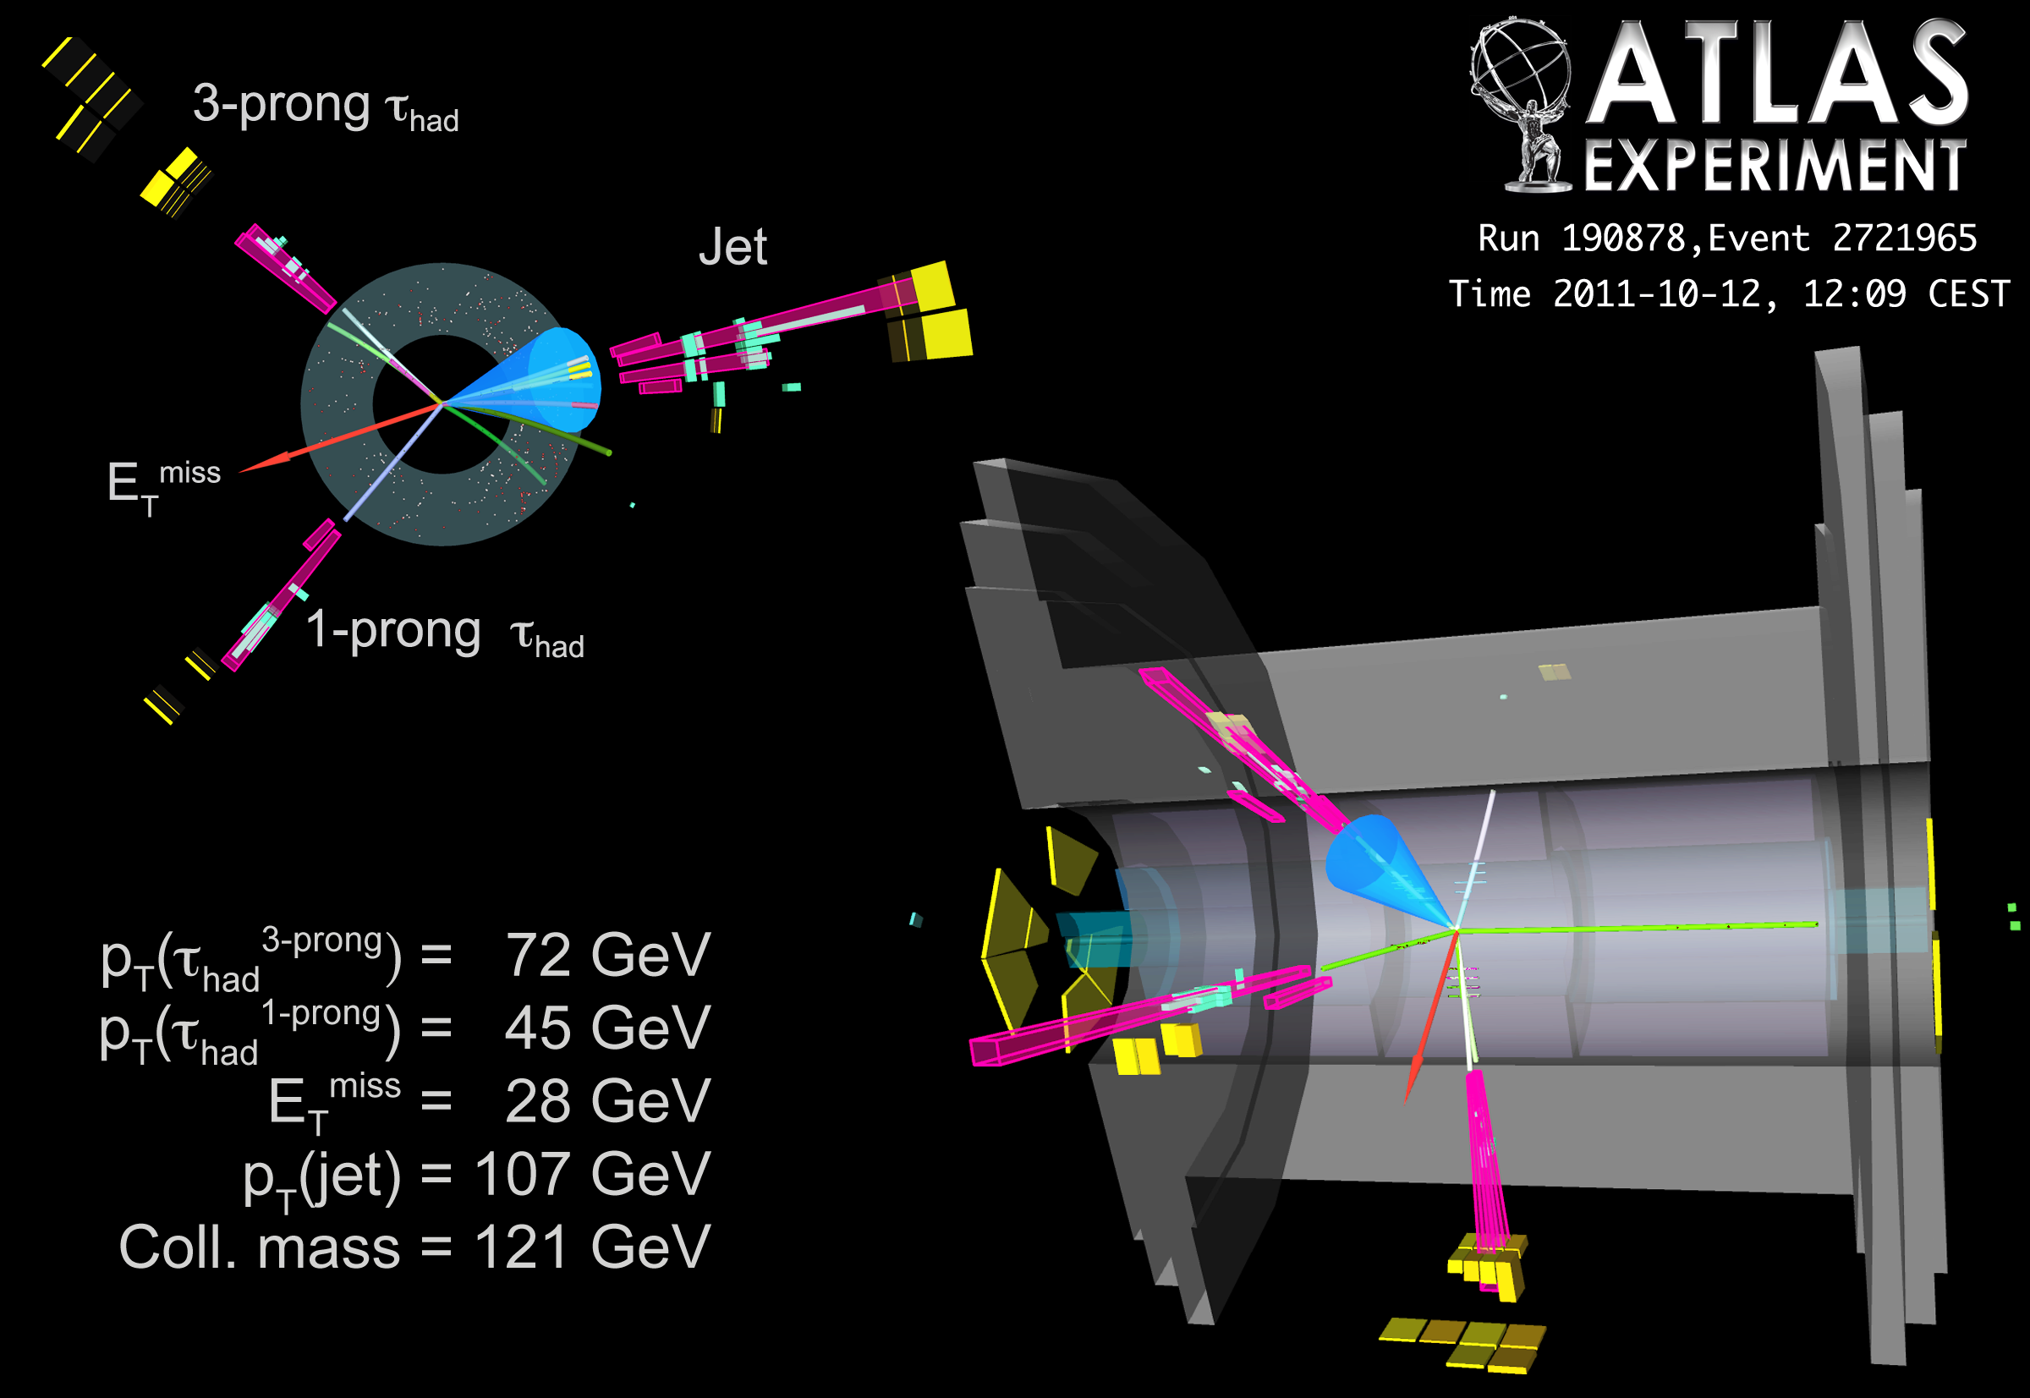

Slide 7
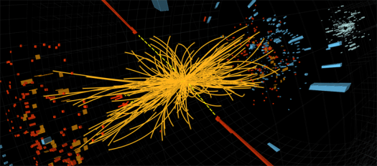
A proton-proton collision event in the CMS experiment produces two high-energy photons (the red towers). This is what physicists would expect to see from the decay of a Higgs boson, but it is also consistent with background Standard Model physics processes.
Orange tracks are charged (they bend) and are mainly forward and back.
The photons are sent off transversely indicative of an extreme event

Slide 8
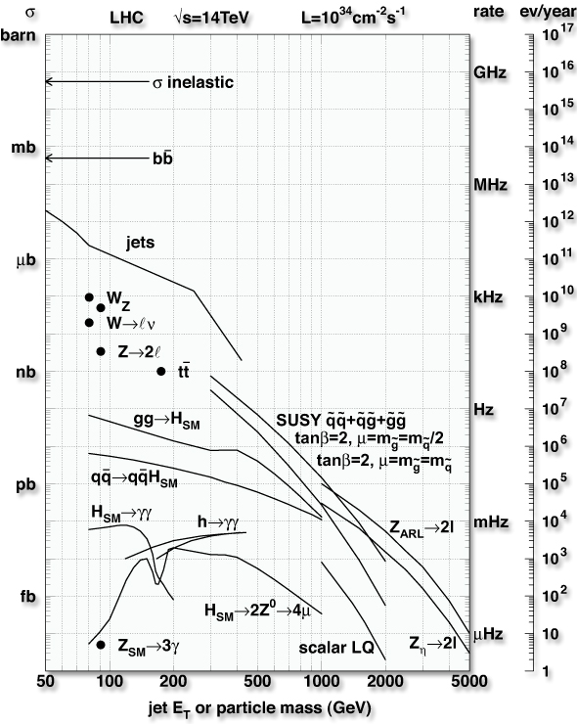
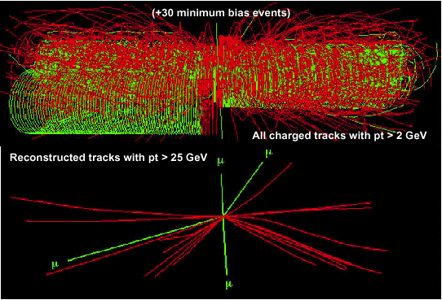
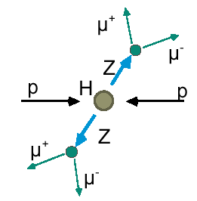
Final States at the LHC
Event rate
~ 30% is diffractive
Level-1
Pedestal Effect
On tape
Discovery
“Golden Channel”

Slide 9
Statistics: IID
There are two simple ways of doing formal statistics of Physics analysis
Poisson Distribution
Binomial distribution
Both give the same answer for case here where the events are very very unlikely
First we note a key assumption/property
Each (physics) event is independent of previous ones
Thus events form independent identically distributed (IID) random variables
Most cases in big data either have this property or it approximately true

Slide 10
Statistics: Law of Large Numbers
Suppose a single valued random variable X has mean μ and standard deviation σ
μ is average value of X
σ² is average value of (X - μ)²
Then let X_{i} (i= 1 .. N) be N IID random variables distributed in same way that X is
Let Observable O = ∑_{i=1}^{N} X_{i} be sum of the N X_{i}
Alternatively can use average of observations ∑_{i=1}^{N} X_{i} /N
Then O has expected value N μ and
O has standard deviation (error) √N σ
Note error/mean ∝ 1/√N
Note amount of “effort” ∝ N and so it takes 4 times the effort to reduce error by a factor of 2

Slide 11
Event/Counting Data
This basically covers all surveys as well as physics case
If you measure N responses to a question – that is similar to counting N events in a histogram – make each question a bin of histogram
Then error is √N and N is distributed with a Normal distribution which allows one to estimate chance that measurement significant
Lets look at this in Python with a survey that has 40,000 answers – each equally likely
First take case 25 is expected number of events in bin and of course √25 = 5

Slide 13
Looking at Error bars in detail

Slide 14
This Corresponds to
Asking a million people a question with 40,000 answers where each answer equally likely
Measuring a million physics events – each with one of 40,000 outcomes – each equally likely
Note bins from 22(start)-28(end) have 2789(22-23), 3060(23-24), 3132(24-25), 3179(25-26), 3111(26-27), 2793(27-28) events in them
The red curve is naïve expected number of events in each bin – Normal distribution
Good but not perfect as actual data shifted to larger values (green tends to be above red if bin start > 25, red tends to be above green if start < 25)
It predicts 3176 events in bins 24-25 and 25-26 with error √3176 = 56

Slide 15
Normal or Gaussian Distribution
Python: def Normal(x, mu, sigma): return exp(- (x-mu)**2/(2*sigma**2))/(sigma*sqrt(2*pi))
See also built in scipy.stats.norm
http://en.wikipedia.org/wiki/Normal_distribution

Slide 16
Generating Events
Events25 = np.random.rand(1000000)
Counters25 = np.zeros(40000)
for value in Events25: Place = int(40000 * value)
Counters25[Place] +=1
# Place assigns to each of one million events, a random category out of 40000

Slide 17
Plotting the 40,000 trials
figure("Count 25 Events 40000 times")
Numcounts25, binedges25, patches = hist(Counters25, bins = 50, range = (0,50), color = "green", alpha = 0.5)
centers25 = 0.5*(binedges25[1:] + binedges25[:-1])
y25 = 40000 * Normal(centers25, 25, sqrt(25))
xbar25 = np.zeros(2)
ybar25 = np.zeros(2)
xbar25[0] = 25 - sqrt(25)
xbar25[1] = 25 + sqrt(25)
ybar25 = 40000*Normal(xbar25, 25, sqrt(25))
plot(xbar25, ybar25, color= "red", alpha = 1.0, lw =5)
plot(centers25, y25, alpha = 1.0, color = "red", lw =5)

Slide 18
Adding Annotations
from scipy.special import ndtri
prob1percent25 = 25 + sqrt(25) * ndtri(0.01)
prob99percent25 = 25 + sqrt(25) * ndtri(0.99)
y1percent25 = 40000*Normal(prob1percent25, 25, sqrt(25))
y99percent25 = 40000*Normal(prob99percent25, 25, sqrt(25))
annotate('One percent', xycoords="data", textcoords='offset points', arrowprops=dict(facecolor='black', arrowstyle="->"), xytext =(-75,50), xy = (prob1percent25, y1percent25))
annotate('99 percent', xycoords="data", textcoords='offset points', arrowprops=dict(facecolor='black', arrowstyle="->"), xytext =(30,50), xy = (prob99percent25, y99percent25))
annotate('One Sigma', xycoords="data", textcoords='offset points', xy = (20,ybar25[0]), xytext = (-70,30), arrowprops=dict(facecolor='black', arrowstyle="->"))
annotate('One Sigma', xycoords="data", textcoords='offset points', xy = (30,ybar25[1]), xytext = (30,30), arrowprops=dict(facecolor='black', arrowstyle="->"))

Slide 19
40000 Total Counts of 250

Slide 20
A larger set of Events
Note if you had a total of ten million events but still 40,000 categories, then the red curve is nearer the green curve and 250 is expected number of events with an error of √250 ≈ 16
The one sigma line runs from 250- √250 to 250 + √250
The plots get rough if reduce number of events from 40000 to 400 or 4000
Use larger bin size (1 becomes 5) if number of events small

Slide 22
Looking at Error bars in detail

Slide 23
Looking at Error bars in detail

Slide 24
Making Error Bars √ Law for y axis
Numcounts25, binedges25, patches = hist(Counters25, bins = 50, range = (0,50), color = "green", alpha = 0.5)
centers25 = 0.5*(binedges25[1:] + binedges25[:-1])
y25 = 40000 * Normal(centers25, 25, sqrt(25))
errors25 = sqrt(y25)
errorbar(centers25, y25, yerr = errors25, linestyle='None', linewidth = 3.0, markeredgewidth = 3.0, marker ='o', color = 'black', markersize= 5.0 )
Note the √ law governs the width of distribution (x-axis) and counts in each bin (y axis)

Slide 25
Making One Sigma Line √ Law for x axis
xbar25 = np.zeros(2)
ybar25 = np.zeros(2)
xbar25[0] = 25 - sqrt(25)
xbar25[1] = 25 + sqrt(25)
ybar25 = 40000*Normal(xbar25, 25, sqrt(25))
plot(xbar25, ybar25, color= "red", alpha = 1.0, lw =5)

Slide 26
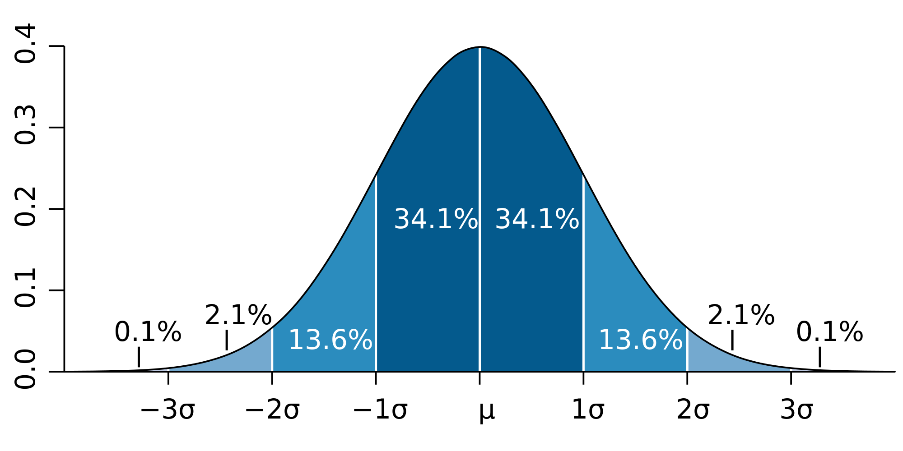
Meaning of a Standard Deviation (one sigma)
From Wikipedia
68% of the time, you will be within one sigma of mean for a normal distribution

Slide 27
Is this stuff Right?
There are two types of corrections to “rule of thumb” that “everything pretty large” is distributed according to Gaussian distribution and for N events, the error is √N
a) There are “mathematical” corrections as rule of thumb only correct “asymptotically”
See results for 40000 counters of 25 – the observed counts are larger than prediction of Gaussian when you are in tail above mean
Easy to correct as exact distributions known. Not very important
b) Biases. If you counted results of a survey on Indiana politics based on people in Bloomington, this is not representative of state and your results will be biased (i.e. wrong)

Slide 28
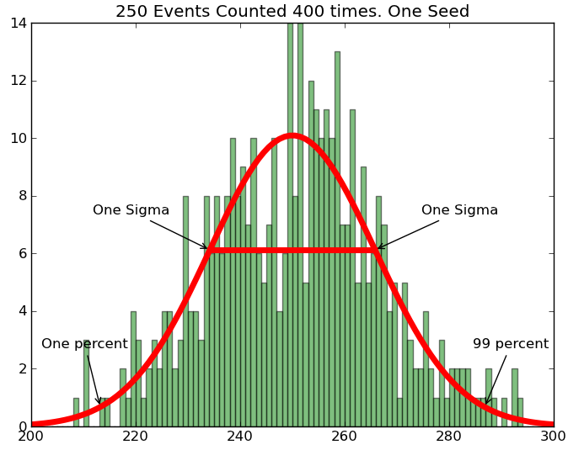
Pretty Raggedy √10 ≈ 3

Slide 29
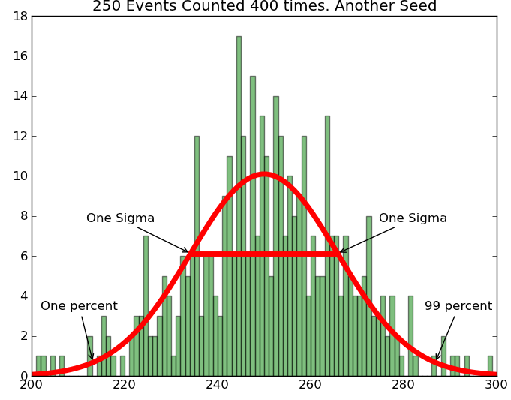
Looks different
Numpy gives
“new random numbers”
each time unless fix seed

Slide 30
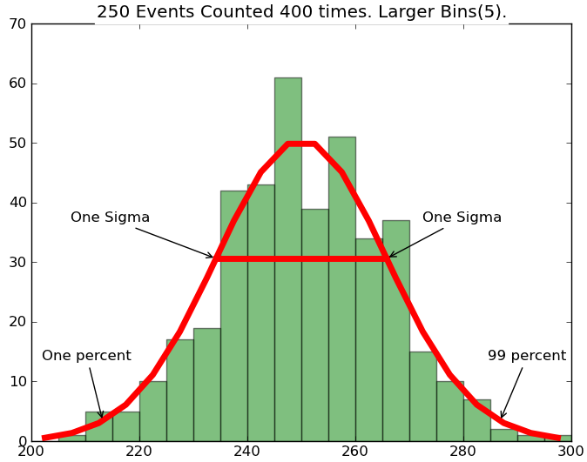
Increase bin size
if too few events
√50 ≈ 7

Slide 31
