Slide 1
Physics-Informatics Looking for Higgs Particle Counting Errors (Finished)
January 30 2013
Geoffrey Fox
gcf@indiana.edu
http://www.infomall.org/X-InformaticsSpring2013/index.html
Associate Dean for Research and Graduate Studies, School of Informatics and Computing
Indiana University Bloomington
2013

Slide 2
Random Numbers I
Would be really random if we observed nuclei decaying but in fact nearly all random numbers are “pseudo random numbers” using “principle” that complicated messy thing end up with random results
In particular low order digits of integer arithmetic are essentially random
http://en.wikipedia.org/wiki/Pseudorandom_number_generator
http://en.wikipedia.org/wiki/Mersenne_twister
http://en.wikipedia.org/wiki/Mersenne_prime
Python uses Mersenne Twister method built around Mersenne primes
Pseudorandom numbers are deterministic; they are generated in order and for a given starting point – seed – the numbers are completely determined
Some computers always use same seed and so always return same sequence by default
Python takes seed from time of day (pretty random) and generates a different sequence each call

Slide 3
Random Numbers II
Sometimes its good to get random numbers but always have the same e.g. if you are debugging something
Use random.seed(seed=some integer) to guarantee same start
random.seed(seed=1234567)
figure("On Top of Each Other")
Base = 110 + 30* np.random.rand(42000)
plt.hist(Base, bins=15, range =(110,140), alpha = 0.5, color="blue")
#
random.seed(seed=1234567)
Base2 = 110 + 30* np.random.rand(42000)
plt.hist(Base2, bins=15, range =(110,140), alpha = 0.5, color="yellow")
plt.title("Two histograms on top of each other as identical random numbers")

Slide 4
More on Seeds
figure("Different")
#
random.seed(seed=1234567)
Base4 = 110 + 30* np.random.rand(42000)
plt.hist(Base4, bins=15, range =(110,140), alpha = 0.5, color="blue")
Base1 = 110 + 30* np.random.rand(42000)
# Note Base1 starts where Base4 ends so is a different set of random numbers
plt.hist(Base1, bins=15, range =(110,140), alpha = 0.5, color="green")
#
random.seed(seed=7654321)
Base3 = 110 + 30* np.random.rand(42000)
plt.hist(Base3, bins=15, range =(110,140), alpha = 0.5, color="red")

Slide 5
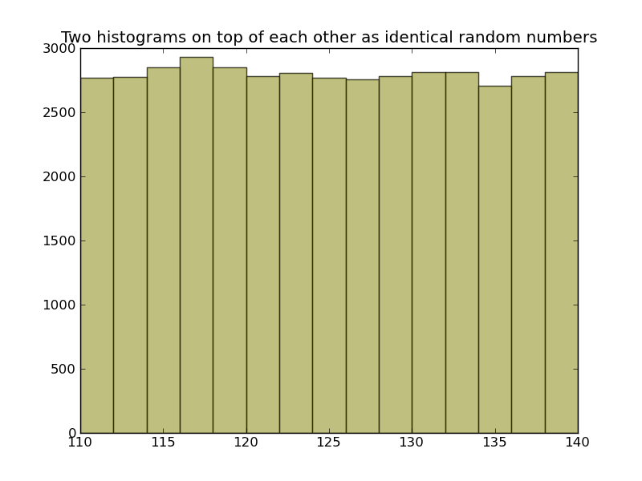

Slide 6
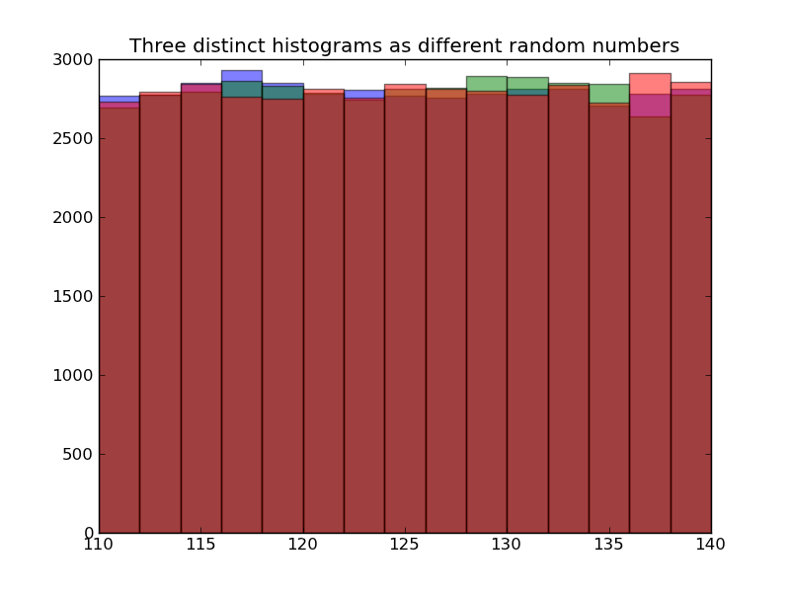

Slide 7
Look at Numbers
random.seed(seed=1234567)
Base = 110 + 30* np.random.rand(42000)
array([ 117.11087505, 110.22945122, 110.59490925, ..., 117.34085492,
138.72156377, 117.25522386])
random.seed(seed=1234567)
Base2 = 110 + 30* np.random.rand(42000)
array([ 117.11087505, 110.22945122, 110.59490925, ..., 117.34085492,
138.72156377, 117.25522386])
Base1 = 110 + 30* np.random.rand(42000)
array([ 133.51704792, 132.87435972, 128.95204036, ..., 115.25271937,
130.21388378, 112.55649254])
random.seed(seed=7654321)
Base3 = 110 + 30* np.random.rand(42000)
array([ 111.05068005, 112.63158568, 124.30148179, ..., 120.35946227,
112.44901602, 133.75223691])

Slide 8
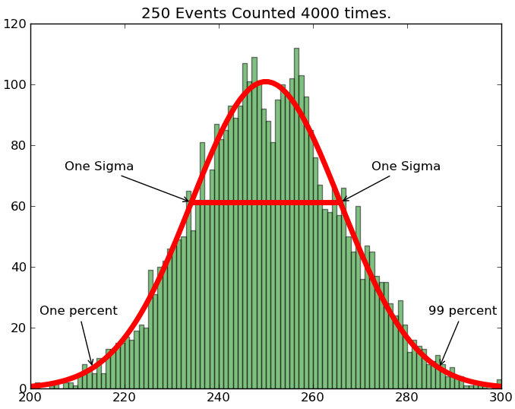
√100 = 10
Funny dip in middle

Slide 9
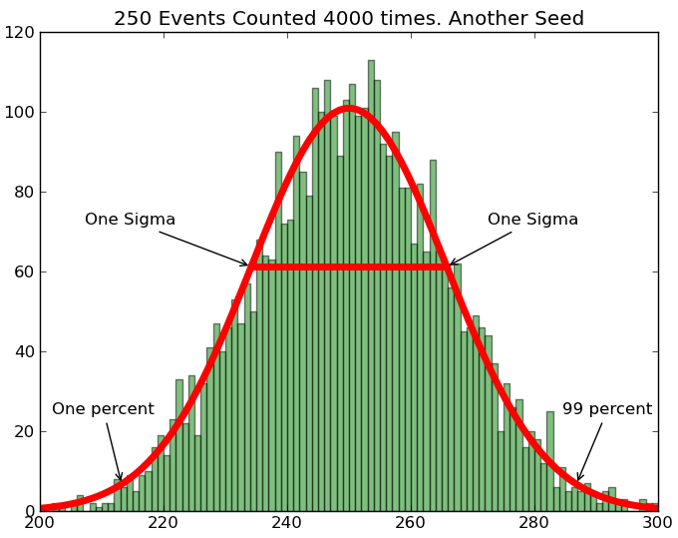
Looks better but just luck

Slide 10
Counting and Binomial Distribution I
Suppose random variable X = 1 (event in a particular bin of histogram) and X=0 (event not in bin)
Let μ be probability that a particular event lies in a bin
This is coin tossing problem with μ probability of heads
If a random variable takes just two values with probability μ (for 1) and 1-μ (for 0), then
Average of X = {0. (1-μ) + 1. μ}/{(1-μ) + μ} = μ
Average of (X-μ)² = {(-μ)². (1-μ) + (1-μ)² . μ} = (1-μ) μ

Slide 11
Counting and Binomial Distribution II
Now in our application μ is tiny
So Average of X = Average of (X-μ)² = μ
i.e. standard deviation of X is square root of mean
If we have a sum of random variables with a binomial distribution
O = ∑_{i=1}^{N} X_{i}
Then O has mean Nμ and standard deviation = √N √μ = √mean

Slide 12
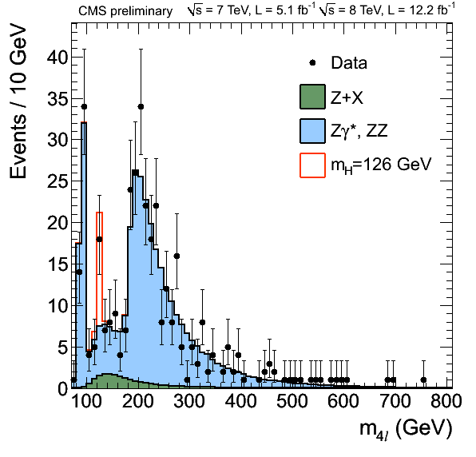
Here is a histogram with 140 bins. We have a random variable for each bin. There is an excess of events in bin from 125 to 130 GeV

Slide 13
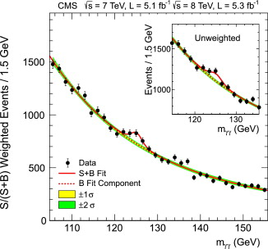

Slide 14
Comments
Note some measurements have a small signal but a small background
Others have a larger signal but also a larger background
If you have signal N_{S} and background N_{B,} then statistical error is √(N_{S} + N_{B}) and one needs
√(N_{S} + N_{B}) much smaller than N_{S} which is harder than √N_{S} much smaller than N_{S}
Typically one quotes “systematic errors” as well. These reflect model-based uncertainties in analysis and will not decrease like sqrt of total event sample

Slide 15
“Monte-Carlo Events”
The events are very complicated with ~100 particles produced and the apparatus is also complex with multiple detection devices measuring energy, momentum and particle type.
To understand how an event “should look” and estimate detection efficiencies, Monte Carlo events are produced
These are “random” events produced by models that build in expected physics
One both generates the “fundamental collision” and tracks particles through apparatus
Although they are motivated by physics, they have many adjustable parameters that are fitted to other data to describe aspects of “theory” that are not predicted “from first principles”
One analyses Monte Carlo data with EXACTLY the same process used by real data
Often amount of Monte Carlo data > that of real data

Slide 16
Poisson Distribution
The Poisson distribution is what you get when you take binomial distribution and let μ get small but keep product μN fixed.
This is actually what I used in discussing histograms
The Poisson distribution describes exactly nuclear decays and can be defined as distribution of events at time T where in small time interval δt, the probability of an event arriving is λδt
Probability (k events) = (λT)^{k} exp(-λT)/ k!
(Written in Wikipedia for case T=1 and varies λ not fixing λ and varying T)
For Poisson: Mean = σ² = λT

Slide 17
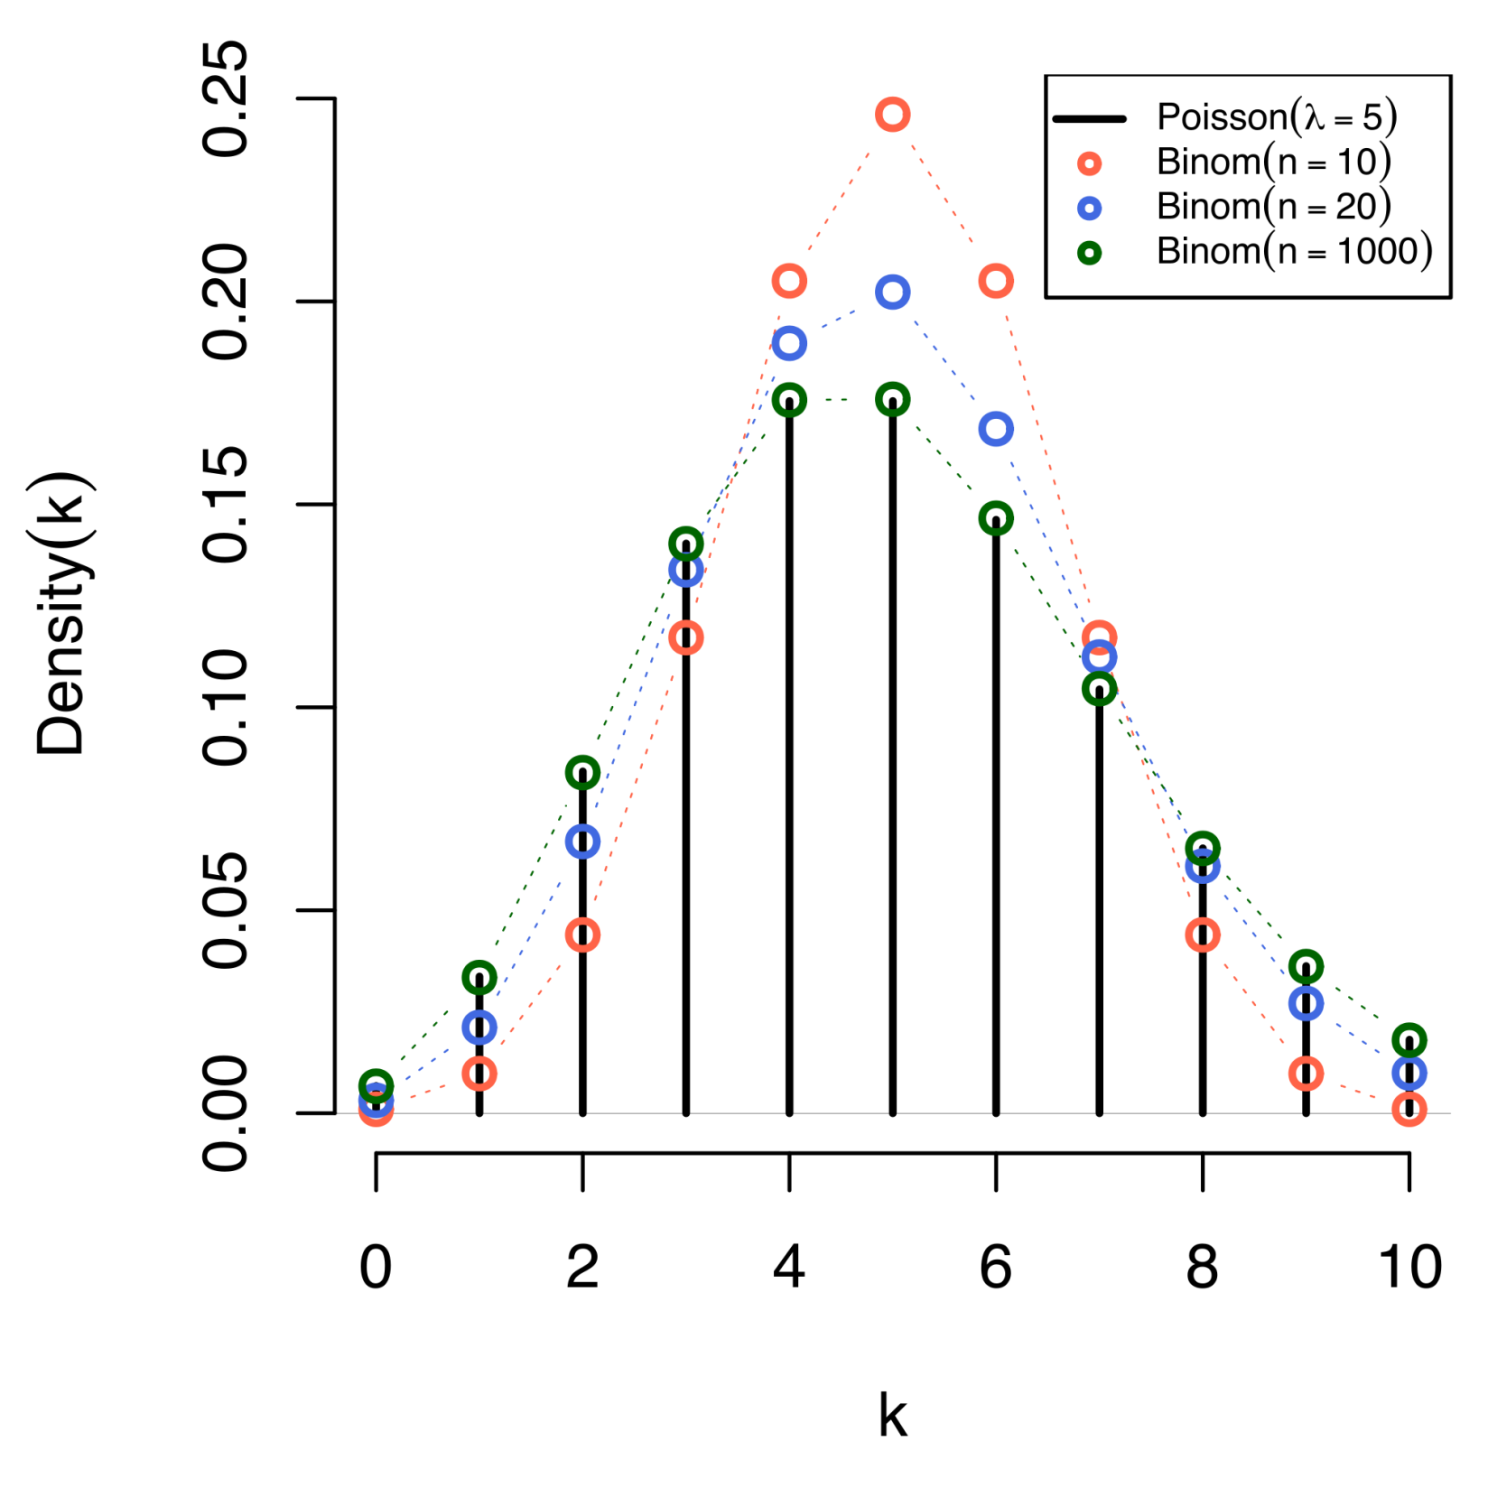
Comparison of the Poisson distribution (black lines) and thebinomial distribution with n=10 (red circles), n=20 (blue circles), n=1000 (green circles). All distributions have a mean of 5. The horizontal axis shows the number of events k. Notice that as n gets larger, the Poisson distribution becomes an increasingly better approximation for the binomial distribution with the same mean. (Wikipedia)

Slide 18
Poisson Examples I (Wikipedia)
Applications of the Poisson distribution can be found in many fields related to counting:
Electrical system example: telephone calls arriving in a system.
Astronomy example: photons arriving at a telescope.
Biology example: the number of mutations on a strand of DNA per unit length.
Management example: customers arriving at a counter or call centre.
Civil engineering example: cars arriving at a traffic light.
Finance and insurance example: Number of Losses/Claims occurring in a given period of Time.
Earthquake seismology example: An asymptotic Poisson model of seismic risk for large earthquakes.

Slide 19
Poisson Examples II (Wikipedia)
The Poisson distribution arises in connection with Poisson processes. It applies to various phenomena of discrete properties (that is, those that may happen 0, 1, 2, 3, ... times during a given period of time or in a given area) whenever the probability of the phenomenon happening is constant in time or space. Examples of events that may be modelled as a Poisson distribution include:
The number of soldiers killed by horse-kicks each year in each corps in the Prussian cavalry. This example was made famous by a book of Ladislaus Josephovich Bortkiewicz (1868–1931).
The number of yeast cells used when brewing Guinness beer. This example was made famous by William Sealy Gosset (1876–1937).
The number of phone calls arriving at a call centre per minute.
The number of goals in sports involving two competing teams.
The number of deaths per year in a given age group.
The number of jumps in a stock price in a given time interval.
Under an assumption of homogeneity, the number of times a web server is accessed per minute.
The number of mutations in a given stretch of DNA after a certain amount of radiation.
The proportion of cells that will be infected at a given multiplicity of infection.
The targeting of V-1 rockets on London during World War II.
These are often called “birth processes”

Slide 20
Central Limit Theorem
The large of large numbers (which is usually most important operationally) tells you about the mean and standard deviation (error) of the sum of many IID random variables
The Central Limit Theorem extends this to tell you about shape of probability distribution and says that for well behaved cases, the shape is that of Gaussian or normal distribution WHATEVER original distribution of X was
i.e. probability of values far from mean fall off exponentially
Pr(O = k) ∝ exp{ - (k- <O>)² / 2<O>}
Where O (sum off IID’s) has mean <O>

Slide 21
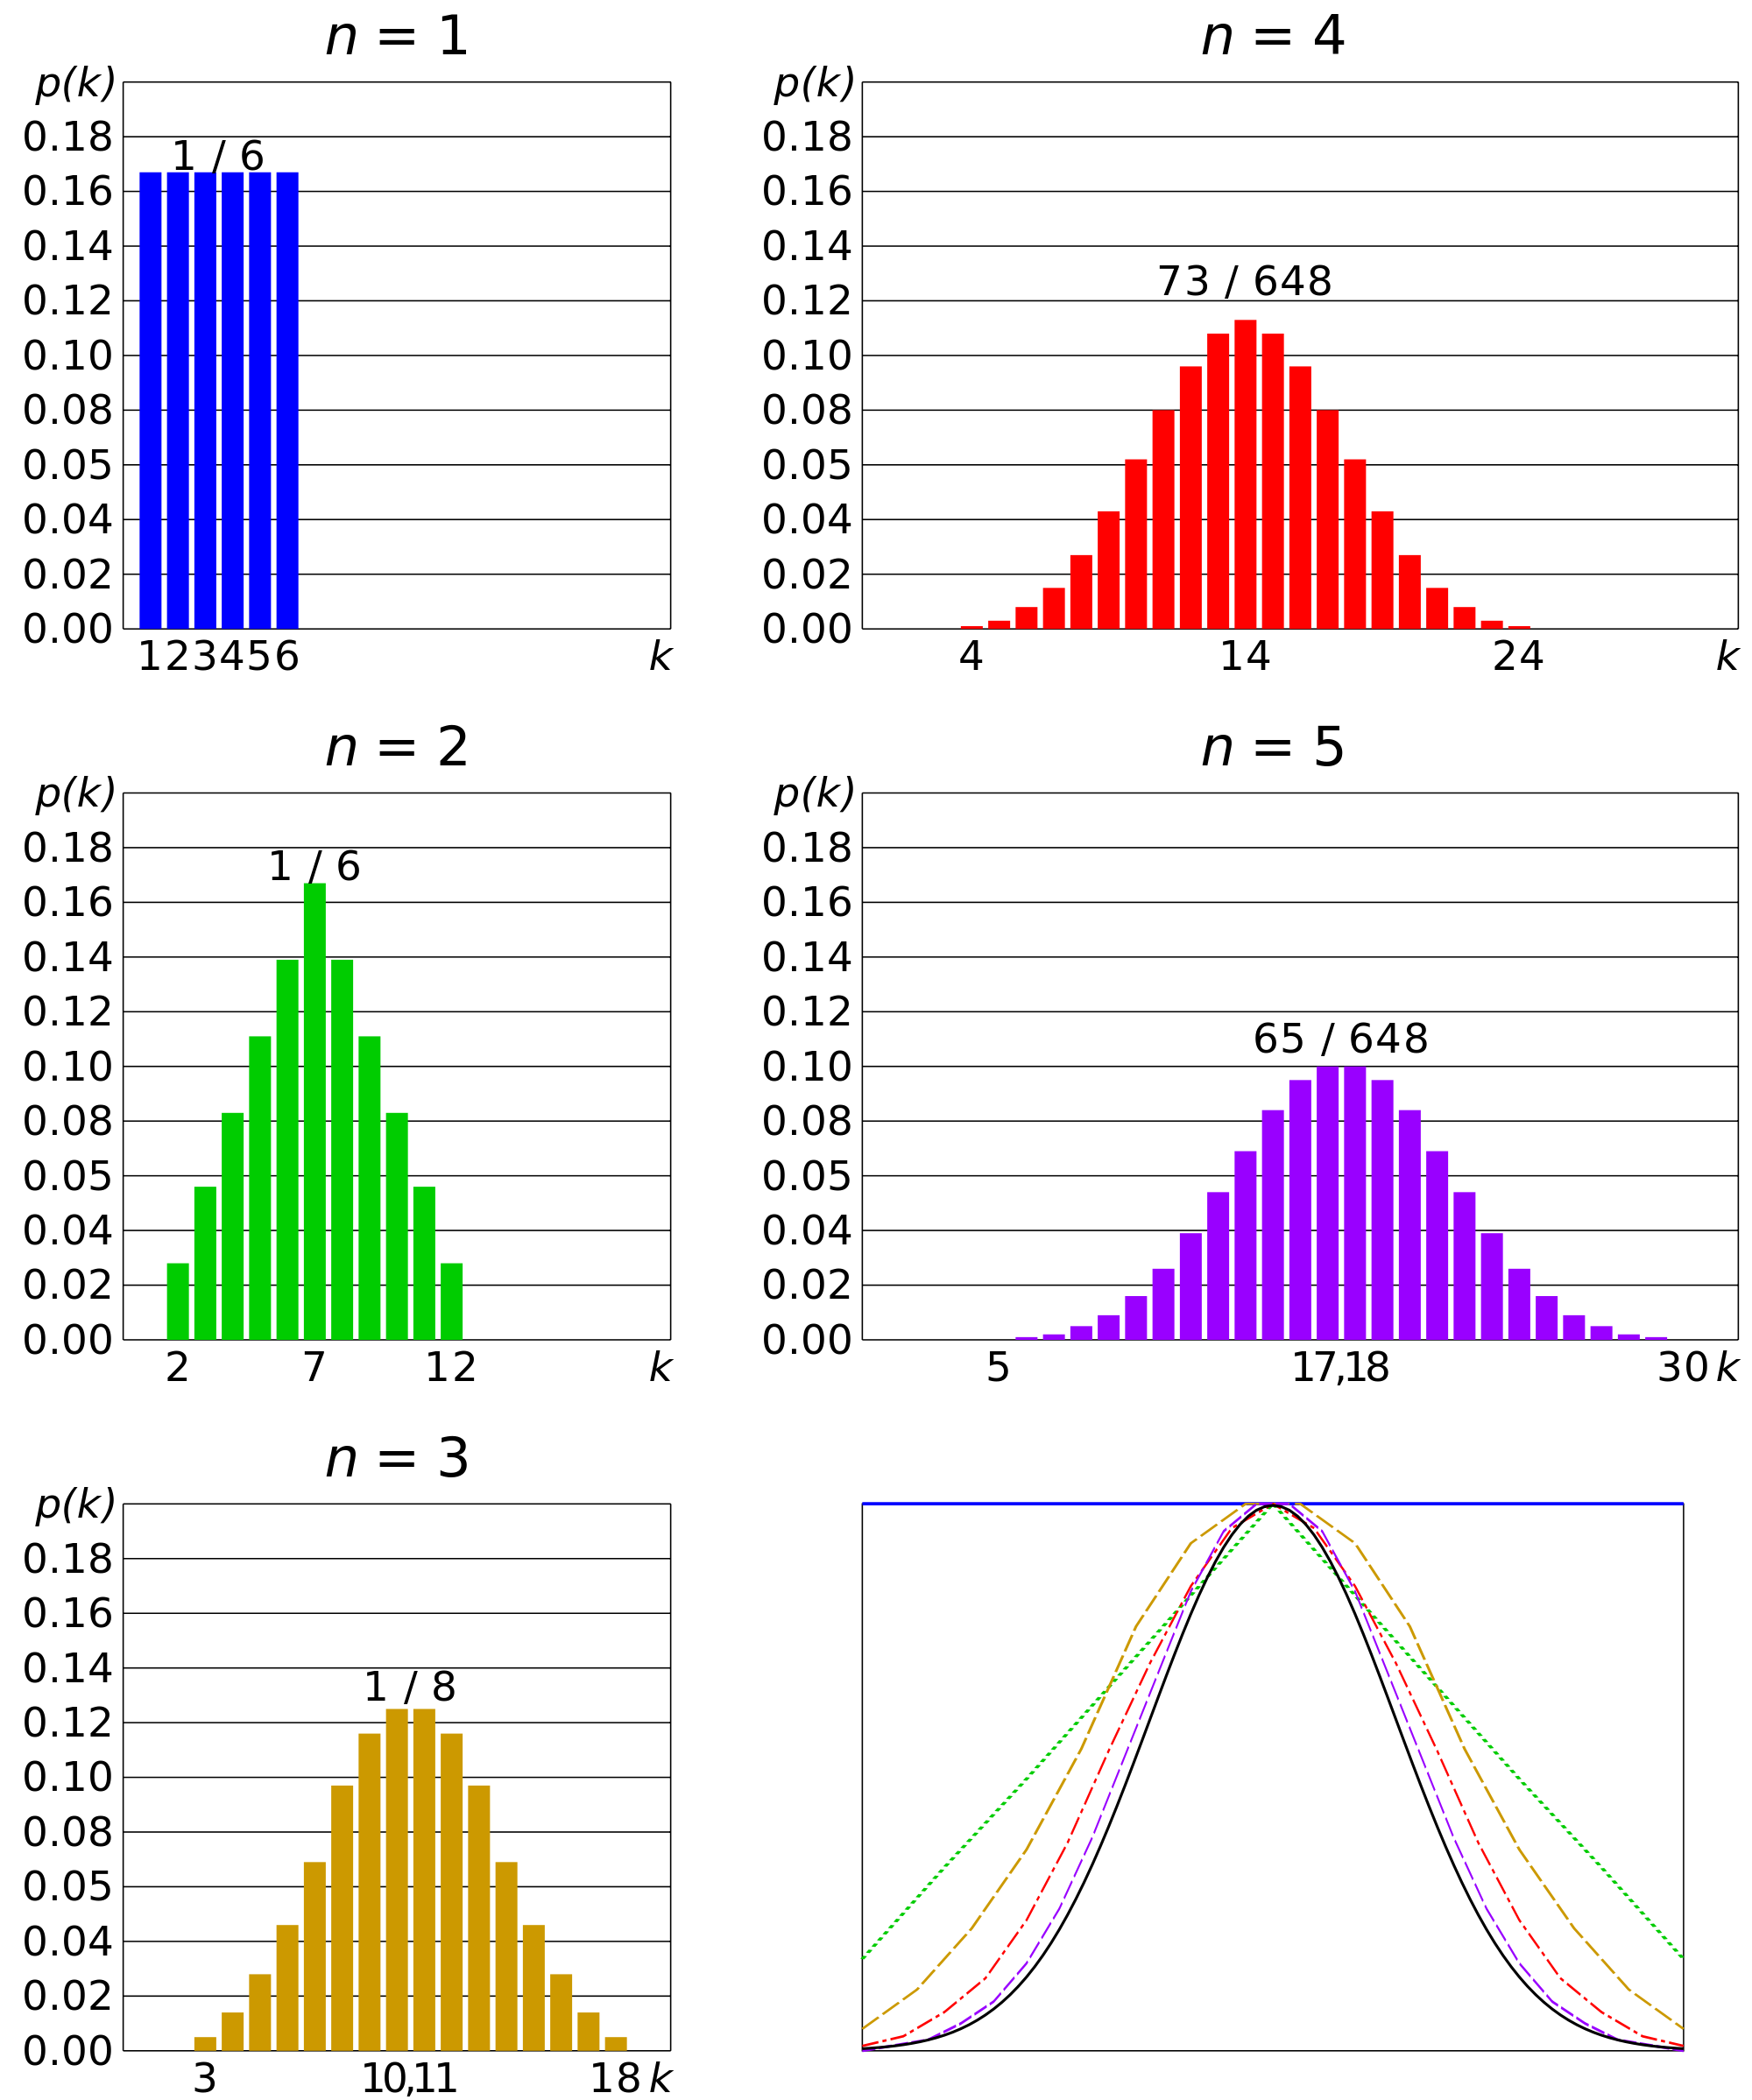
Comparison of probability density functions, p(k) for the sum of n fair 6-sided dice to show their convergence to a normal distribution with increasing n, in accordance to the central limit theorem. In the bottom-right graph, smoothed profiles of the previous graphs are rescaled, superimposed and compared with a normal distribution (black curve).

Slide 22
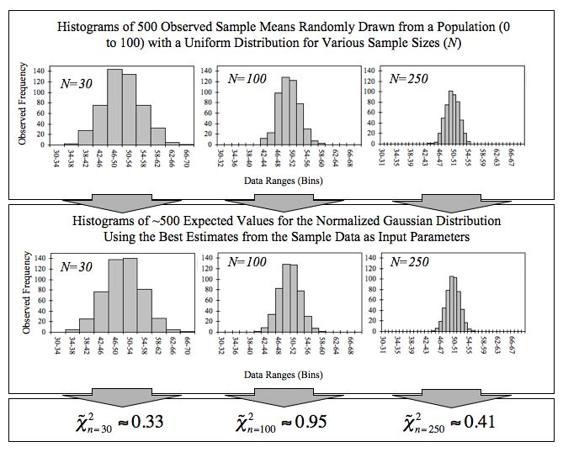
This figure demonstrates the central limit theorem. The sample means are generated using a random number generator, which draws numbers between 1 and 100 from a uniform probability distribution. It illustrates that increasing sample sizes result in the 500 measured sample means being more closely distributed about the population mean (50 in this case).
It also compares the observed distributions with the distributions that would be expected for a Gaussian distribution, and shows the chi-squared values that quantify the goodness of the fit

