Slide 1
X-Informatics Introduction: What is Big Data, Data Analytics and X-Informatics? (Continued)
January 9 2013
Geoffrey Fox
gcf@indiana.edu
http://www.infomall.org/X-InformaticsSpring2013/index.html
Associate Dean for Research and Graduate Studies, School of Informatics and Computing
Indiana University Bloomington
2013

Slide 2
Some Terms
Data: the raw bits and bytes produced by instruments, web , e-mail, social media
Information: The cleaned up data without deep processing applied to it
Knowledge/wisdom/decisions comes from sophisticated analysis of Information
Data Analytics is the process of converting data to Information and Knowledge and then decisions or policy
Data Science describes the whole process
X-Informatics is use of Data Science to produce wisdom in field X

Slide 3
The Course in One Sentence
Study Clouds running Data Analytics processing Big Data to solve problems in X-Informatics

Slide 4
Structure of Course
Based on informal survey, course will cover
Use of (Big) data in application areas (the X in X-Informatics)
Some examples will be based on “academic study”
Some examples will use online resources
Other examples will involve Python

Slide 5
MM = Million
Ruh VP Software GE http://fisheritcenter.haas.berkeley.edu/Big_Data/index.html

Slide 6
Previous slide (sensors in engines) was last one
Continue Big Data in Business (a statistics summary slide followed by eBay)

Slide 7
Trend: Analytical Software Solutions
Integrated software solutions for business problems
What are the opportunities for statisticians?
Problem | Industry
Fraud detection | Banking
Credit and operational risk | Banking
Credit scoring | Financial services
Warranty analysis | Manufacturing
Customer retention | Telecommunications
Markdown optimization | Retail
http://www.hsph.harvard.edu/ncb2011/files/ncb2011-z03-rodriguez.pptx
Notes:
Size and price optimization for retail industry
Fraud detection and credit and operational risk for banks
Credit scoring for financial services
Warranty analysis and supply chain optimization for manufacturing

Slide 8
http://fisheritcenter.haas.berkeley.edu/Big_Data/Williams.pdf

Slide 9
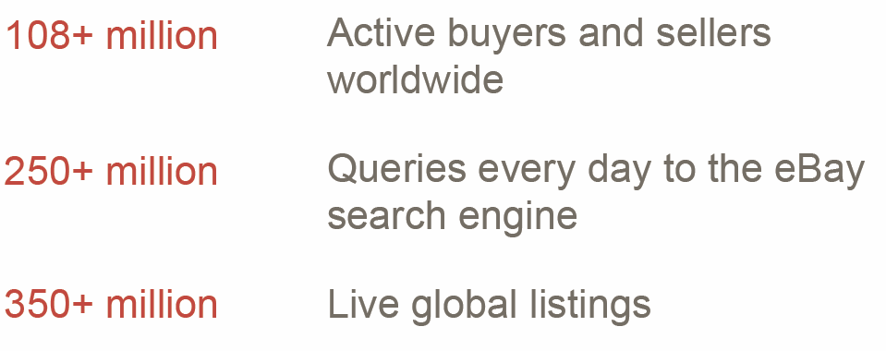

Slide 15
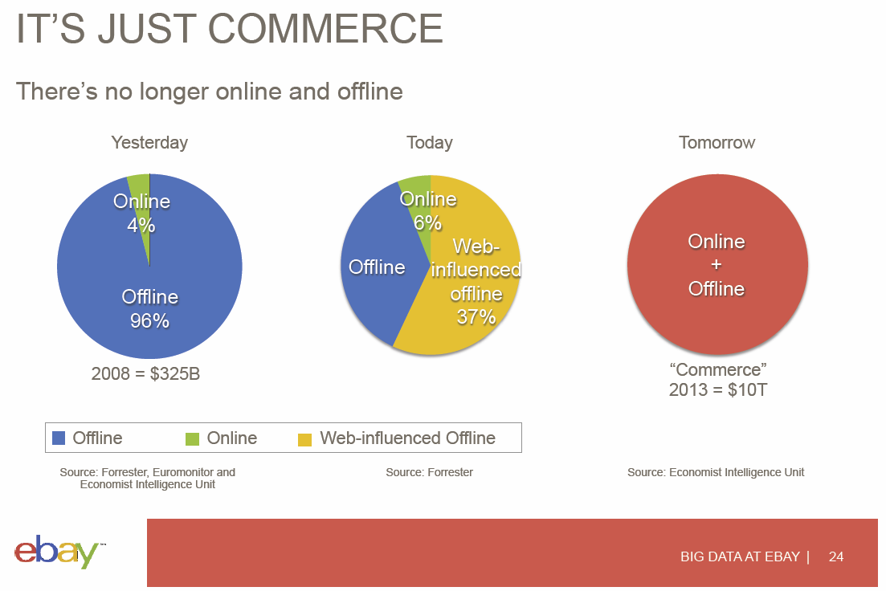

Slide 16
Data Deluge Science & Research

Slide 17
The data deluge: The Economist Feb 25 2010 http://www.economist.com/node/15579717
WHEN the Sloan Digital Sky Survey started work in 2000, its telescope in New Mexico collected more data in its first few weeks than had been amassed in the entire history of astronomy. Now, a decade later, its archive contains a whopping 140 terabytes of information. A successor, the Large Synoptic Survey Telescope, due to come on stream in Chile in 2016, will acquire that quantity of data every five days.
Such astronomical amounts of information can be found closer to Earth too. Wal-Mart, a retail giant, handles more than 1m customer transactions every hour, feeding databases estimated at more than 2.5 petabytes—the equivalent of 167 times the books in America's Library of Congress (see article for an explanation of how data are quantified). Facebook, a social-networking website, is home to 40 billion photos. And decoding the human genome involves analysing 3 billion base pairs—which took ten years the first time it was done, in 2003, but can now be achieved in one week.

Slide 18
Why need cost effective
Computing!
Full Personal Genomics: 3 petabytes per day
http://www.genome.gov/sequencingcosts/

Slide 19
Ninety-six percent of radiology practices in the USA are filmless and Table below illustrates the annual volume of data across the types of diagnostic imaging; this does not include cardiology which would take the total to over 10⁹ GB (an Exabyte).
http://grids.ucs.indiana.edu/ptliupages/publications/Where%20does%20all%20the%20data%20come%20from%20v7.pd
Modality | Part B non HMO | All Medicare | All Population | Per 1000 persons | Ave study size (GB) | Total annual data generated in GB
CT | 22 million | 29 million | 87 million | 287 | 0.25 | 21,750,000
MR | 7 million | 9 million | 26 million | 86 | 0.2 | 5,200,000
Ultrasound | 40 million | 53 million | 159 million | 522 | 0.1 | 15,900,000
Interventional | 10 million | 13 million | 40 million | 131 | 0.2 | 8,000,000
Nuclear Medicine | 10 million | 14 million | 41 million | 135 | 0.1 | 4,100,000
PET | 1 million | 1 million | 2 million | 8 | 0.1 | 200,000
Xray, total incl. mammography | 84 million | 111 million | 332 million | 1,091 | 0.04 | 13,280,000
All Diagnostic Radiology | 174 million | 229 million | 687 million | 2,259 | 0.1 | 68,700,000 68.7 PETAbytes

Slide 20
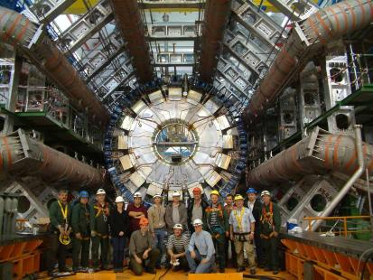
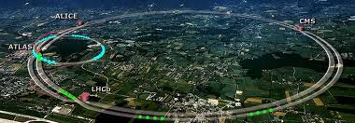
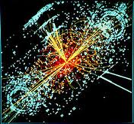
http://grids.ucs.indiana.edu/ptliupages/publications/Where%20does%20all%20the%20data%20come%20from%20v7.pd
This analysis raw data → reconstructed data → AOD and TAGS → Physics is performed on the multi-tier LHC Computing Grid. Note that every event can be analyzed independently so that many events can be processed in parallel with some concentration operations such as those to gather entries in a histogram. This implies that both Grid and Cloud solutions work with this type of data with currently Grids being the only implementation today.
ATLAS Expt
Note LHC lies in a tunnel 27 kilometres (17 mi) in circumference
Higgs Event
The LHC produces some 15 petabytes of data per year of all varieties and with the exact value depending on duty factor of accelerator (which is reduced simply to cut electricity cost but also due to malfunction of one or more of the many complex systems) and experiments. The raw data produced by experiments is processed on the LHC Computing Grid, which has some 200,000 Cores arranged in a three level structure. Tier-0 is CERN itself, Tier 1 are national facilities and Tier 2 are regional systems. For example one LHC experiment (CMS) has 7 Tier-1 and 50 Tier-2 facilities.

Slide 21
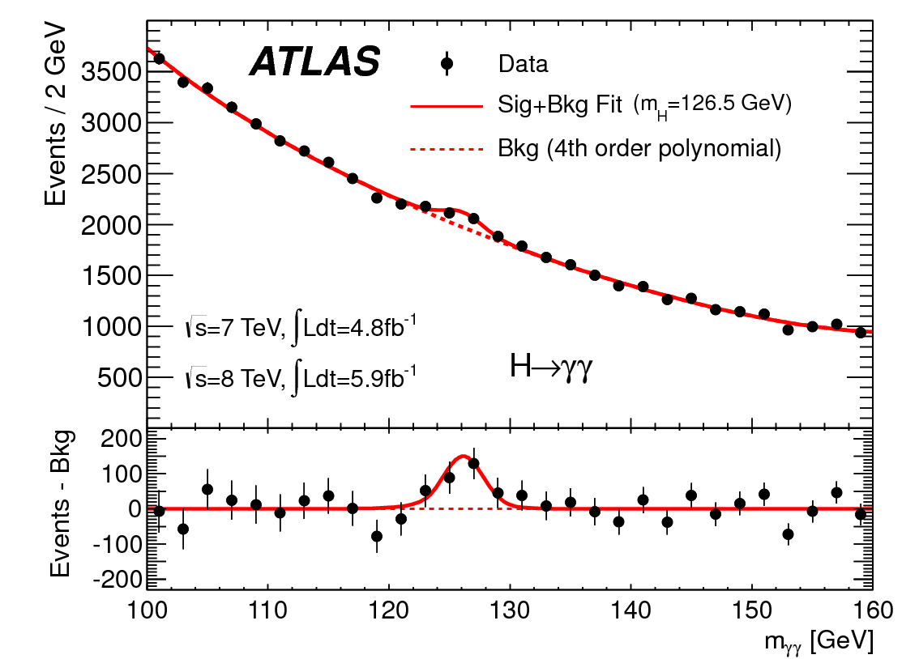
http://www.quantumdiaries.org/2012/09/07/why-particle-detectors-need-a-trigger/atlasmgg/
Model

Slide 22
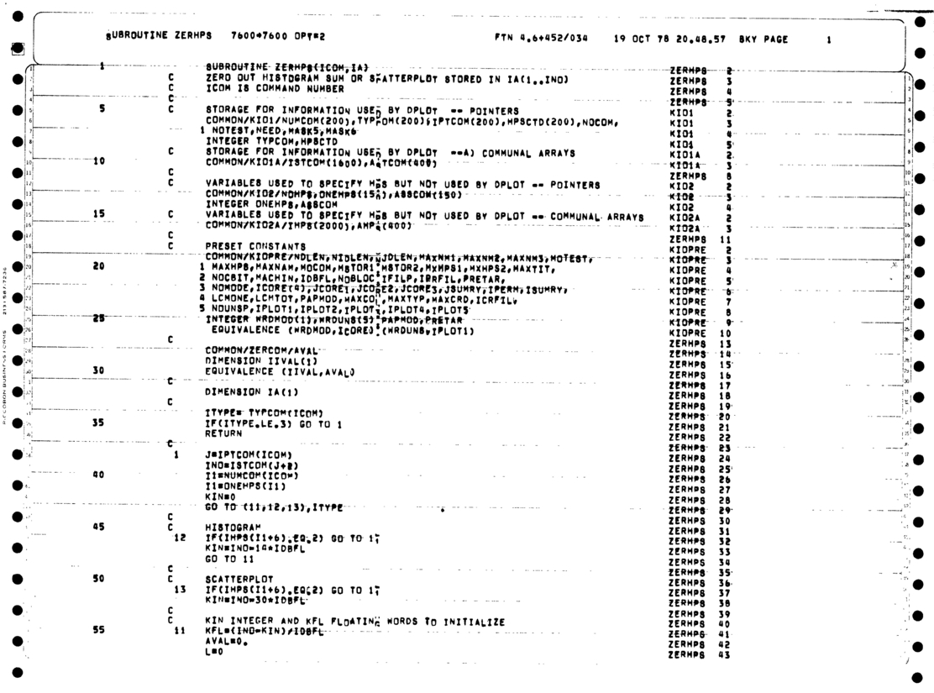
Personal Note
As a naïve undergraduate in 1964, I was told by Professor that bumps like
Were particles. I was amazed and found this more intriguing than anything else I had heard about so I decided to do PhD in area.
Note errors; measurements have errors that are SQRT(N) ( N~2000 measured # of events)
Central Limit theorem that dominates design and study of all such event-based experiments
Note methodology is use of histograms and I used to write (Fortran) code to do all this processing – See routine Papoose at http://salsahpc.indiana.edu/dlib/articles/00001935/ from 1978
Run on CDC 7600 – the supercomputer from that time accessed over over “Internet”
Note perforated paper. Program on cards discarded

Slide 23
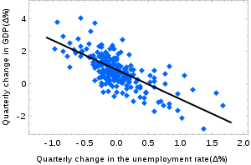
Models and Theory
Newton’s laws such Mass . Acceleration = Force is a theory as is Einstein’s special relativity and gravitational (general relativity) theory
Physicists just discovered a new particle – the Higgs or God particle whose existence was predicted by the “Grand Unified Theory”
Its search was handicapped as theory did not predict mass and a model is needed to calculate this (I used to build such models)
A model is a hopefully theoretically motivated “phenomenological” approach that allows predictions. Models often have parameters that are fit to existing data to predict new data (see FFF paper)
http://en.wikipedia.org/wiki/Simple_linear_regression: Okun's law in macroeconomics is an example of the simple linear regression. Here the dependent variable (GDP growth) is presumed to be in a linear relationship with the changes in the unemployment rate.

Slide 24
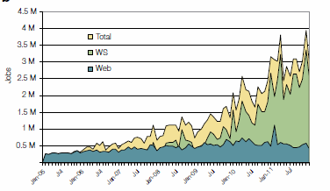
2005-20011 Job request at European Bioinformatics Institute EBI for Web hits and automated services WS
http://www.ebi.ac.uk/Information/Brochures/

Slide 25
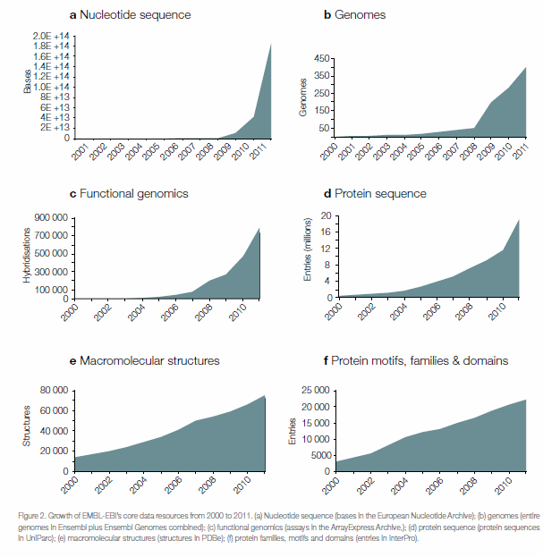
2005-20011 Data stored at European Bioinformatics Institute EBI
http://www.ebi.ac.uk/Information/Brochures/

Slide 26
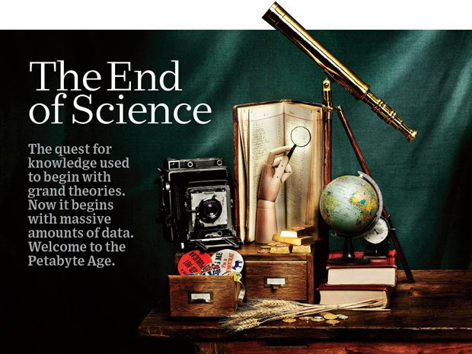
http://www.wired.com/wired/issue/16-07

Slide 27
The 4 paradigms of Scientific Research
Theory
Experiment or Observation
E.g. Newton observed apples falling to design his theory of mechanics
Simulation of theory or model
Data-driven (Big Data) or The Fourth Paradigm: Data-Intensive Scientific Discovery (aka Data Science)
http://research.microsoft.com/en-us/collaboration/fourthparadigm/
A free book
More data; less models

Slide 28
Another Personal Note
In 1990, only methods 1 and 2 were recognized but due to increasing power of computers, method 3 (computation science) was being recognized
I tried to persuade Caltech to adopt a “computational science curriculum” but failed
I left Caltech partly for this reason
I now realize that perhaps not such a good idea as not huge numbers of jobs in area.
However starting in 2005-2010, method 4 and data science emerges
There are lots of jobs in data science so curricula perhaps more interesting

Slide 29
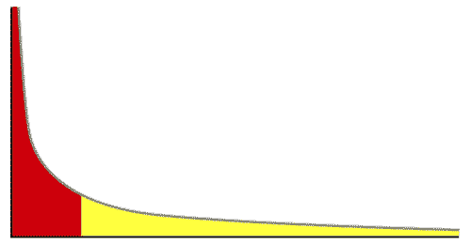
The Long Tail of Science
High energy physics, astronomy
genomics
The long tail: economics, social science, ….
Collectively “long tail” science is generating a lot of data
Estimated at over 1PB per year and it is growing fast.
80-20 rule: 20% users generate 80% data but not necessarily 80% knowledge
Gannon Talk

Slide 30
Internet of Things and the Cloud
It is projected that there will be 24 billion devices on the Internet by 2020. Most will be small sensors that send streams of information into the cloud where it will be processed and integrated with other streams and turned into knowledge that will help our lives in a multitude of small and big ways.
The cloud will become increasing important as a controller of and resource provider for the Internet of Things.
As well as today’s use for smart phone and gaming console support, “Intelligent River” “smart homes and grid” and “ubiquitous cities” build on this vision and we could expect a growth in cloud supported/controlled robotics.
Some of these “things” will be supporting science
Natural parallelism over “things”
“Things” are distributed and so form a Grid

Slide 31
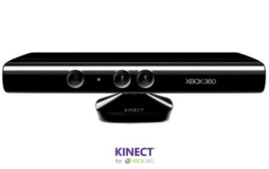
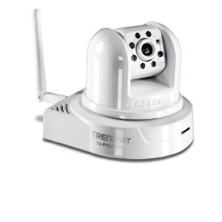
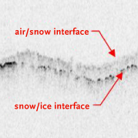
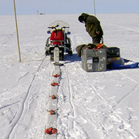
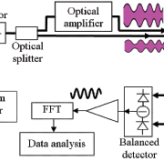
Sensors (Things) as a Service
Output Sensor
Sensors as a Service
Sensor Processing as a Service (could use MapReduce)
A larger sensor ………
https://sites.google.com/site/opensourceiotcloud/ Open Source Sensor (IoT) Cloud

