Slide 1
X-Informatics Introduction: What is Big Data, Data Analytics and X-Informatics? (Continued) Physics Use Case (Start)
January 16 2013
Geoffrey Fox
gcf@indiana.edu
http://www.infomall.org/X-InformaticsSpring2013/index.html
Associate Dean for Research and Graduate Studies, School of Informatics and Computing
Indiana University Bloomington
2013

Slide 3
Data Science Process (Continued)

Slide 4
Tom Davenport Harvard Business School http://fisheritcenter.haas.berkeley.edu/Big_Data/index.html Nov 2012

Slide 5
Is Davenport Correct?
There are the 1.5 million decision makers/managers of McKinsey report
Up to 190,000 “nerds”
Davenport appears to describe nerds not the larger 1.5M body of “generalists”

Slide 6
Jeff Hammerbacher’s Process
Identify problem
Instrument data sources
Collect data
Prepare data (integrate, transform, clean, impute, filter, aggregate)
Build model
Evaluate model
Communicate results
20120117berkeley1.pdf Jeff Hammerbacher

Slide 7
Another Jeff Hammerbacher Process
Obtain
Scrub
Explore
Model
Interpret
20120117berkeley1.pdf Jeff Hammerbacher

Slide 8
Statistician Colin Mallows
Identify data to collect and its relevance to your problem
Statistical specification of the problem
Method selection
Analysis of method
Interpret results for non-statisticians
20120117berkeley1.pdf Jeff Hammerbacher

Slide 9
Ben Fry Data Visualization http://en.wikipedia.org/wiki/Benjamin_Fry
Acquire
Parse
Filter
Mine
Represent
Reﬁne
Interact
20120117berkeley1.pdf Jeff Hammerbacher

Slide 10
Peter Huber Statistics (UCB)
Inspection
Error checking
Modiﬁcation
Comparison
Modeling and model ﬁtting
Simulation
What-if analyses
Interpretation
Presentation of conclusions
20120117berkeley1.pdf Jeff Hammerbacher

Slide 11
Jim Gray Microsoft Database/eScience
Capture
Curate
Communicate
Ted Johnson
Assemble an accurate and relevant data set
Choose the appropriate algorithm
20120117berkeley1.pdf Jeff Hammerbacher

Slide 12
Data Analytics

Slide 13
Tom Davenport Harvard Business School http://fisheritcenter.haas.berkeley.edu/Big_Data/index.html Nov 2012

Slide 14
General Remarks I
An immature (exciting) field: No agreement as to what is data analytics and what tools/computers needed
Databases or NOSQL?
Shared repositories or bring computing to data
What is repository architecture?
Sources: Data from observation or simulation
Different terms: Data analysis, Datamining, Data analytics., machine learning, Information visualization
Fields: Computer Science, Informatics, Library and Information Science, Statistics, Application Fields including Business
Approaches: Big data (cell phone interactions) v. Little data (Ethnography, surveys, interviews)
Topics: Security, Provenance, Metadata, Data Management, Curation

Slide 15
General Remarks II
Tools: Regression analysis; biostatistics; neural nets; bayesian nets; support vector machines; classification; clustering; dimension reduction; artificial intelligence; semantic web
One driving force: Patient records growing fast
Another: Abstract graphs from net leads to community detection
Some data in metric spaces; others very high dimension or none
Large Hadron Collider analysis mainly histogramming – all can be done with MapReduce (larger use than MPI)
Commercial: Google, Bing largest data analytics in world
Time Series: Earthquakes, Tweets, Stock Market (Pattern Informatics)
Image Processing from climate simulations to NASA to DoD to Radiology (Radar and Pathology Informatics – same library)
Financial decision support; marketing; fraud detection; automatic preference detection (map users to books, films)

Slide 16
Algorithms for Data Analytics
In simulation area, it is observed that equal contributions to improved performance come from increased computer power and better algorithms http://cra.org/ccc/docs/nitrdsymposium/pdfs/keyes.pdf
In data intensive area, we haven’t seen this effect so clearly
Information retrieval revolutionized but
Still using Blast in Bioinformatics (although Smith Waterman etc. better)
Still using R library which has many non optimal algorithms
Parallelism and use of GPU’s often ignored

Slide 17
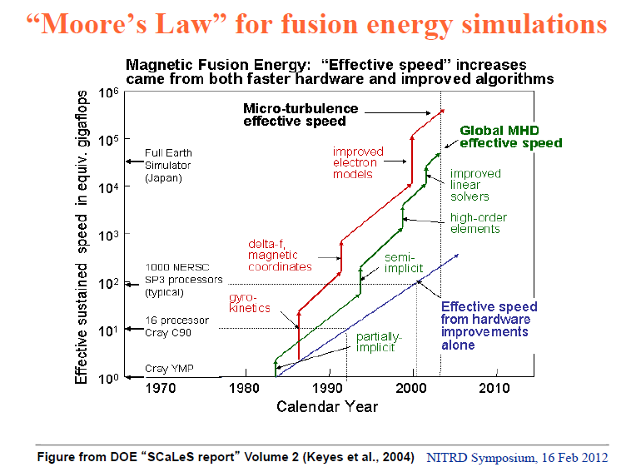

Slide 18
Physics-Informatics Looking for Higgs Particle Counting Errors (start)

Slide 19
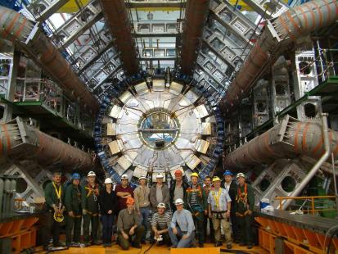
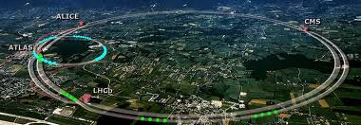
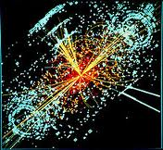
http://grids.ucs.indiana.edu/ptliupages/publications/Where%20does%20all%20the%20data%20come%20from%20v7.pd
This analysis raw data → reconstructed data → AOD and TAGS → Physics is performed on the multi-tier LHC Computing Grid. Note that every event can be analyzed independently so that many events can be processed in parallel with some concentration operations such as those to gather entries in a histogram. This implies that both Grid and Cloud solutions work with this type of data with currently Grids being the only implementation today.
ATLAS Expt
Note LHC lies in a tunnel 27 kilometres (17 mi) in circumference
Higgs Event
The LHC produces some 15 petabytes of data per year of all varieties and with the exact value depending on duty factor of accelerator (which is reduced simply to cut electricity cost but also due to malfunction of one or more of the many complex systems) and experiments. The raw data produced by experiments is processed on the LHC Computing Grid, which has some 200,000 Cores arranged in a three level structure. Tier-0 is CERN itself, Tier 1 are national facilities and Tier 2 are regional systems. For example one LHC experiment (CMS) has 7 Tier-1 and 50 Tier-2 facilities.

Slide 20
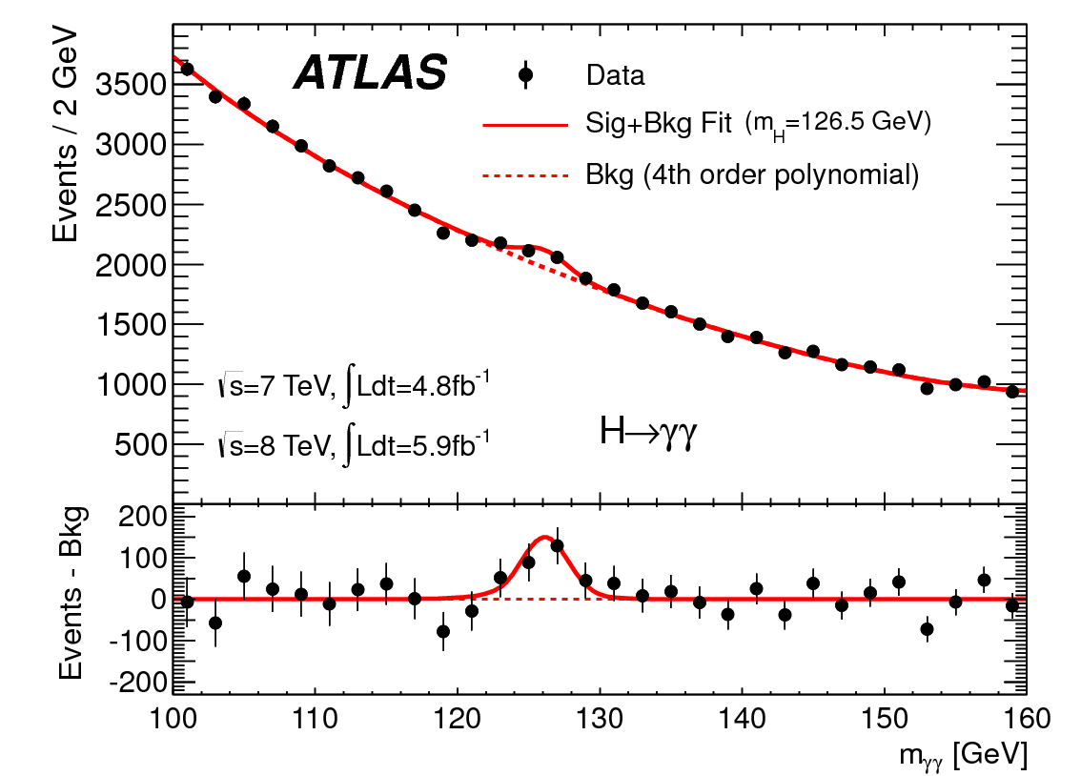
http://www.quantumdiaries.org/2012/09/07/why-particle-detectors-need-a-trigger/atlasmgg/
Model

Slide 21
Personal Note
As a naïve undergraduate in 1964, I was told by Professor that bumps like
Were particles. I was amazed and found this more intriguing than anything else I had heard about so I decided to do PhD in area.
Note errors; measurements have errors that are SQRT(N) ( N~2000 measured # of events)
Central Limit theorem that dominates design and study of all such event-based experiments

Slide 22
More Details
To get that acceleration, the scientists at CERN used the Large Hadron Collider, which is buried under the French/Swiss border. It’s a circular path that’s about 16.8 miles long and about 330 feet below the surface. The Collider has about 9,300 magnets, which are super-cooled to -456.25 degrees Fahrenheit. This enables the Collider to get protons to 99.99% of the speed of light. The protons run through six different detectors, which run different experiments and the amount of electricity that powers it is incredible – 120 Megawatts – about as much as all of the homes in the neighboring Swiss Canton of Geneva.
The Large Hadron Collider took about a decade to construct, for a total cost of about $4.75 billion. Computing power is also a significant part of the cost of running CERN – about $286 million annually. Electricity costs alone for the LHC run about $23.5 million per year. The total operating budget of the LHC runs to about $1 billion per year.
The Large Hadron Collider was first turned on in August of 2008, then stopped for repairs in September until November 2009. Taking all of those costs into consideration, the total cost of finding the Higgs boson ran about $13.25 billion. That’s a large amount, but there are over 50 billionaires on the Forbes list actually worth more than that.

Slide 23
Experiments
ATLAS (A Toroidal LHC Apparatus) is one of the seven particle detector experiments (ALICE, ATLAS, CMS, TOTEM, LHCb, LHCf and MoEDAL) constructed at the Large Hadron Collider (LHC), a particle accelerator at CERN (the European Organization for Nuclear Research) in Switzerland.
ATLAS is 45 metres long, 25 metres in diameter, and weighs about 7,000 tons. The experiment is a collaboration involving roughly 3,000 physicists at 175 institutions in 38 countries
The Compact Muon Solenoid (CMS) experiment is one of two large general-purpose particle physics detectors built on the Large Hadron Collider (LHC) at CERN in Switzerland and France.
Approximately 3,600 people, representing 183 scientific institutes and 38 countries, form the CMS collaboration who built and now operate the detector.
It is located in an underground cavern at Cessy in France, just across the border from Geneva.

Slide 24
Budgets
US Department of Energy particle physics budget $777M a year
LHC is flagship project but may not
ATLAS + CMS (2 largest experiments) are 6,000 people which is perhaps $500M a year

