Slide 1
X-Informatics Case Study: e-Commerce and Life Style Informatics: Recommender Systems III: Algorithms Continued and Software
February 11 2013
Geoffrey Fox
gcf@indiana.edu
http://www.infomall.org/X-InformaticsSpring2013/index.html
Associate Dean for Research and Graduate Studies, School of Informatics and Computing
Indiana University Bloomington
2013

Slide 2
Memory-based and model-based approaches
User-based CF is said to be "memory-based“ (Real-Time)
the rating matrix is directly used to find neighbors / make predictions
does not scale for most real-world scenarios
large e-commerce sites have tens of millions of customers and millions of items
Model-based approaches (Batch or Off Line)
based on an offline pre-processing or "model-learning" phase
at run-time, only the learned model is used to make predictions
models are updated / re-trained periodically
large variety of techniques used
model-building and updating can be computationally expensive
item-based CF is an example for model-based approaches
http://recommenderbook.net/teaching-material/slides Chapter 2

Slide 3
Item-based collaborative filtering
Basic idea:
Use the similarity between items (and not users) to make predictions
Example:
Look for items that are similar to Item5
Take Alice's ratings for these items to predict the rating for Item5
 | Item1 | Item2 | Item3 | Item4 | Item5
Alice | 5 | 3 | 4 | 4 | ?
User1 | 3 | 1 | 2 | 3 | 3
User2 | 4 | 3 | 4 | 3 | 5
User3 | 3 | 3 | 1 | 5 | 4
User4 | 1 | 5 | 5 | 2 | 1

Slide 4
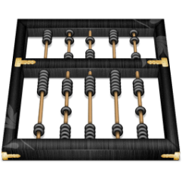
The cosine similarity measure
Produces better results in item-to-item filtering
Ratings are seen as vector in n-dimensional space
Similarity is calculated based on the angle between the vectors
Adjusted cosine similarity
take average user ratings into account, transform the original ratings
$U$: set of users who have rated both items $a$ and $b$
$$sim\left(\vec{a},\vec{b}\right)=\frac{\vec{a}∙\vec{b}}{\left|\vec{a}\right|∗|\vec{b}|}$$
$$sim\left(\vec{a},\vec{b}\right)= \frac{\sum_{u∈U}{(r_{u,a}−\overline{r_{u}})(r_{u,b}−\overline{r_{u}})}}{\sqrt{\sum_{u∈U}{{\left(r_{u,a}−\overline{r_{u}}\right)}^{2}}}\sqrt{\sum_{u∈U}{{\left(r_{u,b}−\overline{r_{u}}\right)}^{2}}}}$$
http://recommenderbook.net/teaching-material/slides Chapter 2

Slide 5
Making predictions
A common prediction function:
Neighborhood size is typically also limited to a specific size
Not all neighbors are taken into account for the prediction
An analysis of the MovieLens dataset indicates that "in most real-world situations, a neighborhood of 20 to 50 neighbors seems reasonable" (Herlocker et al. 2002)
$$pred\left(u,p\right)=\frac{\sum_{i∈ratedItem(u)}{sim\left(i,p\right)∗r_{u,i}}}{\sum_{i∈ratedItem(u)}{sim\left(i,p\right)}}$$

Slide 6
Pre-processing for item-based filtering
Item-based filtering does not solve the scalability problem itself
Pre-processing approach by Amazon.com (in 2003)
Calculate all pair-wise item similarities in advance
The neighborhood to be used at run-time is typically rather small, because only items are taken into account which the user has rated
Item similarities are supposed to be more stable than user similarities
Memory requirements
Up to N² pair-wise similarities to be memorized (N = number of items) in theory
In practice, this is significantly lower (items with no co-ratings)
Further reductions possible
Minimum threshold for co-ratings
Limit the neighborhood size (might affect recommendation accuracy)
http://recommenderbook.net/teaching-material/slides Chapter 2

Slide 7
More on ratings – Explicit ratings
Probably the most precise ratings
Most commonly used (1 to 5, 1 to 7 Likert response scales)
Research topics
Optimal granularity of scale; indication that 10-point scale is better accepted in movie dom.
An even more fine-grained scale was chosen in the joke recommender discussed by Goldberg et al. (2001), where a continuous scale (from −10 to +10) and a graphical input bar were used
No precision loss from the discretization
User preferences can be captured at a finer granularity
Users actually "like" the graphical interaction method
Multidimensional ratings (multiple ratings per movie such as ratings for actors and sound)
Main problems
Users not always willing to rate many items
number of available ratings could be too small → sparse rating matrices → poor recommendation quality
How to stimulate users to rate more items?
http://recommenderbook.net/teaching-material/slides Chapter 2

Slide 8
More on ratings – Implicit ratings
Typically collected by the web shop or application in which the recommender system is embedded
When a customer buys an item, for instance, many recommender systems interpret this behavior as a positive rating
Clicks, page views, time spent on some page, demo downloads …
Implicit ratings can be collected constantly and do not require additional efforts from the side of the user
Main problem
One cannot be sure whether the user behavior is correctly interpreted
For example, a user might not like all the books he or she has bought; the user also might have bought a book for someone else
Implicit ratings can be used in addition to explicit ones; question of correctness of interpretation
http://recommenderbook.net/teaching-material/slides Chapter 2

Slide 9
Data sparsity problems
Cold start problem
How to recommend new items? What to recommend to new users?
Straightforward approaches
Ask/force users to rate a set of items
Use another method (e.g., content-based, demographic or simply non-personalized) in the initial phase
Default voting: assign default values to items that only one of the two users to be compared has rated (Breese et al. 1998)
Alternatives
Use better algorithms (beyond nearest-neighbor approaches)
Example:
In nearest-neighbor approaches, the set of sufficiently similar neighbors might be too small to make good predictions
Assume "transitivity" of neighborhoods
http://recommenderbook.net/teaching-material/slides Chapter 2

Slide 10
Example algorithms for sparse datasets
Recursive CF (Zhang and Pu 2007)
Assume there is a very close neighbor $n$ of $u$ who however has not rated the target item $i$ yet.
Idea:
Apply CF-method recursively and predict a rating for item $i$ for the neighbor
Use this predicted rating instead of the rating of a more distant direct neighbor
 | Item1 | Item2 | Item3 | Item4 | Item5
Alice | 5 | 3 | 4 | 4 | ?
User1 | 3 | 1 | 2 | 3 | ?
User2 | 4 | 3 | 4 | 3 | 5
User3 | 3 | 3 | 1 | 5 | 4
User4 | 1 | 5 | 5 | 2 | 1
sim = 0.85
Predict rating for
User1
http://recommenderbook.net/teaching-material/slides Chapter 2

Slide 11
k Nearest Neighbors
The basic user and item based recommendation systems built around k Nearest Neighbor method
Set k = 3…20 and find the k nearest neighbors
If k too small then sensitive to error (maybe one of the k is somehow screwed up)
The algorithm can be trivial
Calculate all the distances (user i – Alice) where all users including Alice have rated some cutoff number of identical items
Sort distances lowest to highest
Take the lowest k
See Python code

Slide 12
Some difficulties
Users and Items each live in abstract spaces
Users in space of items with rankings as coefficients
Items in space of users with rankings as coefficient
OR in content-based, items live in space defined by their content
Words
Clusters or “latent factors” or “mixtures” or topics
Semantic information as in Music Genome
How do we easily find nearest neighbors?
The trivial algorithm needs O(M) distance computations for M customers and then O( M_{real}(Alice)log{M_{real}(Alice)}) where M_{real}(Alice) users are considered as have rated enough items in common.
Sorting P numbers takes time P logP
If k small, complexity is k M_{real}(Alice)
Note M_{real}(Alice) << M

Slide 13
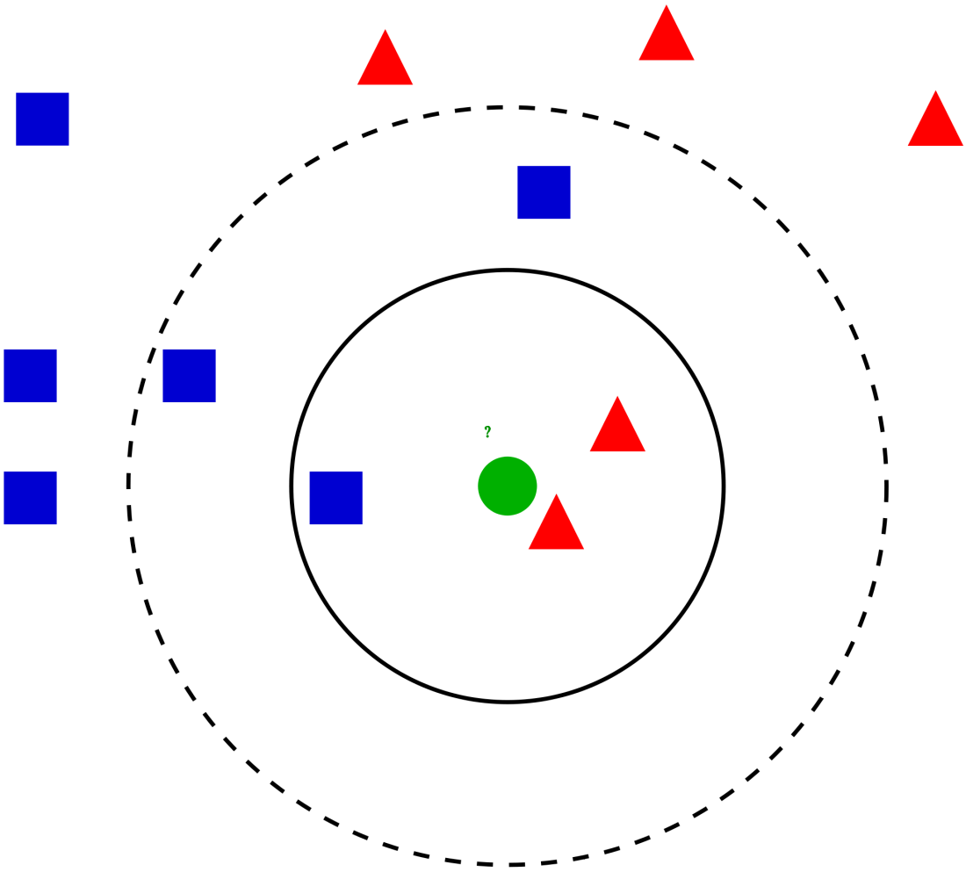
Wikipedia: Example of k-NN classification
The test sample (green circle) should be classified either to the first class of blue squares or to the second class of red triangles. If k = 3(solid line circle) it is assigned to the second class because there are 2 triangles and only 1 square inside the inner circle. If k = 5(dashed line circle) it is assigned to the first class (3 squares vs. 2 triangles inside the outer circle).

Slide 14
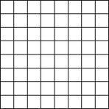
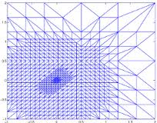
The Curse of Dimensionality
In a low dimension space it is very fast to find nearest neighbors
Divide space into a grid
Assign points to cells of grid
The mesh can be non uniform
Just look at same cell point is in or its neighbors to find k nearest neighbors
Doesn’t work for “abstract” or high dimension spaces as too many cells
Factor analysis or clustering or dimension reduction addresses this

Slide 15
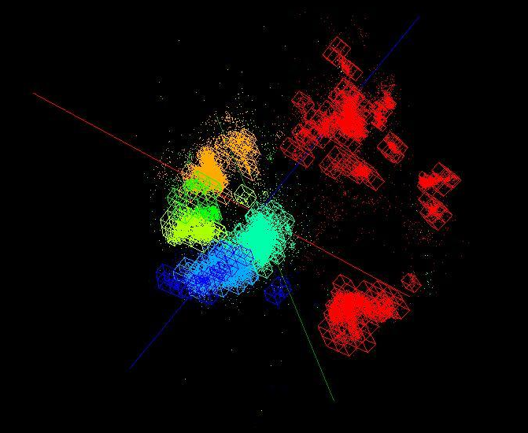
Genome Data projected to 3D and put in a mesh

Slide 16
Python Example
Machine Learning in Action Peter Harrington April, 2012 | 384 pages ISBN: 9781617290183
http://www.manning.com/pharrington/MLiA_SourceCode.zip
Chapter 2

Slide 17
Read a 3D File of Labels and Rating
3D Labels are content
# Set up a datset of 4 (2D vector) items -- each of which has one of two labels
def createDataSet():
group = array([[1.0,1.1],[1.0,1.0],[0,0],[0,0.1]])
labels = ['A','A','B','B']
return group, labels

Slide 18
Python Example I
%cd d:\\Python\RecommenderCh02
import kNN
FigDating = figure()
group,labels = kNN.createDataSet()
colormap1 = { 'A':'red', 'B':'blue'}
ColoredGroupLabels = []
for things in labels:
ColoredGroupLabels.append(colormap1[things])
ax1 = FigDating.add_subplot(311, xlim=(-0.1,1.1), ylim=(-.05,1.15))
ax1.scatter(group[:,0], group[:,1], s= 20, c= ColoredGroupLabels, marker = 'o' )
testvector = [.2, .2]
answer = kNN.classify0(testvector,group, labels, 3)
# type answer to see result

Slide 19
Python Example II
ax1.scatter(testvector[0], testvector[1], s= 20, c= colormap1[answer], marker = 'x' )
testvector = [.5, .5]
answer = kNN.classify0(testvector,group, labels, 3)
ax1.scatter(testvector[0], testvector[1], s= 20, c= colormap1[answer], marker = 'x' )
testvector = [.75, .75]
answer = kNN.classify0(testvector,group, labels, 3)
ax1.scatter(testvector[0], testvector[1], s= 20, c= colormap1[answer], marker = 'x' )
datingDataMat,datingLabels = kNN.file2matrix('datingTestSet2.txt')
datingLabelArray = array(datingLabels)
colormap2 = { 1:'red', 2:'blue', 3:'green' }
ColoredDatingLabel = []
for things in datingLabelArray:
ColoredDatingLabel.append(colormap2[things])

Slide 20
Python Example III
ax2 = FigDating.add_subplot(312, xlim=(0,100000), ylim=(0,25))
ax2.scatter(datingDataMat[:,0], datingDataMat[:,1], s= 20, c= ColoredDatingLabel, marker = 'o' )
normMat, ranges, minVals = kNN.autoNorm(datingDataMat)
ax3 = FigDating.add_subplot(313, xlim=(0,1), ylim=(0,1))
ax3.scatter(normMat[:,0], normMat[:,1], s = 20, c= ColoredDatingLabel, marker = 'o' )
show()
NumberBad = kNN.datingClassTest(0.1)
d:\Python\RecommenderCh02
the total error rate is: 0.050000
Number Bad 5.000000

Slide 21
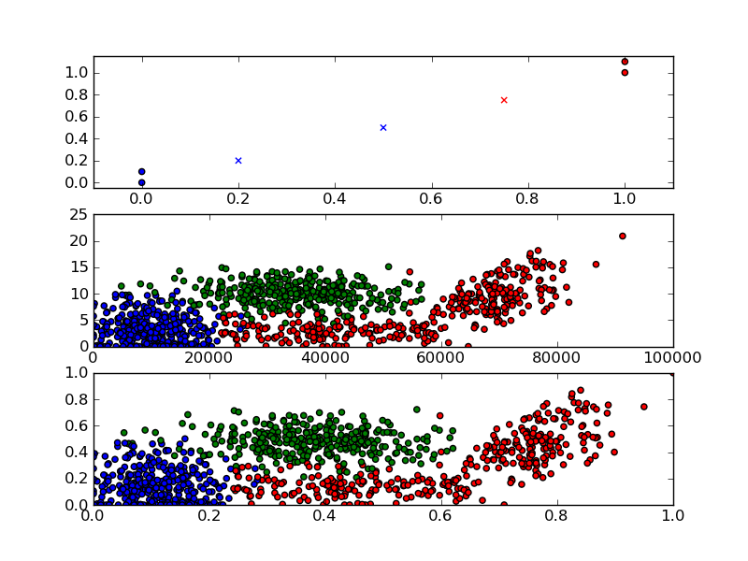

Slide 22
kNN Classifier
# Use k Nearest Neighbors to classify inX accortding to existing dataSet with known ratings in labels
def classify0(inX, dataSet, labels, k):
dataSetSize = dataSet.shape[0] # Number of entries in dataSet
diffMat = tile(inX, (dataSetSize,1)) – dataSet # Array of same shape as dataSet holding inX-dataSet entry in each position
sqDiffMat = diffMat**2 # Square entries in diffMat
sqDistances = sqDiffMat.sum(axis=1) # Sum over vector components
distances = sqDistances**0.5 # Traditional Euclidean distance for each dataSet entry
sortedDistIndicies = distances.argsort() # argsort returns indices that sort distances
classCount={} # An empty dictionary key:value pairs key = labels value = number times this label in set of k
for i in range(k): # Run over k nearest neighbors
voteIlabel = labels[sortedDistIndicies[i]] # Label of this neighbor
classCount[voteIlabel] = classCount.get(voteIlabel,0) + 1 # .get gets current count for voteIlabel and returns zero if first time voteIlabel seen (default = 0)
sortedClassCount = sorted(classCount.iteritems(), key=operator.itemgetter(1), reverse=True) # Sort classCount (highest to lowest) by voteIlabel count
return sortedClassCount[0][0] # The label that occurs most often in k nearest neighbors

Slide 23
Clustering
This is used in somewhat different ways
First is taking a set of points in a space and divide into distinct groups
Second is dividing points into neighboring points but not groups that are separate
There are also latent factor and mixture models which use a different definition of cluster that adds probabilities
These are used to group “items” together in content based approaches
Further one has methods/applications that work in
Real vector spaces
Spaces in which there are no vectors but some or all of distances defined

Slide 24
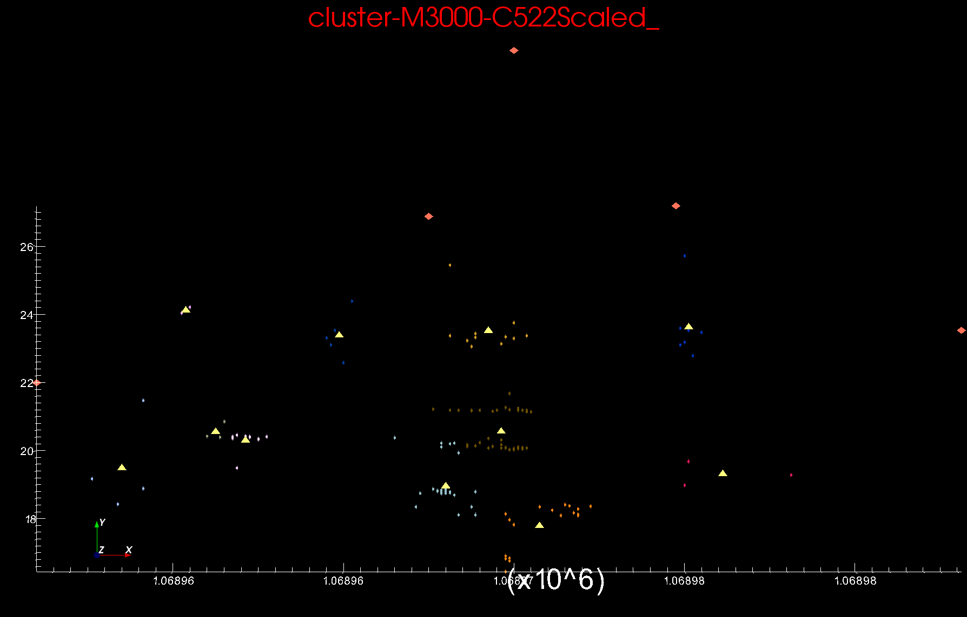
Proteomics 2D DA Clustering T=0.1 small sample of ~30,000 Clusters Count >=2
Sponge Peaks
Centers

Slide 25
Metagenomics
DA-PWC

Slide 26
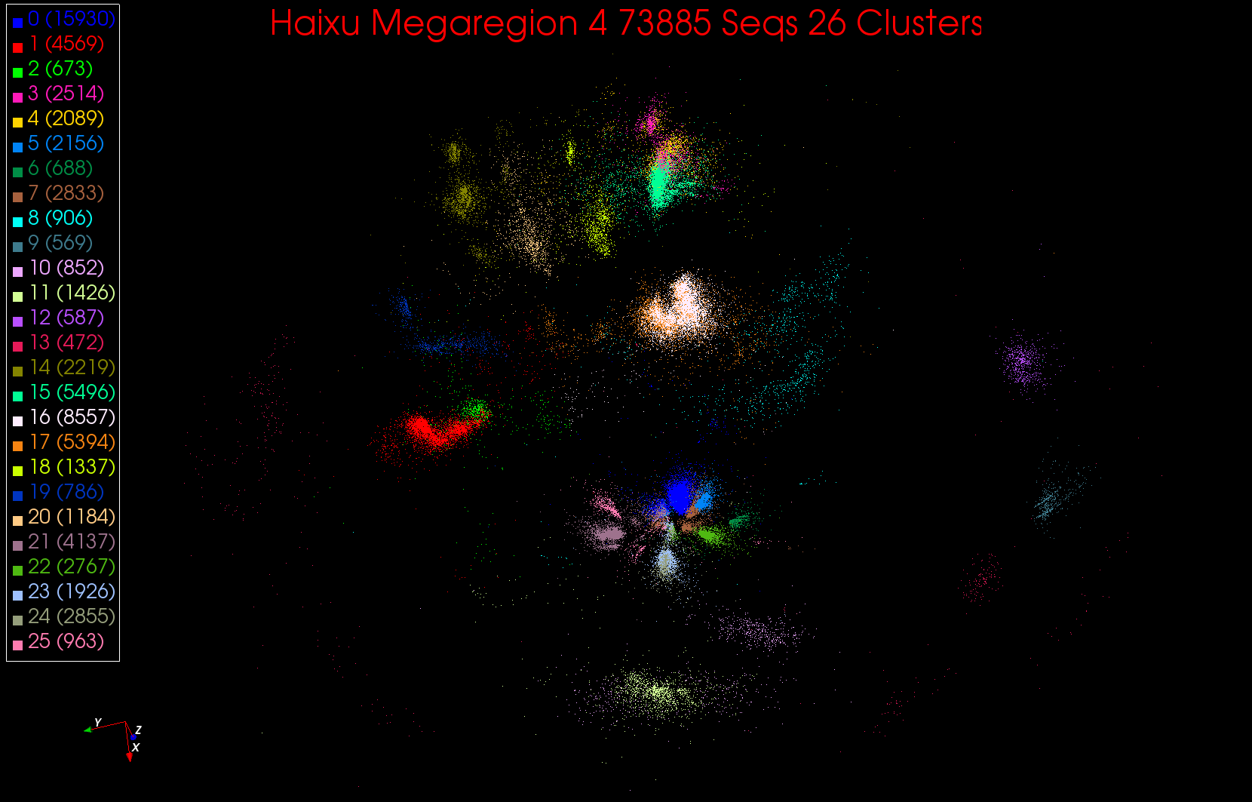
26 Clusters in Region 4

Slide 27
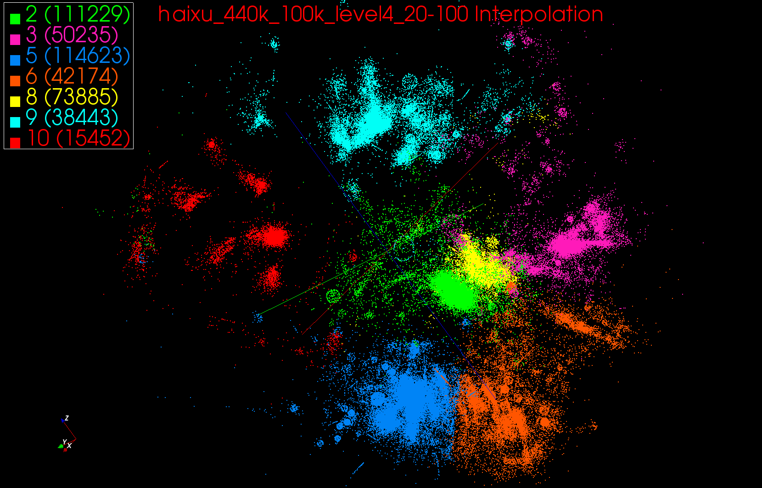
Genomic Data Not fully Clustered

Slide 28
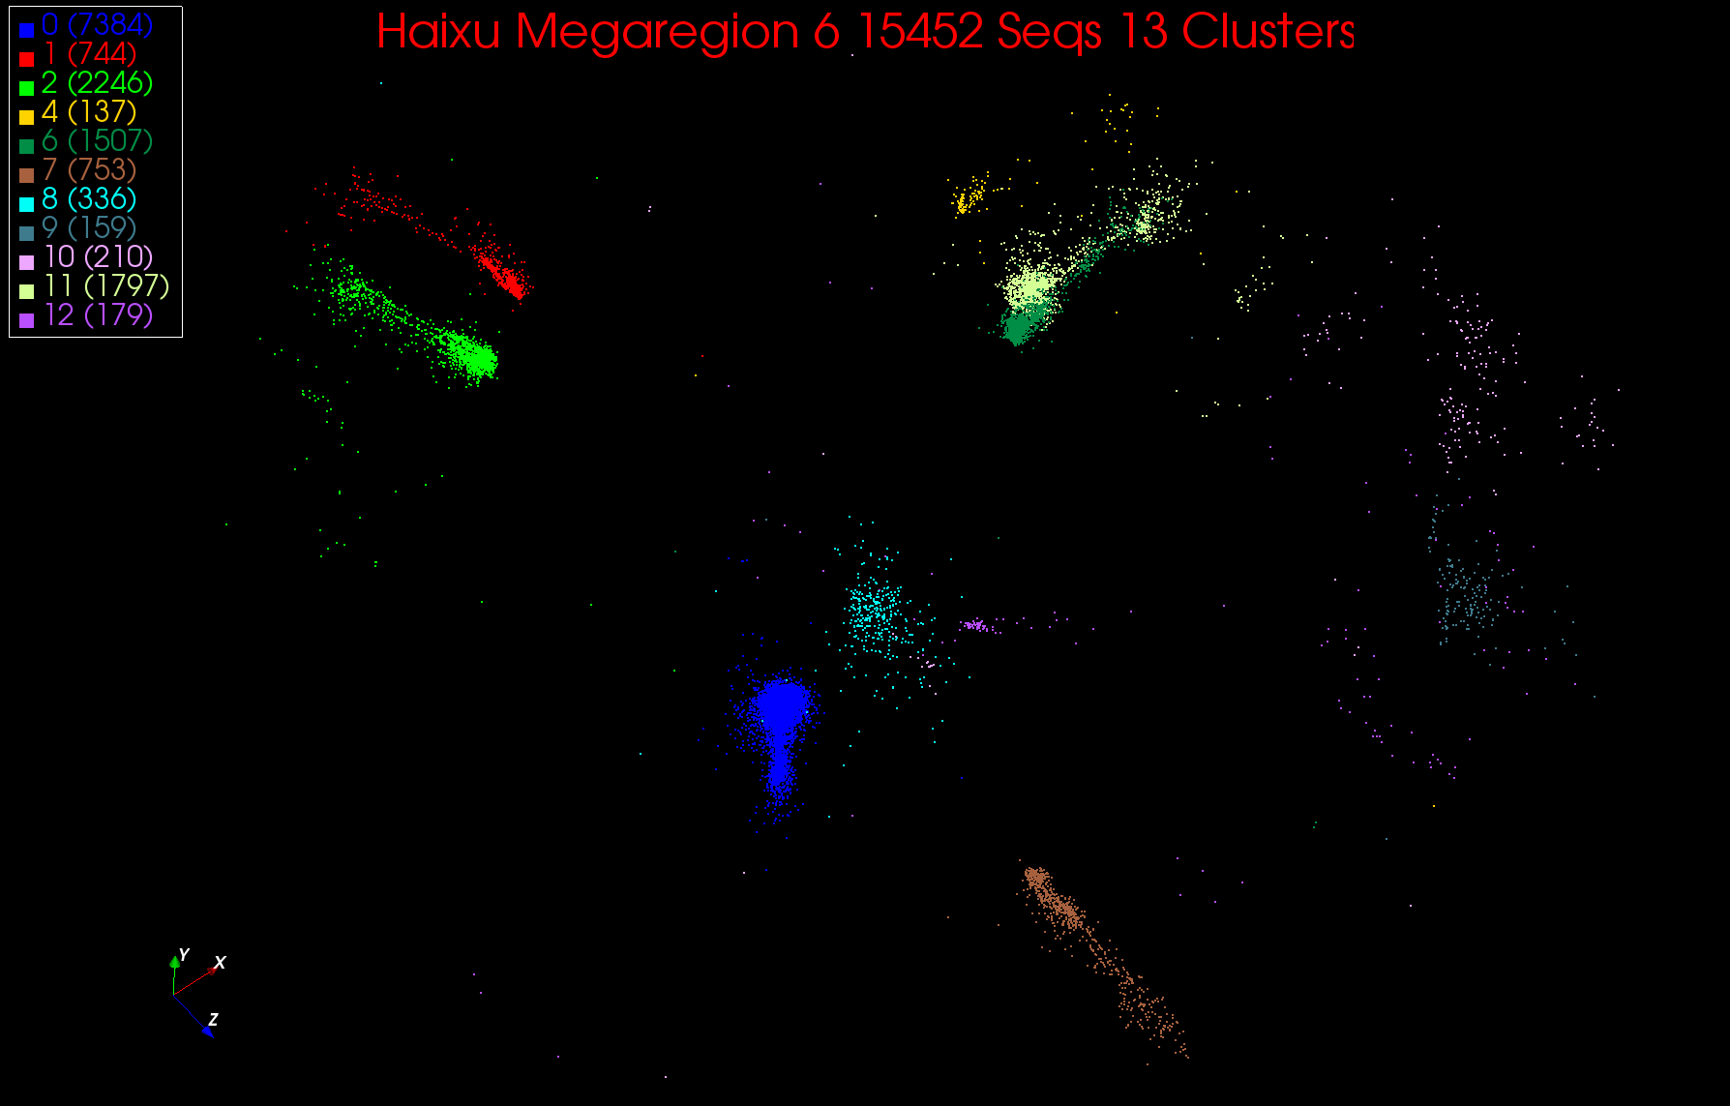
13 Clusters in Region 6

Slide 29
Heuristics (Wikipedia)
In computer science, artificial intelligence, and mathematical optimization, a heuristic is a technique designed for solving a problem more quickly when classic methods are too slow, or for finding an approximate solution when classic methods fail to find any exact solution. This is achieved by trading optimality, completeness, accuracy, and/or precision for speed.
Results about NP-hardness in theoretical computer science make heuristics the only viable option for a variety of complex optimization problems that need to be routinely solved in real-world applications.
Clustering is NP hard although collaborative filtering is just “hard” and computationally intractable for real time use
Roughly NP hard means only (known) exact algorithms are exponential and not polynomial in time to solve

Slide 30
Heuristics II
Collaborative Filtering (user based) is O(MN) for M customers and N items which is polynomial
Clustering is harder to estimate as we don’t have an exact algorithm
There is combinatorial estimate K^{M} where we loop over K assignments for each of M items (K number of clusters)
This is exponential
Note many real world problems are intrinsically “inexact” as
Don’t have exact data
Don’t have exact problem
So heuristics are often/usually just fine and IMHO NP hard is not so important in practice

Slide 31
k means Clustering
Choose k=2 to 10 million (or more) clusters according to some intuition
Initialize k cluster centers (this only works in real spaces)
Then Iterate
Assign each point to cluster whose center it is nearest to
Calculate new center position as centroid (average in each component) of points assigned to it
Converge when center positions change < cut
Lots of variants that are better but k means used as simple and fast
Also methods for when only some distances available and no vector space
Sometimes gets wrong answer – trapped in a local minima

Slide 32
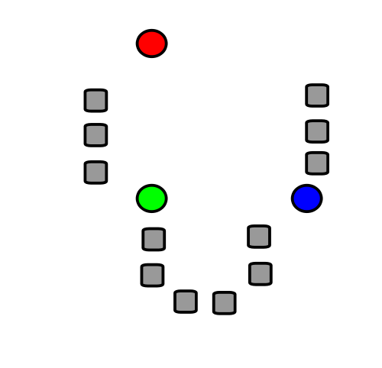
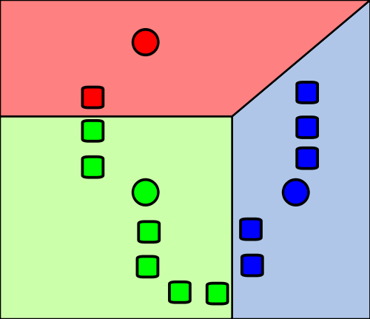
1) k initial "means" (in this case k=3) are randomly generated within the data domain (shown in color).
2) k clusters are created by associating every observation with the nearest mean. The partitions here represent the Voronoi diagram generated by the means.
Wikipedia

Slide 33
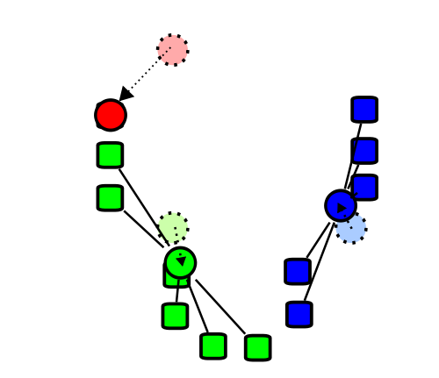
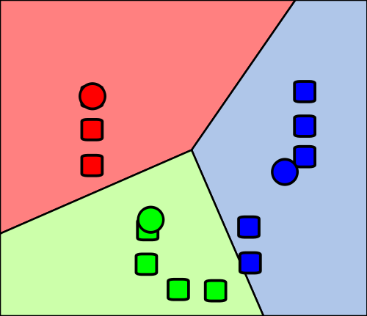
4) Steps 2 and 3 are repeated until convergence has been reached.
But red and green centers (circles) are clearly in wrong place!!! (stars about right)
3) The centroid of each of the k clusters becomes the new mean.
Wikipedia

Slide 34
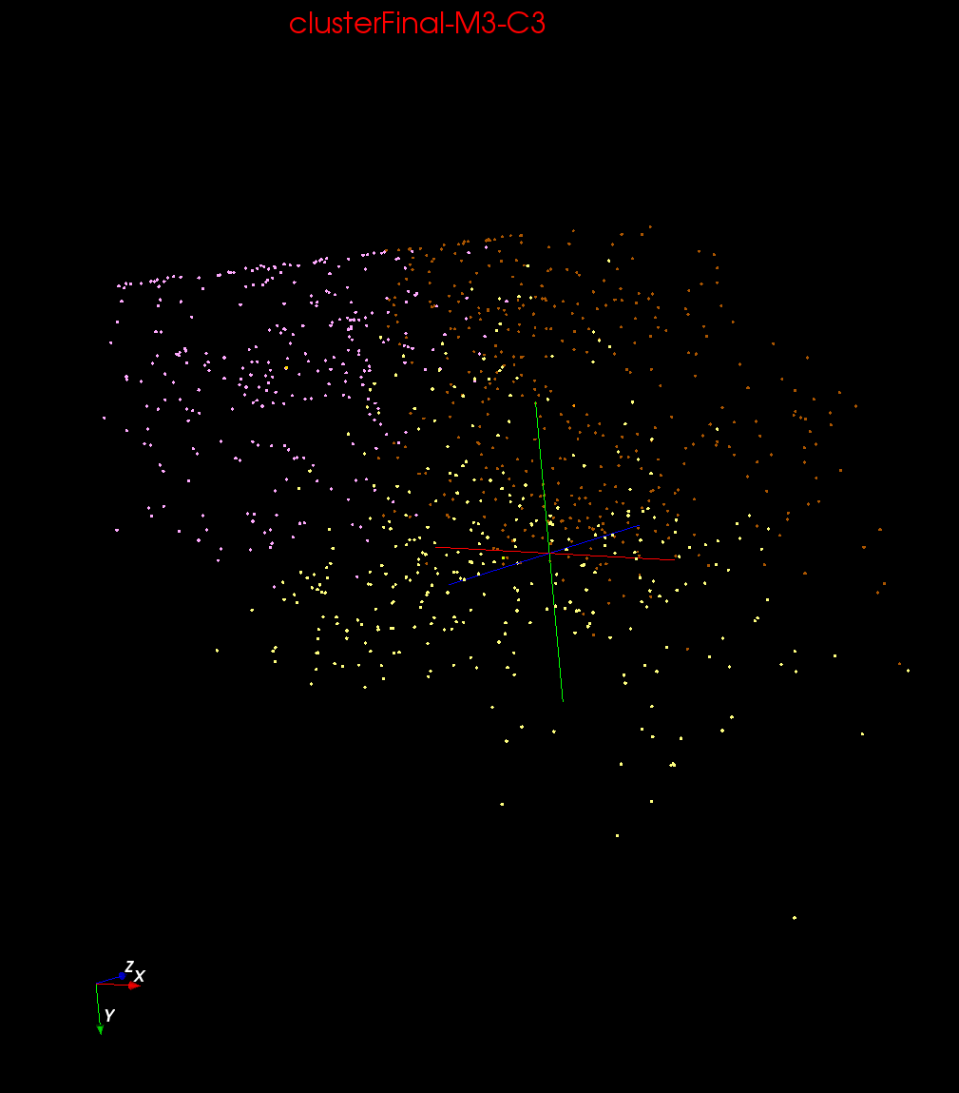
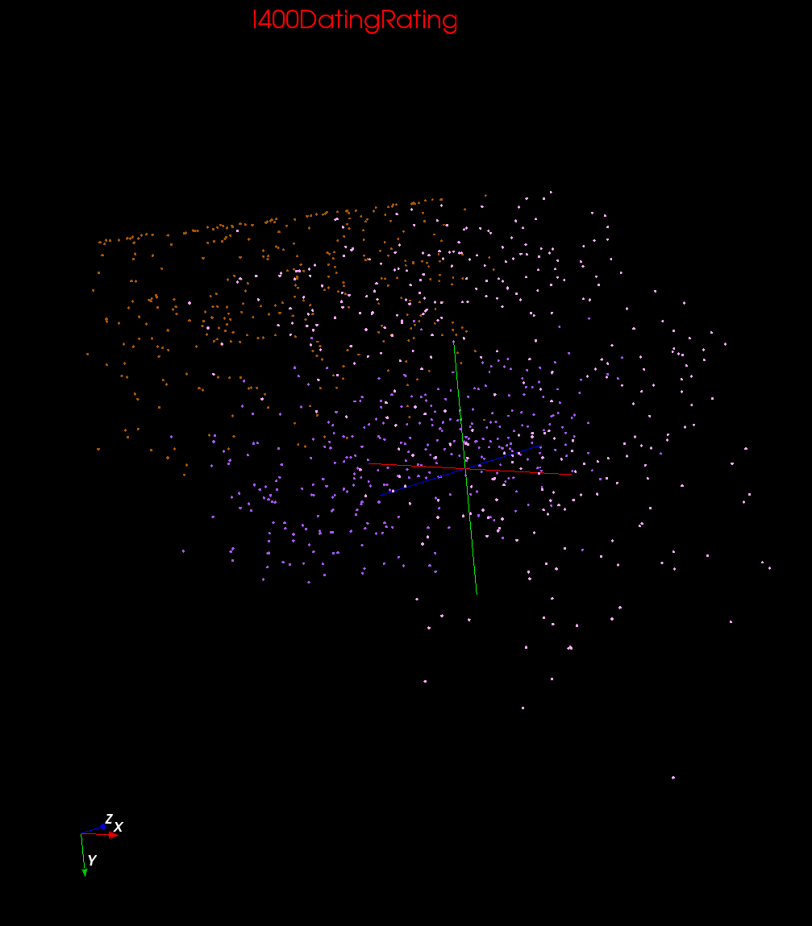
Clustering v User Rating

Slide 35
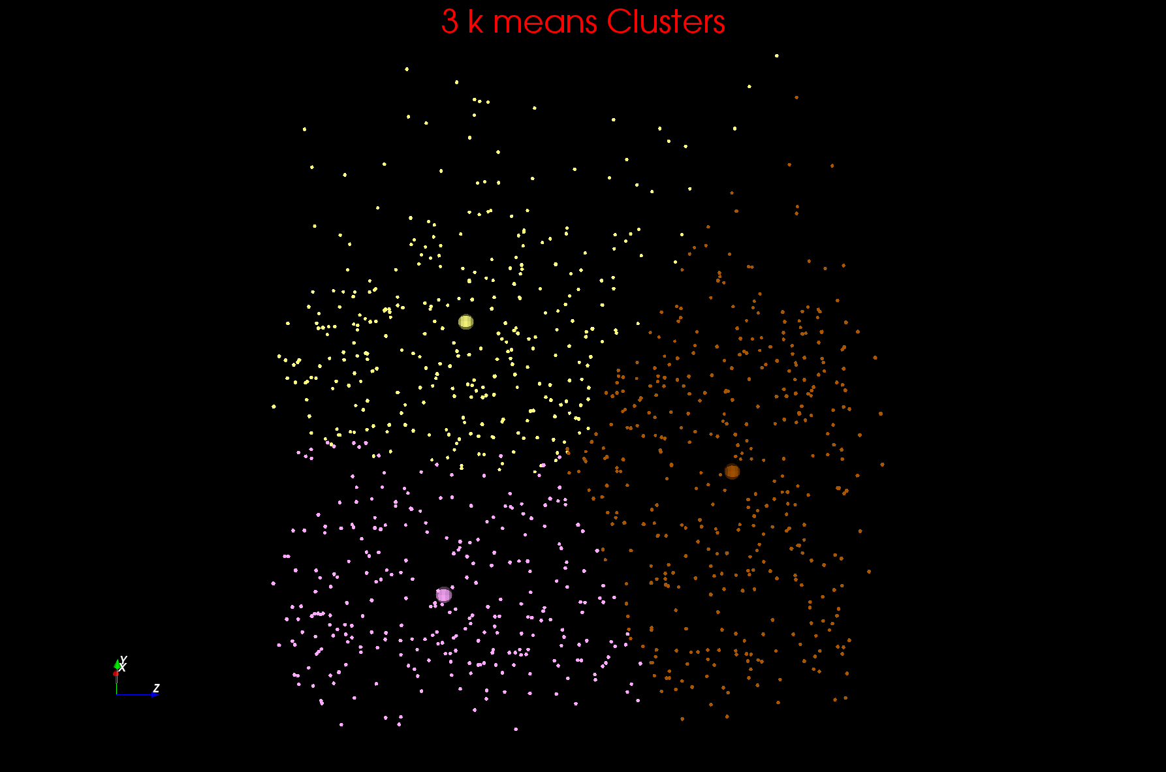
Two views of a 3D Clustering I

Slide 36
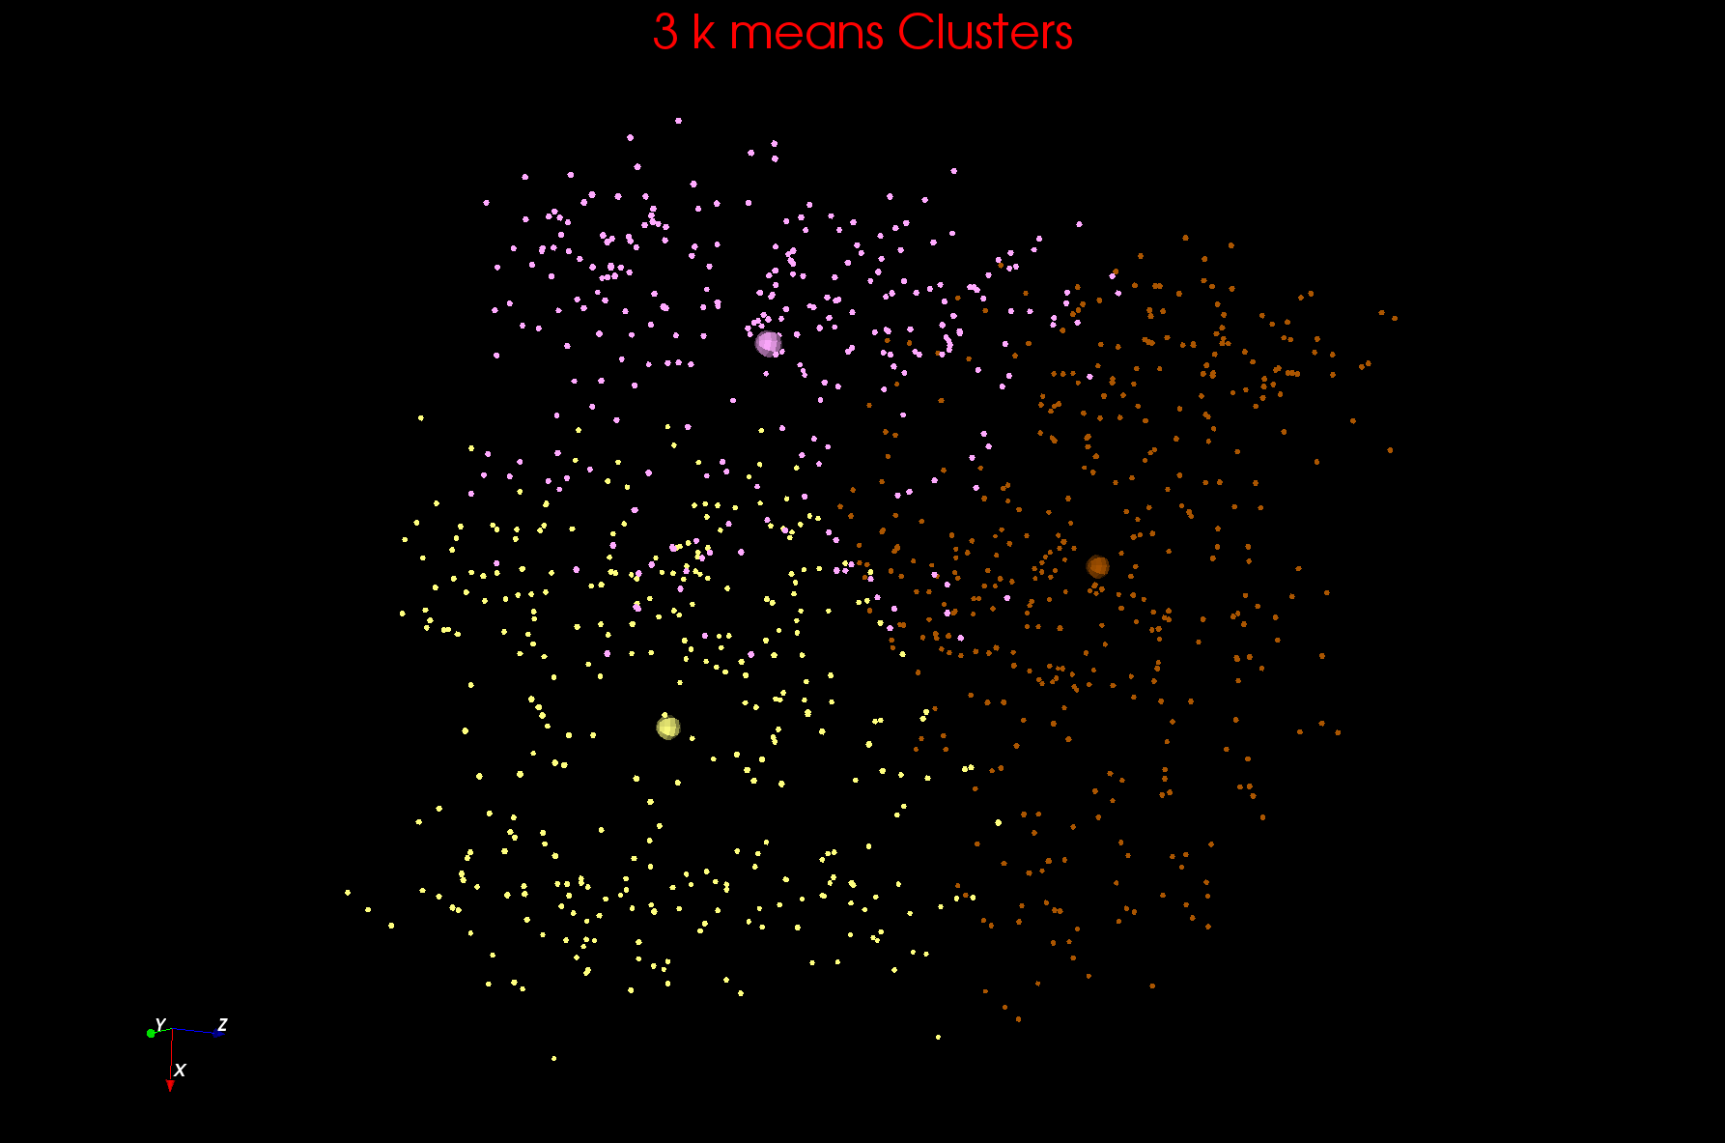
Two views of a 3D Clustering II

Slide 37
Getting the wrong answer
Remember all things in life – including clustering – are optimization problems
Lets say it’s a minimization (change sign if maximizing)
k means always ends at a minimum but maybe a local minimum
Initial Position
Unhappiness
Local Minimum Wrong Answer
Real Minimum
Center Positions

Slide 38
Greedy Algorithms
Many algorithms like k Means are greedy
They consist of iterations
Each iterations makes the step that most obviously minimizes function
Set of short term optima; not always global optima
Same is true of life

Slide 39
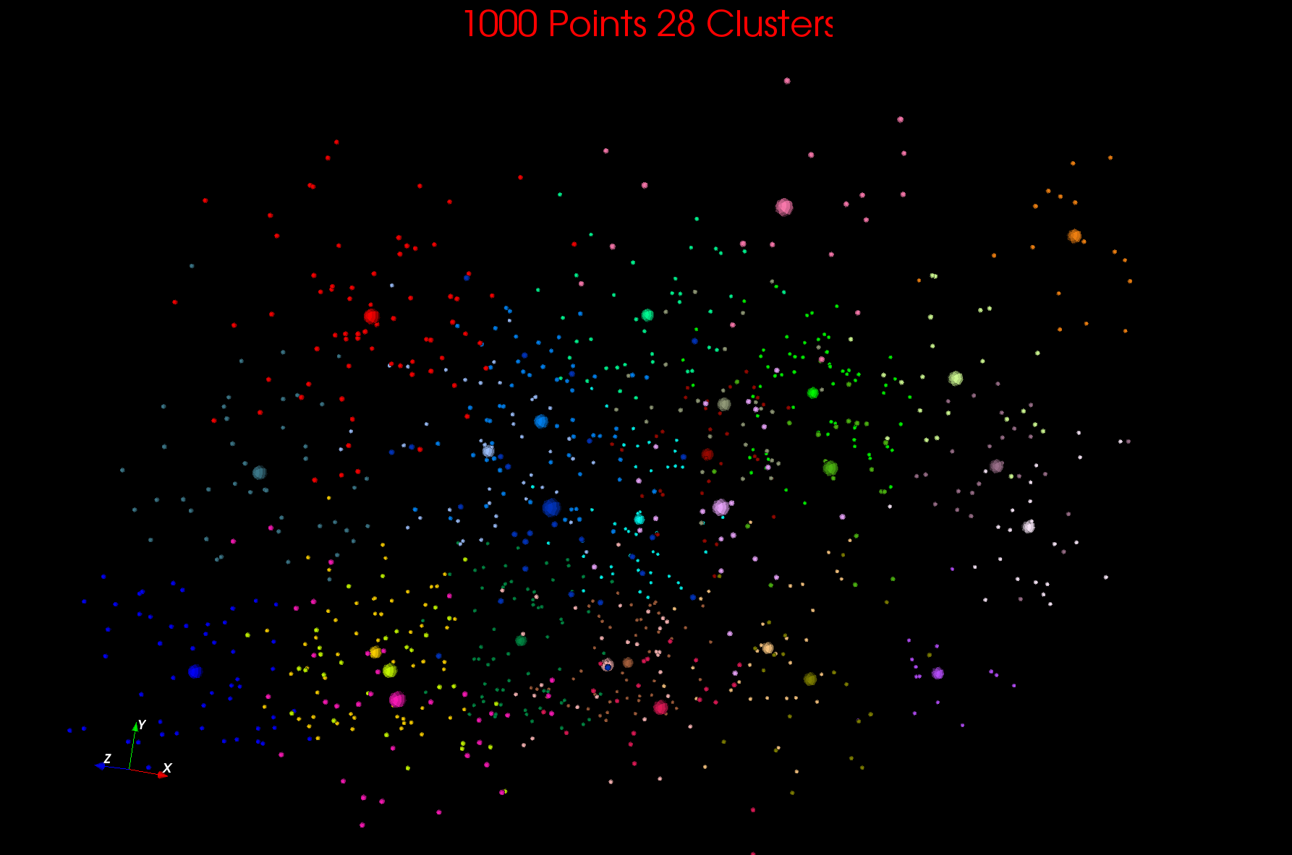

Slide 40
Some Resources
http://www.slideshare.net/beechung/recommender-systems-tutorialpart1intro and other talks there
http://recsyswiki.com/wiki/RecSysWiki:About
http://recommenderbook.net/ including
http://recommenderbook.net/teaching-material/slides
I399 Project https://sites.google.com/site/recsysi399/ (focused on Amazon, Netflix, and Pandora)
http://www.ifi.uzh.ch/ce/teaching/spring2012/16-Recommender-Systems_Slides.pdf
http://www.cs.umd.edu/~samir/498/Amazon-Recommendations.pdf
http://www.cs.umd.edu/~samir/498/schafer01ecommerce.pdf
http://www.cs.umd.edu/~samir/498/CMSC498K_Hyoungtae_Cho.ppt
http://pages.cs.wisc.edu/~beechung/icml11-tutorial/

Slide 41
More resources
http://www.eui.upm.es/~jbobi/jbobi/PapersRS/CollaborativeFilteringRecommenderSystems.pdf
http://www.dcs.warwick.ac.uk/~acristea/courses/CS411/2010/Book%20-%20The%20Adaptive%20Web/HybridWebRecommenderSystems.pdf
http://itlab.dbit.dk/~toine/uchfall2010/lecture09-recommender-systems.pdf
http://www.cs.orst.edu/~herlock/papers/tois2004.pdf
http://ids.csom.umn.edu/faculty/gedas/papers/recommender-systems-survey-2005.pdf
http://ijcai-11.iiia.csic.es/files/proceedings/Tutorial%20IJCAI%202011%20Gesamt.pdf

