Slide 1
X-Informatics Case Study: e-Commerce and Life Style Informatics: Recommender Systems I
February 4 2013
Geoffrey Fox
gcf@indiana.edu
http://www.infomall.org/X-InformaticsSpring2013/index.html
Associate Dean for Research and Graduate Studies, School of Informatics and Computing
Indiana University Bloomington
2013

Slide 2
Overview of Problems
Basic problem is personalized matching of items to people or perhaps collections of items to collections of people
People to products: Online and Offline Commerce
People to People: Social Networking
People to Jobs or Employers: Job Sites

Slide 3
Recommender Systems in more detail
A large number of online and offline commerce activities plus basic Internet site personalization relies on “recommender systems”
Given real-time action by user, immediately suggest new actions (as in Amazon buy recommendations on web)
Based on past actions of users (and others) suggest movies to look at, restaurants to eat at, events to go to, books and music to buy
Based on mix of explicit user choice and grouping of internet sites, present customized Google News page
Given sales statistics, decide on discounts at “real” supermarkets and placement of related (by analysis of buying habits) products
Identify possible colleagues at Social Networking sites like LinkedIn
Identify matches between employers and employees at sites like CareerBuilder and Monster

Slide 4
Everything is an Optimization Problem?
Model to Data
Higgs + Background
User to Jobs or Books or Other Users?
Classification is optimizing an assignment scheme to data

Slide 5
Problem domain
Recommendation systems (RS) help to match users with items
Ease information overload
Sales assistance (guidance, advisory, persuasion,…)
RS are software agents that elicit the interests and preferences of individual consumers […] and make recommendations accordingly.
They have the potential to support and improve the quality of the decisions consumers make while searching for and selecting products online.
(Xiao & Benbasat 2007¹)
Different system designs / paradigms
Based on availability of exploitable data
Implicit and explicit user feedback
Domain characteristics
(1) Xiao and Benbasat, E-commerce product recommendation agents: Use, characteristics, and impact, MIS Quarterly 31 (2007), no. 1, 137–209
http://recommenderbook.net/teaching-material/slides Chapter 1

Slide 6
Purpose and success criteria (1)
Different perspectives/aspects
Depends on domain and purpose
No holistic evaluation scenario exists
Retrieval perspective
Reduce search costs
Provide "correct" proposals
Users know in advance what they want
Recommendation perspective
Serendipity – identify items from the Long Tail
Users did not know about existence
http://recommenderbook.net/teaching-material/slides Chapter 1
Notes:
Could a RS be a persuasive technology? In fact depending on the application area RS are deployed to:

Slide 7
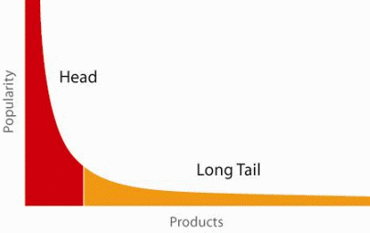
When does a RS do its job well?
90-10 or 80-20 “rule” broadly applicable
"Recommend widely unknown items that users might actually like!"
20% of items accumulate 74% of all positive ratings
Items rated > 3 in MovieLens 100K dataset
Recommend items from the long tail
http://recommenderbook.net/teaching-material/slides Chapter 1

Slide 8
Purpose and success criteria (2)
Prediction perspective
Predict to what degree users like an item
Most popular evaluation scenario in research
Interaction perspective
Give users a "good feeling"
Educate users about the product domain
Convince/persuade users - explain
Finally, conversion perspective
Commercial situations
Increase "hit", "clickthrough", "lookers to bookers" rates
Optimize sales margins and profit
http://recommenderbook.net/teaching-material/slides Chapter 1

Slide 9
Recommender systems
RS seen as a function
Given:
User model (e.g. ratings, preferences, demographics, situational context)
Items (with or without description of item characteristics)
Find:
Relevance score. Used for ranking.
Relation to Information Retrieval:
IR is finding material [..] of an unstructured nature [..] that satisfies an information need from within large collections [..].
(Manning et al. 2008¹)
(1) Manning, Raghavan, and Schütze, Introduction to information retrieval, Cambridge University Press, 2008
Advanced IR does use essentially
recommender system to order results
Recommend links that satisfy search query
http://recommenderbook.net/teaching-material/slides Chapter 1

Slide 10
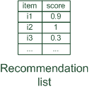
Paradigms of recommender systems
Recommender systems reduce information overload by estimating relevance
http://recommenderbook.net/teaching-material/slides Chapter 1

Slide 11
Paradigms of recommender systems
Personalized recommendations
http://recommenderbook.net/teaching-material/slides Chapter 1

Slide 12
Paradigms of recommender systems
Collaborative: "Tell me what's popular among my peers"
http://recommenderbook.net/teaching-material/slides Chapter 1

Slide 13
Paradigms of recommender systems
Content-based: "Show me more of the same what I've liked"
http://recommenderbook.net/teaching-material/slides Chapter 1

Slide 14
Paradigms of recommender systems
Knowledge-based: "Tell me what fits based on my needs"
http://recommenderbook.net/teaching-material/slides Chapter 1

Slide 15
Paradigms of recommender systems
Hybrid: combinations of various inputs and/or composition of different mechanism
http://recommenderbook.net/teaching-material/slides Chapter 1

Slide 16
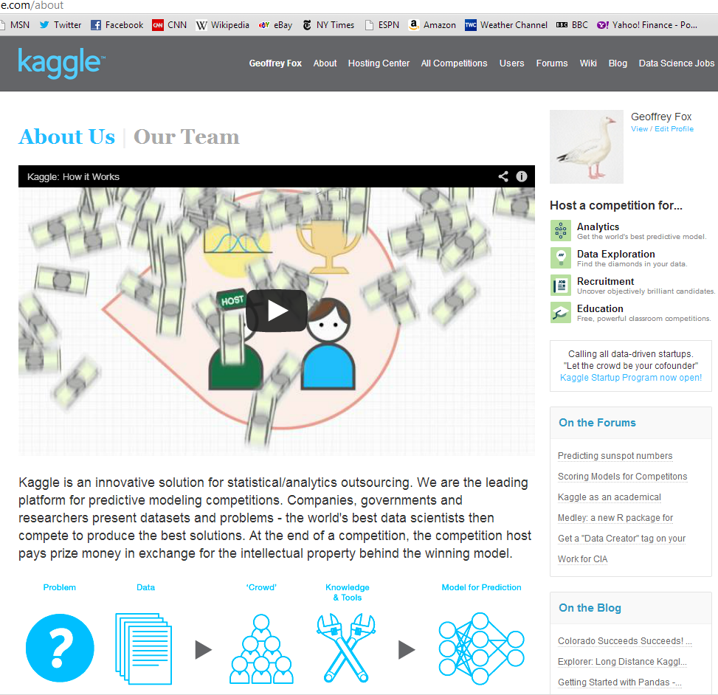
http://www.kaggle.com

Slide 20
UCI Recommender Examples
Amazon.com (Search for your favorite book and look at what other books are recommended)
Bing or Google (Search for computer and view the ads that are displayed)
Netflix (If you have an account see how netflix recommends new movies to you)
Jester (Try it out and rate some jokes)
MovieLens
Pandora (Try adding some songs and observe what it plays for you) Watch this Time Video on the Pandora Recommender System (Then check out that Time Video webpage and observe it is recommending related videos ....)
Y! Music
StumbleUpon (Watch this short video)
YouTube (Observe how it recommends new video based on what you watched before)
and many, many more......
http://www.ics.uci.edu/~welling/teaching/CS77Bwinter12/CS77B_w12.html
http://www.time.com/time/magazine/article/0,9171,1992403,00.html Time magazine on Recommender systems

Slide 21
http://www.slideshare.net/xamat/building-largescale-realworld-recommender-systems-recsys2012-tutorial

Slide 22
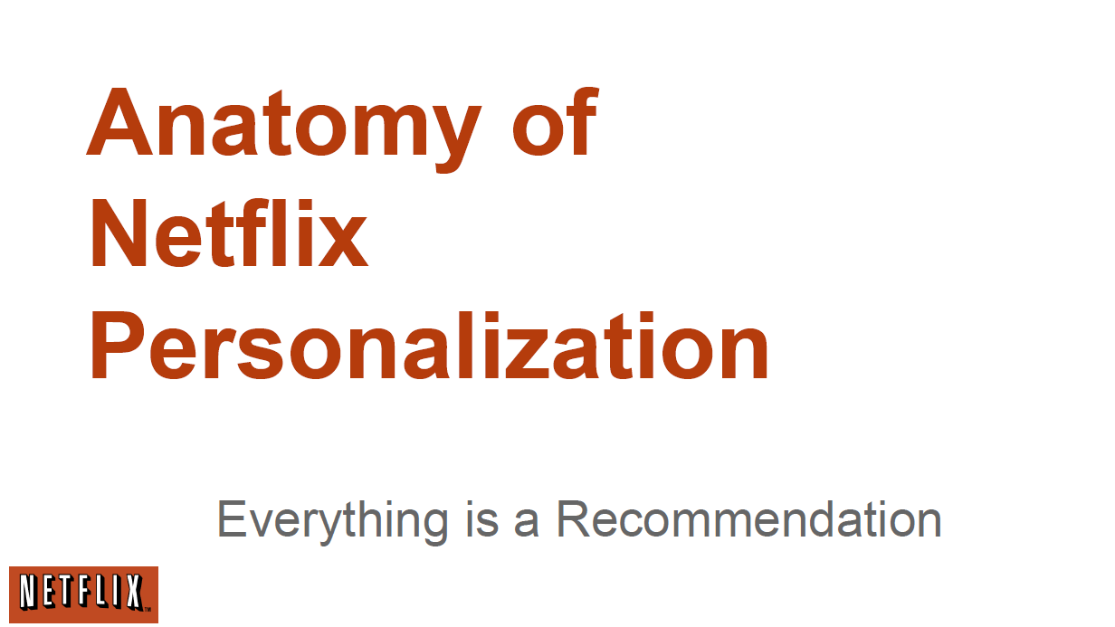
http://www.slideshare.net/xamat/building-largescale-realworld-recommender-systems-recsys2012-tutorial

Slide 23
http://www.slideshare.net/xamat/building-largescale-realworld-recommender-systems-recsys2012-tutorial

Slide 24
http://www.slideshare.net/xamat/building-largescale-realworld-recommender-systems-recsys2012-tutorial

Slide 25
http://www.slideshare.net/xamat/building-largescale-realworld-recommender-systems-recsys2012-tutorial

Slide 26
http://www.slideshare.net/xamat/building-largescale-realworld-recommender-systems-recsys2012-tutorial

Slide 27
http://www.slideshare.net/xamat/building-largescale-realworld-recommender-systems-recsys2012-tutorial

Slide 28
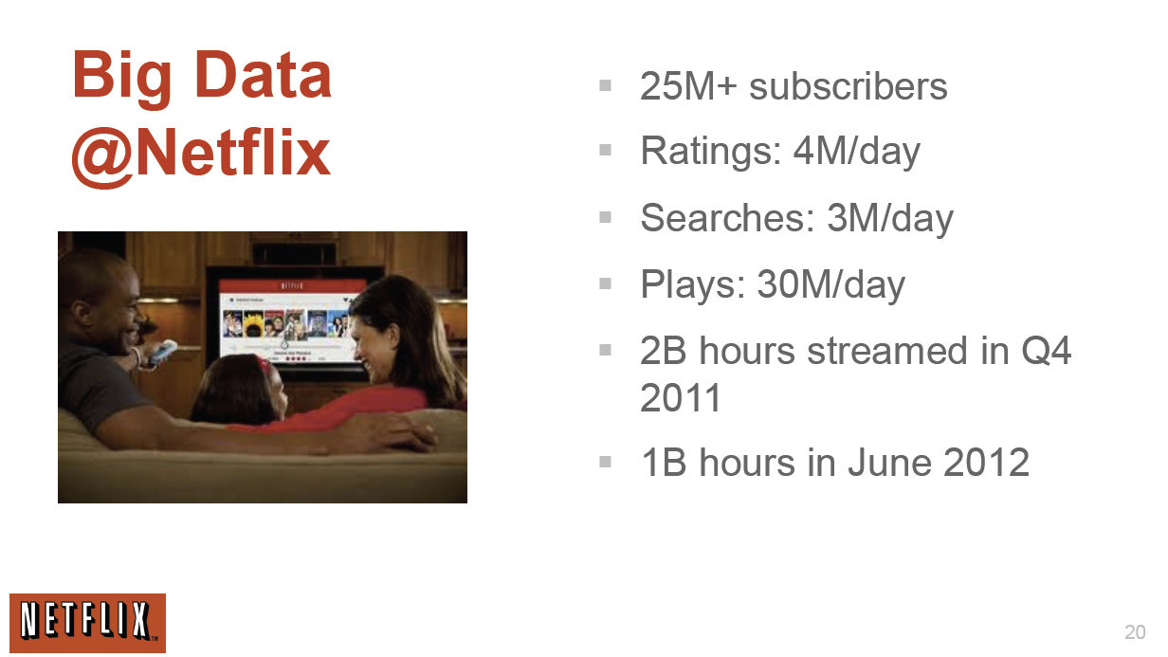
http://www.slideshare.net/xamat/building-largescale-realworld-recommender-systems-recsys2012-tutorial

Slide 29
http://www.slideshare.net/xamat/building-largescale-realworld-recommender-systems-recsys2012-tutorial

Slide 30
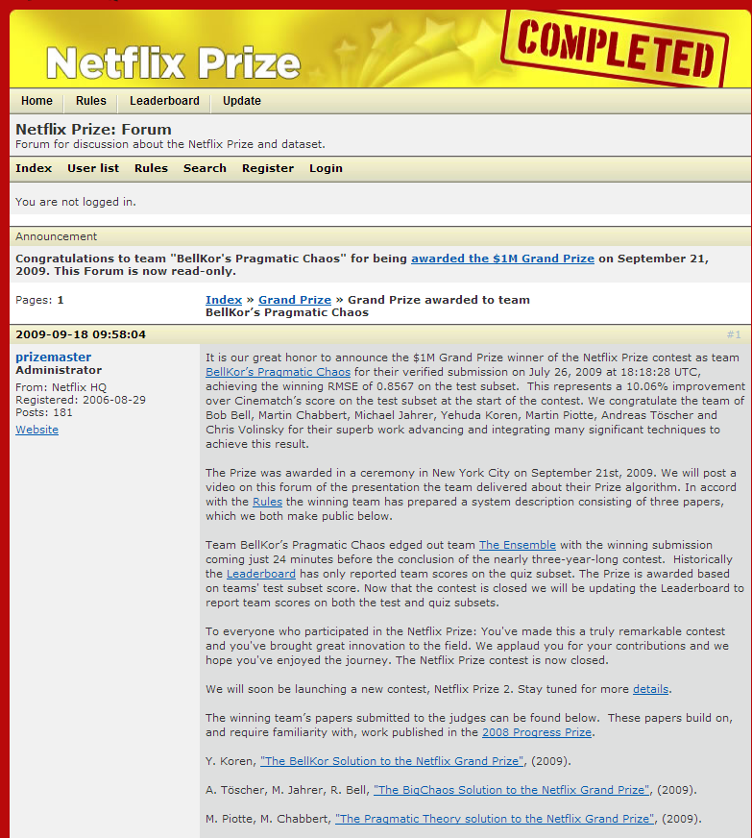
http://www.slideshare.net/xamat/building-largescale-realworld-recommender-systems-recsys2012-tutorial
$1M Prize

Slide 31
http://www.slideshare.net/xamat/building-largescale-realworld-recommender-systems-recsys2012-tutorial

Slide 32
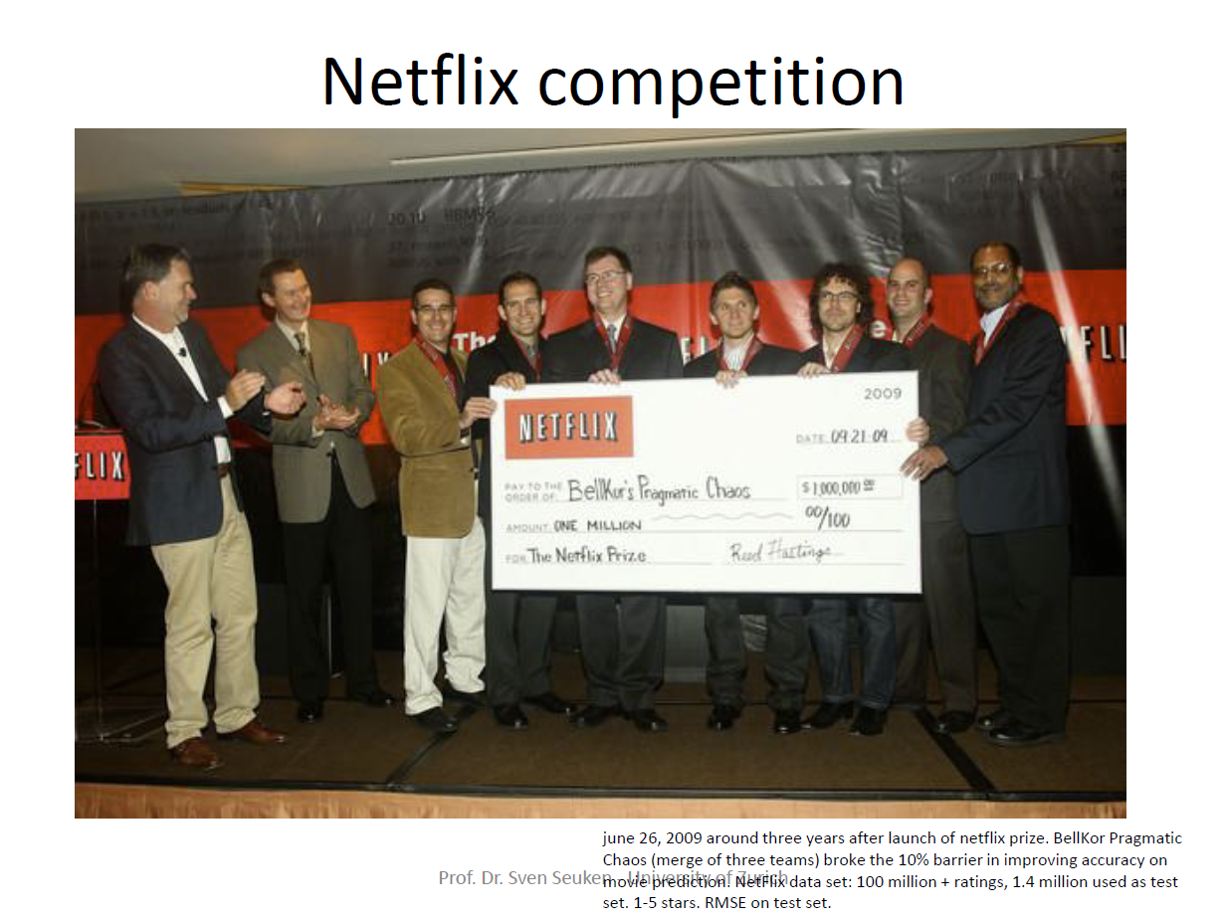
http://www.ifi.uzh.ch/ce/teaching/spring2012/16-Recommender-Systems_Slides.pdf

Slide 33
More data usually beats better algorithms
Here's how the competition works. Netflix has provided a large data set that tells you how nearly half a million people have rated about 18,000 movies. Based on these ratings, you are asked to predict the ratings of these users for movies in the set that they have not rated. The first team to beat the accuracy of Netflix's proprietary algorithm by a certain margin wins a prize of $1 million!
Different student teams in my class adopted different approaches to the problem, using both published algorithms and novel ideas. Of these, the results from two of the teams illustrate a broader point. Team A came up with a very sophisticated algorithm using the Netflix data. Team B used a very simple algorithm, but they added in additional data beyond the Netflix set: information about movie genres from the Internet Movie Database(IMDB). Guess which team did better?
Anand Rajaraman is Senior Vice President at Walmart Global eCommerce, where he heads up the newly created @WalmartLabs,
http://anand.typepad.com/datawocky/2008/03/more-data-usual.html
20120117berkeley1.pdf Jeff Hammerbacher

Slide 34
http://www.slideshare.net/xamat/building-largescale-realworld-recommender-systems-recsys2012-tutorial
CTR = Click-through rate

Slide 35
http://www.slideshare.net/xamat/building-largescale-realworld-recommender-systems-recsys2012-tutorial
Consumer OR
Life Style
Informatics

Slide 36
http://www.slideshare.net/xamat/building-largescale-realworld-recommender-systems-recsys2012-tutorial

Slide 37
A/B Testing from Wikipedia
In web development and marketing, A/B testing or split testing is an experimental approach to web design (especially user experience design), which aims to identify changes to web pages that increase or maximize an outcome of interest (e.g., click-through rate for a banner advertisement).
As the name implies, two versions (A and B) are compared, which are identical except for one variation that might impact a user's behavior. Version A might be the currently used version, while Version B is modified in some respect.
For instance, on an e-commerce website the purchase funnel is typically a good candidate for A/B testing, as even marginal improvements in drop-off rates can represent a significant gain in sales.
Multivariate testing or bucket testing is similar to A/B testing, but tests more than two different versions at the same time.

Slide 38
http://www.slideshare.net/xamat/building-largescale-realworld-recommender-systems-recsys2012-tutorial

Slide 39
http://www.slideshare.net/xamat/building-largescale-realworld-recommender-systems-recsys2012-tutorial

Slide 40
http://www.slideshare.net/xamat/building-largescale-realworld-recommender-systems-recsys2012-tutorial

Slide 41
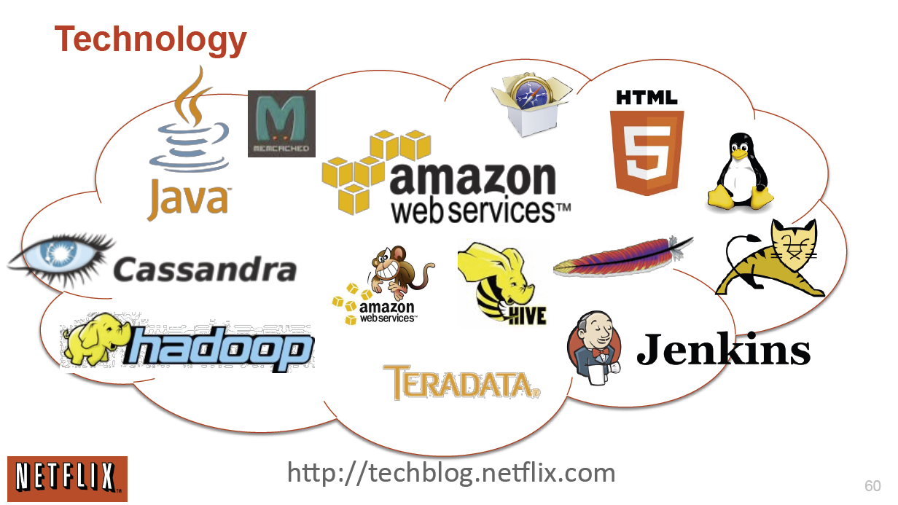
http://www.slideshare.net/xamat/building-largescale-realworld-recommender-systems-recsys2012-tutorial

Slide 42
http://www.slideshare.net/xamat/building-largescale-realworld-recommender-systems-recsys2012-tutorial

Slide 43
Interesting Unanswered Question from Student
What is impact of users representing say a family e.g. father and daughter and so ratings are blended (if represent of interest to one family member) or inconsistent (if a given class of item sometimes rated by one and then other family member)

