Slide 1
X-Informatics Case Study: e-Commerce and Life Style Informatics:
Recommender Systems II: Algorithms
February 4 2013
Geoffrey Fox
gcf@indiana.edu
http://www.infomall.org/X-InformaticsSpring2013/index.html
Associate Dean for Research and Graduate Studies, School of Informatics and Computing
Indiana University Bloomington
2013

Slide 2
Problems
Basic problem is personalized matching of items to people or perhaps collections of items to collections of people
People to products: Online and Offline Commerce
People to People: Social Networking
People to Jobs or Employers: Job Sites

Slide 3
http://en.wikipedia.org/wiki/Recommender_system
When viewing a product on Amazon.com, the store will recommend additional items based on a matrix of what other shoppers bought along with the currently selected item.
Pandora uses the properties of a song or artist (a subset of the 400 attributes provided by the Music Genome Project) in order to seed a "station" that plays music with similar properties. User feedback is used to refine the station's results, deemphasizing certain attributes when a user "dislikes" a particular song and emphasizing other attributes when a user "likes" a song. This is an example of a content-based recommender system.
Last.fm creates a "station" of recommended songs by observing what bands and individual tracks that the user has listened to on a regular basis and comparing those against the listening behavior of other users. Last.fm will play tracks that do not appear in the user's library, but are often played by other users with similar interests. As this approach leverages the behavior of users, it is an example of a collaborative filtering technique.
Netflix offers predictions of movies that a user might like to watch based on the user's previous ratings and watching habits (as compared to the behavior of other users), also taking into account the characteristics (such as the genre) of the film.

Slide 4
The Google News personalization engine
http://recommenderbook.net/teaching-material/slides Chapter 2

Slide 5
Google News portal (1)
Aggregates news articles from several thousand sources
Displays them to signed-in users in a personalized way
Collaborative recommendation approach based on
  the click history of the active user and
  the history of the larger community
Main challenges
  Vast number of articles and users
  Generate recommendation list in real time (at most one second)
  Constant stream of new items
  Immediately react to user interaction
Significant efforts with respect to algorithms, engineering, and parallelization are required
http://recommenderbook.net/teaching-material/slides Chapter 2

Slide 6
Google News portal (2)
Pure memory-based approaches are not directly applicable and for model-based approaches, the problem of continuous model updates must be solved
A combination of model- and memory-based techniques is used
Model-based part: Two clustering techniques are used
  Probabilistic Latent Semantic Indexing (PLSI) as proposed by (Hofmann 2004)
  MinHash as a hashing method
Memory-based part: Analyze story co-visits for dealing with new users
Google's MapReduce technique is used for parallelization in order to make computation scalable
http://recommenderbook.net/teaching-material/slides Chapter 2

Slide 7

Example: Markdown Optimization in Retail
Department stores and fashion retailers clear apparel inventory by reducing prices
  “What prices do we set through the end of the season to meet inventory goals and maximize revenue?”
In practice
  Traditional pricing is based on business rules—not models
  Customers respond to prices, promotions at product-store level
  Weekly decisions are made at store level
Notes:
High inventory leads to deeper discounts.
Business rules constrain the decisions and affect the optimization . Stores start at the beginning of the season and decide which products to mark down (some stores do aggressive markdowns). In this example we are only looking at markdown. When modeling overall demand, the amount of data is fourfold.
The entire analysis is run each week using a moving window of two years’ data. The model is refitted and reoptimized each week. Fast business decisions require high performance computing.
The driver for an analytical approach is the volume of decisions. Some retailers reshuffle the recommendations delivered by the solution; others prefer to use “as is”.

Slide 8
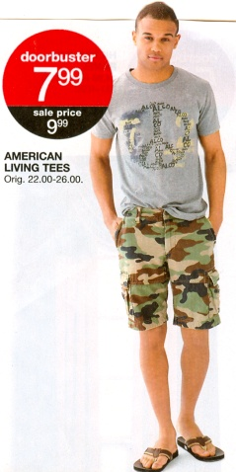
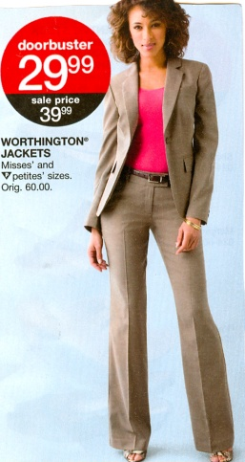
Why an Analytical Solution?
Huge number of decisions
  50,000 products/store x 2,000 stores = 100,000,000 decisions!
1.5 - 3 terabytes of weekly data for two-year moving window
  Number of units sold, price at point of sale, reference price
  Starting and ending inventory in each store
  Promotions, TV ads, circulars, …
Building blocks
  Statistical model for demand
  Price optimization
Notes:
Price is expressed as the ratio of price at point of sale to reference price
Short series (5-6 weeks) at the store-product level
Location: company → climate zones → region → market → store
Product: division → dept → class → subclass → product (sku)
Example: Division (Men’s Wear)
Department (sport or dress)
Class (shirts)
Subclass (casual, dress, formal)
SKU (product)

Slide 9
Modeling Considerations
Demand depends on
  Seasonal effects, holidays
  “Marketing mix” effects: price, promotion, inventory
  Product life cycle effect : introduction and phase-out
Pricing rules and customer behavior are complex
  Magic price points (80% is lowest markdown)
  Discontinuities in response (difference between $1.99 and $2.00)
  Holiday effects are confounded with promotions
Sales data are sparse for a product within a store
Notes:
Customers learn from experience that 80% is lowest markdown
Hard to identify end of season from running out of inventory
Holiday effects are confounded with promotions; what are people responding to?
Insufficient variation of factors
Low rate of sale at store-SKU
Volatility in store-SKU sales data
Short life products
Inadequate price, promotion changes at a Store-SKU to estimate impact
New products every year
Ramp-up, ramp-down effects of product introductions and phase-outs

Slide 10
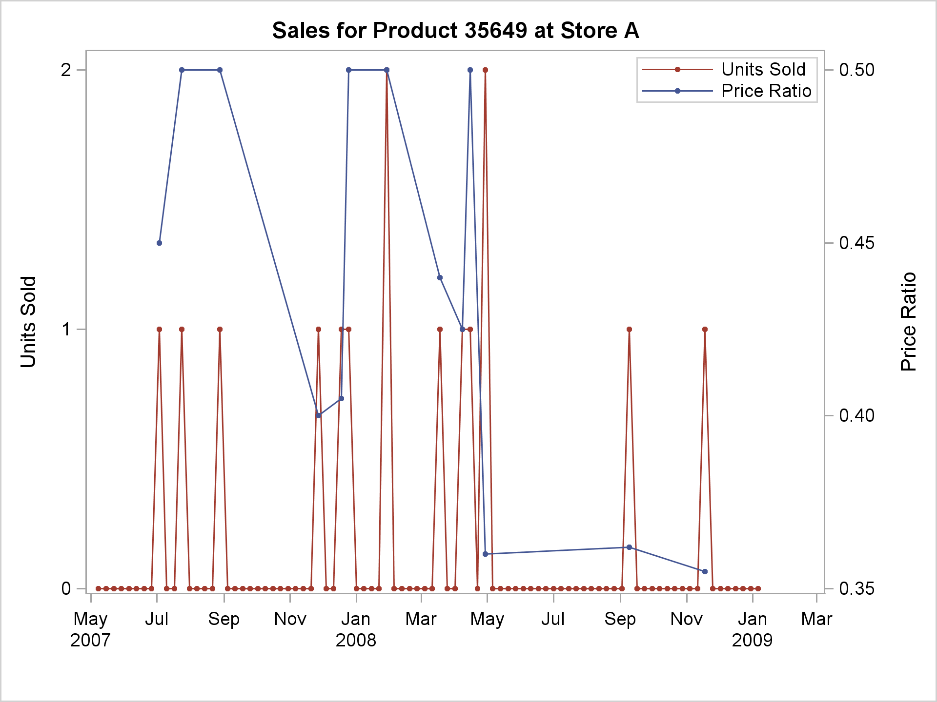
Sparse, Noisy Data at Store-Product Level

Slide 11
What Can You Do With this Data?
How do you estimate the components of demand?
The key lies in analytical hierarchies for
  Products
  Store locations

Slide 12
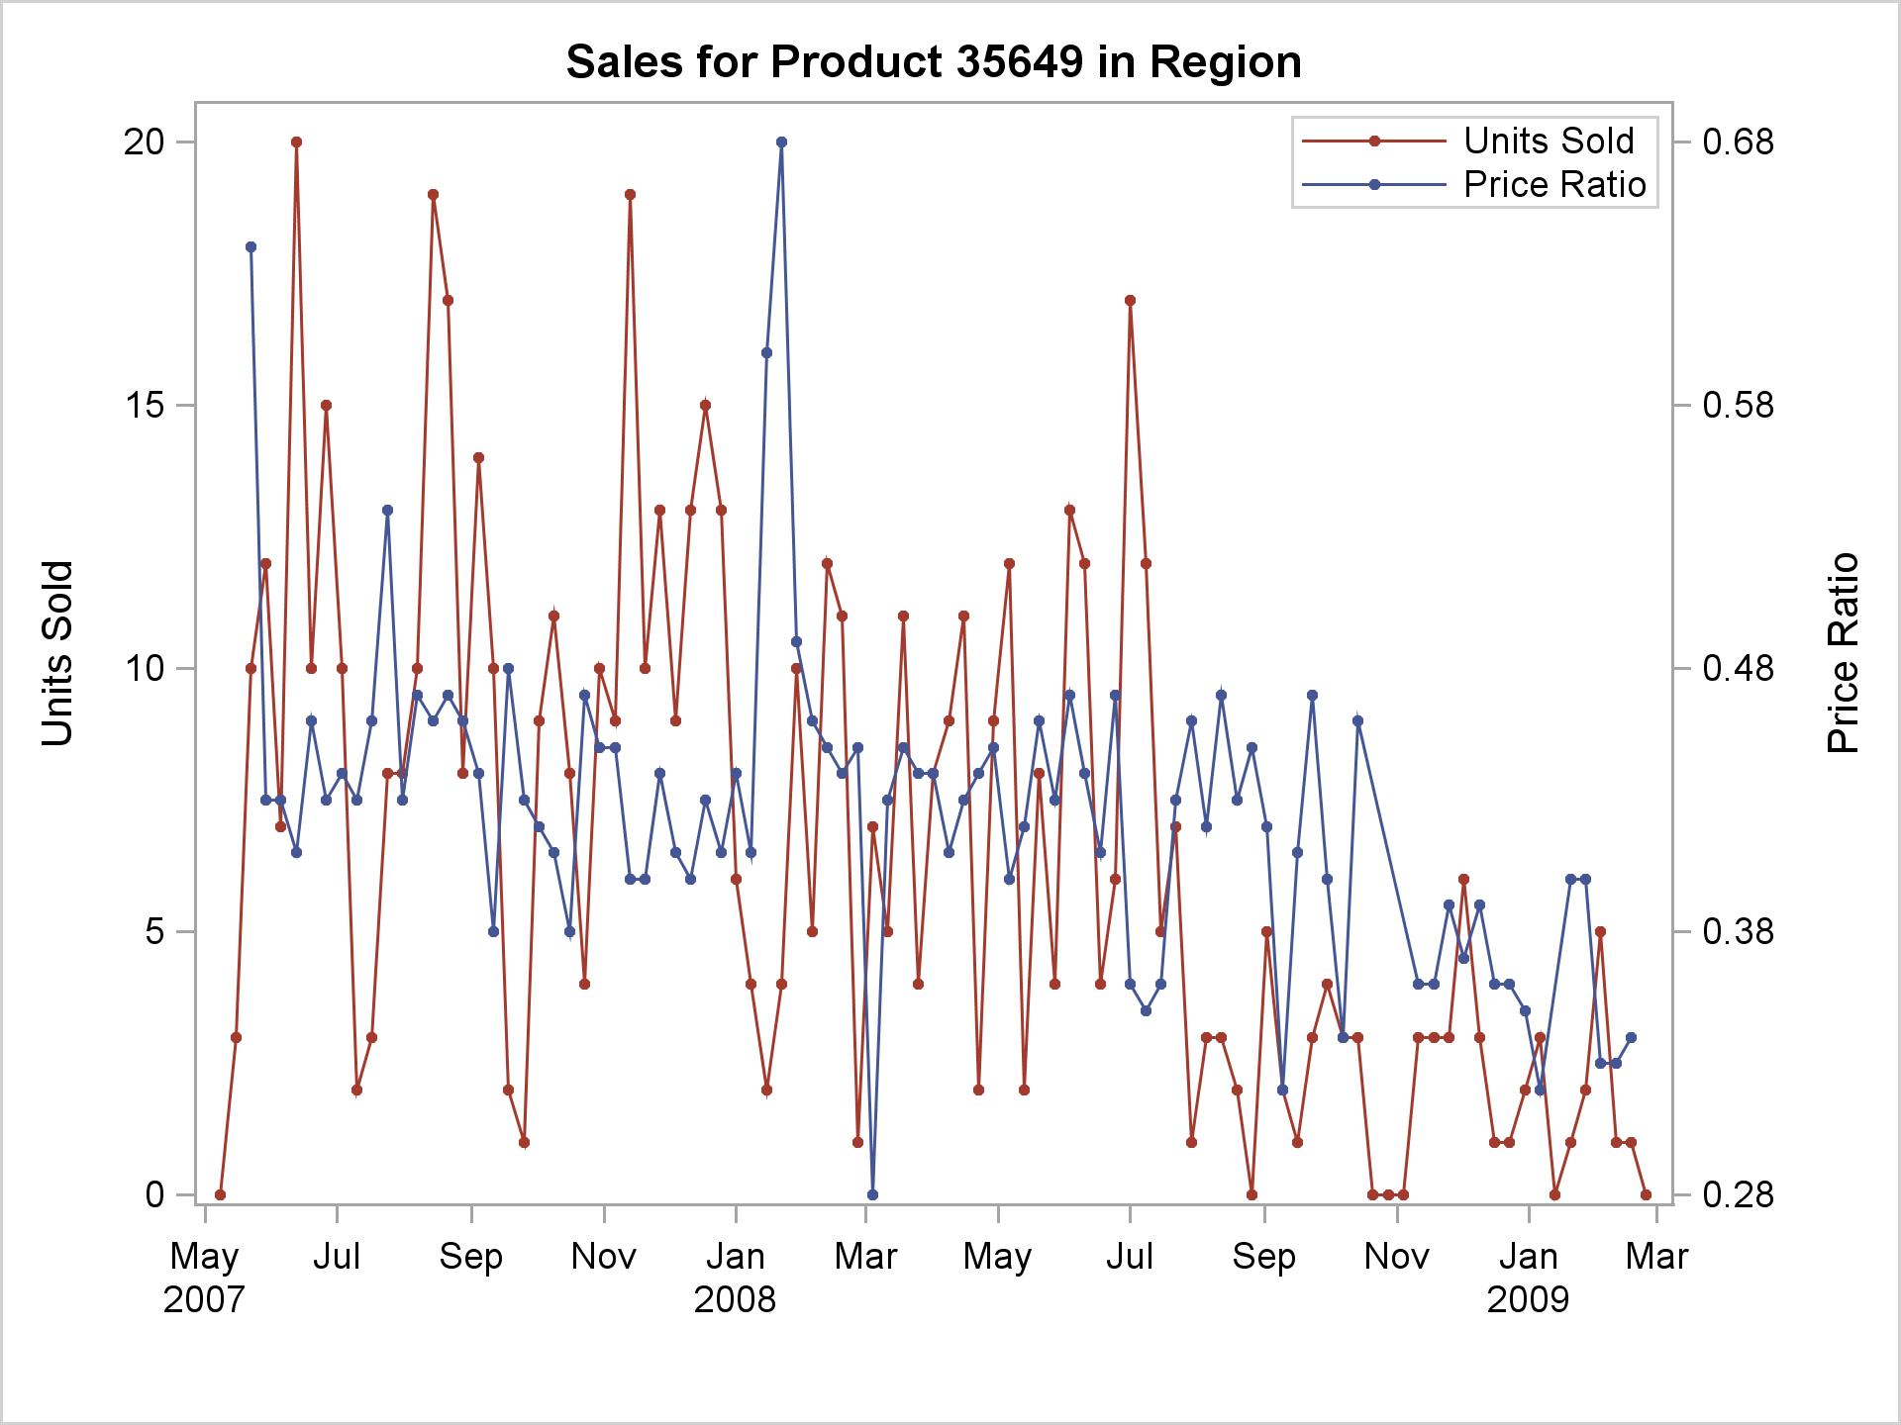
Data Aggregated at Region Level

Slide 13
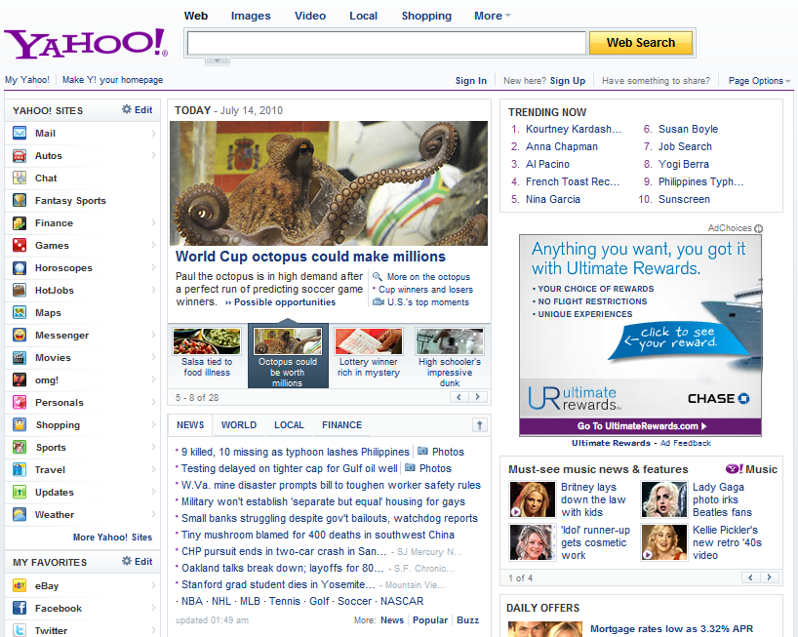
Recommend search queries
Recommend packages:
Image
Title, summary
Links to other pages
Pick 4 out of a pool of K
K = 20 ~ 40
Dynamic
Routes traffic other pages
Recommend applications
Recommend news article

Slide 14
Some examples from content optimization
Simple version
  I have a content module on my page, content inventory is obtained from a third party source which is further refined through editorial oversight. Can I algorithmically recommend content on this module? I want to improve overall click-rate (CTR) on this module
More advanced
  I got X% lift in CTR. But I have additional information on other downstream utilities (e.g. advertising revenue). Can I increase downstream utility without losing too many clicks?
Highly advanced
  There are multiple modules running on my webpage. How do I perform a simultaneous optimization?

Slide 15
Problems in this example
Optimize CTR on multiple modules
  Today Module, Trending Now, Personal Assistant, News
  Simple solution: Treat modules as independent, optimize separately. May not be the best when there are strong correlations.
For any single module
  Optimize some combination of CTR, downstream engagement, and perhaps advertising revenue.

Slide 16
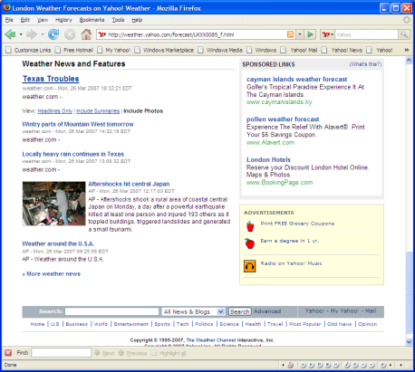
Online Advertising
Response rates
(click, conversion, ad-view)
Bids
conversion
ML /Statistical
model
Auction
Select argmax f(bid,response rates)
Click
Advertisers
Ads
Recommend
Best ad(s)
Page
Ad Network
User
Examples:
Yahoo, Google, MSN, …
Ad exchanges (RightMedia, DoubleClick, …)
Publisher
Notes:
This only shows one scenario; that of content match. Let’s add Sponsored Search (Replace Content with Query) and
Have a new slide for display advertising. This also does not provide info for the revenue model (shall we add it here or later).

Slide 17

Recommender problems in general
Example applications
  Search: Web, Vertical
  Online Advertising
  Content
  …..
Item Inventory
Articles, web page,
ads, …
Context
query, page, …
Use an automated algorithm
to select item(s) to show
Get feedback (click, time spent,..)
Refine the models
Repeat (large number of times)
Optimize metric(s) of interest
(Total clicks, Total revenue,…)
USER

Slide 18
Important Factors
Items: Articles, ads, modules, movies, users, updates, etc.
Context: query keywords, pages, mobile, social media, etc.
Metric to optimize (e.g., relevance score, CTR, revenue, engagement)
  Currently, most applications are single-objective
  Could be multi-objective optimization (maximize X subject to Y, Z,..)
Properties of the item pool
  Size (e.g., all web pages vs. 40 stories)
  Quality of the pool (e.g., anything vs. editorially selected)
  Lifetime (e.g., mostly old items vs. mostly new items)

Slide 19
Factors affecting Solution (continued)
Properties of the context
  Pull: Specified by explicit, user-driven query (e.g., keywords, a form)
  Push: Specified by implicit context (e.g., a page, a user, a session)
    Most applications are somewhere on continuum of pull and push
Properties of the feedback on the matches made
  Types and semantics of feedback (e.g., click, vote)
  Latency (e.g., available in 5 minutes vs. 1 day)
  Volume (e.g., 100K per day vs. 300M per day)
Constraints specifying legitimate matches
  e.g., business rules, diversity rules, editorial Voice
  Multiple objectives
Available Metadata (e.g., link graph, various user/item attributes)

Slide 20
Predicting User-Item Interactions (e.g. CTR)
Myth: We have so much data on the web, if we can only process it the problem is solved
  Number of things to learn increases with sample size
    Rate of increase is not slow
  Dynamic nature of systems make things worse
  We want to learn things quickly and react fast
Data is sparse in web recommender problems
  We lack enough data to learn all we want to learn and as quickly as we would like to learn
  Several Power laws interacting with each other
    E.g. User visits power law, items served power law
      Bivariate Zipf: Owen & Dyer, 2011

Slide 21
Can Machine Learning help?
Fortunately, there are group behaviors that generalize to individuals & they are relatively stable
  E.g. Users in San Francisco tend to read more baseball news
Key issue: Estimating such groups
  Coarse group : more stable but does not generalize that well.
  Granular group: less stable with few individuals
  Getting a good grouping structure is to hit the “sweet spot”
Another big advantage on the web
  Intervene and run small experiments on a small population to collect data that helps rapid convergence to the best choices(s)
    We don’t need to learn all user-item interactions, only those that are good.

Slide 22
Predicting user-item interaction rates
Feature construction
Content: IR, clustering, taxonomy, entity,..
User profiles: clicks, views, social, community,..
Online
(Finer resolution
Corrections)
(item, user level)
(Quick updates)
Offline
( Captures stable characteristics
at coarse resolutions)
(Logistic, Boosting,….)
Initialize
Explore/Exploit
(Adaptive sampling)
(helps rapid convergence
to best choices)

Slide 23
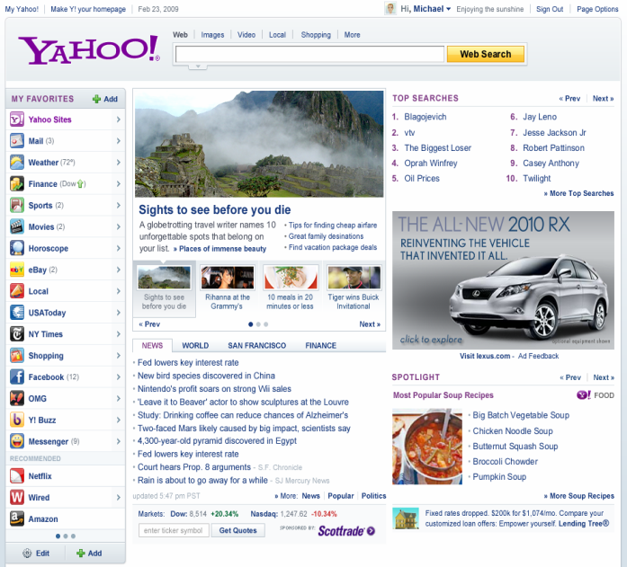
Post-click: An example in Content Optimization
Recommender
EDITORIAL
AD SERVER
DISPLAY ADVERTISING Revenue
Clicks on FP links influence downstream supply distribution
content
SPORTS
NEWS
Downstream engagement
(Time spent)
OMG
FINANCE

Slide 24
Serving Content on Front Page: Click Shaping
What do we want to optimize?
Current: Maximize clicks (maximize downstream supply from FP)
But consider the following
  Article 1: CTR=5%, utility per click = 5
  Article 2: CTR=4.9%, utility per click=10
    By promoting 2, we lose 1 click/100 visits, gain 5 utils
If we do this for a large number of visits --- lose some clicks but obtain significant gains in utility?
  E.g. lose 5% relative CTR, gain 40% in utility (revenue, engagement, etc)

Slide 25
Example Application:
Today Module on Yahoo! Homepage
Currently in production, powered by some methods discussed in this tutorial

Slide 26
Recommend packages:
Image
Title, summary
Links to other pages
Pick 4 out of a pool of K
K = 20 ~ 40
Dynamic
Routes traffic other pages
1
2
3
4

Slide 27
Problem definition
Display “best” articles for each user visit
Best - Maximize User Satisfaction, Engagement
  BUT Hard to obtain quick feedback to measure these
Approximation
  Maximize utility based on immediate feedback (click rate) subject to constraints (relevance, freshness, diversity)
Inventory of articles?
  Created by human editors
  Small pool (30-50 articles) but refreshes periodically

Slide 28
Where are we today?
Before this research
  Articles created and selected for display by editors
After this research
  Article placement done through statistical models
How successful ?
"Just look at our homepage, for example. Since we began pairing our content optimization technology with editorial expertise, we've seen click-through rates in the Today module more than double. ----- Carol Bartz, CEO Yahoo! Inc (Q4, 2009)

Slide 29
Main Goals
Methods to select most popular articles
  This was done by editors before
Provide personalized article selection
  Based on user covariates
  Based on per user behavior
Scalability: Methods to generalize in small traffic scenarios
  Today module part of most Y! portals around the world
  Also syndicated to sources like Y! Mail, Y! IM etc

Slide 30
Challenges

Slide 31
Recall: Some examples
Simple version
  I have an important module on my page, content inventory is obtained from a third party source which is further refined through editorial oversight. Can I algorithmically recommend content on this module? I want to drive up total CTR on this module
More advanced
  I got X% lift in CTR. But I have additional information on other downstream utilities (e.g. dwell time). Can I increase downstream utility without losing too many clicks?
Highly advanced
  There are multiple modules running on my website. How do I take a holistic approach and perform a simultaneous optimization?

Slide 32
For the simple version
Multi-position optimization
  Explore/exploit, optimal subset selection
Explore/Exploit strategies for large content pool and high dimensional problems
  Some work on hierarchical bandits but more needs to be done
Constructing user profiles from multiple sources with less than full coverage
  Couple of papers at KDD 2011
Content understanding
Metrics to measure user engagement (other than CTR)

Slide 33
Other problems
Whole page optimization
  Incorporating correlations
Incentivizing User generated content
Incorporating Social information for better recommendation
Multi-context Learning

Slide 34
Distances in Funny Spaces I
In user-based collaborative filtering, we can think of users in a space of dimension N where there are N items and M users.
  Let i run over items and u over users
Then each user is represented as a vector U_{i}(u) in “item-space” where ratings are vector components. We are looking for users u u’ that are near each other in this space as measured by some distance between U_{i}(u) and U_{i}(u’)
If u and u’ rate all items then these are “real” vectors but almost always they each only rates a small fraction of items and the number in common is even smaller
The “Pearson coefficient” is just one distance measure that can be used
  Only sum over items rated by u and u’

Slide 35
Distances in Funny Spaces II
In item-based collaborative filtering, we can think of items in a space of dimension M where there are N items and M users.
  Let i run over items and u over users
Then each item is represented as a vector R_{u}(i) in “user-space” where ratings are vector components. We are looking for items i i’ that are near each other in this space as measured by some distance between R_{u}(i) and R_{u}(i’)
If i and i’ rated by all users then these are “real” vectors but almost always they are each only rated by a small fraction of users and the number in common is even smaller
The “Cosine measure” is just one distance measure that can be used
  Only sum over users rating both i and i’

Slide 36
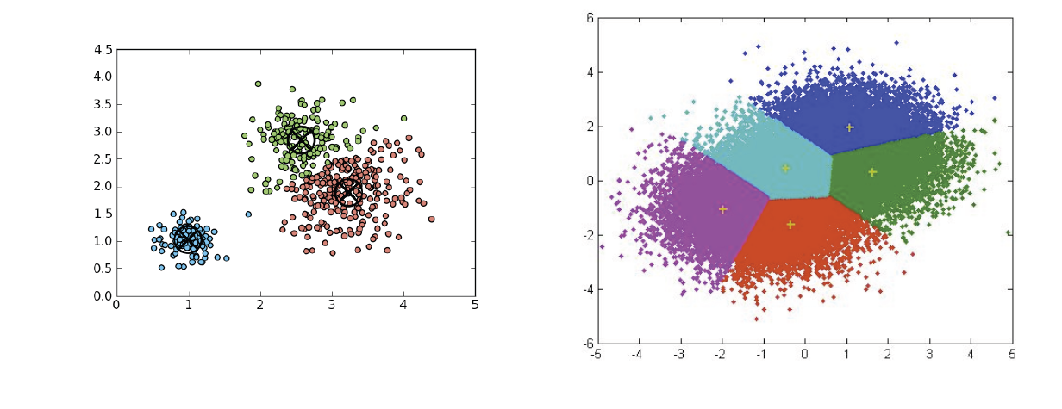
Clustering
One can think of users and/or items as points in a space and try to find clusters
Either clear clusters (as in left) or divisions of space into points close to each other (right picture)
All entities in the same cluster are assigned the same recommendations which can dramatically speed up real time computation
  i.e. all users in same cluster are assigned same recommendations for a given item
  See 2003 Amazon article for comments on need to respond in real time

Slide 37
Do we need “real” spaces?
Much of (eCommerce/LifeStyle) Informatics involves “points”
  Events in LHC analysis
  Users (people) or items (books, jobs, music, other people)
These points can be thought of being in a “space”
  Set of all books
  Set of all physics reactions
  Set of all Internet users
However as in recommender systems where a given user only rates some items, we don’t know “full position”
However we can nearly always define a useful distance d(a,b) between points
Always d(a,b) >= 0
Usually d(a,b) = d(b,a)
Rarely d(a,b) + d(b,c) >= d(a,c) Triangle Inequality

Slide 38
Collaborative Filtering (CF)
The most prominent approach to generate recommendations
  used by large, commercial e-commerce sites
  well-understood, various algorithms and variations exist
  applicable in many domains (book, movies, DVDs, ..)
Approach
  use the "wisdom of the crowd" to recommend items
Basic assumption and idea
  Users give ratings to catalog items (implicitly or explicitly)
  Customers who had similar tastes in the past, will have similar tastes in the future

Slide 39
Pure CF Approaches
Input
  Only a matrix of given user–item ratings
Output types
  A (numerical) prediction indicating to what degree the current user will like or dislike a certain item
  A top-N list of recommended items

Slide 40
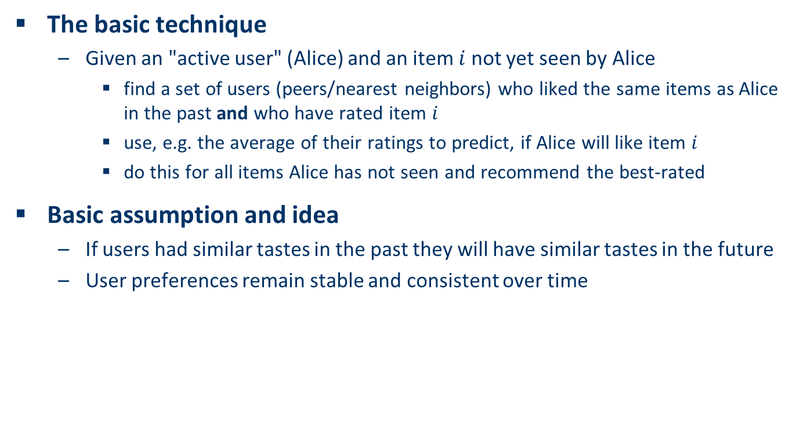
User-based nearest-neighbor collaborative filtering (1)
The basic technique
  Given an "active user" (Alice) and an item $i$ not yet seen by Alice
    find a set of users (peers/nearest neighbors) who liked the same items as Alice in the past and who have rated item $i$
    use, e.g. the average of their ratings to predict, if Alice will like item $i$
    do this for all items Alice has not seen and recommend the best-rated
Basic assumption and idea
  If users had similar tastes in the past they will have similar tastes in the future
  User preferences remain stable and consistent over time

Slide 41
User-based nearest-neighbor collaborative filtering (2)
Example
  A database of ratings of the current user, Alice, and some other users is given:
  Determine whether Alice will like or dislike Item5, which Alice has not yet rated or seen
 | Item1 | Item2 | Item3 | Item4 | Item5
Alice | 5 | 3 | 4 | 4 | ?
User1 | 3 | 1 | 2 | 3 | 3
User2 | 4 | 3 | 4 | 3 | 5
User3 | 3 | 3 | 1 | 5 | 4
User4 | 1 | 5 | 5 | 2 | 1

Slide 42
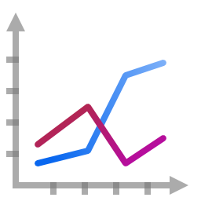
User-based nearest-neighbor collaborative filtering (3)
Some first questions
  How do we measure similarity?
  How many neighbors should we consider?
  How do we generate a prediction from the neighbors' ratings?
 | Item1 | Item2 | Item3 | Item4 | Item5
Alice | 5 | 3 | 4 | 4 | ?
User1 | 3 | 1 | 2 | 3 | 3
User2 | 4 | 3 | 4 | 3 | 5
User3 | 3 | 3 | 1 | 5 | 4
User4 | 1 | 5 | 5 | 2 | 1

Slide 43

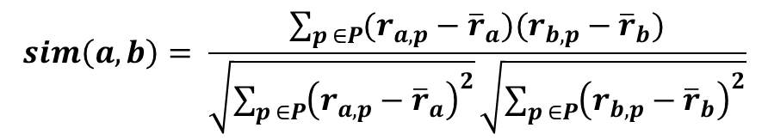
Measuring user similarity (1)
A popular similarity measure in user-based CF: Pearson correlation
  $a$, $b$ : users
  $r_{a,p}$ : rating of user $a$ for item $p$
  $P$ : set of items, rated both by $a$ and $b$
  Possible similarity values between $−1$ and $1$
$$sim\left(a,b\right)= \frac{\sum_{p ∈P}{(r_{a,p}−{\overline{r}}_{a})(r_{b,p}−{\overline{r}}_{b})}}{\sqrt{\sum_{p ∈P}{{\left(r_{a,p}−{\overline{r}}_{a}\right)}^{2}}}\sqrt{\sum_{p ∈P}{{\left(r_{b,p}−{\overline{r}}_{b}\right)}^{2}}}}$$

Slide 44
Measuring user similarity (2)
A popular similarity measure in user-based CF: Pearson correlation
  $a$, $b$ : users
  $r_{a,p}$ : rating of user $a$ for item $p$
  $P$ : set of items, rated both by $a$ and $b$
  Possible similarity values between $−1$ and $1$
 | Item1 | Item2 | Item3 | Item4 | Item5
Alice | 5 | 3 | 4 | 4 | ?
User1 | 3 | 1 | 2 | 3 | 3
User2 | 4 | 3 | 4 | 3 | 5
User3 | 3 | 3 | 1 | 5 | 4
User4 | 1 | 5 | 5 | 2 | 1
sim = 0,85
sim = 0,00
sim = 0,70
sim = -0,79

Slide 45
Pearson correlation
Takes differences in rating behavior into account
Works well in usual domains, compared with alternative measures
  such as cosine similarity

Slide 46

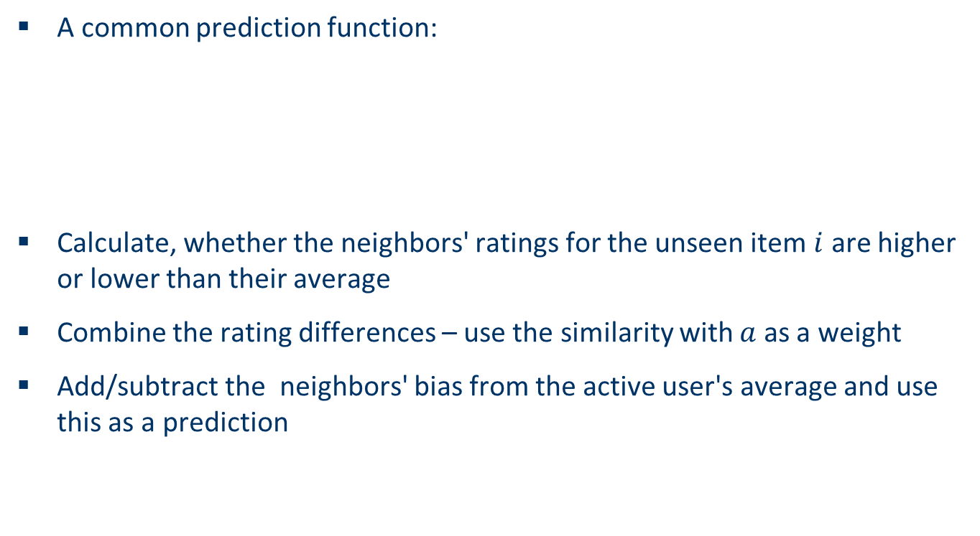
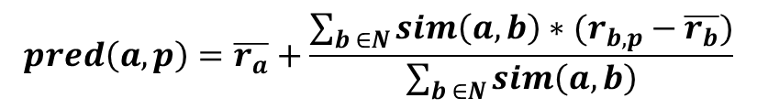
Making predictions
A common prediction function:
Calculate, whether the neighbors' ratings for the unseen item $i$ are higher or lower than their average
Combine the rating differences – use the similarity with $a$ as a weight
Add/subtract the neighbors' bias from the active user's average and use this as a prediction
$$pred\left(a,p\right)=\overline{r_{a}}+\frac{\sum_{b ∈N}{sim\left(a,b\right)∗(r_{b,p}−\overline{r_{b}})}}{\sum_{b ∈N}{sim\left(a,b\right)}}$$

Slide 47
Improving the metrics / prediction function
Not all neighbor ratings might be equally "valuable"
  Agreement on commonly liked items is not so informative as agreement on controversial items
  Possible solution: Give more weight to items that have a higher variance
Value of number of co-rated items
  Use "significance weighting", by e.g., linearly reducing the weight when the number of co-rated items is low
Case amplification
  Intuition: Give more weight to "very similar" neighbors, i.e., where the similarity value is close to 1.
Neighborhood selection
  Use similarity threshold or fixed number of neighbors

