Slide 1
X-Informatics
Sensors
April 10 and 15
Geoffrey Fox
gcf@indiana.edu
http://www.infomall.org/X-InformaticsSpring2013/index.html
Associate Dean for Research and Graduate Studies, School of Informatics and Computing
Indiana University Bloomington
2013

Slide 2

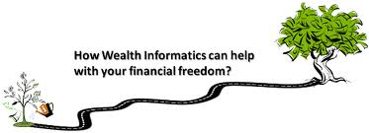





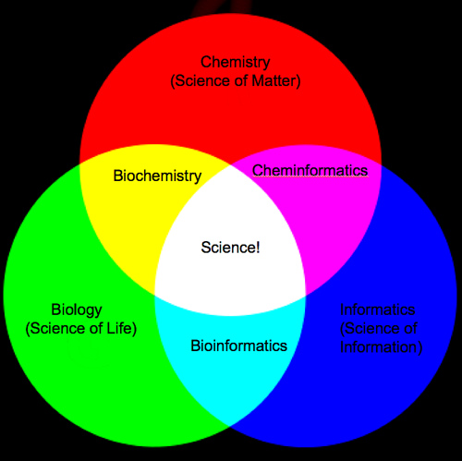
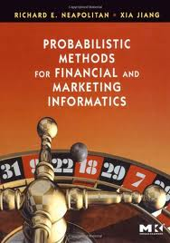
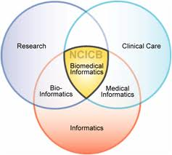
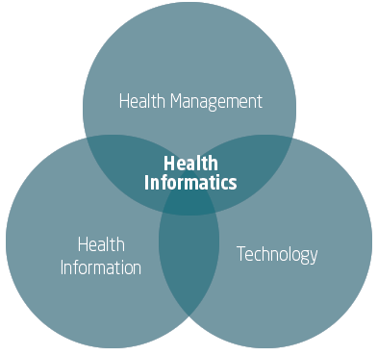
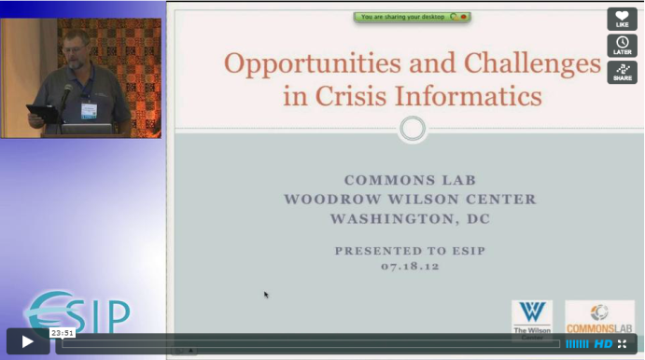
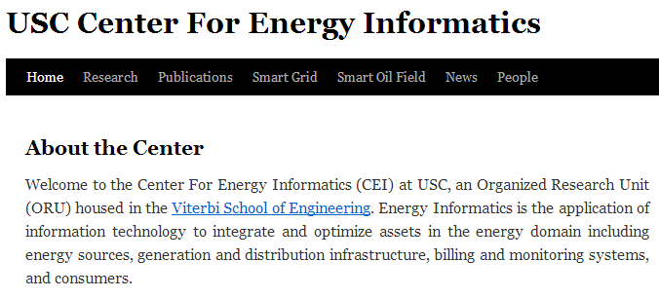
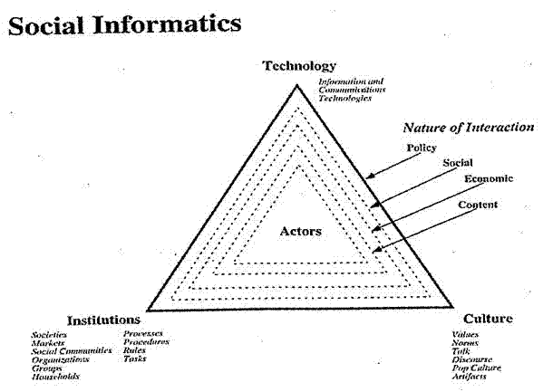

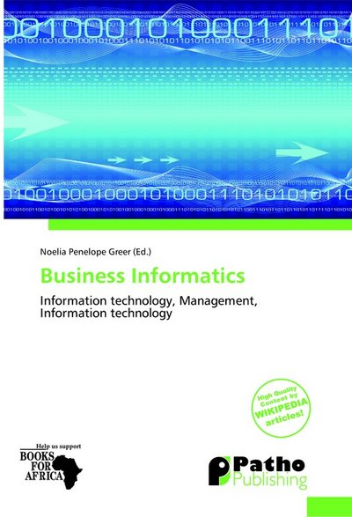
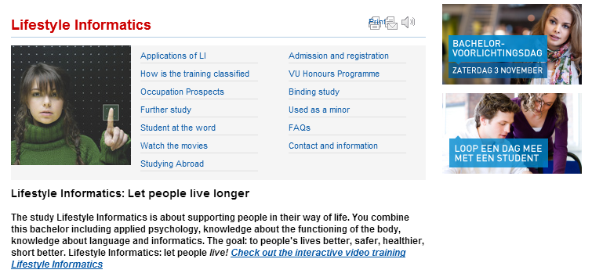



Slide 3
The Course in One Sentence
Study Clouds running Data Analytics processing Big Data to solve problems in X-Informatics

Slide 4
Sensor Informatics

Slide 5

Sensor Grids and Clouds
  A sensor is any source or sink of time series
    In the thin client era, smart phones, Kindles, tablets, Kinects, web-cams are sensors
    Robots, distributed instruments such as environmental measures are sensors
    Web pages, Googledocs, Office 365, WebEx are sensors
    Ubiquitous Cities/Homes are full of sensors
  Sensors – being intrinsically distributed are Grids
  However natural implementation uses clouds to consolidate and control and collaborate with sensors
  Sensors are typically “small” and have pleasingly parallel cloud implementations
    LHC is a large sensor but breaks up into small ones!

Slide 6
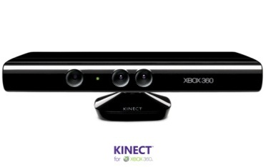
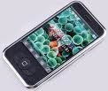
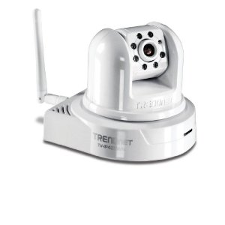
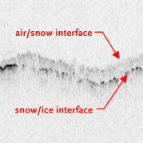
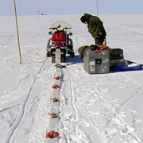

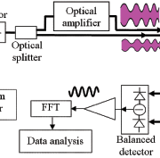
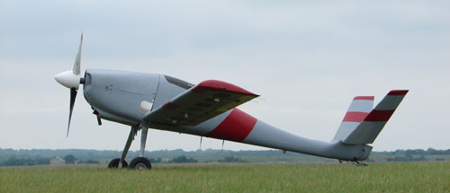
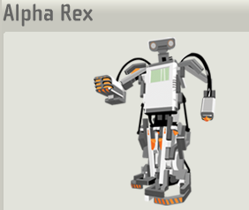
Sensors (Things) as a Service
Output Sensor
Sensors as a Service
Sensor Processing as a Service (could use
MapReduce)
A larger sensor ………
https://sites.google.com/site/opensourceiotcloud/ Open Source Sensor (IoT) Cloud

Slide 7
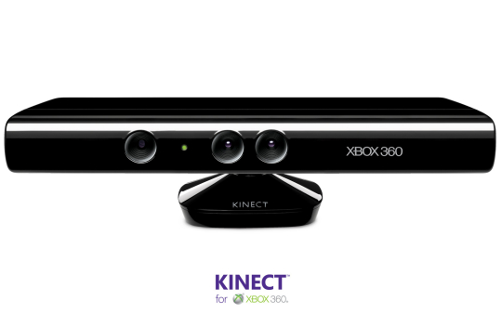
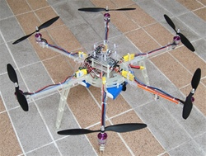
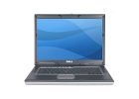
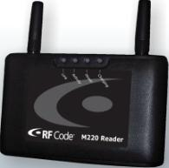
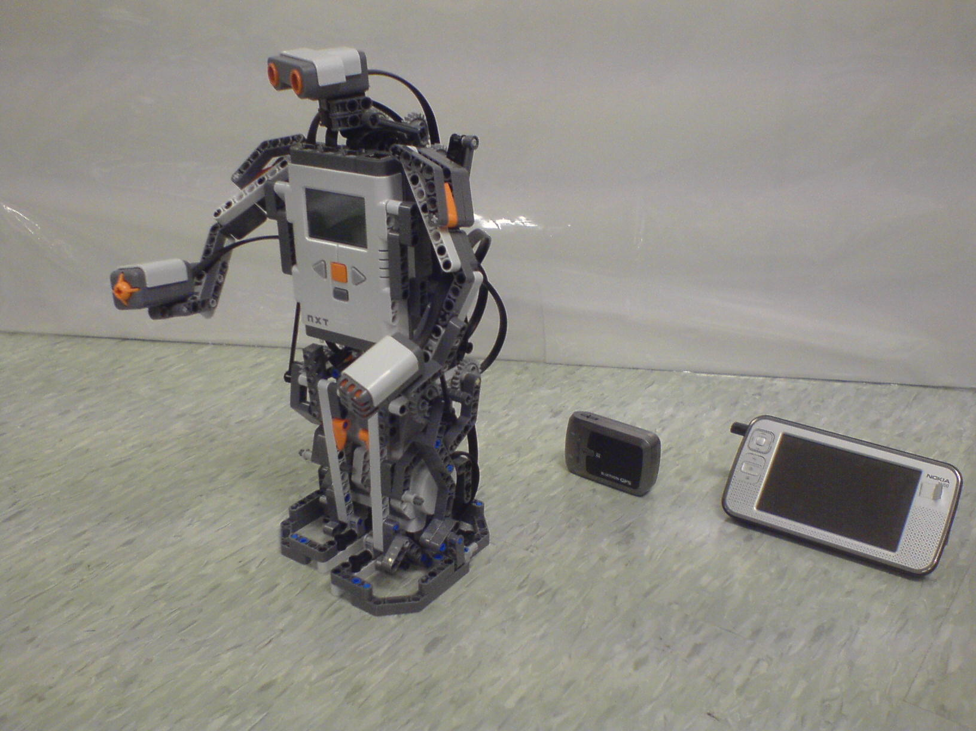
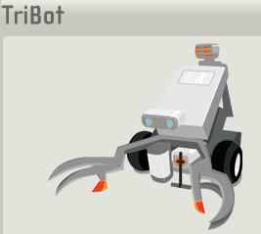

Some Sensors
Hexacopter
Laptop for PowerPoint
Surveillance Camera
RFID Reader
RFID Tag
Lego Robot GPS Nokia N800

Slide 8
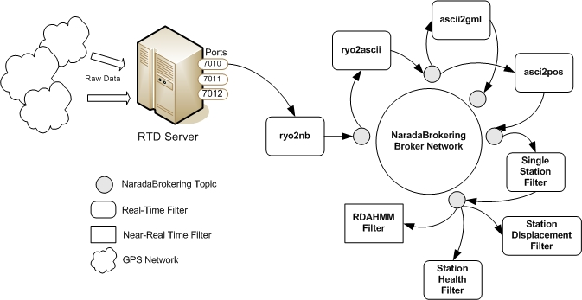
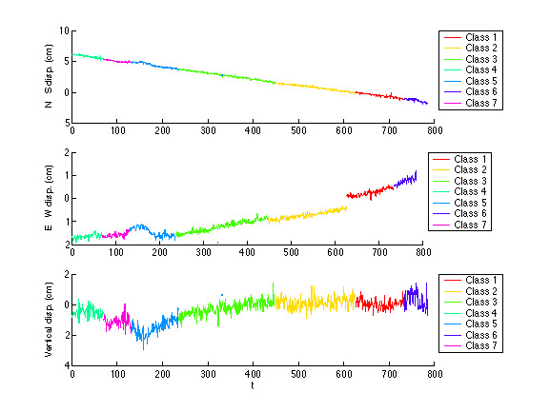
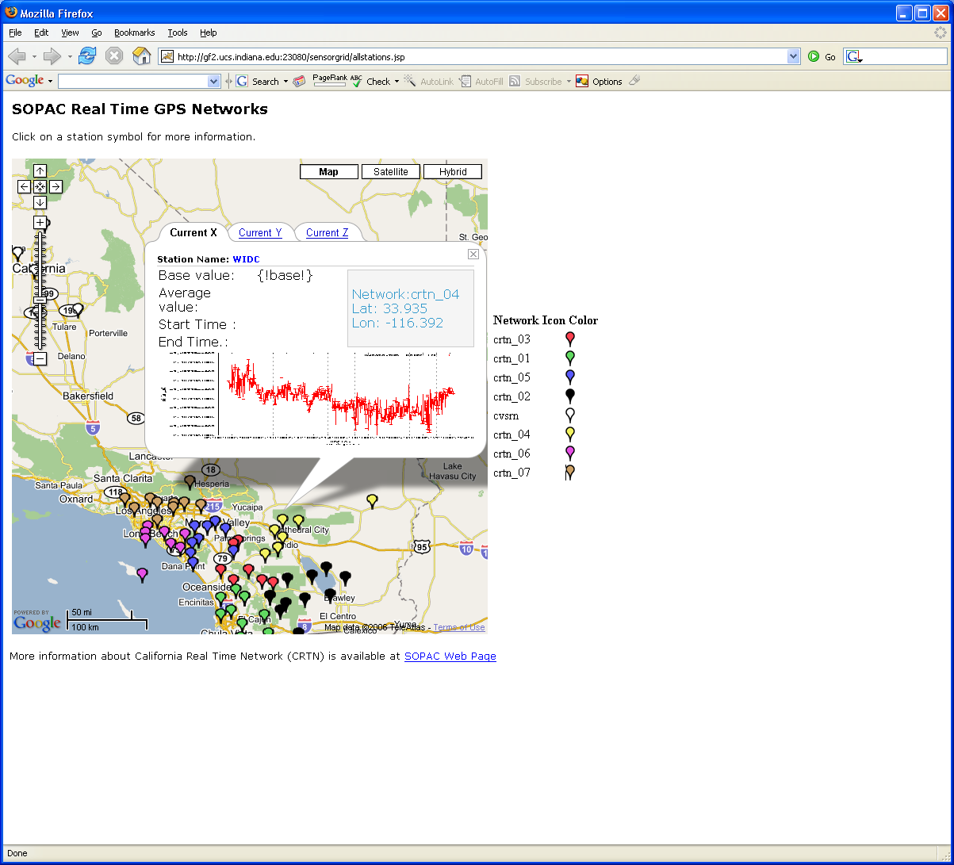
Real-Time GPS Sensor Data-Mining
Services process real time data from ~70 GPS Sensors in Southern California
Brokers and Services on Clouds – no major performance issues
CRTN GPS
Earthquake
Streaming Data
Support
Transformations
Data Checking
Archival
Hidden Markov
Datamining (JPL)
Display (GIS)
Real Time
8
Notes:
8

Slide 9
Sensor Grid supported by Sensor Cloud
Sensor Grid
Sensor
Client Application Enterprise App
Notify
Publish
Publish
Sensor Cloud
Control
Subscribe()
Notify()
Unsubscribe()
Sensor
Notify
Client Application Desktop Client
Sensor
Publish
Notify
Client Application Web Client
Pub-Sub Brokers are cloud interface for sensors
Filters subscribe to data from Sensors
Naturally Collaborative
Rebuilding software from scratch as Open Source – collaboration welcome

Slide 10
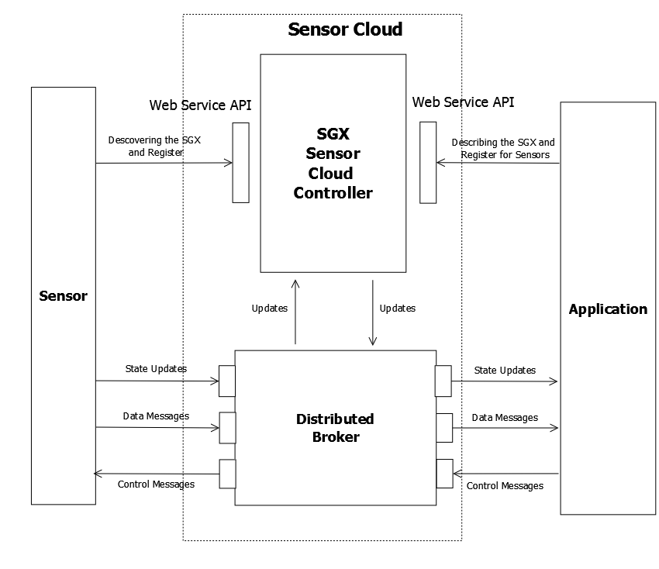
Sensor Cloud Architecture
Originally brokers were from NaradaBrokering
Replace with ActiveMQ and Netty for streaming

Slide 11
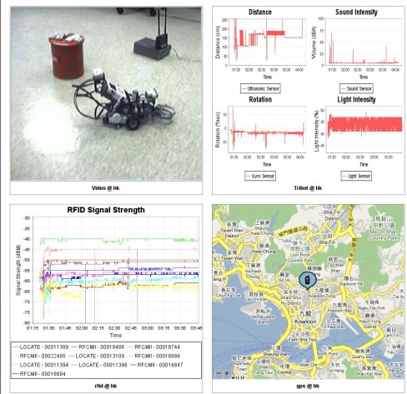
Sensor Grid
Client Outputs
Video
4 Tribot
RFID
GPS

Slide 12
Performance of Pub-Sub Cloud Brokers
High end sensors equivalent to Kinect or MPEG4 TRENDnet TV-IP422WN camera at about 1.8Mbps per sensor instance
OpenStack hosted sensors and middleware

Slide 13
Lightweight Cyberinfrastructure to support mobile Data gathering expeditions plus classic central resources (as a cloud)
Sensors are airplanes here!

Slide 14
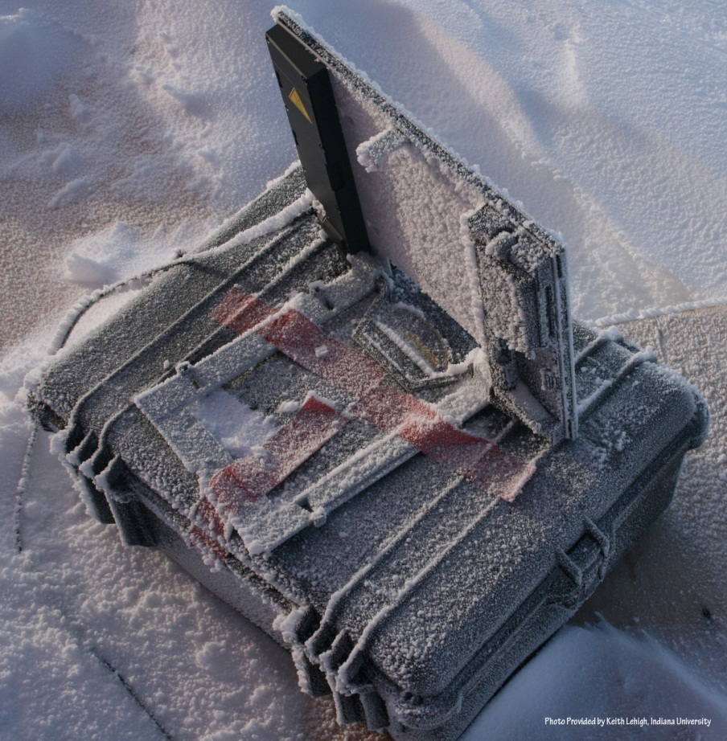
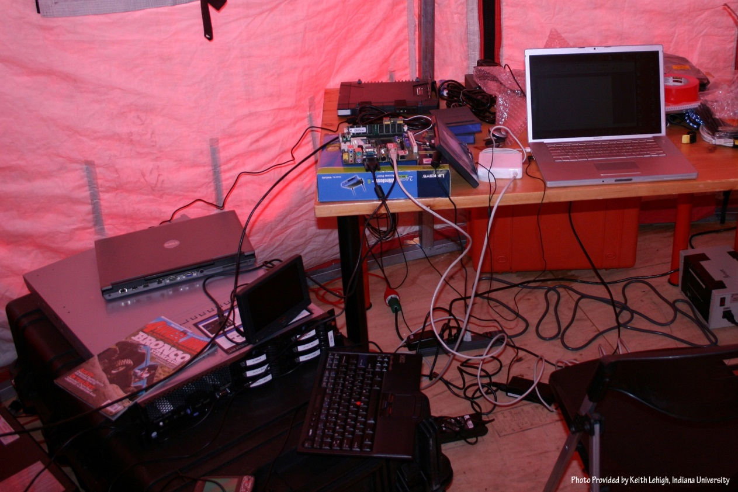
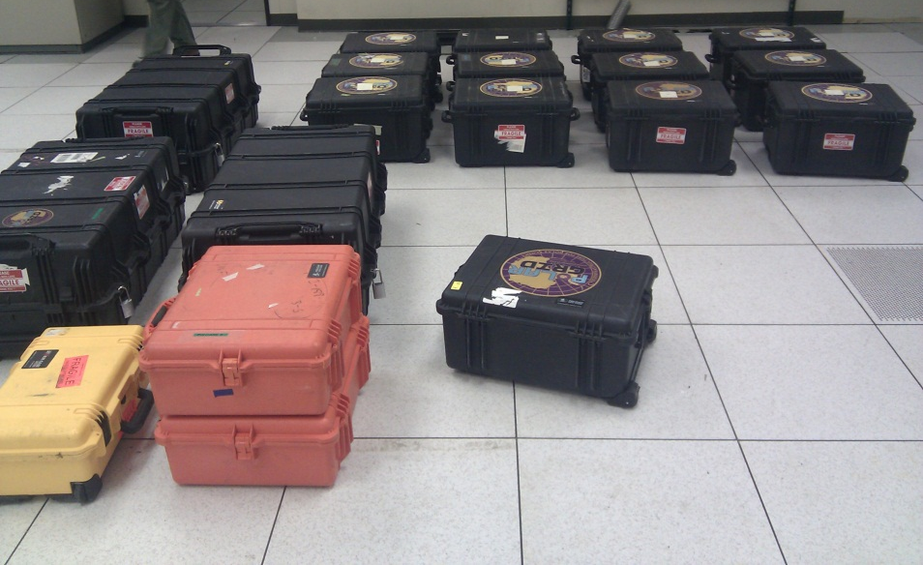
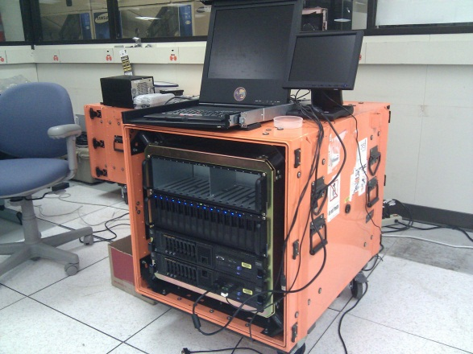

Slide 15
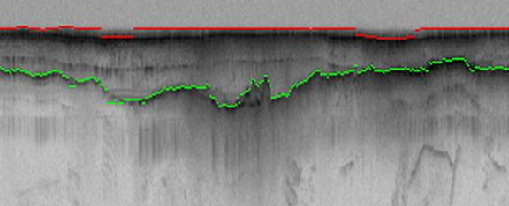
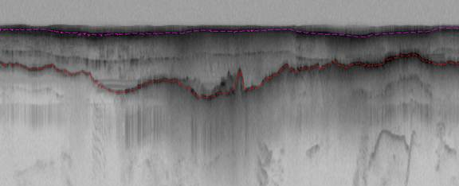
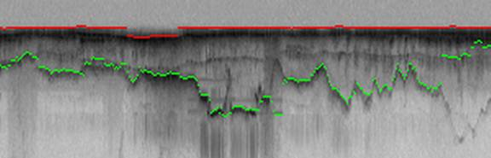
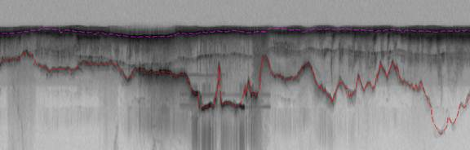
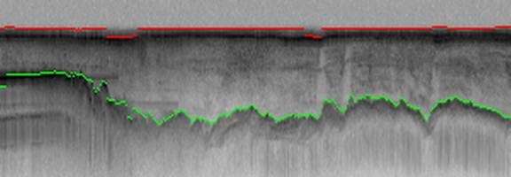
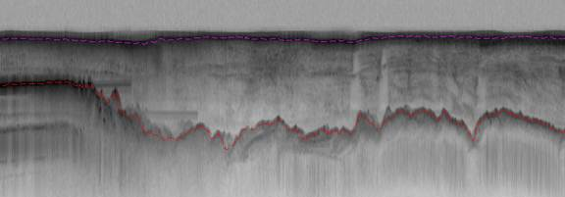
Hidden Markov Method based Layer Finding
P. Felzenszwalb, O. Veksler, Tiered Scene Labeling with Dynamic Programming, IEEE Conference on Computer Vision and Pattern Recognition (CVPR), 2010

Slide 16
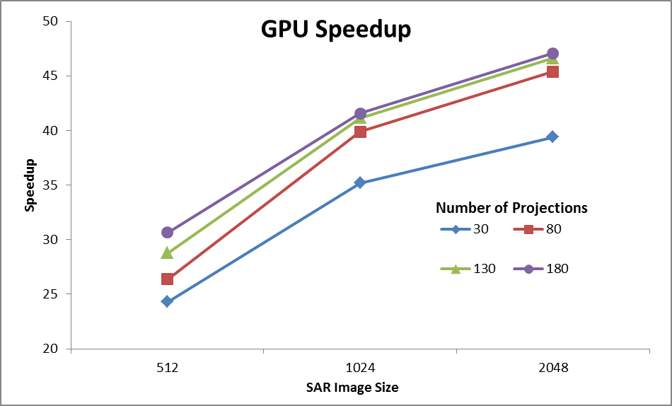
Back Projection
Speedup of GPU wrt Matlab 2 processor Xeon CPU
Wish to replace field hardware by GPU’s to get better power-performance characteristics
Testing environment:
GPU: Geforce GTX 580, 4096 MB, CUDA toolkit 4.0
CPU: 2 Intel Xeon X5492 @ 3.40GHz with 32 GB memory

Slide 17
Smart Cities Homes Transportation
Also Ubiquitous cities …
Sensors everywhere as in earlier examples as in Dublin from IBM
See South Korea where small size enables higher technology per person than in USA
Smart Grids are power networks monitored by sensors with data captured in the cloud
This is a case where power comes from joining lots of data together
In Robot controlled by cloud, system is “more localized”

Slide 18
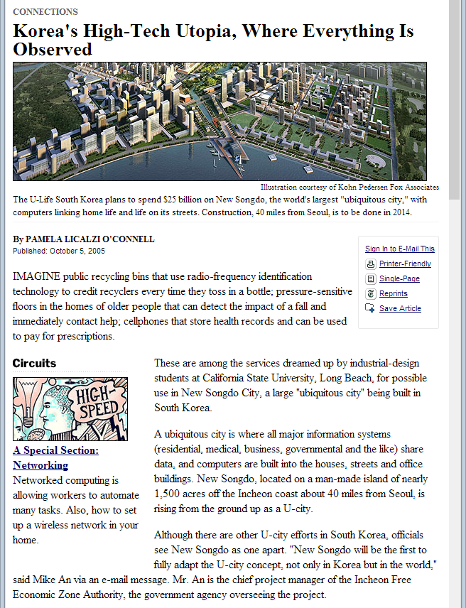
http://www.nytimes.com/2005/10/05/technology/techspecial/05oconnell.html?ex=1286164800&en=4a368c49e8f30bd2&ei=5088

Slide 19
Smart Grid
http://courses.engr.illinois.edu/cs598tar/fa2010/ClassNotes/Grid.ppt

Slide 20
Smart Grid
Fatemeh Saremi, PoLiang Wu, and Heechul Yun
UIUC Illinois 2010

Slide 21
US Electricity Grid
Aged
Centralized
Manual operations
Fragile
Notes:
The electricity delivery system is getting old
60%-70% of the infrastructure is 25-30 years old
Designed in the 50s, installed in the 60s and 70s, before the era of the microprocessor
Population growth has caused the entire transmission system to be over used and fragile

Slide 22
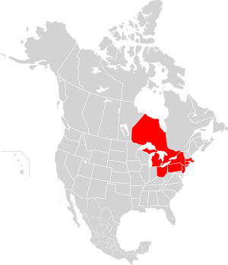
Northeast Blackout – August 14, 2003
Affected 55 million people
$6 billion lost
Per year $135 billions lost for power interruption
~$6 billion lost due to 8/14/03 blackout
Cost of Power Disturbances: $25 - $188 billion per year
4
http://en.wikipedia.org/wiki/Northeast_Blackout_of_2003

Slide 23
Goal
Upgrade the grid in Smart way

Slide 24
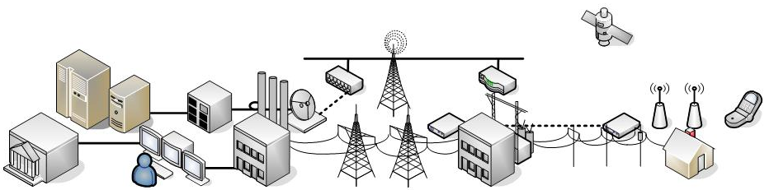
Smart Grid
Uses information technologies to improve how electricity travels from power plants to consumers
Allows consumers to interact with the grid
Integrates new and improved technologies into the operation of the grid
Notes:
A new approach that significantly increases the efficiency of the entire electrical delivery system
Not only does increase reliability, but will also reduce energy in the delivery process and reduce greenhouse gas emissions

Slide 25
Smart Grid Attributes
Information-based
Communicating
Secure
Self-healing
Reliable
Flexible
Cost-effective
Dynamically controllable

Slide 26
Outline
Motivation
Sensing and Measurement
Communications and Security
Components and Subsystems
Interfaces and Decision Support
Control Methods and Topologies
Trading in Smart Grid

Slide 27
Advanced Sensing and Measurement
Enhance power system measurements and enable the transformation of data into information.
Evaluate the health of equipment, the integrity of the grid, and support advanced protective relaying.
Enable consumer choice and demand response, and help relieve congestion

Slide 28
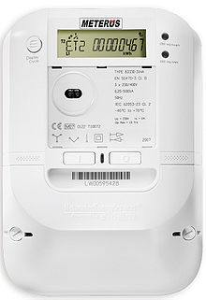
Advanced Sensing and Measurement
Advanced Metering Infrastructure (AMI)
  Provide interface between the utility and its customers: bi-direction control
  Advanced functionality
    Real-time electricity pricing
    Accurate load characterization
    Outage detection/restoration
  California asked all the utilities to deploy the new smart meter

Slide 29
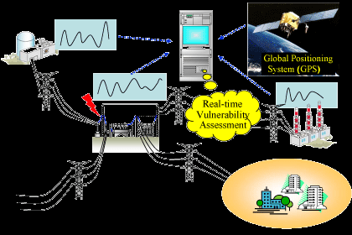
Advanced Sensing and Measurement
Health Monitor: Phasor measurement unit (PMU)
  Measure the electrical waves and determine the health of the system.
  Increase the reliability by detecting faults early, allowing for isolation of operative system, and the prevention of power outages.

Slide 30
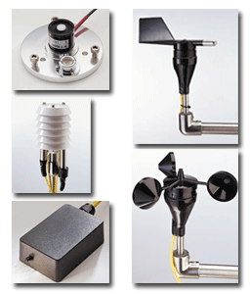
Advanced Sensing and Measurement
Distributed weather sensing
  Widely distributed solar irradiance, wind speed, temperature measurement systems to improve the predictability of renewable energy.
  The grid control systems can dynamically adjust the source of power supply.

Slide 31
Outline
Motivation
Sensing and Measurement
Communications and Security
Components and Subsystems
Interfaces and Decision Support
Control Methods and Topologies
Trading in Smart Grid

Slide 32
Integrated Communications and Security
High-speed, fully integrated, two-way communication technologies that make the smart grid a dynamic, interactive “mega-infrastructure” for real-time information and power exchange.
Cyber Security: the new communication mechanism should consider security, reliability, QoS.

Slide 33
Wireless Sensor Network
The challenges of wireless sensor network in smart grid
  Harsh environmental conditions.
  Reliability and latency requirements
  Packet errors and variable link capacity
  Resource constraints.
The interference will severely affect the quality of wireless sensor network.

Slide 34
Outline
Motivation
Sensing and Measurement
Communications and Security
Components and Subsystems
Interfaces and Decision Support
Control Methods and Topologies
Trading in Smart Grid

Slide 35
Advanced Components and Subsystems
These power system devices apply the latest research in materials, superconductivity, energy storage, power electronics, and microelectronics
Produce higher power densities, greater reliability and power quality, enhanced electrical

Slide 36
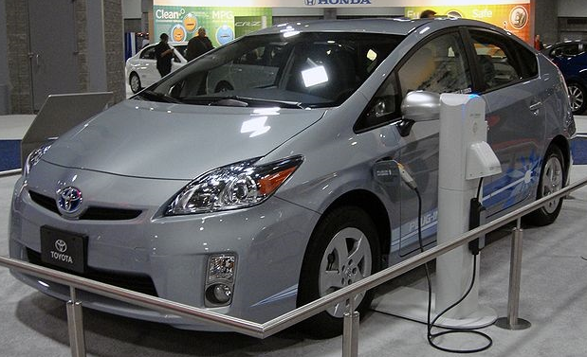
Advanced Components and Subsystems
Advanced Energy Storage
  New Battery Technologies
    Sodium Sulfur (NaS)
  Plug-in Hybrid Electric Vehicle (PHEV)
    Grid-to-Vehicle(G2V) and Vehicle-to-Grid(V2G)
    Peak load leveling

Slide 37
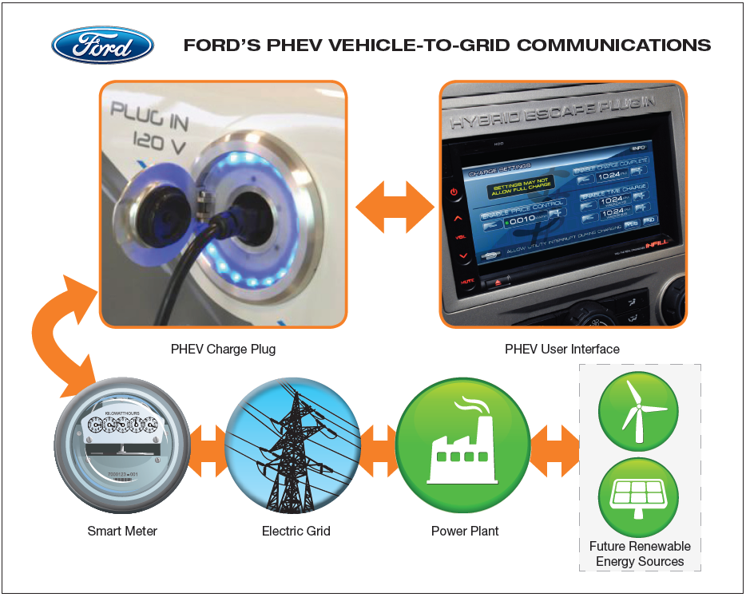
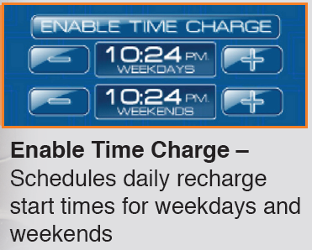
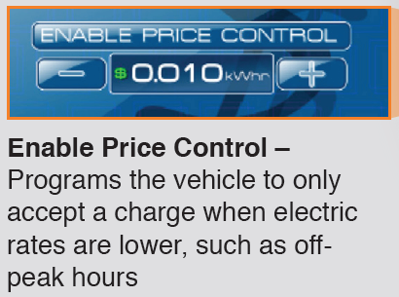

Grid-to-Vehicle (G2V)

Slide 38

V2G: Wind With Storage

Slide 39
Outline
Motivation
Sensing and Measurement
Communications and Security
Components and Subsystems
Interfaces and Decision Support
Control Methods and Topologies
Trading in Smart Grid

Slide 40
Improved Interfaces and Decision Support
The smart grid will require wide, seamless, often real-time use of applications and tools that enable grid operators and managers to make decisions quickly.
Decision support and improved interfaces will enable more accurate and timely human decision making at all levels of the grid, including the consumer level, while also enabling more advanced operator training.

Slide 41

Improved Interfaces and Decision Support
Advanced Pattern Recognition
Visualization Human Interface
  Region of Stability Existence (ROSE)
    Real-time calculate the stable region based on the voltage constraints, thermal limits, etc.

Slide 42
Outline
Motivation
What’s Smart Grid
Sensing and Measurement
Communications and Security
Components and Subsystems
Interfaces and Decision Support
Control Methods and Topologies
Trading in Smart Grid
42

Slide 43
Control Methods and Topologies
Traditional power system problems:
  Centralized
  No local supervisory control unit
  No fault isolation
  Relied entirely on electricity from the grid
43

Slide 44
IDAPS: Intelligent Distributed Autonomous Power Systems
Distributed
Loosely connected APSs
Autonomous
  Can perform automatic control without human intervention, such as fault isolation
Intelligent
  Demand-side management
  Securing critical loads
44

Slide 45


APS: Autonomous Power System
A localized group of electricity sources and loads
  Locally utilizing natural gas or renewable energy
  Reducing the waste during transmission
    Using Combined Heat and Power (CHP)
45
Notes:
Combined heat and power (CHP) is the use of a power station to simultaneously generate both electricity and useful heat.
All power plants must emit a certain amount of heat during electricity generation. CHP captures some or all of the by-product heat for heating purposes

Slide 46
Quantifying Necessary Generation to Secure Critical Loads
Non-linear optimization model
  Minimize the total annual levelized capital and operating costs of the candidate generators
  Subject to
    Reliability constraints
    Maximum size of each technology
    Maximum number of units to be installed
    The annual emission caps for CO₂, NO_{x}, and SO_{x}

Slide 47
Outline
Motivation
What’s Smart Grid
Sensing and Measurement
Communications and Security
Components and Subsystems
Interfaces and Decision Support
Control Methods and Topologies
Trading in Smart Grid
47

Slide 48

Diverse Energy Sources
Fossil
Wind
Solar
Nuclear
http://powerelectronics.com/power_systems/smart-grid-success-rely-system-solutions-20091001/

Slide 49
Electricity Market
“Trading Agents for the Smart Electricity Grid,” AAMAS 2010.
Current practice: Fixed market
  Few producers, less competition
  Regulated by government
The future : Free market
  Many producers (wind, solar, …)
  Less regulation

Slide 50

Goal
Setup a Electricity market
  Self interested (producer, buyer, grid owner)
  Free (no central regulation)
  Efficient (no overload, no shortage)

Slide 51
Design
Trading Mechanism
  Buy/sell electricity
Overload Prevention Mechanism
  Transmission charge
Online Balancing Mechanism
  Price for extra demand and supply in real-time

Slide 52

Stock Market
Buy orders
Sell orders
Market order : buy or sell at market price
Limit order : specify price to sell or buy

Slide 53

Proposed Electricity Trading
Quantity
Price
A day ahead electricity market
A day ahead market
  Based on prediction of a day ahead demand/supply

Slide 54
Conclusion
Smart Grid provides intelligent, advanced power control for the next century
Many new technologies involve for supporting sensing, controlling, human interfaces.
Charging electricity cost is fundermental infrastructure can be implemented similar to stock market in smart grid.

Slide 55
References
S. Massoud Amin and Bruce F. Wollenberg, “Toward a Smart Grid,” IEEE Power and Energy Magazine, September/October 2005.
M. Pipattanasomporn and S. Rahman, “Intelligent Distributed Autonomous Power Systems (IDAPS) and their Impact on Critical Electrical Loads,” IEEE IWCIP 2005.
R. Li, J. Li, G. Poulton, and G. James, “Agent-Based Optimization Systems for Electrical Load Management,” OPTMAS 2008.
J. Li, G. Poulton, and G. James, “Agent-based distributed energy management,” In Proc. 20th Australian Joint Conference on Artificial Intelligence, pages 569–578. Gold Coast, Australia, 2007.
http://www.smartgrid.gov/, November 2010.

Slide 56
References (Cont.)
“GRID 2030: A National Vision for Electricity’s Second 100 Years”, United States Department of Energy, Office of Electric Transmission and Distribution, July 2003.
“What the Smart Grid Means to America’s Future”, Technology Providers – One of the Six Smart Grid Stakeholder Books, 2009.
“San Diego Smart Grid Study Report”
“A Compendium of Smart Grid Technologies”
“Multi-Agent Systems in a Distributed Smart Grid: Design and Implementation”
“Broadband Over Power Lines A White Paper”

Slide 57
References (Cont.)
“V&R Energy Systems Research”
“Emissions and Energy Efficiency Assessment of Baseload Wind Energy Systems”
“Microgrid Energy Management System”
“Opportunities and Challenges of Wireless Sensor Networks in Smart Grid”
P. Vytelingum and S. D. Ramchurn, “Trading Agents for the Smart Electricity Grid,” AAMAS 2010.

Slide 58
U-Korea
See http://www.academia.edu/1731078/Korean_Ubiquitous_Society_Visions

Slide 59



KOREAN
Ubiquitous Society Visions
Jukka Jouhki
Department of History and Ethnology
University of Jyväskylä
jukka.jouhki@jyu.fi

Slide 60
Why u-Society?
Why Korea?
UN on IT :
  IT is affecting foundations of economic, social and cultural life around the world
  even the meaning of space and time are changing
  greater income, profits, knowledge and civilization
South Korea one of the leading IT societies in the world
non-Western societies less researched/discussed

Slide 61


Population
ABOUT KOREA
Unique language
  Culturally isolated until the turn of 20th century
homogenous people
Korea’s heart is Seoul
  Total population 49 M, Seoul area 24.5 M
  Population density per km² ⁼ Korea 491, Japan 337, India 328, Finland 15, SEOUL 17219
  Long history of being ruled by the big brothers of Japan and China

Slide 62


Sociocultural Context
ABOUT KOREA
Societal values
  Cronyist ties: taking care vs. corruption
  Confucian, collective, hierarchical
  Strong ingroup vs. outgroup, significance of contacts/network, loyalty
  competition, saving face
  a young democracy
  Patriarchy, upholding harmony, nationalist

Slide 63
On a Global Scale
ABOUT KOREA
1st in
  broadband access per capita (Point Topic)
  e-government (Brown U.)
  scientific literacy (OECD)
  also in total working hours (OECD)
2nd in
  annual export growth
  GDP growth (OECD)
  granted international patents (WIPO)
3rd in
  IT industry competitiveness (EIU)
5th in
  R&D spending (WB)
  Technological Achievement (UN)
6th in
  number of PCs (ITU)
13th in
  nominal GDP
BUT:
  Quality of life (30th)
  Economic freedom (36th)
  GDP per capita (34th)

Slide 64

Definition & Applications
UBI-QUITOUS?
Mark Weiser: third wave of computing, calm technology
Pervasive
Ambient
RFID
Sensors
Mobile
Wireless
The New new media environment

Slide 65


Internet
KOREAN NEW MEDIA
High population density →
easy internet infrastructure
Superstructure supports and encourages the infrastructure
Techno
-nationalism
Korean Internet is Korean
critical mass of Korean users
Also excessive usage

Slide 66


KOREAN NEW MEDIA
Strong online game culture
  ”PC Bangs” making Internet really social
  The net of young Koreans: MMORPGs and movies
WiBro (cf. mobile WiMax),
  Wireless broadband gives Koreans wlan/wifi on the move
  Since 2006
  Speed over 100 Mbps

Slide 67




Mobile communication culture
KOREAN NEW MEDIA
The business relatively protected
The mobile phone culture
  colorful and ubiquitous
    Mobile TV working seamlessly
    Huge mobile game culture

Slide 68


KOREAN NEW MEDIA
    Strict and refined cell phone etiquette
  The young have a totally different attitude compared to the older Koreans
A device to renew collectivity
  Ubiquitous and 24/7 contact potential to family and friends
A cybernetic extension of body, a wormhole to media world and peer group
    A perfect tool to reinforce Neo-Confucian collective network

Slide 69


KOREAN NEW MEDIA
(has to feel and look pleasurable)
  A modern fetish
Haptic-visual qualities emphasized
    E.g. ringtones reflect collectivity (not individualism)
    E.g. the amount of text messages sent per day correlates with amount of happiness.
E.g. fear of loosing contact

Slide 70



Goal: u-Korea
U-KOREA VISION
Ubiquitous society ”around the corner” but is Korea already around the corner?
The vision of the Big Tech and Gov’t is
  u-Korea where every citizen can use digital networks anytime, anywhere and all the time
  Key emphases on smart home, robotics, mobile phones, e-learning, e-government
  Also traveling, shopping, surveillance
Smart living-room in Ubiquitous Dream Hall exhibition
Ever-2, a female android ”capable of expressing human emotions”

Slide 71
The Vision
U-KOREA VISION
Pervasive computing, everywhere, anytime
Ministry of Information and Communication on u-society:
  just around the corner, and will change everything
  an environment in which anyone can use a computer and network in a convenient, safe manner anytime, anywhere with anyone
  the ubiquitous city truly never sleeps
  filled with human warmth

Slide 72
Applications
U-KOREA VISION
teaching
robotics
sensors
industry
entertainment
u-Office
military
domestic service
translator programs
sensors
u-school
RFID
PDAs
”Cyber Home Learning System”
  remote work
u-Home
smart kitchen
sensors
smart delivery
  shopping
E-government
automatic bureaucracy
sensors

Slide 73

A Crystallizing Case
U-KOREA VISION
The Ubiquitous Dream Hall (UDH) in Seoul
  exhibition of u-Korea
  sections: public, home, office
  a crystallization of Korean ubiquitous society development & vision
How is u-Korea justified?
  the vision has to be ”sold”
  visual and textual rhetoric

Slide 74








Slide 75
U-KOREA VISION
        Today “modern men find themselves at a loss in the middle of the urban desert”
BUT
In u-Korea
  ”More time with my family. I love my family. Growing with my company. I take pride in my job. Giving and sharing with each other. I build a[n] emotional ubiquitous world.”
  your home ”recognizes and sympathizes with you,” ”will be a part of your family” and “respond to your every touch just as a part of your family”
  the government will “bring a digital world full of human emotions within our reach”
  The planned technologies “enable a warmer & richer life”

Slide 76
U-KOREA VISION
Tomorrow’s city…
  helps you find “the fastest route cutting through urban congestion”
  has “advertisements following your every move” adding “vibrancy and dynamism to urban landscape”
It’s TOTAL as…
  there will be “a complete makeover of everyday life”
  the “ubiquitous technology brightens our future”
  Korea is “at the forefront of a new paradigm shift that will change the way of life completely”
  it’s the “Ubiquitous Revolution”

Slide 77
The Rhetoric Emphasizes…
U-KOREA VALUES
(Nuclear) family values
smart & emotional home as part of family
  more time with family
Consumerist values
Work ethic
  easy transport ”through urban congestion”
  shopping
  ubiquitous advertisement
enjoyable labor
  efficient work
Ecological values
no pollution
”placid cityscape”
  The TOTALITY

Slide 78

The Rhetoric Utilizes…
U-KOREA VALUES
Romantic technophilia
Anthropomorphization
emotionalization
of technology
BUT also: Darwinist economical values, technonationalism

Slide 79

The Role of the Citizen?
U-CITIZEN
u-Korea: the human as a happy prisoner of the system or practicing positive anarchy through technology?
Emotional-u bringing additional value to the citizens?
  u-Korea wants technology be part of the family
  Is it ground-breaking innovation or smart marketing?

Slide 80

U-CITIZEN
technology enhancing collectivity → towards more uniform culture?
ubiquitous
urbanity
cyborgization of humans?
Robot-Human interaction
automatic tracking, evaluating, transferring information, control
surveillance society
DIGITAL DIVIDE, DIGERATI

Slide 81




U-KOREA VALUES
u-Korea has no intimacy or ethical issues – or has it?

Slide 82

jukka.jouhki@jyu.fi
Thank you
&
Hug a robot today!

