Slide 1
X-Informatics
Web Search; Text Mining A
2013
Geoffrey Fox
gcf@indiana.edu
http://www.infomall.org/X-InformaticsSpring2013/index.html
Associate Dean for Research and Graduate Studies, School of Informatics and Computing
Indiana University Bloomington
2013

Slide 2




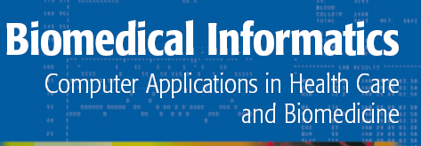


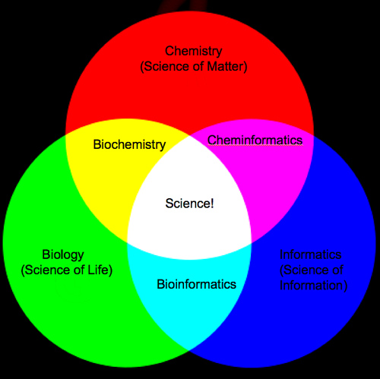

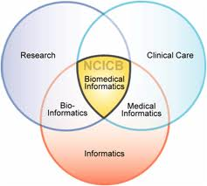
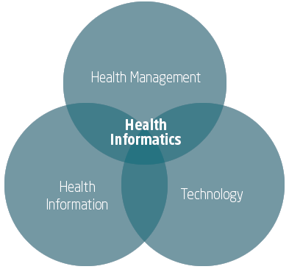
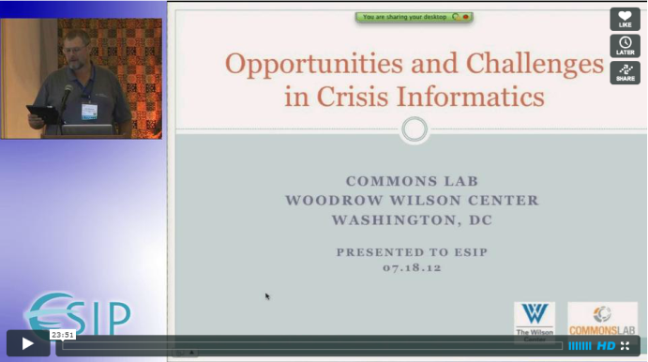
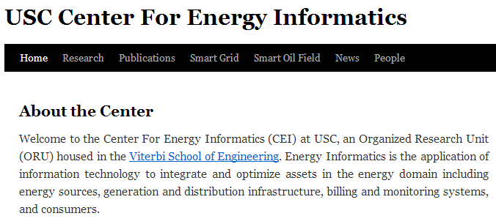
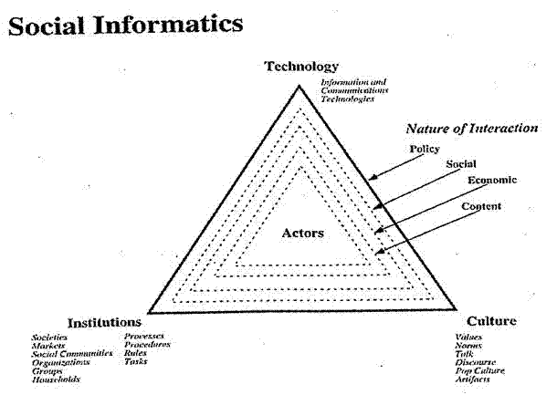


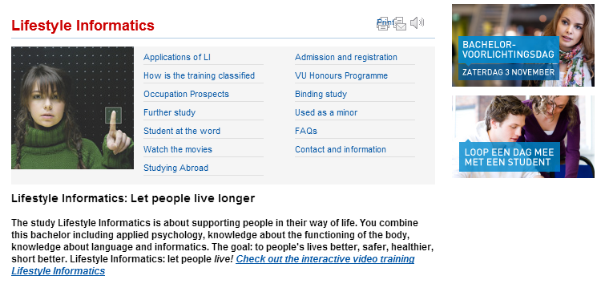



Slide 3
The Course in One Sentence
Study Clouds running Data Analytics processing Big Data to solve problems in X-Informatics

Slide 4
http://saedsayad.com/data_mining_map.htm

Slide 5
http://saedsayad.com/data_mining_map.htm

Slide 6
Web and Document/Text Search
The Problem

Slide 8
Plus the deep Web

Slide 9
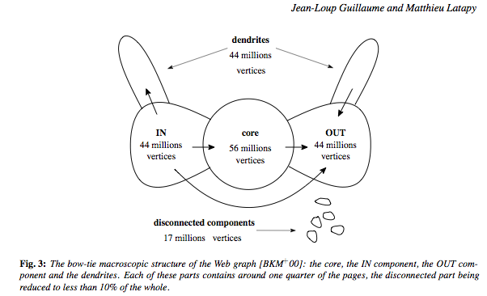

Slide 10
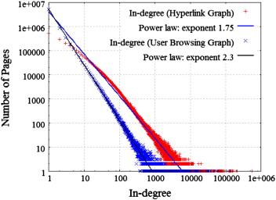
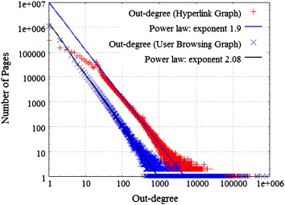
Universal Power Laws for Links
http://www.sciencedirect.com/science/article/pii/S0167923612001844

Slide 12
http://www.ifis.cs.tu-bs.de/teaching/ss-11/irws

Slide 13
DIKW
Data = Raw web pages
Information = Result of Query
Knowledge = Result of processing query results by user
Wisdom = Synthesis of many such actions by a set of users
One possible classification of steps in process

Slide 14
http://www.ifis.cs.tu-bs.de/teaching/ss-11/irws

Slide 15
Keywords v Full Text
Keywords are typically more precise
  Need an ontology (list of possible keywords) but hard to get agreement except on basic things
  See http://www.acm.org/about/class/ccs98-html
Dublin core specifies core document information like Author and Title
Tags tend not to enforce ontology
Full text can be misleading but
Full Text can give information where keywords missing
User can provide additional insight but with keywords you don’t have opportunity!

Slide 16
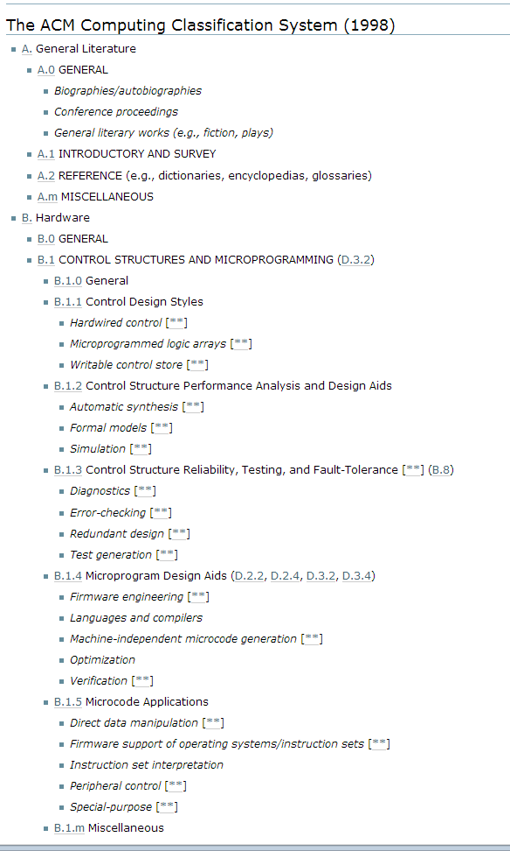
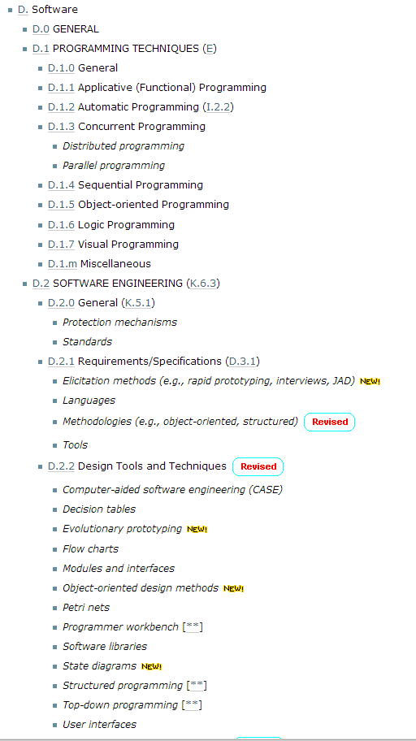

Slide 17
http://www.ifis.cs.tu-bs.de/teaching/ss-11/irws

Slide 18
http://www.ifis.cs.tu-bs.de/teaching/ss-11/irws

Slide 19
Solution in General starting with history

Slide 20
http://www.ifis.cs.tu-bs.de/teaching/ss-11/irws

Slide 21
http://www.ifis.cs.tu-bs.de/teaching/ss-11/irws

Slide 22
http://www.ifis.cs.tu-bs.de/teaching/ss-11/irws

Slide 23
Origin of Semantic Web
http://www.ifis.cs.tu-bs.de/teaching/ss-11/irws

Slide 24
http://www.ifis.cs.tu-bs.de/teaching/ss-11/irws

Slide 25
http://www.ifis.cs.tu-bs.de/teaching/ss-11/irws

Slide 26
http://www.ifis.cs.tu-bs.de/teaching/ss-11/irws

Slide 27
http://www.ifis.cs.tu-bs.de/teaching/ss-11/irws

Slide 28
http://www.ifis.cs.tu-bs.de/teaching/ss-11/irws

Slide 29
http://www.ifis.cs.tu-bs.de/teaching/ss-11/irws

Slide 30
http://www.ifis.cs.tu-bs.de/teaching/ss-11/irws

Slide 31
http://www.ifis.cs.tu-bs.de/teaching/ss-11/irws

Slide 37
http://www.ifis.cs.tu-bs.de/teaching/ss-11/irws

Slide 38
http://www.ifis.cs.tu-bs.de/teaching/ss-11/irws

Slide 40
precision@10 is precision over top 10 ranked documents

Slide 41
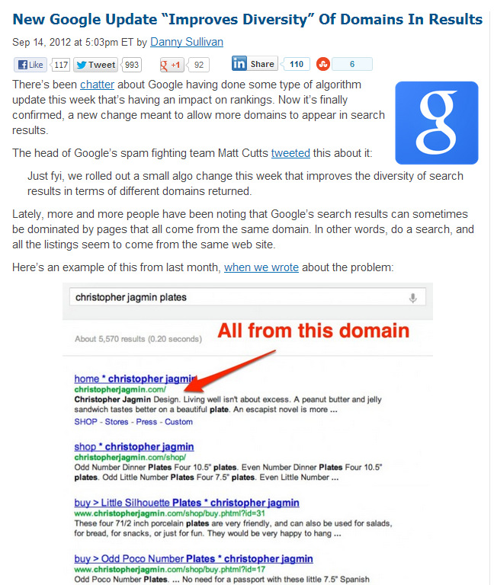
Diversity of Search Results

Slide 42
Information Retrieval (Web Search) Technology

Slide 43
http://www.ifis.cs.tu-bs.de/teaching/ss-11/irws

Slide 44
http://www.ifis.cs.tu-bs.de/teaching/ss-11/irws

Slide 45
http://www.ifis.cs.tu-bs.de/teaching/ss-11/irws

Slide 46
Boolean Query

Slide 48
http://www.ifis.cs.tu-bs.de/teaching/ss-11/irws

Slide 49
http://www.ifis.cs.tu-bs.de/teaching/ss-11/irws

Slide 50
http://www.ifis.cs.tu-bs.de/teaching/ss-11/irws

Slide 51
http://www.ifis.cs.tu-bs.de/teaching/ss-11/irws

Slide 52
http://www.ifis.cs.tu-bs.de/teaching/ss-11/irws

Slide 53
http://www.ifis.cs.tu-bs.de/teaching/ss-11/irws

Slide 54
http://www.ifis.cs.tu-bs.de/teaching/ss-11/irws

Slide 55
http://www.ifis.cs.tu-bs.de/teaching/ss-11/irws

Slide 56
http://www.ifis.cs.tu-bs.de/teaching/ss-11/irws

Slide 57
Fuzzy Index

Slide 58
http://www.ifis.cs.tu-bs.de/teaching/ss-11/irws

Slide 59
http://www.ifis.cs.tu-bs.de/teaching/ss-11/irws

Slide 60
http://www.ifis.cs.tu-bs.de/teaching/ss-11/irws

Slide 61
http://www.ifis.cs.tu-bs.de/teaching/ss-11/irws

Slide 62
http://www.ifis.cs.tu-bs.de/teaching/ss-11/irws

Slide 63
http://www.ifis.cs.tu-bs.de/teaching/ss-11/irws

Slide 64
http://www.ifis.cs.tu-bs.de/teaching/ss-11/irws

Slide 65
Vector Space Model

Slide 67
http://www.ifis.cs.tu-bs.de/teaching/ss-11/irws

Slide 68
http://www.ifis.cs.tu-bs.de/teaching/ss-11/irws

Slide 69
http://www.ifis.cs.tu-bs.de/teaching/ss-11/irws

Slide 70
http://www.ifis.cs.tu-bs.de/teaching/ss-11/irws

Slide 71
http://www.ifis.cs.tu-bs.de/teaching/ss-11/irws

Slide 72
1-distance
http://www.ifis.cs.tu-bs.de/teaching/ss-11/irws

Slide 73
http://www.ifis.cs.tu-bs.de/teaching/ss-11/irws

Slide 74
http://www.ifis.cs.tu-bs.de/teaching/ss-11/irws

Slide 75
http://www.ifis.cs.tu-bs.de/teaching/ss-11/irws

Slide 76
http://www.ifis.cs.tu-bs.de/teaching/ss-11/irws

Slide 77
http://www.ifis.cs.tu-bs.de/teaching/ss-11/irws

Slide 78
http://www.ifis.cs.tu-bs.de/teaching/ss-11/irws

Slide 79
http://www.ifis.cs.tu-bs.de/teaching/ss-11/irws

Slide 80
http://www.ifis.cs.tu-bs.de/teaching/ss-11/irws

Slide 81
http://www.ifis.cs.tu-bs.de/teaching/ss-11/irws

Slide 82
http://www.ifis.cs.tu-bs.de/teaching/ss-11/irws

Slide 83
http://www.ifis.cs.tu-bs.de/teaching/ss-11/irws

Slide 84
http://www.ifis.cs.tu-bs.de/teaching/ss-11/irws

Slide 85
http://www.ifis.cs.tu-bs.de/teaching/ss-11/irws

Slide 86
Probabilistic Models

Slide 88
http://www.ifis.cs.tu-bs.de/teaching/ss-11/irws

Slide 89
http://www.ifis.cs.tu-bs.de/teaching/ss-11/irws

Slide 90
http://www.ifis.cs.tu-bs.de/teaching/ss-11/irws

Slide 91
http://www.ifis.cs.tu-bs.de/teaching/ss-11/irws

Slide 92
http://www.ifis.cs.tu-bs.de/teaching/ss-11/irws

Slide 93
http://www.ifis.cs.tu-bs.de/teaching/ss-11/irws

Slide 94
http://www.ifis.cs.tu-bs.de/teaching/ss-11/irws

Slide 95
http://www.ifis.cs.tu-bs.de/teaching/ss-11/irws

Slide 96
http://www.ifis.cs.tu-bs.de/teaching/ss-11/irws

Slide 97
http://www.ifis.cs.tu-bs.de/teaching/ss-11/irws

Slide 98
http://www.ifis.cs.tu-bs.de/teaching/ss-11/irws

Slide 99
http://www.ifis.cs.tu-bs.de/teaching/ss-11/irws

Slide 100
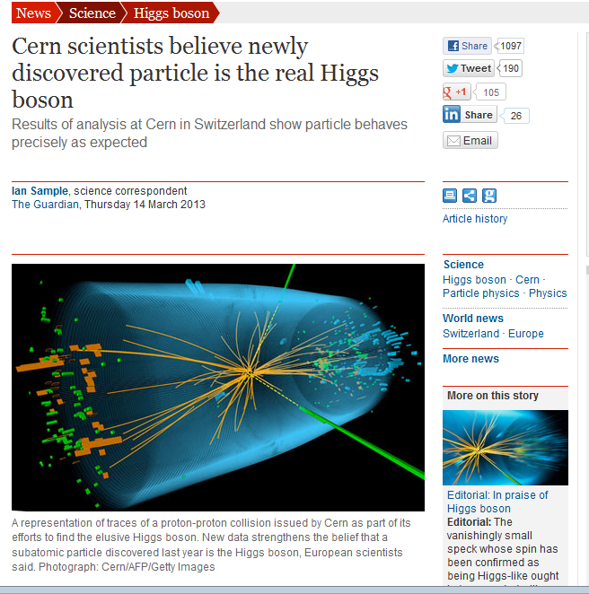
Bayes is most useful
Only do a Physics experiment once
Read recent news about “Belief in Higgs increasing”
Not about frequency of experiments seeing Higgs

Slide 101
http://www.ifis.cs.tu-bs.de/teaching/ss-11/irws

Slide 102
for Probability Methods
http://www.ifis.cs.tu-bs.de/teaching/ss-11/irws

