Slide 1
X-Informatics
Web Search; Text Mining B
2013
Geoffrey Fox
gcf@indiana.edu
http://www.infomall.org/X-InformaticsSpring2013/index.html
Associate Dean for Research and Graduate Studies, School of Informatics and Computing
Indiana University Bloomington
2013

Slide 2




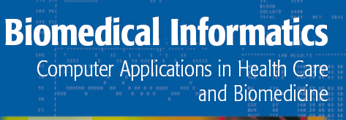


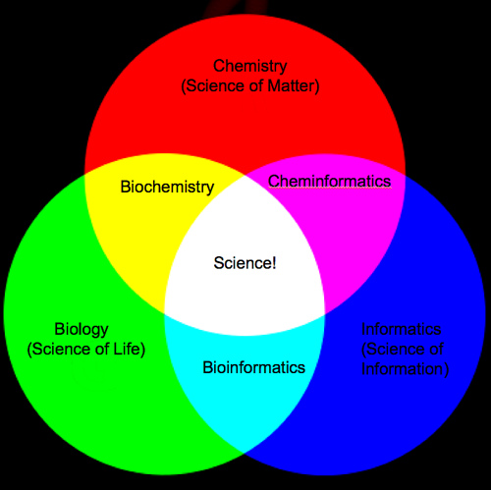
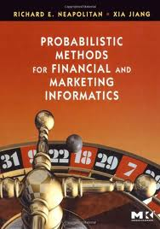
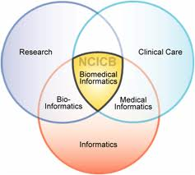

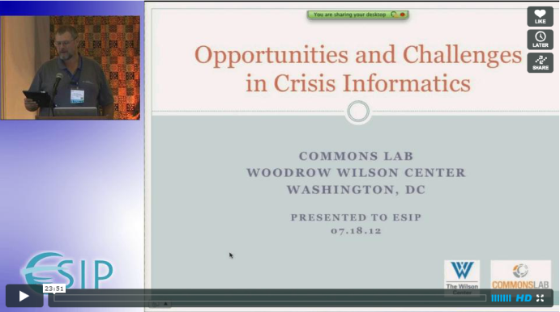
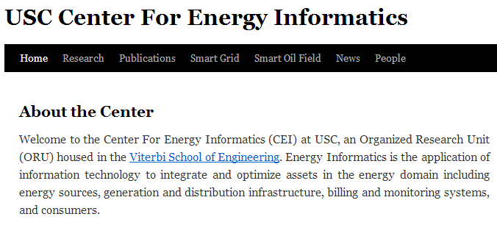
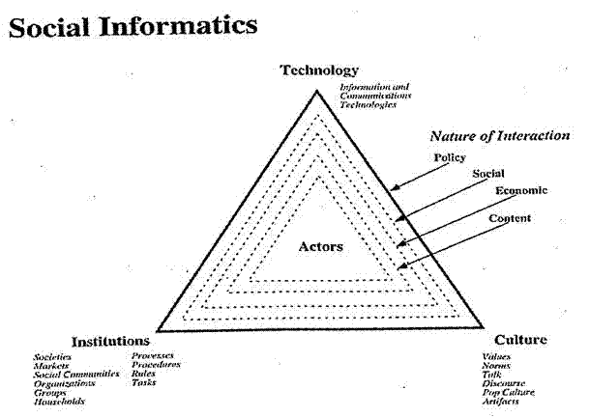


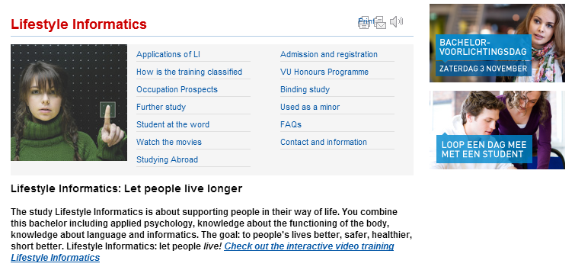



Slide 3
The Course in One Sentence
Study Clouds running Data Analytics processing Big Data to solve problems in X-Informatics

Slide 4
Document Preparation

Slide 5
http://www.ifis.cs.tu-bs.de/teaching/ss-11/irws

Slide 6
http://www.ifis.cs.tu-bs.de/teaching/ss-11/irws

Slide 7
http://www.ifis.cs.tu-bs.de/teaching/ss-11/irws

Slide 8
http://www.ifis.cs.tu-bs.de/teaching/ss-11/irws

Slide 9
http://www.ifis.cs.tu-bs.de/teaching/ss-11/irws

Slide 10
http://www.ifis.cs.tu-bs.de/teaching/ss-11/irws

Slide 11
http://www.ifis.cs.tu-bs.de/teaching/ss-11/irws

Slide 12
http://www.ifis.cs.tu-bs.de/teaching/ss-11/irws

Slide 13
http://www.ifis.cs.tu-bs.de/teaching/ss-11/irws

Slide 14
http://www.ifis.cs.tu-bs.de/teaching/ss-11/irws

Slide 15
Inverted Index

Slide 18
http://www.ifis.cs.tu-bs.de/teaching/ss-11/irws

Slide 19
http://www.ifis.cs.tu-bs.de/teaching/ss-11/irws

Slide 20
Index Construction

Slide 21
http://www.ifis.cs.tu-bs.de/teaching/ss-11/irws

Slide 22
http://www.ifis.cs.tu-bs.de/teaching/ss-11/irws

Slide 23
Then sort by termID and then docID
http://www.ifis.cs.tu-bs.de/teaching/ss-11/irws

Slide 24
http://www.ifis.cs.tu-bs.de/teaching/ss-11/irws

Slide 25
http://www.ifis.cs.tu-bs.de/teaching/ss-11/irws

Slide 26
http://www.ifis.cs.tu-bs.de/teaching/ss-11/irws

Slide 27
Query Structure and Processing

Slide 31
http://www.ifis.cs.tu-bs.de/teaching/ss-11/irws

Slide 32
http://www.ifis.cs.tu-bs.de/teaching/ss-11/irws

Slide 33
http://www.ifis.cs.tu-bs.de/teaching/ss-11/irws

Slide 34
Link Structure Analysis including PageRank

Slide 37
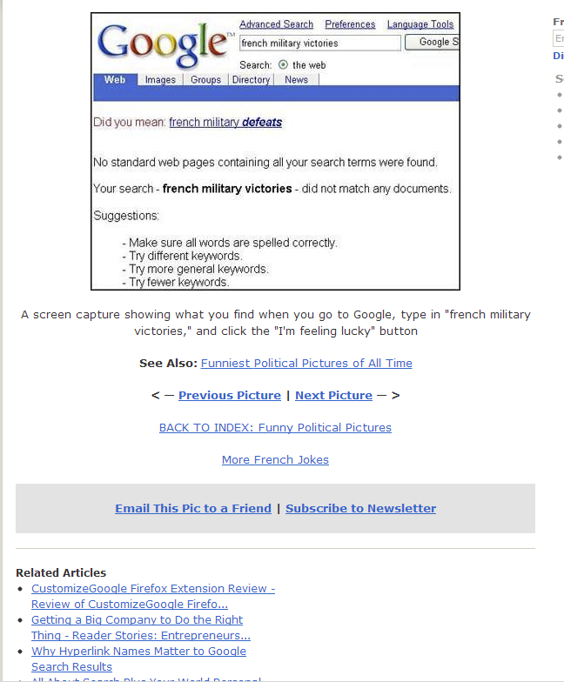

Slide 44
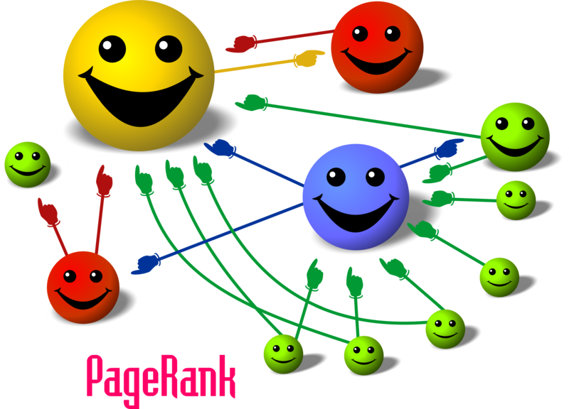
Size of face proportional to PageRank

Slide 45
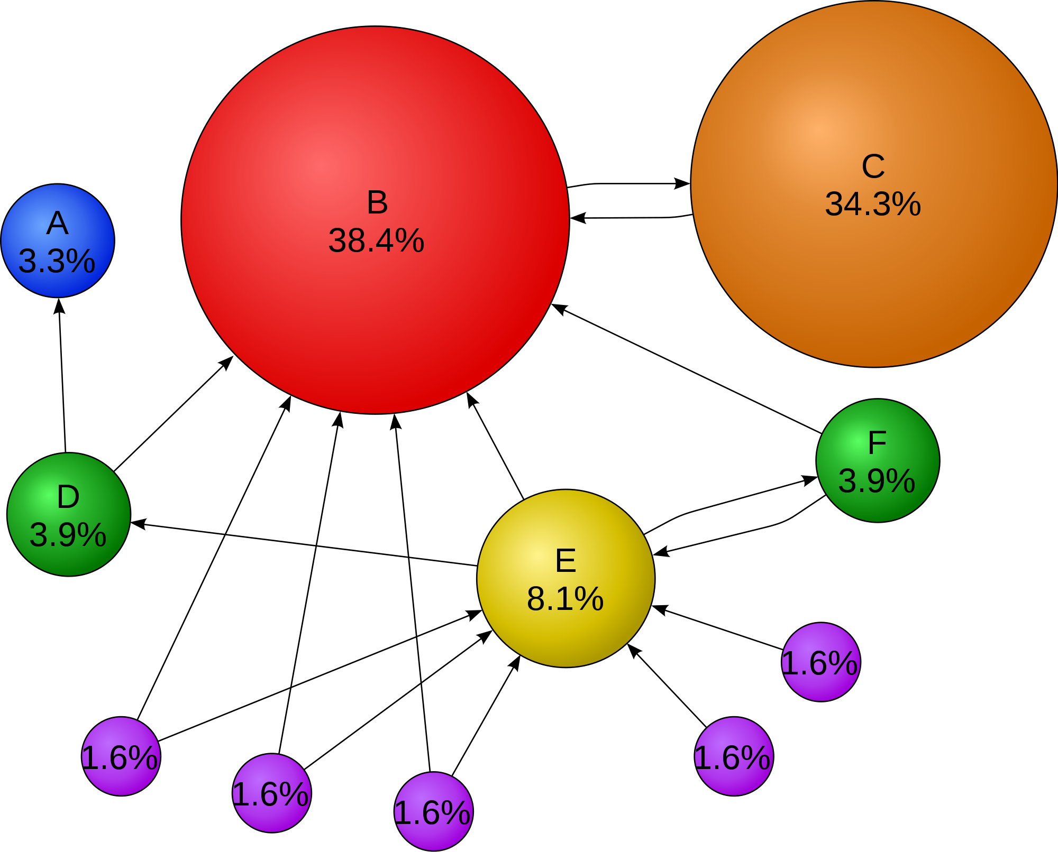
PageRank d=0.85

Slide 46
d = 0.85

Slide 47
PageRank
PageRank is probability that Page will be visited by a surfer is clicks each link on page with equal probability
  minor corrections for pages with no outgoing links
Found Iteratively with each page getting at each iteration a contribution equal to its page rank divided by #Links on page
PR(Page i) = Σ_{Page j pointing at I} PR(Page j)/(Number of Pages linked on Page j)
One adds to this the chance 1-d that surfer types a random URL into web browser.
That takes PageRank to d times above plus (1 - d) divided by total number of pages on web
On general principles, this will converge whatever the starting point
  It can be written as iterative matrix multiplication

Slide 48
Related Applications
Thinking of Page Rank as reputation
A version of PageRank has recently been proposed as a replacement for the traditional Institute for Scientific Information (ISI) impact factor, and implemented at eigenfactor.org. Instead of merely counting total citation to a journal, the "importance" of each citation is determined in a PageRank fashion.
  Impact Factor is number of citations of each article
  The Eigenfactor score of a journal is an estimate of the percentage of time that library users spend with that journal. The Eigenfactor algorithm corresponds to a simple model of research in which readers follow chains of citations as they move from journal to journal.
A similar new use of PageRank is to rank academic doctoral programs based on their records of placing their graduates in faculty positions. In PageRank terms, academic departments link to each other by hiring their faculty from each other (and from themselves).

Slide 49
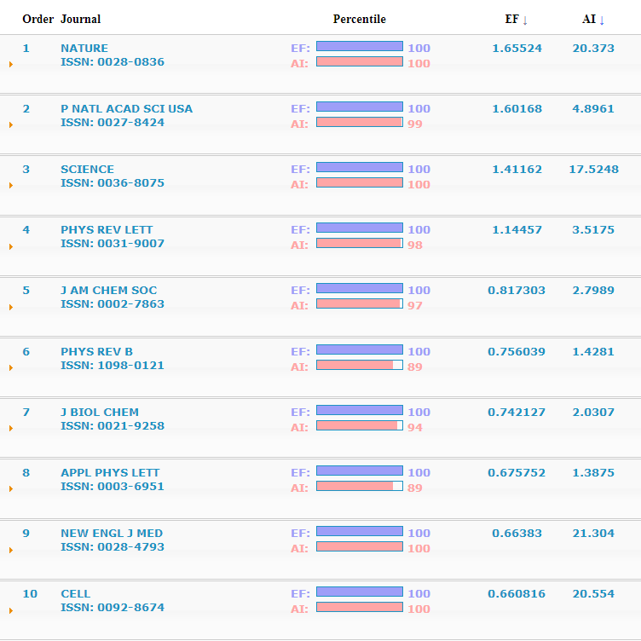
EF= Eigenfactor
AI = Article Influence over the first five years after publication
Eigenfactor scores are scaled so that the sum of the Eigenfactor scores of all journals listed in Thomson's Journal Citation Reports (JCR) is 100
Article Influence scores are normalized so that the mean article in the entire Thomson Journal Citation Reports database has an article influence of 1.00

Slide 50
None done here!

Slide 52
Summary Issues

Slide 57
Crawling the Web

Slide 61
Web Advertising and Search

Slide 69
CS236621 Technion

Slide 70
Clustering and Topics

Slide 71
Grouping Documents Together
The responses to a search query give you a group documents
If we represent documents as points in a space, we can try to identify regions
  Clustering: Nearby regions of points
  Support Vector Machine: Chop space up into parts
  (Gaussian) Mixture Models: A type of fuzzy clustering
  K-Nearest Neighbors (if have examples)
Alternatively we can determine “hidden meaning” with a topic model
  Latent Semantic Indexing
  Latent Dirichlet Allocation
  With lots of variants of these methods to find “latent factors”

Slide 72
Topic Models
Illustrated by Google News
These try to group documents by Topics such as “Presidential Election” and not by inclusion of particular phrases
You imagine each document is a set of topics (the latent factors) and each topic is a bag of words.
Find the best set of topics and best set of words in topics

Slide 73
A Latent Factor Finding Method
http://www.ifis.cs.tu-bs.de/teaching/ss-11/irws

Slide 74
An example of DA-PLSA
Top 10 popular words of the AP news dataset for 30 topics. Processed by DA-PLSI and showing only 5 topics among 30 topics

