Slide 1
Radar Informatics
(with application to glaciology)
Jerome E. Mitchell
School of Informatics and Computing

Slide 2
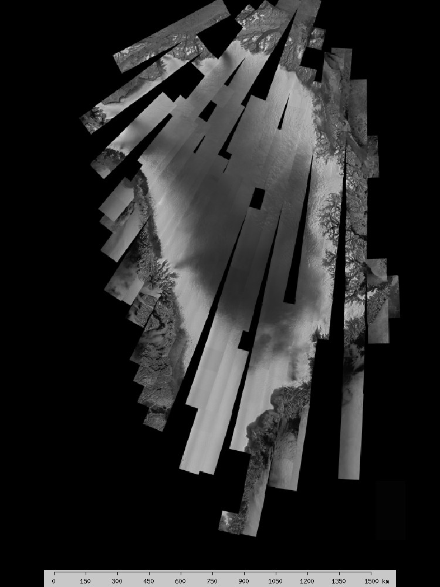
1992

Slide 3
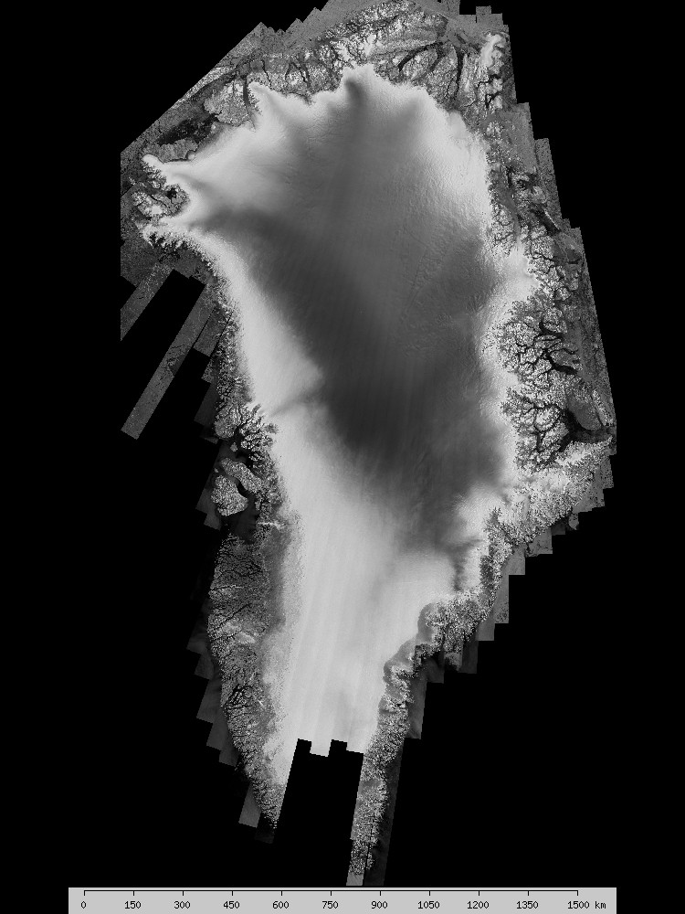
2000

Slide 4
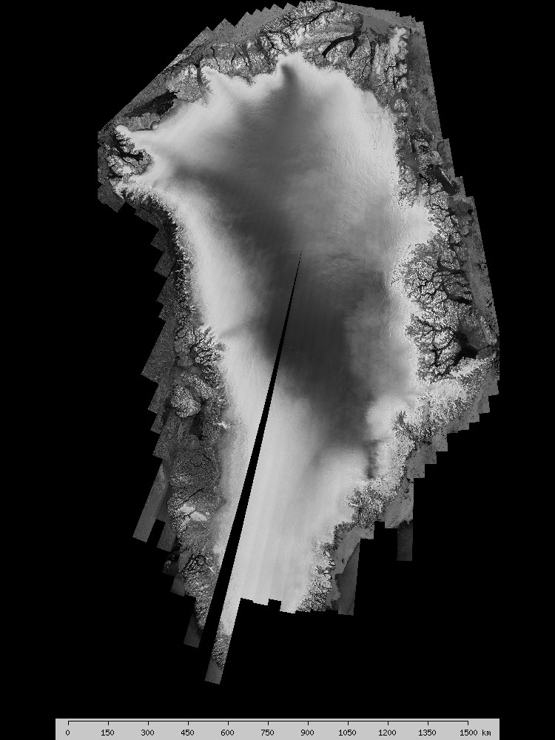
2005

Slide 5
Outline
Background – Remote Sensing
Background – Global Climate Change
Radar Overview
  Radar Basics
Ice Sheet Science
What Are We Doing?
How Are We Doing It?

Slide 6
Outline
Background – Remote Sensing
Background – Global Climate Change
Radar Overview
  Radar Basics
Ice Sheet Science
What Are We Doing?
How Are We Doing It?

Slide 7
What is Remote Sensing?
Remote Sensing is the art and science of
  Acquiring
  Processing and
  Interpreting
Images and related data obtained from ground-based, air or space-borne instruments, which record the interaction between a target and electromagnetic radiation

Slide 8
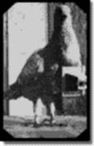
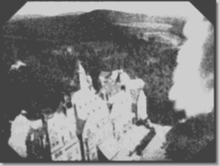
History of Remote Sensing
1903 - The Bavarian Pigeon Corps
1909 - Dresden International
Photographic Exhibition

Slide 9
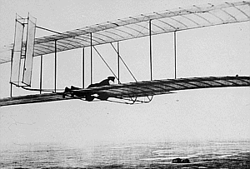
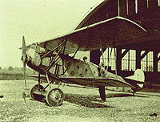
History of Remote Sensing
1908 - First photos from an airplane
1914-1918 - World War I
First flight, Wright Bros., Dec. 1903

Slide 10
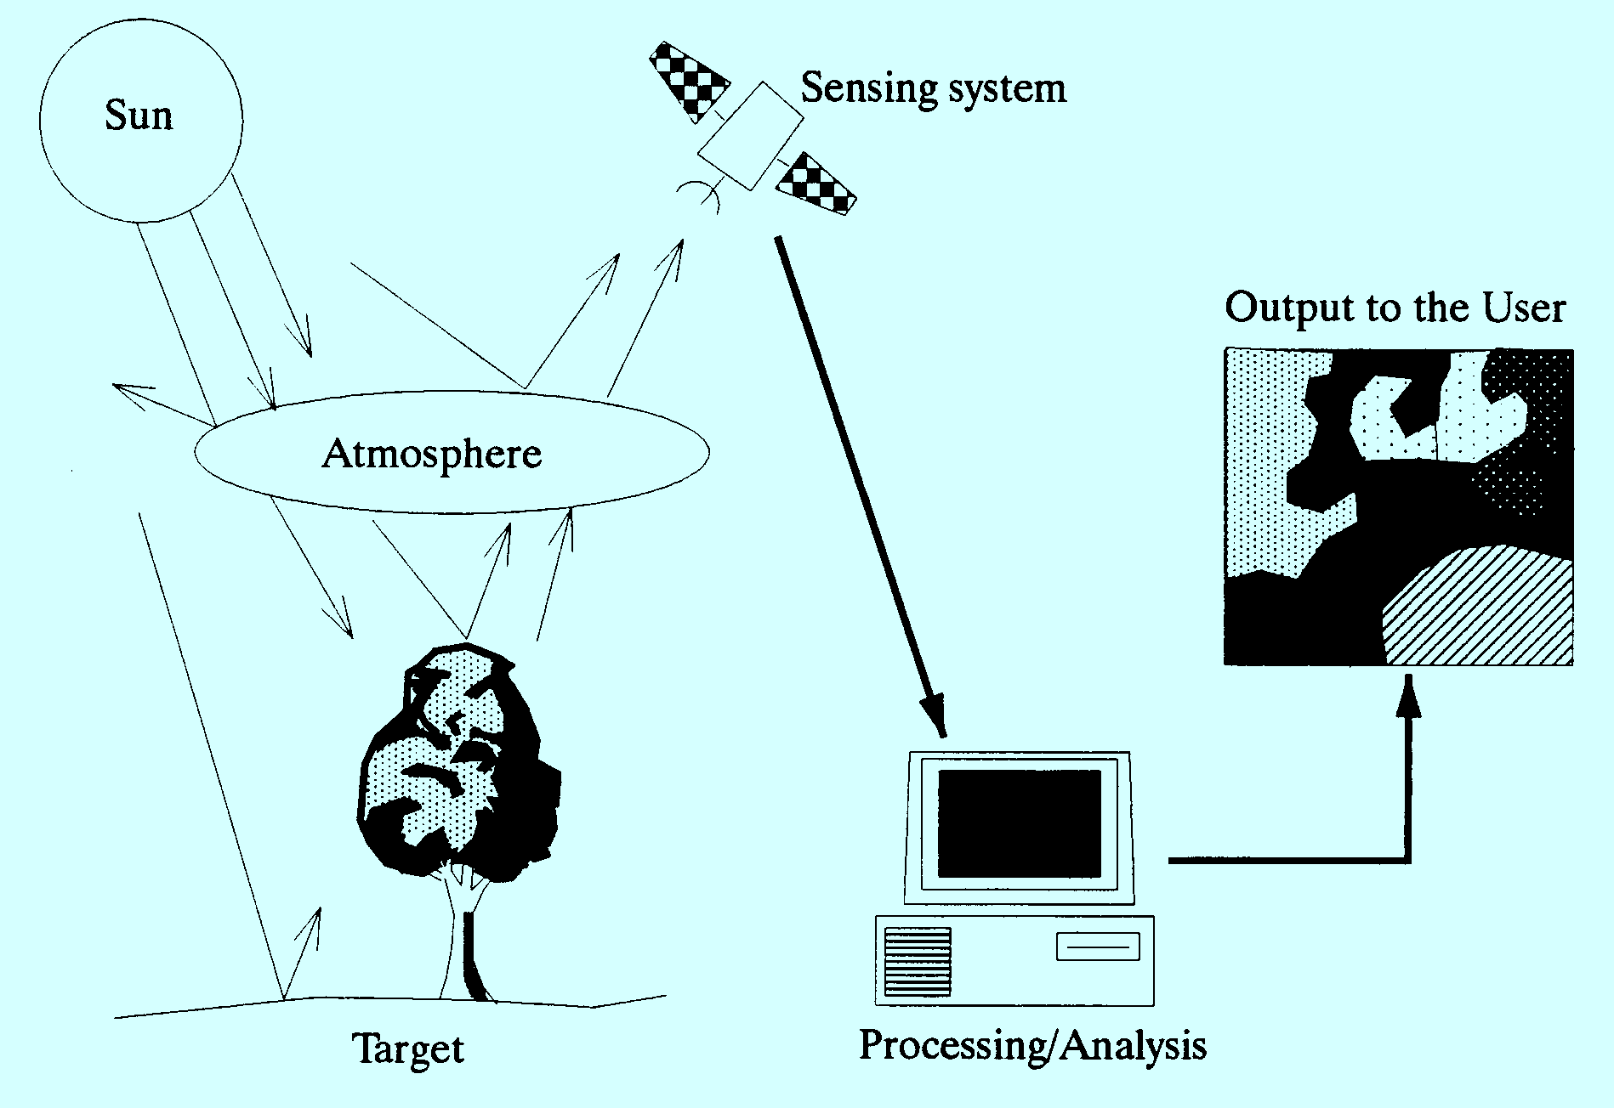
What is Remote Sensing?

Slide 11
Types of Remote Sensing
Passive: uses natural energy, either reflected sunlight (solar energy) or emitted thermal or microwave radiation.
Active: sensor creates its own energy
  Transmitted toward Earth or other targets
  Interacts with atmosphere and/or surface
  Reflects back toward sensor (backscatter)
  Advantages: all weathers and all times

Slide 12
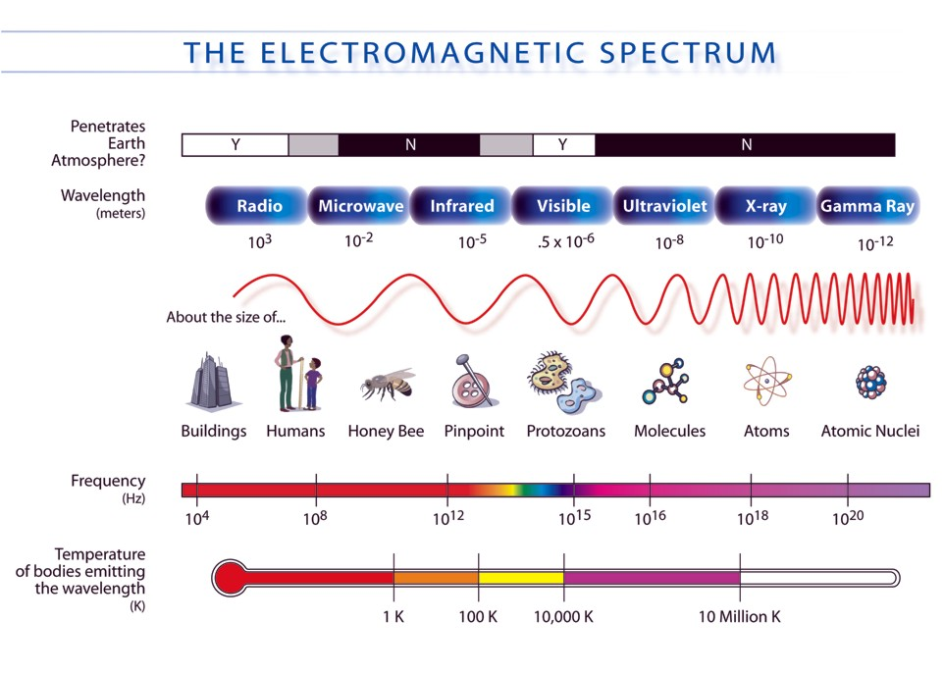

Slide 13
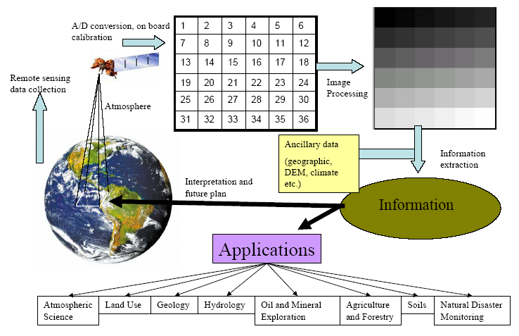
Remote Sensing Process

Slide 14
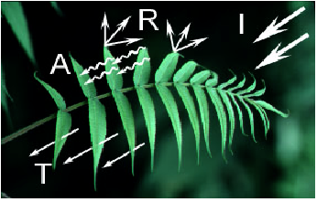
Radiation – Target Interactions

Slide 15
Remote Sensing Applications
Land-Use Mapping
Forest and Agriculture
Telecommunication Planning
Environmental
Hydrology and Coastal Mapping
Urban Planning
Emergencies and Hazards
Global Change and Meteorology

Slide 16
Outline
Background – Remote Sensing
Background – Global Climate Change
Radar Overview
  Radar Basics
Ice Sheet Science
What Are We Doing?
How Are We Doing It?

Slide 17
What have you heard?

Slide 18






Global warming causing new evolutionary patterns
EXAGGERATED SCIENCE
How Global Warming Research is Creating a Climate of Fear
Global warming could burn insurers
Activists call on industry to act
Seattle mayors' meeting a cozy climate for business
In a Shift, White House Cites Global Warming as a Problem
Research Links Global Warming to Wildfires
Is Global Warming Fueling Katrina?
Rise in wild fires a result
of climate change
Seattle reports milestone in cutting emissions
Jellyfish creature the answer to global warming?
www.Scienceblog.com
How one number touched off big climate-change fight at UW
Notes:
Arctic ice!

Slide 19
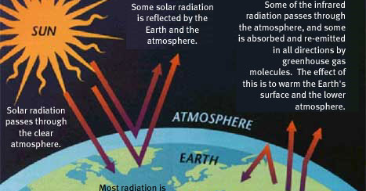
Global Climate…

Slide 20
Background
Sea-level rise resulting from the changing global climate is expected to directly impact many millions of people living in low-lying coastal regions.
Accelerated discharge from polar outlet glaciers is unpredictable and represents a significant threat.
Predictive models of ice sheet behavior require knowledge of the bed conditions, specifically basal topography and whether the bed is frozen or wet

Slide 21
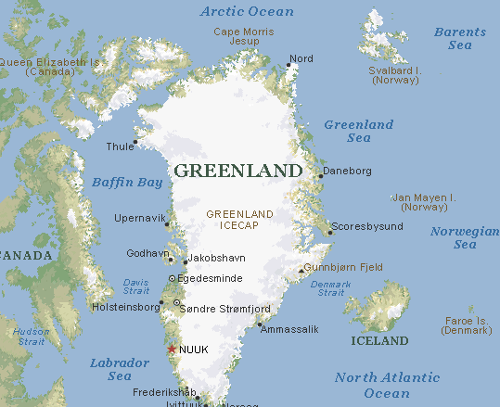
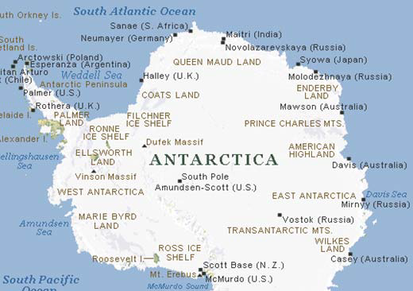
Ice Sheet and Sea Level
Greenland: 1.8 x 10⁶ km² area
(enough water to raise sea level about 7 meters)
Antarctica: 1.3 x 10⁷ km² area
(enough water to raise sea level about 60 meters)

Slide 22
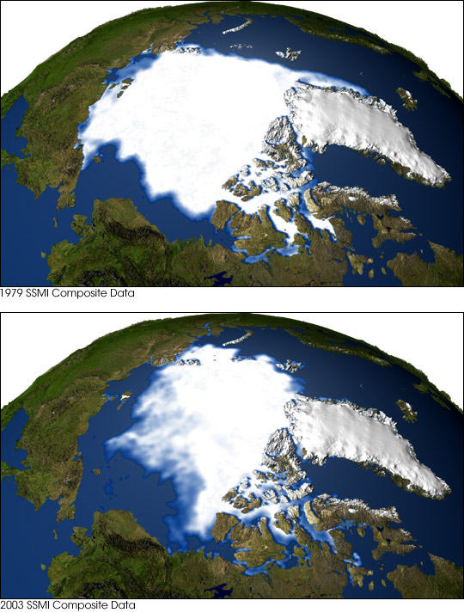
Disappearing Arctic Sea Ice
Summer 1979
Summer 2003

Slide 23
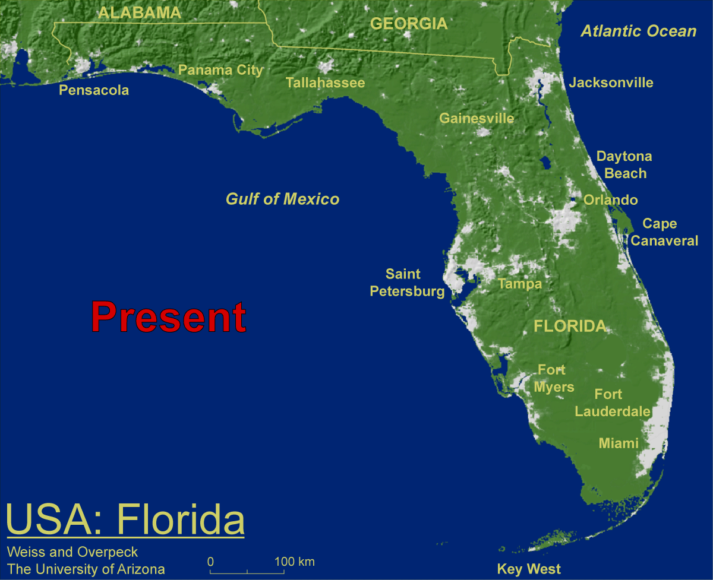
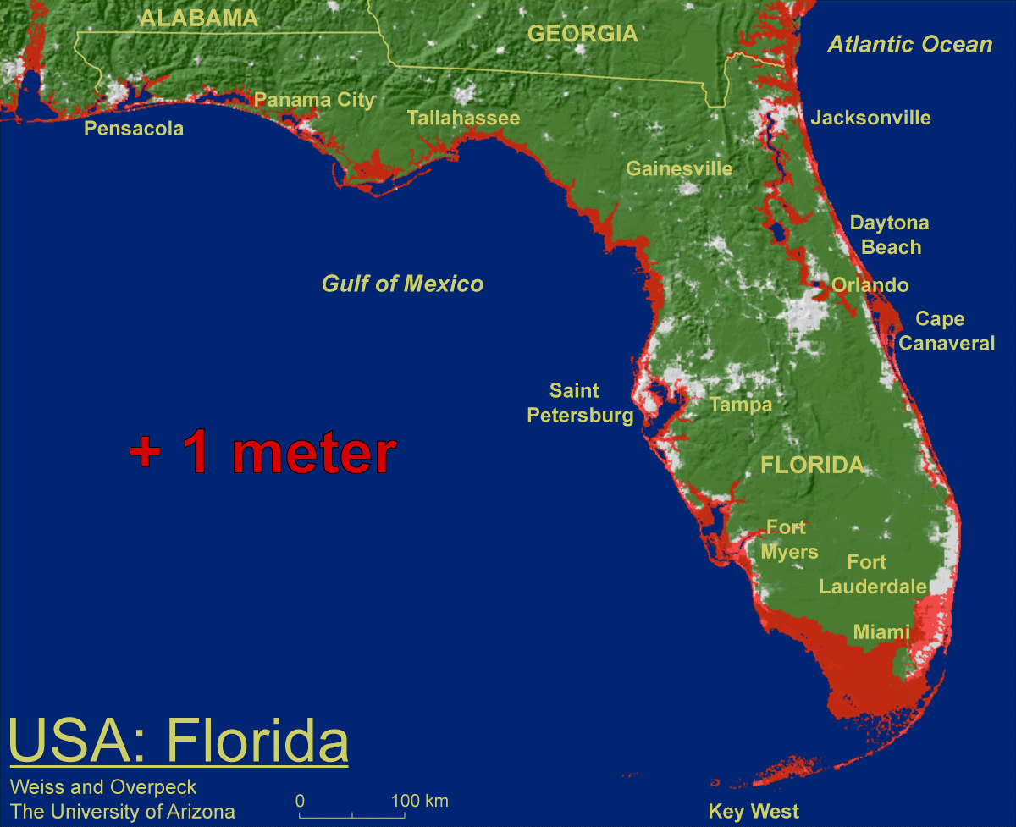
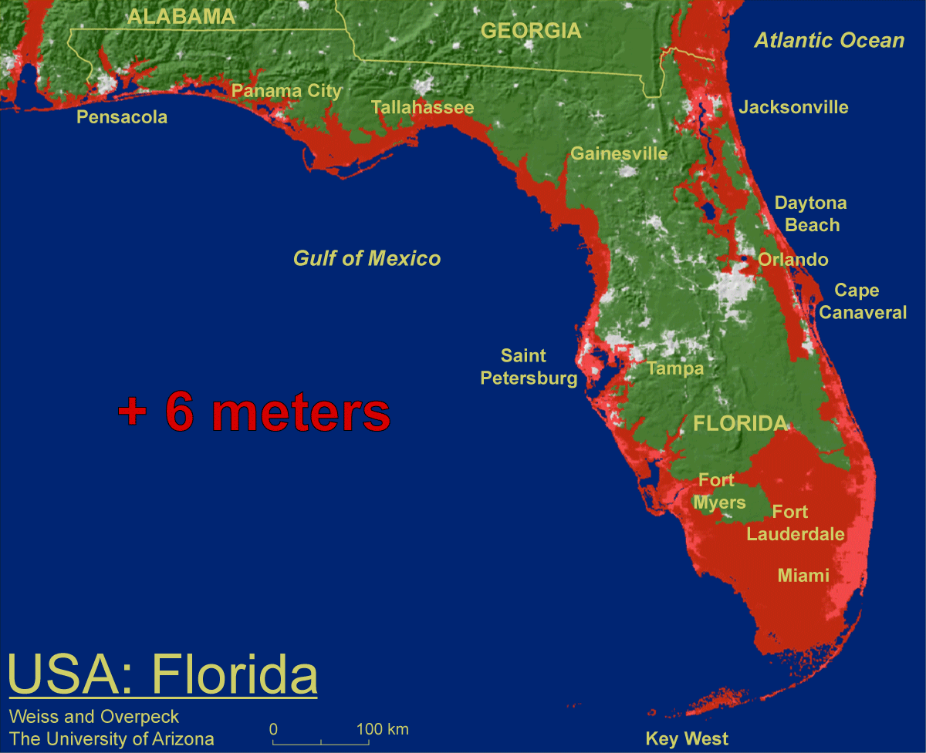
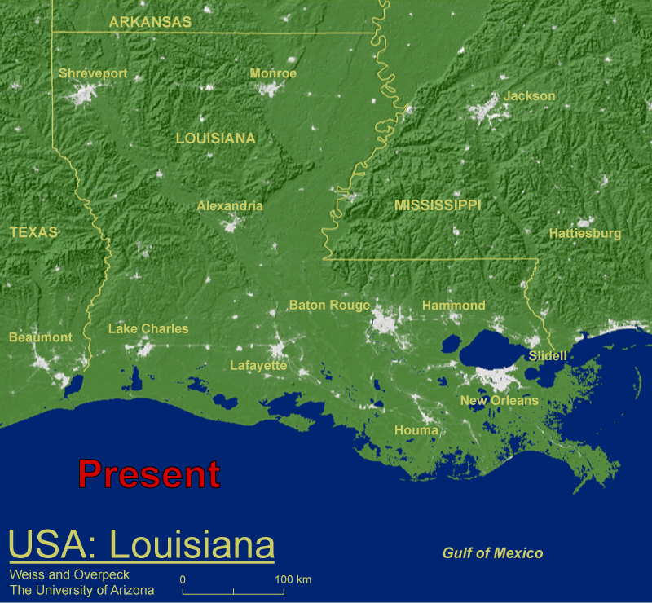
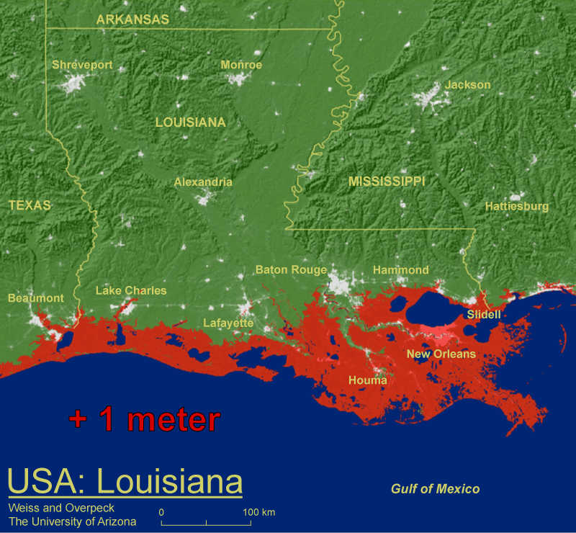
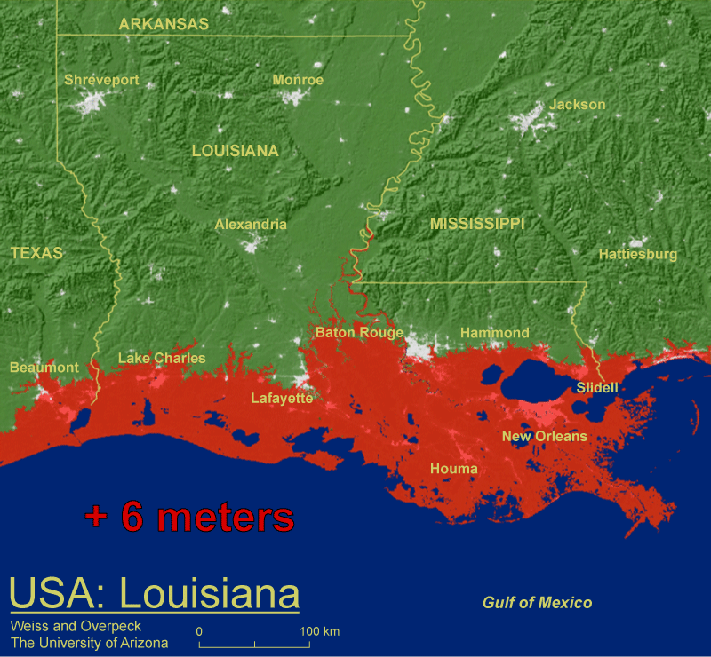
Why Measure Sea Level Rise

Slide 24
Background – Remote Sensing
Background – Global Climate Change
Radar Overview
  Radar Basics
Ice Sheet Science
What Are We Doing?
How Are We Doing It?

Slide 25
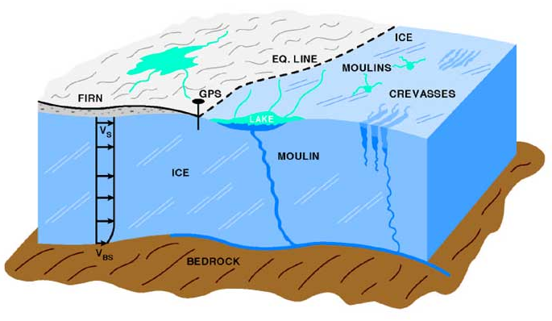
Ice melt flows down to bedrock through crevasses and moulins
Water between bedrock and ice sheet acts as lubricant
Allows ice sheet to move faster toward the coastline

Slide 26
Outline
Background – Remote Sensing
Background – Global Climate Change
Radar Overview
  Radar Basics
Ice Sheet Science
What Are We Doing?
How Are We Doing It?

Slide 27
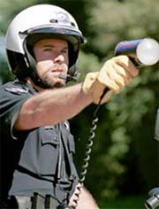
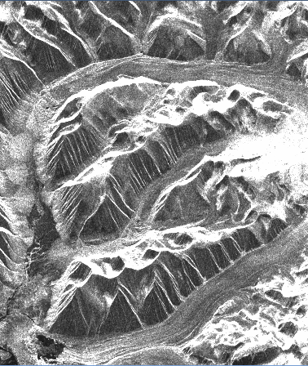
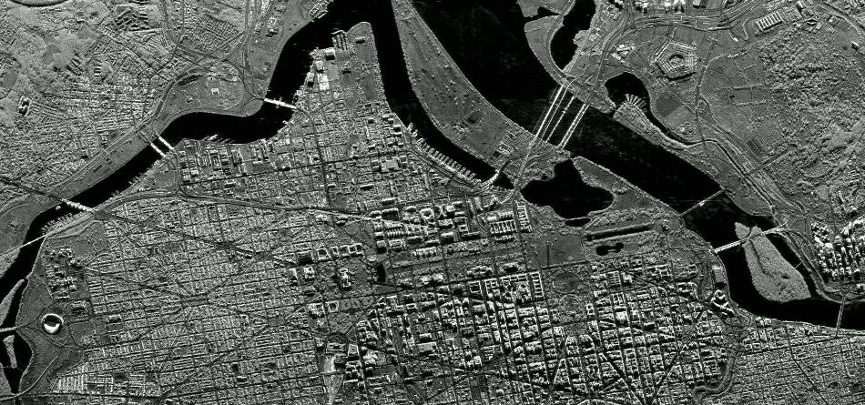
A Brief Overview of Radar
various classes of operation
  Pulsed vs. continuous wave (CW)
measurement capabilities
  Detection, Ranging
  Position (range and direction), Radial velocity (Doppler)
  Target characteristics
Notes:
Pulsed

Slide 28
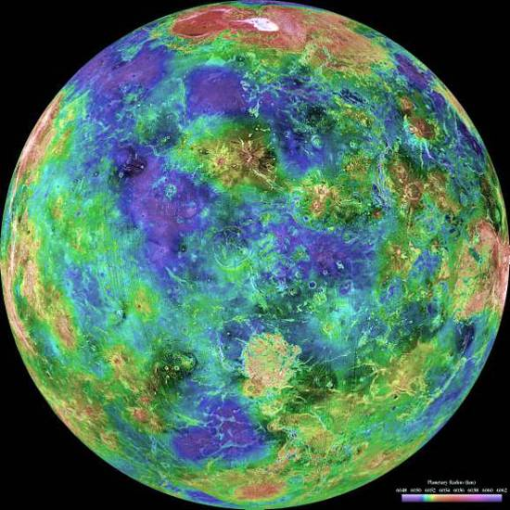
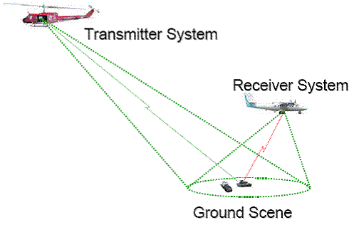
A Brief Overview of Radar
active sensor
  Provides its own illumination
    Operates in day and night
    Largely immune to smoke, haze, fog, rain, snow, …
  Involves both a transmitter and a receiver
Related technologies are purely passive
  Radio astronomy, radiometers
Configurations
  monostatic
    transmitter and receiver co-located
  bistatic
    transmitter and receiver separated
  multistatic
    multiple transmitters and/or receivers
  passive
    exploits non-cooperative illuminator

Slide 29
A Brief Overview of Radar
radar – radio detection and ranging
developed in the early 1900s (pre-World War II)
  1904 Europeans demonstrated use for detecting ships in fog
  1922 U.S. Navy Research Laboratory (NRL) detected wooden ship on Potomac River
  1930 NRL engineers detected an aircraft with simple radar system
world war II accelerated radar’s development
  Radar had a significant impact militarily
  Called “The Invention That Changed The World” in two books by Robert Buderi
radar’s has deep military roots
  it continues to be important militarily
  growing number of civil applications
  objects often called ‘targets’ even civil applications

Slide 31
Active Remote Sensing
• Active microwave (RADAR)
• LIDAR
• SONAR

Slide 32
Types of Radars
NonImaging radar
  doppler radar system
  determine the speed by measuring frequency shift between transmitted and return microwave signal
Imaging radar
  High spatial resolution
  consists of a transmitter, a receiver, one or more antennas, GPS, computers

Slide 33

How Radars Work – The Short Answer
an electromagnetic wave is transmitted by the radar
some of the energy is scattered when it hits a distance
a small portion of the scattered energy is collected by the radar antenna

Slide 34
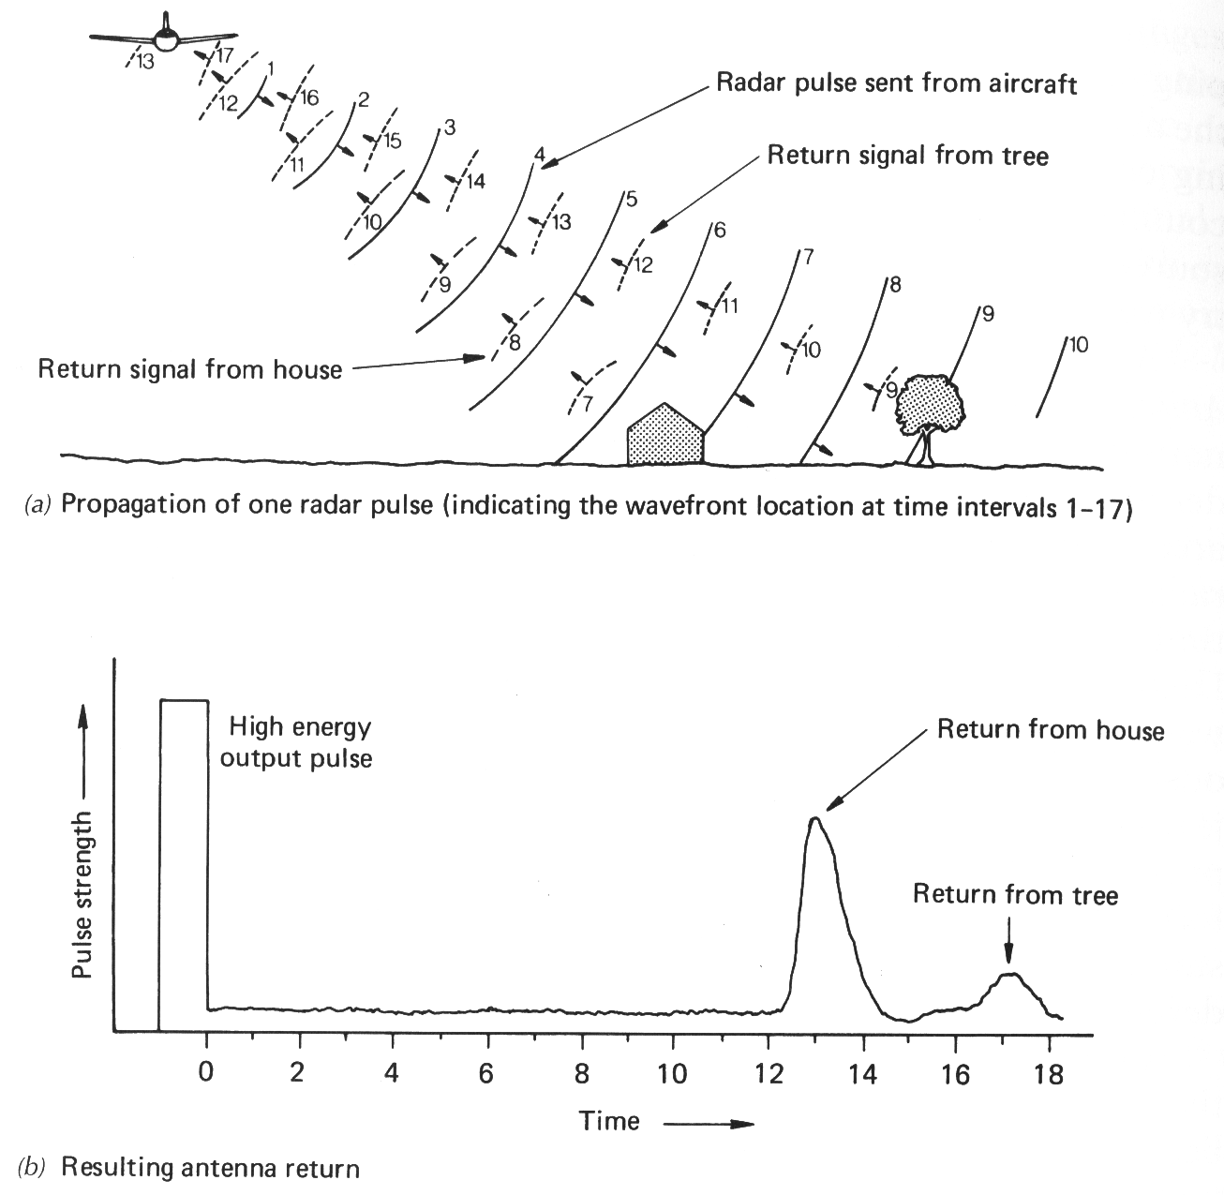

Slide 35
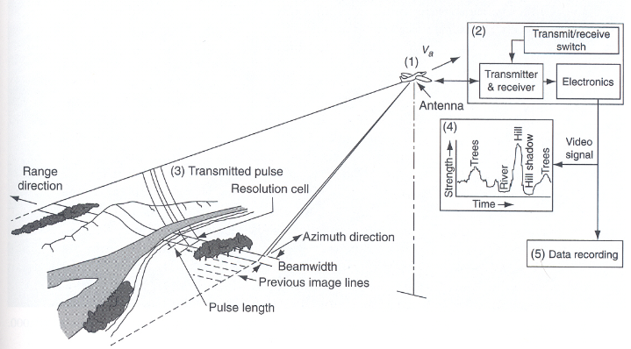
Side-Looking Radar System Operation

Slide 36
Block Diagram of Radar System

Slide 37
Background – Remote Sensing
Background – Global Climate Change
Radar Overview
  Radar Basics
Ice Sheet Science
What Are We Doing?
How Are We Doing It?

Slide 38
Radar Sensors
Instrument | Measurement | Freq./ Wavelength | BW/ Res. | Depth | Power | Altitude | Antenna | Installs
Temperate Ice Depth Sounder | Ice Thickness | 7 MHz 14 MHz 35 MHz | 1 MHz | 2 km | 10 W | In-Situ | Dipole | In-situ/ airborne
MCoRDS/I Radar Depth Sounder | Ice Thickness Int. Layering Bed Properties | 195 MHz 1.5 m | 30 MHz 4 m in ice | 4 km | 800 W | 30000 ft | Dipole Array Wing Mount Fuselage | Twin-Otter P-3 DC-8
Accum. Radar (UHF) | Internal Layering Ice Thickness | 750 MHz 40 cm | 300 MHz ~50 cm | 300 m | 10 W | 1500 ft | Patch Array Vivaldi Array | Twin-Otter P-3
Snow Radar (UWB) | Snow Cover Topography Layering | 5 GHz 7.5 cm | 6 GHz 4 cm | 80 m | 200 mW | 30000 ft | Horn | P-3 DC-8
Ku-Band (UWB) | Topography Layering | 15 GHz 2 cm | 6 GHz 4 cm | 15 m | 200 mW | 30000 ft | Horn | Twin-Otter DC-8

Slide 39
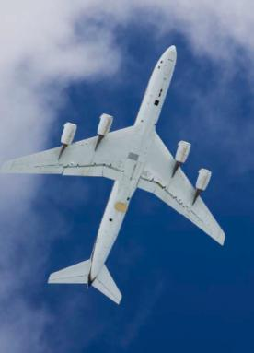
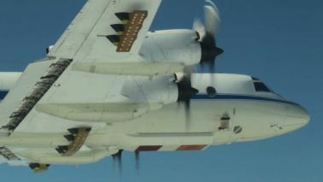
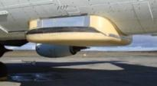
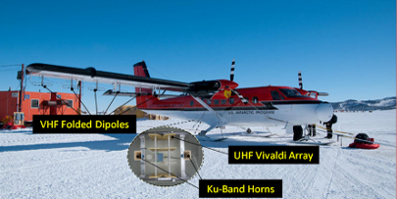
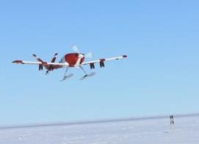
Radars on A Variety of Platforms
NASA DC-8
NASA P-3
  Twin-Otter
UAV’s

Slide 40
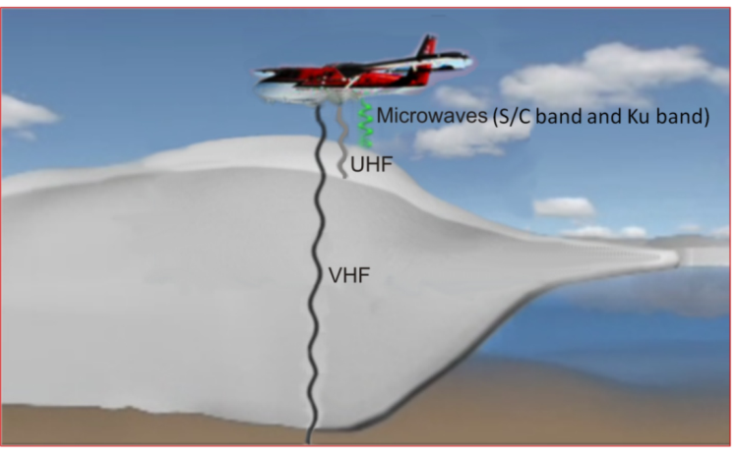
Our Radars
Radars covering frequencies from 7 MHz to 18 GHz
High-frequency radars provide very fine resolution at the surface and
progressing to coarser resolution with deeper sounding capabilities at lower frequencies.

Slide 41
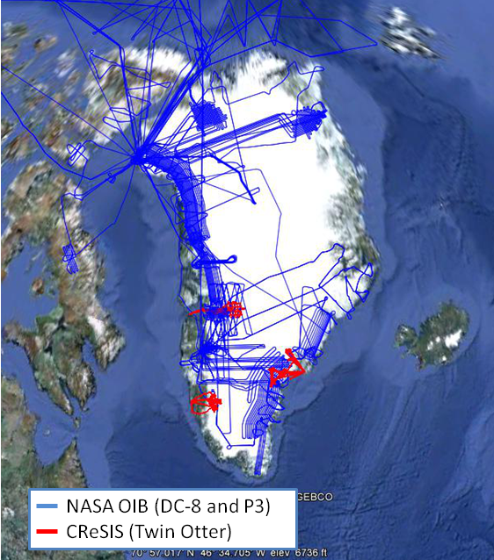
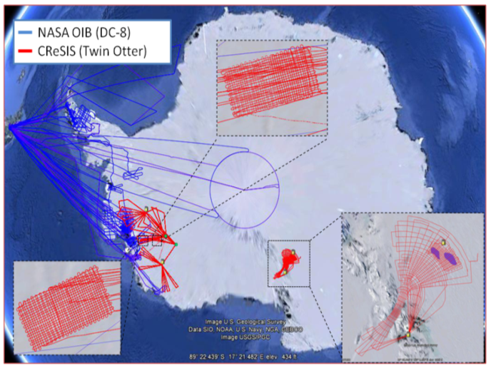
Survey Regions

Slide 42
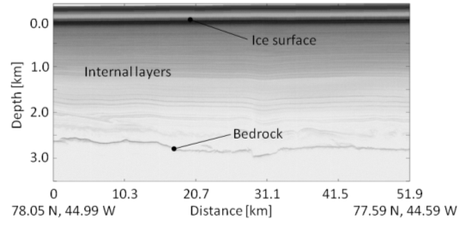

Slide 43
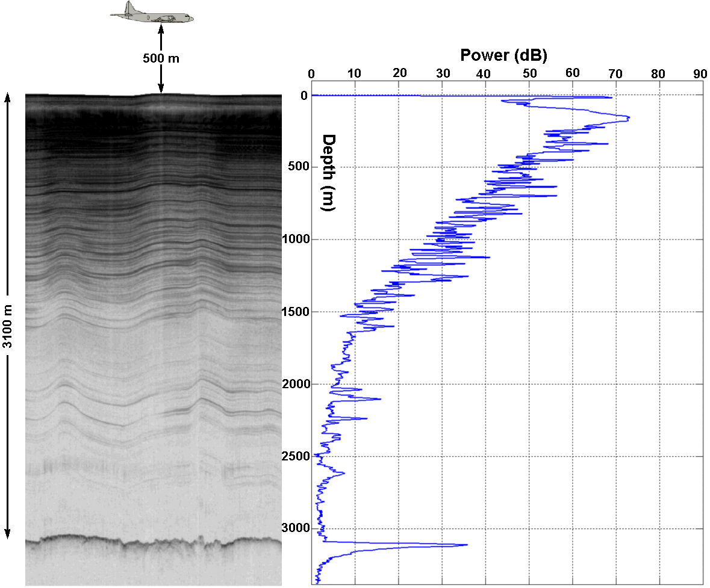

Slide 44
Outline
Background – Remote Sensing
Background – Global Climate Change
Radar Overview
  Radar Basics
Ice Sheet Science
What Are We Doing?
How Are We Doing It?

Slide 45
The Data Deluge
Expect massive increases in amount of data being collected in several diverse fields over the next few years:
  Astronomy - Massive sky surveys
  Biology - Genome databases etc.
  Earth Observing!
  Digitisation of paper, film, tape records etc to create Digital Libraries, Museums . . .
  Particle Physics - Large Hadron Collider
  . . .
  1PByte ~1000 TBytes ~ 1M GBytes ~ 1.4M CDs
  [Petabyte Terabyte Gigabyte]

Slide 46
Challenges of Processing Radar Imagery
Automated processing and extraction of high level information from radar imagery is challenging.
Noise is usually electromagnetic interference from other onboard electronics.
Low magnitude, faint, or non-existent bedrock reflections occur:
  Specific radar settings
  Rough surface/bed topography
  Presence of water on top/internal to the ice sheet.
This produces gaps in the bedrock reflection layer which must be connected to construct an adjacent layer for the completion of ice thickness estimation.

Slide 47
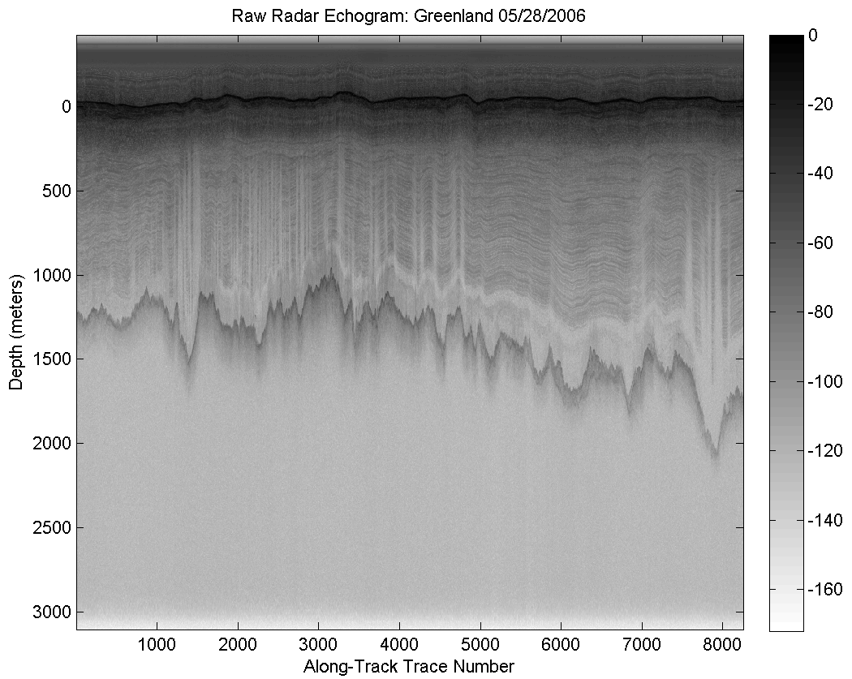
Challenges of Processing Radar Imagery
Backscatter introduce clutter and contributes to regions of images incomprehensible.
In addition, bed topography varies from trace to trace due to rough bedrock interfaces from extended flight segments.
Lastly, a strong surface reflection can be repeated in an image, surface multiple due to energy reflecting off of the ice sheet surface and back again.
If there is a time difference between the first and second surface return, the surface layer will repeat in an image, at a lower magnitude with an identical shape.

Slide 48
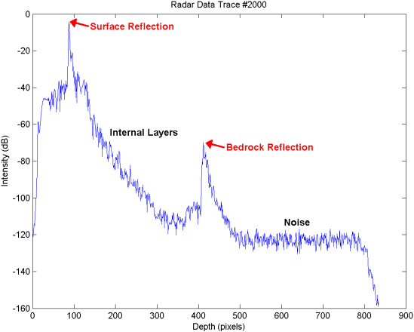
Challenges of Processing Radar Imagery
Each measurement is called a radar trace, and consist of signals, representing energy due to time. The larger time correlates with deeper reflections.
In an image, a trace is an entire column of pixels, each pixel represents a depth.
Each row corresponds to a depth and time for a measurement, as the depth increases further down.
Column
Pixel

Slide 49
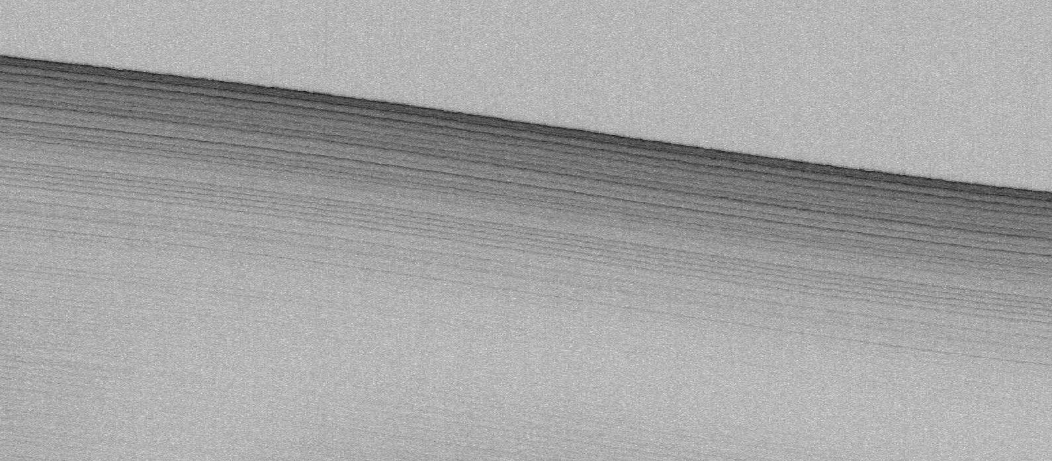
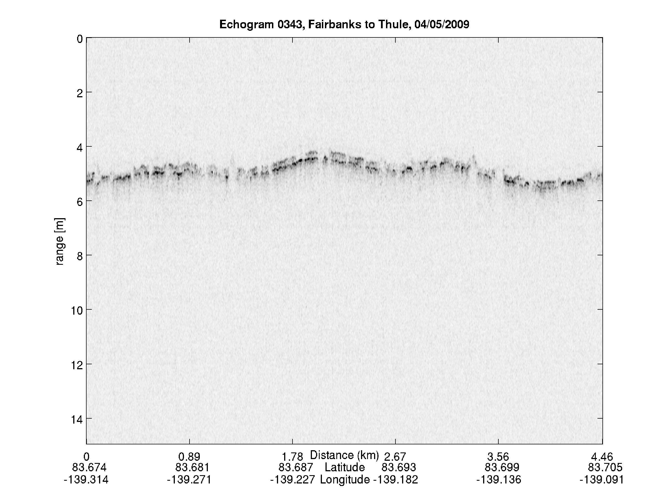
Snow Radar Data Products

Slide 50
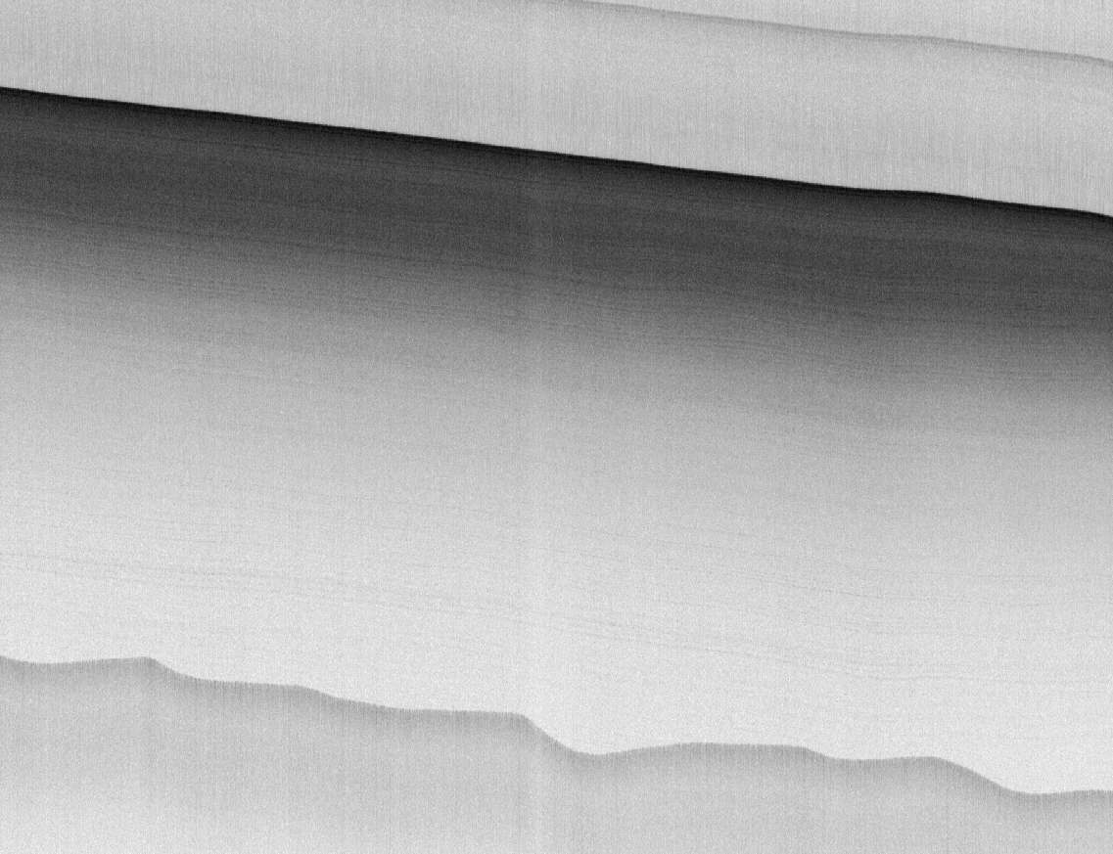
Accumulation Radar Data Products

Slide 51
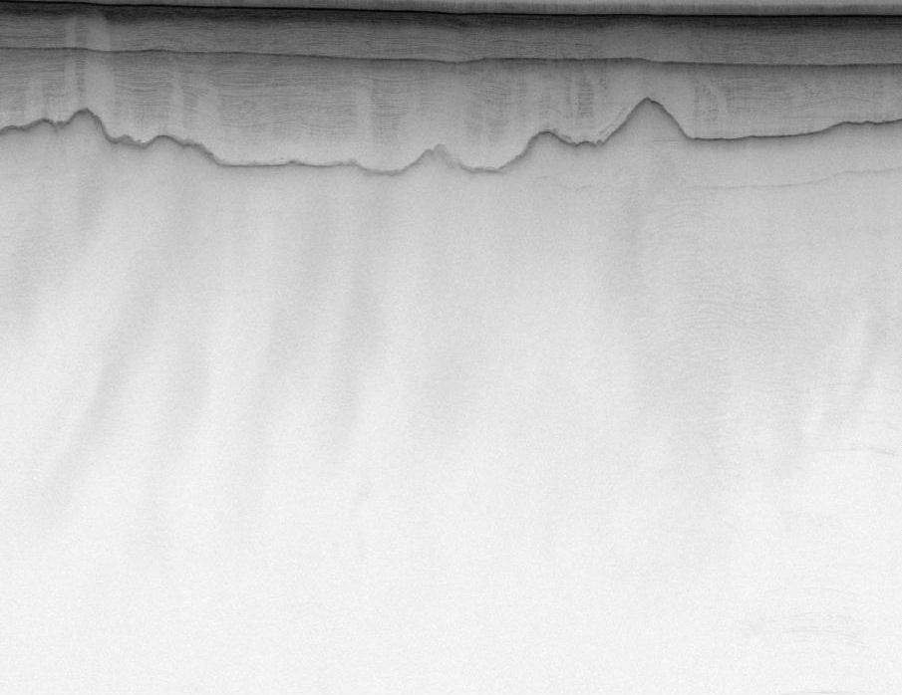
Depth Sounder Radar Data Products

Slide 52
Developing Automated Techniques for Radar Imagery

Slide 53
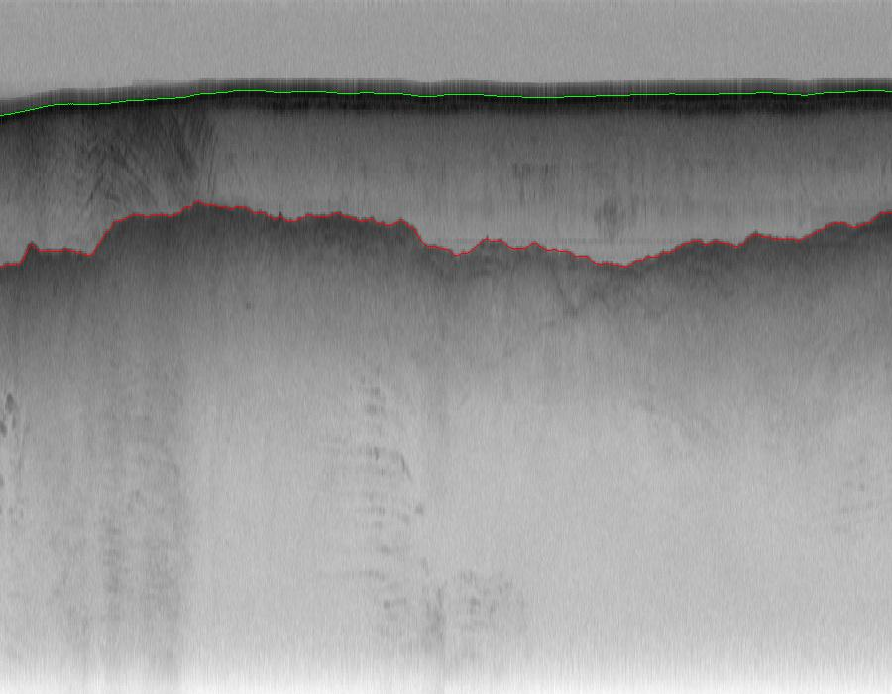

Slide 54
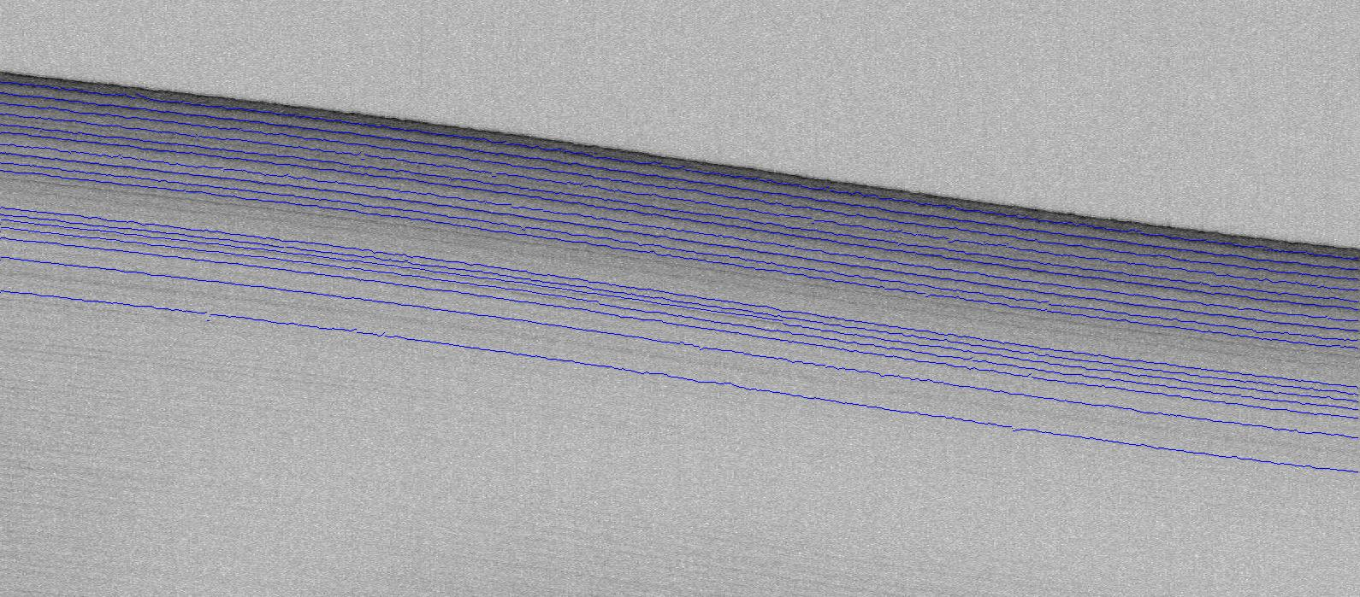

Slide 55
Conclusions
Remote Sensing
Global Climate Change
Radar Theory
Ice Sheet Science

