Slide 1
Analyzing large-scale cheminformatics and chemogenomics datasets through dimension reduction
Judy Qiu
Assistant Professor & Director, Salsa HPC lab Indiana University School of Informatics and Computing xqiu@indiana.edu - http://salsahpc.indiana.edu
David J. Wild
Assistant Professor & Director, Cheminformatics Program Indiana University School of Informatics and Computing djwild@indiana.edu - http://djwild.info
Geoffrey C. Fox
Associate Dean of Research and Graduate Studies
Director of Digital Science Center Indiana University School of Informatics and Computing gcfd@indiana.edu - http://salsahpc.indiana.edu

Slide 2
Important Trends
In all fields of science and throughout life (e.g. web!)
Impacts preservation, access/use, programming model
new commercially supported data center model building on compute grids
Data Deluge
Cloud Technologies
Multicore/
Parallel Computing
eScience
Implies parallel computing important again
Performance from extra cores – not extra clock speed
A spectrum of eScience or eResearch applications (biology, chemistry, physics social science and
humanities …)
Data Analysis
Machine learning

Slide 3
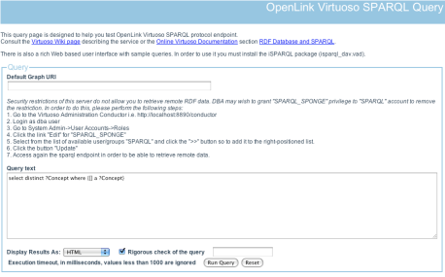
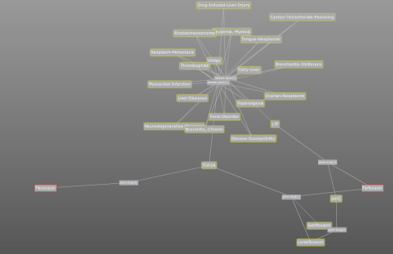
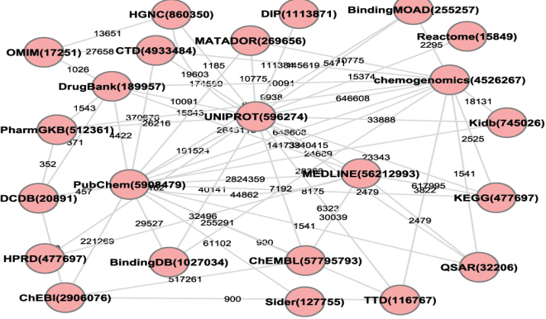
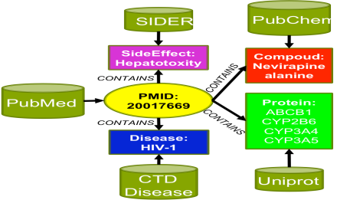
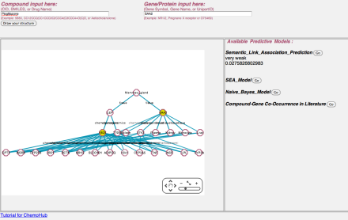
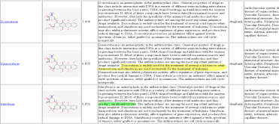
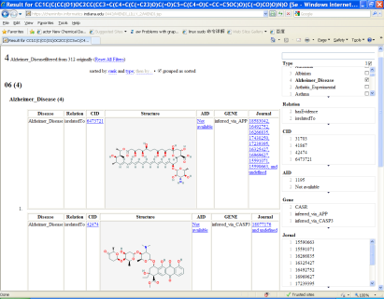
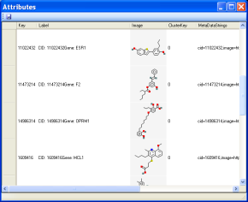
Integrative chemogenomic tools in Wild group – http://djwild.info
SPARQL Query Builder: advanced querying of Chem2Bio2RDF data
Association Search: finding paths between Chem2BioRDF entities ranked by literature support
Chem2Bio2RDF: networking compound, drug, gene, pathway, disease and side-effect information using Semantic Web methods
BioLDA: integrating recent literature using bioterms and providing path ranking using LDA and KL divergence
ChemoHub: quantitative predictions of relationship strength between compounds and genes
WENDI: exploring biological space around new chemical compounds
Chemogenomic Explorer: exploring compound-gene-disease relationships in a facet browser
Plotviz: high dimensional visualization of query results in chemical space
Collaborators: Ying Ding (SLIS), Judy Qiu (SOIC), Lilly, Pfizer

Slide 4
Navigate Chemical Space
Christopher Lipinski & Andrew Hopkins, Pfizer Global R&D, Navigating chemical space for biology and medicine, Nature, Vol 432, 16 Dec 2004
Measured in terms of physicochemical properties and topological descriptors, therapeutically useful compounds appear to cluster together in galaxies.
Are these galaxies are evenly and sparsely distributed?
Are most of the chemical universe is “empty” (with no therapeutically interesting compounds)?

Slide 5
Salsa HPC group – http://salsahpc.indiana.edu
Large and high-dimensional data visualization
Chemical space visualization
Cheminformatics visual data mining
Parallel dimension reduction algorithms
Parallel Generative Topographic Mapping (GTM)
Parallel Multidimensional Scaling (MDS)
Interpolated GTM/MDS

Slide 6
Introduction to PlotViz
A tool for visualizing data points
Dimension reduction by GTM and MDS
Browse large and high-dimensional data
Use many open (value-added) data

Slide 7
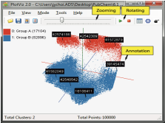
PlotViz System Overview
3-D Map File
SPARQL query
PlotViz
Meta data
Light-weight client
DrugBank
CTD
QSAR
Visualization Algorithms
PubChem
Chem2Bio2RDF
Parallel dimension reduction algorithms
Aggregated public databases

Slide 8
Dimension Reduction Algorithms
Multidimensional Scaling (MDS) [1]
Given the proximity information among points.
Optimization problem to find mapping in target dimension of the given data based on pairwise proximity information while minimize the objective function.
Objective functions: STRESS (1) or SSTRESS (2)
Only needs pairwise distances δ_{ij} between original points (typically not Euclidean)
d_{ij}(X) is Euclidean distance between mapped (3D) points
Generative Topographic Mapping (GTM) [2]
Find optimal K-representations for the given data (in 3D), known as K-cluster problem (NP-hard)
Original algorithm use EM method for optimization
Deterministic Annealing algorithm can be used for finding a global solution
Objective functions is to maximize log-likelihood:
[1] I. Borg and P. J. Groenen. Modern Multidimensional Scaling: Theory and Applications. Springer, New York, NY, U.S.A., 2005.
[2] C. Bishop, M. Svens´en, and C. Williams. GTM: The generative topographic mapping. Neural computation, 10(1):215–234, 1998.

Slide 9
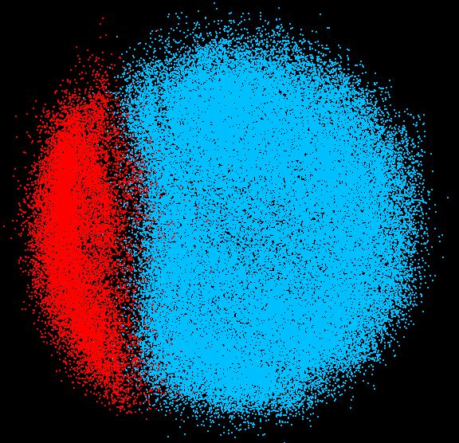
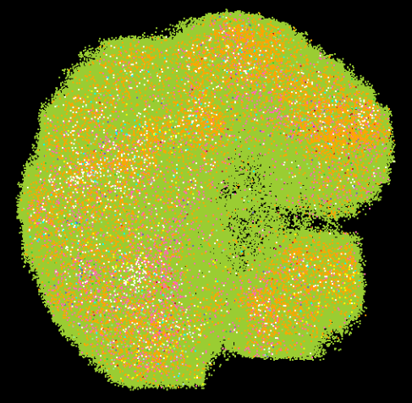
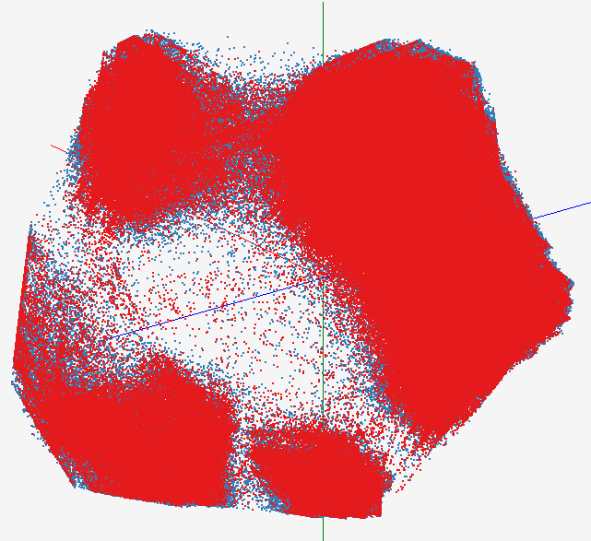
High Performance Data Visualization..
Developed parallel MDS and GTM algorithm to visualize large and high-dimensional data
Processed 0.1 million PubChem data having 166 dimensions
Parallel interpolation can process up to 2M PubChem points
GTM with interpolation for 2M PubChem data
2M PubChem data is plotted in 3D with GTM interpolation approach. Red points are 100k sampled data and blue points are 4M interpolated points.
MDS for 100k PubChem data
100k PubChem data having 166 dimensions are visualized in 3D space. Colors represent 2 clusters separated by their structural proximity.
GTM for 930k genes and diseases
Genes (green color) and diseases (others) are plotted in 3D space, aiming at finding cause-and-effect relationships.
[3] PubChem project, http://pubchem.ncbi.nlm.nih.gov/

Slide 10
Large scale dimension reduction with GTM/MDS
Use 2 methods of dimension reduction: GTM clustering (requires descriptor vectors) and MDS (descriptor vectors or similarity matrix) to map descriptor spaces into 3 dimensions
Our descriptor spaces are similarity space (MACCS keys) and SALI space (normalized SALI values used as similarity). Only MDS can work with the SALI space

Slide 11
Multidimensional Scaling (MDS)
Given the proximity information among points.
Optimization problem to find mapping in target dimension of the data based on given pairwise proximity information while minimize the objective function.
Objective functions: STRESS (1) or SSTRESS (2)
Only needs pairwise dissimilarities δ_{ij} between original points
(not necessary to be Euclidean distance)
d_{ij}(X) is Euclidean distance between mapped (3D) points

Slide 12
Scaling by MAjorizing a COmplicated Function. (SMACOF)
Iterative majorizing algorithm to solve MDS problem.
EM-like hill-climbing approach.
Decrease STRESS value monotonically.
Tend to be trapped in local optima.
Computational complexity and memory requirement is O(N²).

Slide 13
Deterministic Annealing (DA)
Simulated Annealing (SA) applies Metropolis algorithm to minimize F by random walk.
Gibbs Distribution at T (computational temperature).
Minimize Free Energy (F)
As T decreases, more structure of problem space is getting revealed.
DA tries to avoid local optima w/o random walking.
DA finds the expected solution which minimize F by calculating exactly or approximately.
DA applied to clustering, GTM, Gaussian Mixtures etc.

Slide 14
DA-SMACOF (4)

Slide 15
GTM vs. MDS
GTM
MDS (SMACOF)
Purpose
Non-linear dimension reduction
Find an optimal configuration in a lower-dimension
Iterative optimization method
Objective Function
Maximize Log-Likelihood
Minimize STRESS or SSTRESS
Complexity
O(KN) (K << N)
O(N²)
Optimization
Method
EM
Iterative Majorization (EM-like)
MDS also soluble by viewing as nonlinear χ² with iterative linear equation solver

Slide 16
Interpolation Method
MDS and GTM are highly memory and time consuming process for large dataset such as millions of data points
MDS requires O(N²) and GTM does O(KN) (N is the number of data points and K is the number of latent variables)
Training only for sampled data and interpolating for out-of-sample set can improve performance
Interpolation is a pleasingly parallel application
n in-sample
Training
Trained data
N-n
out-of-sample
Interpolated
MDS/GTM map
Interpolation
Total N data

Slide 17
Interpolation Method
Multidimensional Scaling (MDS)
Generative Topographic Mapping (GTM)
Find mapping for a new point based on the pre-mapping result of the sample data (n samples).
For the new input data, find k-NN among those sample data.
Based on the mappings of the k-NN, interpolate the new point.
O(n(N-n)) memory required.
O(n(N-n)) computations
For n samples (n<N), GTM training requires O(Kn)
Training computes the optimal position for K latent variables for n data point
Out-of-sample data (N-n points) is mapped based on the trained result (No training process required)
Interpolation only require O(N-n) memory and time

Slide 18
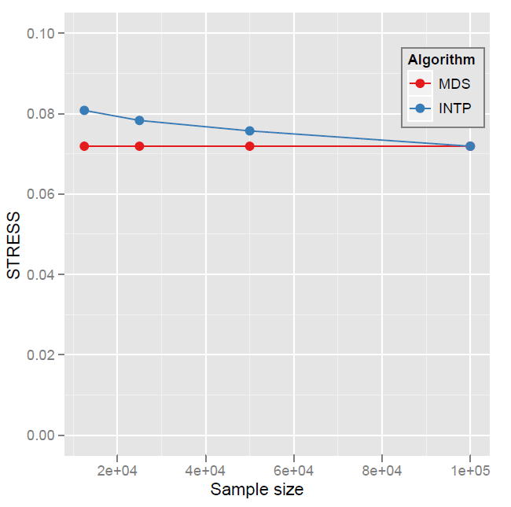
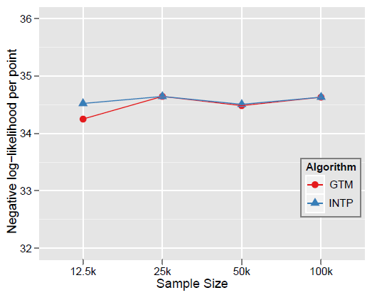
Quality Comparison (Original vs. Interpolation)
MDS
GTM
Quality comparison between Interpolated result upto 100k based on the sample data (12.5k, 25k, and 50k) and original MDS result w/ 100k.
STRESS:
w_{ij} = 1 / ∑δ_{ij}²
Interpolation result (blue) is getting close to the original (read) result as sample size is increasing.

Slide 19
Activity Cliffs in PubChem Bioassays
Selected 22 bioassays based on total compounds tested, number of actives, and type diversity. Generally number of compounds with “real” activity numbers << number of actives (with “outcome” field)
Calculated SALI values (Guha, JCIM 2008, 48(3), 646-658) for all pairs of tested compounds in each assay using MACCS keys and log IC₅₀ or percent inhibition:
Investigated pairs with highest SALI values for each bioassay
Simple SALI maps (heatmaps)
Mapping Bioassay Activity Cliffs in Chemical Space
Use multidimensional scaling and GTM methods to project compounds into 3 dimensions using SALI value as a similarity score
Plot compounds in “3D SALI space”, and color by mean SALI score
Compare with simple coloring with activity in 3D similarity space

Slide 20
Bioassays studied

Slide 21
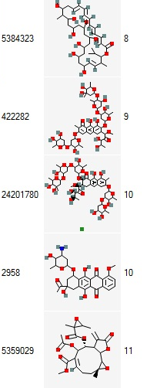
AID79: NCI Colon Cell Line, GI50

Slide 22
AID1274 highlighting top SALI pair

Slide 23
Modified SALI for polypharmacology
Can we look for small changes in activity that produce large changes in polypharmacology profiles?
Uses Chem2Bio2RDF (BMC Bioinformatics, 2010, 11, 255) to establish compound-gene relationships. For this study, we identified 10713 compounds associated with at least one of 305 kinases, all from ChEMBL
Modified SALI index uses hamming distance of binary association profiles in place of activity value (here Assoc = 1 if there is an association, else 0):
Create projections in chemical space where compounds are colored by the number of kinases they are associated with

Slide 24
Kinase compounds in similarity space (GTM)

Slide 25
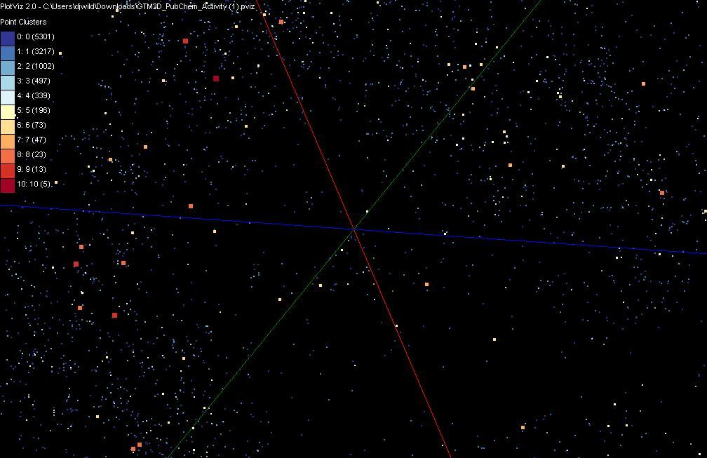
“Doppler Radar Plot” – Fleroxacin neighborhood
Fleroxacin

Slide 26
Top 1000 SALI compounds in SALI space

Slide 27
Multiple Relationships View in Chemical Space

Slide 28
Drugbank (orange) on active PubChem Bioassay (blue)

Slide 29
General Formula DAC GM GTM DAGTM DAGM
N data points X(x) in D dimensions space and minimize F by EM
X(x)
Deterministic Annealing Clustering (DAC)
F is Free Energy
EM is well known expectation maximization method
p(x) with Σ p(x) =1
T is annealing temperature varied down from ∞ with final value of 1
Determine cluster center Y(k) by EM method
K (number of clusters) starts at 1 and is incremented by algorithm

Slide 30
Deterministic Annealing
F({y}, T)
Solve Linear Equations for each temperature
Nonlinearity effects mitigated by initializing with solution at previous higher temperature
Configuration {y}
Minimum evolving as temperature decreases
Movement at fixed temperature going to local minima if not initialized “correctly

Slide 31
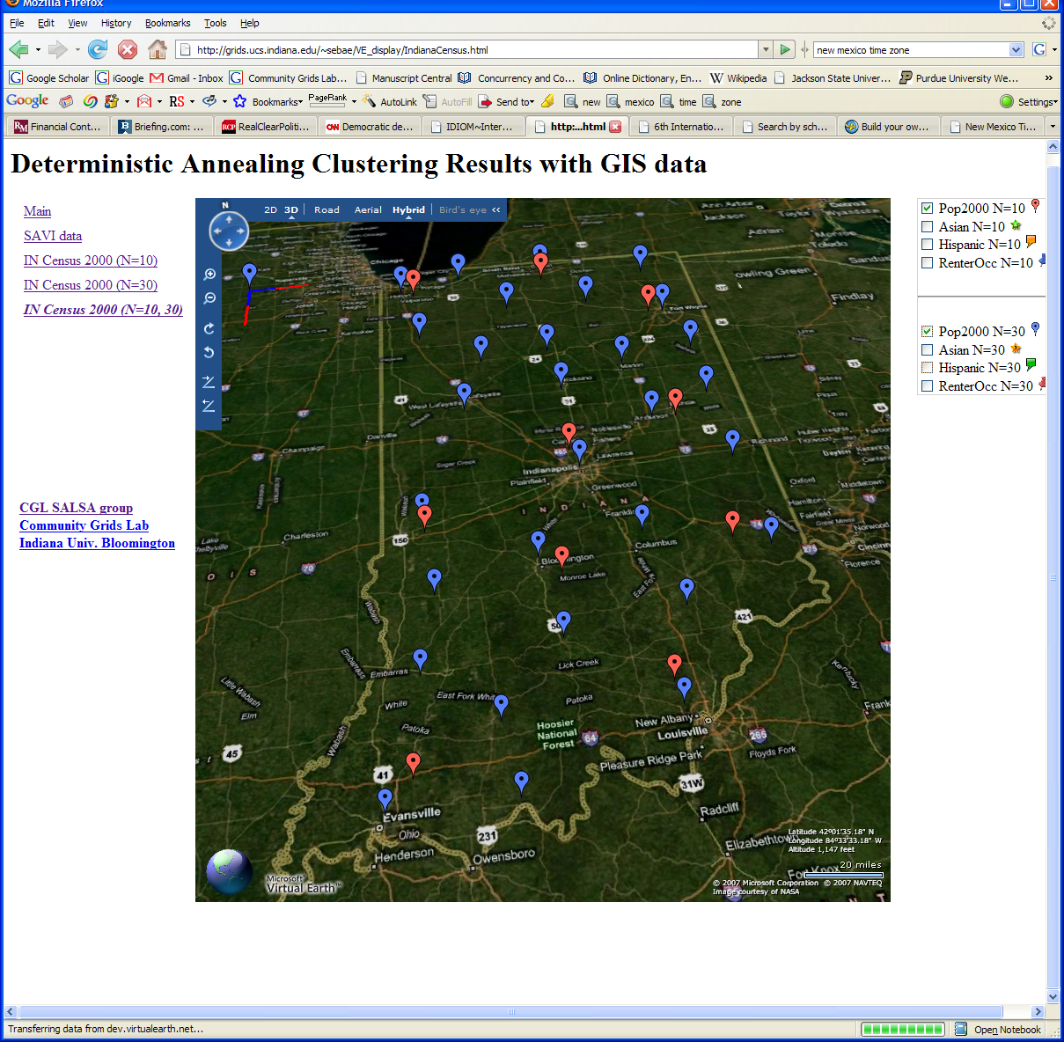
Deterministic Annealing Clustering of Indiana Census Data
Decrease temperature (distance scale) to discover more clusters
Red is coarse resolution with 10 clusters
Blue is finer resolution with 30 clusters
Clusters find cities in Indiana
Distance Scale is √Temperature

Slide 32
Next Generation Sequencing Pipeline on Cloud
MapReduce
Pairwise
clustering
FASTA File N Sequences
block
Pairings
Pairwise
Distance
Calculation
Dissimilarity
Matrix
N(N-1)/2 values
Clustering
Visualization
Plotviz
Blast
Visualization
Plotviz
MPI
1
2
MDS
3
4
5
4
Users submit their jobs to the pipeline and the results will be shown in a visualization tool.
This chart illustrate a hybrid model with MapReduce and MPI. Twister will be an unified solution for the pipeline mode.
The components are services and so is the whole pipeline.
We could research on which stages of pipeline services are suitable for private or commercial Clouds.

Slide 33
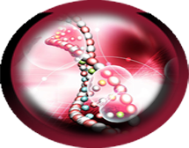
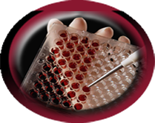
Demos
Visualization of pairwise ALU gene alignment by using Smith Waterman dissimilarity.
Metagenomics
Visualization of biology dataset
Biology Data
Bioassay activity/Inactivity classification
Visualization of PubChem data by using MDS and GTM
PubChem
Bioassay active counts

Slide 34
Sample Data
Morten Alleso, Frans Van Den Berg, Claus Cornett, Flemming Steen Jorgensen, Bent Halling-Sorensen, Heidi Lopeez De Diego, Lars Hovgaard, Jaakko Aaltonen, Jukka Rntanen, University of Copenhagen, Solvent Diversity in Polymorph Screening, Journal of Pharmaceutical Sciences, Vol. 97, 2145-2159, 2008
A database of 218 organic solvents with 24 property descriptors
The data matrix is analyzed using principal component analysis (PCA) and self-organizing maps (SOMs) methods

