Slide 1
51 Use Cases and implications for HPC & Apache Big Data Stack Architecture and Ogres
International Workshop on Extreme Scale Scientific Computing (Big Data and Extreme Computing (BDEC))
Fukuoka Japan February 27 2014
3
Geoffrey Fox
Judy Qiu
Shantenu Jha (Rutgers)
gcf@indiana.edu
http://www.infomall.org
School of Informatics and Computing
Digital Science Center
Indiana University Bloomington

Slide 2
51 Detailed Use Cases: Contributed July-September 2013 Covers goals, data features such as 3 V’s, software, hardware
26 Features for each use case
http://bigdatawg.nist.gov/usecases.php
https://bigdatacoursespring2014.appspot.com/course (Section 5)
Government Operation(4): National Archives and Records Administration, Census Bureau
Commercial(8): Finance in Cloud, Cloud Backup, Mendeley (Citations), Netflix, Web Search, Digital Materials, Cargo shipping (as in UPS)
Defense(3): Sensors, Image surveillance, Situation Assessment
Healthcare and Life Sciences(10): Medical records, Graph and Probabilistic analysis, Pathology, Bioimaging, Genomics, Epidemiology, People Activity models, Biodiversity
Deep Learning and Social Media(6): Driving Car, Geolocate images/cameras, Twitter, Crowd Sourcing, Network Science, NIST benchmark datasets
The Ecosystem for Research(4): Metadata, Collaboration, Language Translation, Light source experiments
Astronomy and Physics(5): Sky Surveys including comparison to simulation, Large Hadron Collider at CERN, Belle Accelerator II in Japan
Earth, Environmental and Polar Science(10): Radar Scattering in Atmosphere, Earthquake, Ocean, Earth Observation, Ice sheet Radar scattering, Earth radar mapping, Climate simulation datasets, Atmospheric turbulence identification, Subsurface Biogeochemistry (microbes to watersheds), AmeriFlux and FLUXNET gas sensors
Energy(1): Smart grid

Slide 3
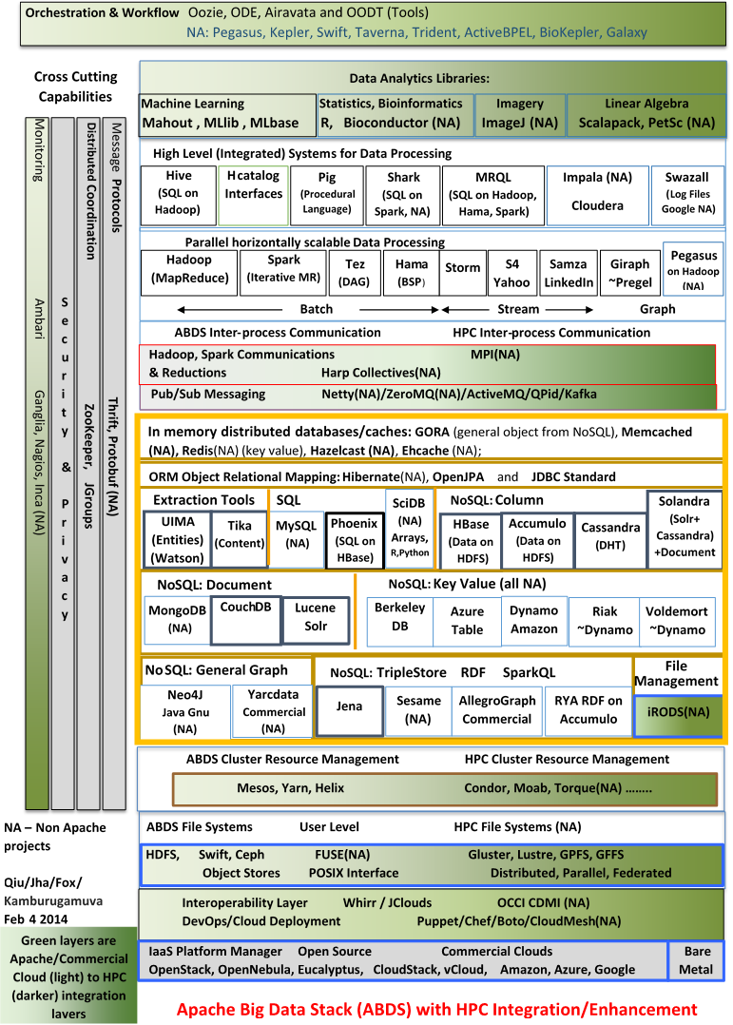
Enhanced Apache Big Data Stack ABDS+
114 Capabilities
Green layers have strong HPC Integration opportunities
Functionality of ABDS
Performance of HPC

Slide 4
NIST Big Data Reference Architecture wants to implement selected use cases as patterns/ogres
INFORMATION VALUE CHAIN
System Orchestrator
Big Data Application Provider
Analytics
Data Provider
Curation
Visualization
Data Consumer
DATA
DATA
SW
Collection
Access
SW
DATA
SW
Big Data Framework Provider
K E Y :
Processing Frameworks (analytic tools, etc.)
IT VALUE CHAIN
Horizontally Scalable
Vertically Scalable
Service Use
Security & Privacy
DATA
Platforms (databases, etc.)
Management
Horizontally Scalable
Data Flow
Vertically Scalable
Infrastructures
Horizontally Scalable (VM clusters)
SW
Vertically Scalable
Analytics Tools Transfer
Physical and Virtual Resources (networking, computing, etc.)

Slide 5
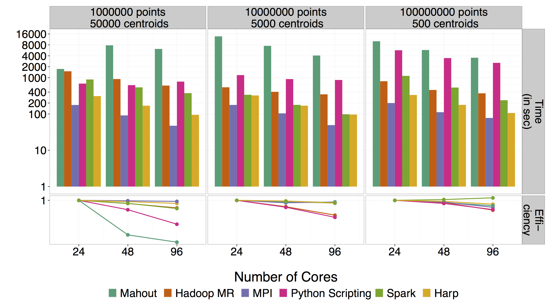
Mahout and Hadoop MR – Slow due to MapReduce Python slow as Scripting Spark Iterative MapReduce, non optimal communication Harp Hadoop plug in with ~MPI collectives MPI fastest as HPC
Increasing Communication
Identical Computation

Slide 6
Big Data Ogres and Their Facets from 51 use cases
The first Ogre Facet captures different problem “architecture”. Such as (i) Pleasingly Parallel – as in Blast, Protein docking, imagery (ii) Local Machine Learning – ML or filtering pleasingly parallel as in bio-imagery, radar (iii) Global Machine Learning seen in LDA, Clustering etc. with parallel ML over nodes of system (iv) Fusion: Knowledge discovery often involves fusion of multiple methods. (v) Workflow
The second Ogre Facet captures source of data (i) SQL, (ii) NOSQL based, (iii) Other Enterprise data systems (10 examples at NIST) (iv)Set of Files (as managed in iRODS), (v) Internet of Things, (vi) Streaming and (vii) HPC simulations.
Before data gets to compute system, there is often an initial data gathering phase which is characterized by a block size and timing. Block size varies from month (Remote Sensing, Seismic) to day (genomic) to seconds (Real time control, streaming)
There are storage/compute system styles: Dedicated, Permanent, Transient
Other characteristics are need for permanent auxiliary/comparison datasets and these could be interdisciplinary implying nontrivial data movement/replication
Notes:
Big dwarfs are Ogres
Implement Ogres in ABDS+

Slide 7
Detailed Structure of Ogres
The third Facet contains Ogres themselves classifying core analytics kernels/mini-applications (i) Recommender Systems (Collaborative Filtering) (ii) SVM and Linear Classifiers (Bayes, Random Forests), (iii) Outlier Detection (iORCA) (iv) Clustering (many methods), (v) PageRank, (vi) LDA (Latent Dirichlet Allocation), (vii) PLSI (Probabilistic Latent Semantic Indexing), (viii) SVD (Singular Value Decomposition), (ix) MDS (Multidimensional Scaling), (x) Graph Algorithms (seen in neural nets, search of RDF Triple stores), (xi) Learning Neural Networks (Deep Learning), (xii) Global Optimization (Variational Bayes); (xiii) Agents, as in epidemiology (swarm approaches) and (xiv) GIS (Geographical Information Systems).
These core applications can be classified by features like (a) Flops per byte; (b) Communication Interconnect requirements; (c) Are data points in metric or non-metric spaces (d) Maximum Likelihood, (e) χ² minimizations, and (f) Expectation Maximization (often Steepest descent)

Slide 8
Lessons / Insights
Please add to set of 51 use cases
Integrate (don’t compete) HPC with “Commodity Big data” (Google to Amazon to Enterprise data Analytics)
i.e. improve Mahout; don’t compete with it
Use Hadoop plug-ins rather than replacing Hadoop
Enhanced Apache Big Data Stack ABDS+ has 114 members – please improve!
6 zettabytes total data; LHC is ~0.0001 zettabytes (100 petabytes)
HPC-ABDS+ Integration areas include file systems, cluster resource management, file and object data management, inter process and thread communication, analytics libraries, workflow and monitoring
Ogres classify Big Data applications by three facets – each with several exemplars
Guide to breadth and depth of Big Data
Does your architecture/software support all the ogres?

