Slide 1
51 Detailed Use Cases: Contributed July-September 2013 Covers goals, data features such as 3 V’s, software, hardware
http://bigdatawg.nist.gov/usecases.php
https://bigdatacoursespring2014.appspot.com/course (Section 5)
Government Operation(4): National Archives and Records Administration, Census Bureau
Commercial(8): Finance in Cloud, Cloud Backup, Mendeley (Citations), Netflix, Web Search, Digital Materials, Cargo shipping (as in UPS)
Defense(3): Sensors, Image surveillance, Situation Assessment
Healthcare and Life Sciences(10): Medical records, Graph and Probabilistic analysis, Pathology, Bioimaging, Genomics, Epidemiology, People Activity models, Biodiversity
Deep Learning and Social Media(6): Driving Car, Geolocate images/cameras, Twitter, Crowd Sourcing, Network Science, NIST benchmark datasets
The Ecosystem for Research(4): Metadata, Collaboration, Language Translation, Light source experiments
Astronomy and Physics(5): Sky Surveys including comparison to simulation, Large Hadron Collider at CERN, Belle Accelerator II in Japan
Earth, Environmental and Polar Science(10): Radar Scattering in Atmosphere, Earthquake, Ocean, Earth Observation, Ice sheet Radar scattering, Earth radar mapping, Climate simulation datasets, Atmospheric turbulence identification, Subsurface Biogeochemistry (microbes to watersheds), AmeriFlux and FLUXNET gas sensors
Energy(1): Smart grid

Slide 2
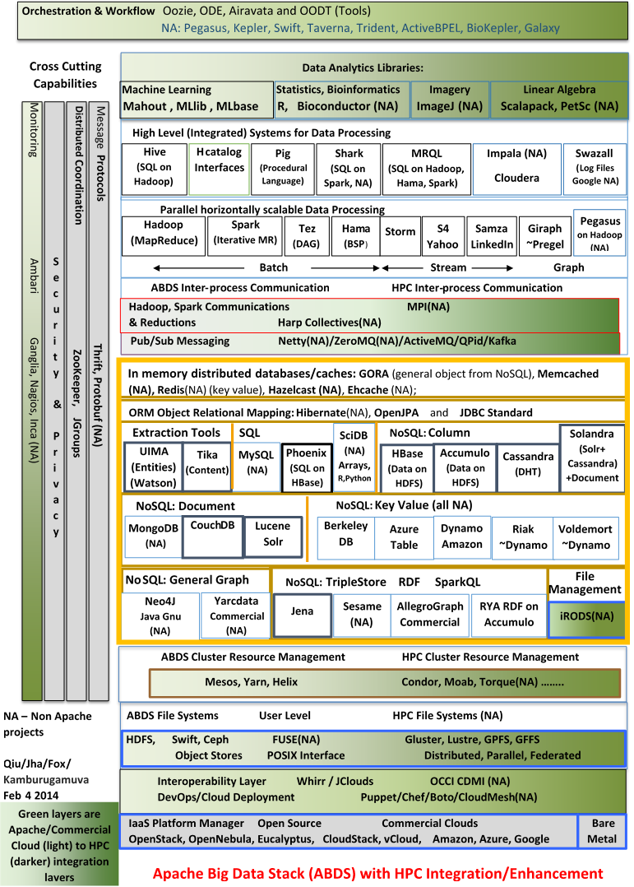
Enhanced Apache Big Data Stack ABDS+
114 Capabilities
Green layers have strong HPC Integration opportunities
Functionality of ABDS
Performance of HPC

Slide 3
Big Data Ogres and Their Facets from 51 use cases
The first Ogre Facet captures different problem “architecture”. Such as (i) Pleasingly Parallel – as in Blast, Protein docking, imagery (ii) Local Machine Learning – ML or filtering pleasingly parallel as in bio-imagery, radar (iii) Global Machine Learning seen in LDA, Clustering etc. with parallel ML over nodes of system (iii) Fusion: Knowledge discovery often involves fusion of multiple methods.
The second Ogre Facet captures source of data (i) SQL, (ii) NOSQL based, (iii) Other Enterprise data systems (10 at NIST) (iv)Set of Files (as managed in iRODS), (v) Internet of Things, (vi) Streaming and (vii) HPC simulations.
The third Ogre Facet is distinctive system features such as (i) Agents, as in epidemiology (swarm approaches) and (ii) GIS (Geographical Information Systems).
The fourth Ogre Facet captures Style of Big Data applications. (i) Are data points in metric or non-metric spaces (ii) Maximum Likelihood, (iii) χ² minimizations, and (iv) Expectation Maximization (often Steepest descent).
The fifth Facet is Ogres themselves classifying core analytics kernels (i) Recommender Systems (Collaborative Filtering) (ii) SVM and Linear Classifiers (Bayes, Random Forests), (iii) Outlier Detection (iORCA) (iv) Clustering (many methods), (v) PageRank, (vi) LDA (Latent Dirichlet Allocation), (vii) PLSI (Probabilistic Latent Semantic Indexing), (viii) SVD (Singular Value Decomposition), (ix) MDS (Multidimensional Scaling), (x) Graph Algorithms (seen in neural nets, search of RDF Triple stores), (xi) Learning Neural Networks (Deep Learning), and (xii) Global Optimization (Variational Bayes).
Notes:
Big dwarfs are Ogres
Implement Ogres in ABDS+

Slide 4
Lessons / Insights
Geoffrey Fox , Judy Qiu (Indiana), Shantenu Jha (Rutgers)
Please add to set of 51 use cases
Integrate (don’t compete) HPC with “Commodity Big data” (Google to Amazon to Enterprise data Analytics)
i.e. improve Mahout; don’t compete with it
Use Hadoop plug-ins rather than replacing Hadoop
Enhanced Apache Big Data Stack ABDS+ has 114 members – please improve!
There is a lot more than Hadoop in ABDS
6 zettabytes total data; LHC is ~0.0001 zettabytes (100 petabytes)
HPC-ABDS+ Integration areas include file systems, cluster resource management, file and object data management, inter process and thread communication, analytics libraries, workflow and monitoring
Ogres classify Big Data applications by five facets – each with several exemplars
Guide to breadth and depth of Big Data
Does your architecture/software support all the ogres?

