Slide 1
ACES and Clouds
ACES Meeting Maui
October 23 2012
Geoffrey Fox
gcf@indiana.edu
Informatics, Computing and Physics
Indiana University Bloomington

Slide 2

Some Trends
  The Data Deluge is clear trend from Commercial (Amazon, e-commerce) , Community (Facebook, Search) and Scientific applications
  Light weight clients from smartphones, tablets to sensors
  Multicore reawakening parallel computing
  Exascale initiatives will continue drive to high end with a simulation orientation
  Clouds with cheaper, greener, easier to use IT for (some) applications
  New jobs associated with new curricula
    Clouds as a distributed system (classic CS courses)
    Data Analytics (Important theme in academia and industry)
    Network/Web Science

Slide 3
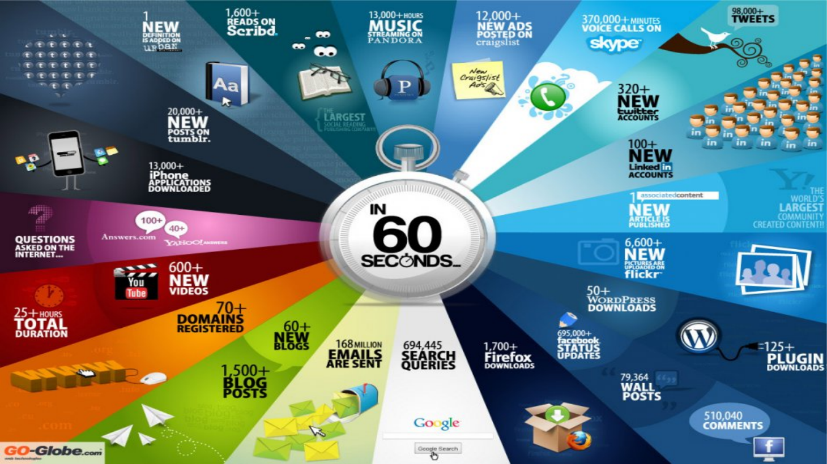
Web 2.0 Data Deluge drove Clouds

Slide 4
Some Data sizes
  ~40 10⁹ Web pages at ~300 kilobytes each = 10 Petabytes
  Youtube 48 hours video uploaded per minute;
    in 2 months in 2010, uploaded more than total NBC ABC CBS
    ~2.5 petabytes per year uploaded?
  LHC 15 petabytes per year
  Radiology 69 petabytes per year
  Square Kilometer Array Telescope will be 100 terabits/second
  Exascale simulation data dumps – terabytes/second
  Earth Observation becoming ~4 petabytes per year
  Earthquake Science – Still quite modest?
  PolarGrid – 100’s terabytes/year

Slide 5
Clouds Offer From different points of view
Features from NIST:
  On-demand service (elastic);
  Broad network access;
  Resource pooling;
  Flexible resource allocation;
  Measured service
Economies of scale in performance (Cheap IT) and electrical power (Green IT)
Powerful new software models
  Platform as a Service is not an alternative to Infrastructure as a Service – it is instead a major valued added

Slide 6

Jobs v. Countries

Slide 7

McKinsey Institute on Big Data Jobs
There will be a shortage of talent necessary for organizations to take advantage of big data. By 2018, the United States alone could face a shortage of 140,000 to 190,000 people with deep analytical skills as well as 1.5 million managers and analysts with the know-how to use the analysis of big data to make effective decisions.

Slide 8
Some Sizes in 2010
http://www.mediafire.com/file/zzqna34282frr2f/koomeydatacenterelectuse2011finalversion.pdf
30 million servers worldwide
Google had 900,000 servers (3% total world wide)
Google total power ~200 Megawatts
  < 1% of total power used in data centers (Google more efficient than average – Clouds are Green!)
  ~ 0.01% of total power used on anything world wide
Maybe total clouds are 20% total world server count (a growing fraction)

Slide 9
Some Sizes Cloud v HPC
Top Supercomputer Sequoia Blue Gene Q at LLNL
  16.32 Petaflop/s on the Linpack benchmark using 98,304 CPU compute chips with 1.6 million processor cores and 1.6 Petabyte of memory in 96 racks covering an area of about 3,000 square feet
  7.9 Megawatts power
Largest (cloud) computing data centers
  100,000 servers at ~200 watts per CPU chip
  Up to 30 Megawatts power
So largest supercomputer is around 1-2% performance of total cloud computing systems with Google ~20% total

Slide 10
2 Aspects of Cloud Computing:
Infrastructure and Runtimes
Cloud infrastructure: outsourcing of servers, computing, data, file space, utility computing, etc..
Cloud runtimes or Platform: tools to do data-parallel (and other) computations. Valid on Clouds and traditional clusters
  Apache Hadoop, Google MapReduce, Microsoft Dryad, Bigtable, Chubby and others
  MapReduce designed for information retrieval but is excellent for a wide range of science data analysis applications
  Can also do much traditional parallel computing for data-mining if extended to support iterative operations
  Data Parallel File system as in HDFS and Bigtable

Slide 11
Infrastructure, Platforms, Software as a Service
Software Services are building blocks of applications
The middleware or computing environment
Nimbus, Eucalyptus, OpenStack
OpenNebula
CloudStack

Slide 12
Science Computing Environments
Large Scale Supercomputers – Multicore nodes linked by high performance low latency network
  Increasingly with GPU enhancement
  Suitable for highly parallel simulations
High Throughput Systems such as European Grid Initiative EGI or Open Science Grid OSG typically aimed at pleasingly parallel jobs
  Can use “cycle stealing”
  Classic example is LHC data analysis
Grids federate resources as in EGI/OSG or enable convenient access to multiple backend systems including supercomputers
  Portals make access convenient and
  Workflow integrates multiple processes into a single job
Specialized visualization, shared memory parallelization etc. machines

Slide 13
Clouds HPC and Grids
Synchronization/communication Performance
Grids > Clouds > Classic HPC Systems
Clouds naturally execute effectively Grid workloads but are less clear for closely coupled HPC applications
Classic HPC machines as MPI engines offer highest possible performance on closely coupled problems
    Likely to remain in spite of Amazon cluster offering
Service Oriented Architectures portals and workflow appear to work similarly in both grids and clouds
May be for immediate future, science supported by a mixture of
  Clouds – some practical differences between private and public clouds – size and software
  High Throughput Systems (moving to clouds as convenient)
  Grids for distributed data and access
  Supercomputers (“MPI Engines”) going to exascale

Slide 14
What Applications work in Clouds
Pleasingly (moving to modestly) parallel applications of all sorts with roughly independent data or spawning independent simulations
  Long tail of science and integration of distributed sensors
Commercial and Science Data analytics that can use MapReduce (some of such apps) or its iterative variants (most other data analytics apps)
Which science applications are using clouds?
  Venus-C (Azure in Europe): 27 applications not using Scheduler, Workflow or MapReduce (except roll your own)
  50% of applications on FutureGrid are from Life Science
  Locally Lilly corporation is commercial cloud user (for drug discovery)
  Nimbus applications in bioinformatics, high energy physics, nuclear physics, astronomy and ocean sciences

Slide 15
27 Venus-C Azure Applications
Chemistry (3)
• Lead Optimization in Drug Discovery
• Molecular Docking
Civil Protection (1)
• Fire Risk estimation and fire propagation
Biodiversity &
Biology (2)
• Biodiversity maps in marine species
• Gait simulation
Civil Eng. and Arch. (4)
• Structural Analysis
• Building information Management
• Energy Efficiency in Buildings
• Soil structure simulation
Physics (1)
• Simulation of Galaxies configuration
Earth Sciences (1)
• Seismic propagation
Mol, Cell. & Gen. Bio. (7)
• Genomic sequence analysis
• RNA prediction and analysis
• System Biology
• Loci Mapping
• Micro-arrays quality.
ICT (2)
• Logistics and vehicle routing
• Social networks analysis
Medicine (3)
• Intensive Care Units decision support.
• IM Radiotherapy planning.
• Brain Imaging
Mathematics (1)
• Computational Algebra
Mech, Naval & Aero. Eng. (2)
• Vessels monitoring
• Bevel gear manufacturing simulation

Slide 16
Parallelism over Users and Usages
“Long tail of science” can be an important usage mode of clouds.
In some areas like particle physics and astronomy, i.e. “big science”, there are just a few major instruments generating now petascale data driving discovery in a coordinated fashion.
In other areas such as genomics and environmental science, there are many “individual” researchers with distributed collection and analysis of data whose total data and processing needs can match the size of big science.
  Multiple users of QuakeSim portal (user parallelism)
Clouds can provide scaling convenient resources for this important aspect of science.
Can be map only use of MapReduce if different usages naturally linked e.g. multiple runs of Virtual California (usage parallelism)
  Collecting together or summarizing multiple “maps” is a simple Reduction

Slide 17
Internet of Things and the Cloud
It is projected that there will be 24 billion devices on the Internet by 2020. Most will be small sensors that send streams of information into the cloud where it will be processed and integrated with other streams and turned into knowledge that will help our lives in a multitude of small and big ways.
The cloud will become increasing important as a controller of and resource provider for the Internet of Things.
As well as today’s use for smart phone and gaming console support, “Intelligent River” “smart homes” and “ubiquitous cities” build on this vision and we could expect a growth in cloud supported/controlled robotics.
Some of these “things” will be supporting science (Seismic and GPS sensors)
Natural parallelism over “things” ; “Things” are distributed and so form a Grid

Slide 18
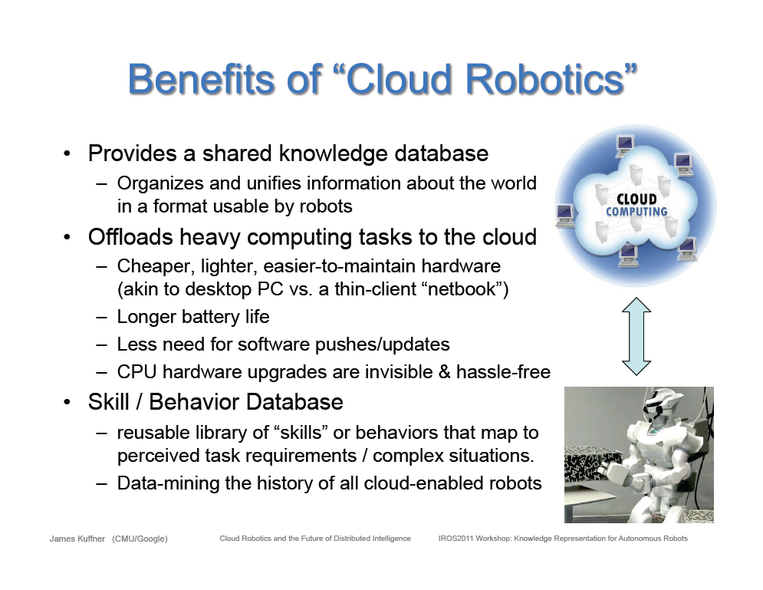
Cloud based robotics from Google

Slide 19
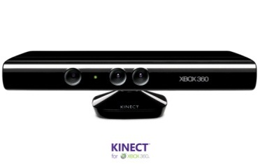








Sensors (Things) as a Service
Output Sensor
Sensors as a Service
Sensor Processing as a Service (could use
MapReduce)
A larger sensor ………
https://sites.google.com/site/opensourceiotcloud/ Open Source Sensor (IoT) Cloud

Slide 20
Classic Parallel Computing
HPC: Typically SPMD (Single Program Multiple Data) “maps” typically processing particles or mesh points interspersed with multitude of low latency messages supported by specialized networks such as Infiniband and technologies like MPI
  Often run large capability jobs with 100K (going to 1.5M) cores on same job
  National DoE/NSF/NASA facilities run 100% utilization
  Fault fragile and cannot tolerate “outlier maps” taking longer than others
Clouds: MapReduce has asynchronous maps typically processing data points with results saved to disk. Final reduce phase integrates results from different maps
  Fault tolerant and does not require map synchronization
  Map only useful special case
HPC + Clouds: Iterative MapReduce caches results between “MapReduce” steps and supports SPMD parallel computing with large messages as seen in parallel kernels (linear algebra) in clustering and other data mining

Slide 21
4 Forms of MapReduce
(a) Map Only
(b) Classic MapReduce
(c) Iterative MapReduce
(d) Loosely Synchronous
Input
Input
Iterations
Input
map
map
map
P_{ij}
reduce
reduce
Output
BLAST Analysis
Parametric sweep
Pleasingly Parallel
High Energy Physics (HEP) Histograms
Distributed search
Expectation maximization Clustering e.g. Kmeans
Linear Algebra, Page Rank
Classic MPI
PDE Solvers and particle dynamics
Domain of MapReduce and Iterative Extensions
Science Clouds
MPI
Exascale

Slide 22
Commercial “Web 2.0” Cloud Applications
Internet search, Social networking, e-commerce, cloud storage
These are larger systems than used in HPC with huge levels of parallelism coming from
  Processing of lots of users or
  An intrinsically parallel Tweet or Web search
Classic MapReduce is suitable (although Page Rank component of search is parallel linear algebra)
Data Intensive
Do not need microsecond messaging latency

Slide 23
Data Intensive Applications
Applications tend to be new and so can consider emerging technologies such as clouds
Do not have lots of small messages but rather large reduction (aka Collective) operations
  New optimizations e.g. for huge messages
  e.g. Expectation Maximization (EM) dominated by broadcasts and reductions
Not clearly a single exascale job but rather many smaller (but not sequential) jobs e.g. to analyze groups of sequences
Algorithms not clearly robust enough to analyze lots of data
  Current standard algorithms such as those in R library not designed for big data
Our Experience
  Multidimensional Scaling MDS is iterative rectangular matrix-matrix multiplication controlled by EM
  Deterministically Annealed Pairwise Clustering as an EM example

Slide 24
Twister for Data Intensive
Iterative Applications
Generalize to arbitrary Collective
Broadcast
Compute
Communication
Reduce/ barrier
New Iteration
Smaller Loop-Variant Data
Larger Loop-Invariant Data
(Iterative) MapReduce structure with Map-Collective is framework
Twister runs on Linux or Azure
Twister4Azure is built on top of Azure tables, queues, storage
Notes:
Most of these applications consists of iterative computation and communication steps where single iterations can easily be specified as MapReduce computations.
Large input data sizes which are loop-invariant and can be reused across iterations.
Loop-variant results.. Orders of magnitude smaller…
While these can be performed using traditional MapReduce frameworks, Traditional is not efficient for these types of computations. MR leaves lot of room for improvements in terms of iterative applications.

Slide 25





Performance – Kmeans Clustering
Overhead between iterations
First iteration performs the initial data fetch
Twister4Azure
Task Execution Time Histogram
Number of Executing Map Task Histogram
Hadoop
Twister
Hadoop on bare metal scales worst
Twister4Azure(adjusted for C#/Java)
Strong Scaling with 128M Data Points
Weak Scaling
Qiu, Gunarathne
Performance with/without
data caching
Speedup gained using data cache
Scaling speedup
Increasing number of iterations

Slide 26
FutureGrid offers Software Defined
Computing Testbed as a Service
FutureGrid Uses
Testbed-aaS Tools
Provisioning
Image Management
IaaS Interoperability
IaaS tools
Expt management
Dynamic Network
Devops
Research
Computing
aaS
Custom Images
Courses
Consulting
Portals
Archival Storage
System e.g. SQL, GlobusOnline
Applications e.g. Amber, Blast
SaaS
FutureGrid Usages
Computer Science
Applications and understanding Science Clouds
Technology Evaluation including XSEDE testing
Education and Training
Cloud e.g. MapReduce
HPC e.g. PETSc, SAGA
Computer Science e.g. Languages, Sensor nets
PaaS
Hypervisor
Bare Metal
Operating System
Virtual Clusters, Networks
IaaS

Slide 27
FutureGrid key Concepts I
FutureGrid is an international testbed modeled on Grid5000
  September 21 2012: 260 Projects, ~1360 users
Supporting international Computer Science and Computational Science research in cloud, grid and parallel computing (HPC)
The FutureGrid testbed provides to its users:
  A flexible development and testing platform for middleware and application users looking at interoperability, functionality, performance or evaluation
  FutureGrid is user-customizable, accessed interactively and supports Grid, Cloud and HPC software with and without VM’s
  A rich education and teaching platform for classes
See G. Fox, G. von Laszewski, J. Diaz, K. Keahey, J. Fortes, R. Figueiredo, S. Smallen, W. Smith, A. Grimshaw, FutureGrid - a reconfigurable testbed for Cloud, HPC and Grid Computing, Bookchapter – draft

Slide 28

FutureGrid key Concepts II
Rather than loading images onto VM’s, FutureGrid supports Cloud, Grid and Parallel computing environments by provisioning software as needed onto “bare-metal” using Moab/xCAT (need to generalize)
  Image library for MPI, OpenMP, MapReduce (Hadoop, (Dryad), Twister), gLite, Unicore, Globus, Xen, ScaleMP (distributed Shared Memory), Nimbus, Eucalyptus, OpenNebula, KVM, Windows …..
  Either statically or dynamically
Growth comes from users depositing novel images in library
FutureGrid has ~4400 distributed cores with a dedicated network and a Spirent XGEM network fault and delay generator
Image1
Image2
…
ImageN
Choose
Load
Run

Slide 29

FutureGrid Grid supports Cloud Grid HPC Computing Testbed as a Service (aaS)
12TF Disk rich + GPU 512 cores
NID: Network Impairment Device
Private
Public
FG Network
29

Slide 30
Compute Hardware
Name | System type | # CPUs | # Cores | TFLOPS | Total RAM (GB) | Secondary Storage (TB) | Site | Status
india | IBM iDataPlex | 256 | 1024 | 11 | 3072 | 180 | IU | Operational
alamo | Dell PowerEdge | 192 | 768 | 8 | 1152 | 30 | TACC | Operational
hotel | IBM iDataPlex | 168 | 672 | 7 | 2016 | 120 | UC | Operational
sierra | IBM iDataPlex | 168 | 672 | 7 | 2688 | 96 | SDSC | Operational
xray | Cray XT5m | 168 | 672 | 6 | 1344 | 180 | IU | Operational
foxtrot | IBM iDataPlex | 64 | 256 | 2 | 768 | 24 | UF | Operational
Bravo | Large Disk & memory | 32 | 128 | 1.5 | 3072 (192GB per node) | 192 (12 TB per Server) | IU | Operational
Delta | Large Disk & memory With Tesla GPU’s | 32 CPU 32 GPU’s | 192+ 14336 GPU | ? 9 | 1536 (192GB per node) | 192 (12 TB per Server) | IU | Operational
 |  |  | TOTAL Cores 4384

Slide 31
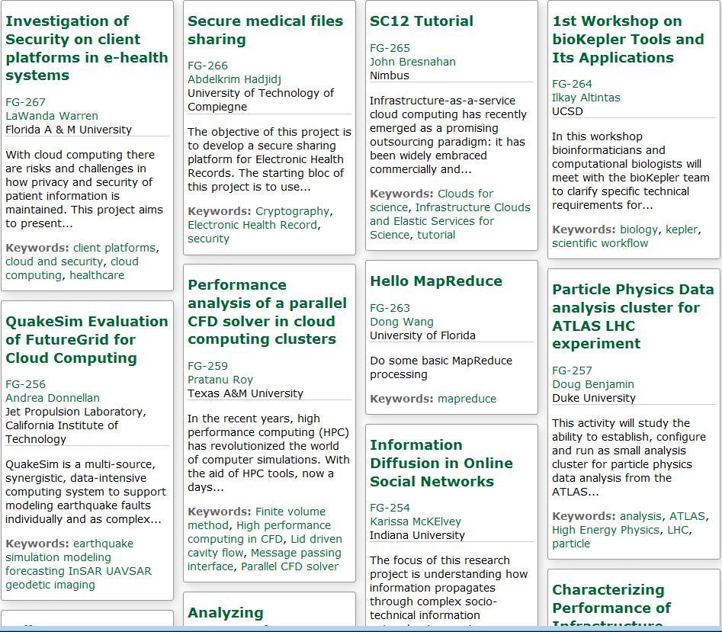
Recent Projects

Slide 32
4 Use Types for FutureGrid TestbedaaS
260 approved projects (1360 users) September 21 2012
  USA, China, India, Pakistan, lots of European countries
  Industry, Government, Academia
Training Education and Outreach (10%)
  Semester and short events; interesting outreach to HBCU
Computer science and Middleware (59%)
  Core CS and Cyberinfrastructure; Interoperability (2%) for Grids and Clouds; Open Grid Forum OGF Standards
Computer Systems Evaluation (29%)
  XSEDE (TIS, TAS), OSG, EGI; Campuses
New Domain Science applications (26%)
  Life science highlighted (14%), Non Life Science (12%)
  Generalize to building Research Computing-aaS
Fractions are as of July 15 2012 add to > 100%

Slide 33
Distribution of FutureGrid Technologies and Areas
220 Projects

Slide 34
Research Computing as a Service
Traditional Computer Center has a variety of capabilities supporting (scientific computing/scholarly research) users.
  Could also call this Computational Science as a Service
IaaS, PaaS and SaaS are lower level parts of these capabilities but commercial clouds do not include
  Developing roles/appliances for particular users
  Supplying custom SaaS aimed at user communities
  Community Portals
  Integration across disparate resources for data and compute (i.e. grids)
  Data transfer and network link services
  Archival storage, preservation, visualization
  Consulting on use of particular appliances and SaaS i.e. on particular software components
  Debugging and other problem solving
  Administrative issues such as (local) accounting
This allows us to develop a new model of a computer center where commercial companies operate base hardware/software
A combination of XSEDE, Internet2 and computer center supply 1) to 9)?

Slide 35
Cosmic Comments
Recent private cloud infrastructure (Eucalyptus 3, OpenStack Essex in USA) much improved
  Nimbus, OpenNebula still good
Commercial (public) Clouds from Amazon, Google, Microsoft
Expect much computing to move to clouds leaving traditional IT support as Research Computing as a Service
More employment opportunities in clouds than HPC and Grids and in data than simulation; so cloud and data related activities popular with students
QuakeSim can be SaaS on clouds with ability to support ensemble computations (Virtual California) and Sensors
Can explore private clouds on FutureGrid and measure performance overheads
  MPI v. MapReduce; Virtualized v. non-virtualized

