Slide 1
Cloud Architecture for Earthquake Science
7th ACES International Workshop
6th October 2010
Grand Park Otaru
Otaru Japan
Geoffrey Fox
gcf@indiana.edu
http://www.infomall.org http://www.futuregrid.org
Director, Digital Science Center, Pervasive Technology Institute
Associate Dean for Research and Graduate Studies, School of Informatics and Computing
Indiana University Bloomington

Slide 2
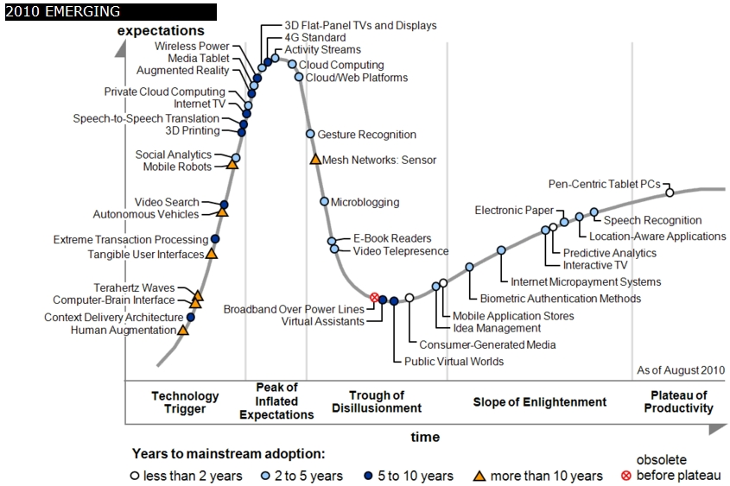
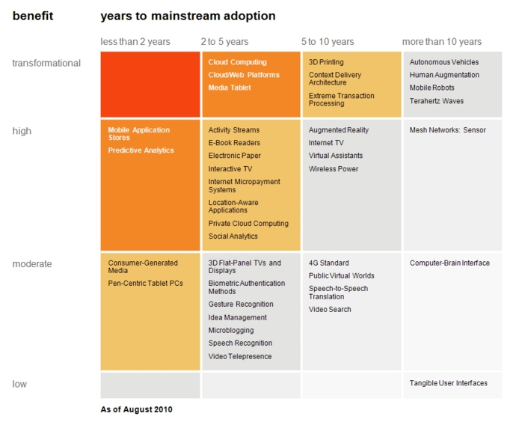

Transformational
High
Moderate
Low
Gartner 2009 Hype Curve
Clouds, Web2.0
Service Oriented Architectures
Cloud Computing
Cloud Web Platforms
Media Tablet

Slide 3



Data Centers Clouds &
Economies of Scale I
Range in size from “edge” facilities to megascale.
Economies of scale
  Approximate costs for a small size center (1K servers) and a larger, 50K server center.
2 Google warehouses of computers on the banks of the Columbia River, in The Dalles, Oregon
Such centers use 20MW-200MW
(Future) each with 150 watts per CPU
Save money from large size, positioning with cheap power and access with Internet
Technology | Cost in small-sized Data Center | Cost in Large Data Center | Ratio
Network | $95 per Mbps/ month | $13 per Mbps/ month | 7.1
Storage | $2.20 per GB/ month | $0.40 per GB/ month | 5.7
Administration | ~140 servers/ Administrator | >1000 Servers/ Administrator | 7.1
Each data center is
11.5 times
the size of a football field

Slide 4


Data Centers, Clouds
& Economies of Scale II
Builds giant data centers with 100,000’s of computers;
~ 200-1000 to a shipping container with Internet access
“Microsoft will cram between 150 and 220 shipping containers filled with data center gear into a new 500,000 square foot Chicago facility. This move marks the most significant, public use of the shipping container systems popularized by the likes of Sun Microsystems and Rackable Systems to date.”

Slide 5
















X as a Service
SaaS: Software as a Service imply software capabilities
(programs) have a service (messaging) interface
  Applying systematically reduces system complexity to being linear in number of components
  Access via messaging rather than by installing in /usr/bin
IaaS: Infrastructure as a Service or HaaS: Hardware as a Service – get your computer time with a credit card and with a Web interface
PaaS: Platform as a Service is IaaS plus core software capabilities on which you build SaaS
Cyberinfrastructure is “Research as a Service”
HazaaS is Hazard Forecasting as a Service
Other Services
Clients

Slide 6
Philosophy of
Clouds and Grids
Clouds are (by definition) commercially supported approach to large scale computing
  So we should expect Clouds to replace Compute Grids
  Current Grid technology involves “non-commercial” software solutions which are hard to evolve/sustain
  Maybe Clouds ~4% IT expenditure 2008 growing to 14% in 2012 (IDC Estimate)
Public Clouds are broadly accessible resources like Amazon and Microsoft Azure – powerful but not easy to customize and perhaps data trust/privacy issues
Private Clouds run similar software and mechanisms but on “your own computers” (not clear if still elastic)
  Platform features such as Queues, Tables, Databases currently limited
Services still are correct architecture with either REST (Web 2.0) or Web Services
Clusters are still critical concept for MPI or Cloud software

Slide 7
Grids MPI and Clouds
Grids are useful for managing distributed systems
  Pioneered service model for Science
  Developed importance of Workflow
  Performance issues – communication latency – intrinsic to distributed systems
  Can never run large differential equation based simulations or datamining
Clouds can execute any job class that was good for Grids plus
  More attractive due to platform plus elastic on-demand model
  MapReduce easier to use than MPI for parallel jobs
  Currently have performance limitations due to poor affinity (locality) for compute-compute (MPI) and Compute-data
  These limitations are not “inevitable” and should gradually improve as in July 13 Amazon Cluster announcement
  Will probably never be best for most sophisticated parallel differential equation based simulations
Classic Supercomputers (MPI Engines) run communication demanding differential equation based simulations
  MapReduce and Clouds replaces MPI for other problems
  Much more data processed today by MapReduce than MPI (Industry Informational Retrieval ~50 Petabytes per day)

Slide 8
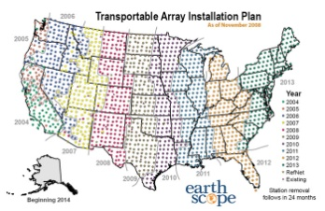
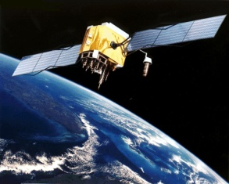




MapReduce “File/Data Repository” Parallelism
Map = (data parallel) computation reading and writing data
Reduce = Collective/Consolidation phase e.g. forming multiple global sums as in histogram
Instruments
Data could just define a set of simulations
Portals
/Users
Map₁
Map₂
Map₃
Reduce
Disks
Specify parameters for separate earthquake system simulation ensemble runs

Slide 9
Processing Real-Time GPS Streams
ascii2gml
ryo2ascii
RYO
Ports
ascii2pos
7010
NB Server
Raw Data
Scripps
RTD
Server
ryo2nb
Single Station
7011
7012
GPS Networks
Displacement Filter
RDAHMM Filter
Station Health
Filter
/SOPAC/GPS/CRTN01/RYO
Broker and
services replicated in
the cloud
Raw Data
ryo2nb
ryo2ascii
/SOPAC/GPS/CRTN01/ASCII
ascii2pos
Single Station
RDAHMM Filter
/SOPAC/GPS/CRTN01/POS
/SOPAC/GPS/CRTN01/DSME
A Complete Sensor Message Processing Path, including a data analysis application.

Slide 10
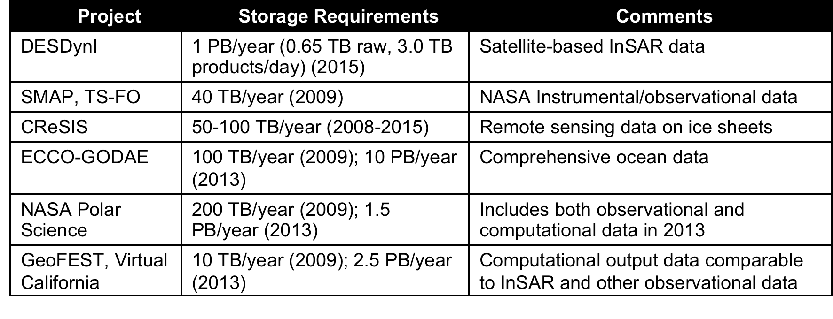
Data Deluge in Earth Science
Common Themes of Data Sources
Focus on geospatial, environmental data sets
  Data from computation and observation.
Rapidly increasing data sizes
Data and data processing pipelines are inseparable.

Slide 11
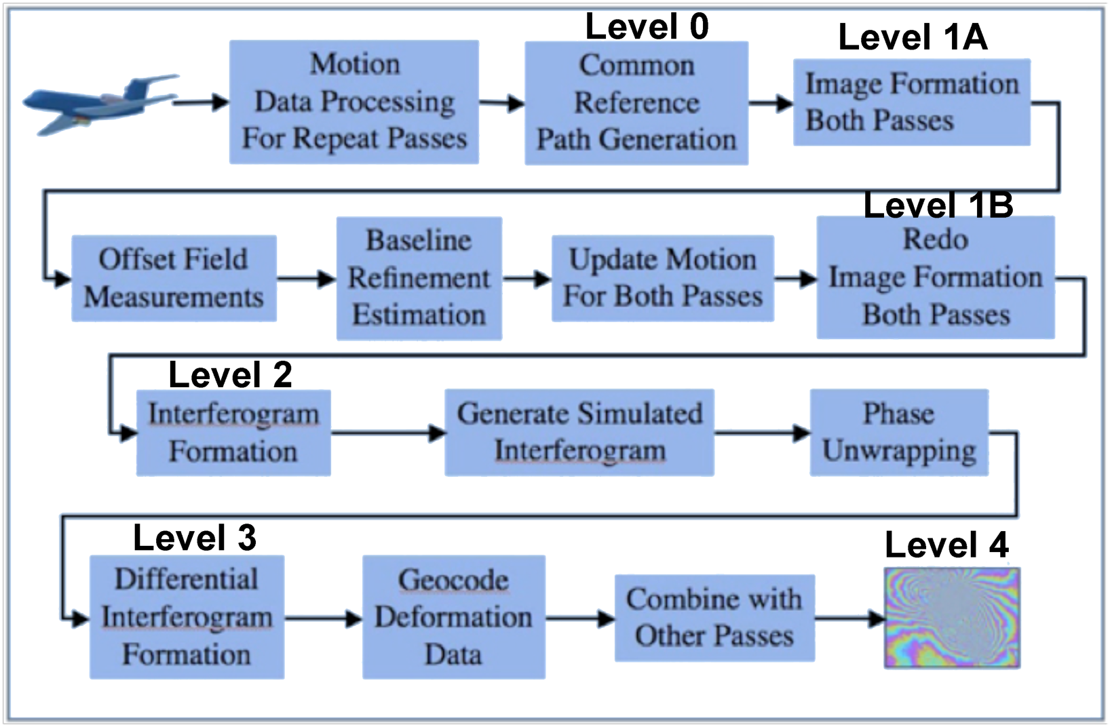
InSAR Data Processing Pipeline of “Maps”
Natural (MapReduce) Data parallel pipeline for the cloud

Slide 12
ACESCloud Concept
Capture both data and data processing pipelines using sustainable hardware.
  Virtual machines for legacy systems
Data will be accessible from resources via Cloud-style interfaces.
  Amazon S3, MS Azure REST interfaces are the core.
  These APIs are the best chance for sustainable access.
  Higher level GIS, search, metadata, ontology services built on these services.
Data processing pipelines/workflows/dataflows will also be stored on virtual machines, virtual clusters.
  Most processing pipelines and ensemble simulations can be implemented using MapReduce
Common ACES Data store in cloud – services processing them on demand
Build HazaaS: Hazard Forecast as an interactive service

Slide 13
Ontologies
Metadata
ACESPortal
Curation
GIS Services
Documentation Services
Data mining/assimilation
Workflow
Web 2.0, Gadgets, Atom Feeds, Social Networks
Access, Portals
Gateways
ACESCloud Services
GIS, Datamining, Ensemble Simulations
ACESCloud Application Middleware
Existing and other non-ACESCloud Middleware
ACESCloud Platform
Core Interfaces
Core Commercial Cloud Platform PaaS
Production Clouds
Amazon, Microsoft,
Government, Campus
Legacy Hardware
VM based IaaS
Infrastructure
FutureGrid
Design/Test
Cloud Resources
Development (FutureGrid) and Production
Core Commercial Cloud Platform PaaS
Existing non-ACESCloud Data Provider Middleware/Interfaces
ACESCloud Cloud Data Provider Middleware/Interfaces
ACESCloud Data
Standard Interfaces
Computational Model Output
Other NASA/NSF/.. GeoData
Data Sources
Simulation/Instruments
DESDynl InSAR Data
Comprehensive Ocean Data
Remote Ice Sensing

Slide 14
US Cyberinfrastructure Context
There are a rich set of facilities
  Production TeraGrid facilities with distributed and shared memory (and MPI!)
  Experimental “Track 2D” Awards
    FutureGrid: Distributed Systems experiments cf. Grid5000
    Keeneland: Powerful GPU Cluster
    Gordon: Large (distributed) Shared memory system with SSD aimed at data analysis/visualization
  Open Science Grid aimed at High Throughput computing and strong campus bridging

Slide 15
FutureGrid Key Concepts I
FutureGrid is an international testbed modeled on Grid5000
Rather than loading images onto VM’s, FutureGrid supports Cloud, Grid and Parallel computing environments by dynamically provisioning software as needed onto “bare-metal” (4 minutes)
  Image library for MPI, OpenMP, MapReduce (Hadoop, Dryad), gLite, Unicore, Globus, Xen, ScaleMP (distributed Shared Memory), Nimbus, Eucalyptus, OpenNebula, KVM, Windows …..
~5000 dedicated cores distributed across country
The FutureGrid testbed provides to its users:
  A flexible development and testing platform for middleware and application users looking at interoperability, functionality and performance
  Each use of FutureGrid is an experiment that is reproducible
  A rich education and teaching platform for advanced cyberinfrastructure classes
Growth comes from users depositing novel images in library

Slide 16
FutureGrid Key Concepts II
Support Computer Science and Computational Science
  Industry and Academia
  Europe Asia and USA
Accept proposals based on merit “only”
Support research and education
Key early user oriented milestones:
  June 2010 Initial users
  November 2010-September 2011 Increasing number of users allocated by FutureGrid
  October 2011 FutureGrid allocatable via TeraGrid process
  3 classes using FutureGrid this fall
Apply now to use FutureGrid on web site www.futuregrid.org

Slide 17
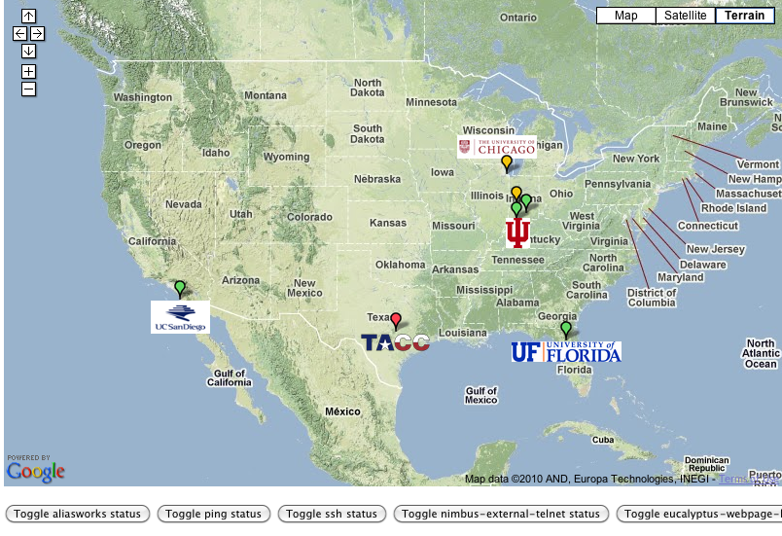
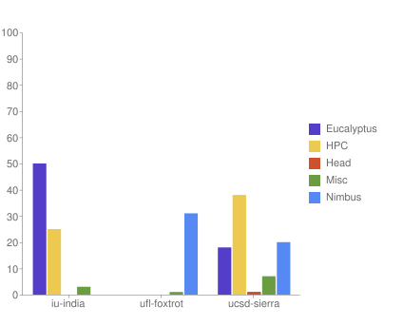

FutureGrid: a Grid/Cloud/HPC Testbed
Operational: IU Cray operational; IU , UCSD, UF & UC IBM iDataPlex operational
Network, NID operational
TACC Dell finished acceptance tests
INCA Node Operating Mode Statistics
NID: Network Impairment Device
Private
Public
FG Network

Slide 18
Some Current FutureGrid early uses
Investigate metascheduling approaches on Cray and iDataPlex
Deploy Genesis II and Unicore end points on Cray and iDataPlex clusters
Develop new Nimbus cloud capabilities
Prototype applications (BLAST) across multiple FutureGrid clusters and Grid’5000
Compare Amazon, Azure with FutureGrid hardware running Linux, Linux on Xen or Windows for data intensive applications
Test ScaleMP software shared memory for genome assembly
Develop Genetic algorithms on Hadoop for optimization
Attach power monitoring equipment to iDataPlex nodes to study power use versus use characteristics
Cummins running CFD codes to study combustion strategies to maximize energy efficiency
Support evaluation needed by XD TIS and TAS services
Investigate performance of Kepler workflow engine
Study scalability of SAGA in difference latency scenarios
Test and evaluate new algorithms for phylogenetics/systematics research in CIPRES portal
Investigate performance overheads of clouds in parallel and distributed environments
Support tutorials and classes in cloud, grid and parallel computing (IU, Florida, LSU)
~12 active/finished users out of ~32 early user applicants

Slide 19

Typical Performance Study
Linux, Linux on VM, Windows, Azure, Amazon Bioinformatics

Slide 20
FutureGrid Viral Growth Model
Users apply for a project
Users improve/develop some software in project
This project leads to new images which are placed in FutureGrid repository
Project report and other web pages document use of new images
Images are used by other users
And so on ad infinitum ………

Slide 21

194 papers submitted to main track; 48 accepted; 4 days of tutorials

