Slide 1
Technology Futures for ACES:
Clouds Web2.0 and Multicore
Cairns Australia
May 15 2008
Geoffrey Fox
Community Grids Laboratory, School of informatics
Indiana University
http://www.infomall.org/multicore
gcf@indiana.edu, http://www.infomall.org
1
Notes:
1

Slide 2
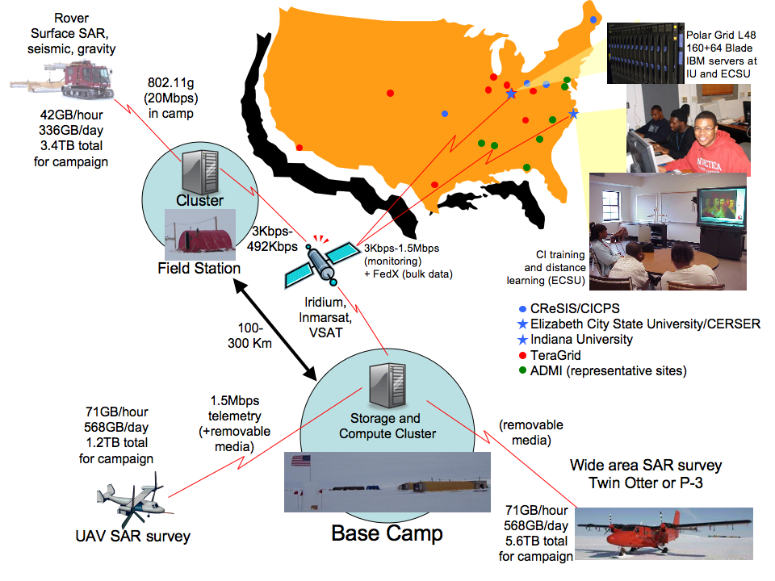
PolarGrid has remote
and TeraGrid components

Slide 3
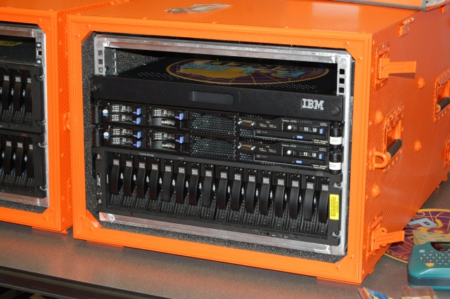
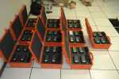
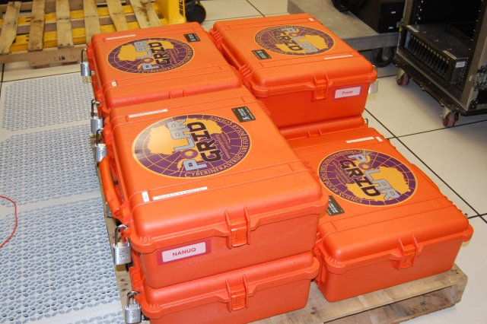
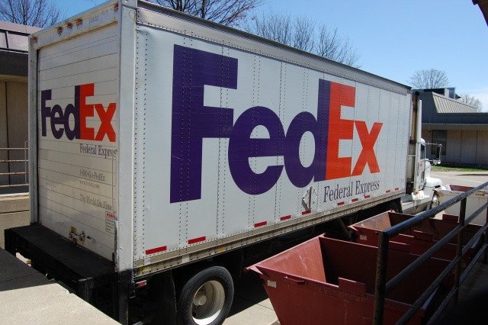
Polar Grid goes to Greenland
Leaving IU for Greenland
Field 8 core server and ruggedized laptops with USB Storage
Base camp 8-64 cores and 32 GB storage
Power: Solar, Hotel Room, Generator

Slide 4

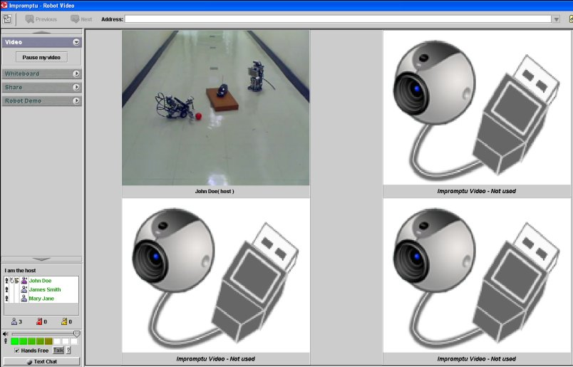
The Sensors on the Fun Grid
Sensors geolocated
by attached GPS
Laptop for PowerPoint (just a sensor)
2 Robots used
Webcams
Lego Robot GPS Nokia N800 RFID Tag RFID Reader

Slide 5
Data from the Robot RFID Sensors
Data from GPS geolocates other sensors
Sensor Data from Lego Light
sensor plus videocams from N800 carried as payload on Lego
RFID Reader sees
many tags

Slide 6
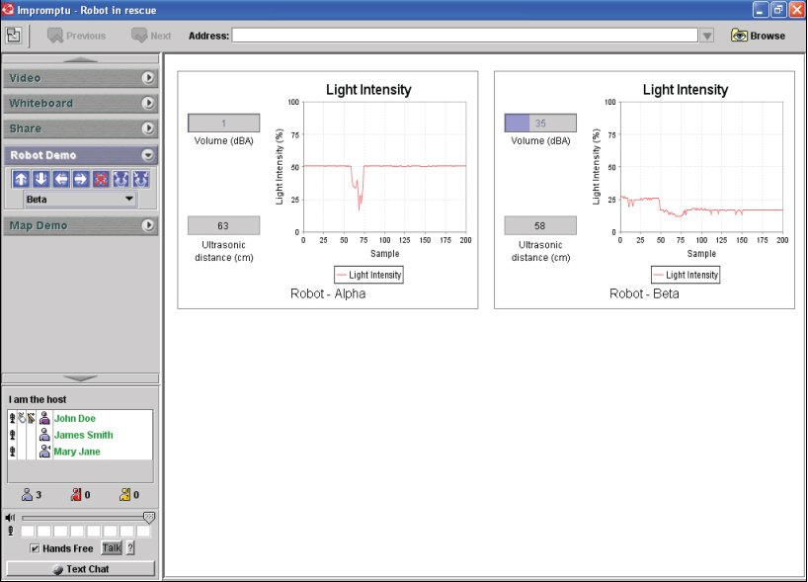
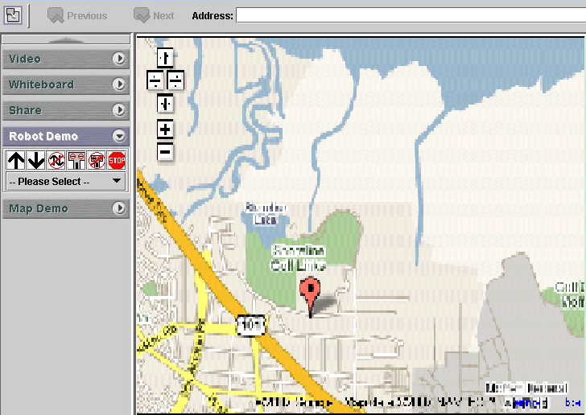
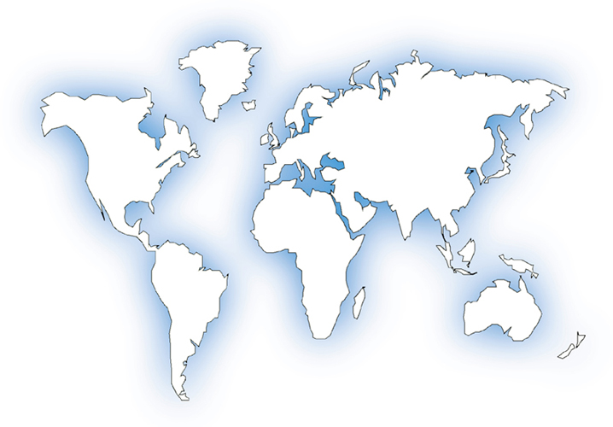

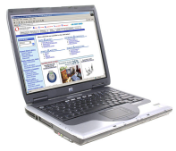


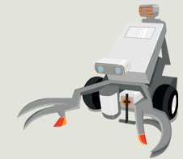


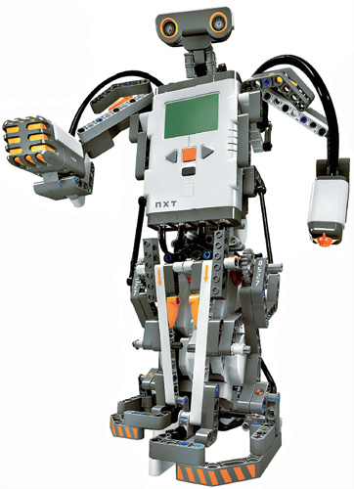
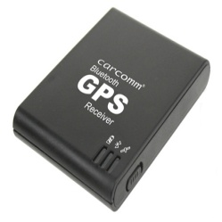
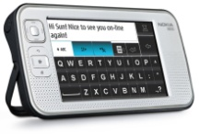
Robot
Tribot
RFID reader
NaradaBrokering
Server
Ultrasonic Sensor
Light Sensor
Sound Sensor
NaradaBrokering
Server
NaradaBrokering
Server
Robot
Alpha Rex
GPS receiver
Tablet PC
Same architecture developed for QuakeSim

Slide 7
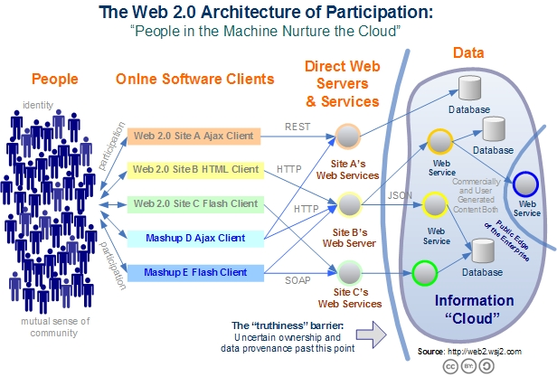
Web 2.0 Systems like Grids have Portals, Services, Resources
Captures the incredible development of interactive Web sites enabling people to create and collaborate

Slide 8
What are Clouds?
Clouds are “Virtual Clusters” (maybe “Virtual Grids”) of usually “Virtual Machines”
  They may cross administrative domains or may “just be a single cluster”; the user cannot and does not want to know
  VMware, Xen .. virtualize a single machine and service (grid) architectures virtualize across machines
Clouds support access to (lease of) computer instances
  Instances accept data and job descriptions (code) and return results that are data and status flags
Clouds can be built from Grids but will hide this from user
Clouds designed to build 100 times larger data centers
Clouds support green computing by supporting remote location where operations including power cheaper

Slide 9
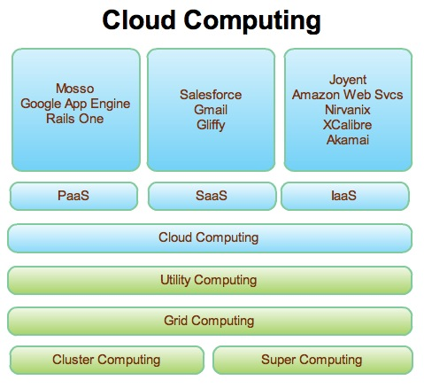
Web 2.0 and Clouds
Grids are no more but most of what we did is reusable
Clouds are designed heterogeneous (for functionality) scalable distributed systems whereas Grids integrate a priori heterogeneous (for politics) systems
Clouds should be easier to use,
cheaper, faster and scale to larger
sizes than Grids
Grids assume you can’t design
system but rather must accept
results of N independent
supercomputer funding calls
SaaS: Software as a Service
IaaS: Infrastructure as a Service
or HaaS: Hardware as a Service
PaaS: Platform as a Service
delivers SaaS on IaaS

Slide 10
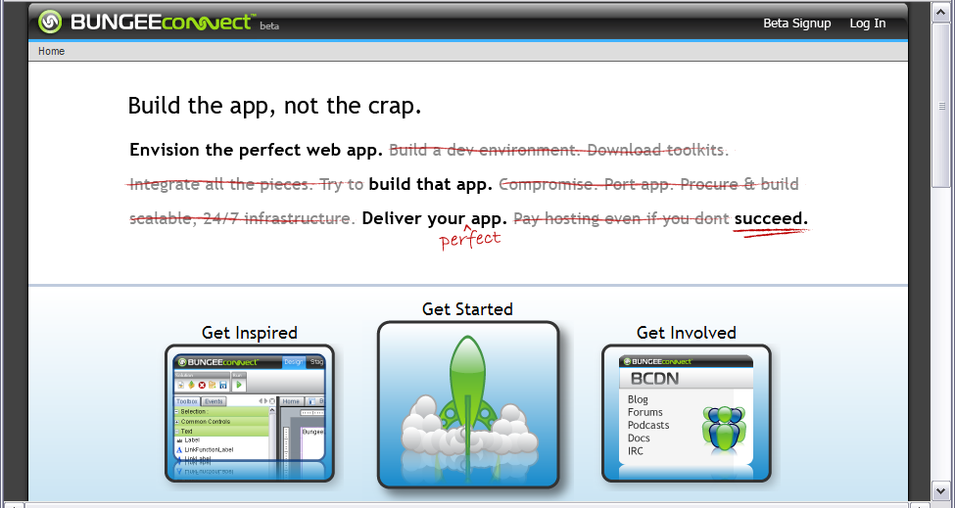
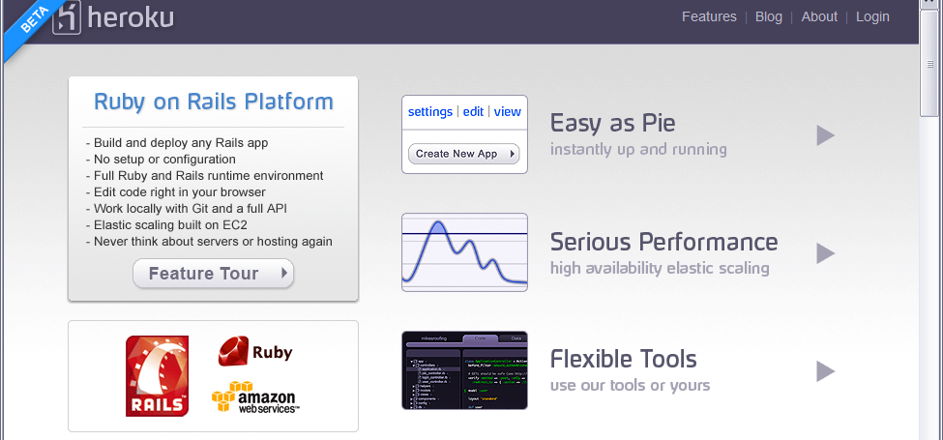
Some Small Cloud Companies
http://www.bungeelabs.com/
http://heroku.com/
http://heroku.com/

Slide 11
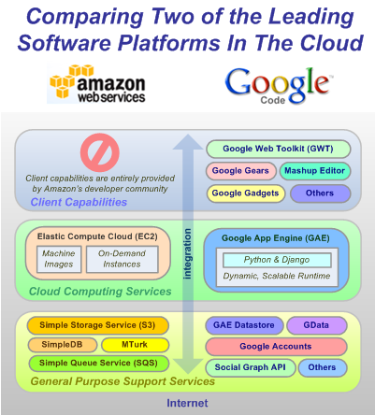
The Big Players!
Amazon and Google
IBM, Dell, Microsoft, Sun ….
are not far behind

Slide 12
Cloud References
http://en.wikipedia.org/wiki/Cloud_computing
  Includes references to Amazon, Apple, Dell, Enomalism, Globus, Google, IBM, KnowledgeTreeLive, Nature, New York Times, Zimdesk
  Others like Microsoft Windows Live Skydrive important
http://en.wikipedia.org/wiki/Amazon_Elastic_Compute_Cloud
http://uc.princeton.edu/main/index.php?option=com_content&task=view&id=2589&Itemid=1 Policy Issues
http://www.cra.org/ccc/home.article.bigdata.html
  Hadoop (MapReduce) and “Data Intensive Computing”
http://ianfoster.typepad.com/blog/2008/01/theres-grid-in.html
Dion Hinchcliffe http://blogs.zdnet.com/Hinchcliffe/?p=166
http://www.productionscale.com/home/2008/4/24/cloud-computing-get-your-head-in-the-clouds.html
http://www.readwriteweb.com/archives/windows_collapsing_2011_tipping_point.php

Slide 13
Web2.0 Offers
Technologies such as Mashups, Gadgets, JSON, Ajax, RSS
S/P/H/IaaS “as a Service” deployment
Some special services implementing VOaaS Virtual Organizations as a Service
  Tagging user generated comments/labels
  Facebook, LinkedIn …..implementing collegiality
  Shared files (electronic resources) by P2P or Flickr/YouTube approach
  OaaS (Office as a Service) as in Google documents
  Blogs, Wikis including Wikipedia itself
  SciVee and myExperiment are some eScience examples

Slide 14
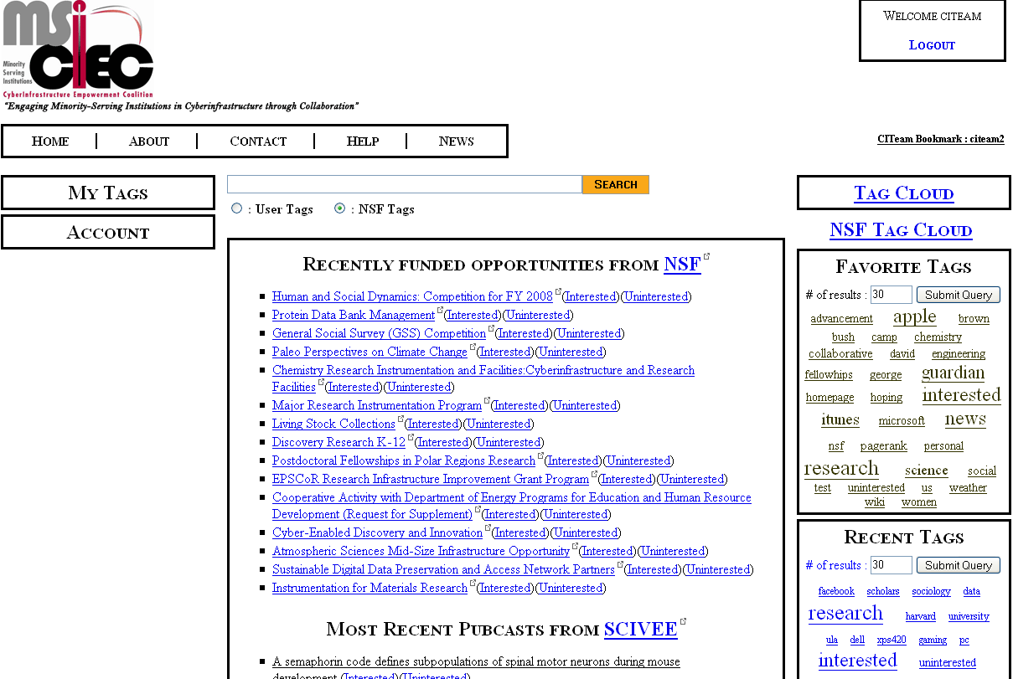
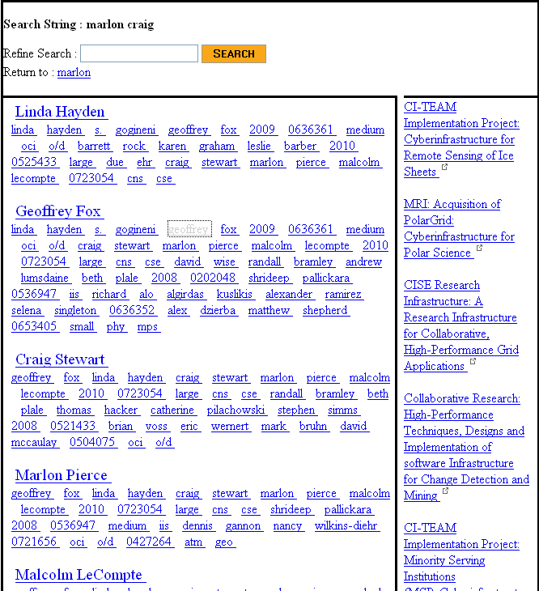
MSI-CIEC Web 2.0 Research Matching Portal
Portal supporting tagging and linkage of Cyberinfrastructure Resources
NSF (and other agencies via grants.gov) Solicitations and Awards
MSI-CIEC Portal Homepage
Feeds such as SciVee and NSF
Researchers on NSF Awards
User and Friends
TeraGrid Allocations
Search Results
Search for linked people, grants etc.
Could also be used to support matching of students and faculty for REUs etc.
MSI-CIEC Portal Homepage
Search Results

Slide 15
Web 2.0 and Web Services
I once thought Web Services were inevitable but this is no longer clear to me
They achieved interoperability by exposing everything )in SOAP headers)
  Alternative (REST) exposes the minimum needed
Web services are complicated, slow and non functional
  WS-Security is unnecessarily slow and pedantic (canonicalization of XML)
  WS-RM (Reliable Messaging) seems to have poor adoption and doesn’t work well in collaboration
  WSDM (distributed management) specifies a lot
There are de facto Web 2.0 standards like Google Maps and powerful suppliers like Google/Microsoft which “define the architectures/interfaces

Slide 16
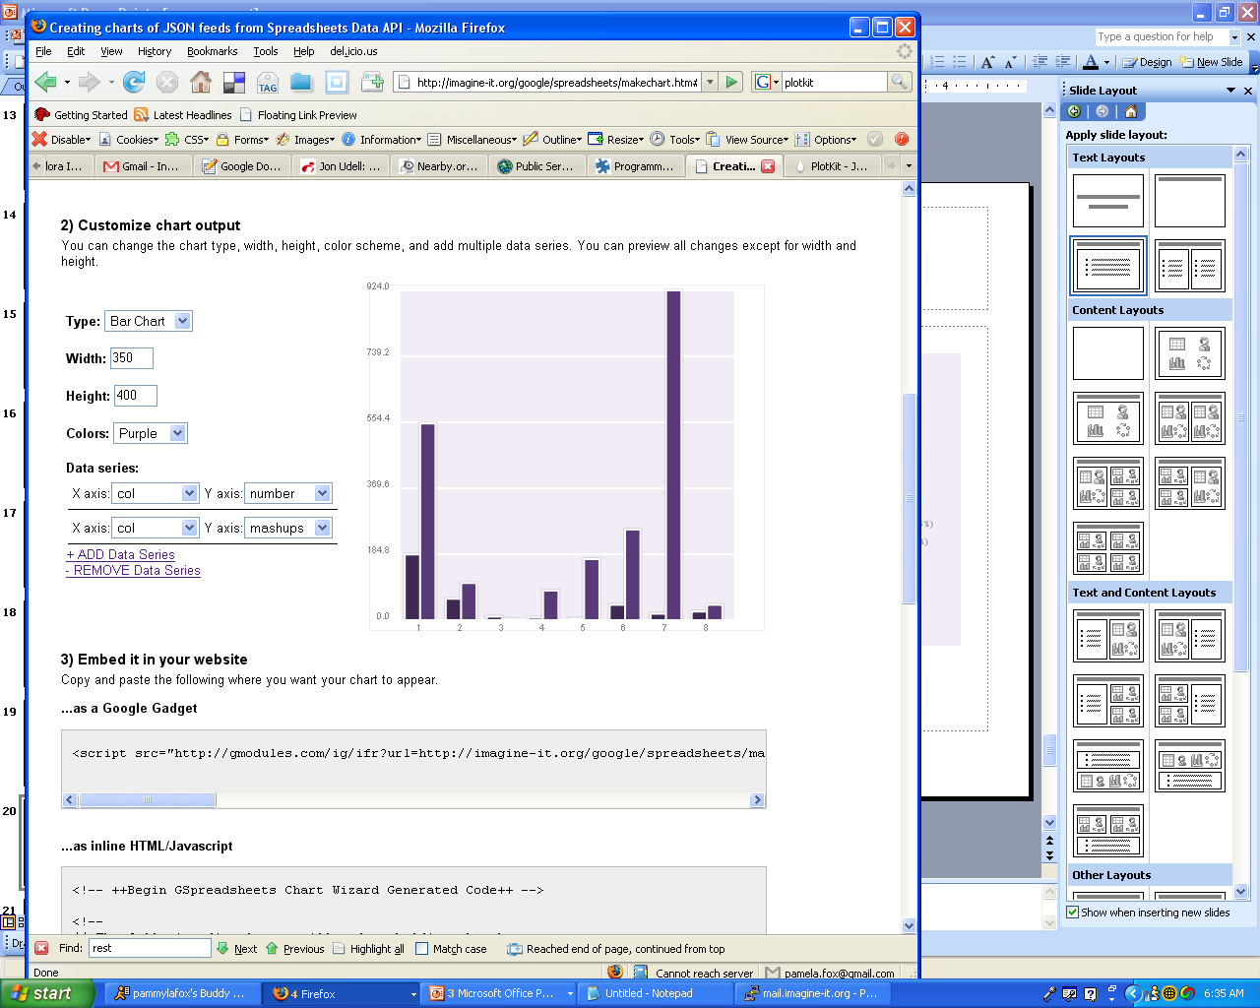
Distribution of APIs and Mashups per Protocol
Google maps
Number of
APIs
Number of
Mashups
del.icio.us
SOAP is quite a small fraction
virtual earth
411sync
yahoo! search
yahoo! geocoding
technorati
netvibes
yahoo! images
trynt
Amazon ECS
yahoo! local
live.com
Google search
flickr
YouTube
eBay
Amazon S3
REST
SOAP
XML-RPC
REST,
XML-RPC
REST,
XML-RPC, SOAP
REST,
SOAP
JS
Other

Slide 17
Too much Computing?
Historically both grids and parallel computing have tried to increase computing capabilities by
  Optimizing performance of codes at cost of re-usability
  Exploiting all possible CPU’s such as Graphics co-processors and “idle cycles” (across administrative domains)
  Linking central computers together such as NSF/DoE/DoD supercomputer networks without clear user requirements
Next Crisis in technology area will be the opposite problem – commodity chips will be 32-128way parallel in 5 years time and we currently have no idea how to use them on commodity systems – especially on clients
  Only 2 releases of standard software (e.g. Office) in this time span so need solutions that can be implemented in next 3-5 years

Slide 18
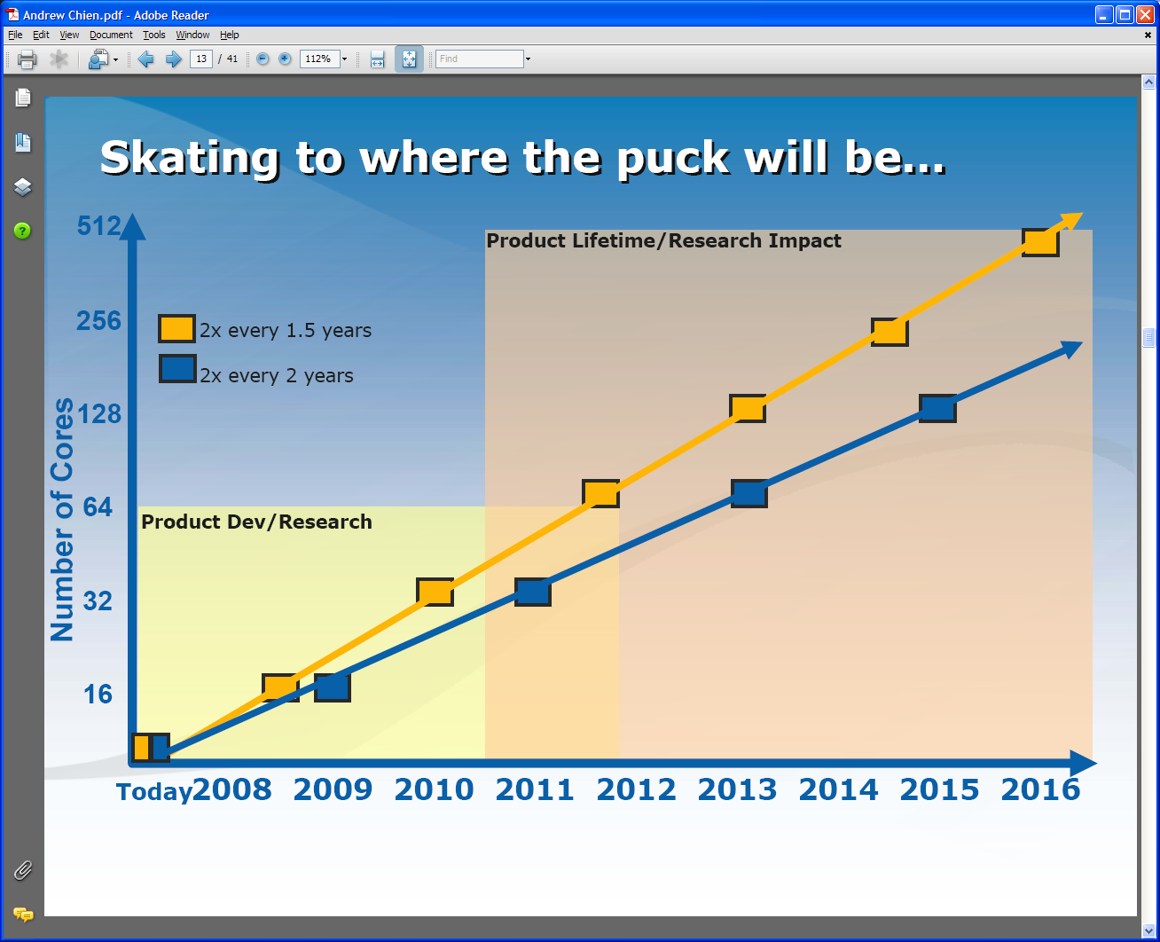
Intel’s Projection

Slide 19
Intel’s Application Stack

Slide 20
Too much Data to the Rescue?
Multicore servers have clear “universal parallelism” as many users can access and use machines simultaneously
Maybe also need application parallelism (e.g. datamining) as needed on client machines
Over next years, we will be submerged of course in data deluge
  Scientific observations for e-Science
  Local (video, environmental) sensors
  Data fetched from Internet defining users interests
Maybe data-mining of this “too much data” will use up the “too much computing” both for science and commodity PC’s
  PC will use this data(-mining) to be intelligent user assistant?
  Must have highly parallel algorithms

Slide 21
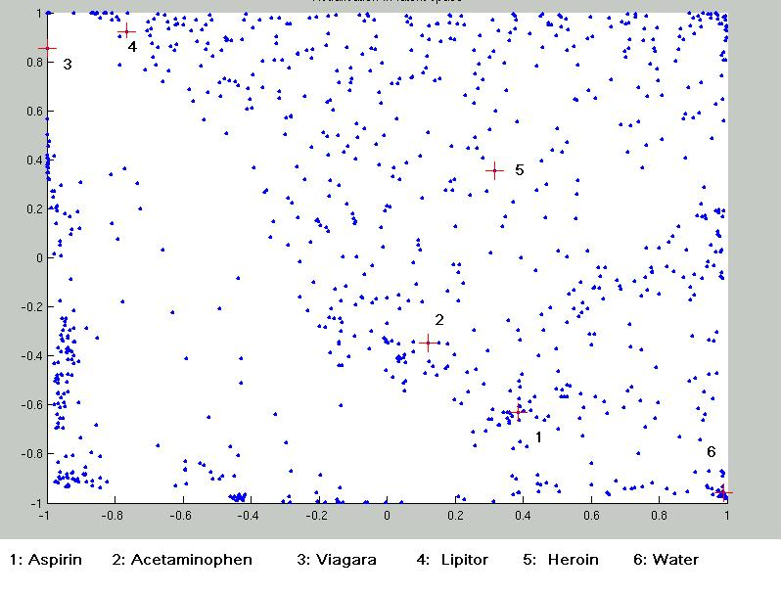
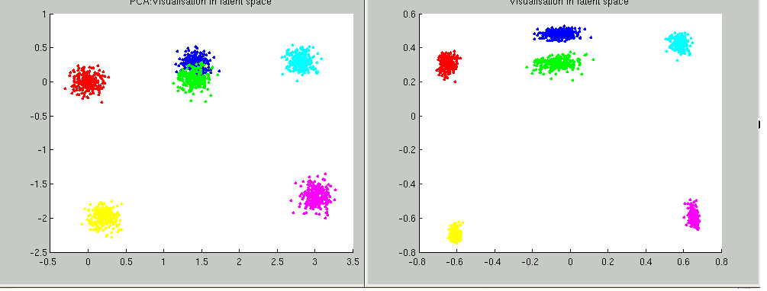
Parallel Generative Topographic Mapping GTM
Parallel Datamining on multicore systems using algorithms related to deterministic annealing as used in RDAHMM
Reduce dimensionality preserving topology and perhaps distances
Here project to 2D
GTM Projection of PubChem: 10,926,94 compounds in 166 dimension binary property space takes 4 days on 8 cores. 64X64 mesh of GTM clusters interpolates PubChem. Could usefully use 1024 cores!
Use for GIS style 2D browsing interface to chemistry
f ≈ 1-efficiency
PCA
GTM
Linear PCA v. nonlinear GTM on 6 Gaussians in 3D
PCA is Principal Component Analysis
GTM Speedup ≥ 7.8 on 8 cores for large problems
SALSA
Notes:
21

Slide 22
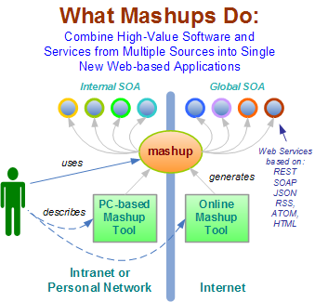
Mashups v Workflow?
Mashup Tools are reviewed at http://blogs.zdnet.com/Hinchcliffe/?p=63
Workflow Tools are reviewed by Gannon and Fox http://grids.ucs.indiana.edu/ptliupages/publications/Workflow-overview.pdf
Both include scripting in PHP, Python, ssh etc. as both implement distributed programming at level of services
Mashups use all types of service interfaces and perhaps do not have the potential robustness (security) of Grid service approach
Mashups typically “pure” HTTP (REST)
22
Notes:
22

Slide 23
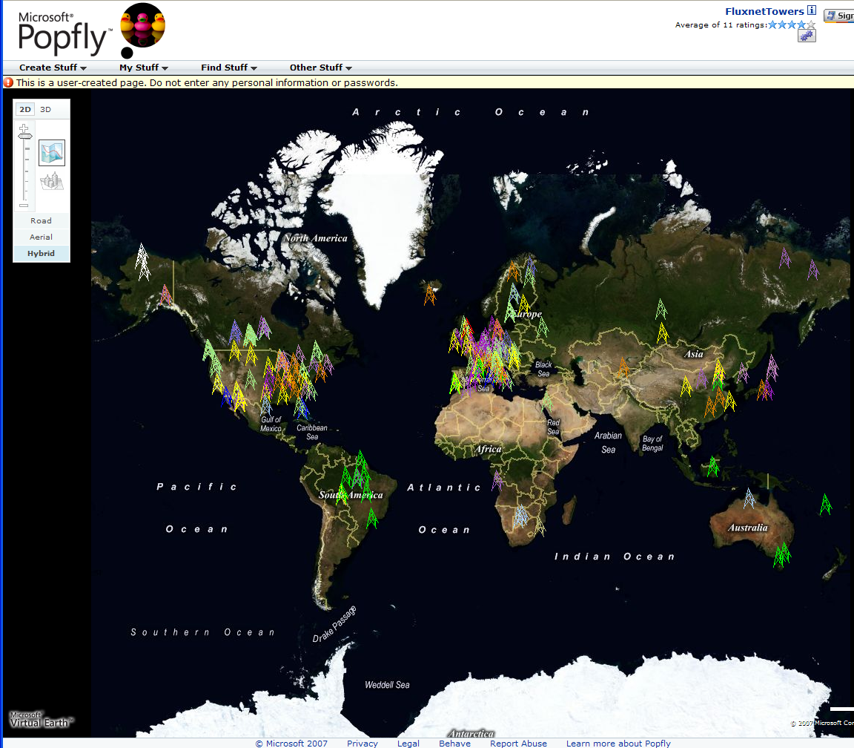
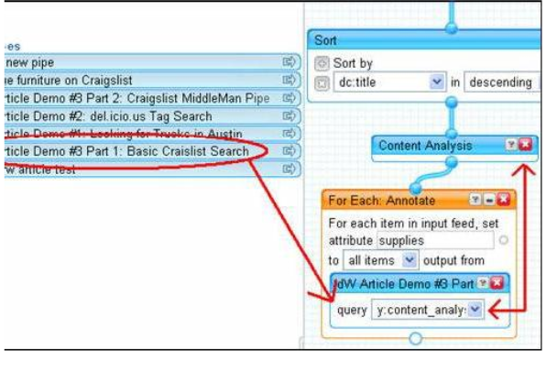
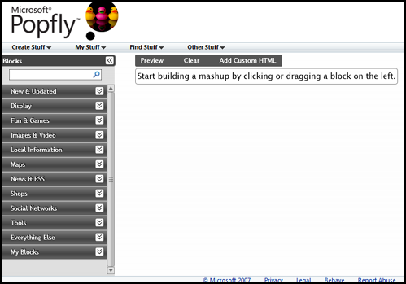
Major Companies entering mashup area
Web 2.0 Mashups (by definition the largest market) are likely to drive composition tools for Grid and web
Recently we see Mashup tools like Yahoo Pipes and Microsoft Popfly which have familiar graphical interfaces
Currently only simple examples but tools could become powerful
Yahoo Pipes

Slide 24
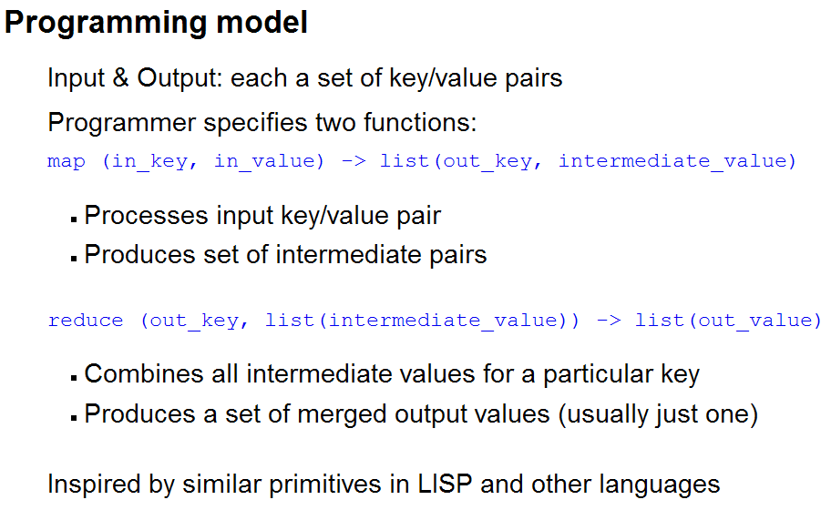
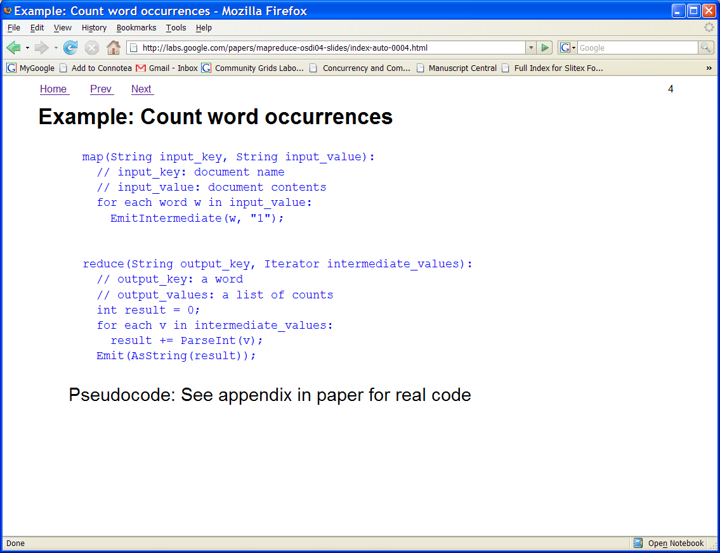
Google MapReduce
Simplified Data Processing on Clusters/Clouds
http://labs.google.com/papers/mapreduce.html
This is a dataflow model between services where services can do useful document oriented data parallel applications including reductions
The decomposition of services onto cluster engines (clouds) is automated
The large I/O requirements of datasets changes efficiency analysis in favor of dataflow
Services (count words in example) can obviously be extended to general parallel applications
There are many alternatives to language expressing either dataflow and/or parallel operations and/or workflow

Slide 25
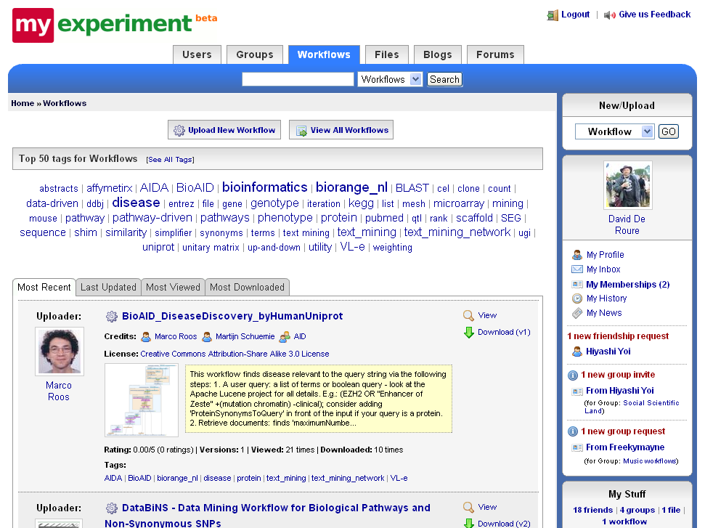

Slide 26
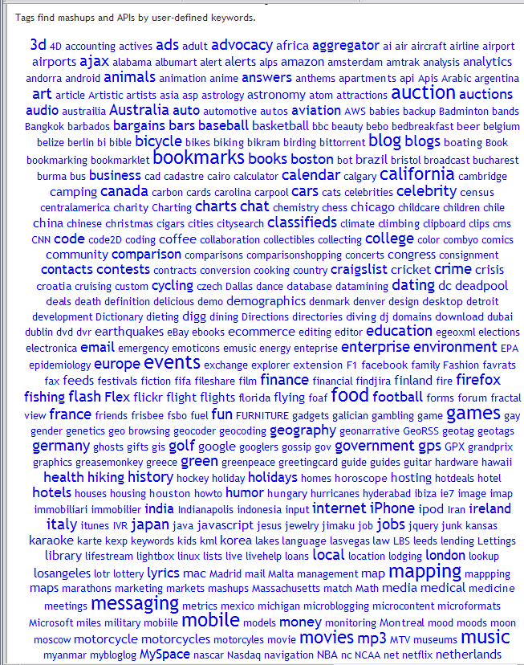
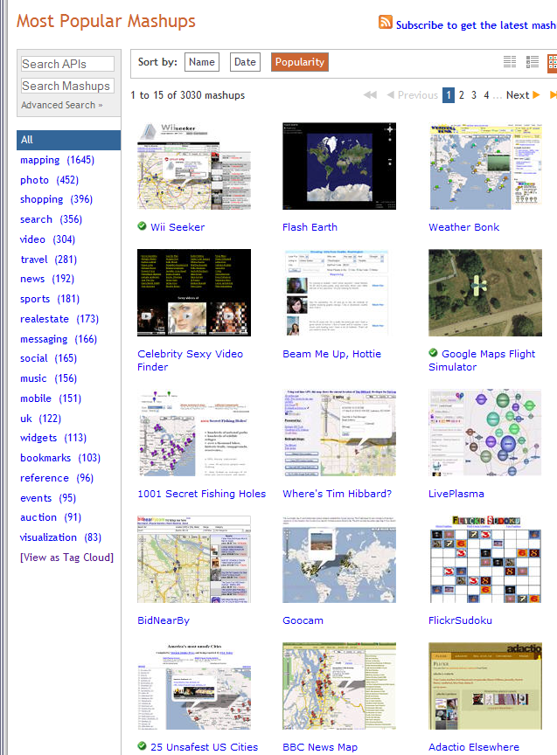
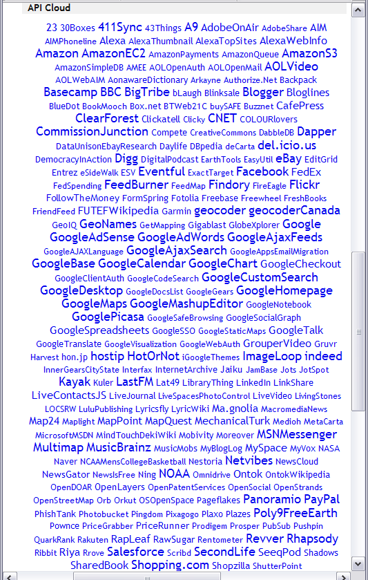
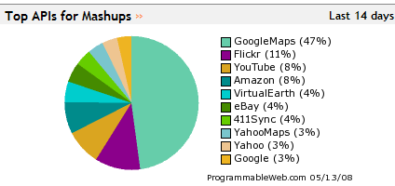
Web 2.0 Mashups and APIs
http://www.programmableweb.com/ has (May 14 2008) 3030 Mashups and 748 Web 2.0 APIs
and with GoogleMaps the most often used in Mashups
This is the Web 2.0 UDDI (service registry)

Slide 27
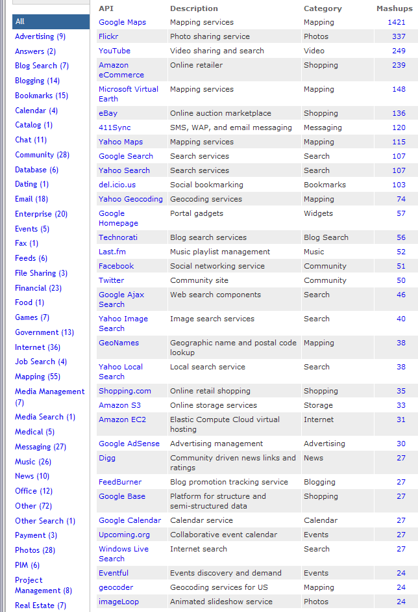
The List of Web 2.0 API’s
Each site has API and its features
Divided into broad categories
Only a few used a lot
(64 API’s used in 10 or
more mashups)
RSS feed of new APIs
Google maps dominates
but Amazon EC2/S3
growing in popularity
Interesting that no such eScience site; we are not building interoperable
(re-usable) services?

Slide 28
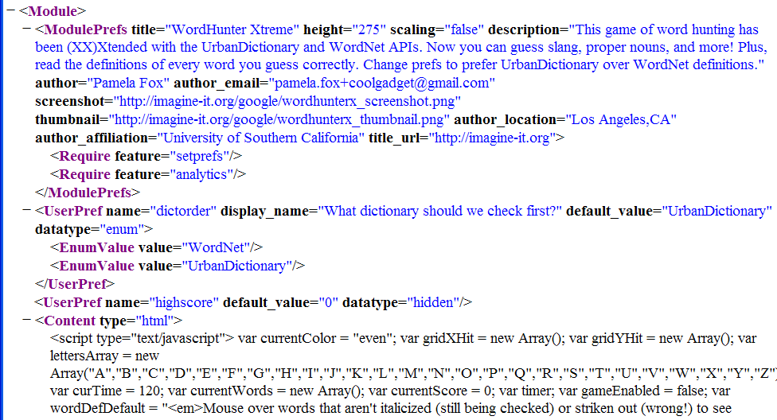
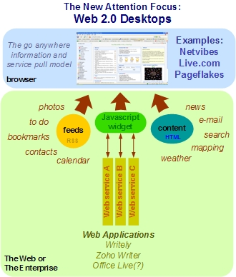
Typical Google Gadget Structure
Google Gadgets are an example of
Start Page (Web 2.0 term for portals) technology
See http://blogs.zdnet.com/Hinchcliffe/?p=8
… Lots of HTML and JavaScript </Content> </Module>
Portlets build User Interfaces by combining fragments in a standalone Java Server
Google Gadgets build User Interfaces by combining fragments with JavaScript on the client
Notes:
28

Slide 29
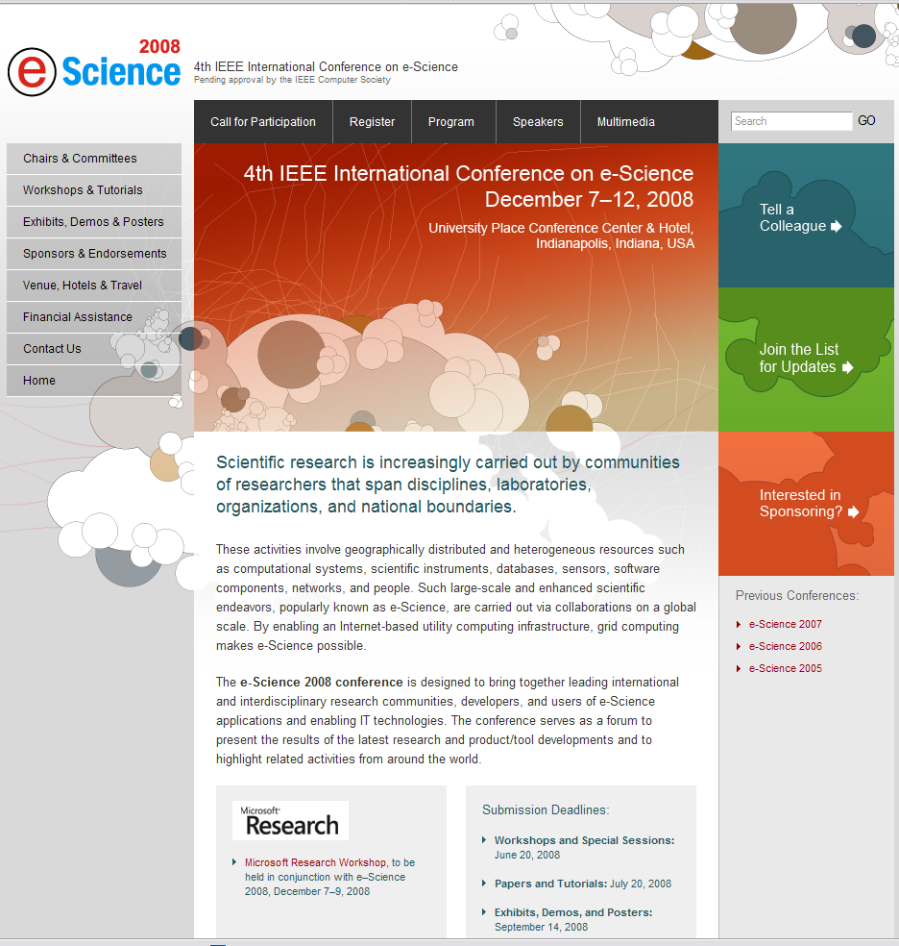
Please submit a paper and/or workshop proposal to eScience 2008
http://escience2008.iu.edu/
Conference
December 7-12 2008
Papers July 20
Workshops June 20

