Slide 1
Cloud-Based Perception and Control of Sensor Nets and Robot Swarms
AFOSR FA9550-13-1-0225
DDDAS Program Review
IBM T.J. Watson Research Center
December 3 2014
Geoffrey Fox, David Crandall, Kris Hauser
Students: Supun Kamburugamuve, Hengjing He,
Jangwon Lee, Jingya Wang
gcf@indiana.edu
http://www.infomall.org
School of Informatics and Computing
Digital Science Center
Indiana University Bloomington

Slide 2
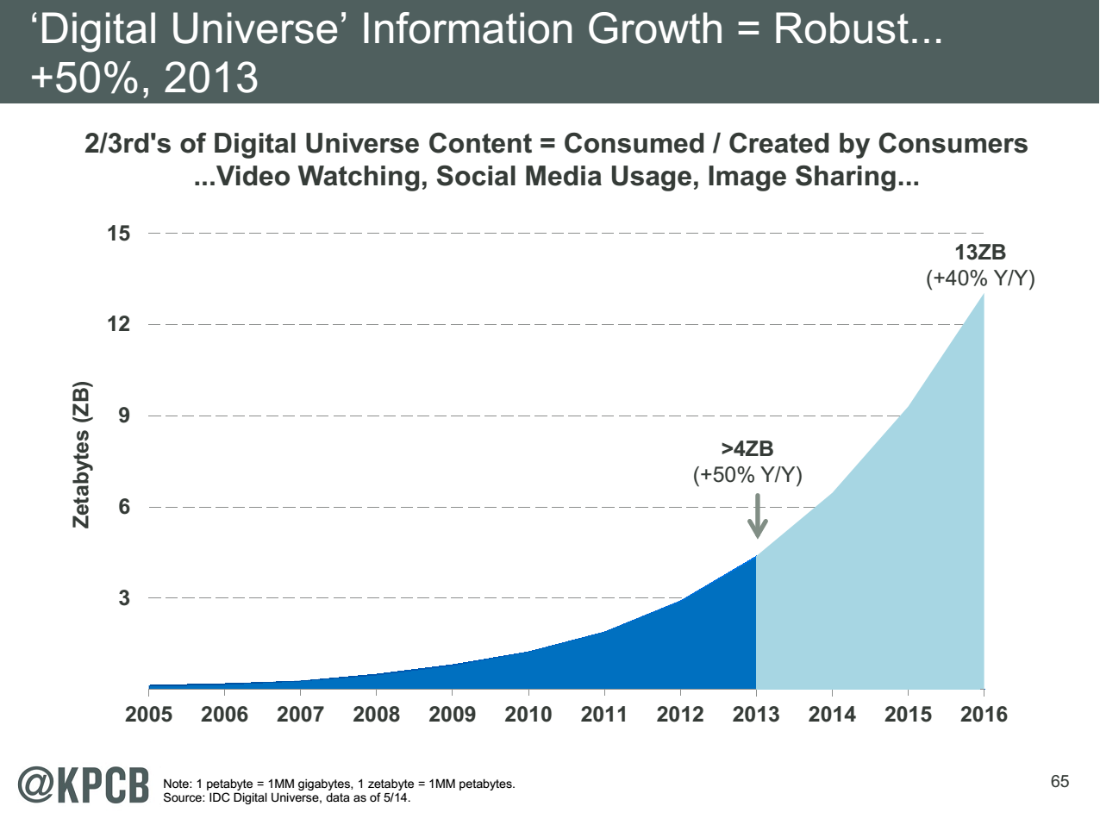
Zettabyte = 1000 Exabytes = 10⁶ Petabytes
Note largest science ~100 petabytes = 0.000025 total
Motivates leverage of commercial infrastructure
Note 7 ZB (7. 10²¹) is about a
terabyte (10¹²) for each person
in world
http://www.kpcb.com/internet-trends

Slide 3
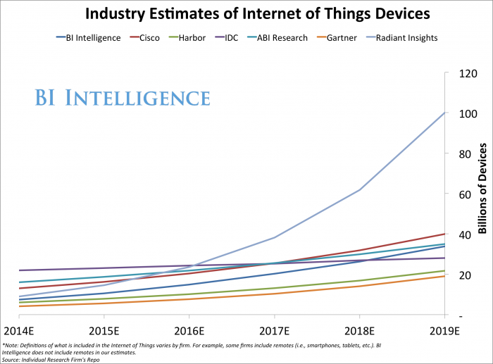

Slide 4
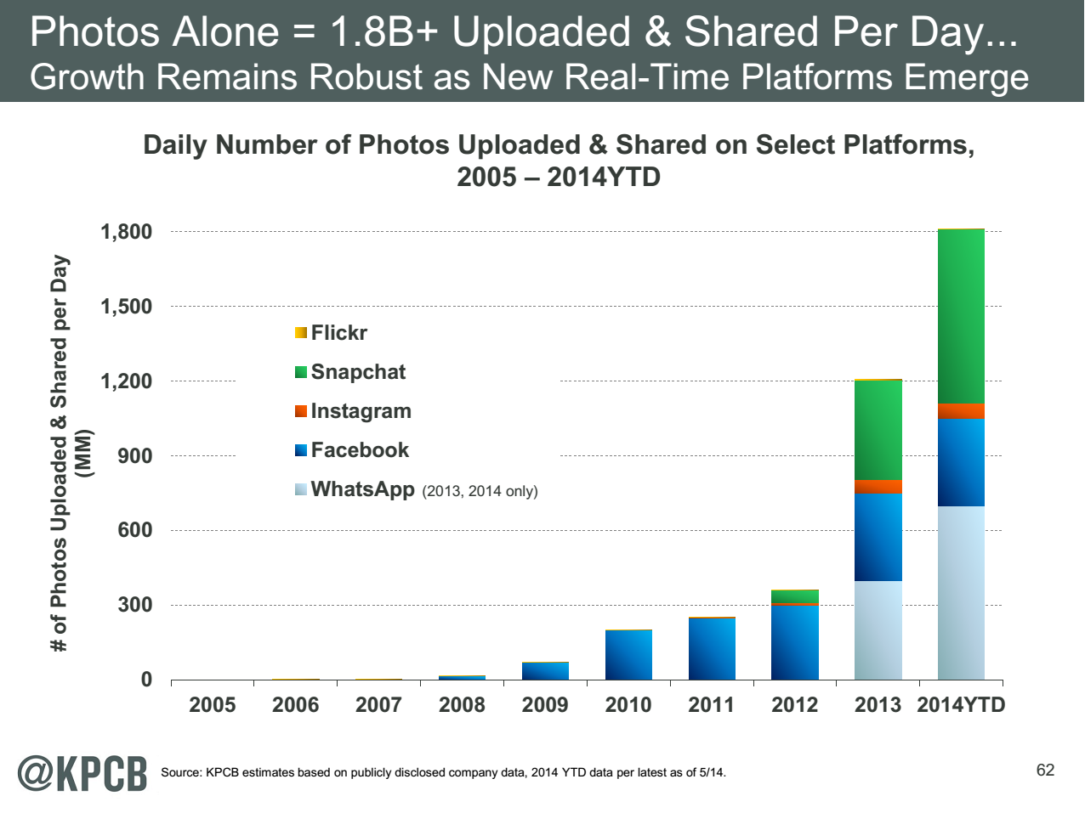
http://www.kpcb.com/internet-trends

Slide 5
51 Detailed Use Cases: Contributed July-September 2013
http://bigdatawg.nist.gov/usecases.php, 26 Features for each use case
Government Operation(4): National Archives and Records Administration, Census Bureau
Commercial(8): Finance in Cloud, Cloud Backup, Mendeley (Citations), Netflix, Web Search, Digital Materials, Cargo shipping (as in UPS)
Defense(3): Sensors, Image surveillance, Situation Assessment
Healthcare and Life Sciences(10): Medical records, Graph and Probabilistic analysis, Pathology, Bioimaging, Genomics, Epidemiology, People Activity models, Biodiversity
Deep Learning and Social Media(6): Driving Car, Geolocate images/cameras, Twitter, Crowd Sourcing, Network Science, NIST benchmark datasets
The Ecosystem for Research(4): Metadata, Collaboration, Translation, Light source data Astronomy and Physics(5): Sky Surveys including comparison to simulation, Large Hadron Collider at CERN, Belle II Accelerator in Japan
Earth, Environmental and Polar Science(10): Radar Scattering in Atmosphere, Earthquake, Ocean, Earth Observation, Ice sheet Radar scattering, Earth radar mapping, Climate simulation datasets, Atmospheric turbulence identification, Subsurface Biogeochemistry (microbes to watersheds), AmeriFlux and FLUXNET gas sensors
Energy(1): Smart grid
Largest open collection of Big Data Requirements?
Analyzed for common characteristics

Slide 6
Computer Cloud Assumptions I
Clouds will continue to grow in importance
Clouds consists of an “infinite” number of compute/storage/network nodes available on demand
Clouds can be public and/or private with similar architectures (but different security issues)
Clouds have some overheads but these are decreasing using SR-IOV and better hypervisors
Clouds are getting more powerful with better networks but
  Exascale Supercomputer will not be a cloud although most other systems will be!
Performance of clouds can be (easily) understood using standard (parallel computing) methods
Streaming and Internet of Things applications (80% NIST use cases) particularly well suited to clouds
Can deploy “arbitrary parallel resources” to address DDDAS/IoT

Slide 7
Computer Cloud Assumptions II
Big data revolution built around cloud processing
Incredibly powerful software ecosystem (the “Apache Big Data Stack” or ABDS) emerged to support Big Data
Much of this software is open-source and at all points in stack at least one good open source choice
DevOps (Chef, Cobbler ..) deploys dynamic virtual clusters
Research (science and engineering) similar big data needs to commercial but less search and recommender engines
  Both have large pleasingly parallel component (50%)
  Less classic MapReduce and more iterative algorithms
Streaming (DDDAS) dominant (80%) and similar needs in research and commercial
HPC-ABDS links classic parallel computing and ABDS and runs on clouds or HPC systems

Slide 8
Overhead of KVM between 0.8% and 0.5% compared to native Bare-metal

Slide 9
SR-IOV Enhanced Chemistry on Clouds
SR-IOV is single root I/O virtualization and cuts through virtualization overhead
VMs running LAMMPs achieve near-native performance at 32 cores & 4GPUs
  96.7% efficiency for LJ
  99.3% efficiency for Rhodo

Slide 10
There are a lot of Big Data and HPC Software systems
Challenge! Manage environment offering these different components

Slide 11
Maybe a Big Data Initiative would include
We don’t need 266 software packages so can choose e.g.
Workflow: IPython, Pegasus or Kepler (replaced by tools like Crunch, Tez?)
Data Analytics: Mahout, R, ImageJ, Scalapack
High level Programming: Hive, Pig
Parallel Programming model: Hadoop, Spark, Giraph (Twister4Azure, Harp), MPI;
Streaming: Storm, Kapfka or RabbitMQ (Sensors)
In-memory: Memcached
Data Management: Hbase, MongoDB, MySQL or Derby
Distributed Coordination: Zookeeper
Cluster Management: Yarn, Slurm
File Systems: HDFS, Lustre
DevOps: Cloudmesh, Chef, Puppet, Docker, Cobbler
IaaS: Amazon, Azure, OpenStack, Libcloud
Monitoring: Inca, Ganglia, Nagios

Slide 12
ABDS Big Data HPC
Orchestration Crunch, Tez, Cloud Dataflow Kepler, Pegasus
Libraries Mllib/Mahout, R, Python Matlab, Eclipse, Apps
High Level Programming Pig, Hive, Drill Domain-specific Languages
Platform as a Service App Engine, BlueMix, Elastic Beanstalk XSEDE Software Stack
Languages Java, Erlang, SQL, SparQL Fortran, C/C++
Streaming Storm, Kafka, Kinesis
Parallel Runtime MapReduce MPI/OpenMP/OpenCL
Coordination Zookeeper
Caching Memcached
Data Management Hbase, Neo4J, MySQL iRODS
Data Transfer Sqoop GridFTP
Scheduling Yarn Slurm
File Systems HDFS, Object Stores Lustre
Formats Thrift, Protobuf FITS, HDF
Infrastructure CLOUDS SUPERCOMPUTERS
Integrated Software Ecosystem
Using ABDS gives sustainable software
Deploy with Python+Chef Cloudmesh DevOps on public/private cloud, container or bare-metal as Software defined system (virtual cluster)

Slide 13
Harp Plug-in to Hadoop
Make ABDS high performance – do not replace it!
Work of Judy Qiu and Bingjing Zhang.
Left diagram shows architecture of Harp Hadoop Plug-in that adds high performance communication, Iteration (caching) and support for rich data abstractions including key-value
Alternative to Spark, Giraph, Flink, Reef, Hama etc.
Right side shows efficiency for 16 to 128 nodes (each 32 cores) on WDA-SMACOF dimension reduction dominated by conjugate gradient
WDA-SMACOF is general purpose dimension reduction

Slide 14
Open Source Apache Storm
http://storm.apache.org/ Written in Clojure (Lisp to Java) & Java
Apache Storm is a distributed real time (DDDAS/streaming) computation framework for processing streaming data exposing a coarse grain dataflow model
Storm is being used to do real time analytics, online machine learning (Spark, Hadoop …..), distributed RPC etc.
Provides scalable, fault tolerant and guaranteed message processing.
Trident is a high level API on top of Storm which provides functions like stream joins, groupings, filters etc. Also Trident has exactly-once processing guarantees.
The project was originally developed at Twitter for processing Tweets from users and was donated to ASF in 2013.
  S4 (Yahoo) and Samza (LinkedIn) are also Apache Streaming systems
  Google MillWheel, Amazon Kinesis, Azure Stream Analytics
Storm has being used in major deployments in Twitter, Yahoo, Alibaba, Groupon etc.

Slide 15
Apache Storm - Architecture
Supervisor runs stream
processing code using
its workers
ZooKeeper acts as a
communication and
coordination
layer between Nimbus
and Supervisors
User
Supervisor
User submits and controls
running topologies
through Nimbus
ZooKeeper
Supervisor
Nimbus
ZooKeeper
Supervisor
Master node controling
the running topologies
ZooKeeper
Supervisor
ZooKeeper Cluster
Multiple nodes in the cluster
run Supervisor

Slide 16
Storm uses Tuples & Streams
Tuple
  “user”, 1000, Point Object
Tuple is a ordered list of elements and
storm should know how to serialize each element
Stream
  Tuple
  Tuple
  Tuple
  Tuple
  Tuple
Stream is an unbounded sequence of tuples

Slide 17
Storm – Spouts & Bolts
Spouts & Bolts are written by user
Entry point of data to Storm
Get data from external sources
like Message Queues, Databases
Spout
  Tuple
  Tuple
  Tuple
  Tuple
  Tuple
Output the data as a
sequence of tuples, i.e stream
Process
the data
Receive tuples from Spouts & Bolts
Bolt
  Tuple
  Tuple
  Tuple
  Tuple
  Tuple
  Tuple
  Tuple
  Tuple
Output a sequence
of tuples, i.e stream
Process
the tuples

Slide 18
Storm Dataflow Topology
A user defined arrangement of Spouts and Bolts
Bolt
Spout
Bolt
Bolt
Sequence of Tuples
Bolt
Spout
Bolt
The tuples are sent using messaging,
Storm uses Kryo to serialize the tuples
and Netty to transfer the messages
The topology defines how the bolts
receive its messages using Stream Grouping

Slide 19
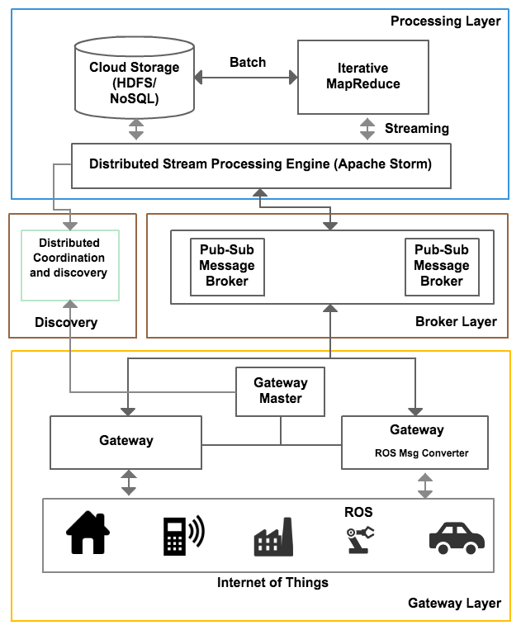
Scalable DDDAS IoTCloud Architecture
Basic Pub-Sub IoT system developed under AFRL WPAFB funding
This year extended to use Apache Storm and test
https://github.com/iotcloud
http://iotcloud.github.io/source.html

Slide 20
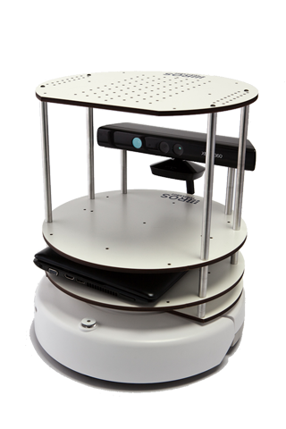
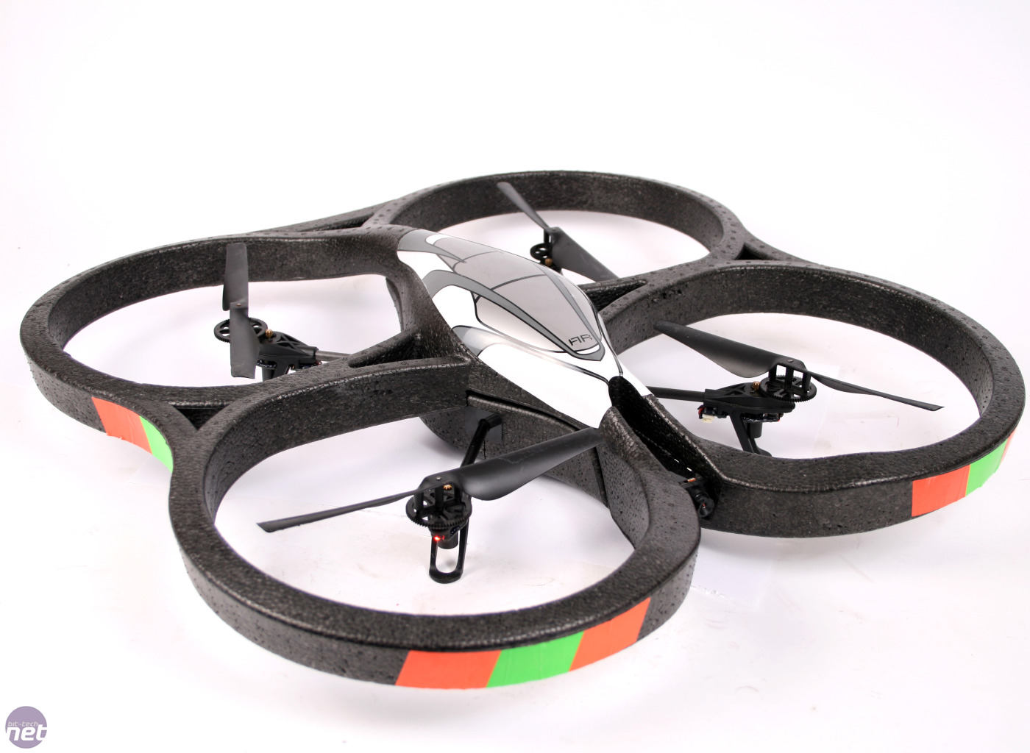
Deployment
Cloud Environment
Drone
RabbitMQ
ROS
TurtleBot
Data &
Control Messages
Gateway
Performance
RabbitMQ
Data &
Control Messages
Apache Storm
processing data
In OpenStack Cloud
Brokers
Spout
Bolt

Slide 21
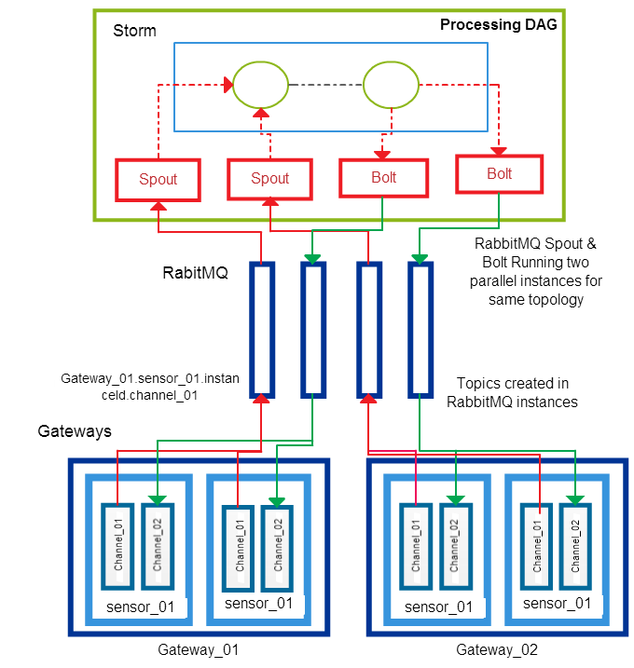
Set up with RabbitMQ – Shared Channels

Slide 22
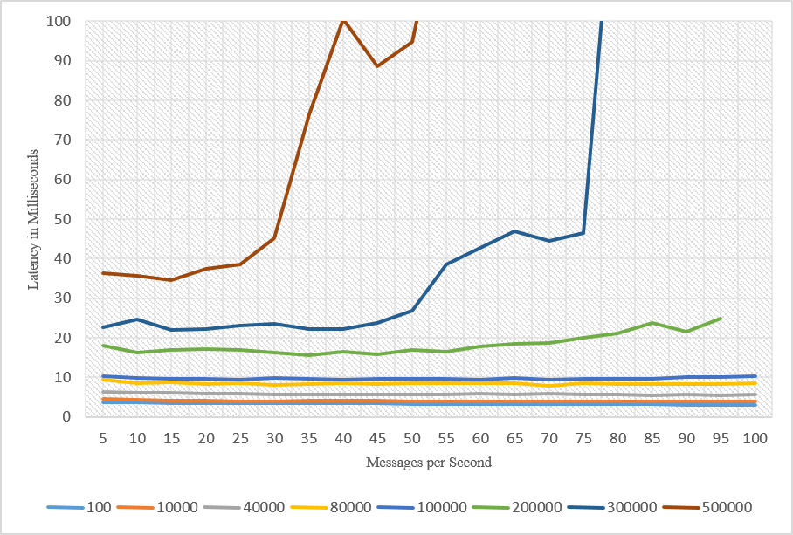
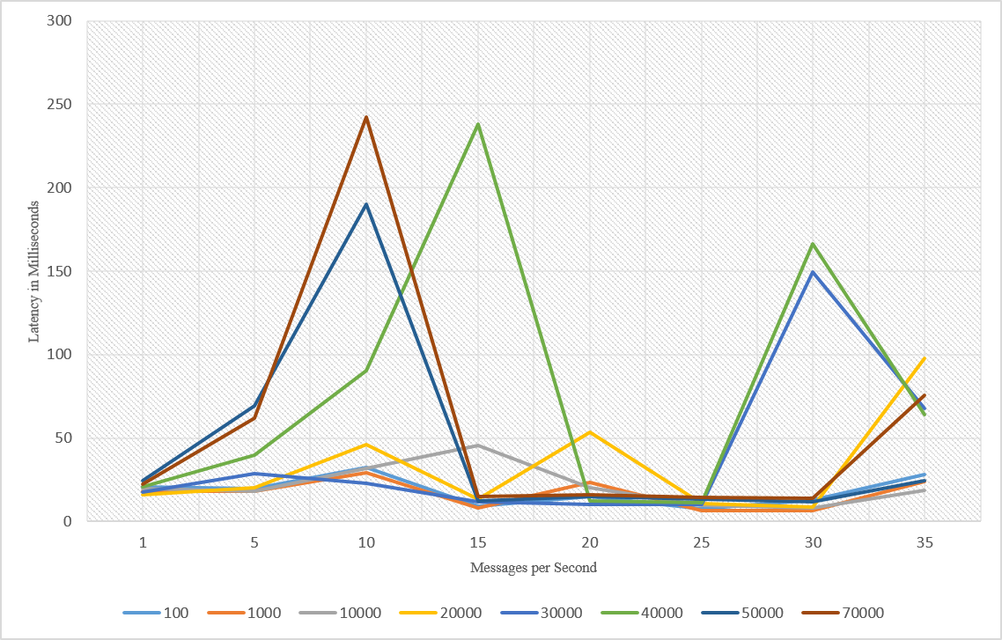
Latency with Kafka
Note change in scales
Latency with RabbitMQ
Message sizes in bytes

Slide 23
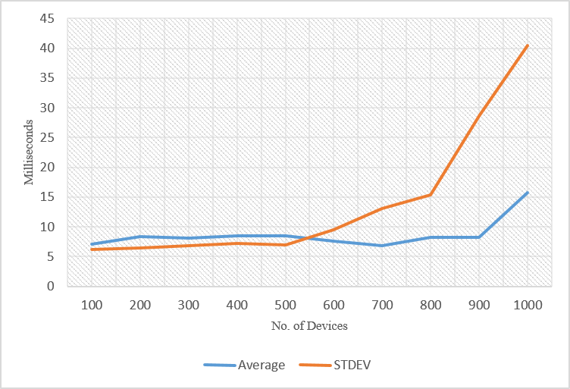
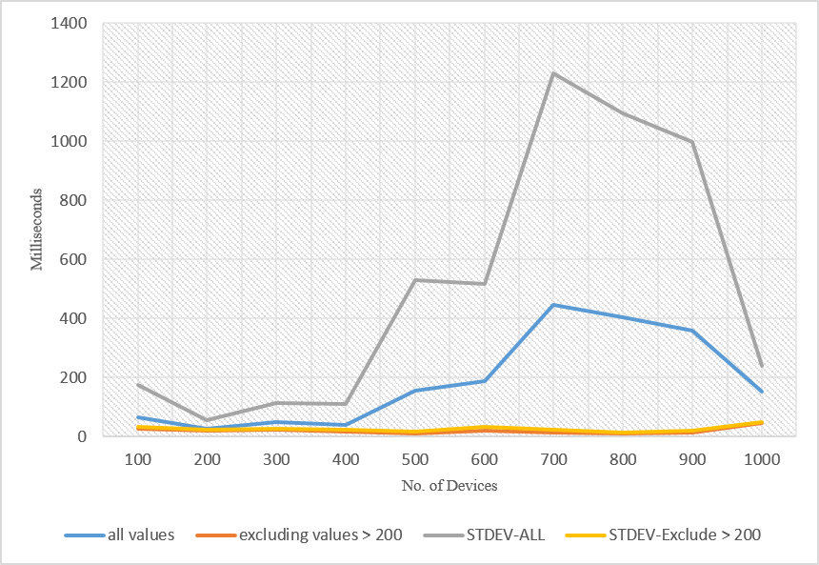
Varying number of Devices –
Kafka
Varying number of Devices- RabbitMQ

Slide 24
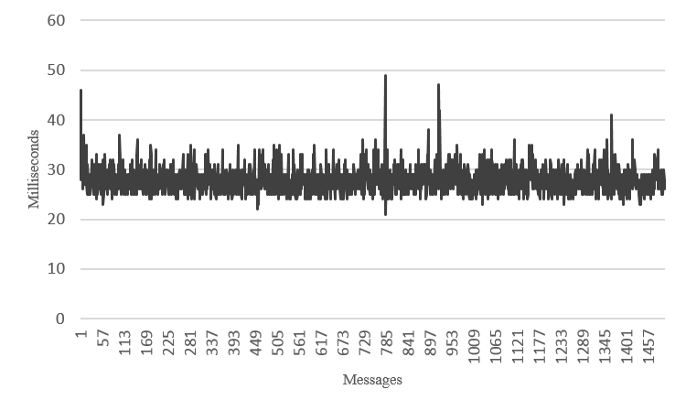
Robot Latency RabbitMQ
Turtlebot
Drone

Slide 25
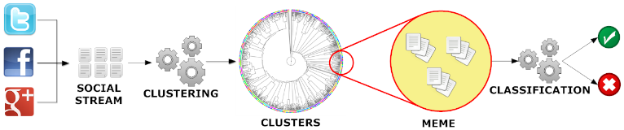
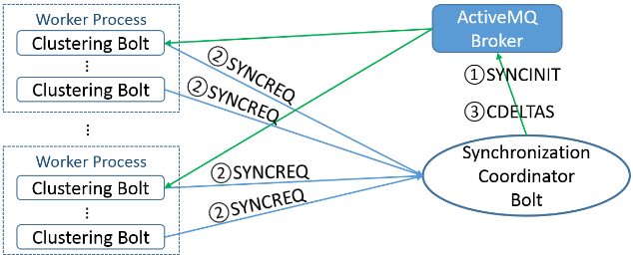
Parallel Tweet Clustering with Storm
Judy Qiu and Xiaoming Gao
Storm Bolts coordinated by ActiveMQ to synchronize parallel cluster center updates – add loops to Storm
2 million streaming tweets processed in 40 minutes; 35,000 clusters
Sequential
Parallel – eventually 10,000 bolts

Slide 26
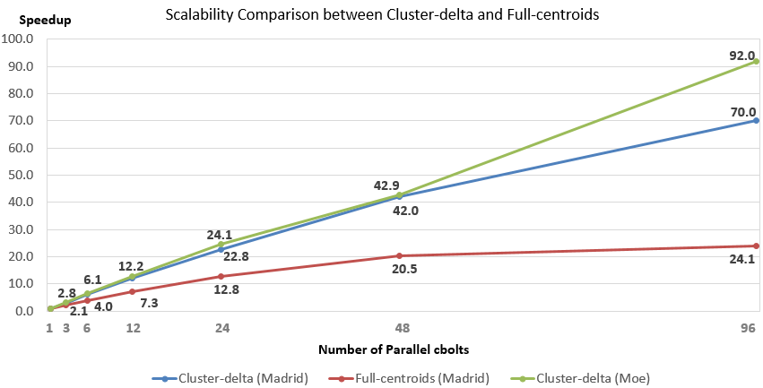
Parallel Tweet Clustering with Storm
Speedup on up to 96 bolts on two clusters Moe and Madrid
Red curve is old algorithm;
green and blue new algorithm
Full Twitter – 1000 way parallelism
Full Everything – 10,000 way parallelism

Slide 27
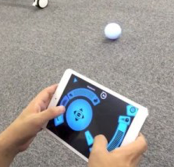
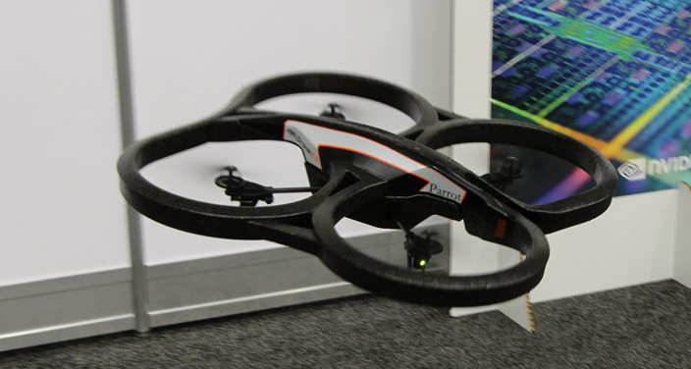
Proof-of-concept robot scenario
Simulated search-and-rescue/-destroy
  Aerial drone (Parrot AR.Drone 2) recognizes and tracks a moving ground-based robot (Sphero), while also recognizing other important objects and distractors
  Drone needs to map unknown environment (Simultaneous Localization and Mapping)

Slide 28
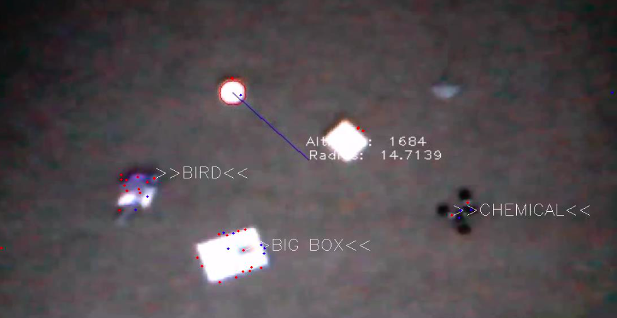
Visual recognition and tracking
Currently use shape, color, and structural features to recognize and track objects
  Fast Sphero recognition/localization using generalized Hough transform and color matching, track with Kalman filters
  Recognize other objects by matching SURF (Sped-Up Robust Features) and SIFT (Scale Invariant Feature Transform) points to a set of object models

Slide 29
Role of cloud
Cloud has latency but “unlimited” resources on demand for planning
Drone visual processing done on OpenStack cloud (FutureSystems)
  Raw images transmitted to cloud
  Sphero recognition and tracking will be parallelized
  Other object recognition pleasingly parallel (multiple object models can be considered in parallel)
Turtlebot SLAM (Simultaneous Localization and Mapping) and ORCA (Optimal Reciprocal Collision Avoidance) algorithms will be supported in parallel
Compare Storm and Harp (Hadoop with iterative high performance) parallel versions
Local v. Cloud computing
Security issues

Slide 30

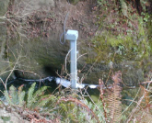
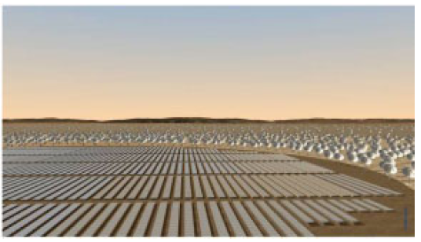
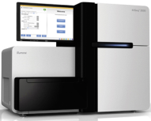
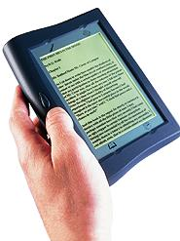





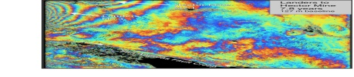
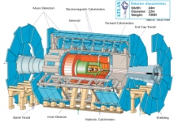
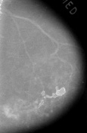

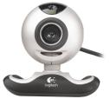

Data Deluge is also Information/Knowledge/Wisdom/Decision Deluge?
Raw Data → Data → Information → Knowledge → Wisdom → Decisions
Another
Grid
SS
SS
SS
SS
SS
SS
SS
Filter
Cloud
Discovery
Cloud
Portal
Filter
Cloud
Fusion for Discovery/Decisions
SS
Filter
Cloud
Another
Service
SS
Filter
Cloud
Filter
Cloud
Filter
Cloud
Discovery
Cloud
SS
SS
SS: Sensor or Data
Interchange
Service
Workflow through multiple filter/discovery clouds
Filter
Cloud
Filter
Cloud
Filter
Cloud
Filter
Cloud
SS
Another
Cloud
SS
SS
SS
SS
SS
SS
SS
SS
SS
SS
SS
SS
SS
Compute
Cloud
Storage
Cloud
Distributed
Grid
Hadoop Cluster
Database

Slide 31
Cloud DIKW based on HPC-ABDS to integrate streaming and batch Big Data
System Orchestration / Dataflow / Workflow
Archival Storage – NOSQL like Hbase
Batch Processing (Iterative MapReduce)
Analytics
Raw Data
Data
Information
Knowledge
Wisdom
Decisions
Analytics
Streaming Processing (Iterative MapReduce)
Storm
Storm
Storm
Storm
Storm
Storm
Pub-Sub
Internet of Things (Sensors, Robots)

Slide 32
Conclusions
All software as open source HPC enhancements to open source HPC-ABDS; sustainable!
Reworked DDDAS IoTCloud using Apache Storm getting good results with RabbitMQ or ActiveMQ.
  “official Kafka pub-sub system too heavy weight”
  Latencies <~10ms upto 100K byte messages
Batch + Streaming supported by Cloud DIKW
  Integrated with DevOps dynamic interoperable deployment
Tested with 10% Twitter feed on ~100 nodes parallel streaming clustering
Drone and Turtlebot operational with scene analysis and planning being parallelized
Applies to general DDDAS applications?

Slide 33
SPARE

Slide 34
Runtime & Scalability
Components of a Topology runs as Tasks in Supervisor Nodes
Supervisor runs worker processes and these workers run the tasks
A user can run any number of instances of a Spout or Bolt in parallel
Supervisor
Supervisor
Bolt
Task
Spout
Task
Spout
Task
Bolt
Task
Two threads running two
instances of the spout
Bolt
Task
Spout
Task
1 Thread running two
instances of the spout
Spout
Task
Bolt
Task
Bolt
Task
Bolt
Task
Worker
Worker
Topology can specify how many workers it needs to run on
Spout or Bolt can specify Parallelism and Tasks
  Parallelism defines how many threads a spout or bolt runs on
  Tasks defines how many instances of a spout or bolt to run
  Parallelism ≤ Tasks
A Simple Topology running on two worker nodes
Spout
Bolt
Bolt
Parallelism = 2
Tasks = 4
Parallelism = 4
Tasks = 4
Parallelism = 2
Tasks = 2

Slide 35
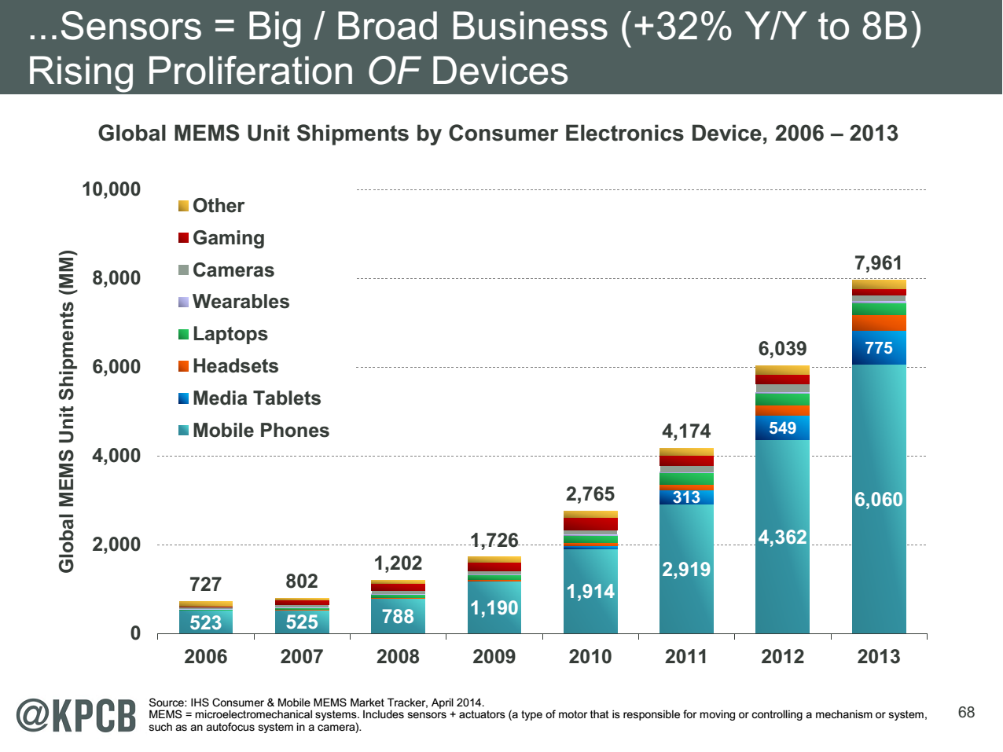
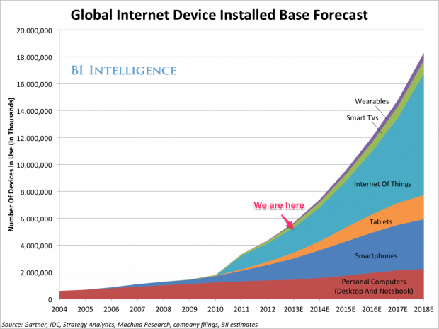
http://www.kpcb.com/internet-trends

Slide 36
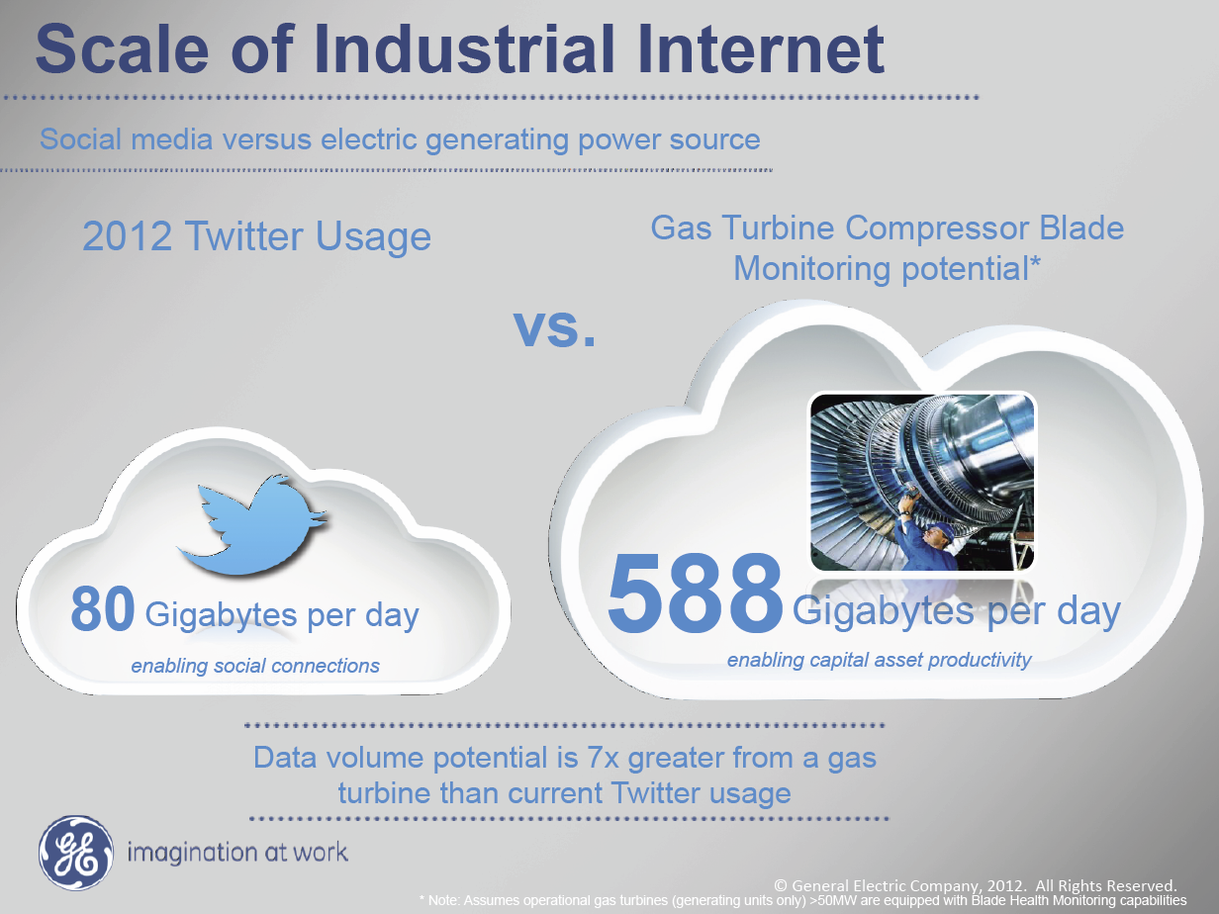
Ruh VP Software GE http://fisheritcenter.haas.berkeley.edu/Big_Data/index.html

