Slide 1
Remarks on Big Data Clustering (and its visualization)
Big Data and Extreme-scale Computing (BDEC) Charleston SC May 1 2013
Geoffrey Fox
gcf@indiana.edu
http://www.infomall.org/
School of Informatics and Computing
Indiana University Bloomington
2013

Slide 2
Remarks on Clustering and MDS
The standard data libraries (R, Matlab, Mahout) do not have best algorithms/software in either functionality or scalable parallelism
A lot of algorithms are built around “classic full matrix” kernels
Clustering, Gaussian Mixture Models, PLSI (probabilistic latent semantic indexing), LDA (Latent Dirichlet Allocation) similar
Multi-Dimensional Scaling (MDS) classic information visualization algorithm for high dimension spaces (map preserving distances)
Vector O(N) and Non Vector semimetric O(N²) space cases for N points; “all” apps are points in spaces – not all “Proper linear spaces”
Trying to release ~most powerful (in features/performance) available Clustering and MDS library although unfortunately in C#
Supported Features: Vector, Non-Vector, Deterministic annealing, Hierarchical, sharp (trimmed) or general cluster sizes, Fixed points and general weights for MDS, (generalized Elkans algorithm)

Slide 3
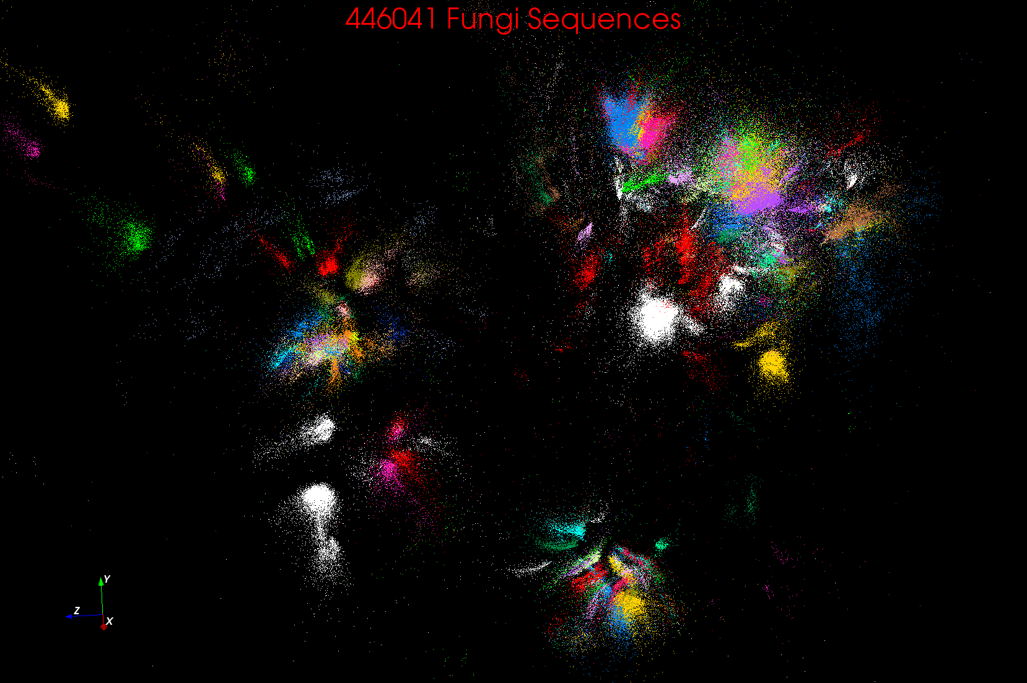
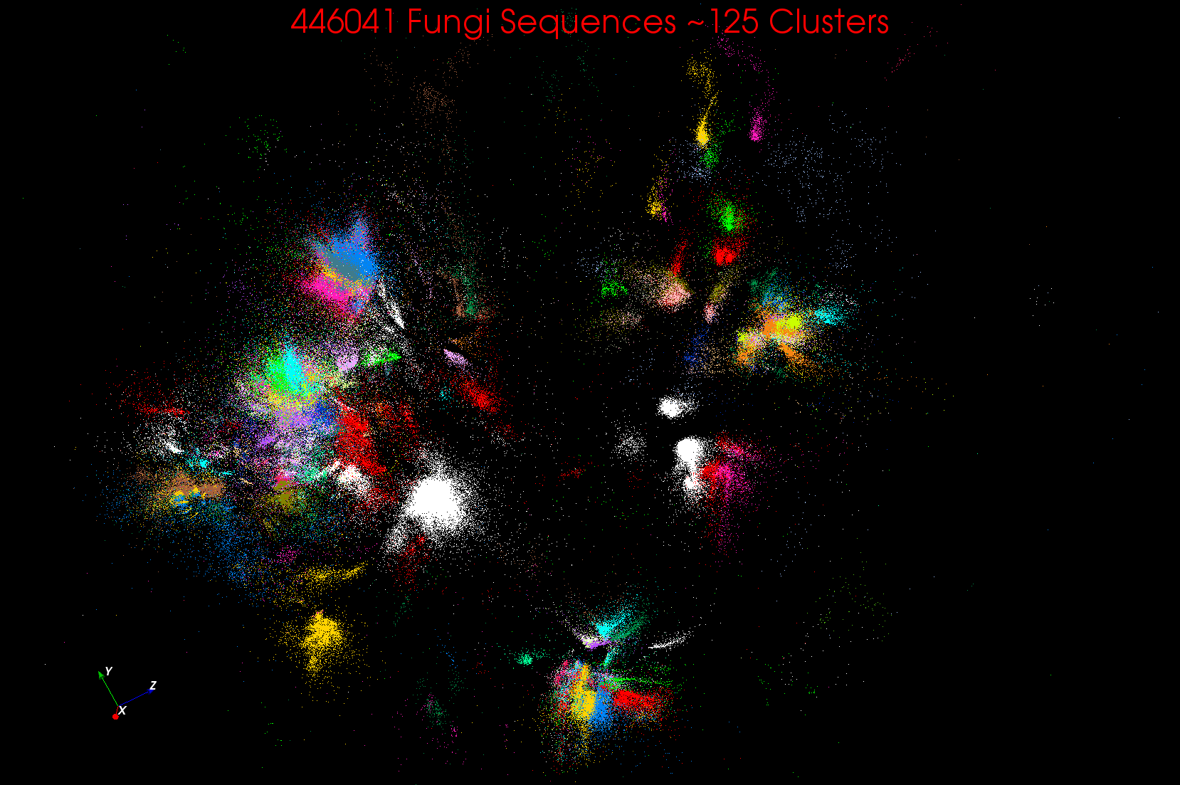
~125 Clusters from Fungi sequence set
Non metric space
Sequences Length ~500 Smith Waterman
A month on 768 cores

Slide 4
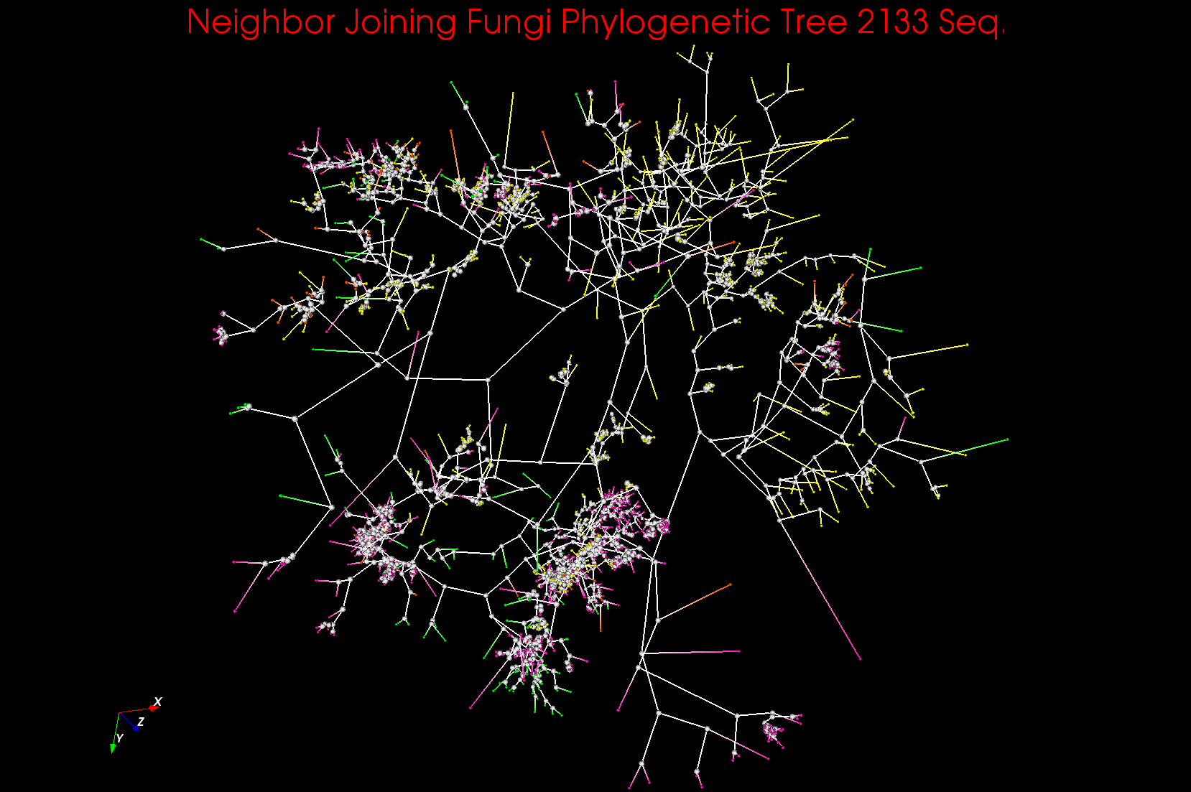
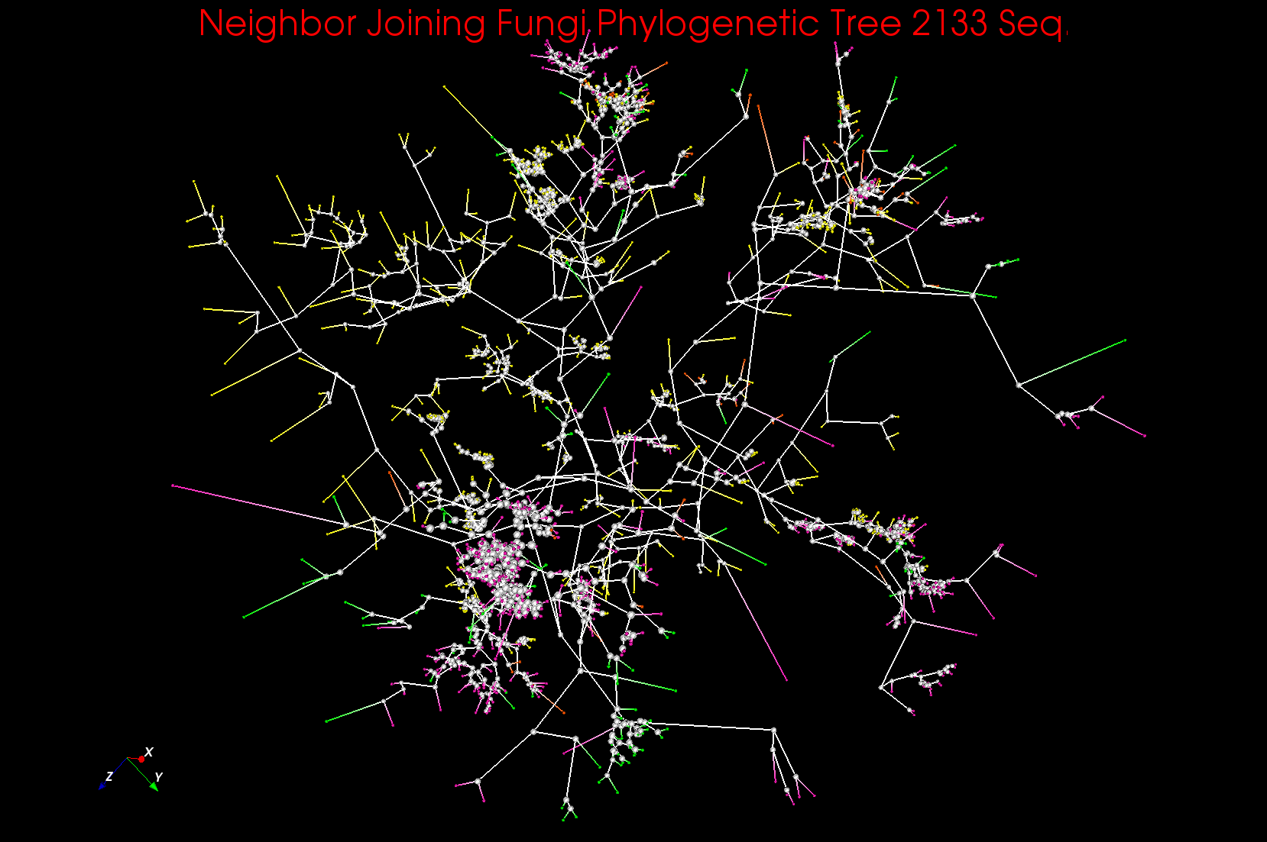
Phylogenetic Trees in 3D (usual 1D)
~125 centers (consensus vectors) found from Fungi data plus existing sequences from GenBank etc.

Slide 5
Clustering + MDS Applications
Cases where “real clusters” as in genomics
Cases as in pathology, proteomics, deep learning and recommender systems (Amazon, Netflix ….) where used for unsupervised classification of related items
Recent “deep learning” papers either use Neural networks with 40 million- 11 billion parameters (10-50 million YouTube images) or (Kmeans) Clustering with up to 1-10 million clusters
  Applications include automatic (Face) recognition; Autonomous driving; Pathology detection (Saltz)
  Generalize to χ² fit of all (Internet) data to a model
  Internet offers “infinite” image and text data
MDS (map all points to 3D for visualization) can be used to verify “correctness” of analysis and/or to browse data as in Geographical Information Systems
Mini-app of Joel Saltz
Ab-initio (hardest, compute dominated) and Update (streaming, interpolation)

Slide 6
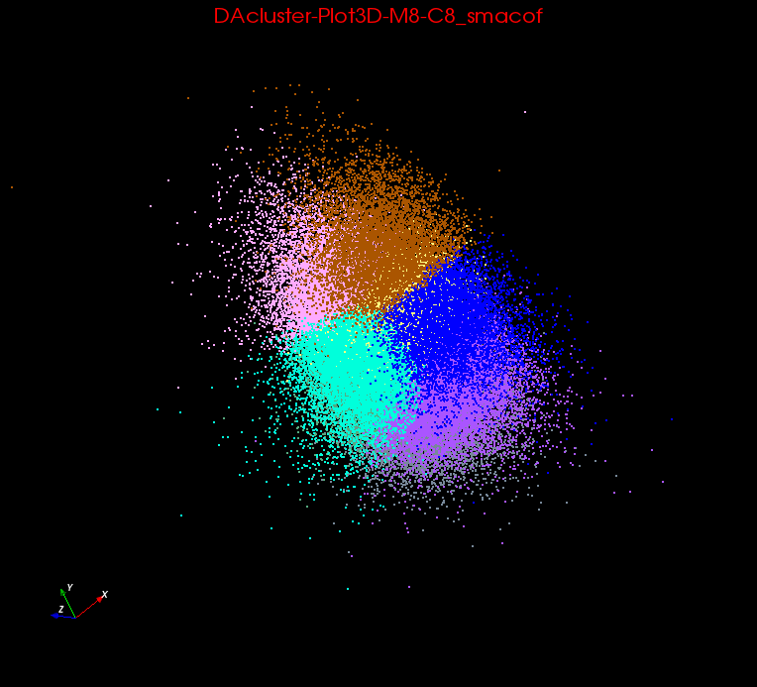
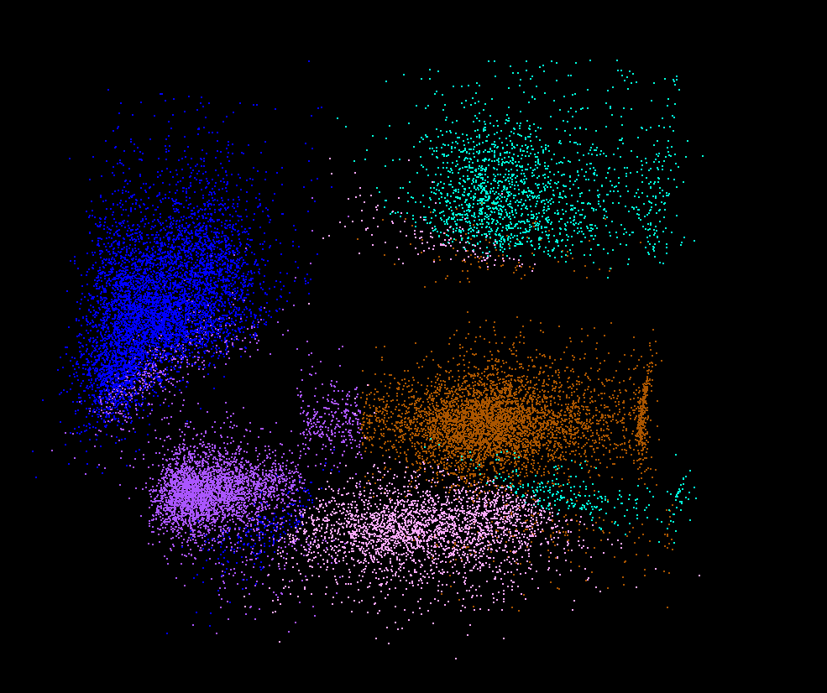
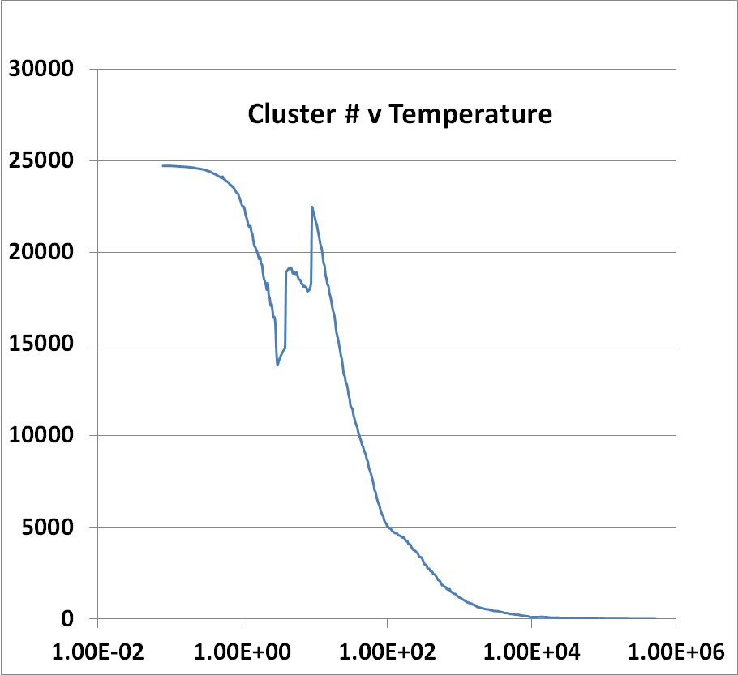
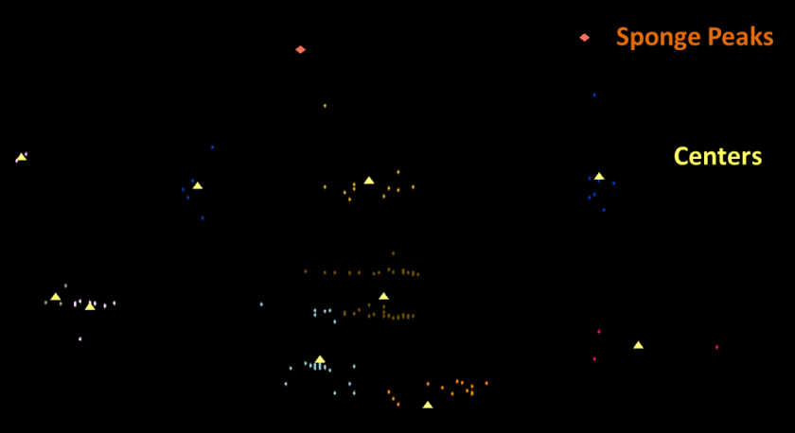
Lymphocytes 4D
Pathology 54D
Comparison of clustering and classification (top right)
LC-MS Mass Spectrometry Sharp Clusters as known error in measurement
LC-MS 2D
(sponge points not in cluster)

Slide 7
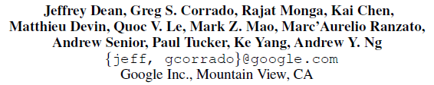

Large Scale Distributed Deep Networks
NIPS 2012
DistBelief (Google) rejected MapReduce but still didn’t work well
Coates and Ng (Stanford) et al. redid much larger problem on HPC cluster with Infiniband with 16 nodes and 64 GPU’s
Could use Iterative MapReduce (Twister) with GPU’s
40 million parameters
Scaling Breaks Down

Slide 8
Triangle Inequality and Kmeans
Dominant part of Kmeans algorithm is finding nearest center to each point
O(#Points * #Clusters * Vector Dimension)
Simple algorithms finds
min over centers c: d(x, c) = distance(point x, center c)
But most of d(x, c) calculations are wasted as much larger than minimum value
Elkan (2003) showed how to use triangle inequality to speed up using relations like
d(x, c) >= d(x,c-last) – d(c, c-last)
c-last position of center at last iteration
So compare d(x,c-last) – d(c, c-last) with d(x, c-best) where c-best is nearest cluster at last iteration
Complexity reduced by a factor = Vector Dimension and so this important in clustering high dimension spaces such as social imagery with 512 or more features per image
GPU performance unclear

Slide 9
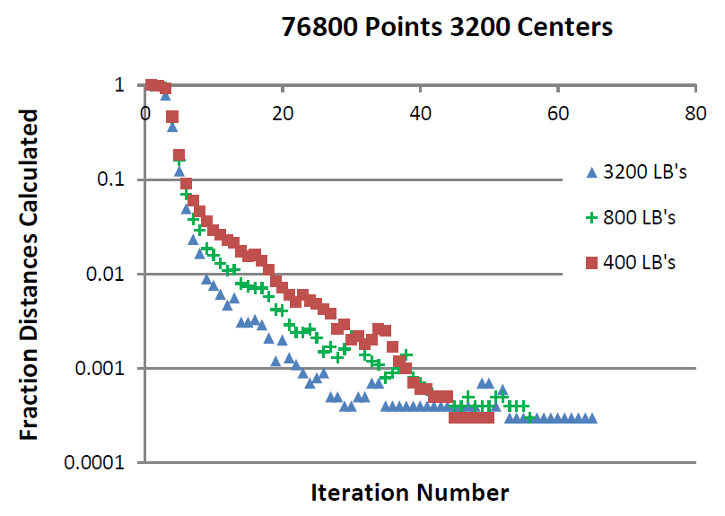
Fraction of Point-Center Distances
Calculated in Kmeans D=2048

Slide 10

Protein Universe Browser for COG Sequences with a few illustrative biologically identified clusters

Slide 11
Big Data Ecosystem in One Sentence
I apologize that I come from other end of problem …..
Undergraduate X-Informatics Class http://www.infomall.org/X-InformaticsSpring2013/
Big data MOOC http://x-informatics.appspot.com/preview
Mantra of class
Use Clouds running Data Analytics processing Big Data to solve problems in X-Informatics ( or e-X)
X = Astronomy, Biology, Biomedicine, Business, Chemistry, Climate, Crisis, Earth Science, Energy, Environment, Finance, Health, Intelligence, Lifestyle, Marketing, Medicine, Pathology, Policy, Radar, Security, Sensor, Social, Sustainability, Wealth and Wellness with more fields (physics) defined implicitly
Spans Industry and Science (research)
Education: Data Science see recent New York Times articles
http://datascience101.wordpress.com/2013/04/13/new-york-times-data-science-articles/

Slide 12
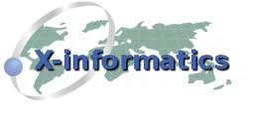


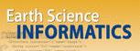


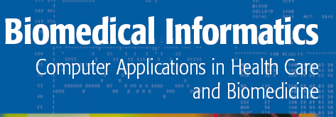


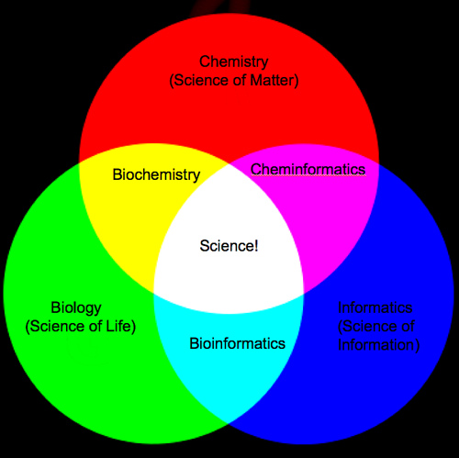
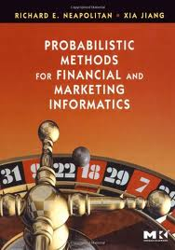
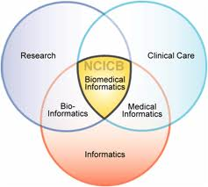
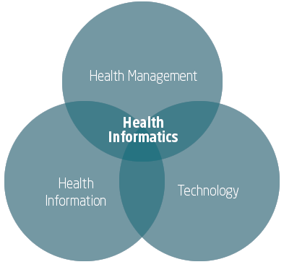
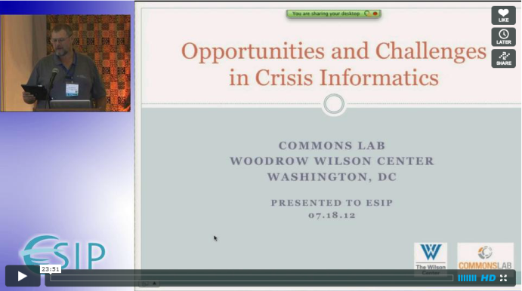

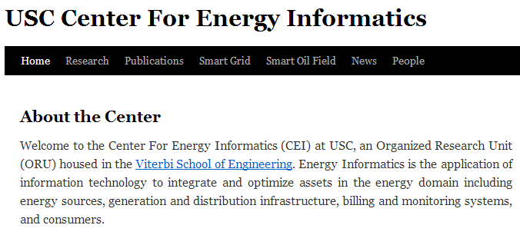
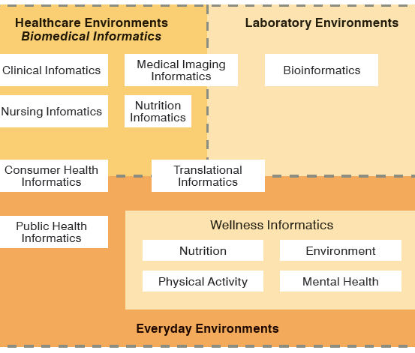
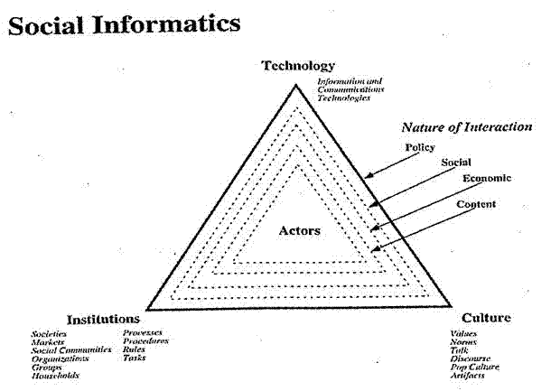

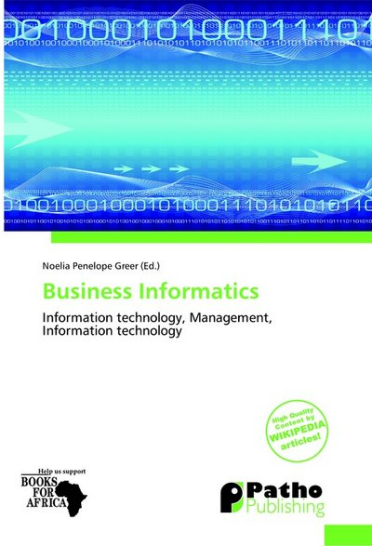
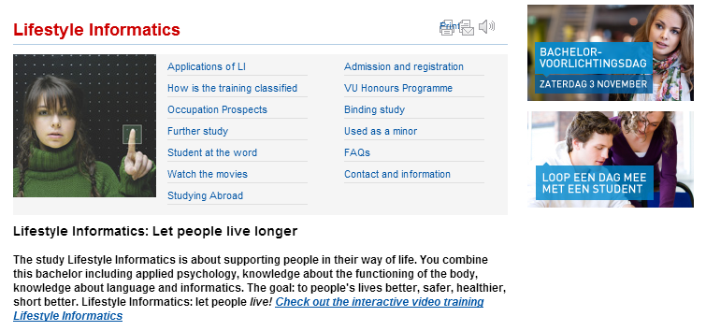
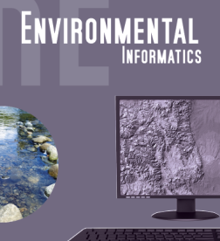

Social Informatics

