Slide 1
Sensor Cloud Technical Interchange Meeting
July 27th 2011
Ball Aerospace Fairborn, OH
Ryan Hartman (rdhartma@indiana.edu)

Slide 2
Core SCGMMS (Sensor Centric Grid Middleware Management System)
Architects Geoffrey Fox and Alex Ho
The IU Middleware Developer Team:
Ryan Hartman
Sankarbala Manoharan
Vignesh Ravindran
Vinod Periasamy -> Leaving to take a position at the School of Education
Project Website https://sites.google.com/site/sensorcloudproject

Slide 3
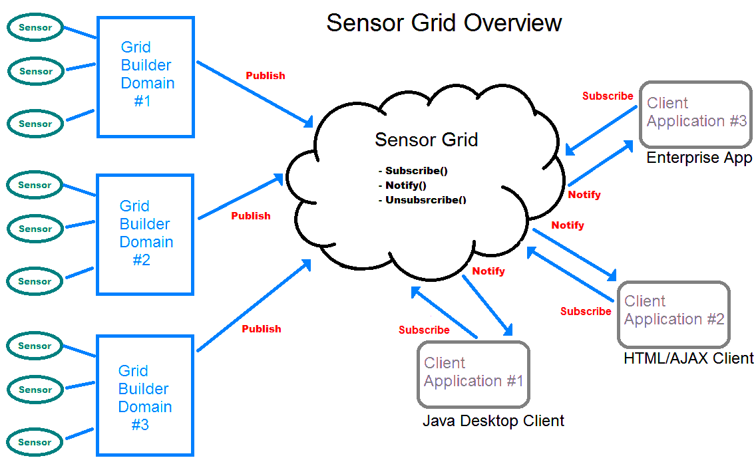
Review of the Sensor Grid Architecture

Slide 4
Current Research Activities Available in SGX 1.3 release
Infrastructure
Extended the SGX code to support end-to-end SSL data encryption
Demonstrated the deployment of SGX on OpenStack Hosted VMs
Web Based Interface to SGX
Used the RestEasy API from JBoss to create RESTFul Web Services
Clients are able to view sensor data and send control messages via Web Services
New Sensors
Android Camera Sensor
Implemented an early prototype of Dr. Myer’s contextual analysis work as a Trustworthiness Sensor

Slide 5
Data Encryption
Sensors
Existing Clients
New Web Clients
And under-lying Middleware
Now all fully support SSL encryption

Slide 6
Security and Trustworthiness
A talk on side-channel exploits and their defense from Yangyi Chen later
A talk on trustworthiness and theft detection from Sankarbala Manoharan

Slide 7
Cloud Support
We have demonstrated deploying SGX based sensor grids in Open Stack provisioned VM’s
OpenStack Software is developed by NASA and RackSpace.com and delivers a massively scalable cloud operating system with good AWS support
http://www.openstack.org/
More on Cloud Computing from Dr. Fox

Slide 8
Web Based Interface
The current product is based on RestEasy and can be hosted in any standard Java servlet container
JQuery on the client
Future work is planned to add HTML 5 web socket support which is more efficient than existing server long-polling techniques
RESTFul Interface:
Web Browsers, Traditional Apps even scripts can interact with the Sensor Grid via web protocols
HTTP get to receive data
HTTP put to send data
Virtually universal client support!

Slide 9
Examples
http://10.80.53.44:8080/sensorcloud/restful-services/sgxservice/getSensors
<collection>
<sensor>
<sensorId>c9b368ea-b7d5-11e0-b970-9f71990cd90f</sensorId>
<sensorType>Radiation Simulation Sensor</sensorType>
</sensor>
<sensor>
<sensorId>73e4c8ff-b7d7-11e0-9672-879487dba1b6</sensorId>
<sensorType>GPS</sensorType>
</sensor>
<sensor>
<sensorId>bbdcaa47-b7d6-11e0-8659-bbdc973d941e</sensorId>
<sensorType>GPS</sensorType>
</sensor>
<sensor>
<sensorId>872eef8b-b7d2-11e0-8b19-b13b5b2b54ff</sensorId>
<sensorType>GPS</sensorType>
</sensor>
</collection>
This example is POX but it is easy to change the out put to JSON, or ATOM etc.

Slide 10
Get Sensor Data
http://10.80.53.44:8080/sensorcloud/restful-services/sgxservice/getSensor/data/c9b368ea-b7d5-11e0-b970-9f71990cd90f
Returns
<RadiationSensorData>
<timestamp>1311722808075</timestamp>
<lat>51.27710</lat>
<lng>30.22900</lng>
<radiationLevel>137</radiationLevel>
</RadiationSensorData>

Slide 11
Send a Sensor Control From the Web
URL: http://10.80.53.:8080/sensorcloud/restful-services/sgxservice/putSensor/control/{uuid}
Headers:
User-Agent: AppleWebKit/531.21.10
Host: localhost:8080
Content-Type: application/xml
Content-Length: 84
Request Body:
<sensorcontrol>
<controlId>1</controlId>
<params>.3</params>
</sensorcontrol>

Slide 12
Let’s See a demo:
SGX on an Open Stack “micro” Cloud
New Web Client
With the Side Channel Defense!

Slide 13
Questions?
Ryan Hartman
rdhartman@indiana.edu

