Slide 1
Digital Science Center Overview
July 8 2012
Beihang University, Beijing
Geoffrey Fox
gcf@indiana.edu
http://www.infomall.org https://portal.futuregrid.org
Director, Digital Science Center, Pervasive Technology Institute
Associate Dean for Research and Graduate Studies, School of Informatics and Computing
Indiana University Bloomington

Slide 2
FutureGrid key Concepts I
FutureGrid is an international testbed modeled on Grid5000
June 27 2012: 225 Projects, 920 users
Supporting international Computer Science and Computational Science research in cloud, grid and parallel computing (HPC)
Industry and Academia
The FutureGrid testbed provides to its users:
A flexible development and testing platform for middleware and application users looking at interoperability, functionality, performance or evaluation
Each use of FutureGrid is an experiment that is reproducible
A rich education and teaching platform for advanced cyberinfrastructure (computer science) classes

Slide 3
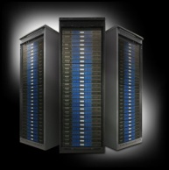
FutureGrid key Concepts II
Rather than loading images onto VM’s, FutureGrid supports Cloud, Grid and Parallel computing environments by provisioning software as needed onto “bare-metal” using Moab/xCAT (need to generalize)
Image library for MPI, OpenMP, MapReduce (Hadoop, (Dryad), Twister), gLite, Unicore, Globus, Xen, ScaleMP (distributed Shared Memory), Nimbus, Eucalyptus, OpenNebula, KVM, Windows …..
Either statically or dynamically
Growth comes from users depositing novel images in library
FutureGrid has ~4400 distributed cores with a dedicated network and a Spirent XGEM network fault and delay generator
Image1
Image2
…
ImageN
Choose
Load
Run

Slide 4
Compute Hardware
Name | System type | # CPUs | # Cores | TFLOPS | Total RAM (GB) | Secondary Storage (TB) | Site | Status
india | IBM iDataPlex | 256 | 1024 | 11 | 3072 | 180 | IU | Operational
alamo | Dell PowerEdge | 192 | 768 | 8 | 1152 | 30 | TACC | Operational
hotel | IBM iDataPlex | 168 | 672 | 7 | 2016 | 120 | UC | Operational
sierra | IBM iDataPlex | 168 | 672 | 7 | 2688 | 96 | SDSC | Operational
xray | Cray XT5m | 168 | 672 | 6 | 1344 | 180 | IU | Operational
foxtrot | IBM iDataPlex | 64 | 256 | 2 | 768 | 24 | UF | Operational
Bravo | Large Disk & memory | 32 | 128 | 1.5 | 3072 (192GB per node) | 192 (12 TB per Server) | IU | Operational
Delta | Large Disk & memory With Tesla GPU’s | 32 CPU 32 GPU’s | 192+ 14336 GPU | ? 9 | 1536 (192GB per node) | 192 (12 TB per Server) | IU | Operational
 |  |  | TOTAL Cores 4384

Slide 5
5 Use Types for FutureGrid
225 approved projects (~920 users) June 27 2012
USA, China, India, Pakistan, lots of European countries
Industry, Government, Academia
Training Education and Outreach (8%)
Semester and short events; promising for small universities
Interoperability test-beds (3%)
Grids and Clouds; Standards; from Open Grid Forum OGF
Domain Science applications (31%)
Life science highlighted (18%), Non Life Science (13%)
Computer science (47%)
Largest current category
Computer Systems Evaluation (27%)
XSEDE (TIS, TAS), OSG, EGI
Clouds are meant to need less support than other models; FutureGrid needs more user support …….

Slide 6
https://portal.futuregrid.org/projects

Slide 7
Distribution of FutureGrid Technologies and Areas
220 Projects

Slide 8
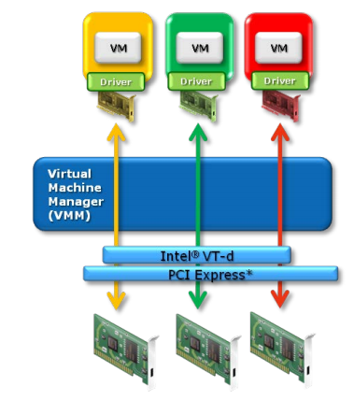
GPU’s in Cloud: Xen PCI Passthrough
Pass through the PCI-E GPU device to DomU
Use Nvidia Tesla CUDA programming model
Work at ISI East (USC)
Intel VT-d or AMD IOMMU extensions
Xen pci-back
FutureGrid “delta” has16 192GB memory nodes each with 2 GPU’s (Tesla C2075 - 6GB)
CUDA
CUDA
CUDA
GPU1
GPU2
GPU3

Slide 9
FutureGrid Tutorials
Cloud Provisioning Platforms
Using Nimbus on FutureGrid [novice]
Nimbus One-click Cluster Guide
Using OpenStack Nova on FutureGrid Using Eucalyptus on FutureGrid [novice]
Connecting private network VMs across Nimbus clusters using ViNe [novice]
Using the Grid Appliance to run FutureGrid Cloud Clients [novice]
Cloud Run-time Platforms
Running Hadoop as a batch job using MyHadoop [novice]
Running SalsaHadoop (one-click Hadoop) on HPC environment [beginner]
Running Twister on HPC environment
Running SalsaHadoop on Eucalyptus
Running FG-Twister on Eucalyptus
Running One-click Hadoop WordCount on Eucalyptus [beginner]
Running One-click Twister K-means on Eucalyptus
Image Management and Rain
Using Image Management and Rain [novice]
Storage
Using HPSS from FutureGrid [novice]
Educational Grid Virtual Appliances
Running a Grid Appliance on your desktop
Running a Grid Appliance on FutureGrid
Running an OpenStack virtual appliance on FutureGrid
Running Condor tasks on the Grid Appliance
Running MPI tasks on the Grid Appliance
Running Hadoop tasks on the Grid Appliance
Deploying virtual private Grid Appliance clusters using Nimbus
Building an educational appliance from Ubuntu 10.04
Customizing and registering Grid Appliance images using Eucalyptus
High Performance Computing
Basic High Performance Computing
Running Hadoop as a batch job using MyHadoop
Performance Analysis with Vampir
Instrumentation and tracing with VampirTrace
Experiment Management
Running interactive experiments [novice]
Running workflow experiments using Pegasus
Pegasus 4.0 on FutureGrid Walkthrough [novice]
Pegasus 4.0 on FutureGrid Tutorial [intermediary]
Pegasus 4.0 on FutureGrid Virtual Cluster [advanced]

Slide 10
aaS and Roles/Appliances
If you package a capability X as XaaS, it runs on a separate VM and you interact with messages
SQLaaS offers databases via messages similar to old JDBC model
If you build a role or appliance with X, then X built into VM and you just need to add your own code and run
Generalized worker role builds in I/O and scheduling
FG will take capabilities – MPI, MapReduce, Workflow .. – and offer as roles or aaS (or both)
Perhaps workflow has a controller aaS with graphical design tool while runtime packaged in a role?
Package parallelism as a virtual cluster

Slide 11
Selected List of Services Offered
FutureGrid
User
IaaS
Bare Metal
Nimbus
PaaS
Hadoop
Twister
Hive
Hbase
MPI
Others
FG RAIN
Portal
Inca
Eucalyptus
OpenStack
OpenNebula
ViNE
HPCC
Ganglia
Experiment Management
(Pegasus)
OpenMP
ScaleMP
CUDA
XSEDE Software
Grid
Globus
Unicore
SAGA
Genesis II

Slide 12
Science Computing Environments
Large Scale Supercomputers – Multicore nodes linked by high performance low latency network
Increasingly with GPU enhancement
Suitable for highly parallel simulations
High Throughput Systems such as European Grid Initiative EGI or Open Science Grid OSG typically aimed at pleasingly parallel jobs
Can use “cycle stealing”
Classic example is LHC data analysis
Grids federate resources as in EGI/OSG or enable convenient access to multiple backend systems including supercomputers
Portals make access convenient and
Workflow integrates multiple processes into a single job
Specialized visualization, shared memory parallelization etc. machines

Slide 13
Clouds and Grids/HPC
Synchronization/communication Performance Grids > Clouds > Classic HPC Systems
Clouds naturally execute effectively Grid workloads but are less clear for closely coupled HPC applications
Service Oriented Architectures portals and workflow appear to work similarly in both grids and clouds
May be for immediate future, science supported by a mixture of
Clouds – some practical differences between private and public clouds – size and software
High Throughput Systems (moving to clouds as convenient)
Grids for distributed data and access
Supercomputers (“MPI Engines”) going to exascale

Slide 14
What Applications work in Clouds
Pleasingly parallel applications of all sorts with roughly independent data or spawning independent simulations
Long tail of science and integration of distributed sensors
Commercial and Science Data analytics that can use MapReduce (some of such apps) or its iterative variants (most other data analytics apps)
Which science applications are using clouds?
Many demonstrations –Conferences, OOI, HEP ….
Venus-C (Azure in Europe): 27 applications not using Scheduler, Workflow or MapReduce (except roll your own)
50% of applications on FutureGrid are from Life Science but there is more computer science than total applications
Locally Lilly corporation is major commercial cloud user (for drug discovery) but Biology department is not

Slide 15
4 Forms of MapReduce
(a) Map Only
(b) Classic MapReduce
(c) Iterative MapReduce
(d) Loosely Synchronous
Input
Input
Iterations
Input
map
map
map
P_{ij}
reduce
reduce
Output
BLAST Analysis
Parametric sweep
Pleasingly Parallel
High Energy Physics (HEP) Histograms
Distributed search
Expectation maximization Clustering e.g. Kmeans
Linear Algebra, Page Rank
Classic MPI
PDE Solvers and particle dynamics
Domain of MapReduce and Iterative Extensions
Science Clouds
MPI
Exascale

Slide 16
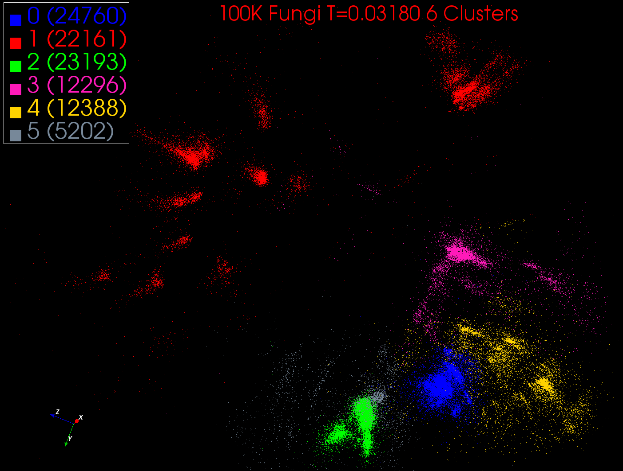
Intermediate step in DA-PWC
With 6 clusters
MDS used to project from high dimensional to 3D space
Each of 100K points is a sequence. Clusters are Fungi families. 140 Clusters at end of iteration
N=100K points is 10^5 core hours
Scales between O(N) and O(N²)

