Slide 1
Towards an Understanding of Facets and Exemplars of Big Data Applications
20 Years of Beowulf: Workshop to Honor
Thomas Sterling's 65th Birthday
Annapolis
October 14 2014
Geoffrey Fox
gcf@indiana.edu
http://www.infomall.org
School of Informatics and Computing
Digital Science Center
Indiana University Bloomington

Slide 2
SPIDAL: Scalable Parallel Interoperable Data Analytics Library
I sort of left HPC in 1990 but I now returning to do parallel computing for large scale data analytics – SPIDAL
  More data scientists than computational scientists so HPC implications of data analytics could be influential on simulation software and hardware
  Certainly Beowulf just fine!
Analyze Big Data applications to identify analytics needed and generate benchmark applications
Analyze existing analytics libraries (in practice limit to some application domains) – catalog library members available and performance
  Apache Mahout low performance and not many entries; R largely sequential and missing key algorithms; Apache MLlib just starting
Identify big data computer architectures
Identify software model to allow interoperability and performance
Design or identify new or existing algorithms including parallel implementation
Collaborate application scientists, computer systems and statistics/algorithms communities

Slide 3
In 1980-1985 I wondered around Caltech seeing what people where using computers for and thinking of parallel simulation algorithms. Now lets repeat for Big Data. Get applications from NIST study this time
NIST Big Data Initiative
Led by Chaitin Baru, Bob Marcus, Wo Chang

Slide 4

Use Case Template
26 fields completed for 51 areas
Government Operation: 4
Commercial: 8
Defense: 3
Healthcare and Life Sciences: 10
Deep Learning and Social Media: 6
The Ecosystem for Research: 4
Astronomy and Physics: 5
Earth, Environmental and Polar Science: 10
Energy: 1

Slide 5
51 Detailed Use Cases: Contributed July-September 2013
Covers goals, data features such as 3 V’s, software, hardware
26 Features for each use case
Biased to science
http://bigdatawg.nist.gov/usecases.php
https://bigdatacoursespring2014.appspot.com/course (Section 5)
Government Operation(4): National Archives and Records Administration, Census Bureau
Commercial(8): Finance in Cloud, Cloud Backup, Mendeley (Citations), Netflix, Web Search, Digital Materials, Cargo shipping (as in UPS)
Defense(3): Sensors, Image surveillance, Situation Assessment
Healthcare and Life Sciences(10): Medical records, Graph and Probabilistic analysis, Pathology, Bioimaging, Genomics, Epidemiology, People Activity models, Biodiversity
Deep Learning and Social Media(6): Driving Car, Geolocate images/cameras, Twitter, Crowd Sourcing, Network Science, NIST benchmark datasets
The Ecosystem for Research(4): Metadata, Collaboration, Language Translation, Light source experiments
Astronomy and Physics(5): Sky Surveys including comparison to simulation, Large Hadron Collider at CERN, Belle Accelerator II in Japan
Earth, Environmental and Polar Science(10): Radar Scattering in Atmosphere, Earthquake, Ocean, Earth Observation, Ice sheet Radar scattering, Earth radar mapping, Climate simulation datasets, Atmospheric turbulence identification, Subsurface Biogeochemistry (microbes to watersheds), AmeriFlux and FLUXNET gas sensors
Energy(1): Smart grid

Slide 6

Table 4: Characteristics of 6 Distributed Applications
Application Example | Execution Unit | Communication | Coordination | Execution Environment
Montage | Multiple sequential and parallel executable | Files | Dataflow (DAG) | Dynamic process creation, execution
NEKTAR | Multiple concurrent parallel executables | Stream based | Dataflow | Co-scheduling, data streaming, async. I/O
Replica-Exchange | Multiple seq. and parallel executables | Pub/sub | Dataflow and events | Decoupled coordination and messaging
Climate Prediction (generation) | Multiple seq. & parallel executables | Files and messages | Master-Worker, events | @Home (BOINC)
Climate Prediction (analysis) | Multiple seq. & parallel executables | Files and messages | Dataflow | Dynamics process creation, workflow execution
SCOOP | Multiple Executable | Files and messages | Dataflow | Preemptive scheduling, reservations
Coupled Fusion | Multiple executable | Stream-based | Dataflow | Co-scheduling, data streaming, async I/O
Part of Property Summary Table

Slide 7
Big Data Patterns – the Ogres

Slide 8
HPC Benchmark Classics
Linpack or HPL: Parallel LU factorization for solution of linear equations
NPB version 1: Mainly classic HPC solver kernels
  MG: Multigrid
  CG: Conjugate Gradient
  FT: Fast Fourier Transform
  IS: Integer sort
  EP: Embarrassingly Parallel
  BT: Block Tridiagonal
  SP: Scalar Pentadiagonal
  LU: Lower-Upper symmetric Gauss Seidel

Slide 9
13 Berkeley Dwarfs
Dense Linear Algebra
Sparse Linear Algebra
Spectral Methods
N-Body Methods
Structured Grids
Unstructured Grids
MapReduce
Combinational Logic
Graph Traversal
Dynamic Programming
Backtrack and Branch-and-Bound
Graphical Models
Finite State Machines
First 6 of these correspond to Colella’s original.
Monte Carlo dropped.
N-body methods are a subset of Particle in Colella.
Note a little inconsistent in that MapReduce is a programming model and spectral method is a numerical method.
Need multiple facets!

Slide 10
7 Computational Giants of
NRC Massive Data Analysis Report
G1: Basic Statistics (see MRStat later)
G2: Generalized N-Body Problems
G3: Graph-Theoretic Computations
G4: Linear Algebraic Computations
G5: Optimizations e.g. Linear Programming
G6: Integration e.g. LDA and other GML
G7: Alignment Problems e.g. BLAST

Slide 11
51 Use Cases: What is Parallelism Over?
People: either the users (but see below) or subjects of application and often both
Decision makers like researchers or doctors (users of application)
Items such as Images, EMR, Sequences below; observations or contents of online store
  Images or “Electronic Information nuggets”
  EMR: Electronic Medical Records (often similar to people parallelism)
  Protein or Gene Sequences;
  Material properties, Manufactured Object specifications, etc., in custom dataset
  Modelled entities like vehicles and people
Sensors – Internet of Things
Events such as detected anomalies in telescope or credit card data or atmosphere
(Complex) Nodes in RDF Graph
Simple nodes as in a learning network
Tweets, Blogs, Documents, Web Pages, etc.
  And characters/words in them
Files or data to be backed up, moved or assigned metadata
Particles/cells/mesh points as in parallel simulations

Slide 12
Features of 51 Use Cases I
PP (26) “All” Pleasingly Parallel or Map Only
MR (18) Classic MapReduce MR (add MRStat below for full count)
MRStat (7) Simple version of MR where key computations are simple reduction as found in statistical averages such as histograms and averages
MRIter (23) Iterative MapReduce or MPI (Spark, Twister)
Graph (9) Complex graph data structure needed in analysis
Fusion (11) Integrate diverse data to aid discovery/decision making; could involve sophisticated algorithms or could just be a portal
Streaming (41) Some data comes in incrementally and is processed this way
Classify (30) Classification: divide data into categories
S/Q (12) Index, Search and Query

Slide 13
Features of 51 Use Cases II
CF (4) Collaborative Filtering for recommender engines
LML (36) Local Machine Learning (Independent for each parallel entity) – application could have GML as well
GML (23) Global Machine Learning: Deep Learning, Clustering, LDA, PLSI, MDS,
  Large Scale Optimizations as in Variational Bayes, MCMC, Lifted Belief Propagation, Stochastic Gradient Descent, L-BFGS, Levenberg-Marquardt . Can call EGO or Exascale Global Optimization with scalable parallel algorithm
Workflow (51) Universal
GIS (16) Geotagged data and often displayed in ESRI, Microsoft Virtual Earth, Google Earth, GeoServer etc.
HPC (5) Classic large-scale simulation of cosmos, materials, etc. generating (visualization) data
Agent (2) Simulations of models of data-defined macroscopic entities represented as agents

Slide 14
4 Forms of MapReduce
(1) Map Only
(2) Classic MapReduce
(3) Iterative Map Reduce or Map-Collective
(4) Point to Point or Map-Communication
Input
Input
Iterations
Input
map
map
map
Local
reduce
reduce
Output
Graph
PP | MR MRStat | MRIter | Graph, HPC
BLAST Analysis Local Machine Learning Pleasingly Parallel | High Energy Physics (HEP) Histograms Distributed search Recommender Engines | Expectation maximization Clustering e.g. K-means Linear Algebra, PageRank | Classic MPI PDE Solvers and Particle Dynamics Graph Problems
MapReduce and Iterative Extensions (Spark, Twister) |  |  | MPI, Giraph
Integrated Systems such as Hadoop + Harp with Compute and Communication model separated
Correspond to 4 Big Data Architectures

Slide 15
Global Machine Learning aka EGO – Exascale Global Optimization
Typically maximum likelihood or χ² with a sum over the N data items – documents, sequences, items to be sold, images etc. and often links (point-pairs). Usually it’s a sum of positive numbers as in least squares
Covering clustering/community detection, mixture models, topic determination, Multidimensional scaling, (Deep) Learning Networks
PageRank is “just” parallel linear algebra
Note many Mahout algorithms are sequential – partly as MapReduce limited; partly because parallelism unclear
  MLLib (Spark based) better
SVM and Hidden Markov Models do not use large scale parallelization in practice?
Detailed papers on particular parallel graph algorithms
Name invented at Argonne-Chicago workshop

Slide 16
Data Gathering, Storage, Use

Slide 17
Data Source and Style Facet I
(i) SQL or NoSQL: NoSQL includes Document, Column, Key-value, Graph, Triple store
(ii) Other Enterprise data systems: e.g. Warehouses
(iii) Set of Files: as managed in iRODS and extremely common in scientific research
(iv) File, Object, Block and Data-parallel (HDFS) raw storage: Separated from computing?
(v) Internet of Things: 24 to 50 Billion devices on Internet by 2020
(vi) Streaming: Incremental update of datasets with new algorithms to achieve real-time response (G7)
(vii) HPC simulations: generate major (visualization) output that often needs to be mined
(viii) Involve GIS: Geographical Information Systems provide attractive access to geospatial data
Notes:
Big dwarfs are Ogres
Implement Ogres in ABDS+

Slide 18
2. Perform real time analytics on data source streams and notify users when specified events occur
Specify filter
Filter Identifying Events
Fetch streamed Data
Post Selected Events
Streaming Data
Posted Data
Identified Events
Streaming Data
Streaming Data
Archive
Repository
Storm, Kafka, Hbase, Zookeeper

Slide 19



5. Perform interactive analytics on data in analytics-optimized data system
Mahout, R
Hadoop, Spark, Giraph, Pig …
Data Storage: HDFS, Hbase
Data, Streaming, Batch …..

Slide 20
Data Source and Style Facet II
Before data gets to compute system, there is often an initial data gathering phase which is characterized by a block size and timing. Block size varies from month (Remote Sensing, Seismic) to day (genomic) to seconds or lower (Real time control, streaming)
There are storage/compute system styles: Shared, Dedicated, Permanent, Transient
Other characteristics are needed for permanent auxiliary/comparison datasets and these could be interdisciplinary, implying nontrivial data movement/replication
10 Data Access/Use Styles from Bob Marcus at NIST (you have seen his patterns 2 and 5 and my extension for science 5A follows)
Notes:
Big dwarfs are Ogres
Implement Ogres in ABDS+

Slide 21
5A. Perform interactive analytics on observational scientific data
Science Analysis Code, Mahout, R
Grid or Many Task Software, Hadoop, Spark, Giraph, Pig …
Data Storage: HDFS, Hbase, File Collection (Lustre)
Direct Transfer
Transport batch of data to primary analysis data system
Streaming Twitter data for Social Networking
Local Accumulate and initial computing
NIST Examples include LHC, Remote Sensing, Astronomy and Bioinformatics
Record Scientific Data in “field”

Slide 22
Analytics Facet (kernels) of the Ogres

Slide 23
Core Analytics I
Map-Only
  Pleasingly parallel - Local Machine Learning
MapReduce: Search/Query/Index
  Summarizing statistics as in LHC Data analysis (histograms) (G1)
  Recommender Systems (Collaborative Filtering)
  Linear Classifiers (Bayes, Random Forests)
Alignment and Streaming (G7)
  Genomic Alignment, Incremental Classifiers
Global Analytics: Nonlinear Solvers (structure depends on objective function) (G5,G6)
  Stochastic Gradient Descent SGD
  (L-)BFGS approximation to Newton’s Method
  Levenberg-Marquardt solver
Notes:
BFGS Broyden–Fletcher–Goldfarb–Shanno algorithm
L = limited memory

Slide 24
Core Analytics II
Global Analytics: Map-Collective (See Mahout, MLlib) (G2,G4,G6)
  Often use matrix-matrix,-vector operations, solvers (conjugate gradient)
  Clustering (many methods), Mixture Models, LDA (Latent Dirichlet Allocation), PLSI (Probabilistic Latent Semantic Indexing)
  SVM and Logistic Regression
  Outlier Detection (several approaches)
  PageRank, (find leading eigenvector of sparse matrix)
  SVD (Singular Value Decomposition)
  MDS (Multidimensional Scaling)
  Learning Neural Networks (Deep Learning)
  Hidden Markov Models

Slide 25
Core Analytics III
Global Analytics – Map-Communication (targets for Giraph) (G3)
  Graph Structure (Communities, subgraphs/motifs, diameter, maximal cliques, connected components)
  Network Dynamics - Graph simulation Algorithms (epidemiology)
Global Analytics – Asynchronous Shared Memory (may be distributed algorithms)
  Graph Structure (Betweenness centrality, shortest path) (G3)
  Linear/Quadratic Programming, Combinatorial Optimization, Branch and Bound (G5)

Slide 26
Remarks on Parallelism I
Most use parallelism over items in data set
  Entities to cluster or map to Euclidean space
Except deep learning (for image data sets)which has parallelism over pixel plane in neurons not over items in training set
  as need to look at small numbers of data items at a time in Stochastic Gradient Descent SGD
  Need experiments to really test SGD – as no easy to use parallel implementations tests at scale NOT done
  Maybe got where they are as most work sequential
Maximum Likelihood or χ² both lead to structure like
Minimize sum ∑_{items=1}^{N} (Positive nonlinear function of unknown parameters for item i)
All solved iteratively with (clever) first or second order approximation to shift in objective function
  Sometimes steepest descent direction; sometimes Newton
  11 billion deep learning parameters; Newton impossible
  Have classic Expectation Maximization structure
  Steepest descent shift is sum over shift calculated from each point
SGD – take randomly a few hundred of items in data set and calculate shifts over these and move a tiny distance
  Classic method – take all (millions) of items in data set and move full distance

Slide 27
Remarks on Parallelism II
Need to cover non vector semimetric and vector spaces for clustering and dimension reduction (N points in space)
MDS Minimizes Stress
σ(X) = Σ_{i<j=1}^{N} weight(i,j) (δ(i, j) - d(X_{i} , X_{j}))²
Semimetric spaces just have pairwise distances defined between points in space δ(i, j)
Vector spaces have Euclidean distance and scalar products
  Algorithms can be O(N) and these are best for clustering but for MDS O(N) methods may not be best as obvious objective function O(N²)
  Important new algorithms needed to define O(N) versions of current O(N²) – “must” work intuitively and shown in principle
Note matrix solvers all use conjugate gradient – converges in 5-100 iterations – a big gain for matrix with a million rows. This removes factor of N in time complexity
Ratio of #clusters to #points important; new ideas if ratio >~ 0.1

Slide 28
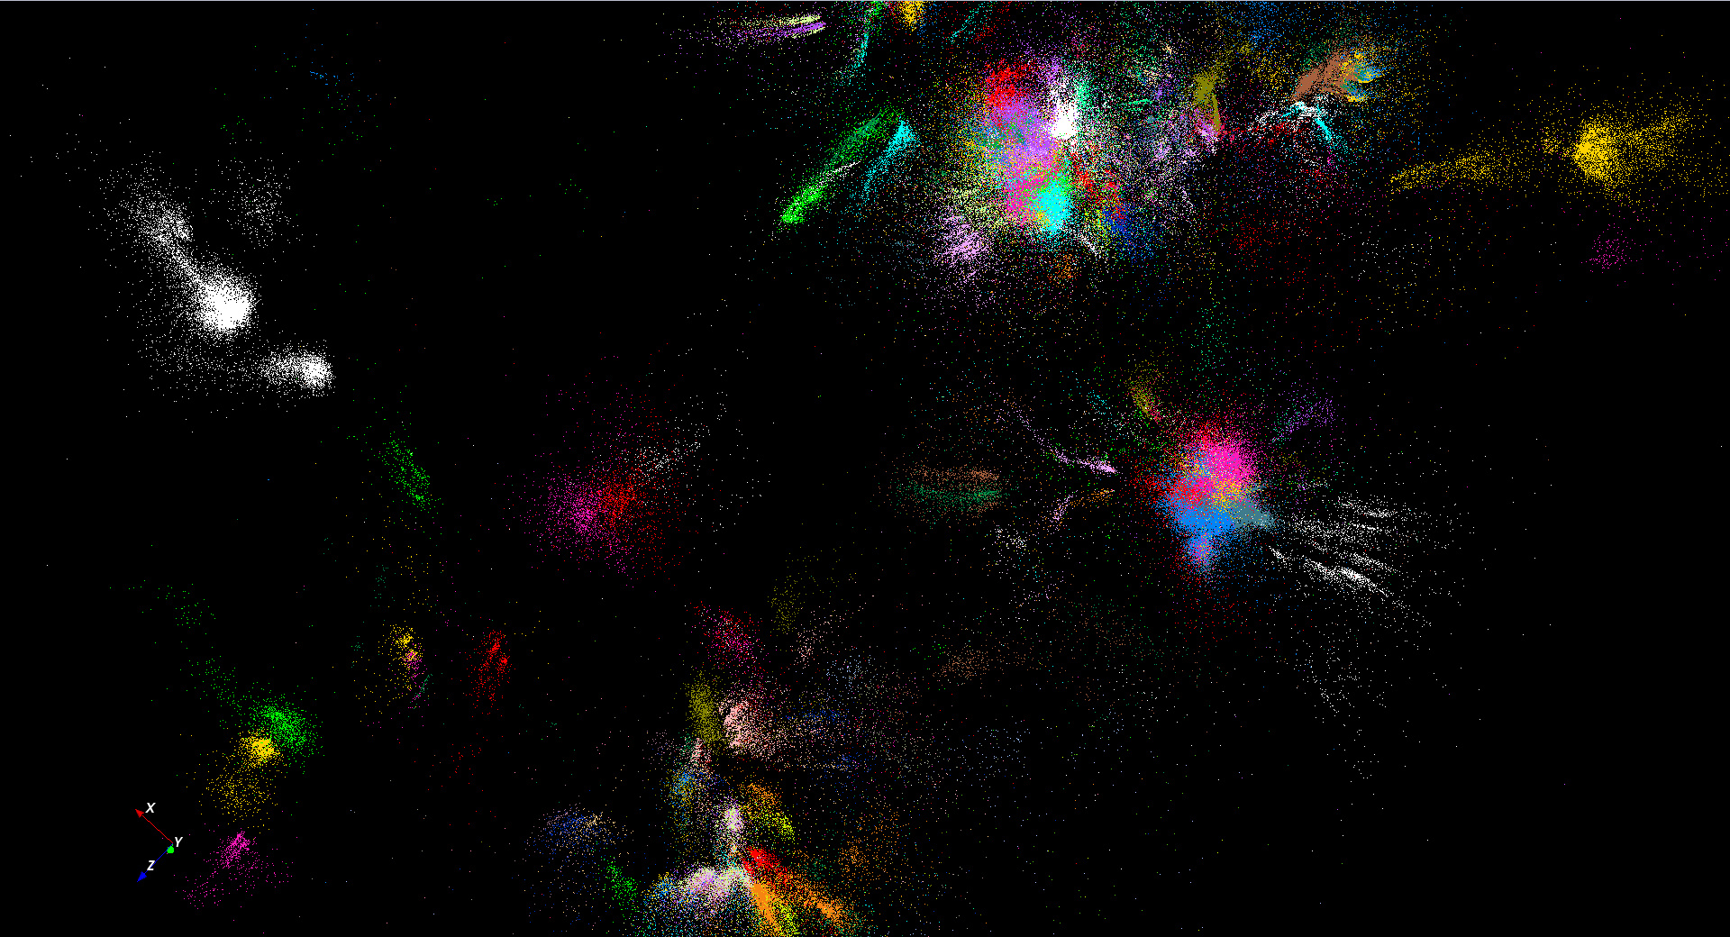
446K sequences
~100 clusters

Slide 29
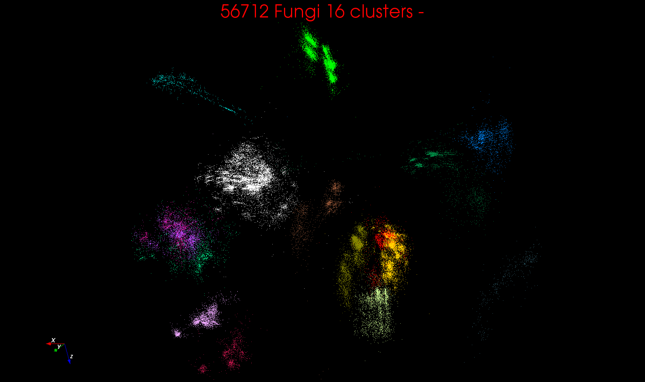
“clean” sample of 446K
O(N²) green-green and purple-purple interactions have value but green-purple are “wasted”
O(N²) interactions between green and purple clusters should be able to represent by centroids as in Barnes-Hut.
Hard as no Gauss theorem; no multipole expansion and points really in 1000 dimension space as clustered before 3D projection

Slide 30
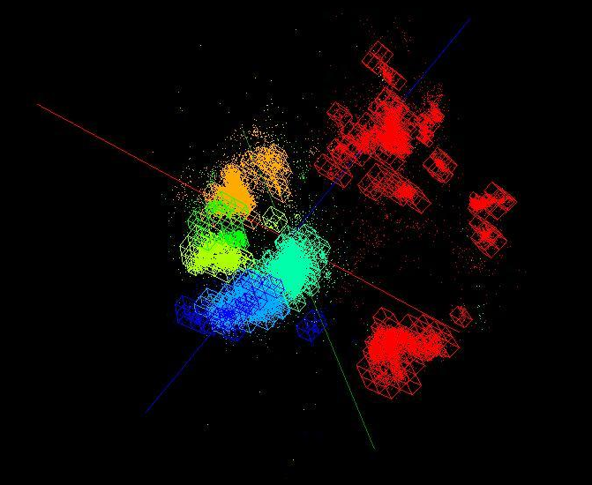
OctTree for 100K sample of Fungi
We use OctTree for logarithmic interpolation (streaming data)

Slide 31
Algorithm Challenges
See NRC Massive Data Analysis report
O(N) algorithms for O(N²) problems
Parallelizing Stochastic Gradient Descent
Streaming data algorithms – balance and interplay between batch methods (most time consuming) and interpolative streaming methods
Graph algorithms
Claims data analytics sparse; many cases are full matrices
BTW Need Java Grande – Some C++ but Java most popular in ABDS, with Python, Erlang, Go, Scala (compiles to JVM) …..

Slide 32
Proposed Spectrum of Benchmarks/Features
Classic Database: TPC benchmarks
NoSQL Data systems: store, index, query (e.g. on Tweets)
Hard core commercial: Web Search, Collaborative Filtering (different structure and defer to Google!)
Streaming: Gather in Pub-Sub(Kafka) + Process (Apache Storm) solution (e.g. gather tweets, Internet of Things)
Pleasingly parallel (Local Analytics): as in initial steps of LHC, Astronomy, Pathology, Bioimaging (differ in type of data analysis)
“Global” Analytics: Deep Learning, SVM, Multidimensional Scaling, Graph Community finding (~Clustering) to Shortest Path (? Shared memory)
Workflow linking above

Slide 33
HPC-ABDS
Integrating High Performance Computing with Apache Big Data Stack
Shantenu Jha, Judy Qiu, Andre Luckow

Slide 35
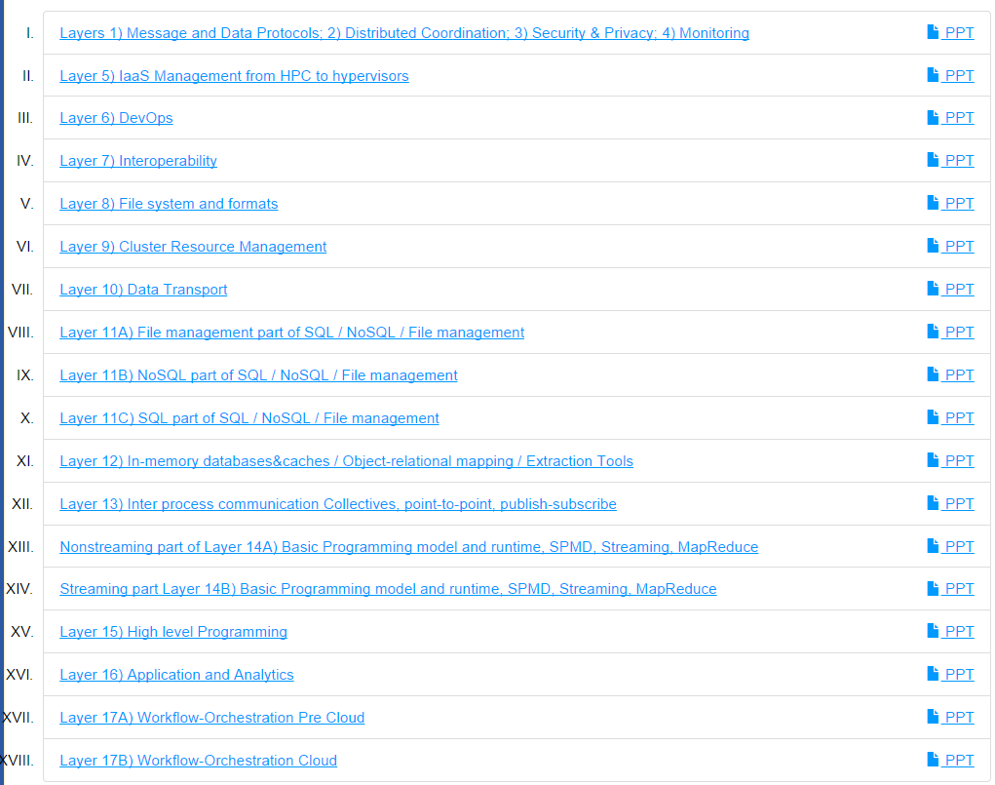
6 hours of Video describing 200 technologies from online class

Slide 36
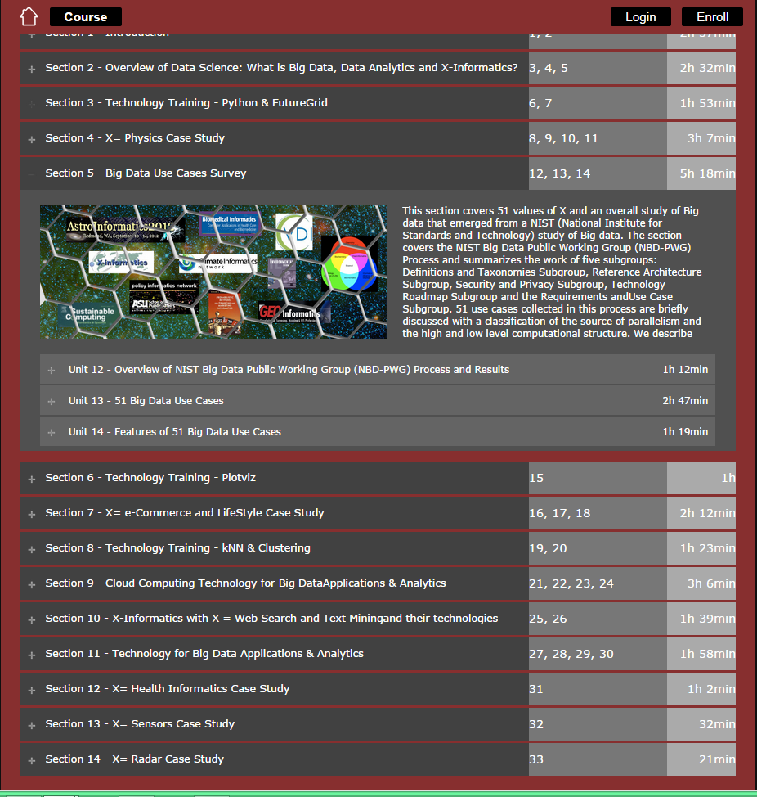
5 hours of video on 51 use cases
Online classes in Data Science Certificate /Masters
Prettier as Google Course Builder

Slide 37
Maybe a Big Data Initiative would include
We don’t need 200 software packages so can choose e.g.
Workflow: Python or Kepler or Apache Crunch
Data Analytics: Mahout, R, ImageJ, Scalapack
High level Programming: Hive, Pig
Parallel Programming model: Hadoop, Spark, Giraph (Twister4Azure, Harp), MPI; Storm, Kapfka or RabbitMQ (Sensors)
In-memory: Memcached
Data Management: Hbase, MongoDB, MySQL or Derby
Distributed Coordination: Zookeeper
Cluster Management: Yarn, Slurm
File Systems: HDFS, Lustre
DevOps: Cloudmesh, Chef, Puppet, Docker, Cobbler
IaaS: Amazon, Azure, OpenStack, Libcloud
Monitoring: Inca, Ganglia, Nagios

Slide 38
WDA SMACOF MDS (Multidimensional Scaling) using Harp on IU Big Red 2
Parallel Efficiency: on 100-300K sequences
Best available MDS (much better than that in R)
Java
Harp (Hadoop plugin)
Cores =32 #nodes
Conjugate Gradient (dominant time) and Matrix Multiplication

Slide 39
Lessons / Insights
Proposed classification of Big Data applications with features and kernels for analytics
Data intensive algorithms do not have the well developed high performance libraries familiar from HPC
Global Machine Learning or (Exascale Global Optimization) particularly challenging
Develop SPIDAL (Scalable Parallel Interoperable Data Analytics Library)
  New algorithms and new high performance parallel implementations
Integrate (don’t compete) HPC with “Commodity Big data” (Google to Amazon to Enterprise Data Analytics)
  i.e. improve Mahout; don’t compete with it
  Use Hadoop plug-ins rather than replacing Hadoop
Enhanced Apache Big Data Stack HPC-ABDS has ~200 members with HPC opportunities at Resource management, Storage/Data, Streaming, Programming, monitoring, workflow layers.

