Slide 1
Big Data in the Cloud:
Research and Education
September 9 2013
PPAM 2013 Warsaw
Geoffrey Fox
gcf@indiana.edu
http://www.infomall.org http://www.futuregrid.org
School of Informatics and Computing
Community Grids Laboratory
Indiana University Bloomington

Slide 2
Some Issues to Discuss Today
Economic Imperative: There are a lot of data and a lot of jobs
Computing Model: Industry adopted clouds which are attractive for data analytics. HPC also useful in some cases
Progress in scalable robust Algorithms: new data need different algorithms than before
Progress in Data Intensive Programming Models
Progress in Data Science Education: opportunities at universities

Slide 3
Data Deluge

Slide 4
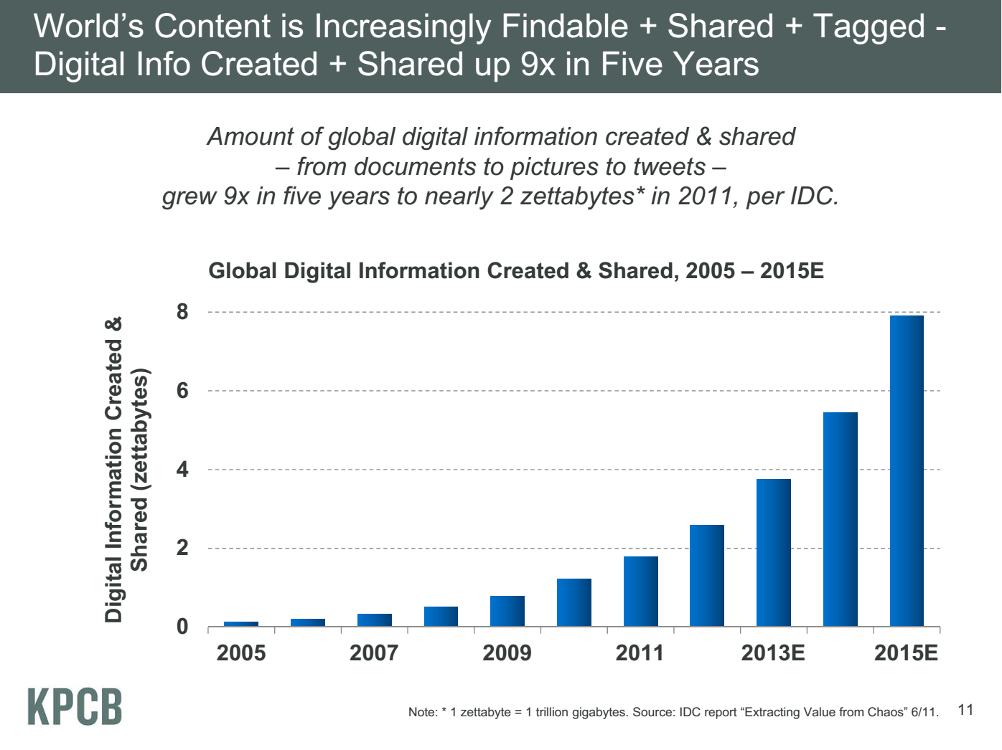
IP Traffic per year ~ 12% Total Created
Meeker/Wu May 29 2013 Internet Trends D11 Conference

Slide 5
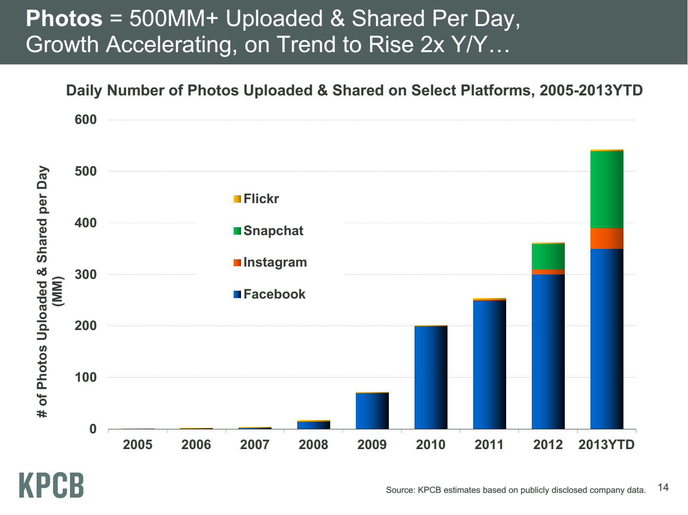
Meeker/Wu May 29 2013 Internet Trends D11 Conference

Slide 6

Some Data sizes
  ~40 10⁹ Web pages at ~300 kilobytes each = 10 Petabytes
  LHC 15 petabytes per year
  Radiology 69 petabytes per year
  Square Kilometer Array Telescope will be 100 terabits/second; LSST Survey >20TB per day
  Earth Observation becoming ~4 petabytes per year
  Earthquake Science – few terabytes total today
  PolarGrid – 100’s terabytes/year becoming petabytes
  Exascale simulation data dumps – terabytes/second
  Deep Learning to train self driving car; 100 million megapixel images ~ 100 terabytes

Slide 7
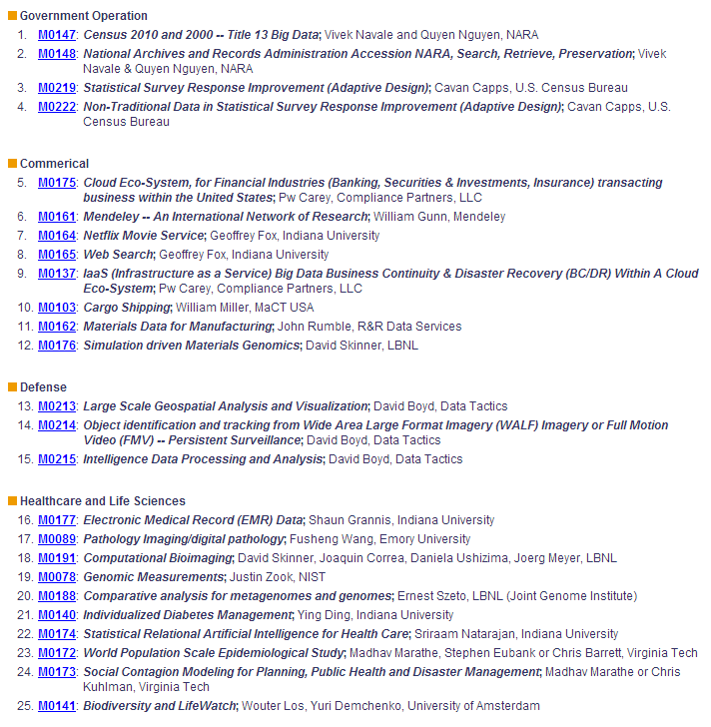
4
8
51 NIST Big Data Use Cases
http://bigdatawg.nist.gov/usecases.php
3
10

Slide 8
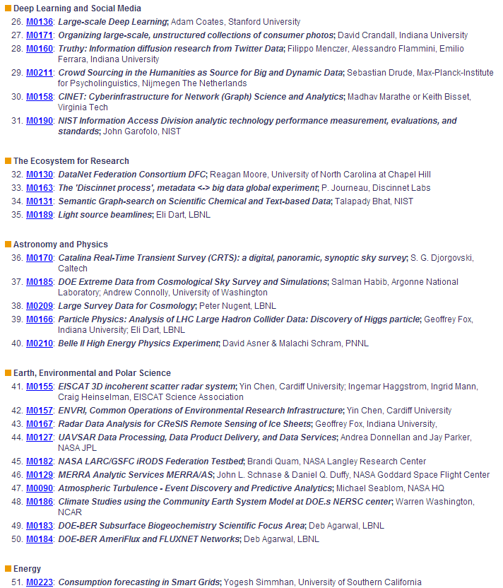
6
4
51 NIST Big Data Use Cases
http://bigdatawg.nist.gov/usecases.php
5
10
1

Slide 9
Jobs

Slide 10

Jobs v. Countries
http://www.microsoft.com/en-us/news/features/2012/mar12/03-05CloudComputingJobs.aspx

Slide 11

McKinsey Institute on Big Data Jobs
There will be a shortage of talent necessary for organizations to take advantage of big data. By 2018, the United States alone could face a shortage of 140,000 to 190,000 people with deep analytical skills as well as 1.5 million managers and analysts with the know-how to use the analysis of big data to make effective decisions.
At IU, Informatics aimed at 1.5 million jobs. Computer Science covers the 140,000 to 190,000
http://www.mckinsey.com/mgi/publications/big_data/index.asp.

Slide 12
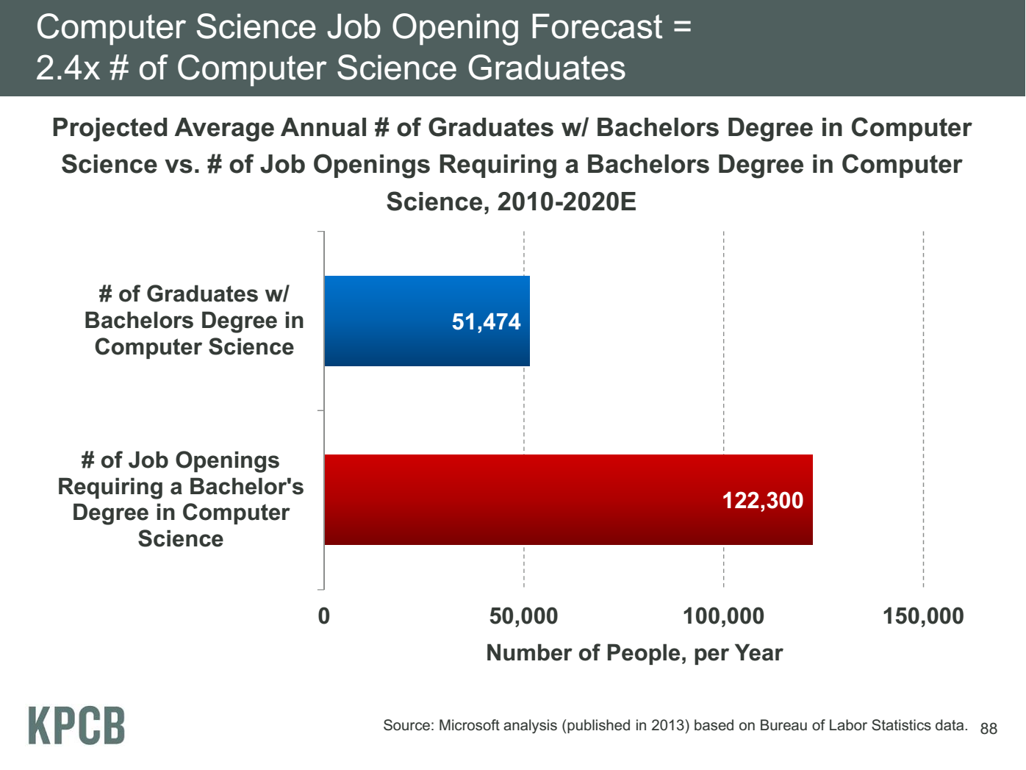
Meeker/Wu May 29 2013 Internet Trends D11 Conference

Slide 13
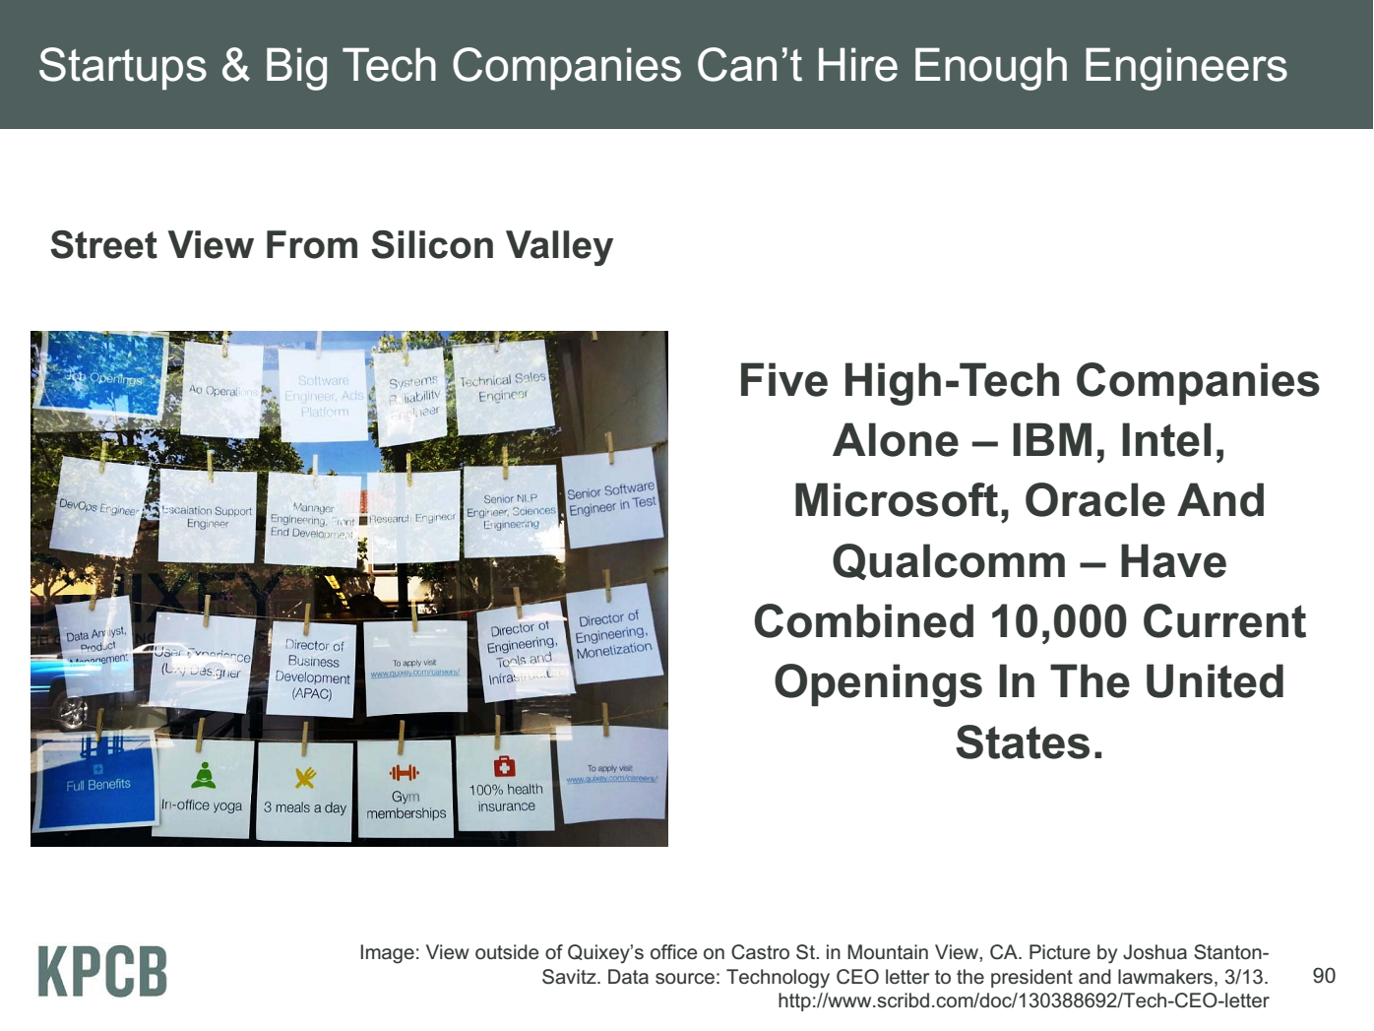
Meeker/Wu May 29 2013 Internet Trends D11 Conference

Slide 14
Computing Model
Industry adopted clouds which are attractive for data analytics

Slide 15
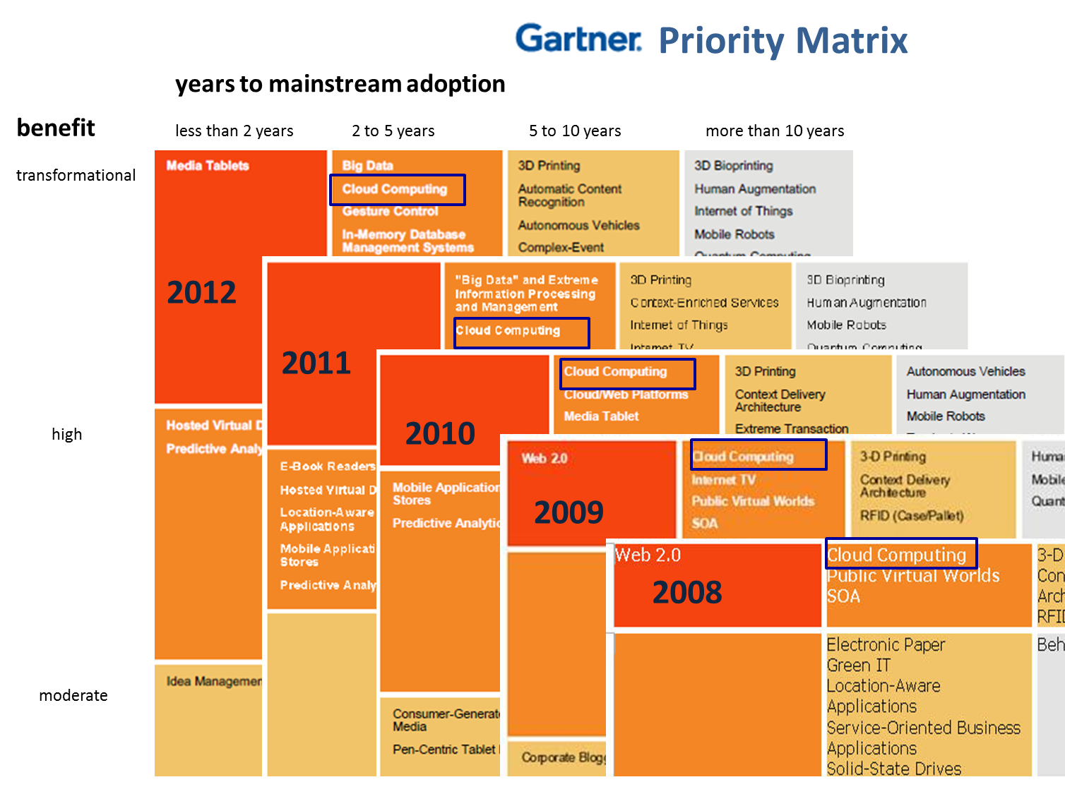
5 years Cloud Computing
2 years Big Data Transformational

Slide 16
Amazon making money
It took Amazon Web Services (AWS) eight years to hit $650 million in revenue, according to Citigroup in 2010.
Just three years later, Macquarie Capital analyst Ben Schachter estimates that AWS will top $3.8 billion in 2013 revenue, up from $2.1 billion in 2012 (estimated), valuing the AWS business at $19 billion.

Slide 17
Physically Clouds are Clear
A bunch of computers in an efficient data center with an excellent Internet connection
They were produced to meet need of public-facing Web 2.0 e-Commerce/Social Networking sites
They can be considered as “optimal giant data center” plus internet connection
Note enterprises use private clouds that are giant data centers but not optimized for Internet access
Exascale build-out of commercial cloud infrastructure: for 2014-15 expect 10,000,000 new servers and 10 Exabytes of storage in major commercial cloud data centers worldwide.

Slide 18
Data Intensive Applications and Programming Models

Slide 19
Clouds & Data Intensive Applications
Applications tend to be new and so can consider emerging technologies such as clouds
Do not have lots of small messages but rather large reduction (aka Collective) operations
  New optimizations e.g. for huge messages
“Large Scale Optimization”: Deep Learning, Social Image Organization, Clustering and Multidimensional Scaling which are variants of EM
EM (expectation maximization) tends to be good for clouds and Iterative MapReduce
  Quite complicated computations (so compute largish compared to communicate)
  Communication is Reduction operations (global sums or linear) or Broadcast
Machine Learning has FULL Matrix kernels

Slide 20
Some (NIST)Large Data mining Problems I
http://salsahpc.indiana.edu/summerworkshop2013/index.html
Deep Learning: (Google/Stanford) Recognize features such as bikes or faces with a learning network
Find W’s by iteration (Steepest Descent method)
Find 11 Billion W’s from 10 million images = 9 layer NN
“Pure” Full Matrix Multiplication
MPI+GPU gets near
optimal performance
GPU+MPI 100 times
previous Google work
Note Datamining
often gives full matrices

Slide 21

Protein Universe Browser for COG Sequences with a few illustrative biologically identified clusters
Dimension reduction MDS for visualization and clustering in non metric spaces
O(N²) algorithms with full matrices
Important Online (interpolation) methods
Expectation Maximization (Iterative AllReduce) and Levenberg Marquardt with Conjugate Gradient

Slide 22
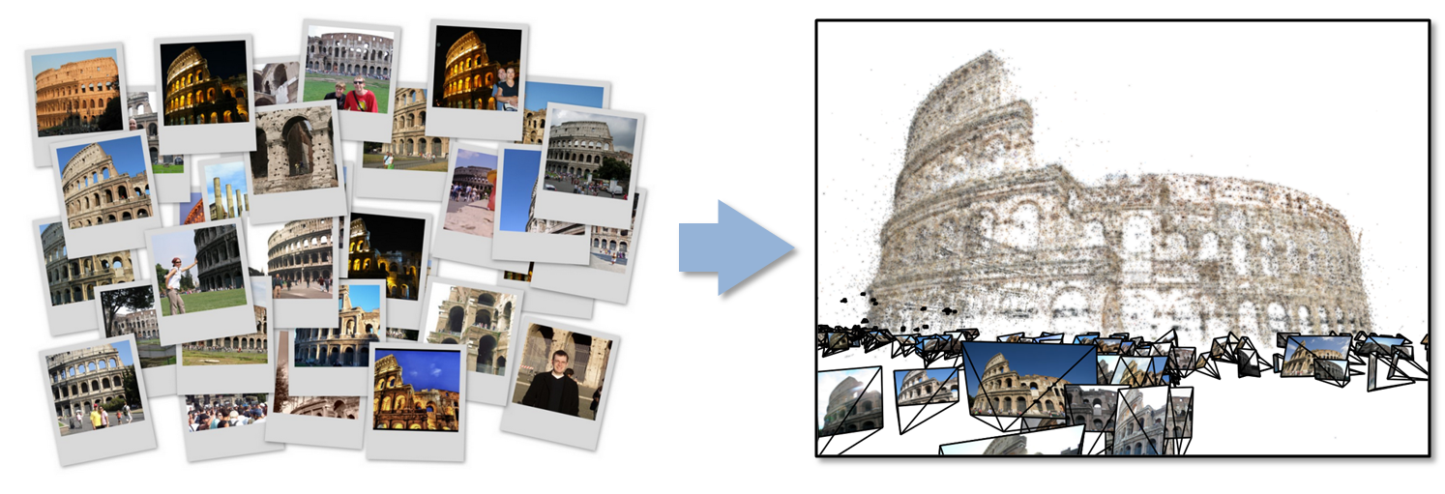
Some (NIST)Large Data mining Problems II
Determine optimal geo and angle representation of “all” images by giant least squares fit to 6-D Camera pose of each image and 3D position of points in scene
Levenberg-Marquardt using Conjugate Gradient to estimate leading eigenvector and solve equations
Note such Newton approaches fail for learning networks as too many parameters
Need Hadoop and HDFS with “trivial problem” of just 15,000 images and 75,000 points giving 1 TB messages per iteration
Over 500 million images uploaded each day (1 in 1000 Eiffel tower) …..

Slide 23
Alternative Approach to Image Classification
Instead of learning networks one can (always) use clustering to divide spaces into compact nearby regions
Characterize images by a feature vector in 512-2048 dimensional spaces (HOG or Histograms of Oriented Gradients)
Cluster (K-means) 100 million vectors (100,000 images) into 10 million clusters
Giant Broadcast and AllReduce Operations that stress most MPI implementations
Note Kmeans (Mahout) dreadful with Hadoop

Slide 24
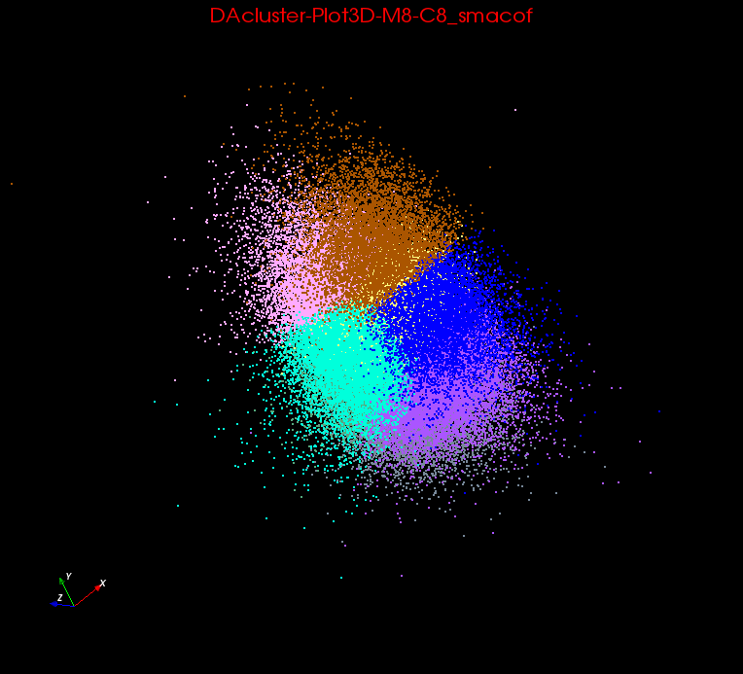
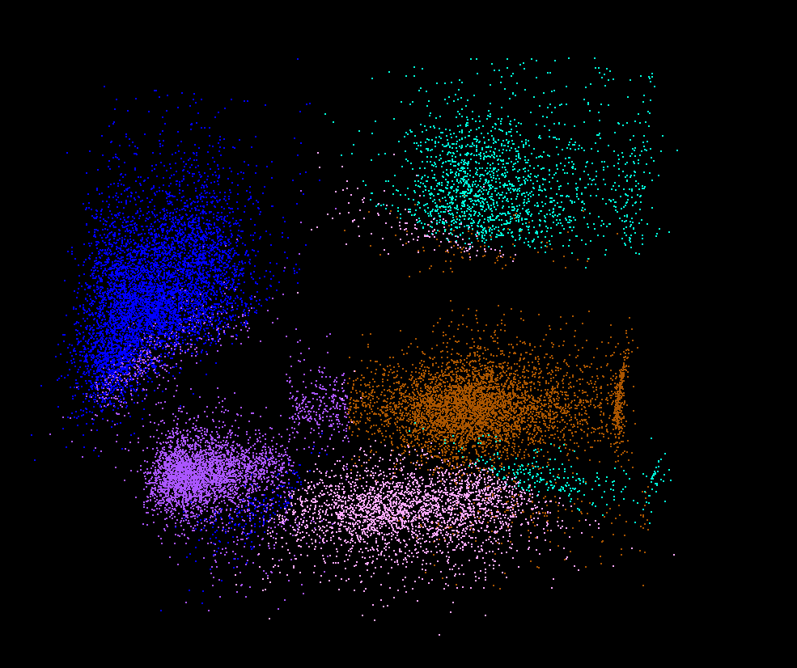
Clusters v. Regions
Lymphocytes 4D
Pathology 54D
In Lymphocytes clusters are distinct
In Pathology (NIST Big Data Use Case), clusters divide space into regions and sophisticated methods like deterministic annealing are probably unnecessary

Slide 25
Map Collective Model (Judy Qiu)
Combine MPI and MapReduce ideas
Implement collectives optimally on Infiniband, Azure, Amazon ……
Iterate
Input
map
Initial Collective Step
Generalized Reduce
Final Collective Step

Slide 26
4 Forms of MapReduce
(a) Map Only
(b) Classic MapReduce
(c) Iterative MapReduce
(d) Loosely Synchronous
Input
Input
Iterations
Input
map
map
map
P_{ij}
reduce
reduce
Output
BLAST Analysis
Parametric sweep
Pleasingly Parallel
High Energy Physics (HEP) Histograms
Distributed search
Expectation maximization Clustering e.g. Kmeans
Linear Algebra, Page Rank
Classic MPI
PDE Solvers and particle dynamics
Domain of MapReduce and Iterative Extensions
Science Clouds
MPI
Exascale
MPI is Map followed by Point to Point Communication – as in style d)

Slide 27
Twister for Data Intensive
Iterative Applications
Generalize to arbitrary Collective
Broadcast
Compute
Communication
Reduce/ barrier
New Iteration
Smaller Loop-Variant Data
Larger Loop-Invariant Data
(Iterative) MapReduce structure with Map-Collective is framework
Twister runs on Linux or Azure
Twister4Azure is built on top of Azure tables, queues, storage
Qiu, Gunarathne
Notes:
Most of these applications consists of iterative computation and communication steps where single iterations can easily be specified as MapReduce computations.
Large input data sizes which are loop-invariant and can be reused across iterations.
Loop-variant results.. Orders of magnitude smaller…
While these can be performed using traditional MapReduce frameworks, Traditional is not efficient for these types of computations. MR leaves lot of room for improvements in terms of iterative applications.

Slide 28
Kmeans Clustering on Azure
Number of tasks running as function of time
This shows that the communication and synchronization overheads between iterations are very small (less than one second, which is the lowest measured unit for this graph).
128 Million data points(19GB), 500 centroids (78KB), 20 dimensions
10 iterations, 256 cores, 256 map tasks per iteration

Slide 29
Kmeans Clustering
Execution Time per task
128 Million data points(19GB), 500 centroids (78KB), 20 dimensions
10 iterations, 256 cores, 256 map tasks per iteration

Slide 30
Kmeans and (Iterative) MapReduce
Shaded areas are computing only where Hadoop on HPC cluster fastest
Areas above shading are overheads where T4A smallest and T4A with AllReduce collective has lowest overhead
Note even on Azure Java (Orange) faster than T4A C#

Slide 31
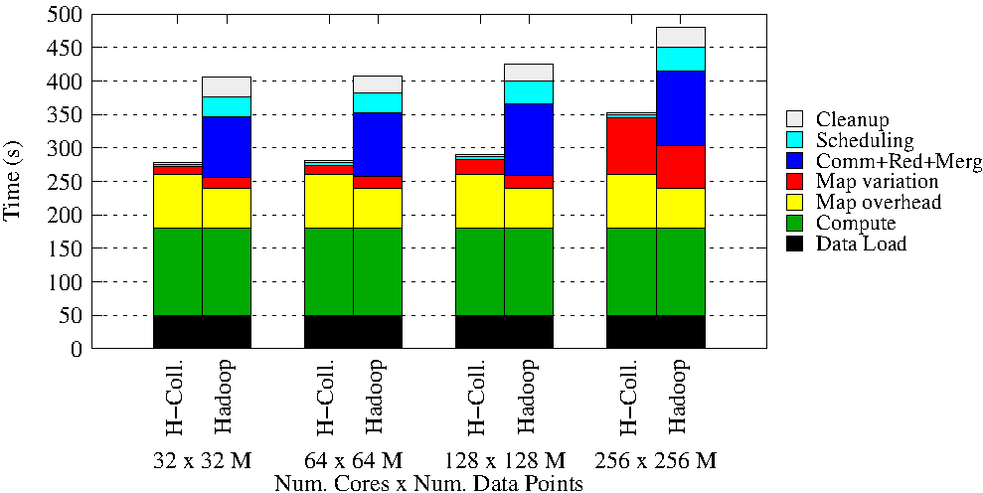
Details of K-means Linux Hadoop and Hadoop with AllReduce Collective

Slide 32
Data Science Education
Opportunities at universities
see recent New York Times articles
http://datascience101.wordpress.com/2013/04/13/new-york-times-data-science-articles/

Slide 33
Data Science Education
Broad Range of Topics from Policy to curation to applications and algorithms, programming models, data systems, statistics, and broad range of CS subjects such as Clouds, Programming, HCI,
Plenty of Jobs and broader range of possibilities than computational science but similar cosmic issues
  What type of degree (Certificate, minor, track, “real” degree)
  What implementation (department, interdisciplinary group supporting education and research program)
NIST Big Data initiative identifies Big Data, Data Science, Data Scientist as core concepts
There are over 40 Data Science Curricula (4 Undergraduate, 31 Masters, 5 Certificate, 3 PhD)

Slide 34
Computational Science
Interdisciplinary field between computer science and applications with primary focus on simulation areas
Very successful as a research area
  XSEDE and Exascale systems enable
Several academic programs but these have been less successful than computational science research as
  No consensus as to curricula and jobs (don’t appoint faculty in computational science; do appoint to DoE labs)
  Field relatively small
Started around 1990

Slide 35
Data Science at Indiana University
Link Statistics & School of Informatics and Computing (Computer Science, Informatics, Information & Library Science)
Broader than most offerings
Ought IMHO to involve application faculty
Areas Data Analysis and Statistics, Data Lifecycle, Infrastructure (Clouds, Security), Applications
  How broad should requirements be
Offer online Masters in MOOC format in full scale Fall 2014 and as certificate on January 2014.
  Also allow residential students in flipped mode
Free trial run of my MOOC on Big Data Mid October 2013

Slide 36
MOOC’s

Slide 37
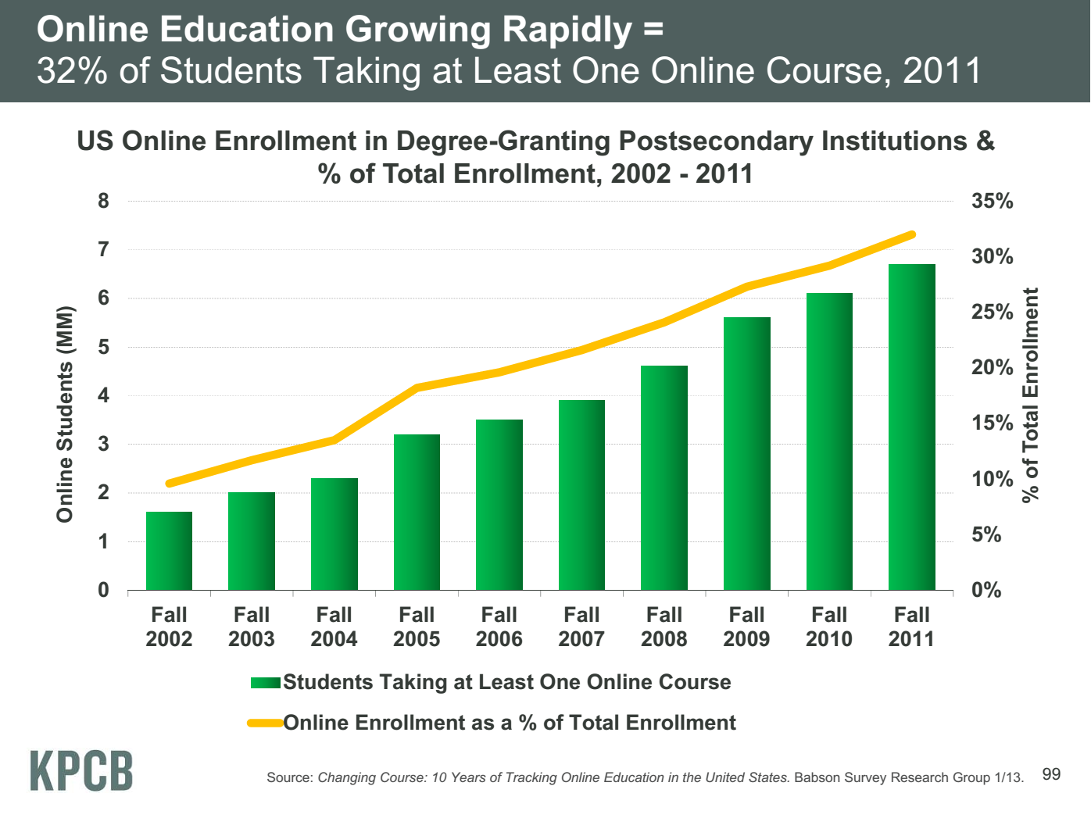
Meeker/Wu May 29 2013 Internet Trends D11 Conference

Slide 38
Massive Open Online Courses (MOOC)
MOOC’s are very “hot” these days with Udacity and Coursera as start-ups; perhaps over 100,000 participants
Relevant to Data Science (where IU is preparing a MOOC) as this is a new field with few courses at most universities
Typical model is collection of short prerecorded segments (talking head over PowerPoint) of length 3-15 minutes
These “lesson objects” can be viewed as “songs”
Google Course Builder (python open source) builds customizable MOOC’s as “playlists” of “songs”
Tells you to capture all material as “lesson objects”
We are aiming to build a repository of many “songs”; used in many ways – tutorials, classes …

Slide 39
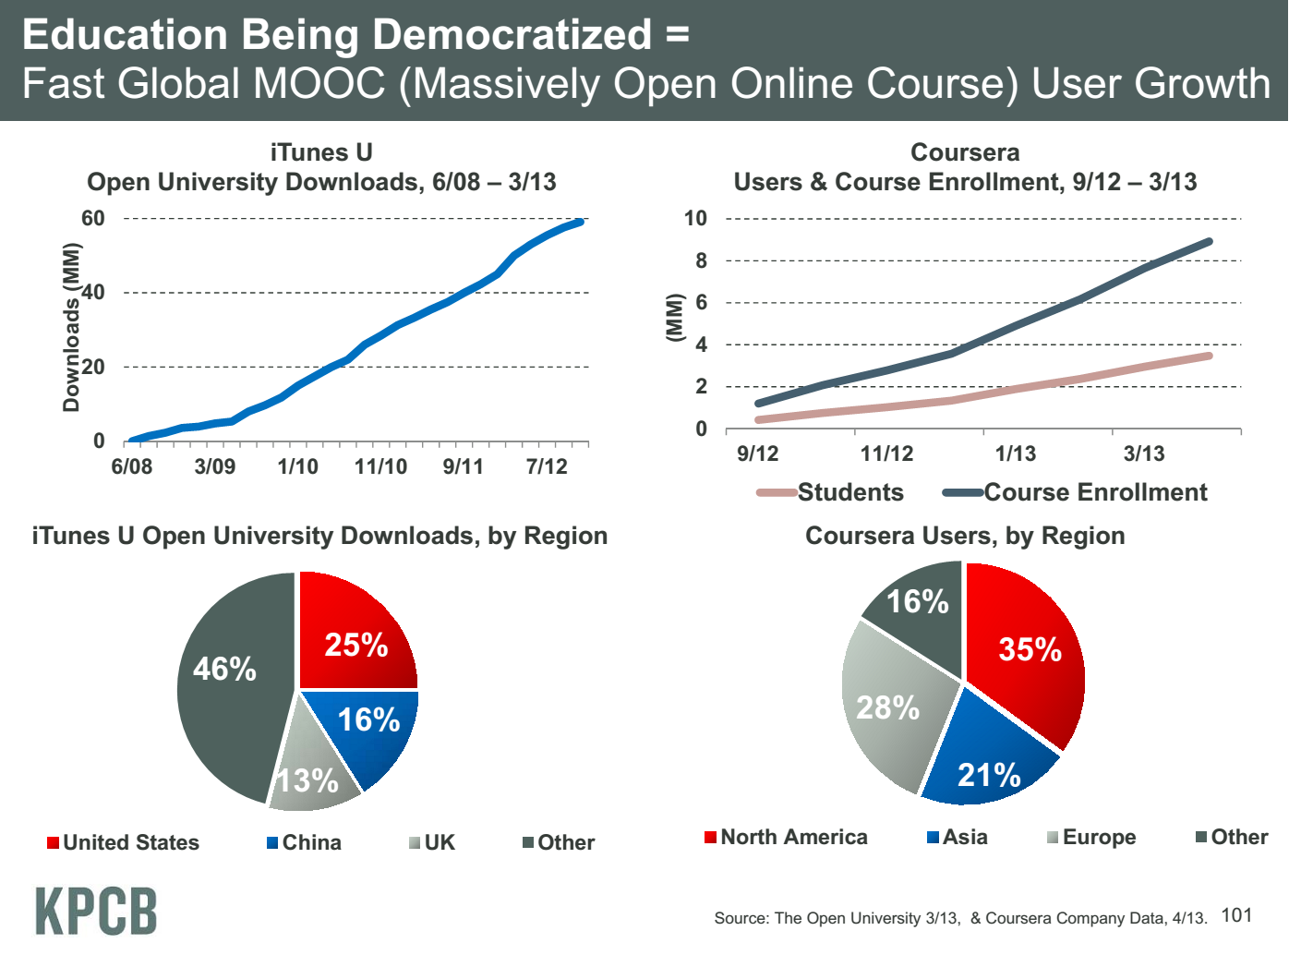
Meeker/Wu May 29 2013 Internet Trends D11 Conference

Slide 40
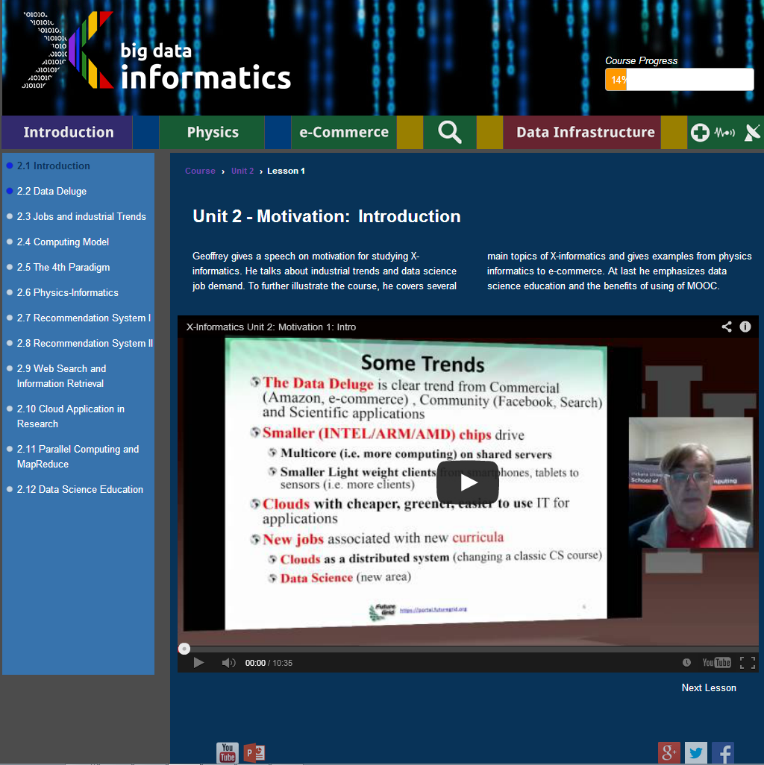
Twelve ~10 minutes lesson objects in this lecture
IU wants us to close caption if use in real course

Slide 41
Customizable MOOC’s
We could teach one class to 100,000 students or 2,000 classes to 50 students
The 2,000 class choice has 2 useful features
  One can use the usual (electronic) mentoring/grading technology
  One can customize each of 2,000 classes for a particular audience given their level and interests
  One can even allow student to customize – that’s what one does in making play lists in iTunes
  Flipped Classroom
Both models can be supported by a repository of lesson objects (3-15 minute video segments) in the cloud
The teacher can choose from existing lesson objects and add their own to produce a new customized course with new lessons contributed back to repository

Slide 42
Key MOOC areas costing money/effort
Make content including content, quizzes, homework
Record video
Make web site
Social Networking Interaction for mentoring student- Teaching assistants and student-student
Defining how to support computing labs with FutureGrid or appliances + Virtual Box
  Appliances scale as download to student’s client
  Virtual machines essential
Analyse/Evaluate interactions

Slide 43
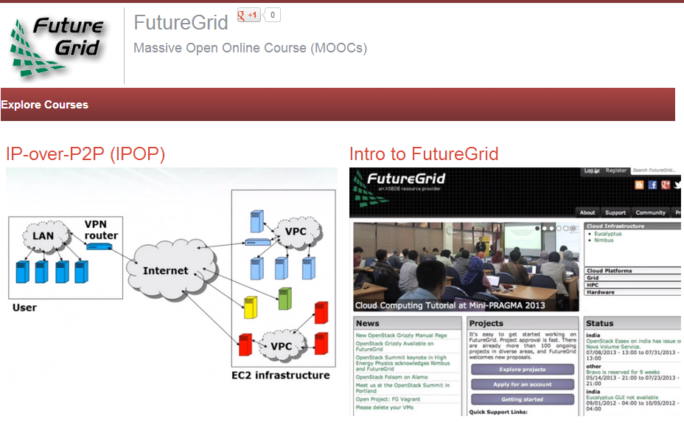
FutureGrid hosts many classes per semester
How to use FutureGrid is shared MOOC

Slide 44
Conclusions

Slide 45
Conclusions
Data Intensive programs are not like simulations as they have large “reductions” (“collectives”) and do not have many small messages
  Clouds suitable and in fact HPC sometimes optimal
Iterative MapReduce an interesting approach; need to optimize collectives for new applications (Data analytics) and resources (clouds, GPU’s …)
Need an initiative to build scalable high performance data analytics library on top of interoperable cloud-HPC platform
  Full matrices important
More employment opportunities in clouds than HPC and Grids and in data than simulation; so cloud and data related activities popular with students
Community activity to discuss data science education
  Agree on curricula; is such a degree attractive?
Role of MOOC’s for either
  Disseminating new curricula
  Managing course fragments that can be assembled into custom courses for particular interdisciplinary students

