Slide 1
Performance Model for Parallel Matrix Multiplication with Dryad: Dataflow Graph Runtime
Hui Li
School of Informatics and Computing
Indiana University
11/1/2012

Slide 2
Outline
Dryad
Dryad Dataflow Runtime
Dryad Deployment Environment
Performance Modeling
Fox Algorithm of PMM
Modeling Communication Overhead
Results and Evaluation

Slide 3
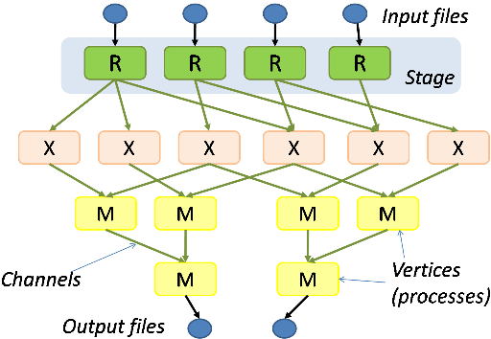
Movtivation: Performance Modeling for Dataflow Runtime
3.293*10*^-8*M^2+2.29*10^-12*M^3
Dryad
MPI
Notes:
People care about the cost effectiveness of data flow runtime

Slide 4
Overview of Performance Modeling
Modeling Approach
Analytical Modeling
Empirical Modeling
Semi-empirical Modeling
Simulations
Applications
Parallel Applications
(Matrix Multiplication)
BigData Applications
Applications
Runtime Environments
Message Passing
(MPI)
MapReduce
(Hadoop)
Data Flow
(Dryad)
Infrastructure
Supercomputer
Cloud
(Azure)
HPC Cluster
Notes:
BigData Application; BigData App; Con

Slide 5
Dryad Processing Model
Outputs
Directed Acyclic Graph (DAG)
Processing
vertices
Channels
(file, pipe,
shared
memory)
Inputs
Notes:
Use the file pipe to exchange the data between different nodes;

Slide 6
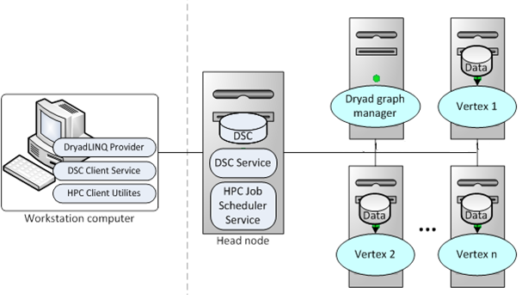
Dryad Deployment Model
for (int i = 0; i < _iteration; i++)
{
DistributedQuery<double[]> partialRVTs = null;
partialRVTs = WebgraphPartitions.ApplyPerPartition(subPartitions => subPartitions.AsParallel()
.Select(partition => calculateSingleAmData(partition, rankValueTable,_numUrls)));
rankValueTable = mergePartialRVTs(partialRVTs);
}

Slide 7
Dryad Deployment Environment
Windows HPC Cluster
Low Network Latency
Low System Noise
Low Runtime Performance Fluctuation
Azure
High Network Latency
High System Noise
High Runtime Performance Fluctuation
Notes:
People usually run dataflow runtime on cloud infrastructure,

Slide 8
Steps of Performance Modeling for Parallel Applications
Identify parameters that influence runtime performance (runtime environment model)
Identify application kernels (problem model)
Determine communication pattern, and model the communication overhead
Determine communication/computation overlap to get more accurate modeled results
Notes:
For example, the compuation complexity of PMM is O(N^3) and memory complexity of PMM is O(N^2); for example the broadcast operation has different behavior in different implementations.

Slide 9
Step1-a: Parameters affect Runtime Performance
Latency
Time delay to access remote data or service
Runtime overhead
Critical path work to required to manage parallel physical resources and concurrent abstract tasks
Communication overhead
Overhead to transfer data and information between processes
Critical to performance of parallel applications
Determined by algorithm and implementation of communication operations
Notes:
The latency and runtime overhead are typically in terms of tens or hundreds of milli-seconds

Slide 10
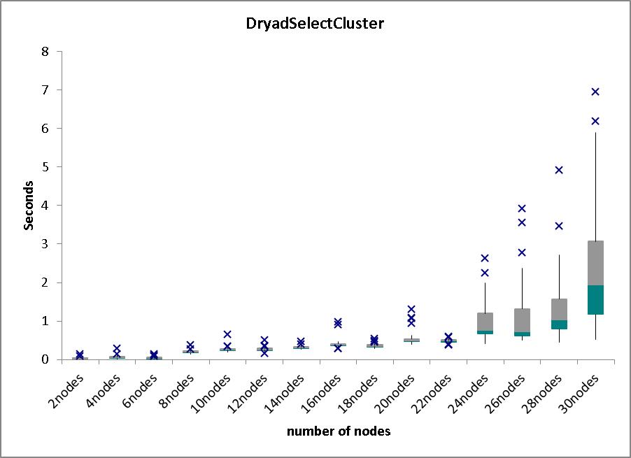
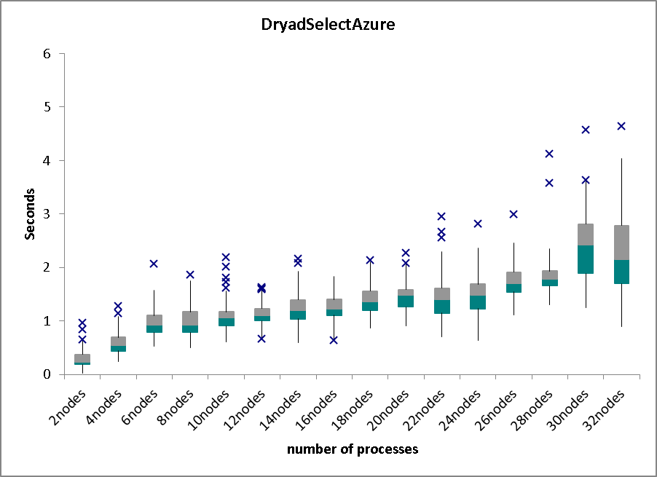
Step 1-b: Identify Overhead of Dryad Primitives Operations
Dryad use flat tree to broadcast messages to all of its vertices
Dryad_Select using up to 30 nodes on Tempest
Dryad_Select using up to 30 nodes on Azure
more nodes incur more aggregated random system interruption, runtime fluctuation, and network jitter.
Cloud show larger random detour due to the fluctuations.
the average overhead of Dryad Select on Tempest and Azure were both linear with the number of nodes.
Notes:
So this won’t be the performance bottleneck of computation intensive applications

Slide 11
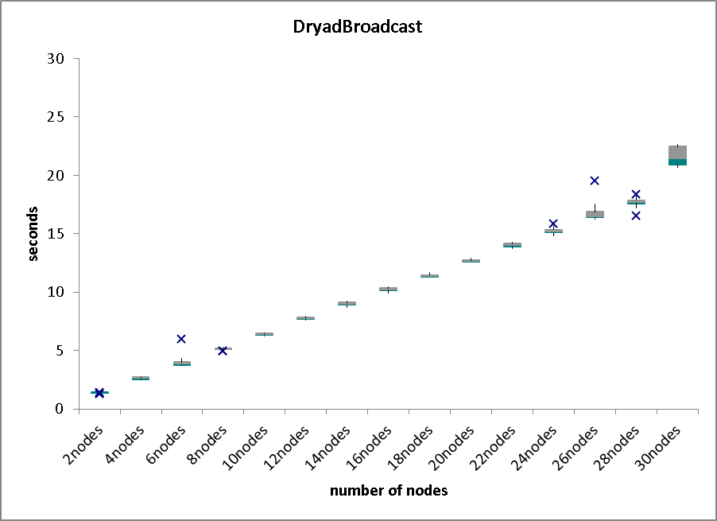
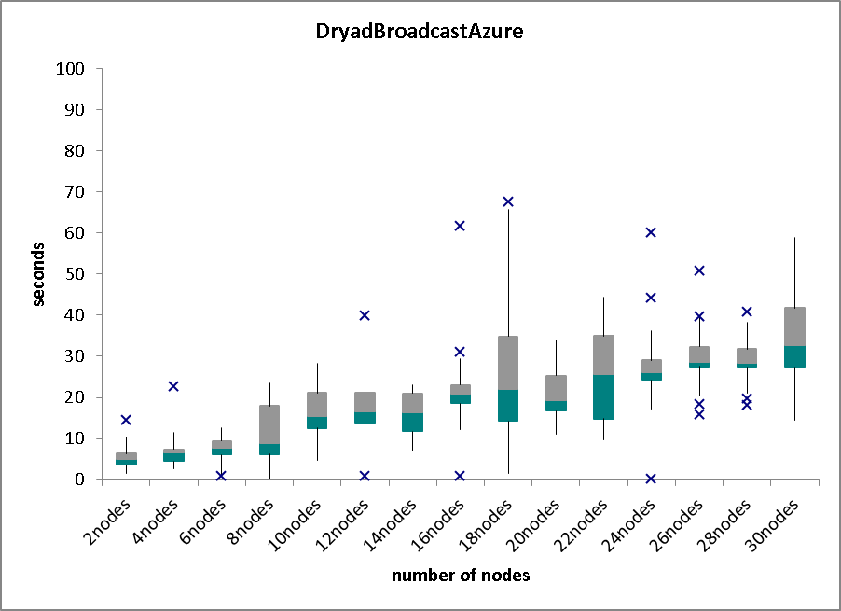
Step 1-c: Identify Communication Overhead of Dryad
72 MB on 2-30 nodes on Tempest
72 MB on 2-30 small instances on Azure
Dryad use flat tree to broadcast messages to all of its vertices
Overhead of Dryad broadcasting operation is linear with the number of computer nodes.
Dryad collective communication is not parallelized, which is not scalable behavior for message intensive applications; but still won’t be the performance bottleneck for computation intensive applications.

Slide 12
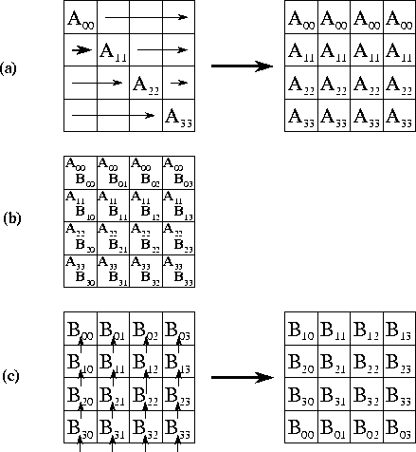
Step2: Fox Algorithm of PMM
Pseudo Code of Fox algorithm:
Partitioned matrix A, B to blocks
For each iteration i:
1) broadcast matrix A block (j,i) to row j
2) compute matrix C blocks, and add the partial results to the previous result of matrix C block
3) roll-up matrix B block
Also named BMR algorithm,
Geoffrey Fox gave the timing model in 1987 for hypercube machine
has well established communication and computation pattern
Notes:
Program easily scale from multiple core to multiple nodes; it cost 300 lines to implement Fox algorithm with DryadLINQ. Implement Row partition is easy cost about 50 lines; do not pipeline the communication. MPI can broadcast to a subset of grid of processors, while DryadLinq not. It can pipeline the communication, while Dryad can pipeline the execution of computation steps. O(N^3), O(N^2)

Slide 13
Step3: Determine Communication Pattern
Broadcast is the major communication overhead of Fox algorithm
Summarizes the performance equations of the broadcast algorithms of the three different implementations
Parallel overhead increase faster when converge rate is bigger.
Implementation | Broadcast algorithm | Broadcast overhead of N processes | Converge rate of parallel overhead
Fox | Pipeline Tree | (M²)*T_{comm} | (√N)/M
MS.MPI | Binomial Tree | (log₂N)*(M²)*T_{comm} | (√N*(1 + (log₂√N)))/(4*M)
Dryad | Flat Tree | N*(M²)*(T_{comm} + T_{io}) | (√N*(1 + √N))/(4*M)

Slide 14
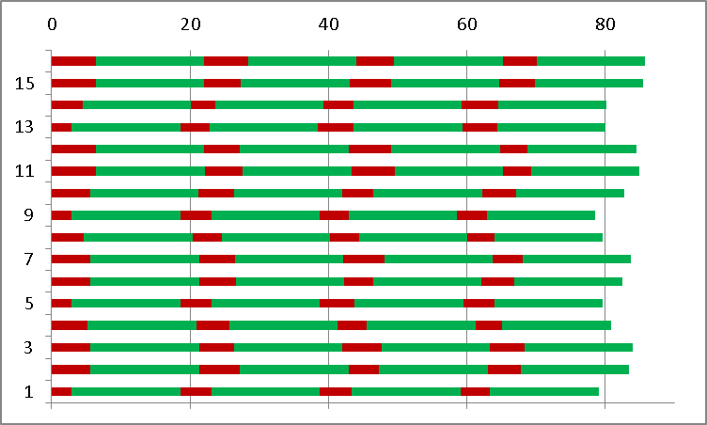
Step 4-a: Identify the overlap between communication and computation
Profiling the communication and computation overhead of Dryad PMM using 16 nodes on Windows HPC cluster
The red bar represents communication overhead; green bar represents computation overhead.
The communication overhead varied in different iterations, computations overhead are the same
Communication overhead is overlapped with computation overhead of other process
Using average overhead to model the long term communication overhead to eliminate the varied communication overhead in different iterations
Notes:
Dryad on Tempest; The computation overhead is the same for all the processes

Slide 15
Step 4-b: Identify the overlap between communication and computation
Profiling the communication and computation overhead of Dryad PMM using 100 small instances on Azure with reserved 100Mbps network
The red bar represents communication overhead; green bar represents the computation overhead.
Communication overhead are varied in different iteration due to behavior of Dryad broadcast operations and cloud fluctuation.
Using average overhead to model the long term communication overhead to eliminate the performance fluctuation in cloud
Notes:
Dryad on Azure

Slide 16
Experiments Environments
Windows cluster with up to 400 cores, Azure with up to 100 instances, and Linux cluster with up to 100 nodes
We use the beta release of Dryad, named LINQ to HPC, released in Nov 2011, and use MS.MPI, IntelMPI, OpenMPI for our performance comparisons.
Both LINQ to HPC and MS.MPI use .NET version 4.0; IntelMPI with version 4.0.0 and OpenMPI with version 1.4.3

Slide 17
Modeling Equations Using Different Runtime Environments
Runtime environments | #nodes #cores | T_{flops} | Network | T_{io+comm} (Dryad) T_{comm} (MPI) | Equation of analytic model of PMM jobs
Dryad Tempest | 25x1 | 1.16*10⁻¹⁰ | 20Gbps | 1.13*10⁻⁷ | 6.764*10⁻⁸*M² + 9.259*10⁻¹²*M³
Dryad Tempest | 25x16 | 1.22*10⁻¹¹ | 20Gbps | 9.73*10⁻⁸ | 6.764*10⁻⁸*M² + 9.192*10⁻¹³*M³
Dryad Azure | 100x1 | 1.43*10⁻¹⁰ | 100Mbps | 1.62*10⁻⁷ | 8.913*10⁻⁸*M² + 2.865*10⁻¹²*M³
MS.MPI Tempest | 25x1 | 1.16*10⁻¹⁰ | 1Gbps | 9.32*10⁻⁸ | 3.727*10⁻⁸*M² + 9.259*10⁻¹²*M³
MS.MPI Tempest | 25x1 | 1.16*10⁻¹⁰ | 20Gbps | 5.51*10⁻⁸ | 2.205*10⁻⁸*M² + 9.259*10⁻¹²*M³
IntelMPI Quarry | 100x1 | 1.08*10⁻¹⁰ | 10Gbps | 6.41*10⁻⁸ | 3.37*10⁻⁸*M² + 2.06*10⁻¹²*M³
OpenMPI Odin | 100x1 | 2.93*10⁻¹⁰ | 10Gbps | 5.98*10⁻⁸ | 3.293*10⁻⁸*M² + 5.82*10⁻¹²*M³
The scheduling overhead is eliminated for large problem sizes.
Assume the aggregated message sizes is smaller than the maximum bandwidth.
The final results show that our analytic model produces accurate predictions within 5% of the measured results.

Slide 18
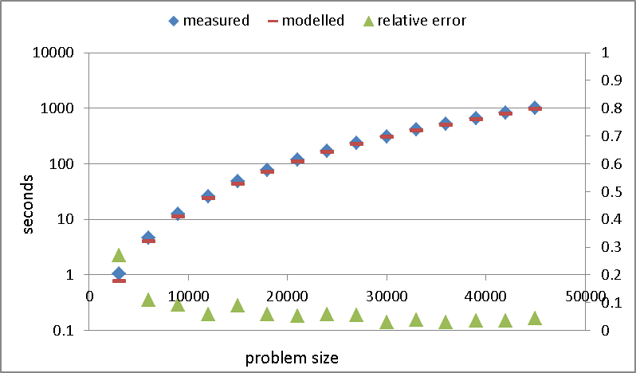
Compare Modeled Results with Measured Results of Dryad PMM on HPC Cluster
modeled job running time is calculated with model equation with the measured parameters, such as Tflops, Tio+comm.
Measured job running time is measured by C# timer on head node
The relative error between model time and the measured result is within 5% for large matrices sizes.
Dryad PMM on 25 nodes on Tempest

Slide 19
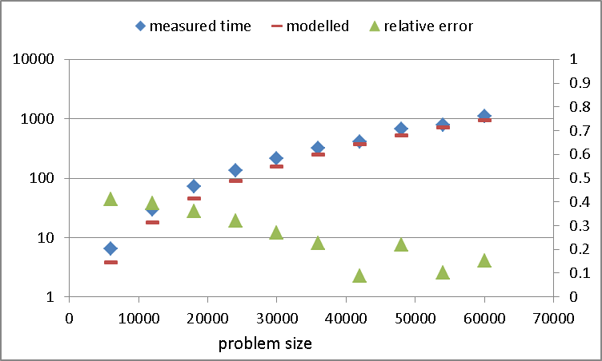
Compare Modeled Results with Measured Results of Dryad PMM on Cloud
modeled job running time is calculated with model equation with the measured parameters, such as Tflops, Tio+comm.
Measured job running time is measured by C# timer on head node.
Show larger relative error (about 10%) due to performance fluctuation in Cloud.
Dryad PMM on 100 small instances on Azure

Slide 20
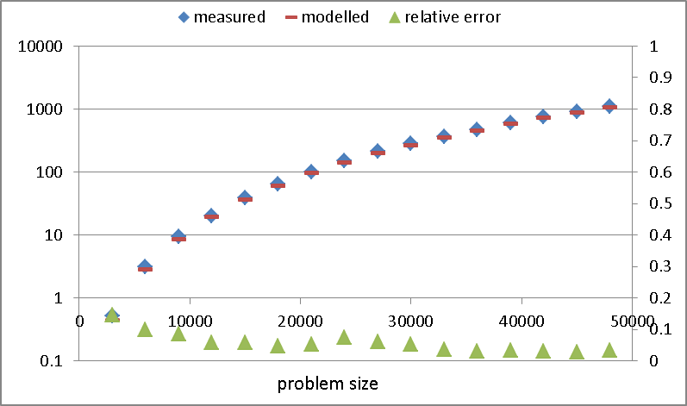
Compare Modeling Results with Measured Results of MPI PMM on HPC
Network bandwidth 10Gbps.
Measured job running time is measured by Relative C# timer on head node
The relative error between model time and the measured result is within 3% for large matrices sizes.
OpenMPI PMM on 100 nodes on HPC cluster

Slide 21
Conclusions
We proposed the analytic timing model of Dryad implementations of PMM in realistic settings.
Performance of collective communications is critical to model parallel application.
We proved some cases that using average communication overhead to model performance of parallel matrix multiplication jobs on HPC clusters and Cloud is the practical approach

Slide 22
Acknowledgement
Advisor:
Geoffrey Fox, Judy Qiu
Dryad Team@Microsoft External Research
UITS@IU
Ryan Hartman, John Naab
SALSAHPC Team@IU
Yang Ruan, Yuduo Zhou

Slide 23
Question? Thank you!

Slide 24
Backup Slides

Slide 25
Step 4: Identify and Measure Parameters
plot parallel overhead vs. (√N*(√N+1))/(4*M) of Dryad PMM using different number of nodes on Tempest.

Slide 26
Modeling Approaches
Analytical modeling:
Determine application requirements and system speeds to compute time (e.g., bandwidth)
Empirical modeling:
“Black-box” approach: machine learning, neural networks, statistical learning …
Semi-empirical modeling (widely used):
“White box” approach: find asymptotically tight analytic models, parameterize empirically (curve fitting)

Slide 27
Communication and Computation Patterns of PMM on HPC and Cloud
MS.MPI on 16 small instances on Azure with 100Mbps network. (d) Dryad on 16nodes on Tempest with 20Gbps network.
Notes:
Performance Model in Cloud Environment, Using the average overhead to predicate the overall overhead in Cloud environment

Slide 28
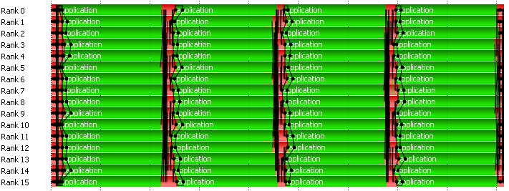
Step 4-c: Identify the overlap between communication and computation
MS.MPI on 16nodes on Tempest with 20Gbps network.
Notes:
Dryad on MS.MPI

