Slide 1
A Brief Introduction of Existing Big Data Tools
Bingjing Zhang

Slide 2
Outline
The world map of big data tools
Layered architecture
Big data tools for HPC and supercomputing
MPI
Big data tools on clouds
MapReduce model
Iterative MapReduce model
DAG model
Graph model
Collective model
Machine learning on big data
Query on big data
Stream data processing

Slide 3
The World of Big Data Tools
DAG Model
MapReduce Model
Graph Model
BSP/Collective Model
Hadoop
For Iterations/ Learning
MPI
HaLoop
Giraph
Twister
Hama
GraphLab
Spark
GraphX
Harp
Stratosphere
Dryad/ DryadLINQ
Reef
For Query
Pig/PigLatin
Hive
Drill
Tez
Shark
MRQL
For Streaming
S4
Storm
Samza
Spark Streaming

Slide 4
Layered Architecture (Upper)
Orchestration & Workflow Oozie, ODE, Airavata and OODT (Tools) NA: Pegasus, Kepler, Swift, Taverna, Trident, ActiveBPEL, BioKepler, Galaxy
Cross Cutting Capabilities
Data Analytics Libraries:
Machine Learning Mahout , MLlib , MLbase CompLearn (NA)
NA – Non Apache projects
Green layers are Apache/Commercial Cloud (light) to HPC (darker) integration layers
Statistics, Bioinformatics R, Bioconductor (NA)
Imagery ImageJ (NA)
Linear Algebra Scalapack, PetSc (NA)
Monitoring: Ambari, Ganglia, Nagios, Inca (NA)
Security & Privacy
Distributed Coordination: ZooKeeper, JGroups
Message Protocols: Thrift, Protobuf (NA)
High Level (Integrated) Systems for Data Processing
Hive (SQL on Hadoop)
Hcatalog Interfaces
Pig (Procedural Language)
Shark (SQL on Spark, NA)
MRQL (SQL on Hadoop, Hama, Spark)
Impala (NA)
Cloudera
(SQL on Hbase)
Swazall (Log Files Google NA)
Parallel Horizontally Scalable Data Processing
Pegasus on Hadoop (NA)
Hadoop (Map Reduce)
Spark (Iterative MR)
NA:Twister Stratosphere Iterative MR
Tez (DAG)
Hama (BSP)
Storm
S4 Yahoo
Samza LinkedIn
Giraph ~Pregel
Batch
Stream
Graph
ABDS Inter-process Communication
HPC Inter-process Communication
Hadoop, Spark Communications MPI (NA) & Reductions Harp Collectives (NA)
Pub/Sub Messaging Netty (NA)/ZeroMQ (NA)/ActiveMQ/Qpid/Kafka

Slide 5
Layered Architecture (Lower)
Cross Cutting Capabilities
In memory distributed databases/caches: GORA (general object from NoSQL), Memcached (NA), Redis(NA) (key value), Hazelcast (NA), Ehcache (NA);
ORM Object Relational Mapping: Hibernate(NA), OpenJPA and JDBC Standard
Monitoring: Ambari, Ganglia, Nagios, Inca (NA)
Security & Privacy
Distributed Coordination: ZooKeeper, JGroups
Message Protocols: Thrift, Protobuf (NA)
Extraction Tools
SQL
SciDB (NA) Arrays, R,Python
NoSQL: Column
Solandra (Solr+ Cassandra) +Document
UIMA (Entities) (Watson)
Tika (Content)
MySQL (NA)
Phoenix (SQL on HBase)
HBase (Data on HDFS)
Accumulo (Data on HDFS)
Cassandra (DHT)
NoSQL: Document
NoSQL: Key Value (all NA)
NA – Non Apache projects
Green layers are Apache/Commercial Cloud (light) to HPC (darker) integration layers
MongoDB (NA)
CouchDB
Lucene Solr
Berkeley DB
Azure Table
Dynamo Amazon
Riak ~Dynamo
Voldemort ~Dynamo
NoSQL: General Graph
NoSQL: TripleStore RDF SparkQL
File Management
Neo4J Java Gnu (NA)
Yarcdata Commercial (NA)
Jena
Sesame (NA)
AllegroGraph Commercial
RYA RDF on Accumulo
iRODS(NA)
Data Transport BitTorrent, HTTP, FTP, SSH Globus Online (GridFTP)
ABDS Cluster Resource Management
HPC Cluster Resource Management
Mesos, Yarn, Helix, Llama(Cloudera) Condor, Moab, Slurm, Torque(NA) ……..
ABDS File Systems User Level HPC File Systems (NA)
HDFS, Swift, Ceph FUSE(NA) Gluster, Lustre, GPFS, GFFS Object Stores POSIX Interface Distributed, Parallel, Federated
Interoperability Layer Whirr / JClouds OCCI CDMI (NA) DevOps/Cloud Deployment Puppet/Chef/Boto/CloudMesh(NA)
IaaS System Manager Open Source Commercial Clouds OpenStack, OpenNebula, Eucalyptus, CloudStack, vCloud, Amazon, Azure, Google
Bare Metal

Slide 6
Big Data Tools for HPC and Supercomputing
MPI(Message Passing Interface, 1992)
Provide standardized function interfaces for communication between parallel processes.
Collective communication operations
Broadcast, Scatter, Gather, Reduce, Allgather, Allreduce, Reduce-scatter.
Popular implementations
MPICH (2001)
OpenMPI (2004)
http://www.open-mpi.org/

Slide 7
MapReduce Model
Google MapReduce (2004)
Jeffrey Dean et al. MapReduce: Simplified Data Processing on Large Clusters. OSDI 2004.
Apache Hadoop (2005)
http://hadoop.apache.org/
http://developer.yahoo.com/hadoop/tutorial/
Apache Hadoop 2.0 (2012)
Vinod Kumar Vavilapalli et al. Apache Hadoop YARN: Yet Another Resource Negotiator, SOCC 2013.
Separation between resource management and computation model.

Slide 8
Key Features of MapReduce Model
Designed for clouds
Large clusters of commodity machines
Designed for big data
Support from local disks based distributed file system (GFS / HDFS)
Disk based intermediate data transfer in Shuffling
MapReduce programming model
Computation pattern: Map tasks and Reduce tasks
Data abstraction: KeyValue pairs

Slide 9
Google MapReduce
Mapper: split, read, emit intermediate KeyValue pairs
User
Program
Reducer: repartition, emits final output
(1) fork
(1) fork
(1) fork
(2)
assign
map
Master
(2)
assign
reduce
Worker
(6) write
Worker
Output
File 0
Split 0
(3) read
(4) local write
Split 1
Worker
Split 2
Worker
Output
File 1
Worker
(5) remote read
Input files
Intermediate files
(on local disks)
Reduce phase
Output files
Map phase

Slide 10
Iterative MapReduce Model
Twister (2010)
Jaliya Ekanayake et al. Twister: A Runtime for Iterative MapReduce. HPDC workshop 2010.
http://www.iterativemapreduce.org/
Simple collectives: broadcasting and aggregation.
HaLoop (2010)
Yingyi Bu et al. HaLoop: Efficient Iterative Data Processing on Large clusters. VLDB 2010.
http://code.google.com/p/haloop/
Programming model $R_{i+1}=R_{0}∪\left(R_{i}⋈L\right)$
Loop-Aware Task Scheduling
Caching and indexing for Loop-Invariant Data on local disk

Slide 11
Twister Programming Model
Main program’s process space
Worker Nodes
configureMaps(…)
Local Disk
configureReduce(…)
while(condition){
Cacheable map/reduce tasks
runMapReduce(...)
May scatter/broadcast <Key,Value> pairs directly
Map()
Iterations
May merge data in shuffling
Reduce()
Combine() operation
Communications/data transfers via the pub-sub broker network & direct TCP
updateCondition()
Main program may contain many MapReduce invocations or iterative MapReduce invocations
} //end while
close()

Slide 12
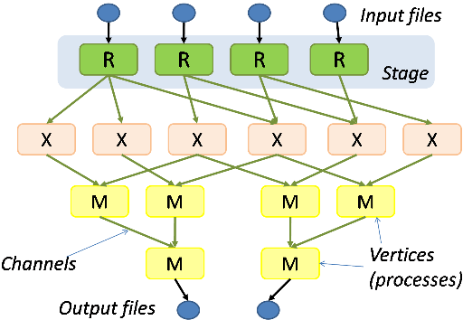
DAG (Directed Acyclic Graph) Model
Dryad and DryadLINQ (2007)
Michael Isard et al. Dryad: Distributed Data-Parallel Programs from Sequential Building Blocks, EuroSys, 2007.
http://research.microsoft.com/en-us/collaboration/tools/dryad.aspx

Slide 13
Model Composition
Apache Spark (2010)
Matei Zaharia et al. Spark: Cluster Computing with Working Sets,. HotCloud 2010.
Matei Zaharia et al. Resilient Distributed Datasets: A Fault-Tolerant Abstraction for In-Memory Cluster Computing. NSDI 2012.
http://spark.apache.org/
Resilient Distributed Dataset (RDD)
RDD operations
MapReduce-like parallel operations
DAG of execution stages and pipelined transformations
Simple collectives: broadcasting and aggregation

Slide 14
Graph Processing with BSP model
Pregel (2010)
Grzegorz Malewicz et al. Pregel: A System for Large-Scale Graph Processing. SIGMOD 2010.
Apache Hama (2010)
https://hama.apache.org/
Apache Giraph (2012)
https://giraph.apache.org/
Scaling Apache Giraph to a trillion edges
https://www.facebook.com/notes/facebook-engineering/scaling-apache-giraph-to-a-trillion-edges/10151617006153920

Slide 15
Pregel & Apache Giraph
Vote to halt
Active
Computation Model
Superstep as iteration
Vertex state machine: Active and Inactive, vote to halt
Message passing between vertices
Combiners
Aggregators
Topology mutation
Master/worker model
Graph partition: hashing
Fault tolerance: checkpointing and confined recovery
3
6
2
1
Superstep 0
6
6
2
6
Superstep 1
6
6
6
6
Superstep 2
6
6
6
6
Superstep 3
Maximum Value Example

Slide 16
Giraph Page Rank Code Example
public class PageRankComputation extends BasicComputation<IntWritable, FloatWritable, NullWritable, FloatWritable> {
/** Number of supersteps */
public static final String SUPERSTEP_COUNT = "giraph.pageRank.superstepCount";
@Override
public void compute(Vertex<IntWritable, FloatWritable, NullWritable> vertex, Iterable<FloatWritable> messages) throws IOException {
if (getSuperstep() >= 1) {
float sum = 0;
for (FloatWritable message : messages) {
sum += message.get();
}
vertex.getValue().set((0.15f / getTotalNumVertices()) + 0.85f * sum);
}
if (getSuperstep() < getConf().getInt(SUPERSTEP_COUNT, 0)) {
sendMessageToAllEdges(vertex,
new FloatWritable(vertex.getValue().get() / vertex.getNumEdges()));
} else {
vertex.voteToHalt();
}
}
}

Slide 17
GraphLab (2010)
Yucheng Low et al. GraphLab: A New Parallel Framework for Machine Learning. UAI 2010.
Yucheng Low, et al. Distributed GraphLab: A Framework for Machine Learning and Data Mining in the Cloud. PVLDB 2012.
http://graphlab.org/projects/index.html
http://graphlab.org/resources/publications.html
Data graph
Update functions and the scope
Sync operation (similar to aggregation in Pregel)

Slide 18
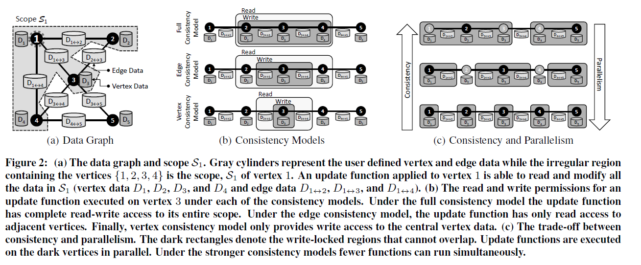
Data Graph

Slide 19
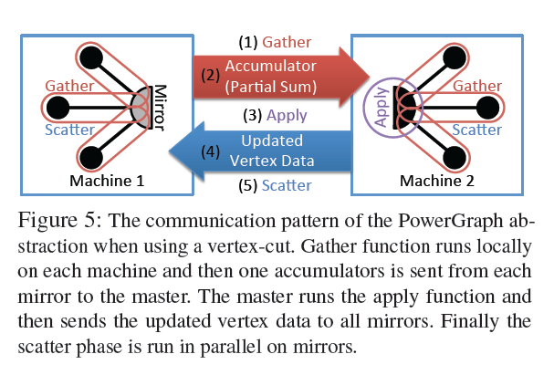
Vertex-cut v.s. Edge-cut
PowerGraph (2012)
Joseph E. Gonzalez et al. PowerGraph: Distributed Graph-Parallel Computation on Natural Graphs. OSDI 2012.
Gather, apply, Scatter (GAS) model
GraphX (2013)
Reynold Xin et al. GraphX: A Resilient Distributed Graph System on Spark. GRADES (SIGMOD workshop) 2013.
https://amplab.cs.berkeley.edu/publication/graphx-grades/
Edge-cut (Giraph model)
Vertex-cut (GAS model)

Slide 20
To reduce communication overhead….
Option 1
Algorithmic message reduction
Fixed point-to-point communication pattern
Option 2
Collective communication optimization
Not considered by previous BSP model but well developed in MPI
Initial attempts in Twister and Spark on clouds
Mosharaf Chowdhury et al. Managing Data Transfers in Computer Clusters with Orchestra. SIGCOMM 2011.
Bingjing Zhang, Judy Qiu. High Performance Clustering of Social Images in a Map-Collective Programming Model. SOCC Poster 2013.

Slide 21
Collective Model
Harp (2013)
https://github.com/jessezbj/harp-project
Hadoop Plugin (on Hadoop 1.2.1 and Hadoop 2.2.0)
Hierarchical data abstraction on arrays, key-values and graphs for easy programming expressiveness.
Collective communication model to support various communication operations on the data abstractions.
Caching with buffer management for memory allocation required from computation and communication
BSP style parallelism
Fault tolerance with check-pointing

Slide 22
Harp Design
Parallelism Model
Architecture
MapReduce Model
Map-Collective Model
MapReduce Applications
Map-Collective Applications
M
M
M
M
Application
M
M
M
M
MapReduce V2
Harp
Shuffle
Framework
R
R
Collective Communication
Resource Manager
YARN

Slide 23
Hierarchical Data Abstraction and Collective Communication
Broadcast, Allgather, Allreduce, Regroup-(combine/reduce),
Message-to-Vertex, Edge-to-Vertex
Table
Array Table <Array Type>
Edge
Table
Message Table
Vertex Table
KeyValue Table
Partition
Array Partition < Array Type >
Edge Partition
Message Partition
Vertex Partition
KeyValue Partition
Broadcast, Send
Long Array
Int Array
Double Array
Byte Array
Vertices, Edges, Messages
Key-Values
Basic Types
Array
Struct Object
Broadcast, Send, Gather
Commutable

Slide 24
Harp Bcast Code Example
protected void mapCollective(KeyValReader reader, Context context) throws IOException, InterruptedException {
ArrTable<DoubleArray, DoubleArrPlus> table = new ArrTable<DoubleArray, DoubleArrPlus>(0, DoubleArray.class, DoubleArrPlus.class);
if (this.isMaster()) {
String cFile = conf.get(KMeansConstants.CFILE);
Map<Integer, DoubleArray> cenDataMap = createCenDataMap(cParSize, rest, numCenPartitions, vectorSize, this.getResourcePool());
loadCentroids(cenDataMap, vectorSize, cFile, conf);
addPartitionMapToTable(cenDataMap, table);
}
arrTableBcast(table);
}

Slide 25
Pipelined Broadcasting with Topology-Awareness
Twister vs. MPI
(Broadcasting 0.5~2GB data)
Twister vs. MPJ
(Broadcasting 0.5~2GB data)
Twister vs. Spark (Broadcasting 0.5GB data)
Twister Chain with/without topology-awareness
Tested on IU Polar Grid with 1 Gbps Ethernet connection

Slide 26
K-Means Clustering Performance on Madrid Cluster (8 nodes)

Slide 27
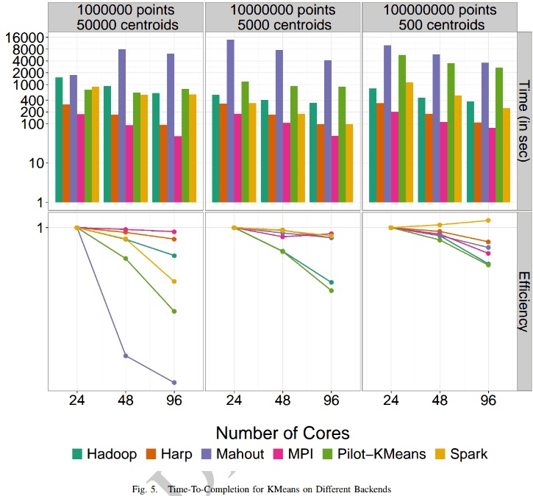
K-means Clustering Parallel Efficiency
Shantenu Jha et al. A Tale of Two Data-Intensive Paradigms: Applications, Abstractions, and Architectures. 2014.

Slide 28
WDA-MDS Performance on Big Red II
WDA-MDS
Yang Ruan, Geoffrey Fox. A Robust and Scalable Solution for Interpolative Multidimensional Scaling with Weighting. IEEE e-Dcience 2013.
Big Red II
http://kb.iu.edu/data/bcqt.html
Allgather
Bucket algorithm
Allreduce
Bidirectional exchange algorithm

Slide 29
Execution Time of 100k Problem

Slide 30
Parallel Efficiency Based On 8 Nodes and 256 Cores

Slide 31
Scale Problem Size (100k, 200k, 300k)

Slide 32
Machine Learning on Big Data
Mahout on Hadoop
https://mahout.apache.org/
MLlib on Spark
http://spark.apache.org/mllib/
GraphLab Toolkits
http://graphlab.org/projects/toolkits.html
GraphLab Computer Vision Toolkit

Slide 33
Query on Big Data
Query with procedural language
Google Sawzall (2003)
Rob Pike et al. Interpreting the Data: Parallel Analysis with Sawzall. Special Issue on Grids and Worldwide Computing Programming Models and Infrastructure 2003.
Apache Pig (2006)
Christopher Olston et al. Pig Latin: A Not-So-Foreign Language for Data Processing. SIGMOD 2008.
https://pig.apache.org/

Slide 34
SQL-like Query
Apache Hive (2007)
Facebook Data Infrastructure Team. Hive - A Warehousing Solution Over a Map-Reduce Framework. VLDB 2009.
https://hive.apache.org/
On top of Apache Hadoop
Shark (2012)
Reynold Xin et al. Shark: SQL and Rich Analytics at Scale. Technical Report. UCB/EECS 2012.
http://shark.cs.berkeley.edu/
On top of Apache Spark
Apache MRQL (2013)
http://mrql.incubator.apache.org/
On top of Apache Hadoop, Apache Hama, and Apache Spark

Slide 35
Other Tools for Query
Apache Tez (2013)
http://tez.incubator.apache.org/
To build complex DAG of tasks for Apache Pig and Apache Hive
On top of YARN
Dremel (2010) Apache Drill (2012)
Sergey Melnik et al. Dremel: Interactive Analysis of Web-Scale Datasets. VLDB 2010.
http://incubator.apache.org/drill/index.html
System for interactive query

Slide 36
Stream Data Processing
Apache S4 (2011)
http://incubator.apache.org/s4/
Apache Storm (2011)
http://storm.incubator.apache.org/
Spark Streaming (2012)
https://spark.incubator.apache.org/streaming/
Apache Samza (2013)
http://samza.incubator.apache.org/

Slide 37
REEF
Retainable Evaluator Execution Framework
http://www.reef-project.org/
Provides system authors with a centralized (pluggable) control flow
Embeds a user-defined system controller called the Job Driver
Event driven control
Package a variety of data-processing libraries (e.g., high-bandwidth shuffle, relational operators, low-latency group communication, etc.) in a reusable form.
To cover different models such as MapReduce, query, graph processing and stream data processing

Slide 38
Thank You!
Questions?

