Slide 1

ANABAS
Taking Collaboration to the Next Level
“We have seen the future
and it is here…”
WWW.ANABAS.COM Tel: (1) 415.651.8808

Slide 2
ANABAS
Phoenix, A Collaborative Sensor-Grid
Framework for Application
Development/Deployment/Management
by
Alex Ho, Anabas
Geoffrey Fox, Anabas/Indiana University

Slide 3
ANABAS
AGENDA
Briefing of Company Background
Collaborative Sensor-Centric Grid Architecture
Web 2.0, Grid, Cloud and Collaboration Technologies

Slide 4
ANABAS
Company People Background
Alex Ho
  CEO & co-founder, Anabas
  Former CEO & co-founder, Interpix Software
  Former researcher, IBM Research (Almaden, Watson)
  Former researcher, Caltech Concurrent Computation Program
Geoffrey Fox
  CTO & co-founder, Anabas
  Professor, Indiana University
  Chair of Informatics department, Indiana University
  Director, Indiana University Community Grids Lab
  Vice-President, Open Grid Forum

Slide 5
ANABAS
Selected highlights of some company products/projects
Real-time Collaboration Products
  Impromptu for Web Conferencing
  Classtime for eLearning
  HQ Telepresence (a third party product – by a Singapore-listed public company,
  an Hong Kong R&D Center and the Hong Kong Polytechnic University -
  that licensed Anabas RTC)
Collaboration Technology Projects
  AFRL SBIR Phase 1 & 2
    Grid of Grids for Information Management
    Collaborative Sensor-Centric Grid
  DOE SBIR Phase 1
    Enhanced Collaborative Visualization for the Fusion Community
AFRL Simulation Study
  Sub-contractor of SAIC
Expecting and planning future AFRL Projects
Working on future mobile computing applications
High Performance Multicore Computing Architecture
  Consultant for Microsoft Research

Slide 6
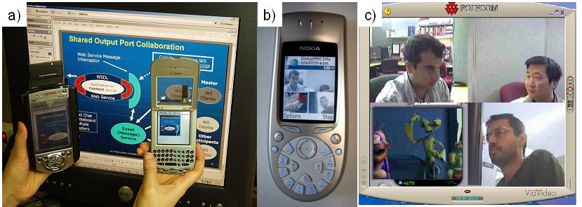
ANABAS
Cross-device collaboration – Anabas/IU
:
Figure a: An Impromptu collaboration client runs on a PC and shares with a Sprint Treo 600 handset and a Compaq iPaq PDA.
(2) Figure b and c: 3 Webcam streams and an animation stream being shared between a Nokia 3650 and Polycom device.

Slide 7
SBIR Introduction I
Grids and Cyberinfrastructure have emerged as key technologies to support distributed activities that span scientific data gathering networks with commercial RFID or (GPS enabled) cell phone nets. This SBIR extends the Grid implementation of SaaS (Software as a Service) to SensaaS (Sensor as a service) with a scalable architecture consistent with commercial protocol standards and capabilities. The prototype demonstration supports layered sensor nets and an Earthquake science GPS analysis system with a Grid of Grids management environment that supports the inevitable system of systems that will be used in DoD’s GiG.

Slide 8
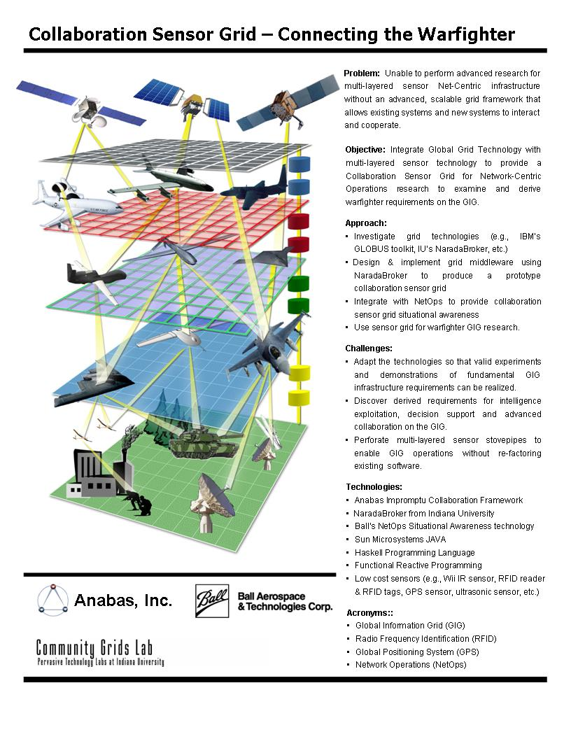
ANABAS

Slide 9
SBIR Introduction II
The final delivered software both demonstrates the concept and provides a framework with which to extend both the supported sensors and core technology
The SBIR team was led by Anabas which provided collaboration Grid and the expertise that developed SensaaS. Indiana University provided core technology and the Earthquake science application. Ball Aerospace integrated NetOps into the SensaaS framework and provided DoD relevant sensor application.
Extensions to support the growing sophistication of layered sensor nets and evolving core technologies are proposed

Slide 10
Objectives
ANABAS
Integrate Global Grid Technology with multi-layered sensor technology to provide a Collaboration Sensor Grid for Network-Centric Operations research to examine and derive warfighter requirements on the GIG.
Build Net Centric Core Enterprise Services compatible with GGF/OGF and Industry.
Add key additional services including advance collaboration services and those for sensors and GIS.
Support Systems of Systems by federating Grids of Grids supporting a heterogeneous software production model allowing greater sustainability and choice of vendors.
Build tool to allow easy construction of Grids of Grids.
Demonstrate the capabilities through sensor-centric applications with situational awareness.

Slide 11
Technology Evolution
During course of SBIR, there was substantial technology evolution in especially mainstream commercial Grid applications
These evolved from (Globus) Grids to clouds allowing enterprise data centers of 100x current scale
This would impact Grid components supporting background data processing and simulation as these need not be distributed
However Sensors and their real time interpretation are naturally distributed and need traditional Grid systems
Experience has simplified protocols and deprecated use of some complex Web Service technologies

Slide 12
Commercial Technology Backdrop
ANABAS
Build everything as Services
Grids are any collection of Services and manage distributed services or distributed collections of Services i.e. Grids to give Grids of Grids
Clouds aresimplified scalable Grids
XaaS or X as a Service is dominant trend
  X = S: Software (applications) as a Service
  X = I: Infrastructure (data centers) as a Service
  X = P: Platform (distributed O/S) as a Service
SBIR added X = C: Collections (Grids) as a Service
  and X = Sens(or Y): Sensors as a Service
Services interact with messages; using publish-subscribe messaging enables collaborative systems
Multicore needs run times and programming models from cores to clouds

Slide 13
Typical Sensor Grid Interface

Slide 14

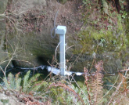
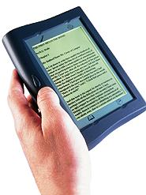





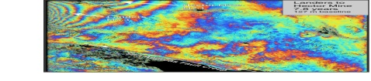
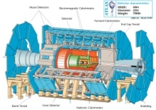
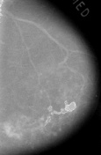



Information and Cyberinfrastructure
Raw Data → Data → Information → Knowledge → Wisdom → Decisions
Another
Grid
Another
Grid
SS
SS
SS
SS
SS
SS
fs
fs
Discovery
Cloud
Filter
Service
Portal
Filter
Cloud
fs
fs
SS
fs
fs
Filter
Cloud
Inter-Service Messages
Another
Service
fs
fs
SS
Filter
Cloud
fs
Filter
Service
fs
fs
fs
SS
fs
fs
fs
Filter
Service
fs
Discovery
Cloud
fs
fs
fs
fs
SS
Traditional Grid with exposed services
Filter
Cloud
fs
Filter
Service
fs
Filter
Cloud
Filter
Cloud
SS
fs
fs
Another
Grid
SS
SS
SS
SS
SS
SS
Sensor or Data
Interchange
Service
SS
SS
SS
SS
SS
SS
Compute
Cloud
Storage
Cloud
Database

Slide 15
Component Grids Integrated
ANABAS
Sensor display and control
  A sensor is a time-dependent stream of information with a geo-spatial location.
  A static electronic entity is a broken sensor with a broken GPS! i.e. a sensor architecture applies to everything
Filters for GPS and video analysis (Compute or Simulation Grids)
Earthquake forecasting
Collaboration Services
Situational Awareness Service

Slide 16
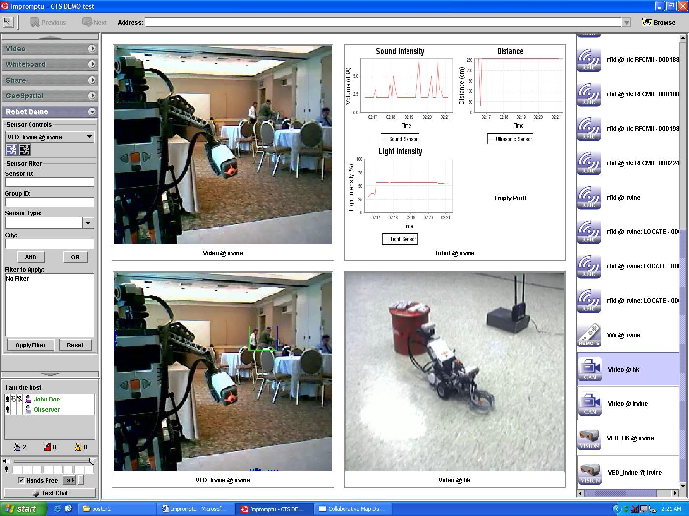
ANABAS

Slide 17
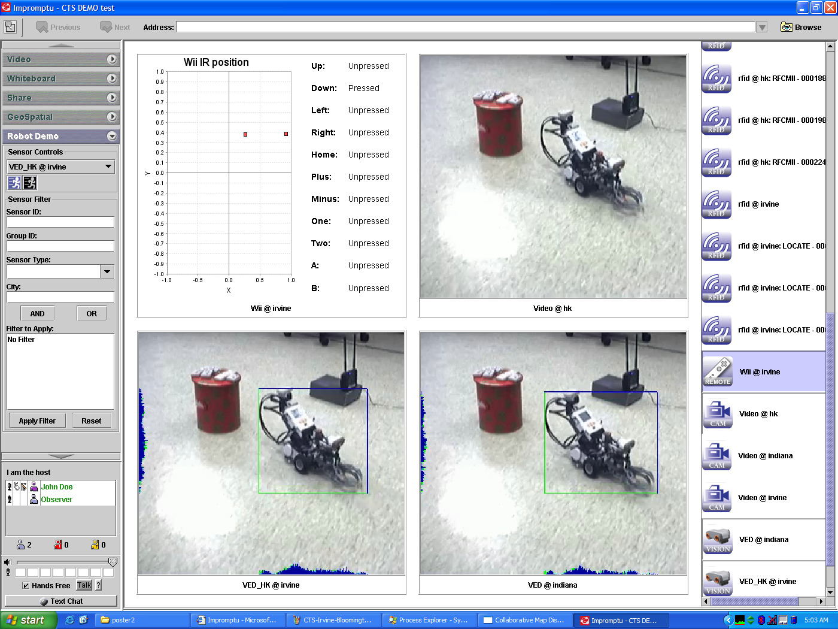

Slide 18
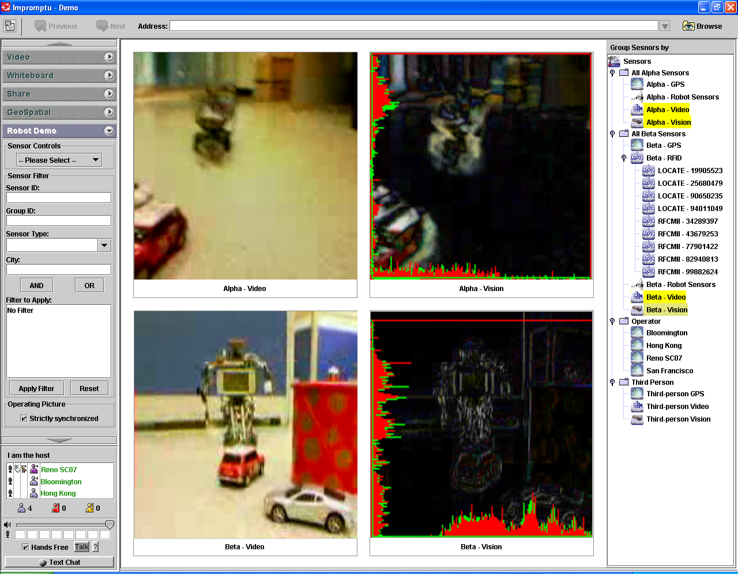
Edge Detection Filter on Video Sensors

Slide 19
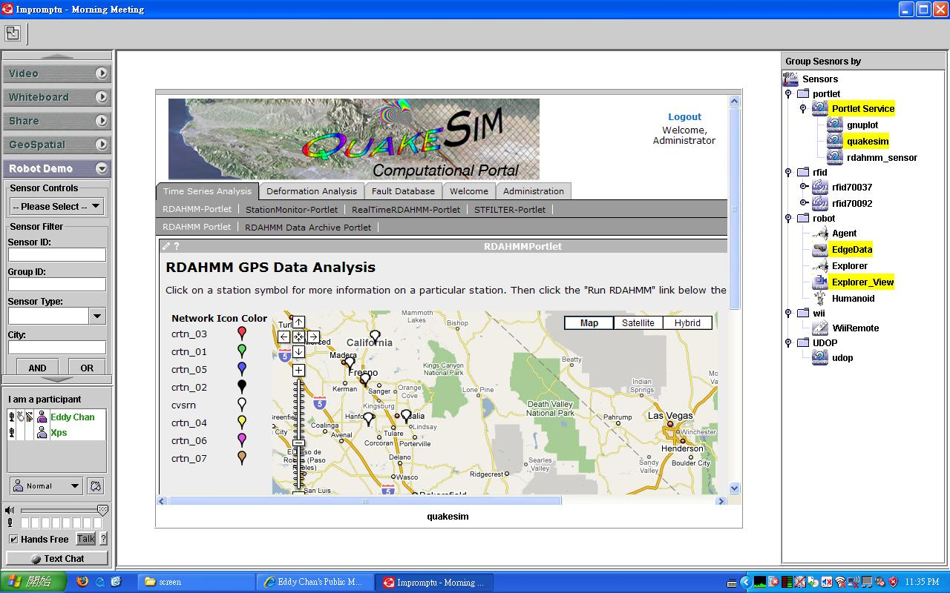
QuakeSim Grid of Grids with RDAHMM Filter (Compute) Grid

Slide 20
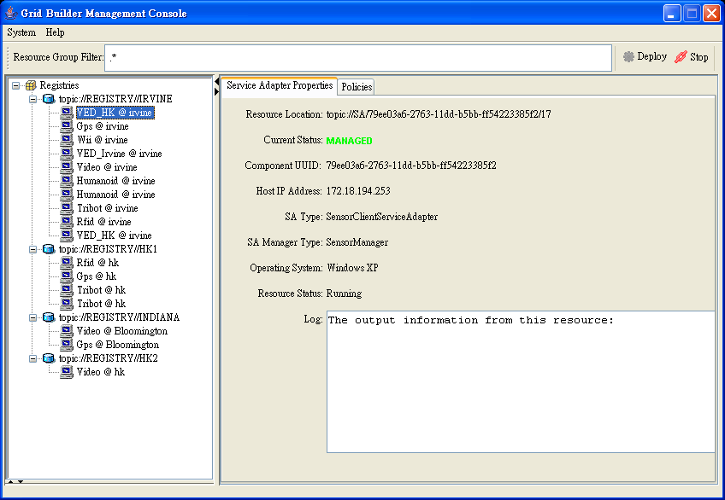
Grid Builder Service Management Interface

Slide 21
Multiple Sensors Scaling for NASA application
NB Server
RYO To ASCII Converter
Simple Filter
RYO Publisher 1
RYO Publisher 2
RYO Publisher n
Topic 2
Topic 1A
Topic n
Topic 1B
The results show that 1000 publishers (9000 GPS sensors) can be supported with no performance loss. This is an operating system limit that can be improved

Slide 22
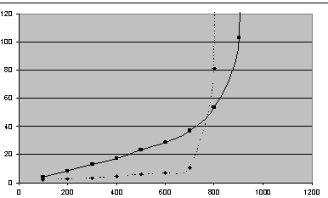
Average Video Delays
Scaling for video streams with one broker
Multiple
sessions
One session
Latency ms
30 frames/sec
# Receivers

Slide 23
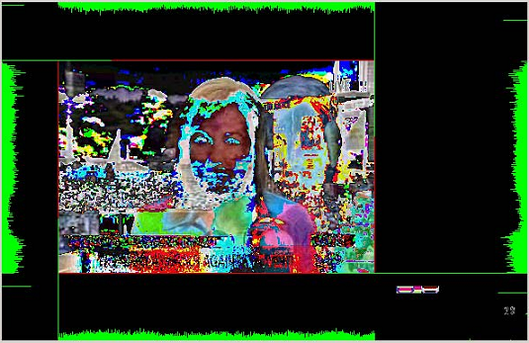
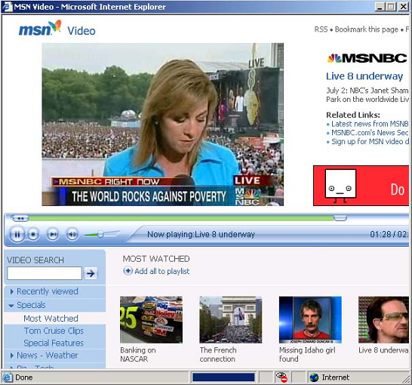
Illustration of Hybrid Shared Display on the sharing of a browser window with a fast changing region.
ANABAS

Slide 24
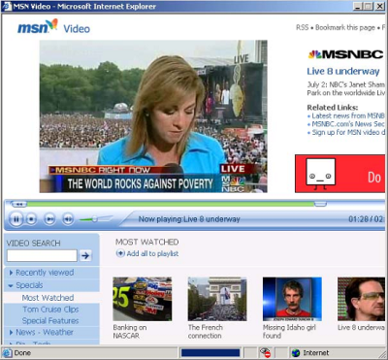
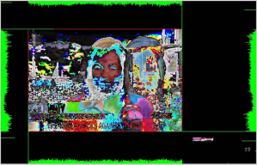
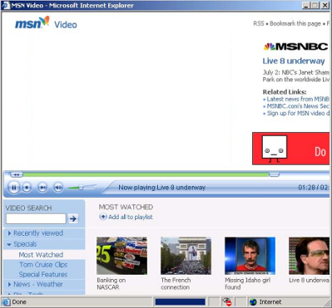
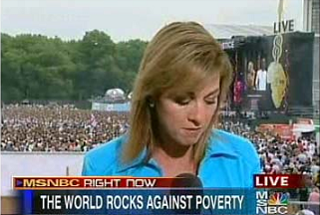
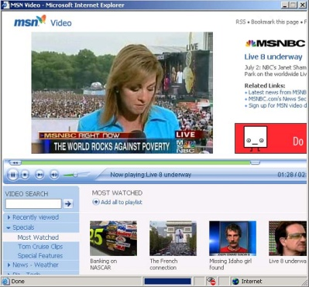
ANABAS
Screen capturing
HSD Flow
Region finding
VSD
CSD
Video encoding
SD screen data encoding
Through NaradaBrokering
Presenter
Network transmission (RTP)
Network transmission (TCP)
Participants
Video Decoding (H.261)
SD screen data decoding
Rendering
Rendering
Screen display

Slide 25
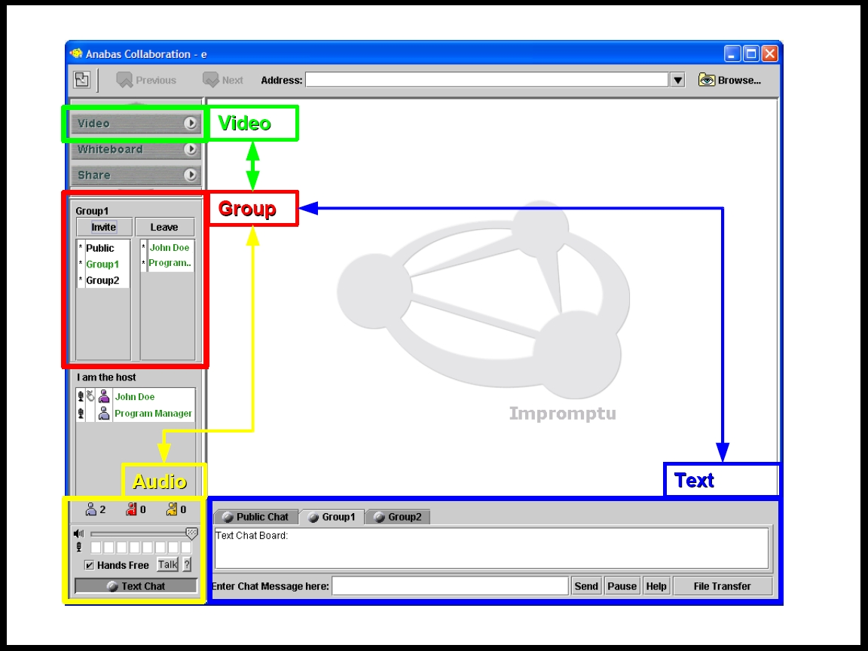

Slide 26
What are Clouds?
Clouds are “Virtual Clusters” (maybe “Virtual Grids”) of usually “Virtual Machines”
  They may cross administrative domains or may “just be a single cluster”; the user cannot and does not want to know
  VMware, Xen .. virtualize a single machine and service (grid) architectures virtualize across machines
Clouds support access to (lease of) computer instances
  Instances accept data and job descriptions (code) and return results that are data and status flags
Clouds can be built from Grids but will hide this from user
Clouds designed to build 100 times larger data centers
Clouds support green computing by supporting remote location where operations including power cheaper

Slide 27
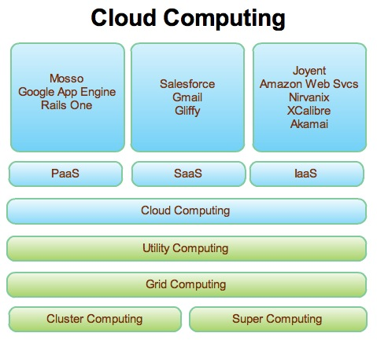
Web 2.0 and Clouds
Grids are less popular than before but can re-use technologies
Clouds are designed heterogeneous (for functionality) scalable distributed systems whereas Grids integrate a priori heterogeneous (for politics) systems
Clouds should be easier to use,
cheaper, faster and scale to larger
sizes than Grids
Grids assume you can’t design
system but rather must accept
results of N independent
supercomputer funding calls
SaaS: Software as a Service
IaaS: Infrastructure as a Service
or HaaS: Hardware as a Service
PaaS: Platform as a Service
delivers SaaS on IaaS

Slide 28
Emerging Cloud Architecture
IAAS
PAAS
Build VO
Build Portal
Gadgets
Open Social
Ringside
Deploy VM
Classic Compute File Database
on a cloud
Move Service
(from PC to Cloud)
Build Cloud Application
Ruby on Rails
Django(GAI)
VM
VM
VM
VM
VM
VM
VM
EC2, S3, SimpleDB
CloudDB, Red Dog
Bigtable
GFS (Hadoop)
? Lustre GPFS
? MPI CCR
? Windows Cluster
for VM
Workflow becomes
Mashups
Security
Model
VOMS
“UNIX”
Shib
OpenID
MapReduce
Taverna
BPEL
DSS
Windows
Workflow
DRYAD, F#
High level
Parallel
Scripted Math
“HPF”
Sho
Matlab
Mathematica
Libraries
R
SCALAPACK

Slide 29
Analysis of DoD Net Centric Services in terms of Web and Grid services

Slide 30
The Grid and Web Service Institutional Hierarchy
4: Application or Community of Interest (CoI)
Specific Services such as “Map Services”, “Run BLAST” or “Simulate a Missile”
XBML
XTCE VOTABLE
CML
CellML
3: Generally Useful Services and Features
(OGSA and other GGF, W3C) Such as “Collaborate”, “Access a Database” or “Submit a Job”
OGSA GS-*
and some WS-*
GGF/W3C/….
XGSP (Collab)
2: System Services and Features
(WS-* from OASIS/W3C/Industry)
Handlers like WS-RM, Security, UDDI Registry
WS-* from
OASIS/W3C/
Industry
1: Container and Run Time (Hosting)
Environment (Apache Axis, .NET etc.)
Apache Axis
.NET etc.
Must set standards to get interoperability

Slide 31
The Ten areas covered by the 60 core WS-* Specifications
WS-* Specification Area | Examples
1: Core Service Model | XML, WSDL, SOAP
2: Service Internet | WS-Addressing, WS-MessageDelivery; Reliable Messaging WSRM; Efficient Messaging MOTM
3: Notification | WS-Notification, WS-Eventing (Publish-Subscribe)
4: Workflow and Transactions | BPEL, WS-Choreography, WS-Coordination
5: Security | WS-Security, WS-Trust, WS-Federation, SAML, WS-SecureConversation
6: Service Discovery | UDDI, WS-Discovery
7: System Metadata and State | WSRF, WS-MetadataExchange, WS-Context
8: Management | WSDM, WS-Management, WS-Transfer
9: Policy and Agreements | WS-Policy, WS-Agreement
10: Portals and User Interfaces | WSRP (Remote Portlets)

Slide 32
WS-* Areas and Web 2.0
WS-* Specification Area | Web 2.0 Approach
1: Core Service Model | XML becomes optional but still useful SOAP becomes JSON RSS ATOM WSDL becomes REST with API as GET PUT etc. Axis becomes XmlHttpRequest
2: Service Internet | No special QoS. Use JMS or equivalent?
3: Notification | Hard with HTTP without polling– JMS perhaps?
4: Workflow and Transactions (no Transactions in Web 2.0) | Mashups, Google MapReduce Scripting with PHP JavaScript ….
5: Security | SSL, HTTP Authentication/Authorization, OpenID is Web 2.0 Single Sign on
6: Service Discovery | http://www.programmableweb.com
7: System Metadata and State | Processed by application – no system state – Microformats are a universal metadata approach
8: Management==Interaction | WS-Transfer style Protocols GET PUT etc.
9: Policy and Agreements | Service dependent. Processed by application
10: Portals and User Interfaces | Start Pages, AJAX and Widgets(Netvibes) Gadgets

Slide 33
Activities in Global Grid Forum Working Groups
GGF Area | GS-* and OGSA Standards Activities
1: Architecture | High Level Resource/Service Naming (level 2 of slide 6), Integrated Grid Architecture
2: Applications | Software Interfaces to Grid, Grid Remote Procedure Call, Checkpointing and Recovery, Interoperability to Job Submittal services, Information Retrieval,
3: Compute | Job Submission, Basic Execution Services, Service Level Agreements for Resource use and reservation, Distributed Scheduling
4: Data | Database and File Grid access, Grid FTP, Storage Management, Data replication, Binary data specification and interface, High-level publish/subscribe, Transaction management
5: Infrastructure | Network measurements, Role of IPv6 and high performance networking, Data transport
6: Management | Resource/Service configuration, deployment and lifetime, Usage records and access, Grid economy model
7: Security | Authorization, P2P and Firewall Issues, Trusted Computing

Slide 34
Net-Centric Core Enterprise Services
Core Enterprise Services | Service Functionality
NCES1: Enterprise Services Management (ESM) | including life-cycle management
NCES2: Information Assurance (IA)/Security | Supports confidentiality, integrity and availability. Implies reliability and autonomic features
NCES3: Messaging | Synchronous or asynchronous cases
NCES4: Discovery | Searching data and services
NCES5: Mediation | Includes translation, aggregation, integration, correlation, fusion, brokering publication, and other transformations for services and data. Possibly agents
NCES6: Collaboration | Provision and control of sharing with emphasis on synchronous real-time services
NCES7: User Assistance | Includes automated and manual methods of optimizing the user GiG experience (user agent)
NCES8: Storage | Retention, organization and disposition of all forms of data
NCES9: Application | Provisioning, operations and maintenance of applications.

Slide 35
The Core Features/Service Areas I
Service or Feature | WS-* | GS-* | NCES (DoD) | Comments
A: Broad Principles
FS1: Use SOA: Service Oriented Arch. | WS1 |  |  | Core Service Architecture, Build Grids on Web Services. Industry best practice
FS2: Grid of Grids |  |  |  | Distinctive Strategy for legacy subsystems and modular architecture
B: Core Services
FS3: Service Internet, Messaging | WS2 |  | NCES3 | Streams/Sensors.
FS4: Notification | WS3 |  | NCES3 | JMS, MQSeries.
FS5 Workflow | WS4 |  | NCES5 | Grid Programming
FS6 : Security | WS5 | GS7 | NCES2 | Grid-Shib, Permis Liberty Alliance ...
FS7: Discovery | WS6 |  | NCES4 | UDDI
FS8: System Metadata & State | WS7 |  |  | Globus MDS Semantic Grid, WS-Context
FS9: Management | WS8 | GS6 | NCES1 | CIM
FS10: Policy | WS9 |  | ECS

Slide 36
The Core Feature/Service Areas II
Service or Feature | WS-* | GS-* | NCES | Comments
B: Core Services (Continued)
FS11: Portals and User assistance | WS10 |  | NCES7 | Portlets JSR168, NCES Capability Interfaces
FS12: Computing |  | GS3 |  | Clouds!
FS13: Data and Storage |  | GS4 | NCES8 | NCOW Data Strategy Clouds!
FS14: Information |  | GS4 |  | JBI for DoD, WFS for OGC
FS15: Applications and User Services |  | GS2 | NCES9 | Standalone Services Proxies for jobs
FS16: Resources and Infrastructure |  | GS5 |  | Ad-hoc networks
FS17: Collaboration and Virtual Organizations |  | GS7 | NCES6 | XGSP, Shared Web Service ports
FS18: Scheduling and matching of Services and Resources |  | GS3 |  | Current work only addresses scheduling “batch jobs”. Need networks and services

Slide 37
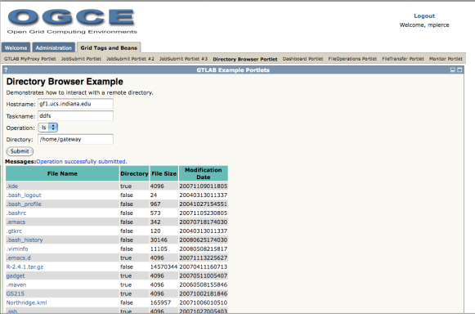
Web 2.0 Impact
Portlets become Gadgets
Common portal architecture. Aggregation is in the portlet container. Users have limited selections of components.
HTML/HTTP
Tomcat
+
Portlets and Container
SOAP/HTTP
Grid and Web Services
(TeraGrid, GiG, etc)
Grid and Web Services
(TeraGrid, GiG, etc)
Grid and Web Services
(TeraGrid, GiG, etc)

Slide 38
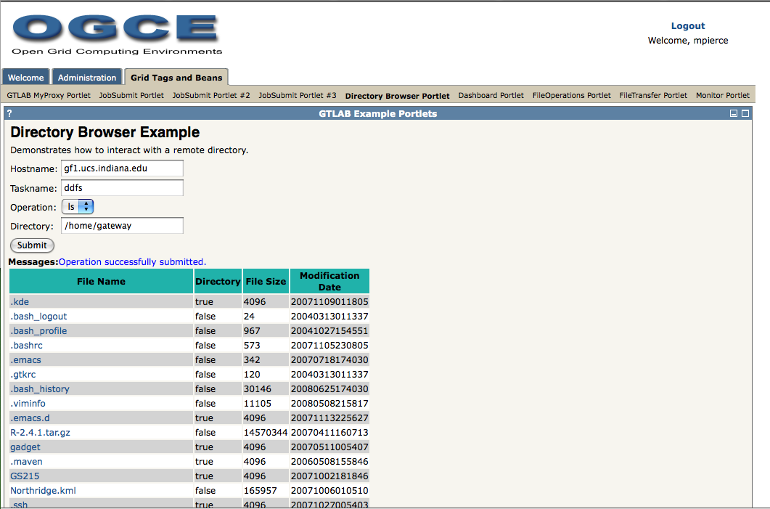
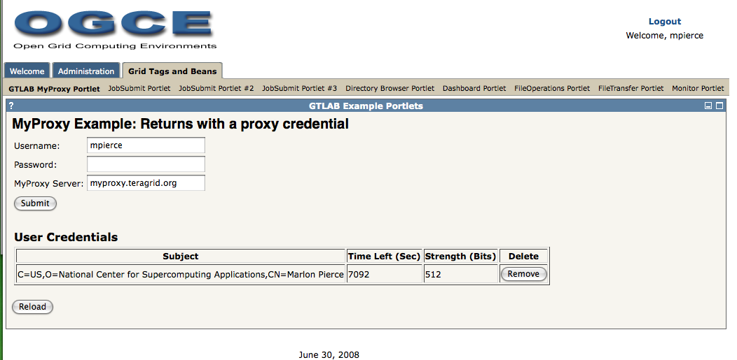
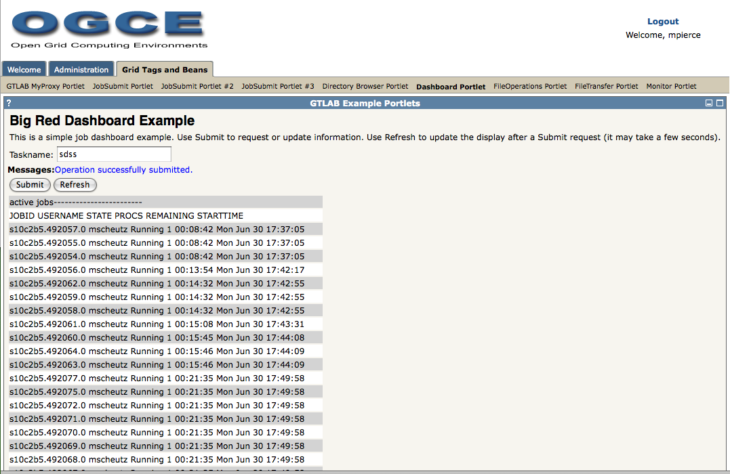
Various GTLAB applications deployed as portlets:
Remote directory browsing, proxy management, and LoadLeveler queues.

Slide 39
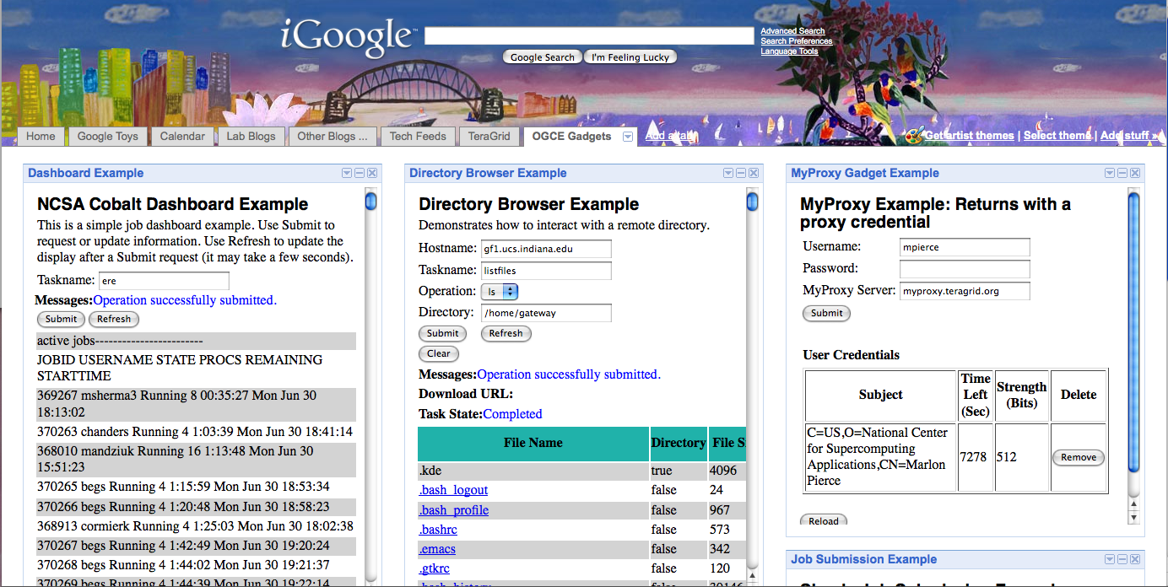
GTLAB Applications as Google Gadgets: MOAB dashboard, remote directory browser, and proxy management.

Slide 40
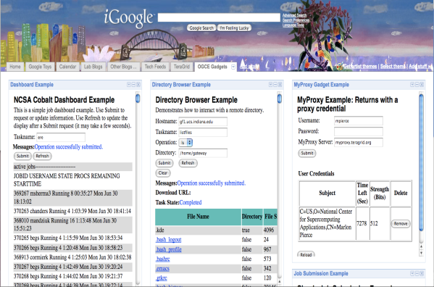

Gadget containers aggregate content from multiple providers. Content is aggregated on the client by the user. Nearly any web application can be a simple gadget (as Iframes)
GTLAB interfaces to Gadgets or Portlets
Gadgets do not need GridSphere
Other Gadgets
Providers
Tomcat + GTLAB Gadgets
Other Gadgets
Providers
RSS Feed, Cloud, etc
Services
Grid and Web Services
(TeraGrid, GiG, etc)
Social Network
Services (Orkut, LinkedIn,etc)

Slide 41
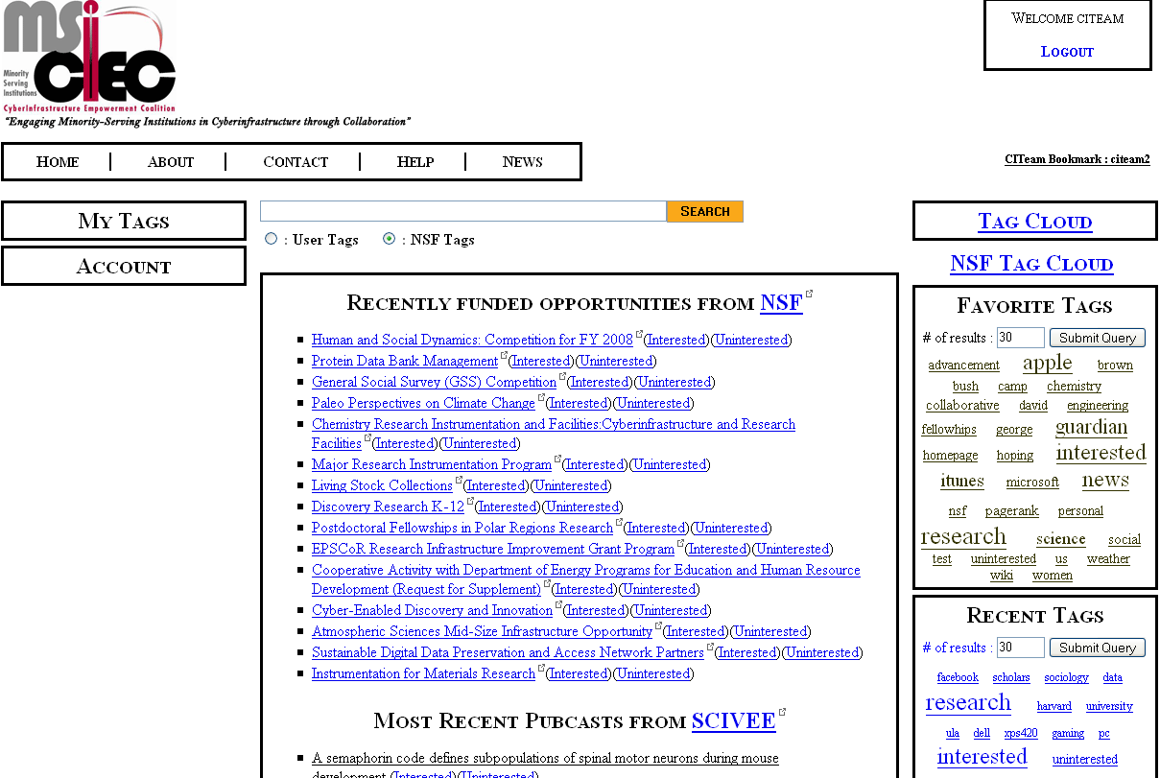
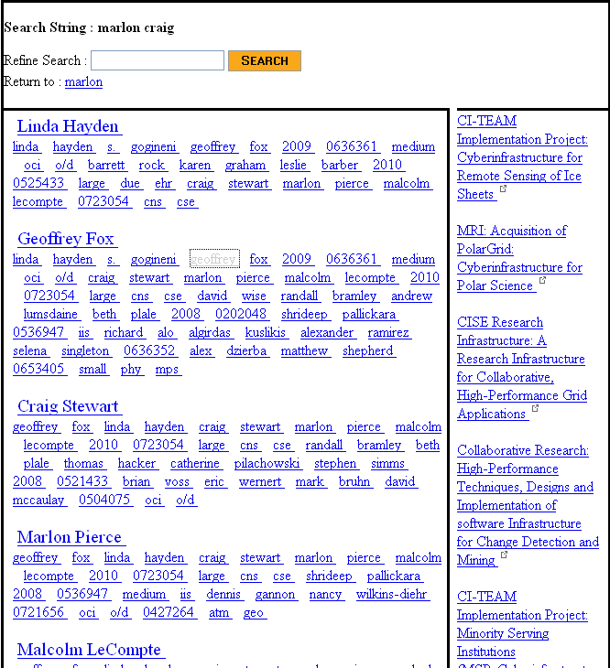
MSI-CIEC Web 2.0 Research Matching Portal
Portal supporting tagging and linkage of Cyberinfrastructure Resources
NSF (and other agencies via grants.gov) Solicitations and Awards
MSI-CIEC Portal Homepage
Feeds such as SciVee and NSF
Researchers on NSF Awards
User and Friends
TeraGrid Allocations
Search Results
Search for linked people, grants etc.
Could also be used to support matching of students and faculty for REUs etc.
MSI-CIEC Portal Homepage
Search Results

Slide 42
Parallel Programming 2.0
Web 2.0 Mashups (by definition the largest market) will drive composition tools for Grid, web and parallel programming
Parallel Programming 2.0 can build on same Mashup tools like Yahoo Pipes and Microsoft Popfly for workflow.
Alternatively can use “cloud” tools like MapReduce
We are using workflow technology DSS developed by Microsoft for Robotics
Classic parallel programming for core image and sensor programming
MapReduce/”DSS” integrates data processing/decision support together
We are integrating and comparing Cloud(MapReduce), Workflow, parallel computing (MPI) and thread approaches

Slide 43
Map Reduce
“MapReduce is a programming model and an associated implementation for processing and generating large data sets. Users specify a map function that processes a key/value pair to generate a set of intermediate key/value pairs, and a reduce function that merges all intermediate values associated with the same intermediate key.”
MapReduce: Simplified Data Processing on Large Clusters
Jeffrey Dean and Sanjay Ghemawat
map(key, value)
Applicable to most loosely coupled data parallel applications
The data is split into m parts and the map function is performed on each part of the data concurrently
Each map function produces r number of results
A hash function maps these r results to one ore more reduce functions
The reduce function collects all the results that maps to it and processes them
A combine function may be necessary to combine all the outputs of the reduce functions together
It is “just” workflow with messaging runtime
reduce(key, list<value>)
E.g. Word Count
map(String key, String value):
// key: document name
// value: document contents
reduce(String key, Iterator values):
// key: a word
// values: a list of counts

Slide 44
How does it work?
The framework supports the splitting of data
Outputs of the map functions are passed to the reduce functions
The framework sorts the inputs to a particular reduce function based on the intermediate keys before passing them to the reduce function
An additional step may be necessary to combine all the results of the reduce functions
D1
map
reduce
O1
D2
map
Data
reduce
O2
reduce
Or
Dm
map
data split
map
reduce

Slide 45
Hadoop (Apache’s map-reduce)
A
B
Data is distributed in the data/computing nodes
Name Node maintains the namespace of the entire file system
Name Node and Data Nodes are part of the Hadoop Distributed File System (HDFS)
Job Client
  Compute the data split
  Get a JobID from the Job Tracker
  Upload the job specific files (map, reduce, and other configurations) to a directory in HDFS
  Submit the jobID to the Job Tracker
Job Tracker
  Use the data split to identify the nodes for map tasks
  Instruct TaskTrackers to execute map tasks
  Monitor the progress
  Sort the output of the map tasks
  Instruct the TaskTracker to execute reduce tasks
1
1
2
2
DN
TT
DN
TT
Data/Compute Nodes
C
D
3
4
4
3
DN
TT
DN
TT
Name Node
Job Tracker
Job Client
Data Block
DN
Data Node
TT
Task Tracker
Point to Point Communication

Slide 46
CGL Map Reduce
A map-reduce run time that supports iterative map reduce by keeping intermediate results in-memory and using long running threads
A combine phase is introduced to merge the results of the reducers
Intermediate results are transferred directly to the reducers(eliminating the overhead of writing intermediate results to the local files)
A content dissemination network is used for all the communications
API supports both traditional map reduce data analyses and iterative map-reduce data analyses
Fixed Data
Variable Data
map
reduce
combine

Slide 47
CGL Map Reduce - Implementation
Implemented using Java
Messaging system NaradaBrokering is used for the content dissemination
NaradaBrokering has APIs for both Java and C++
CGL Map Reduce supports map and reduce functions written in different languages; currently Java and C++
Can also implement algorihm using MPI and indeed “compile” Mapreduce programs to efficient MPI

Slide 48
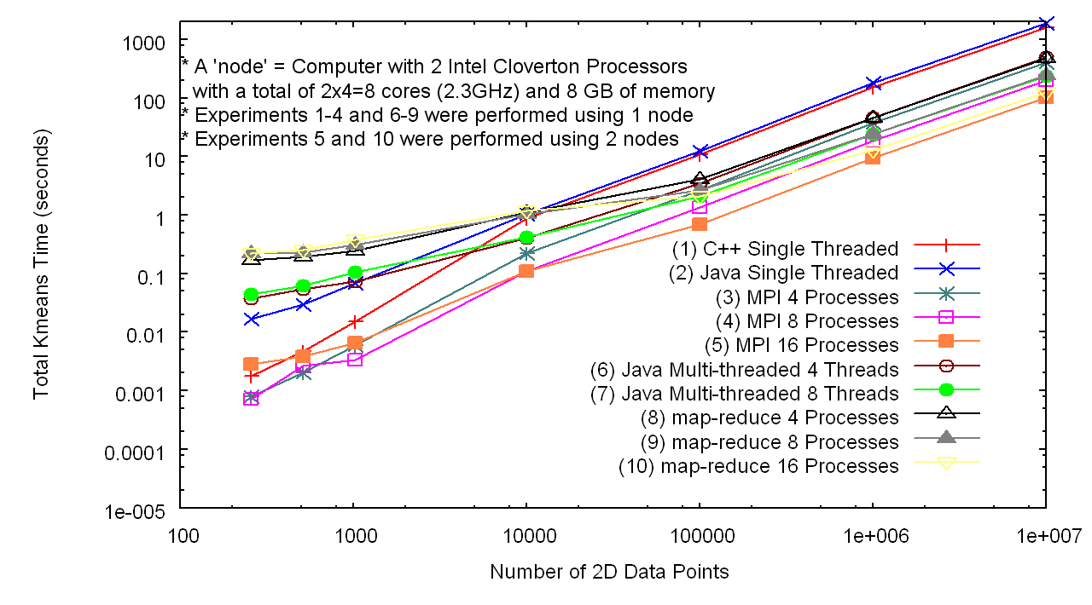
Initial Results - Performance
In memory Map Reduce based Kmeans Algorithm is used to cluster 2D data points
Compared the performance against both MPI (C++) and the Java multi-threaded version of the same algorithm
The experiments are performed on a cluster of multi-core computers
Number of Data Points

Slide 49
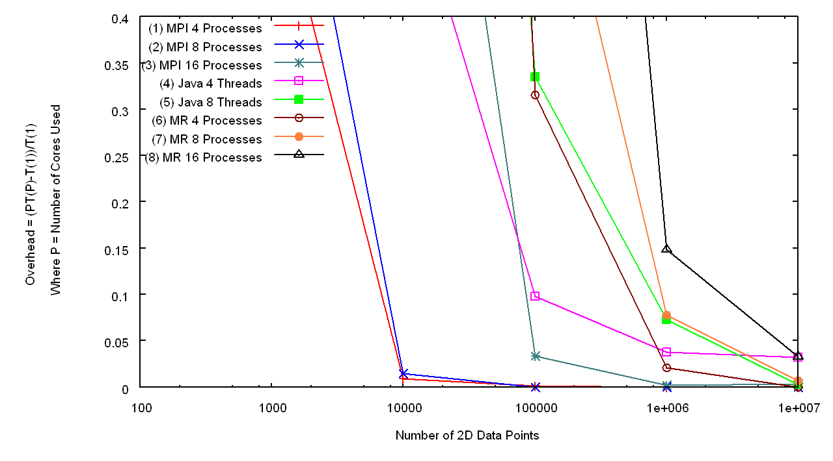
Initial Results – Overhead I
Overhead of the map-reduce runtime for the different data sizes
Java
Java
MR
MR
MR
MPI
MPI
Number of Data Points

Slide 50
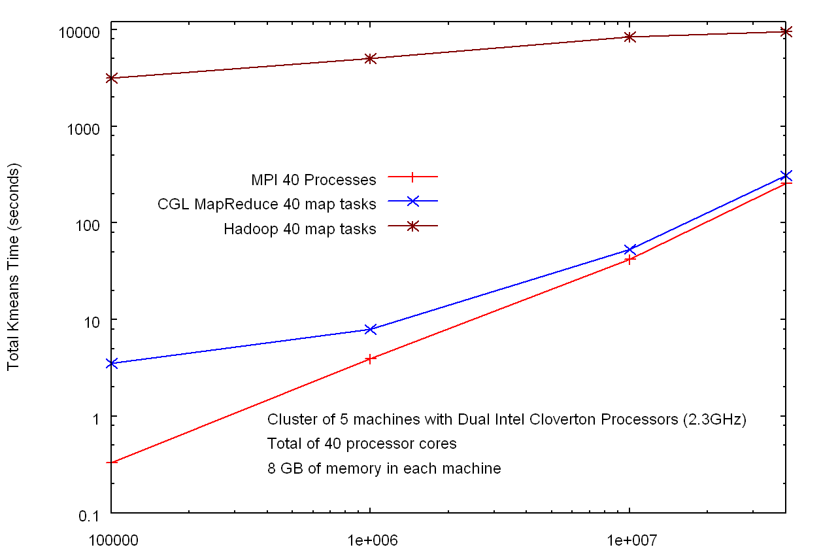
Initial Results – Hadoop v In Memory MapReduce
HADOOP
Factor of 30
Factor of 10³
CGL MapReduce
MPI
Number of Data Points

Slide 51
Deterministic Annealing Clustering
Scaled Speedup Tests on 4 8-core Systems
10 Clusters; 160,000 points per cluster per thread
1, 2, 4. 8, 16, 32-way parallelism
Parallel
Overhead
32-way
16-way
2-way
8-way
4-way
Nodes
1 2 1 1 4 2 1 2 1 1 4 2 1 4 2 1 2 1 1 4 2 4 2 4 2 2 4 4 4 4
MPI Processes per Node
1 1 2 1 1 2 4 1 2 1 2 4 8 1 2 4 1 2 1 4 8 2 4 1 2 1 8 4 2 1
CCR Threads per Process
1 1 1 2 1 1 1 2 2 4 1 1 1 2 2 2 4 4 8 1 1 2 2 4 4 8 1 2 4 8

