Slide 1
Robust Parallel Clustering Algorithms
CCDSC Clusters, Clouds, and Data for Scientific Computing La Maison des Contes Lyon France
September 13 2012
Geoffrey Fox
gcf@indiana.edu
http://www.infomall.org http://www.futuregrid.org
School of Informatics and Computing
Digital Science Center
Indiana University Bloomington

Slide 2
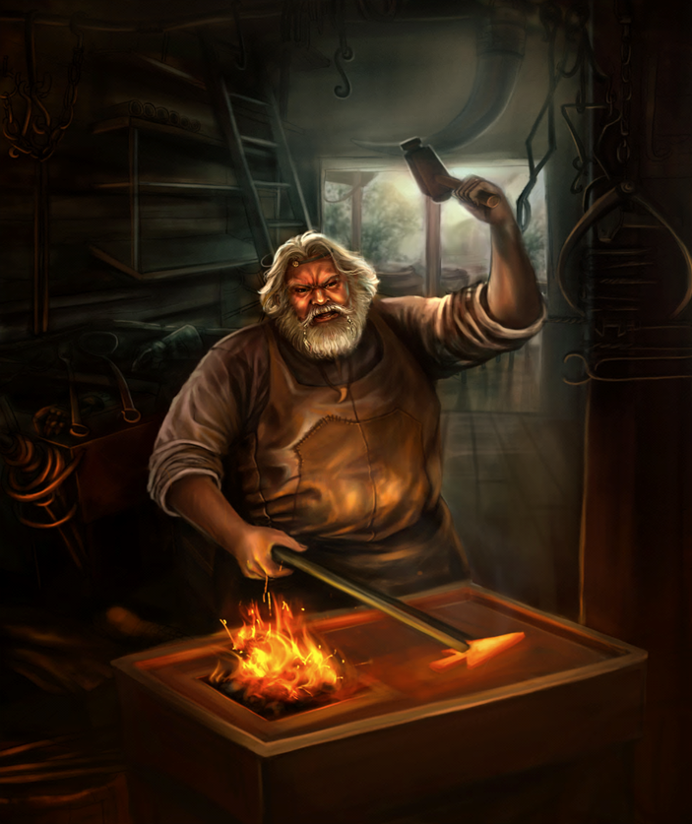
Some Motivation
Big Data requires high performance – achieve with parallel computing
Big Data requires robust algorithms as more opportunity to make mistakes
Deterministic annealing (DA) is one of better approaches to optimization
Tends to remove local optima
Addresses overfitting
Faster than simulated annealing
Return to my heritage (physics) with an approach I called Physical Computation (cf. also genetic algs) -- methods based on analogies to nature
Physics systems find true lowest energy state if you anneal i.e. you equilibrate at each temperature as you cool

Slide 3
Some Ideas
Deterministic annealing is better than many well-used optimization problems
Started as “Elastic Net” by Durbin for Travelling Salesman Problem TSP
Basic idea behind deterministic annealing is mean field approximation, which is also used in “Variational Bayes” and “Variational inference”
Markov chain Monte Carlo (MCMC) methods are roughly single temperature simulated annealing
Less sensitive to initial conditions
Avoid local optima
Not equivalent to trying random initial starts
Notes:
Color on right is stress from polarizing filters

Slide 4
(Our) Uses of Deterministic Annealing
Clustering
Vectors: Rose (Gurewitz and Fox)
Clusters with fixed sizes and no tails (Proteomics team at Broad)
No Vectors: Hofmann and Buhmann (Just use pairwise distances)
Dimension Reduction for visualization and analysis
Vectors: GTM Generative Topographic Mapping
No vectors: Multidimensional Scaling) MDS (Just use pairwise distances)
Can apply to HMM & general mixture models (less study)
Gaussian Mixture Models
Probabilistic Latent Semantic Analysis with Deterministic Annealing DA-PLSA as alternative to Latent Dirichlet Allocation for finding “hidden factors”

Slide 5
Basic Deterministic Annealing
Gibbs Distribution at Temperature T P(χ) = exp( - H(χ)/T) / ∫ dχ exp( - H(χ)/T)
Or P(χ) = exp( - H(χ)/T + F/T )
Minimize Free Energy combining Objective Function and Entropy F = < H - T S(P) > = ∫ dχ {P(χ)H + T P(χ) lnP(χ)}
H is objective function to be minimized as a function of parameters χ
Simulated annealing corresponds to doing these integrals by Monte Carlo
Deterministic annealing corresponds to doing integrals analytically (by mean field approximation) and is much faster than Monte Carlo
In each case temperature is lowered slowly – say by a factor 0.95 to 0.9999 at each iteration

Slide 6
Implementation of DA Central Clustering
Here points to cluster are in a metric space
Clustering variables are M_{i}(k) where this is probability that point i belongs to cluster k and ∑_{k=1}^{K} M_{i}(k) = 1
In Central or PW Clustering, take H₀ = ∑_{i=1}^{N} ∑_{k=1}^{K} M_{i}(k) ε_{i}(k)
Linear form allows DA integrals to be done analytically
Central clustering has ε_{i}(k) = (X(i)- Y(k))² and M_{i}(k) determined by Expectation step
H_{Central} = ∑_{i=1}^{N} ∑_{k=1}^{K} M_{i}(k) (X(i)- Y(k))²
<M_{i}(k)> = exp( -ε_{i}(k)/T ) / ∑_{k=1}^{K} exp( -ε_{i}(k)/T )
Centers Y(k) are determined in M step of EM method

Slide 7
Deterministic Annealing
F({y}, T)
Solve Linear Equations for each temperature
Nonlinear effects mitigated by initializing with solution at previous higher temperature
Configuration {y}
Minimum evolving as temperature decreases
Movement at fixed temperature going to false minima if not initialized “correctly

Slide 8
General Features of DA
In many problems, decreasing temperature is classic multiscale – finer resolution (√T is “just” distance scale)
We have factors like (X(i)- Y(k))² / T
In clustering, one then looks at second derivative matrix (can derive analytically) of Free Energy and as temperature is lowered this develops negative eigenvalue
Or have multiple clusters at each center and perturb
Trade-off depends on problem – high dimension takes time to find eigenvector
This is a phase transition and one splits cluster into two and continues EM iteration till desired resolution reached
One can start with just one cluster

Slide 9
Continuous Clustering
This is a subtlety introduced by Ken Rose but not widely known
Take a cluster k and split into 2 with centers Y(k)_{A} and Y(k)_{B} with initial values Y(k)_{A} = Y(k)_{B} at original center Y(k)
Then typically if you make this change and perturb the Y(k)_{A} Y(k)_{B}, they will return to starting position as F at stable minimum
But instability can develop and one finds
Implement by adding arbitrary number p(k) of centers for each cluster Z_{i} = ∑_{k=1}^{K} p(k) exp(-ε_{i}(k)/T) and M step gives p(k) = C(k)/N
Halve p(k) at splits; can’t split easily in standard case p(k) = 1
Free Energy F
Y(k)_{A} and Y(k)_{B}
Free Energy F
Free Energy F
Y(k)_{A} + Y(k)_{B}
Y(k)_{A} - Y(k)_{B}

Slide 10
Rose, K., Gurewitz, E., and Fox, G. C. ``Statistical mechanics and phase transitions in clustering,'' Physical Review Letters, 65(8):945-948, August 1990.
My #6 most cited article (425 cites including 15 in 2012)
System becomes unstable as Temperature lowered and there is a phase transition and one splits cluster into two and continues EM iteration
One can start with just one cluster and need NOT specify desired # clusters; rather specify cluster resolution

Slide 11
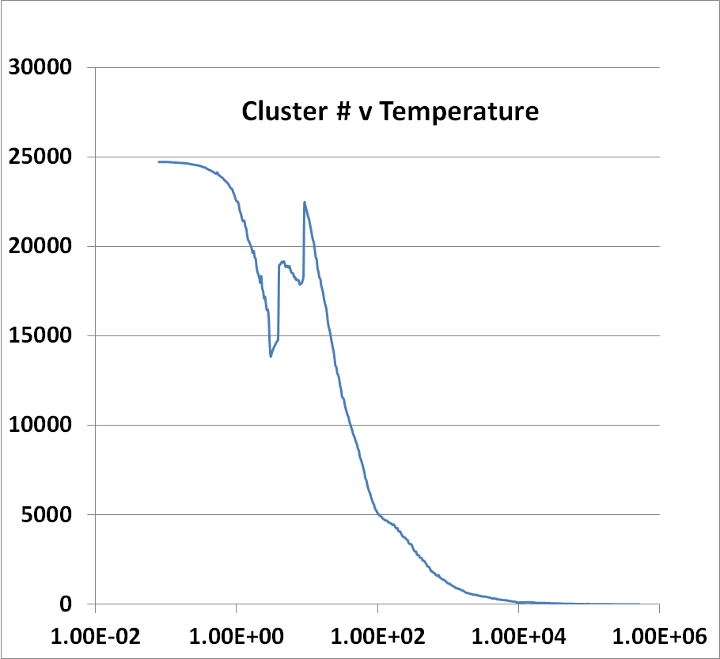
Introduce Sponge
Running on 8 nodes, 16 cores each
241605 Peaks
Complex Parallelization of
Peaks=points (usual) and Clusters (Switch on after # gets to 256)
Low Temperature -- End
High Temperature -- Start

Slide 12
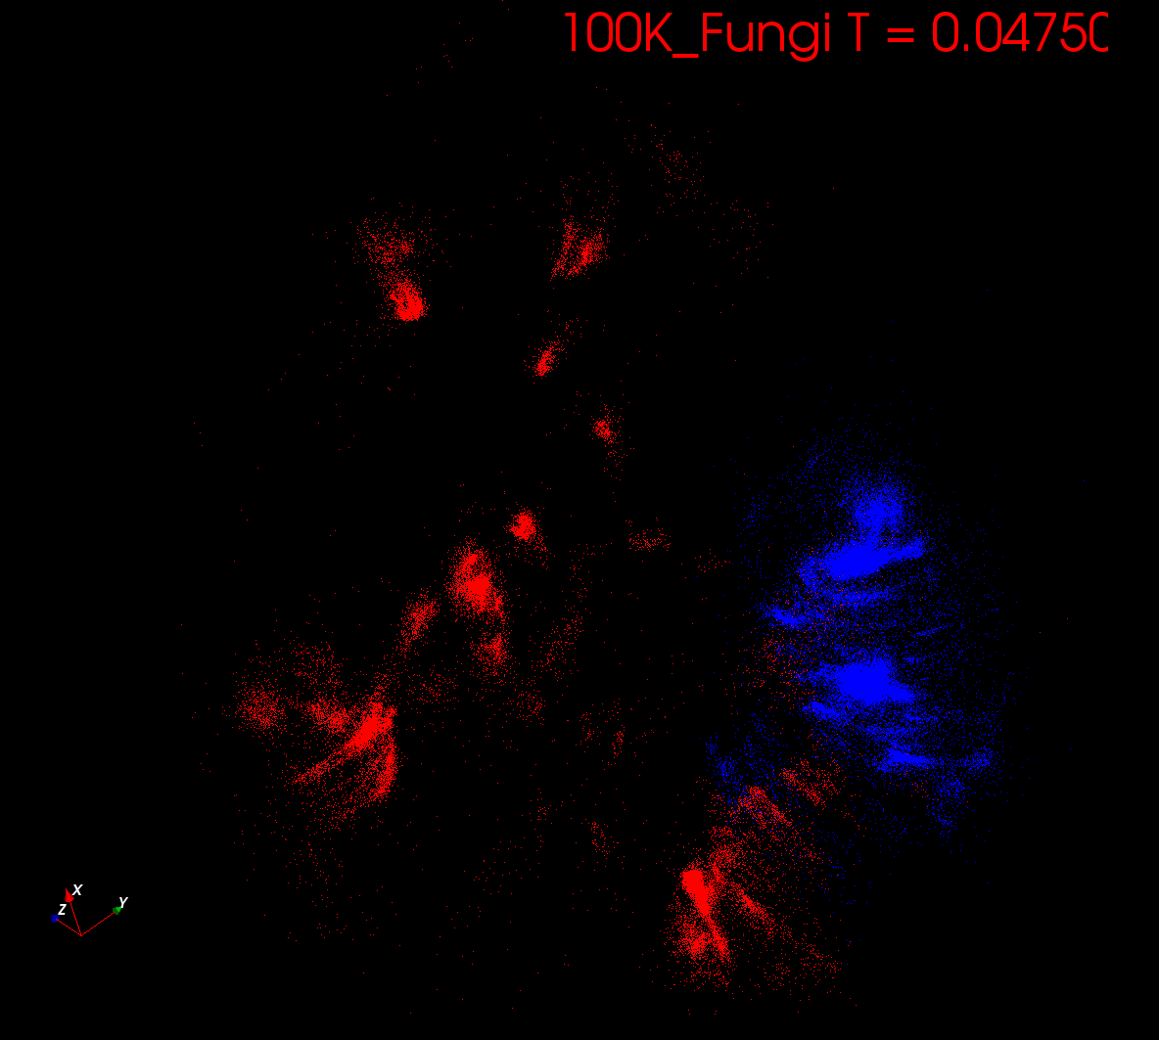
Start at T= “∞” with 1 Cluster
Decrease T, Clusters emerge at instabilities

Slide 13
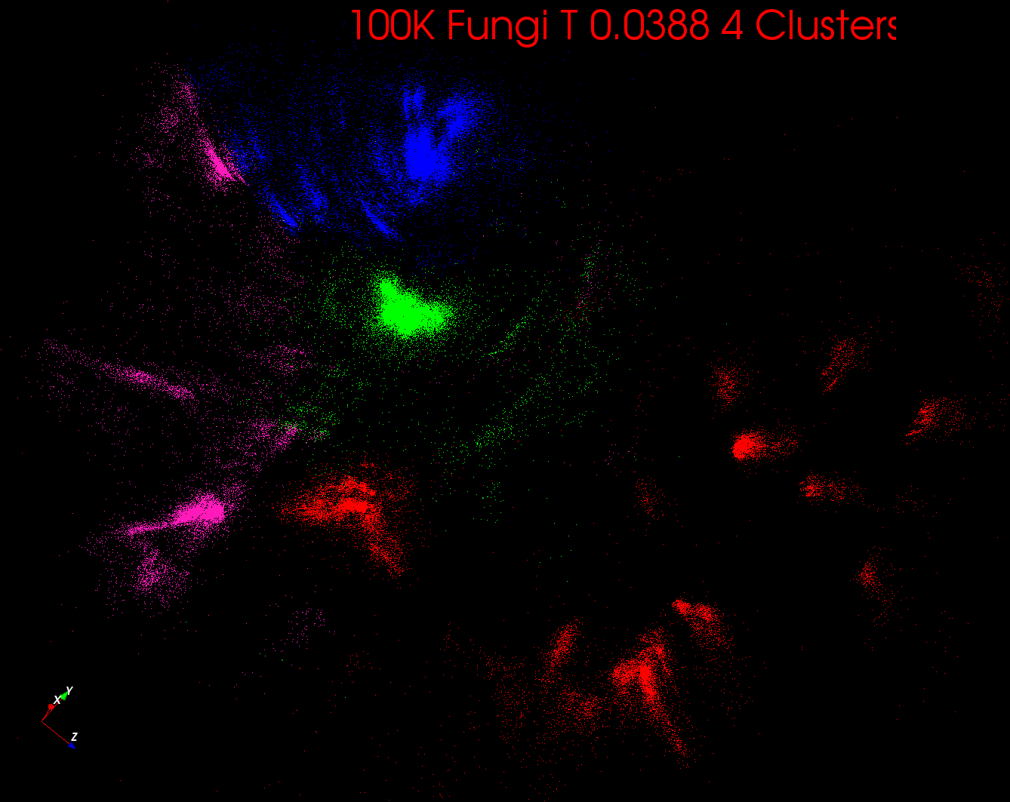

Slide 14
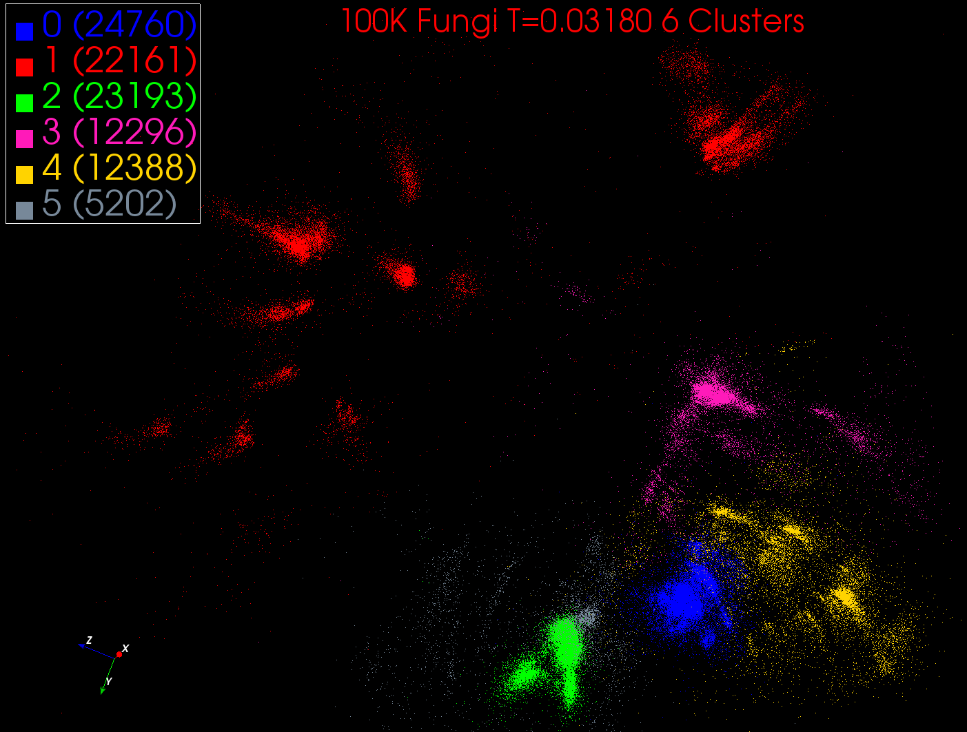

Slide 15
Some non-DA Ideas
Dimension reduction gives Low dimension mappings of data to both visualize and apply geometric hashing
No-vector (can’t define metric space) problems are O(N²)
Genes are no-vector unless multiply aligned
For no-vector case, one can develop O(N) or O(NlogN) methods as in “Fast Multipole and OctTree methods”
Map high dimensional data to 3D and use classic methods developed originally to speed up O(N²) 3D particle dynamics problems

Slide 16
Some Problems
Analysis of Mess Spectrometry data to find peptides by clustering peaks (Broad Institute)
~0.5 million points in 2 dimensions (one experiment) -- ~ 50,000 clusters summed over charges
Metagenomics – 0.5 million (increasing rapidly) points NOT in a vector space – hundreds of clusters per sample
Pathology Images (cf. Joel’s talk) 2 Dimensions
Social image analysis is in a highish dimension vector space
10-50 million images; 1000 features per image; million clusters
Finding communities from network graphs coming from Social media contacts etc.
No vector space; can be huge in all ways

Slide 17
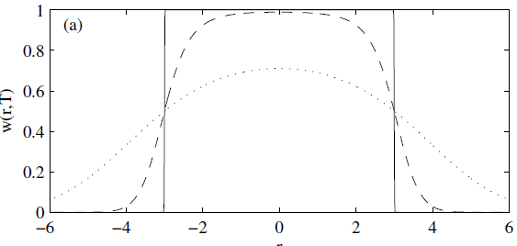
Trimmed Clustering
Clustering with position-specific constraints on variance: Applying redescending M-estimators to label-free LC-MS data analysis (Rudolf Frühwirth , D R Mani and Saumyadipta Pyne) BMC Bioinformatics 2011, 12:358
H_{TCC} = ∑_{k=0}^{K} ∑_{i=1}^{N} M_{i}(k) f(i,k)
f(i,k) = (X(i) - Y(k))²/2σ(k)² k > 0
f(i,0) = c² / 2 k = 0
The 0’th cluster captures (at zero temperature) all points outside clusters (background)
Clusters are trimmed (X(i) - Y(k))²/2σ(k)² < c² / 2
Applied to Proteomics Mass Spectrometry
T = 1
T ~ 0
T = 5
Distance from cluster center

Slide 18
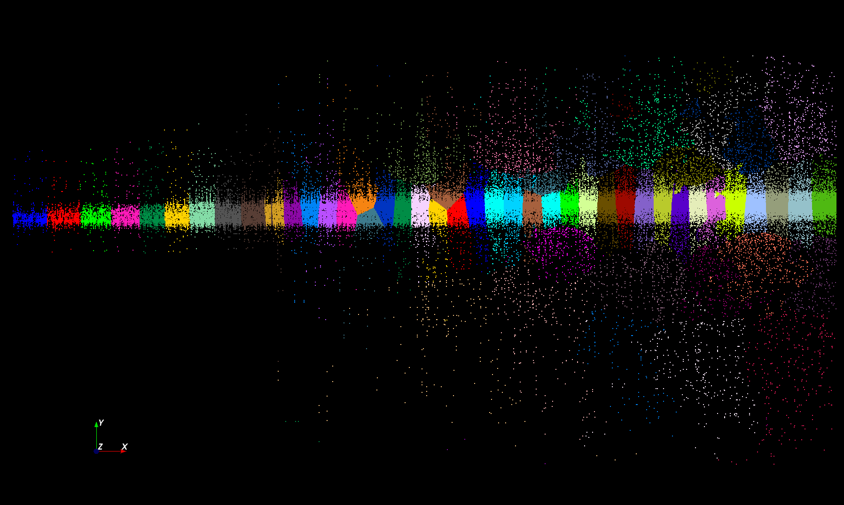
Proteomics 2D DA Clustering T= 25000 60 Clusters

Slide 19
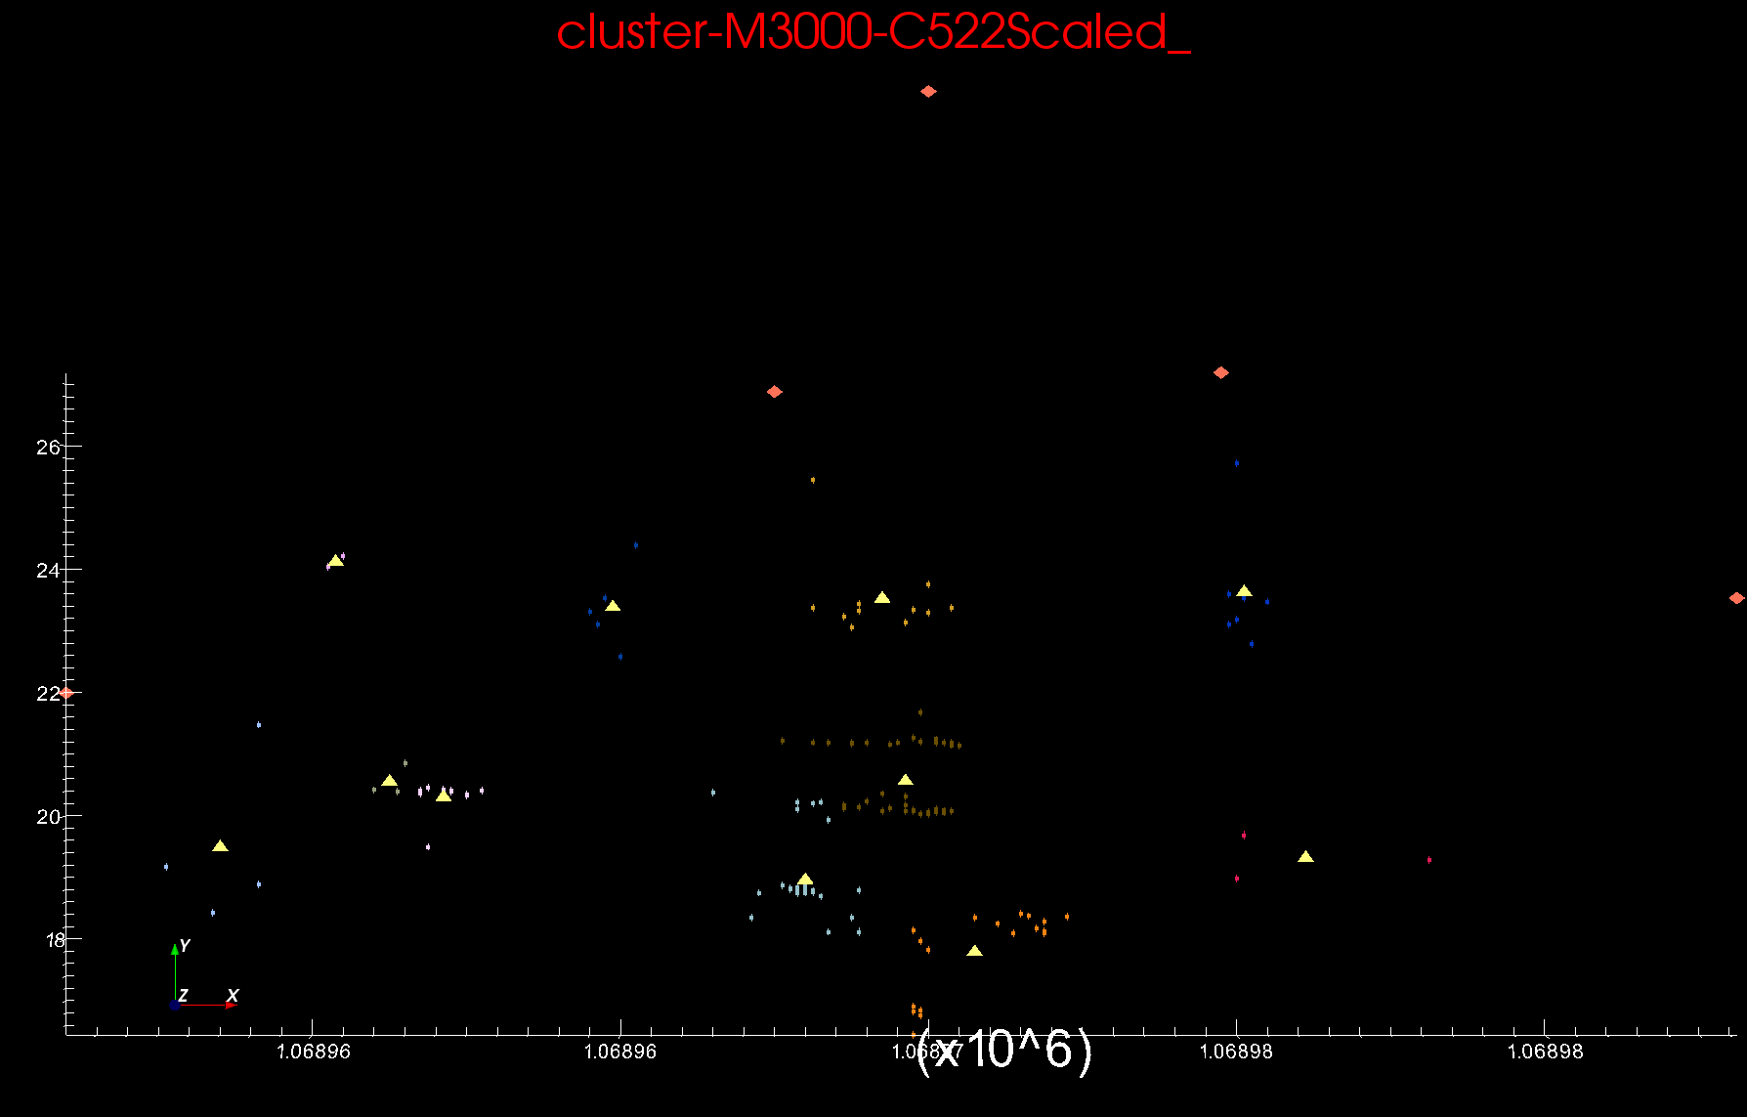
Proteomics 2D DA Clustering T=0.1 small sample of ~30,000 Clusters Count >=2
Sponge Peaks
Centers

Slide 20
Basic Equations
N Number of Points and K Clusters
NK Unknowns <M_{i}(k)> determined by
ε_{i}(k) = (X_{i}- Y(k))²
<M_{i}(k)> = p(k) exp( -ε_{i}(k)/T ) / ∑_{k=1}^{K} p(k) exp( -ε_{i}(k)/T )
C(k) = ∑_{i=1}^{N} <M_{i}(k)> Number of points in Cluster k
Y(k) = ∑_{i=1}^{N} <M_{i}(k)> X_{i} / C(k)
p(k) = C(k) / N
Iterate T = “∞” to 0.025
<M_{i}(k)> probability that point i in cluster k

Slide 21
Simple Parallelism
Decompose points i over processors
Equations either pleasingly parallel “maps” over i
Or “All-Reductions” summing over i for each cluster
Each process holds all clusters and calculates contributions to clusters from points in node
e.g. Y(k) = ∑_{i=1}^{N} <M_{i}(k)> X_{i} / C(k)
Runs well in MPI or MapReduce
See all the MapReduce k-means papers

Slide 22
Better Parallelism
This model is correct at start but each point does not really contribute to each cluster as damped exponentially by exp( - (X_{i}- Y(k))² /T )
For Proteomics problem, on average 6.45 clusters needed per point (X_{i}- Y(k))² /T ≤ ~40 (Average number of Clusters ~ 20,000)
A factor of ~3000
So only need to keep nearby clusters for each point
Further reductions are not global; they are nearest neighbor and calculated by parallelism over clusters

Slide 23
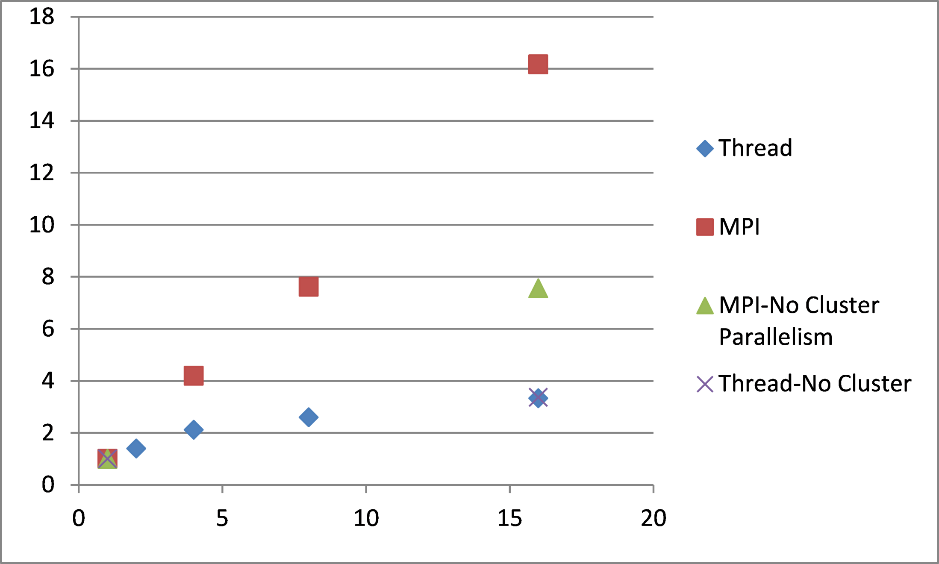
Speedup
Parallelism (#cores or nodes)

Slide 24
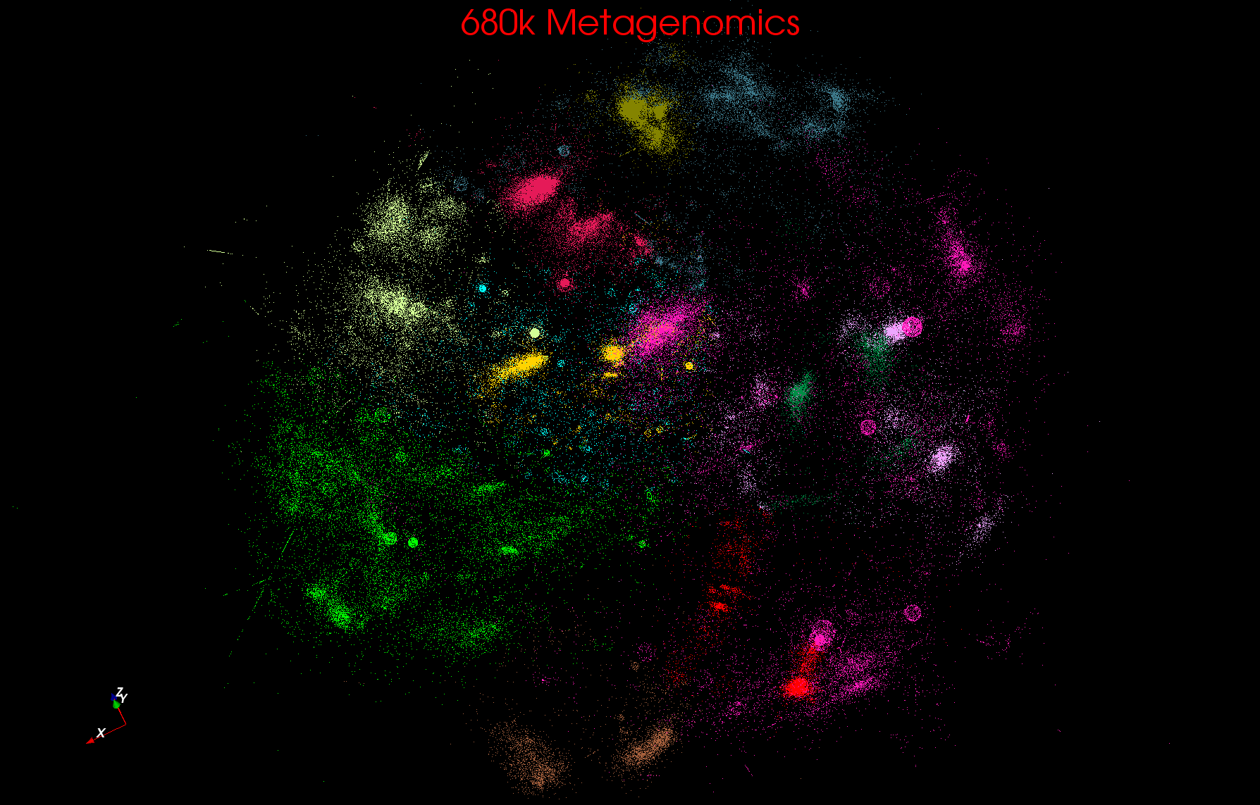
Metagenomics

Slide 25
Metagenomics with 3 Clustering Methods
DA-PWC 188 Clusters; CD-Hit 6000; UCLUST 8418
DA-PWC doesn’t need seeding like other methods – All clusters found by splitting
# Clusters

Slide 26
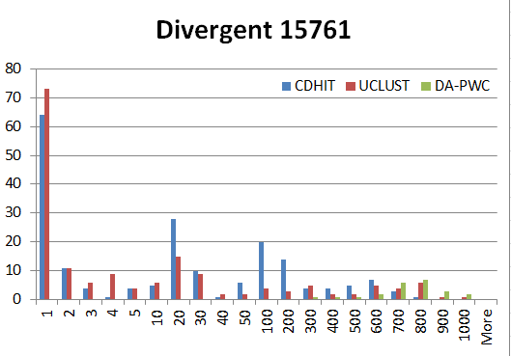
“Divergent” Data Sample 23 True Sequences
DA-PWC
UClust
CDhit
Divergent Data Set UClust (Cuts 0.65 to 0.95)
DAPWC 0.65 0.75 0.85 0.95 Total # of clusters 23 4 10 36 91 Total # of clusters uniquely identified 23 0 0 13 16 (i.e. one original cluster goes to 1 uclust cluster )
Total # of shared clusters with significant sharing 0 4 10 5 0 (one uclust cluster goes to > 1 real cluster)
Total # of uclust clusters that are just part of a real cluster 0 4 10 17(11) 72(62) (numbers in brackets only have one member)
Total # of real clusters that are 1 uclust cluster 0 14 9 5 0 but uclust cluster is spread over multiple real clusters
Total # of real clusters that have 0 9 14 5 7 significant contribution from > 1 uclust cluster

Slide 27
Conclusions and Next Steps
Clustering(and other DA) like a particle (or PIC) code with range of interaction (SQRT(T)) that varies during iteration
Spans long range force (T=∞) to nearest neighbor(T~0.1)
Data Intensive programs are not like simulations as they have large “reductions” (“collectives”) and do not have many small messages
Good for Clouds(MapReduce) and HPC(MPI)
Need an initiative to build SPIDAL scalable high performance data analytics library on top of interoperable cloud-HPC platform
Working with Saltz and others on this! Collaboration welcome
Many promising algorithms such as deterministic annealing not used as implementations not available in R/Matlab/Mahout etc. – DA clearly superior in theory and practice than well used systems
More software and runs longer but can be efficiently if nontrivially parallelized so runtime not a big issue
Current DA codes 3000-10,000 lines of (mainly) C# each

