Slide 1
Data Science, Clouds and X-Informatics
May 8 2013
3rd International Conference on Cloud Computing and Services Science, CLOSER 2013
Eurogress Aachen
Geoffrey Fox
gcf@indiana.edu
http://www.infomall.org http://www.futuregrid.org
School of Informatics and Computing
Digital Science Center
Indiana University Bloomington

Slide 2
Abstract
We explore the principle that much of “the future” will be characterized by “Using Clouds running Data Analytics processing Big Data to solve problems in X-Informatics”. Applications (values of X) include explicitly already Astronomy, Biology, Biomedicine, Business, Chemistry, Crisis, Energy, Environment, Finance, Health, Intelligence, Lifestyle, Marketing, Medicine, Pathology, Policy, Radar, Security, Sensor, Social, Sustainability, Wealth and Wellness with more fields defined implicitly. We discuss the implications of this concept for education and research. Education requires new curricula – generically called data science – which will be hugely popular due to the many millions of jobs opening up in both “core technology” and within applications where of course there are most opportunities. We discuss possibility of using MOOC’s to jumpstart field. On research side, big data (i.e. large applications) require big (i.e. scalable) algorithms on big infrastructure running robust convenient programming environments. We discuss clustering and information visualization using dimension reduction as examples of scalable algorithms. We compare Message Passing Interface MPI and extensions of MapReduce as the core technology to execute data analytics.
We mention FutureGrid and a software defined Computing Testbed as a Service

Slide 3
Big Data Ecosystem in One Sentence
Use Clouds running Data Analytics processing Big Data to solve problems in X-Informatics ( or e-X)
X = Astronomy, Biology, Biomedicine, Business, Chemistry, Crisis, Energy, Environment, Finance, Health, Intelligence, Lifestyle, Marketing, Medicine, Pathology, Policy, Radar, Security, Sensor, Social, Sustainability, Wealth and Wellness with more fields (physics) defined implicitly
Spans Industry (AHEAD?) and Science (research)
Education: Data Science see recent New York Times articles
http://datascience101.wordpress.com/2013/04/13/new-york-times-data-science-articles/

Slide 4
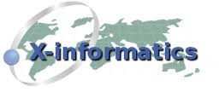
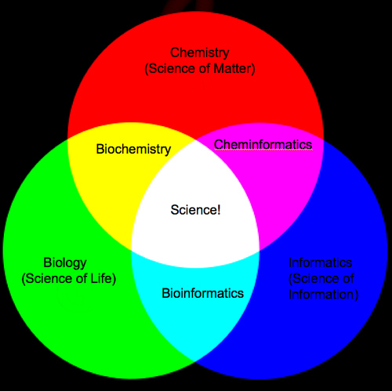
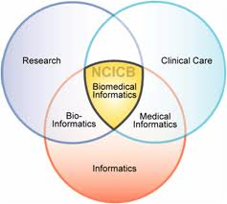
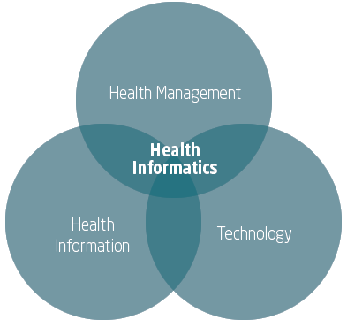
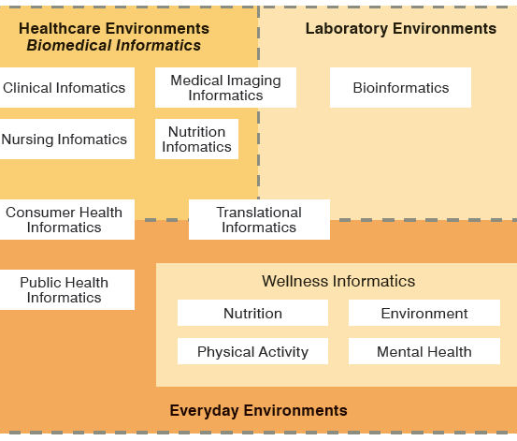
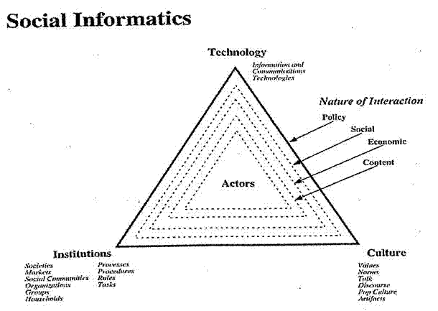
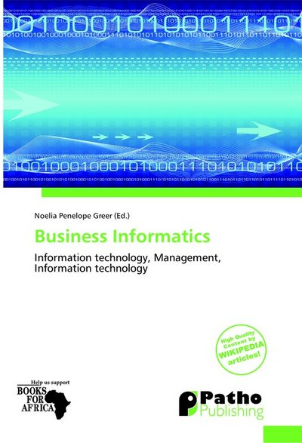
Social Informatics

Slide 5
Issues of Importance
Economic Imperative: There are a lot of data and a lot of jobs
Computing Model: Industry adopted clouds which are attractive for data analytics. Research has not adopted?
Research Model: 4th Paradigm; From Theory to Data driven science?
Progress in Data Science Education: opportunities at universities
Confusion in a new-old field: lack of consensus academically in several aspects of data intensive computing from storage to algorithms, to processing and education
Progress in Data Intensive Programming Models
Progress in Academic (open source) clouds
Progress in scalable robust Algorithms: new data need better algorithms?
FutureGrid: Develop Experimental Systems

Slide 6
Economic Imperative First Data
There are a lot of data and a lot of jobs

Slide 7
Some Trends
The Data Deluge is clear trend from Commercial (Amazon, e-commerce) , Community (Facebook, Search) and Scientific applications
Light weight clients from smartphones, tablets to sensors
Multicore reawakening parallel computing
Compelling server side
Exascale initiatives will continue drive to high end with a simulation orientation
Clouds with cheaper, greener, easier to use IT for (some) applications
New jobs associated with new curricula
Clouds as (part of) a distributed system (classic CS courses)
Data Analytics (Important theme in academia and industry)

Slide 8
Some Data sizes
~40 10⁹ Web pages at ~300 kilobytes each = 10 Petabytes
Youtube 48 hours video uploaded per minute;
in 2 months in 2010, uploaded more than total NBC ABC CBS
~2.5 petabytes per year uploaded?
LHC 15 petabytes per year
Radiology 69 petabytes per year
Earth Observation becoming ~4 petabytes per year
Earthquake Science – few terabytes total today
PolarGrid – 100’s terabytes/year
Exascale simulation data dumps – terabytes/second = 30 exabytes/year
Square Kilometer Array Telescope will be 100 terabits/second = 400 exabytes/year

Slide 9
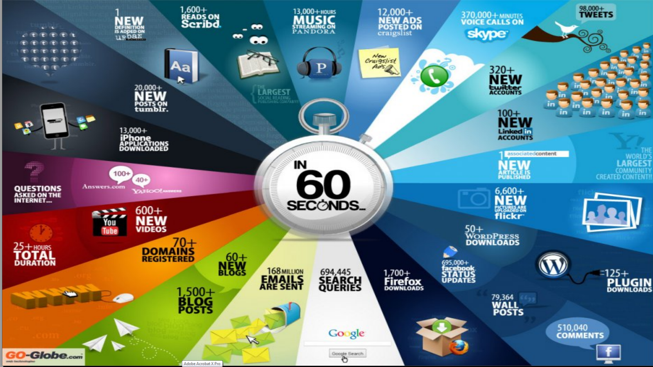
http://cs.metrostate.edu/~sbd/ Oracle

Slide 10
MM = Million
Ruh VP Software GE http://fisheritcenter.haas.berkeley.edu/Big_Data/index.html

Slide 11
Why need cost effective
Computing!
Full Personal Genomics: 3 petabytes per day
http://www.genome.gov/sequencingcosts/

Slide 12
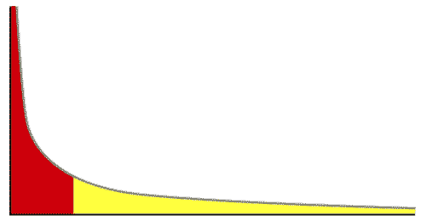
The Long Tail of Science
High energy physics, astronomy
genomics
The long tail: economics, social science, ….
Collectively “long tail” science is generating a lot of data
Estimated at over 1PB per year and it is growing fast.
80-20 rule: 20% users generate 80% data but not necessarily 80% knowledge
From Dennis Gannon Talk

Slide 13
Economic Imperative Now Jobs
There are a lot of data and a lot of jobs

Slide 14
Jobs v. Countries
http://www.microsoft.com/en-us/news/features/2012/mar12/03-05CloudComputingJobs.aspx

Slide 15
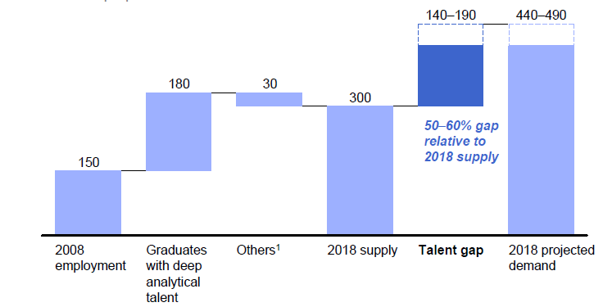
McKinsey Institute on Big Data Jobs
There will be a shortage of talent necessary for organizations to take advantage of big data. By 2018, the United States alone could face a shortage of 140,000 to 190,000 people with deep analytical skills as well as 1.5 million managers and analysts with the know-how to use the analysis of big data to make effective decisions.
Informatics aimed at 1.5 million jobs. Computer Science covers the 140,000 to 190,000
http://www.mckinsey.com/mgi/publications/big_data/index.asp.

Slide 16
Tom Davenport Harvard Business School http://fisheritcenter.haas.berkeley.edu/Big_Data/index.html Nov 2012

Slide 17
Computing Model
Industry adopted clouds which are attractive for data analytics

Slide 18
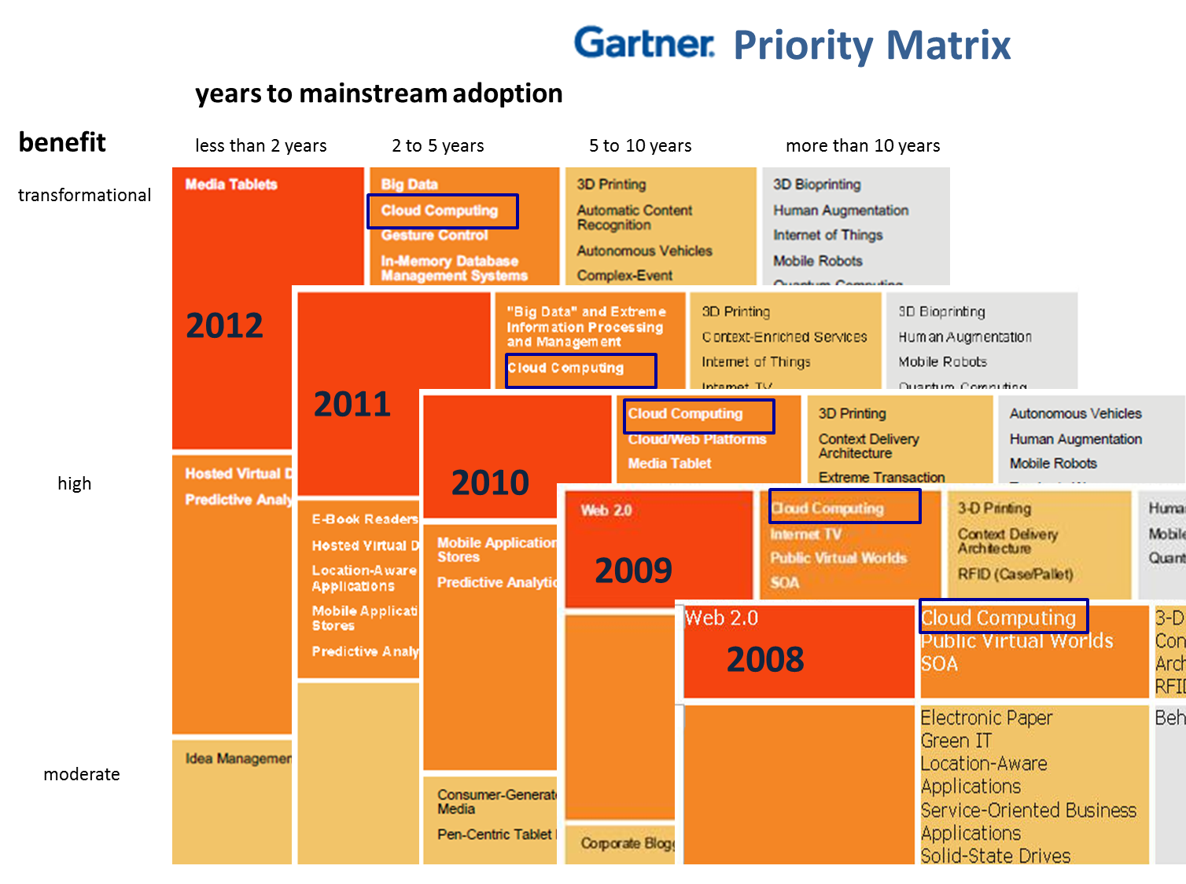
5 years Cloud Computing
2 years Big Data Transformational

Slide 19
Amazon making money
It took Amazon Web Services (AWS) eight years to hit $650 million in revenue, according to Citigroup in 2010.
Just three years later, Macquarie Capital analyst Ben Schachter estimates that AWS will top $3.8 billion in 2013 revenue, up from $2.1 billion in 2012 (estimated), valuing the AWS business at $19 billion.

Slide 20
Physically Clouds are Clear
A bunch of computers in an efficient data center with an excellent Internet connection
They were produced to meet need of public-facing Web 2.0 e-Commerce/Social Networking sites
They can be considered as “optimal giant data center” plus internet connection
Note enterprises use private clouds that are giant data centers but not optimized for Internet access

Slide 21
Virtualization made several things more convenient
Virtualization = abstraction; run a job – you know not where
Virtualization = use hypervisor to support “images”
Allows you to define complete job as an “image” – OS + application
Efficient packing of multiple applications into one server as they don’t interfere (much) with each other if in different virtual machines;
They interfere if put as two jobs in same machine as for example must have same OS and same OS services
Also security model between VM’s more robust than between processes

Slide 22
Clouds Offer From different points of view
Features from NIST:
On-demand service (elastic);
Broad network access;
Resource pooling;
Flexible resource allocation;
Measured service
Economies of scale in performance and electrical power (Green IT)
Powerful new software models
Platform as a Service is not an alternative to Infrastructure as a Service – it is instead an incredible valued added
Amazon is as much PaaS as Azure
They are cheaper than classic clusters unless latter 100% utilized

Slide 23
Research Model
4th Paradigm; From Theory to Data driven science?

Slide 24
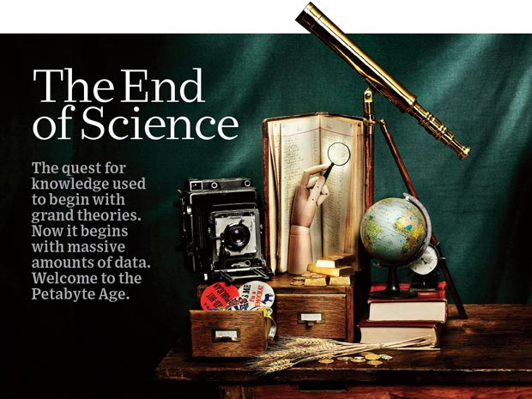
http://www.wired.com/wired/issue/16-07 September 2008

Slide 25
The 4 paradigms of Scientific Research
Theory
Experiment or Observation
E.g. Newton observed apples falling to design his theory of mechanics
Simulation of theory or model (computational Science)
Data-driven (Big Data) or The Fourth Paradigm: Data-Intensive Scientific Discovery (aka Data Science)
http://research.microsoft.com/en-us/collaboration/fourthparadigm/ A free book
More data; less models
Note Data → Information→ Wisdom →Knowledge→ Decisions pipeline

Slide 26
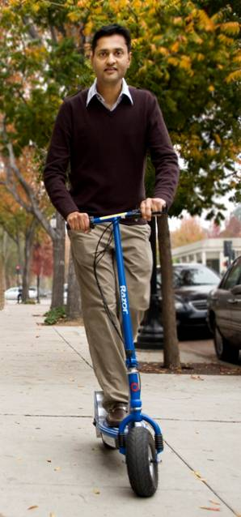
More data usually beats better algorithms
Here's how the competition works. Netflix has provided a large data set that tells you how nearly half a million people have rated about 18,000 movies. Based on these ratings, you are asked to predict the ratings of these users for movies in the set that they have not rated. The first team to beat the accuracy of Netflix's proprietary algorithm by a certain margin wins a prize of $1 million!
Different student teams in my class adopted different approaches to the problem, using both published algorithms and novel ideas. Of these, the results from two of the teams illustrate a broader point. Team A came up with a very sophisticated algorithm using the Netflix data. Team B used a very simple algorithm, but they added in additional data beyond the Netflix set: information about movie genres from the Internet Movie Database(IMDB). Guess which team did better?
Anand Rajaraman is Senior Vice President at Walmart Global eCommerce, where he heads up the newly created @WalmartLabs,
http://anand.typepad.com/datawocky/2008/03/more-data-usual.html
20120117berkeley1.pdf Jeff Hammerbacher

Slide 27
Data Science Education
Opportunities at universities
see recent New York Times articles
http://datascience101.wordpress.com/2013/04/13/new-york-times-data-science-articles/

Slide 28
Data Science Education
Broad Range of Topics from Policy to curation to applications and algorithms, programming models, data systems, statistics, and broad range of CS subjects such as Clouds, Programming, HCI,
Plenty of Jobs and broader range of possibilities than computational science but similar cosmic issues
What type of degree (Certificate, minor, track, “real” degree)
What implementation (department, interdisciplinary group supporting education and research program)

Slide 29
Computational Science
Interdisciplinary field between computer science and applications with primary focus on simulation areas
Very successful as a research area
XSEDE and Exascale systems enable
Several academic programs but these have been less successful than computational science research as
No consensus as to curricula and jobs (don’t appoint faculty in computational science; do appoint to DoE labs)
Field relatively small
Started around 1990

Slide 30
MOOC’s

Slide 31
Massive Open Online Courses (MOOC)
MOOC’s are very “hot” these days with Udacity and Coursera as start-ups
Over 100,000 participants but concept valid at smaller sizes
Relevant to Data Science as this is a new field with few courses at most universities
Technology to make MOOC’s: Google Open Source Course Builder is lightweight LMS (learning management system)
Supports MOOC model as a collection of short prerecorded segments (talking head over PowerPoint) termed lessons – typically 15 minutes long
Compose playlists of lessons into sessions, modules, courses
Session is an “Album” and lessons are “songs” in an iTunes analogy

Slide 32
MOOC’s for Traditional Lectures
We can take MOOC lessons and view them as a “learning object” that we can share between different teachers
i.e. as a way of teaching typical sized classes but with less effort as shared material
Start with what’s in repository;
pick and choose;
Add custom material of individual teachers
The ~15 minute Video over PowerPoint of MOOC’s much easier to re-use than PowerPoint
Do not need special mentoring support
Defining how to support computing labs with FutureGrid or appliances + Virtual Box

Slide 33
Confusion in the new-old data field
lack of consensus academically in several aspects from storage to algorithms, to processing and education

Slide 34
Data Communities Confused I?
Industry seems to know what it is doing although it’s secretive – Amazon’s last paper on their recommender system was 2003
Industry runs the largest data analytics on clouds
But industry algorithms are rather different from science
Academia confused on repository model: traditionally one stores data but one needs to support “running Data Analytics” and one is taught to bring computing to data as in Google/Hadoop file system
Either store data in compute cloud OR enable high performance networking between distributed data repositories and “analytics engines”
Academia confused on data storage model: Files (traditional) v. Database (old industry) v. NOSQL (new cloud industry)
Hbase MongoDB Riak Cassandra are typical NOSQL systems
Academia confused on curation of data: University Libraries, Projects, National repositories, Amazon/Google?

Slide 35
Data Communities Confused II?
Academia agrees on principles of Simulation Exascale Architecture: HPC Cluster with accelerator plus parallel wide area file system
Industry doesn’t make extensive use of high end simulation
Academia confused on architecture for data analysis: Grid (as in LHC), Public Cloud, Private Cloud, re-use simulation architecture with database, object store, parallel file system, HDFS style data
Academia has not agreed on Programming/Execution model: “Data Grid Software”, MPI, MapReduce ..
Academia has not agreed on need for new algorithms: Use natural extension of old algorithms, R or Matlab. Simulation successes built on great algorithm libraries;
Academia has not agreed on what algorithms are important?
Academia could attract more students: with data-oriented curricula that prepare for industry or research careers (as discussed)

Slide 36
Clouds in Research

Slide 37
Clouds have highlighted SaaS PaaS IaaS
But equally valid for classic clusters
Software
(Application
Or Usage) SaaS
Education
Applications
CS Research Use e.g. test new compiler or storage model
Software Services are building blocks of applications
The middleware or computing environment including HPC, Grids …
Nimbus, Eucalyptus, OpenStack, OpenNebula CloudStack plus Bare-metal
OpenFlow – likely to grow in importance
Cloud e.g. MapReduce
HPC e.g. PETSc, SAGA
Computer Science e.g. Compiler tools, Sensor nets, Monitors
Platform PaaS
Infra
structure
IaaS
Software Defined Computing (virtual Clusters)
Hypervisor, Bare Metal
Operating System
Network
NaaS
Software Defined Networks
OpenFlow GENI

Slide 38
Science Computing Environments
Large Scale Supercomputers – Multicore nodes linked by high performance low latency network
Increasingly with GPU enhancement
Suitable for highly parallel simulations
High Throughput Systems such as European Grid Initiative EGI or Open Science Grid OSG typically aimed at pleasingly parallel jobs
Can use “cycle stealing”
Classic example is LHC data analysis
Grids federate resources as in EGI/OSG or enable convenient access to multiple backend systems including supercomputers
Use Services (SaaS)
Portals make access convenient and
Workflow integrates multiple processes into a single job

Slide 39
Clouds HPC and Grids
Synchronization/communication Performance Grids > Clouds > Classic HPC Systems
Clouds naturally execute effectively Grid workloads but are less clear for closely coupled HPC applications
Classic HPC machines as MPI engines offer highest possible performance on closely coupled problems
The 4 forms of MapReduce/MPI
Map Only – pleasingly parallel
Classic MapReduce as in Hadoop; single Map followed by reduction with fault tolerant use of disk
Iterative MapReduce use for data mining such as Expectation Maximization in clustering etc.; Cache data in memory between iterations and support the large collective communication (Reduce, Scatter, Gather, Multicast) use in data mining
Classic MPI! Support small point to point messaging efficiently as used in partial differential equation solvers

Slide 40
What Applications work in Clouds
Pleasingly (moving to modestly) parallel applications of all sorts (over users or usages) with roughly independent data or spawning independent simulations
Long tail of science and integration of distributed sensors
Commercial and Science Data analytics that can use MapReduce (some of such apps) or its iterative variants (most other data analytics apps)
Which science applications are using clouds?
Venus-C (Azure in Europe): 27 applications not using Scheduler, Workflow or MapReduce (except roll your own)
50% of applications on FutureGrid are from Life Science
Locally Lilly corporation is commercial cloud user (for drug discovery) but not IU Biology
But overall very little science use of clouds

Slide 41
Internet of Things and the Cloud
It is projected that there will be 24 billion devices on the Internet by 2020. Most will be small sensors that send streams of information into the cloud where it will be processed and integrated with other streams and turned into knowledge that will help our lives in a multitude of small and big ways.
The cloud will become increasing important as a controller of and resource provider for the Internet of Things.
As well as today’s use for smart phone and gaming console support, “Intelligent River” “smart homes and grid” and “ubiquitous cities” build on this vision and we could expect a growth in cloud supported/controlled robotics.
Some of these “things” will be supporting science
Natural parallelism over “things”
“Things” are distributed and so form a Grid

Slide 42
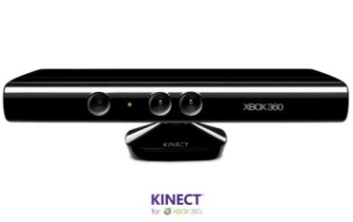
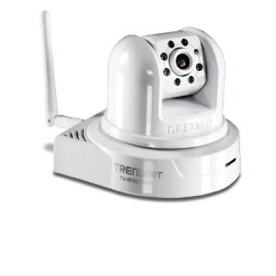
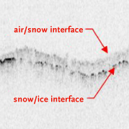
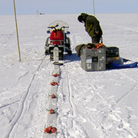
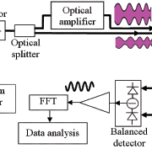
Sensors (Things) as a Service
Output Sensor
Sensors as a Service
Sensor Processing as a Service (could use MapReduce)
A larger sensor ………
https://sites.google.com/site/opensourceiotcloud/ Open Source Sensor (IoT) Cloud

Slide 43
Data Intensive Programming Models

Slide 44
Map Collective Model (Judy Qiu)
Combine MPI and MapReduce ideas
Implement collectives optimally on Infiniband, Azure, Amazon ……
Iterate
Input
map
Initial Collective Step
Generalized Reduce
Final Collective Step

Slide 45
Twister Iterative MapReduce for Data Intensive Applications
Generalize to arbitrary Collective
Broadcast
Compute
Communication
Reduce/ barrier
New Iteration
Smaller Loop-Variant Data
Larger Loop-Invariant Data
(Iterative) MapReduce structure with Map-Collective is framework
Twister runs on Linux or Azure
Twister4Azure is built on top of Azure tables, queues, storage
Qiu, Gunarathne
Notes:
Most of these applications consists of iterative computation and communication steps where single iterations can easily be specified as MapReduce computations.
Large input data sizes which are loop-invariant and can be reused across iterations.
Loop-variant results.. Orders of magnitude smaller…
While these can be performed using traditional MapReduce frameworks, Traditional is not efficient for these types of computations. MR leaves lot of room for improvements in terms of iterative applications.

Slide 46
Kmeans
Hadoop adjusted for Azure: Hadoop KMeans run time adjusted for the performance difference of iDataplex vs Azure

Slide 47
FutureGrid Technology addressing Poor Cloud Performance?

Slide 48
FutureGrid Testbed as a Service
FutureGrid is part of XSEDE set up as a testbed with cloud focus
Operational since Summer 2010 (i.e. now in third year of use)
The FutureGrid testbed provides to its users:
Support of Computer Science and Computational Science research
A flexible development and testing platform for middleware and application users looking at interoperability, functionality, performance or evaluation
FutureGrid is user-customizable, accessed interactively and supports Grid, Cloud and HPC software with and without VM’s
A rich education and teaching platform for classes
Offers OpenStack, Eucalyptus, Nimbus, OpenNebula, HPC (MPI) on same hardware moving to software defined systems; supports both classic HPC and Cloud storage

Slide 49
4 Use Types for FutureGrid TestbedaaS
292 approved projects (1734 users) April 6 2013
USA(79%), Puerto Rico(3%- Students in class), India, China, lots of European countries (Italy at 2% as class)
Industry, Government, Academia
Computer science and Middleware (55.6%)
Core CS and Cyberinfrastructure; Interoperability (3.6%) for Grids and Clouds such as Open Grid Forum OGF Standards
New Domain Science applications (20.4%)
Life science highlighted (10.5%), Non Life Science (9.9%)
Training Education and Outreach (14.9%)
Long (27 full semester) and short events
Computer Systems Evaluation (9.1%)
XSEDE (TIS, TAS), OSG, EGI; Campuses

Slide 50
Sample FutureGrid Projects I
FG18 Privacy preserving gene read mapping developed hybrid MapReduce. Small private secure + large public with safe data. Won 2011 PET Award for Outstanding Research in Privacy Enhancing Technologies
FG132, Power Grid Sensor analytics on the cloud with distributed Hadoop. Won the IEEE Scaling challenge at CCGrid2012.
FG156 Integrated System for End-to-end High Performance Networking showed that the RDMA over Converged Ethernet (InfiniBand made to work over Ethernet network frames) protocol could be used over wide-area networks, making it viable in cloud computing environments.
FG172 Cloud-TM on distributed concurrency control (software transactional memory): "When Scalability Meets Consistency: Genuine Multiversion Update Serializable Partial Data Replication,“ 32nd International Conference on Distributed Computing Systems (ICDCS'12) (good conference) used 40 nodes of FutureGrid

Slide 51
Sample FutureGrid Projects II
FG42,45 SAGA Pilot Job P* abstraction and applications. XSEDE Cyberinfrastructure used on clouds
FG130 Optimizing Scientific Workflows on Clouds. Scheduling Pegasus on distributed systems with overhead measured and reduced. Used Eucalyptus on FutureGrid
FG133 Supply Chain Network Simulator Using Cloud Computing with dynamic virtual machines supporting Monte Carlo simulation with Grid Appliance and Nimbus
FG257 Particle Physics Data analysis for ATLAS LHC experiment used FutureGrid + Canadian Cloud resources to study data analysis on Nimbus + OpenStack with up to 600 simultaneous jobs
FG254 Information Diffusion in Online Social Networks is evaluating NoSQL databases (Hbase, MongoDB, Riak) to support analysis of Twitter feeds
FG323 SSD performance benchmarking for HDFS on Lima

Slide 52
Education and Training Use of FutureGrid
27 Semester long classes: 563+ students
Cloud Computing, Distributed Systems, Scientific Computing and Data Analytics
3 one week summer schools: 390+ students
Big Data, Cloudy View of Computing (for HBCU’s), Science Clouds
1 two day workshop: 28 students
5 one day tutorials: 173 students
From 19 Institutions
Developing 2 MOOC’s (Google Course Builder) on Cloud Computing and use of FutureGrid supported by either FutureGrid or downloadable appliances (custom images)
See http://cgltestcloud1.appspot.com/preview
FutureGrid appliances support Condor/MPI/Hadoop/Iterative MapReduce virtual clusters

Slide 53
Clouds have highlighted SaaS PaaS IaaS
But equally valid for classic clusters
Software
(Application
Or Usage) SaaS
Education
Applications
CS Research Use e.g. test new compiler or storage model
Software Services are building blocks of applications
The middleware or computing environment including HPC, Grids …
Nimbus, Eucalyptus, OpenStack, OpenNebula CloudStack plus Bare-metal
OpenFlow – likely to grow in importance
Cloud e.g. MapReduce
HPC e.g. PETSc, SAGA
Computer Science e.g. Compiler tools, Sensor nets, Monitors
Platform PaaS
Infra
structure
IaaS
Software Defined Computing (virtual Clusters)
Hypervisor, Bare Metal
Operating System
Network
NaaS
Software Defined Networks
OpenFlow GENI

Slide 54
Performance of Dynamic Provisioning
4 Phases a) Design and create image (security vet) b) Store in repository as template with components c) Register Image to VM Manager (cached ahead of time) d) Instantiate (Provision) image

Slide 55
Direct GPU Virtualization
Allow VMs to directly access GPU hardware
Enables CUDA and OpenCL code – no need for custom APIs
Utilizes PCI-passthrough of device to guest VM
Hardware directed I/O virt (VT-d or IOMMU)
Provides direct isolation and security of device from host or other VMs
Removes much of the Host <-> VM overhead
Similar to what Amazon EC2 uses (proprietary)

Slide 56
Performance 1
Notes:
See native performance for FLOPS metrics (great!) See a 4-5% overhead and slightly higher variance with PCI-Express bus speed benchmarks. Still not bad!

Slide 57
Performance 2
Notes:
Overall FFT and all Matrix multiplication is near native. As we can see with the PCIE benchmarks, there is some added overhead there, but only a few % of native.

Slide 58
Algorithms
Scalable Robust Algorithms: new data need better algorithms?

Slide 59
Algorithms for Data Analytics
In simulation area, it is observed that equal contributions to improved performance come from increased computer power and better algorithms http://cra.org/ccc/docs/nitrdsymposium/pdfs/keyes.pdf
In data intensive area, we haven’t seen this effect so clearly
Information retrieval revolutionized but
Still using Blast in Bioinformatics (although Smith Waterman etc. better)
Still using R library which has many non optimal algorithms
Parallelism and use of GPU’s often ignored

Slide 60
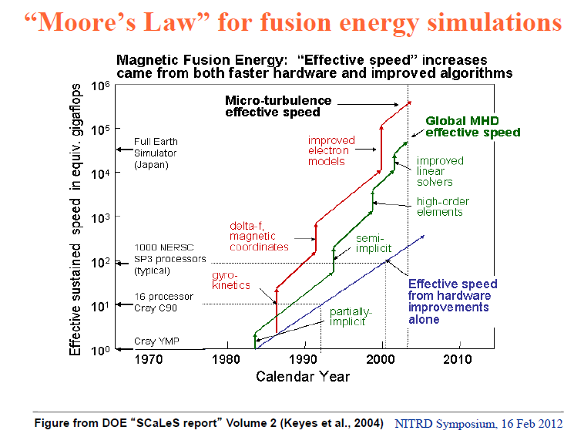

Slide 61
Data Analytics Futures?
PETSc and ScaLAPACK and similar libraries very important in supporting parallel simulations
Need equivalent Data Analytics libraries
Include datamining (Clustering, SVM, HMM, Bayesian Nets …), image processing, information retrieval including hidden factor analysis (LDA), global inference, dimension reduction
Many libraries/toolkits (R, Matlab) and web sites (BLAST) but typically not aimed at scalable high performance algorithms
Should support clouds and HPC; MPI and MapReduce
Iterative MapReduce an interesting runtime; Hadoop has many limitations
Need a coordinated Academic Business Government Collaboration to build robust algorithms that scale well
Crosses Science, Business Network Science, Social Science
Propose to build community to define & implement SPIDAL or Scalable Parallel Interoperable Data Analytics Library

Slide 62
Conclusions

Slide 63
Conclusions
Clouds and HPC are here to stay and one should plan on using both
Data Intensive programs are not like simulations as they have large “reductions” (“collectives”) and do not have many small messages
Clouds suitable
Iterative MapReduce an interesting approach; need to optimize collectives for new applications (Data analytics) and resources (clouds, GPU’s …)
Need an initiative to build scalable high performance data analytics library on top of interoperable cloud-HPC platform
Many promising data analytics algorithms such as deterministic annealing not used as implementations not available in R/Matlab etc.
More sophisticated software and runs longer but can be efficiently parallelized so runtime not a big issue

Slide 64
Conclusions II
Software defined computing systems linking NaaS, IaaS, PaaS, SaaS (Network, Infrastructure, Platform, Software) likely to be important
More employment opportunities in clouds than HPC and Grids and in data than simulation; so cloud and data related activities popular with students
Community activity to discuss data science education
Agree on curricula; is such a degree attractive?
Role of MOOC’s as either
Disseminating new curricula
Managing course fragments that can be assembled into custom courses for particular interdisciplinary students

