Slide 1
Clouds and Sensor Grids
CTS2009 Conference
May 21 2009
Alex Ho
Anabas Inc.
Geoffrey Fox
Computer Science, Informatics, Physics
Chair Informatics Department
Director Community Grids Laboratory and Digital Science Center
Indiana University Bloomington IN 47404
gcf@indiana.edu
http://www.infomall.org

Slide 2
Gartner 2008 Technology Hype Curve
Clouds, Microblogs and Green IT appear
Basic Web Services, Wikis and SOA
becoming mainstream

Slide 3


Clouds as Cost Effective Data Centers
Exploit the Internet by allowing one to build giant data centers with 100,000’s of computers; ~ 200-1000 to a shipping container
“Microsoft will cram between 150 and 220 shipping containers filled with data center gear into a new 500,000 square foot Chicago facility. This move marks the most significant, public use of the shipping container systems popularized by the likes of Sun Microsystems and Rackable Systems to date.”

Slide 4

Clouds hide Complexity
Build portals around all computing capability
SaaS: Software as a Service
IaaS: Infrastructure as a Service or HaaS: Hardware as a Service
PaaS: Platform as a Service delivers SaaS on IaaS
Cyberinfrastructure is “Research as a Service”
2 Google warehouses of computers on the banks of the Columbia River, in The Dalles, Oregon
Such centers use 20MW-200MW
(Future) each
150 watts per core
Save money from large size, positioning with cheap power and access with Internet

Slide 5
Sensors can be almost anything
Note sensors are any time dependent source of information and a fixed source of information is just a broken sensor
  SAR Satellites
  Environmental Monitors
  Nokia N800 pocket computers
  RFID tags and readers
  GPS Sensors
  Lego Robots
  RSS Feeds
  Audio/video: web-cams
  Presentation of teacher in distance education
  Text chats of students
  Cell phones

Slide 6

Components of the Sensor Grid
Laptop for PowerPoint
2 Robots used
Lego Robot GPS Nokia N800 RFID Tag RFID Reader

Slide 7
Clouds and Data
Clouds are very suitable for data deluge as data analysis is “embarrassingly parallel” over data
Either single instrument (DNA sequencer or particle accelerator) streams out “events” that can be analyzed separately
Or we have lots of sensors (instruments) whose produced data can be analyzed separately
Parallel over events or over sensors
MapReduce (Hadoop or Dryad) manage analysis
Publish-Subscribe can be used for efficient Staging
Sensor as a Service – maps each sensor to a dynamic cloud “proxy”

Slide 8
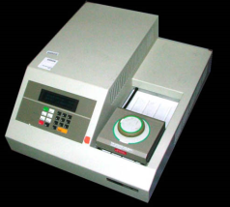

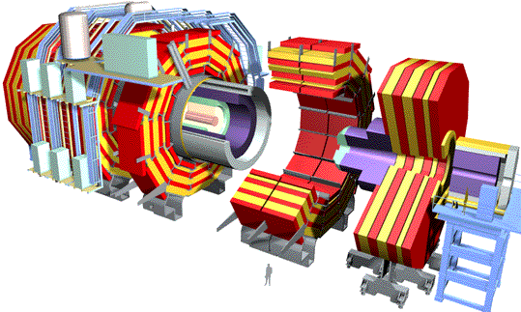




“File/Data Repository” Parallelism
Instruments
Map = (data parallel) computation reading and writing data
Reduce = Collective/Consolidation phase e.g. forming multiple global sums as in histogram
Communication via Messages/Files
Portals
/Users
Disks
Map₁
Map₂
Map₃
Reduce
Computers/Disks

Slide 9
Some File/Data Parallel Examples from Indiana University Biology Dept
EST (Expressed Sequence Tag) Assembly: 2 million mRNA sequences generates 540000 files taking 15 hours on 400 TeraGrid nodes (CAP3 run dominates)
MultiParanoid/InParanoid gene sequence clustering: 476 core years just for Prokaryotes
Population Genomics: (Lynch) Looking at all pairs separated by up to 1000 nucleotides
Sequence-based transcriptome profiling: (Cherbas, Innes) MAQ, SOAP
Systems Microbiology (Brun) BLAST, InterProScan
Metagenomics (Fortenberry, Nelson) Pairwise alignment of 7243 16s sequence data took 12 hours on TeraGrid
All can use Dryad or Hadoop on Clouds

Slide 10
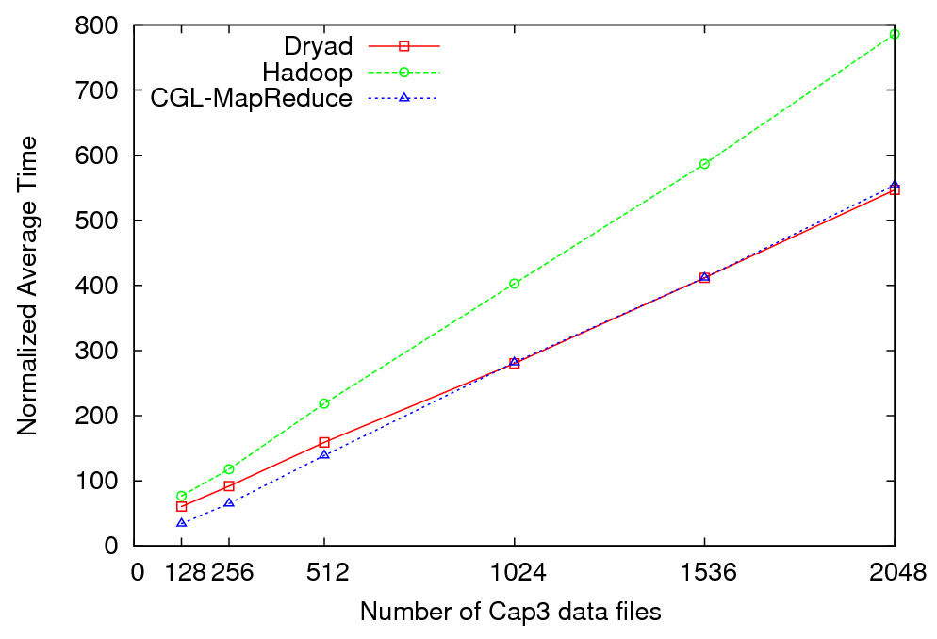
Cap3 Data Analysis - Performance
Normalized Average Time vs. Amount of Data Processed

Slide 11
Data Intensive Cloud Architecture
MPI/GPU Engines
Instruments
User Data
Specialized
Systems
e.g.
Windows
Clouds
Cloud
Files
Files
Files
Files
Sensors
Users

Slide 12
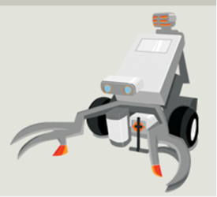
Sensors as a (Cloud) Service
Out of Cloud
Pub-Sub
Broker
Filter
Data
Filter
Data
Out of Cloud
Cloud

Slide 13
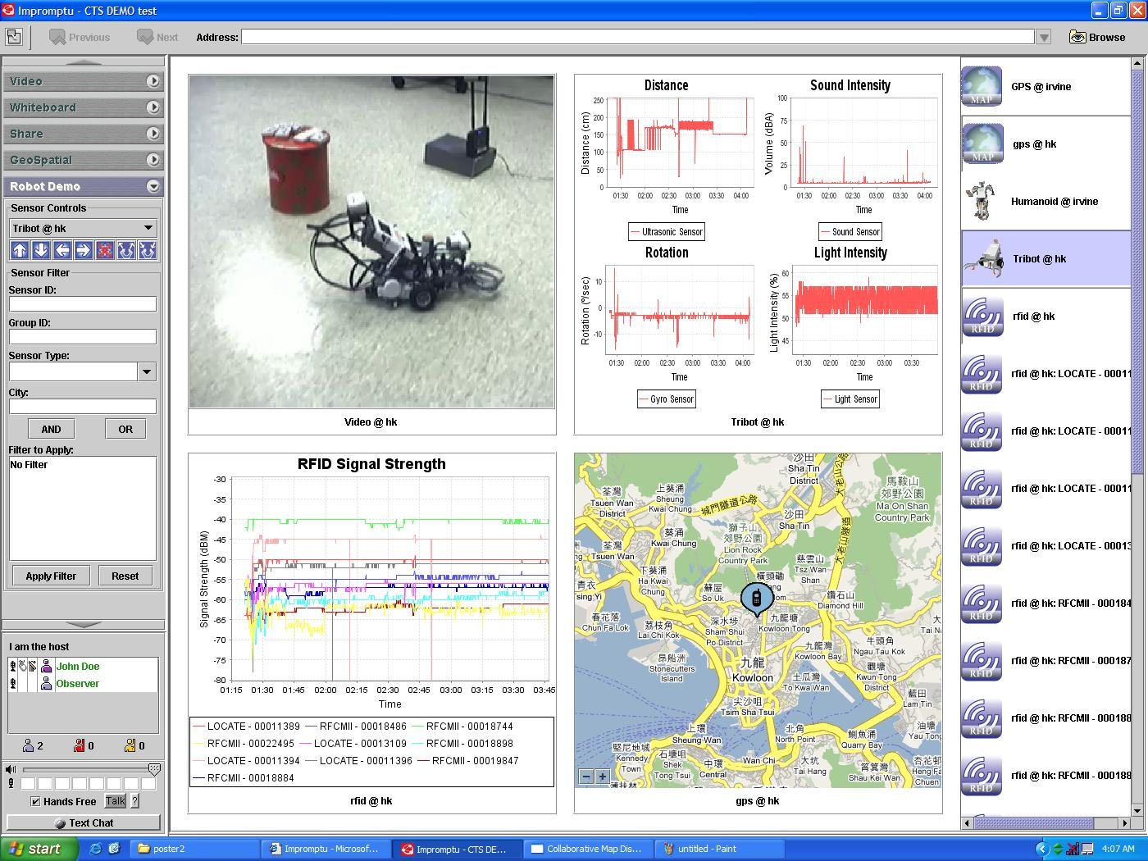

Slide 14
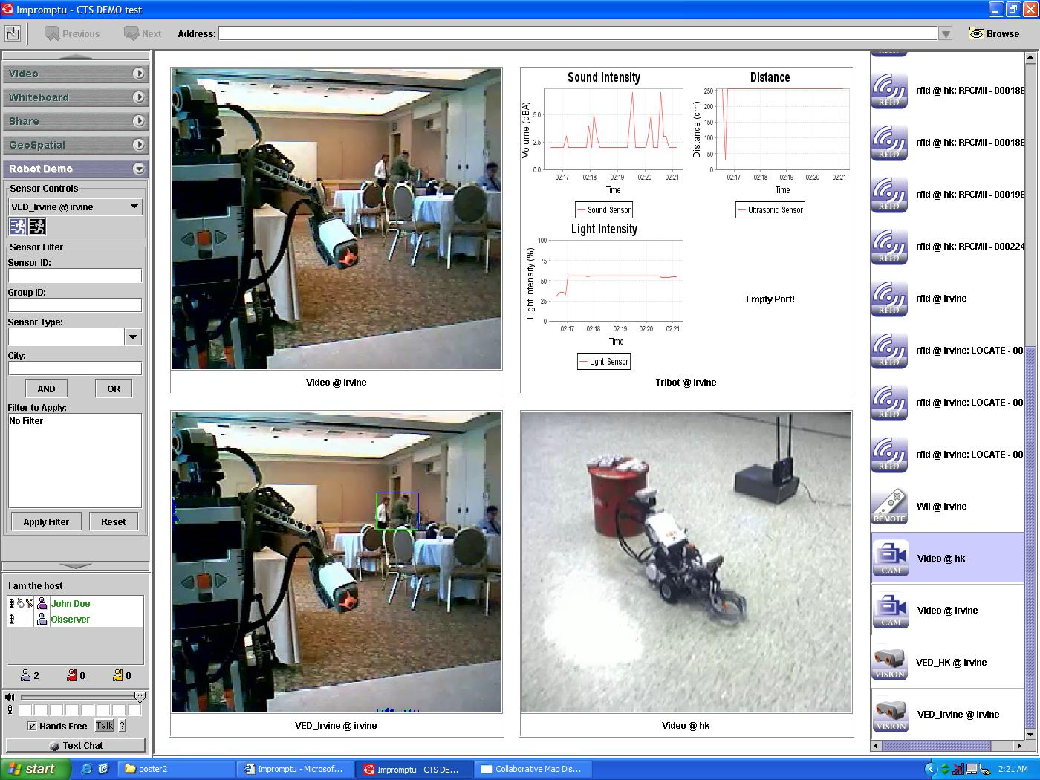

Slide 15
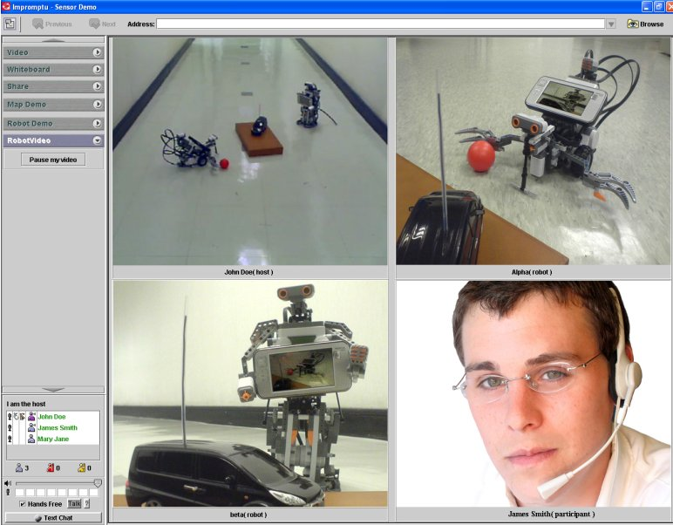

Slide 16
Cloud Latencies: Europe--US
Total Users | Minimum 2-way Latency (ms) | Maximum 2-way Latency (ms) | Average 2-way Latency (ms) | Average 2-way Jitter (ms)
200 | 90.15 | 124 | 99.51 | 16.70
400 | 91.09 | 133.81 | 108.38 | 26.92
600 | 90.61 | 155.79 | 109.80 | 28.67
800 | 91.21 | 183.69 | 107.56 | 29.67
1200 | 91.87 | 189.82 | 110.79 | 35.48
1400 | 92.18 | 165.74 | 106.39 | 38.69
1600 | 94.40 | 235.14 | 118.94 | 50.63
1800 | 93.56 | 197.89 | 110.80 | 33.77
2000 | 91.25 | 270.44 | 110.93 | 31.98
2200 | 108.30 | 318.08 | 151.66 | 74.33
2400 | 93.2 | 682.01 | 141.82 | 57.92
Cisco’s VoIP system deployment guideline requires enterprise networks to be able to sustain at most 300 ms round-trip latency, average two-way jitter less than 60 ms,

Slide 17
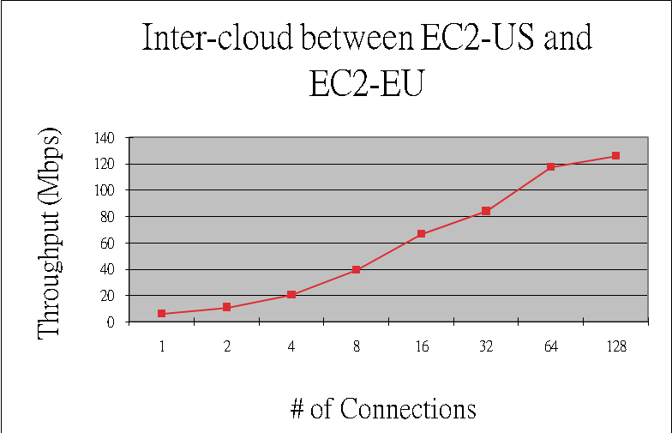
Trans-Atlantic Cloud Bandwidth
EU
USA

Slide 18
Trans-Atlantic Cloud Bandwidth

Slide 19
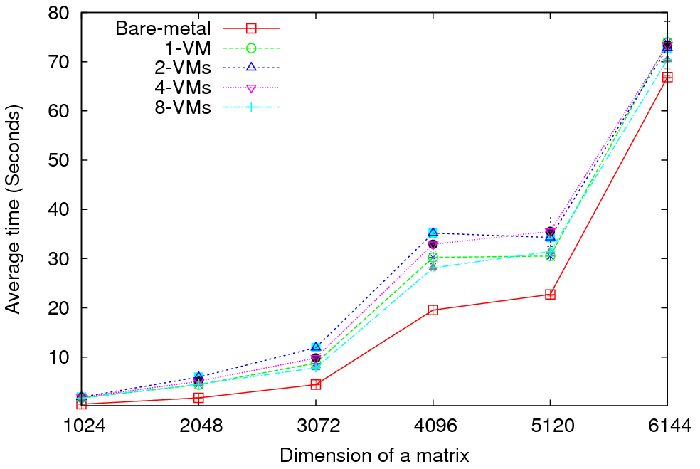
Matrix Multiplication - Performance
Eucalyptus (Xen) versus “Bare Metal Linux” on communication Intensive trivial problem (2D Laplace) and matrix multiplication
Cloud Overhead ~3 times Bare Metal; OK if communication modest
Notes:
MPI Cloud Overhead
1 VM = 1 VM in each node, each VM having access to all the CPU cores (8)
and all the memory (30 GB).
2 VMs = 2 VMs in each node, each VM having access to 4 CPU cores and 15 GB
of memory.
4 VMs = 4 VMs in each node, each VM having access to 2 CPU cores and 7.5 GB
of memory.
8 VMs = 8 VMs in each node, each VM having access to 1 CPU core and 3.75 GB
of memory.
Each node has the following hardware configuration.
2 Quad Core (Intel Xeon) processors (Total of 8 cores)
32 GB of memory.
Kmeans used all the 128 processors cores in 16 nodes.
Matrix multiplication uses only 64 cores in 8 nodes.

Slide 20
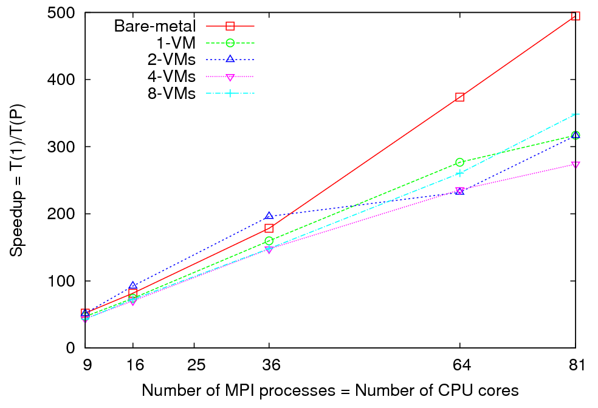
Matrix Multiplication - Speedup
Notes:
Performance and Overhead results are obtained using 8 nodes (64 cores) (Using a MPI grid of 8x8) Size of a matrix is shown in X axis. For speedup results I used a matrix of size 5184x5184 Number of MPI processes= Number of CPU cores is shown in X axis.

Slide 21
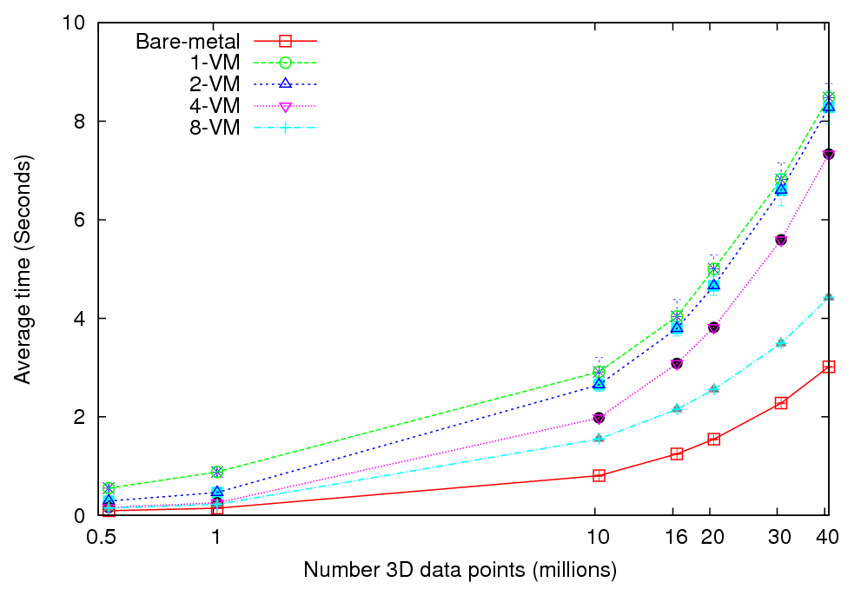
Kmeans Clustering - Performance
More VMs = better utilization?

Slide 22
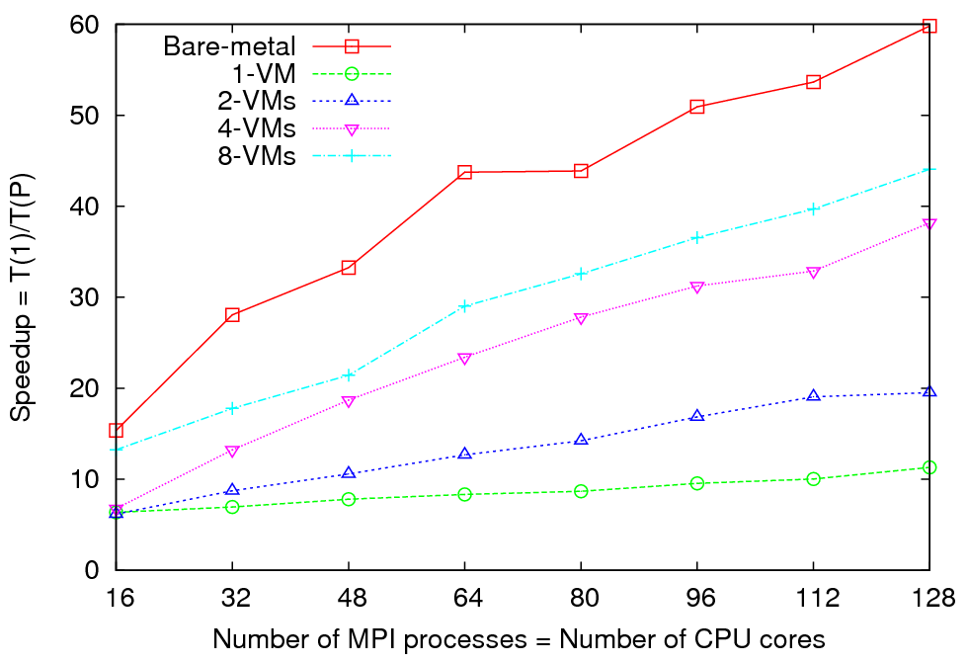
Kmeans Clustering - Speedup
Notes:
Performance and Overhead results are obtained using 16 nodes (128 cores) Each MPI process processes X/128 number of 3D data points. (0.5< X <40 ) millions. For speedup results, I used 860160 ( 0.8 million) 3D data points. Number of MPI processes= Number of CPU cores is shown in X axis.

