Slide 1
FutureGrid Overview
CTS Conference 2011
Philadelphia
May23 2011
Geoffrey Fox
gcf@indiana.edu
http://www.infomall.org https://portal.futuregrid.org
Director, Digital Science Center, Pervasive Technology Institute
Associate Dean for Research and Graduate Studies, School of Informatics and Computing
Indiana University Bloomington

Slide 2
US Cyberinfrastructure Context
There are a rich set of facilities
Production TeraGrid facilities with distributed and shared memory
Experimental “Track 2D” Awards
FutureGrid: Distributed Systems experiments cf. Grid5000
Keeneland: Powerful GPU Cluster
Gordon: Large (distributed) Shared memory system with SSD aimed at data analysis/visualization
Open Science Grid aimed at High Throughput computing and strong campus bridging

Slide 3
FutureGrid key Concepts I
FutureGrid is an international testbed modeled on Grid5000
Supporting international Computer Science and Computational Science research in cloud, grid and parallel computing (HPC)
Industry and Academia
The FutureGrid testbed provides to its users:
A flexible development and testing platform for middleware and application users looking at interoperability, functionality, performance or evaluation
Each use of FutureGrid is an experiment that is reproducible
A rich education and teaching platform for advanced cyberinfrastructure (computer science) classes

Slide 4
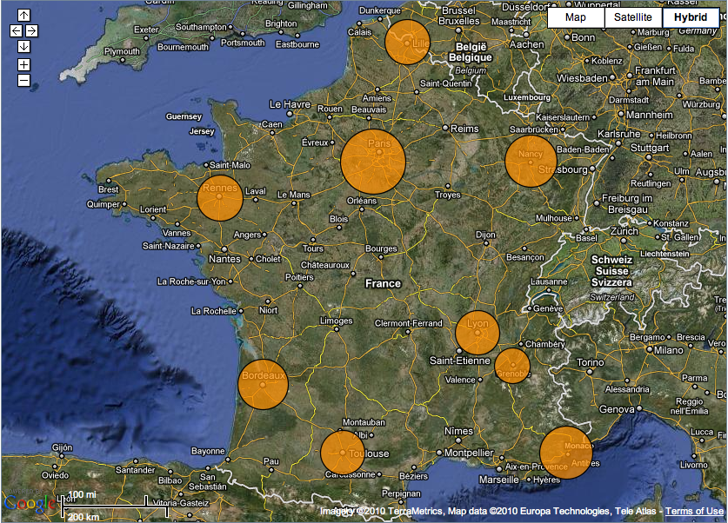
FutureGrid modeled on Grid’5000
Experimental testbed
Configurable, controllable, monitorable
Established in 2003
10 sites
9 in France
Porto Allegre in Brazil
~5000+ cores

Slide 5
FutureGrid key Concepts II
FutureGrid has a complementary focus to both the Open Science Grid and the other parts of TeraGrid.
FutureGrid is user-customizable, accessed interactively and supports Grid, Cloud and HPC software with and without virtualization.
FutureGrid is an experimental platform where computer science applications can explore many facets of distributed systems
and where domain sciences can explore various deployment scenarios and tuning parameters and in the future possibly migrate to the large-scale national Cyberinfrastructure.
FutureGrid supports Interoperability Testbeds – OGF really needed!
Note much of current use Education, Computer Science Systems and Biology/Bioinformatics

Slide 6
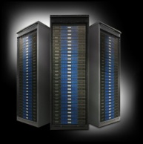
FutureGrid key Concepts III
Rather than loading images onto VM’s, FutureGrid supports Cloud, Grid and Parallel computing environments by dynamically provisioning software as needed onto “bare-metal” using Moab/xCAT
Image library for MPI, OpenMP, Hadoop, Dryad, gLite, Unicore, Globus, Xen, ScaleMP (distributed Shared Memory), Nimbus, Eucalyptus, OpenNebula, KVM, Windows …..
Growth comes from users depositing novel images in library
FutureGrid has ~4000 (will grow to ~5000) distributed cores with a dedicated network and a Spirent XGEM network fault and delay generator
Image1
Image2
…
ImageN
Choose
Load
Run

Slide 7
Dynamic Provisioning Results
Number of nodes
Time elapsed between requesting a job and the jobs reported start time on the provisioned node. The numbers here are an average of 2 sets of experiments.

Slide 8
FutureGrid Partners
Indiana University (Architecture, core software, Support)
Purdue University (HTC Hardware)
San Diego Supercomputer Center at University of California San Diego (INCA, Monitoring)
University of Chicago/Argonne National Labs (Nimbus)
University of Florida (ViNE, Education and Outreach)
University of Southern California Information Sciences (Pegasus to manage experiments)
University of Tennessee Knoxville (Benchmarking)
University of Texas at Austin/Texas Advanced Computing Center (Portal)
University of Virginia (OGF, Advisory Board and allocation)
Center for Information Services and GWT-TUD from Technische Universtität Dresden. (VAMPIR)
Red institutions have FutureGrid hardware

Slide 9
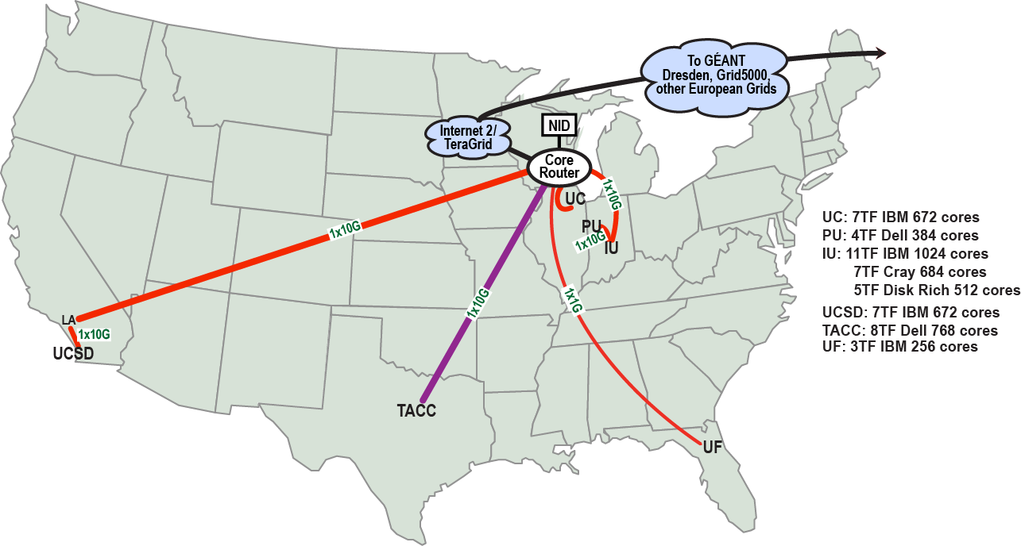
FutureGrid: a Grid/Cloud/HPC Testbed
NID: Network Impairment Device
Private Public
FG Network

Slide 10
Compute Hardware
System type | # CPUs | # Cores | TFLOPS | Total RAM (GB) | Secondary Storage (TB) | Site | Status
IBM iDataPlex | 256 | 1024 | 11 | 3072 | 339* | IU | Operational
Dell PowerEdge | 192 | 768 | 8 | 1152 | 30 | TACC | Operational
IBM iDataPlex | 168 | 672 | 7 | 2016 | 120 | UC | Operational
IBM iDataPlex | 168 | 672 | 7 | 2688 | 96 | SDSC | Operational
Cray XT5m | 168 | 672 | 6 | 1344 | 339* | IU | Operational
IBM iDataPlex | 64 | 256 | 2 | 768 | On Order | UF | Operational
Large disk/memory system TBD | 128 | 512 | 5 | 7680 | 768 on nodes | IU | New System TBD
High Throughput Cluster | 192 | 384 | 4 | 192 |  | PU | Not yet integrated
Total | 1336 | 4960 | 50 | 18912 | 1353

Slide 11
Storage Hardware
System Type | Capacity (TB) | File System | Site | Status
DDN 9550 (Data Capacitor) | 339 | Lustre | IU | Existing System
DDN 6620 | 120 | GPFS | UC | New System
SunFire x4170 | 96 | ZFS | SDSC | New System
Dell MD3000 | 30 | NFS | TACC | New System
Will add substantially more disk on node and at IU and UF as shared storage

Slide 12
Network Impairment Device
Spirent XGEM Network Impairments Simulator for jitter, errors, delay, etc
Full Bidirectional 10G w/64 byte packets
up to 15 seconds introduced delay (in 16ns increments)
0-100% introduced packet loss in .0001% increments
Packet manipulation in first 2000 bytes
up to 16k frame size
TCL for scripting, HTML for manual configuration

Slide 13
FutureGrid: Online Inca Summary

Slide 14
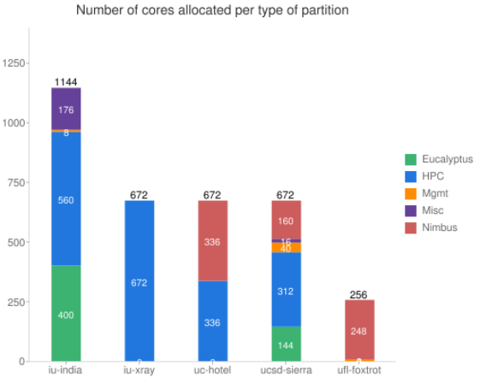
FutureGrid: Inca Monitoring

Slide 15
5 Use Types for FutureGrid
~100 approved projects over last 6 months
Training Education and Outreach
Semester and short events; promising for non research intensive universities
Interoperability test-beds
Grids and Clouds; Standards; Open Grid Forum OGF really needs
Domain Science applications
Life science highlighted
Computer science
Largest current category (> 50%)
Computer Systems Evaluation
TeraGrid (TIS, TAS, XSEDE), OSG, EGI
Clouds are meant to need less support than other models; FutureGrid needs more user support …….

Slide 16
Some Current FutureGrid projects I
Project | Institution | Details
Educational Projects
VSCSE Big Data | IU PTI, Michigan, NCSA and 10 sites | Over 200 students in week Long Virtual School of Computational Science and Engineering on Data Intensive Applications & Technologies
LSU Distributed Scientific Computing Class | LSU | 13 students use Eucalyptus and SAGA enhanced version of MapReduce
Topics on Systems: Cloud Computing CS Class | IU SOIC | 27 students in class using virtual machines, Twister, Hadoop and Dryad
Interoperability Projects
OGF Standards | Virginia, LSU, Poznan | Interoperability experiments between OGF standard Endpoints
Sky Computing | University of Rennes 1 | Over 1000 cores in 6 clusters across Grid’5000 & FutureGrid using ViNe and Nimbus to support Hadoop and BLAST demonstrated at OGF 29 June 2010

Slide 17
Some Current FutureGrid projects II
Domain Science Application Projects
Combustion | Cummins | Performance Analysis of codes aimed at engine efficiency and pollution
Cloud Technologies for Bioinformatics Applications | IU PTI | Performance analysis of pleasingly parallel/MapReduce applications on Linux, Windows, Hadoop, Dryad, Amazon, Azure with and without virtual machines
Computer Science Projects
Cumulus | Univ. of Chicago | Open Source Storage Cloud for Science based on Nimbus
Differentiated Leases for IaaS | University of Colorado | Deployment of always-on preemptible VMs to allow support of Condor based on demand volunteer computing
Application Energy Modeling | UCSD/SDSC | Fine-grained DC power measurements on HPC resources and power benchmark system
Evaluation and TeraGrid/OSG Support Projects
Use of VM’s in OSG | OSG, Chicago, Indiana | Develop virtual machines to run the services required for the operation of the OSG and deployment of VM based applications in OSG environments.
TeraGrid QA Test & Debugging | SDSC | Support TeraGrid software Quality Assurance working group
TeraGrid TAS/TIS | Buffalo/Texas | Support of XD Auditing and Insertion functions

Slide 18
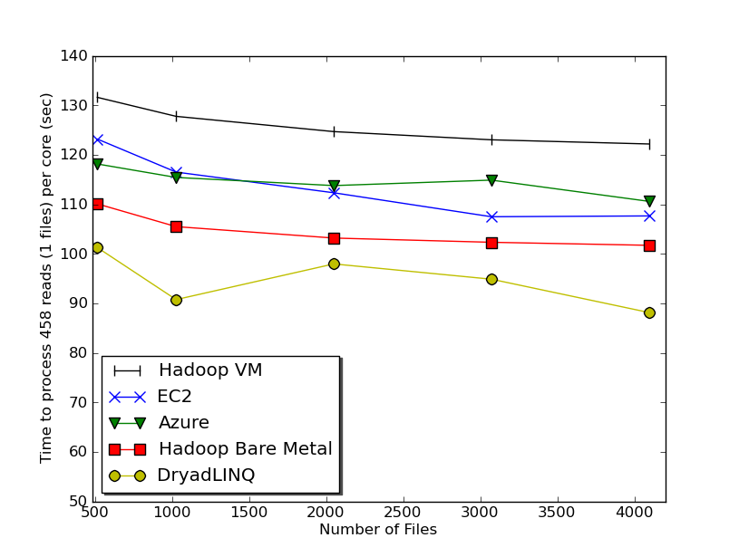
Typical FutureGrid Performance Study
Linux, Linux on VM, Windows, Azure, Amazon Bioinformatics

Slide 19
OGF’10 Demo from Rennes
SDSC
Rennes
Grid’5000 firewall
UF
Lille
UC
Sophia
ViNe provided the necessary inter-cloud connectivity to deploy CloudBLAST across 6 Nimbus sites, with a mix of public and private subnets.

Slide 20
Education & Outreach on FutureGrid
Build up tutorials on supported software
Support development of curricula requiring privileges and systems destruction capabilities that are hard to grant on conventional TeraGrid
Offer suite of appliances (customized VM based images) supporting online laboratories
Supported ~200 students in Virtual Summer School on “Big Data” July 26-30 with set of certified images – first offering of FutureGrid 101 Class; TeraGrid ‘10 “Cloud technologies, data-intensive science and the TG”; CloudCom conference tutorials Nov 30-Dec 3 2010
Experimental class use fall semester at Indiana, Florida and LSU; follow up core distributed system class Spring at IU
Offering ADMI (HBCU CS depts) Summer School on Clouds and REU program at Elizabeth City State University

Slide 21
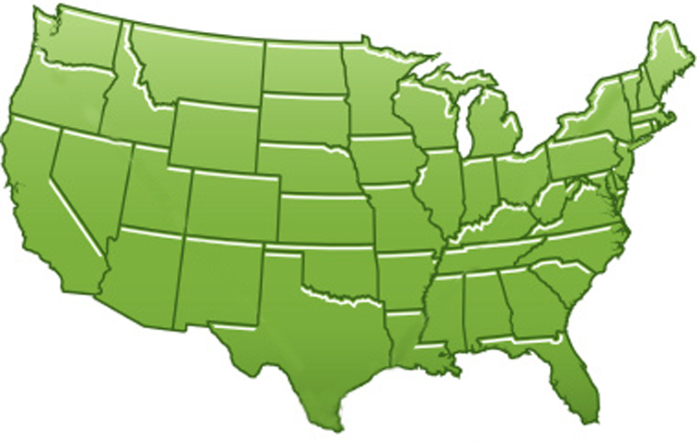
300+ Students learning about Twister & Hadoop
MapReduce technologies, supported by FutureGrid.
July 26-30, 2010 NCSA Summer School Workshop
http://salsahpc.indiana.edu/tutorial
Washington
University
University of
Minnesota
Michigan
State
Johns
Hopkins
Univ.Illinois
at Chicago
Iowa
Penn
State
IBM Almaden
Research Center
Notre
Dame
University of
California at
Los Angeles
Indiana
University
San Diego
Supercomputer
Center
University of
Texas at El Paso
University of
Arkansas
University
of Florida

Slide 22
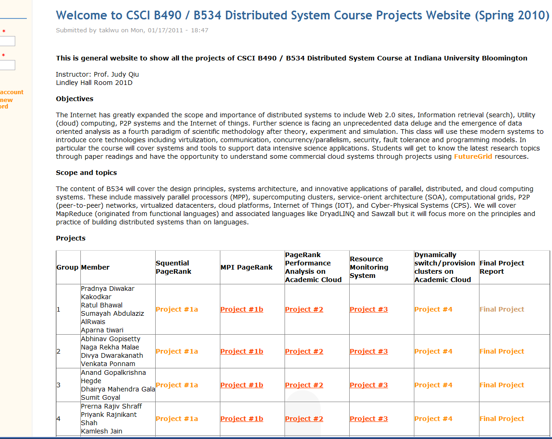
B534 Distributed Systems Class
17 3-4 person projects

Slide 23
FutureGrid Tutorials
Tutorial topic 3: Educational Virtual Appliances
Tutorial GA1: Introduction to the Grid Appliance
Tutorial GA2: Creating Grid Appliance Clusters
Tutorial GA3: Building an educational appliance from Ubuntu 10.04
Tutorial GA4: Deploying Grid Appliances using Nimbus
Tutorial GA5: Deploying Grid Appliances using Eucalyptus
Tutorial GA7: Customizing and registering Grid Appliance images using Eucalyptus
Tutorial MP1: MPI Virtual Clusters with the Grid Appliances and MPICH2
Tutorial topic 4: High Performance Computing
Tutorial VA1: Performance Analysis with Vampir
Tutorial VT1: Instrumentation and tracing with VampirTrace
Tutorial topic 1: Cloud Provisioning Platforms
Tutorial NM1: Using Nimbus on FutureGrid
Tutorial NM2: Nimbus One-click Cluster Guide
Tutorial GA6: Using the Grid Appliances to run FutureGrid Cloud Clients
Tutorial EU1: Using Eucalyptus on FutureGrid
Tutorial topic 2: Cloud Run-time Platforms
Tutorial HA1: Introduction to Hadoop using the Grid Appliance
Tutorial HA2: Running Hadoop on FG using Eucalyptus (.ppt)
Tutorial HA2: Running Hadoop on Eualyptus

Slide 24
Software Components
Portals including “Support” “use FutureGrid” “Outreach”
Monitoring – INCA, Power (GreenIT)
Experiment Manager: specify/workflow
Image Generation and Repository
Intercloud Networking ViNE
Virtual Clusters built with virtual networks
Performance library
Rain or Runtime Adaptable InsertioN Service for images
Security Authentication, Authorization,
Note Software integrated across institutions and between middleware and systems Management (Google docs, Jira, Mediawiki)
Note many software groups are also FG users
“Research”
Above and below
Nimbus OpenStack Eucalyptus

Slide 25
FutureGrid Software Architecture
Note on Authentication and Authorization
We have different environments and requirements from TeraGrid
Non trivial to integrate/align security model with TeraGrid

Slide 26
Detailed Software Architecture

Slide 27
Rain in FutureGrid

Slide 28
FG RAIN Command
Example ``rain'' a Hadoop environment defined by an user on a cluster.
fg-hadoop -n 8 -app myHadoopApp.jar …
fg-rain –h hostfile –iaas nimbus –image img
fg-rain –h hostfile –paas hadoop …
fg-rain –h hostfile –paas dryad …
fg-rain –h hostfile –gaas gLite …
fg-rain –h hostfile –image img
Authorization is required to use fg-rain without virtualization.

Slide 29
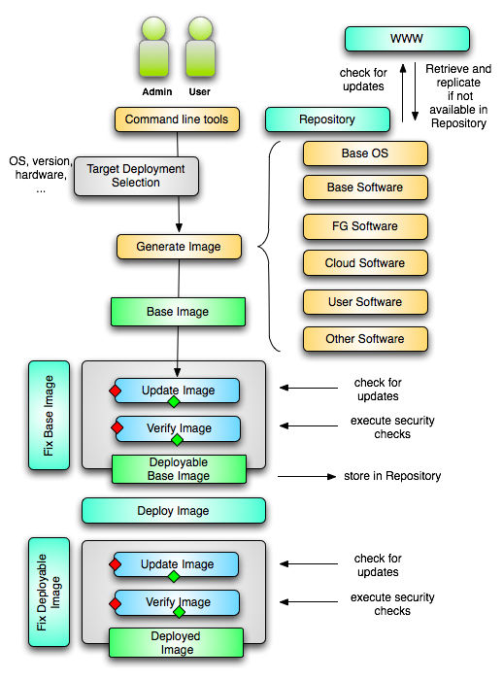
Image Creation
Creating deployable image
User chooses one base mages
User decides who can access the image; what additional software is on the image
Image gets generated; updated; and verified
Image gets deployed
Deployed image gets continuously
Updated; and verified
Note: Due to security requirement an image must be customized with authorization mechanism
limit the number of images through the strategy of "cloning" them from a number of base images.
users can build communities that encourage reuse of "their" images
features of images are exposed through metadata to the community
Administrators will use the same process to create the images that are vetted by them
Customize images in CMS

Slide 30
Portal Plans

Slide 31
FutureGrid Viral Growth Model
Users apply for a project
Users improve/develop some software in project
This project leads to new images which are placed in FutureGrid repository
Project report and other web pages document use of new images
Images are used by other users
And so on ad infinitum ………
Please bring your nifty software up on FutureGrid!!

