Slide 1
Getting Access to FutureGrid
CTS Conference 2011
Philadelphia
May23 2011
Geoffrey Fox
gcf@indiana.edu
http://www.infomall.org https://portal.futuregrid.org
Director, Digital Science Center, Pervasive Technology Institute
Associate Dean for Research and Graduate Studies, School of Informatics and Computing
Indiana University Bloomington

Slide 2
Portal Account, Projects, and System Accounts
The main entry point to get access to the systems and services is the FutureGrid Portal.
We distinguish the portal account from system and service accounts.
You may have multiple system accounts and may have to apply for them separately, e.g. Eucalyptus, Nimbus
Why several accounts:
Some services may not be important for you, so you will not need an account for all of them.
In future we may change this and have only one application step for all system services.
Some services may not be easily integratable in a general authentication framework

Slide 3
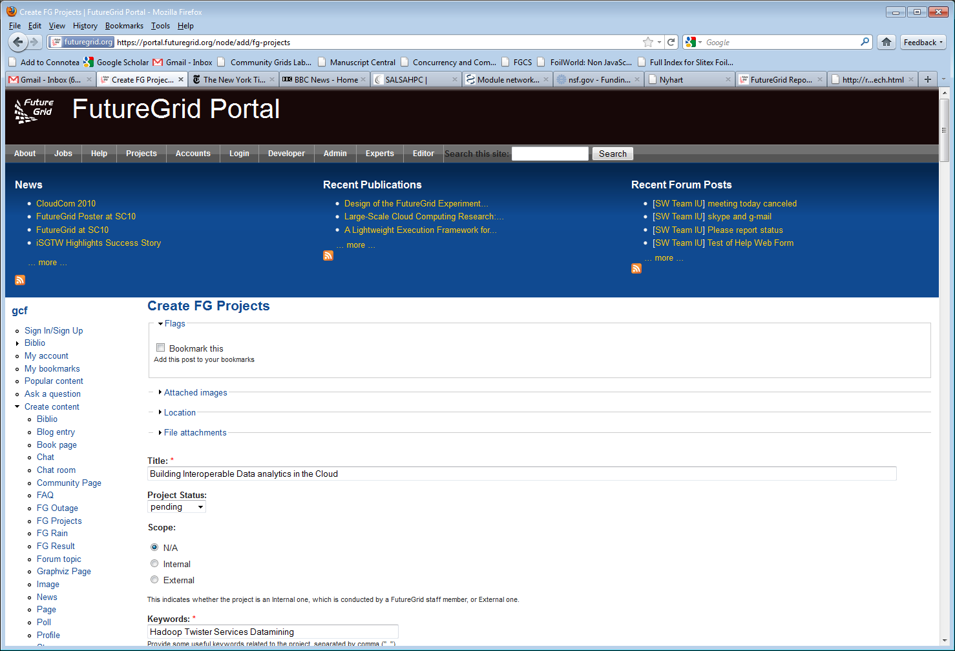
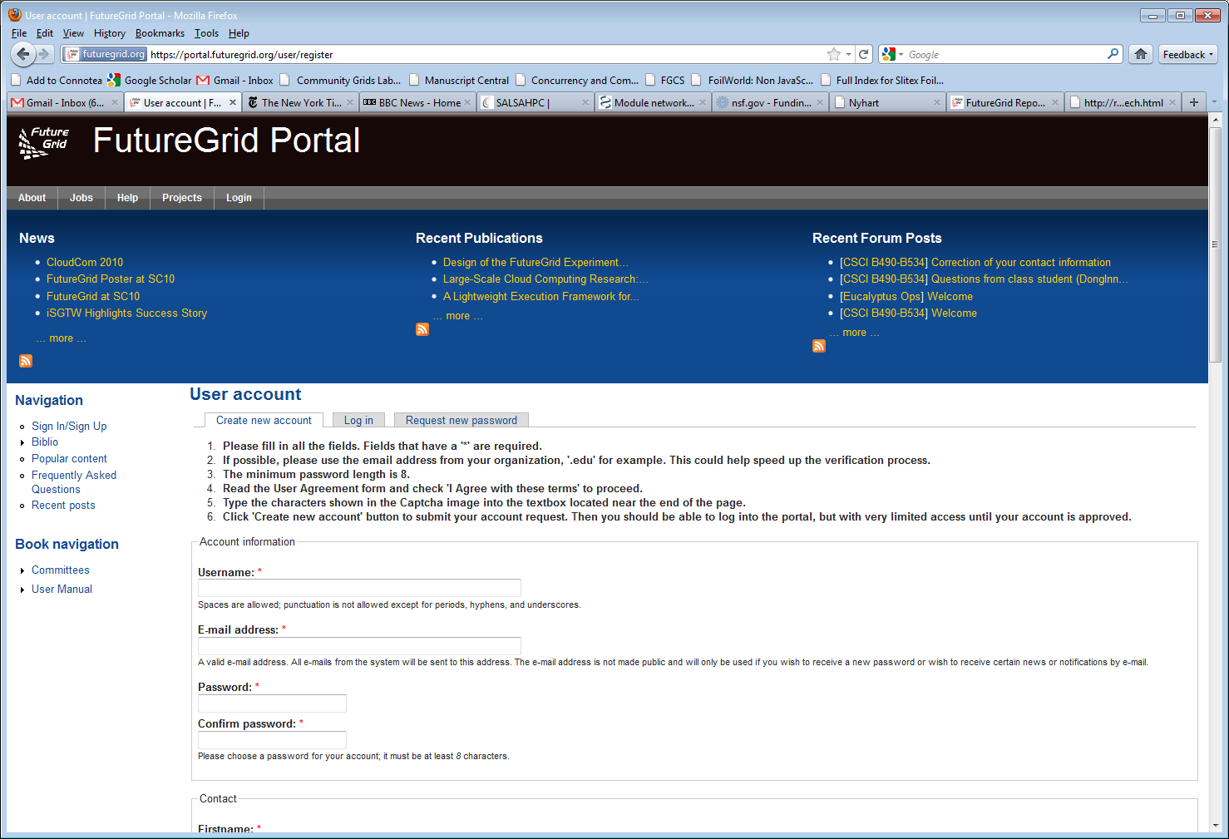
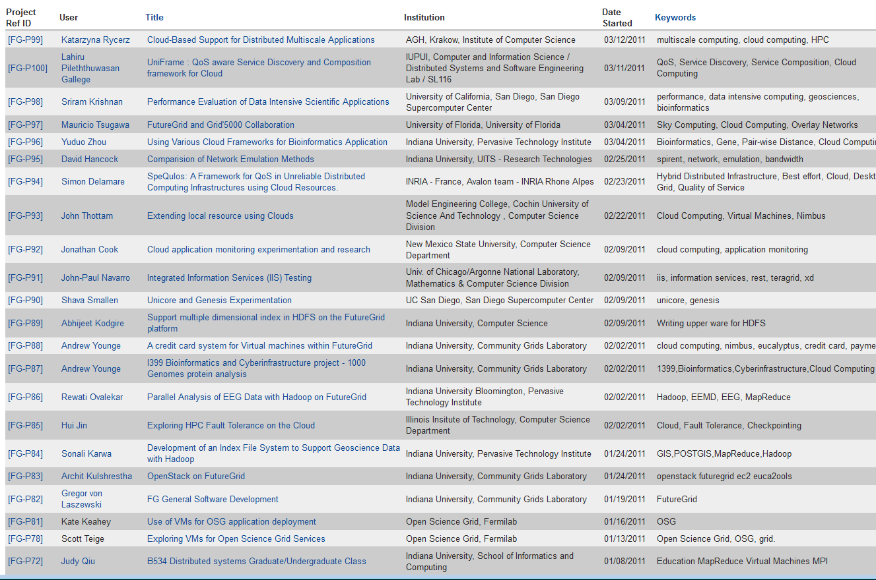
Create a Portal Account and apply for a Project

Slide 4
The Process: A new Project
(1) get a portal account
portal account is approved
(2) propose a project
project is approved
(3) ask your partners for their portal account names and add them to your projects as members
No further approval needed
(4) if you need an additional person being able to add members designate him as project manager (currently there can only be one).
No further approval needed
You are in charge who is added or not!
Similar model as in Web 2.0 Cloud services, e.g. sourceforge
(1)
(2)
(4)
(3)

Slide 5
The Process: Join A Project
(1) get a portal account
portal account is approved
Skip steps (2) – (4)
(2u) Communicate with your project lead which project to join and give him your portal account name
Next step done by project lead
(3) The project lead will add you to the project
You are responsible to make sure the project lead adds you!
Similar model as in Web 2.0 Cloud services, e.g. sourceforge
(1)
(2u)
(3)

Slide 6
Apply for a Portal Account

Slide 7
Apply for a Portal Account

Slide 8
Apply for a Portal Account
Please Fill Out.
Use proper capitalization
Use e-mail from your organization
Chose a strong password

Slide 9
Apply for a Portal Account
Please Fill Out.
Use proper department and university
Specify advisor or supervisors contact
Use the postal address, use proper capitalization

Slide 10
Apply for a Portal Account
Please Fill Out.
Report your citizenship
READ THE RESPONSIBILITY AGREEMENT
AGREE IF YOU DO. IF NOT CONTACT FG.
You may not be able to use it.

Slide 11
Wait
Wait till you get notified that you have a portal account.
Now you have a portal account (cont.)

Slide 12
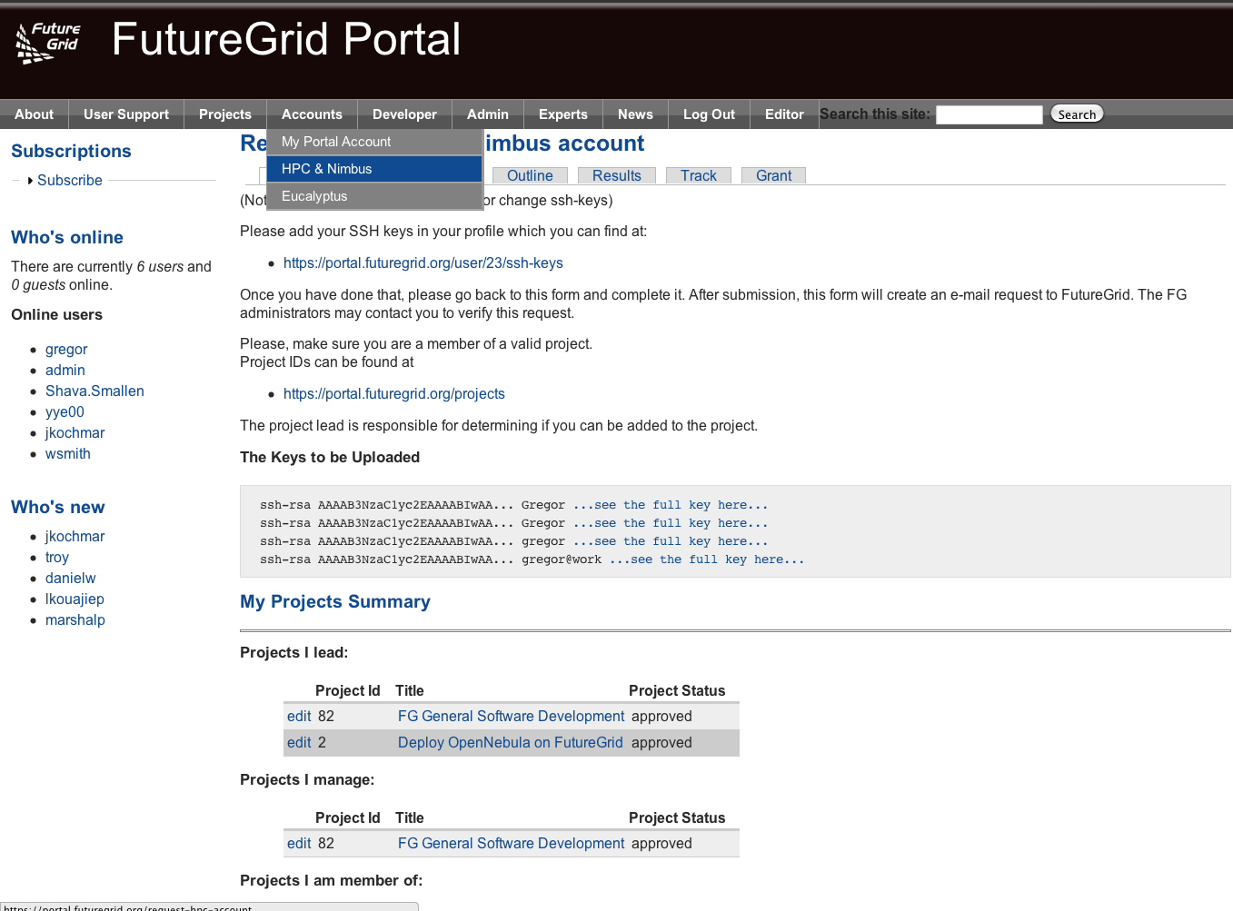
Apply for an HPC and Nimbus account
Login into the portal
Simple go to
Accounts-> HPC&Nimbus
(1) add you ssh keys
(3) make sure you are in a valid project
(2) wait for 24 business hours
(for tutorial users we accelerate)
No accounts will be granted between Friday 5pm EST – Monday 9 am EST

Slide 13
Check your Account Status
Goto:
Accounts-My Portal Account
Check if the account status bar is green
Errors wil indicate an issue or a task that requires waiting
Since you are already here:
Upload a portrait
Check if you have other things that need updating
Add ssh keys if needed

Slide 14
Wait
HPC Account creation | Wait time
India | 24 hours
Sierra | 24 hours + x min
Xray | 24 hours + x min
Alamo | 24 hours + x min
Hotel | 24 hours + x min
Foxtrot | 24 hours + x min
Bravo | 24 hours + x min
Once you have everything green, you have an HPC and a Nimbus account.
PROPAGATION OF THE ACCOUNTS TO NIMBUS CURRENTLY REQUIRES AN ADDITIONAL 30 – 60 minutes
For the impatient please check your Portal account page
Service creation | Wait time
Eucalyptus | 24 hours
Nimbus | HPC account creation + x min
Hours = Business hours!!!!!!!!!

Slide 15
Eucalyptus Account Creation
Use the Eucalyptus Web Interfaces at https://eucalyptus.india.futuregrid.org:8443/
On the Login page click on Apply for account.
On the next page that pops up fill out ALL the Mandatory AND optional fields of the form.
Once complete click on signup and the Eucalyptus administrator will be notified of the account request.
You will get an email once the account has been approved.
Click on the link provided in the email to confirm and complete the account creation process.
http://futuregrid.org

