Slide 1

Cloud Computing for K-12
Gregor von Laszewski
laszewski@gmail.com
Indiana University
Tom Hacker
tjhacker@purdue.edu
Purdue University

Slide 2
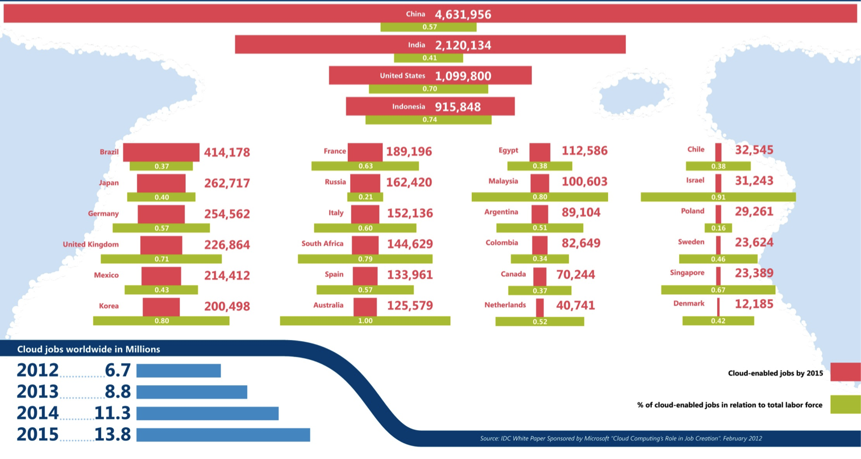
Why is it important for you:
Possibly a way to finance your hobbies
Job Market

Slide 3

Why is it important for me: It is cool!

Slide 4
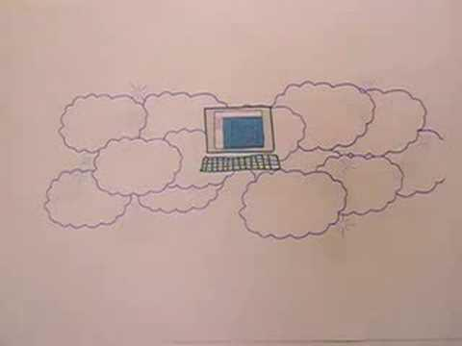
Introduction to Cloud Computing
Source: GoGrid

Slide 5


Clouds as Cost Effective Data Centers
Clouds can be considered as just the best biggest data centers
Right is 2 Google warehouses of computers on the banks of the Columbia River, in The Dalles, Oregon
Left is shipping container (each with 200-1000 servers) model used in Microsoft Chicago data center holding 150-220
Data Center Part | Cost in small-sized Data Center | Cost in Large Data Center | Ratio
Network | $95 per Mbps/ month | $13 per Mbps/ month | 7.1
Storage | $2.20 per GB/ month | $0.40 per GB/ month | 5.7
Administration | ~140 servers/ Administrator | >1000 Servers/ Administrator | 7.1

Slide 6
Some Sizes in 2010
http://www.mediafire.com/file/zzqna34282frr2f/koomeydatacenterelectuse2011finalversion.pdf
30 million servers worldwide
Google had 900,000 servers (3% total world wide)
Google total power ~200 Megawatts
  < 1% of total power used in data centers (Google more efficient than average – Clouds are Green!)
  ~ 0.01% of total power used on anything world wide
Maybe total clouds are 20% total world server count (a growing fraction)

Slide 7
Outline of the next sections
Software
As a Service
Platform as a Service
Infrastructure as a Service

Slide 8
Infrastructure, Platforms, Software as a Service
Software Services are building blocks of applications
The middleware or computing environment
We will cover virtual clusters, networks, management systems Nimbus, Eucalyptus, OpenStack

Slide 9
Application
Platform as a Service
Infrastructure as a Service

Slide 10
Infrastructure as a Service
Public Cloud
Amazon
MS Based
Azure
OpenStack based
HP cloud
Rackspace
....
Private Cloud
IaaS
  Eucalyptus
  OpenStack
  OpenNebula
  ...
  Nimbus

Slide 11
Application
Platform as a Service
Infrastructure as a Service

Slide 12
Platform as a Service
Azure
  Map Reduce
Google Apps
Amazon Elastic Beanstalk
Cloud Foundry
Heroku
...
"identify" a platform that is right for you, making the choice of an IaaS a secondary decision.

Slide 13
Map Reduce
"Map" step:
(a) The master node takes the input,
(b) divides it into smaller sub-problems
(c) distributes them to worker nodes.
A worker node may do this again in turn, leading to a multi-level tree structure.
The worker node processes the smaller problem, and passes the answer back to its master node.
"Reduce" step:
(a) The master node then collects the answers to all the sub-problems and
(b) combines them in some way to form the output
(c) the answer to the problem it was originally trying to solve.

Slide 14
4 Forms of MapReduce
(a) Map Only
(b) Classic MapReduce
(c) Iterative MapReduce
(d) Loosely Synchronous
Input
Input
Iterations
Input
map
map
map
P_{ij}
reduce
reduce
Output
BLAST Analysis
Parametric sweep
Pleasingly Parallel
High Energy Physics (HEP) Histograms
Distributed search
Expectation maximization Clustering e.g. Kmeans
Linear Algebra, Page Rank
Classic MPI
PDE Solvers and particle dynamics
Domain of MapReduce and Iterative Extensions
Science Clouds
MPI
Exascale

Slide 15
Software
as a Service
Platform as a Service
Infrastructure as a Service

Slide 16
Writing Documents/Presentations
The Good
Documents are stored for you
In case of hardware failure the document is in the cloud
I can share my documents
I can work on projects in a team
Risks
Someone else has access to your document
The cloud can fail to (disk, network)
I make mistakes while sharing documents that I did not want to share
My teammates destroyed my work
Sophisticated cheating becomes possible

Slide 17
Cloud Services in General
Music
  Pandora
  iTunes
  Last.FM
Documents
  Google Docs
  Microsoft live.com
  IBM Lotus Live
E-mail, Calendar
  Google, Yahoo, Microsoft, ...
Videos
  YouTube
Social Media
  twitter
  facebook
  LinkedIn
Bibliography
  Google Scholar, Microsoft Academic Searc, Mendelay, Zotero, ISI Web of Knowledge
Computing
  ...

Slide 18

Applications: Apache Mahout
Source Apache

Slide 19
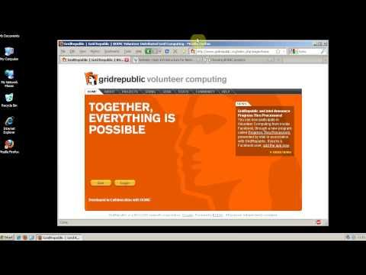
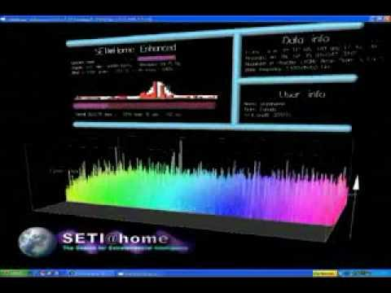
Volunteer Computing &
Testbeds
Seti@Home
Planet Lab
http://youtube.googleapis.com/v/G8C0JXpeABc
http://youtube.googleapis.com/v/_kG4xpM47uE

Slide 20
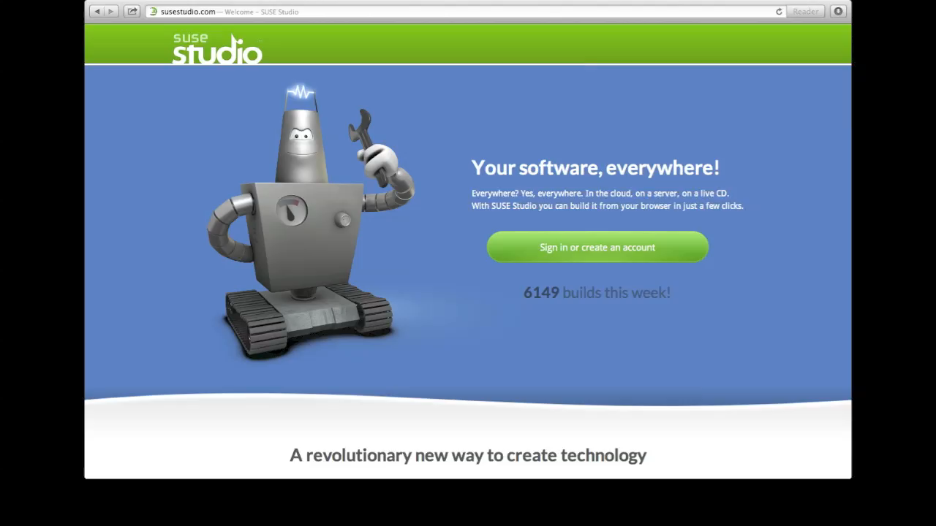
Lets go to a cloud

Slide 21
Its Cool!

