Slide 1
Science of Cloud Computing
Panel Cloud2011
Washington DC
July 5 2011
Geoffrey Fox
gcf@indiana.edu
http://www.infomall.org http://www.futuregrid.org
Director, Digital Science Center, Pervasive Technology Institute
Associate Dean for Research and Graduate Studies, School of Informatics and Computing
Indiana University Bloomington

Slide 2
Science of or with
Cloud Computing?
In that cloud computing is likely to dominate “mainstream” data center computing, any science of useful computing implies there is a science of clouds
Research issues for Clouds:
  Computer Science
  Computational Science – are clouds useful for science – if clouds provide most cost effective computing, lets hope they are
Clouds provide Infrastructure – elastic computing on demand – useful and important and cost effective
Clouds were developed for large scale data services and associated platforms are transformational for data enabled science
  Clouds match the data deluge

Slide 3
Clouds and Grids/HPC
Synchronization/communication Performance
Grids > Clouds > HPC Systems
Clouds appear to execute effectively Grid workloads but are not easily used for closely coupled HPC applications
Service Oriented Architectures and workflow appear to work similarly in both grids and clouds
Assume for immediate future, science supported by a mixture of
  Clouds
  Grids/High Throughput Systems (moving to clouds as convenient)
  Supercomputers (“MPI Engines”) going to exascale

Slide 4
Authentication and Authorization: Provide single sign in to All system architectures
Workflow: Support workflows that link job components between Grids and Clouds.
Provenance: Continues to be critical to record all processing and data sources
Data Transport: Transport data between job components on Grids and Commercial Clouds respecting custom storage patterns like Lustre v HDFS
Program Library: Store Images and other Program material
Blob: Basic storage concept similar to Azure Blob or Amazon S3
DPFS Data Parallel File System: Support of file systems like Google (MapReduce), HDFS (Hadoop) or Cosmos (dryad) with compute-data affinity optimized for data processing
Table: Support of Table Data structures modeled on Apache Hbase/CouchDB or Amazon SimpleDB/Azure Table. There is “Big” and “Little” tables – generally NOSQL
SQL: Relational Database
Queues: Publish Subscribe based queuing system
Worker Role: This concept is implicitly used in both Amazon and TeraGrid but was (first) introduced as a high level construct by Azure. Naturally support Elastic Utility Computing
MapReduce: Support MapReduce Programming model including Hadoop on Linux, Dryad on Windows HPCS and Twister on Windows and Linux. Need Iteration for Datamining
Software as a Service: This concept is shared between Clouds and Grids
Web Role: This is used in Azure to describe user interface and can be supported by portals in Grid or HPC systems
Components of a Scientific Computing Platform

Slide 5






MapReduce “File/Data Repository” Parallelism
Map = (data parallel) computation reading and writing data
Reduce = Collective/Consolidation phase e.g. forming multiple global sums as in histogram
Instruments
Iterative MapReduce
Map Map Map Map
Reduce Reduce Reduce
Communication
Reduce
Portals
/Users
Disks
Map₁
Map₂
Map₃

Slide 6

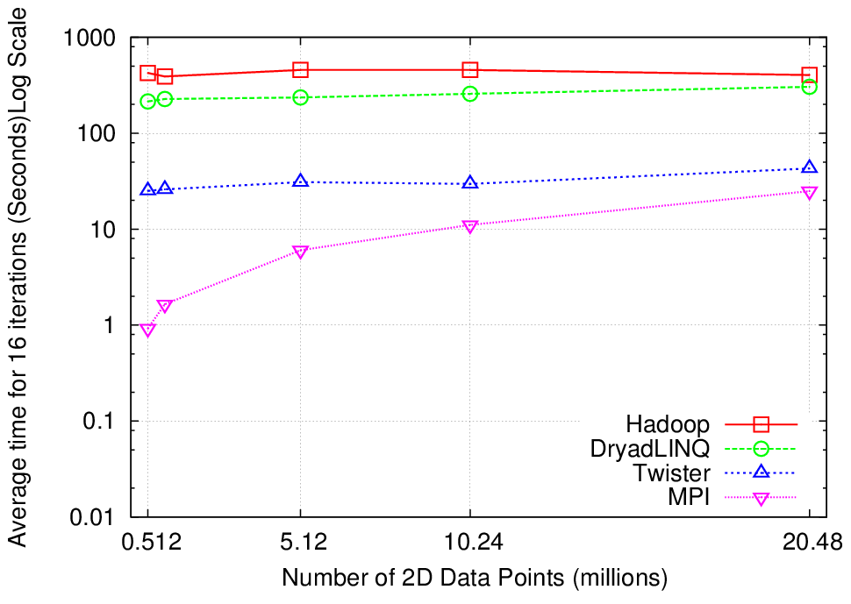
Why Iterative MapReduce? K-means
http://www.iterativemapreduce.org/
Compute the distance to each data point from each cluster center and assign points to cluster centers
map
map
Time for 20 iterations
reduce
Compute new cluster
centers
User program
Compute new cluster centers
Typical iterative data analysis
Typical MapReduce runtimes incur extremely high overheads
  New maps/reducers/vertices in every iteration
  File system based communication
Long running tasks and faster communication in Twister (Iterative MapReduce) enables it to perform close to MPI

Slide 7
The Power of Cloud Platforms: Twister4Azure Architecture

Slide 8
Research Issues for
(Iterative) MapReduce
Quantify and Extend that Data analysis for Science seems to work well on Iterative MapReduce and clouds so far.
  Iterative MapReduce spans all architectures as unifying idea
Performance and Fault Tolerance Trade-offs;
  Writing to disk each iteration (as in Hadoop) naturally lowers performance but increases fault-tolerance
  Integration of GPU’s
Security and Privacy technology and policy essential for use in many biomedical applications
Storage: multi-user data parallel file systems have scheduling and management
  NOSQL and SciDB on virtualized and HPC systems
Data parallel Data analysis languages: Sawzall and Pig Latin more successful than HPF?
Scheduling: How does research here fit into scheduling built into clouds and Iterative MapReduce (Hadoop)
  important load balancing issues for MapReduce for heterogeneous workloads

Slide 9
Traditional File System?
S
Data
C
C
C
C
S
C
C
C
C
Archive
Data
S
C
C
C
C
Data
C
C
C
C
S
Data
Compute Cluster
Storage Nodes
Typically a shared file system (Lustre, NFS …) used to support high performance computing
Big advantages in flexible computing on shared data but doesn’t “bring computing to data”

Slide 10
Data Parallel File System?
Block1
Replicate each block
File1
Block2
……
Breakup
BlockN
C
C
C
C
Data
Data
Data
Data
C
C
C
C
Data
Data
Data
Data
C
C
C
C
Data
Data
Data
Data
C
C
C
C
Data
Data
Data
Data
Block1
File1
Block2
……
Breakup
Replicate each block
BlockN
No archival storage and computing brought to data

Slide 11
FutureGrid key Concepts I
FutureGrid is an international testbed modeled on Grid5000
Supporting international Computer Science and Computational Science research in cloud, grid and parallel computing (HPC)
  Industry and Academia
  Note much of current use Education, Computer Science Systems and Biology/Bioinformatics
The FutureGrid testbed provides to its users:
  A flexible development and testing platform for middleware and application users looking at interoperability, functionality, performance or evaluation
  Each use of FutureGrid is an experiment that is reproducible
  A rich education and teaching platform for advanced cyberinfrastructure (computer science) classes

Slide 12

FutureGrid key Concepts II
Rather than loading images onto VM’s, FutureGrid supports Cloud, Grid and Parallel computing environments by dynamically provisioning software as needed onto “bare-metal” using Moab/xCAT
  Image library for MPI, OpenMP, Hadoop, Dryad, gLite, Unicore, Globus, Xen, ScaleMP (distributed Shared Memory), Nimbus, Eucalyptus, OpenNebula, KVM, Windows …..
Growth comes from users depositing novel images in library
FutureGrid has ~4000 (will grow to ~5000) distributed cores with a dedicated network and a Spirent XGEM network fault and delay generator
Image1
Image2
…
ImageN
Choose
Load
Run

Slide 13

FutureGrid: a Grid/Cloud/HPC Testbed
NID: Network Impairment Device
Private
Public
FG Network

Slide 14
FutureGrid Partners
Indiana University (Architecture, core software, Support)
Purdue University (HTC Hardware)
San Diego Supercomputer Center at University of California San Diego (INCA, Monitoring)
University of Chicago/Argonne National Labs (Nimbus)
University of Florida (ViNE, Education and Outreach)
University of Southern California Information Sciences (Pegasus to manage experiments)
University of Tennessee Knoxville (Benchmarking)
University of Texas at Austin/Texas Advanced Computing Center (Portal)
University of Virginia (OGF, Advisory Board and allocation)
Center for Information Services and GWT-TUD from Technische Universtität Dresden. (VAMPIR)
Red institutions have FutureGrid hardware

Slide 15
5 Use Types for FutureGrid
~122 approved projects over last 10 months
Training Education and Outreach (11%)
  Semester and short events; promising for non research intensive universities
Interoperability test-beds (3%)
  Grids and Clouds; Standards; Open Grid Forum OGF really needs
Domain Science applications (34%)
  Life sciences highlighted (17%)
  Computer science (41%)
  Largest current category
Computer Systems Evaluation (29%)
  TeraGrid (TIS, TAS, XSEDE), OSG, EGI, Campuses
Clouds are meant to need less support than other models; FutureGrid needs more user support …….

Slide 16
Software Components
Portals including “Support” “use FutureGrid” “Outreach”
Monitoring – INCA, Power (GreenIT)
Experiment Manager: specify/workflow
Image Generation and Repository
Intercloud Networking ViNE
Virtual Clusters built with virtual networks
Performance library
Rain or Runtime Adaptable InsertioN Service for images
Security Authentication, Authorization,
“Research”
Above and below
Nimbus OpenStack Eucalyptus

