Slide 1
Experimenting with FutureGrid
CloudCom 2010 Conference
Indianapolis
December 2 2010
Geoffrey Fox
gcf@indiana.edu
http://www.infomall.org http://www.futuregrid.org
Director, Digital Science Center, Pervasive Technology Institute
Associate Dean for Research and Graduate Studies, School of Informatics and Computing
Indiana University Bloomington

Slide 2
Are clouds for you?
You have learnt about Azure, MapReduce (Hadoop) and could have learnt at conference about
Eucalyptus, Nimbus, OpenNebula, RackSpace, OpenStack, Twister, Sector/Sphere, Standards (CDMI OCCI …), Security ….
You might of learnt about Google App Engine, GoGrid etc.
How do you decide what to do?
NSF and the State of Indiana can possibly help!

Slide 3
FutureGrid key Concepts I
FutureGrid is an international testbed modeled on Grid5000
Supporting international Computer Science and Computational Science research in cloud, grid and parallel computing
Industry and Academia
Prototype software development and Education/Training
The FutureGrid testbed provides to its users:
A flexible development and testing platform for middleware and application users looking at interoperability, functionality and performance, exploring new computing paradigms
Each use of FutureGrid is an experiment that is reproducible
A rich education and teaching platform for advanced cyberinfrastructure classes
Support for users experimentation
Apply now to use FutureGrid on web site www.futuregrid.org

Slide 4
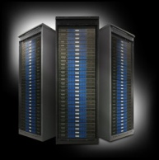
FutureGrid key Concepts II
Rather than loading images onto VM’s, FutureGrid supports Cloud, Grid and Parallel computing environments by dynamically provisioning software as needed onto “bare-metal” using Moab/xCAT
Image library for all the different environments you might like to explore …..
Growth comes from users depositing novel images in library
Maximizes need for FG Systems Admins; minimizes your need
FutureGrid has ~4000 (will grow to ~5000) distributed cores with a dedicated network and a Spirent XGEM network fault and delay generator
Image1
Image2
…
ImageN
Choose
Load
Run

Slide 5
FutureGrid Partners
Indiana University (Architecture, core software, Support)
Collaboration between research and infrastructure groups
Purdue University (HTC Hardware)
San Diego Supercomputer Center at University of California San Diego (INCA, Monitoring)
University of Chicago/Argonne National Labs (Nimbus)
University of Florida (ViNE, Education and Outreach)
University of Southern California Information Sciences (Pegasus to manage experiments)
University of Tennessee Knoxville (Benchmarking)
University of Texas at Austin/Texas Advanced Computing Center (Portal)
University of Virginia (OGF, Advisory Board and allocation)
Center for Information Services and GWT-TUD from Technische Universtität Dresden. (VAMPIR)
Red institutions have FutureGrid hardware

Slide 6
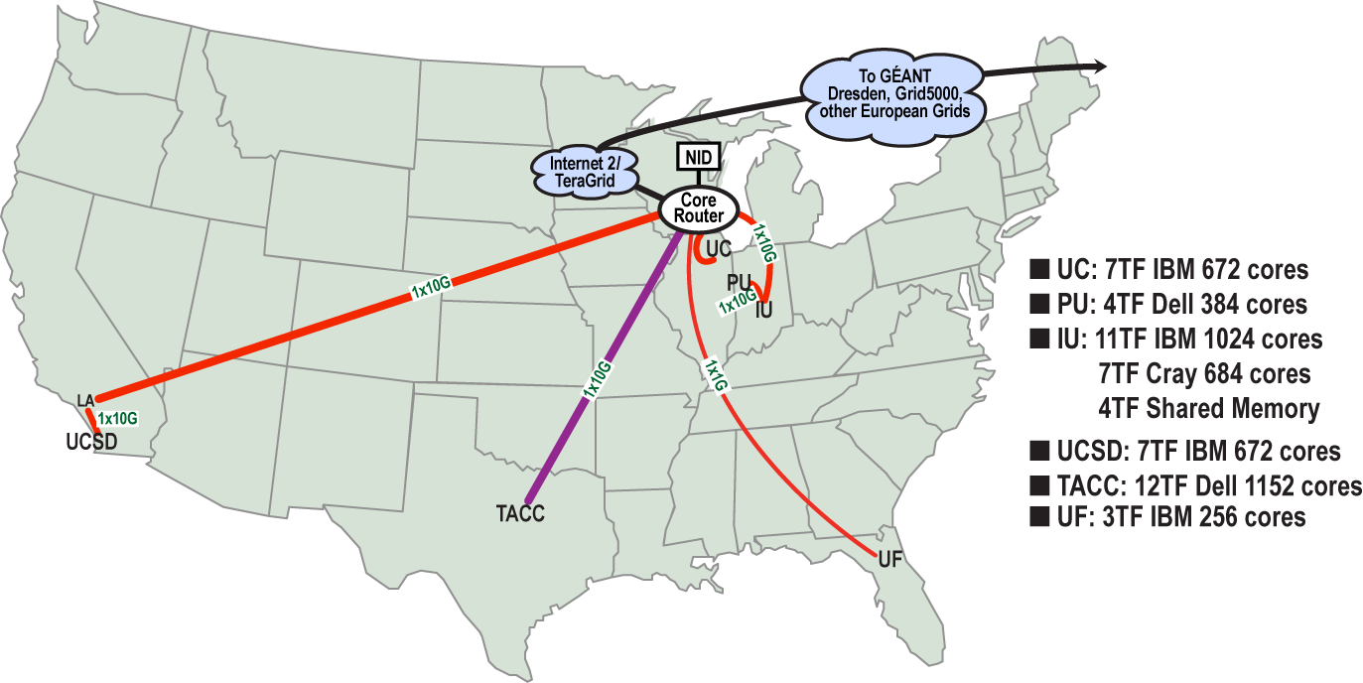
FutureGrid: a Grid/Cloud/HPC Testbed
NID: Network Impairment Device
Private Public
FG Network

Slide 7
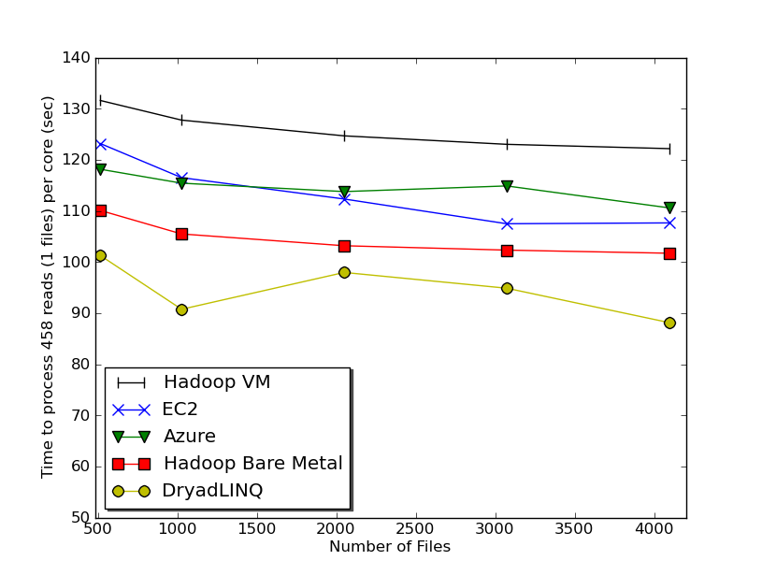
Typical Performance Study
Linux, Linux on VM, Windows, Azure, Amazon Bioinformatics

Slide 8
OGF’10 Demo
SDSC
Rennes
Grid’5000 firewall
UF
Lille
UC
Sophia
ViNe provided the necessary inter-cloud connectivity to deploy CloudBLAST across 5 Nimbus sites, with a mix of public and private subnets.

Slide 9
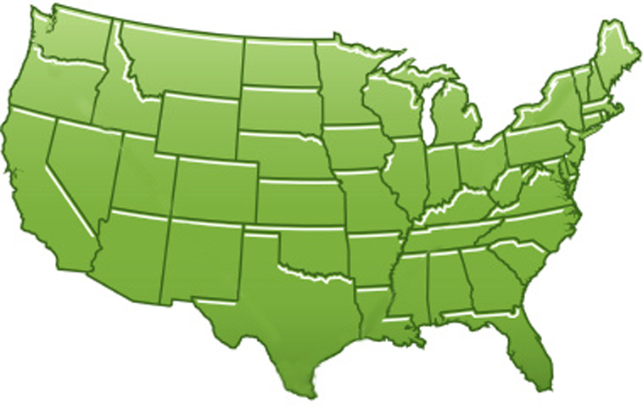
300+ Students learning about Twister & Hadoop
MapReduce technologies, supported by FutureGrid.
July 26-30, 2010 NCSA Summer School Workshop
http://salsahpc.indiana.edu/tutorial
Washington
University
University of
Minnesota
Michigan
State
Johns
Hopkins
Univ.Illinois
at Chicago
Iowa
State
Penn
State
IBM Almaden
Research Center
Notre
Dame
University of
California at
Los Angeles
Indiana
University
San Diego
Supercomputer
Center
University of
Texas at El Paso
University of
Arkansas
University
of Florida

Slide 10
User Support
Being upgraded now as we get into major use
Regular support: there is a group forming FET or “FutureGrid Expert Team” – initially 12 PhD students and researchers from Indiana University
User requests project at http://www.futuregrid.org/early-adopter-account-project-registration
Each user assigned a member of FET when project approved
Users given accounts when project approved
FET member and user interact to get going on FutureGrid
Advanced User Support: limited special support available on request
Cummins engine simulation supported in this way

Slide 11
FutureGrid Viral Growth Model
Users apply for a project
Users improve/develop some software in project
This project leads to new images which are placed in FutureGrid repository
Project report and other web pages document use of new images
Images are used by other users
And so on ad infinitum ………

Slide 12
FutureGrid Interaction with Commercial Clouds
We support environments on FutureGrid – Nimbus, Eucalyptus, OpenNebula Openstack -- that are similar to Commercial Clouds and natural for performance and functionality comparisons
These can both be used to prepare for using Commercial Clouds and as the most likely starting point for porting to them
Simplest is use of virtual machines
Sophisticated example is support of MapReduce-like environments on FutureGrid including Hadoop on Linux and Dryad on Windows
Expertise and support porting to Commercial Clouds from other Windows or Linux environments
Comparisons between and integration of multiple commercial Cloud environments – especially Amazon and Azure in the immediate future
Tutorials and expertise to help users move to Commercial Clouds from other environments

