Slide 1
FutureGrid
Cloud Technologies and Bioinformatics Applications
CloudCom 2009
Beijing Jiaotong University
Beijing December 2 2009
Geoffrey Fox
gcf@indiana.edu http://salsaweb.ads.iu.edu/salsa
Community Grids Laboratory
Pervasive Technology Institute
Indiana University
Notes:
SALSA is
Service Aggregated Linked Sequential Activities

Slide 2
FutureGrid
The goal of FutureGrid is to support the research on the future of distributed, grid, and cloud computing.
FutureGrid will build a robustly managed simulation environment or testbed to support the development and early use in science of new technologies at all levels of the software stack: from networking to middleware to scientific applications.
The environment will mimic TeraGrid and/or general parallel and distributed systems – FutureGrid is part of TeraGrid and one of two experimental TeraGrid systems (other is GPU)
This test-bed will succeed if it enables major advances in science and engineering through collaborative development of science applications and related software.
FutureGrid is a (small >5000 core) Science/Computer Science Cloud but it is more accurately a virtual machine based simulation environment

Slide 3
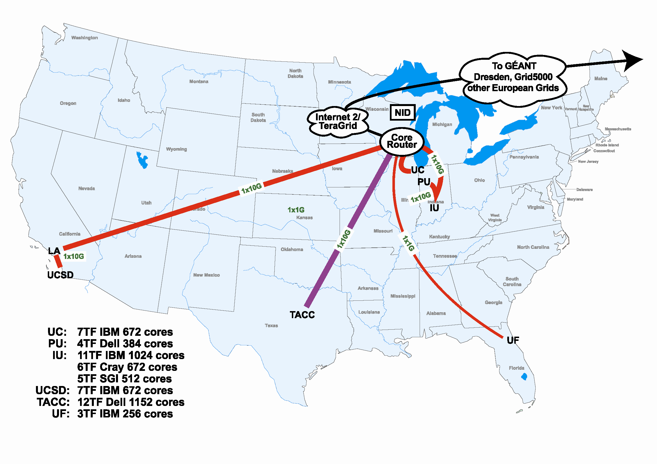
FutureGrid Hardware

Slide 4
Compute Hardware
System type | # CPUs | # Cores | TFLOPS | Total RAM (GB) | Secondary Storage (TB) | Site | Status
Dynamically configurable systems
IBM iDataPlex | 256 | 1024 | 11 | 3072 | 339* | IU | New System
Dell PowerEdge | 192 | 1152 | 8 | 1152 | 15 | TACC | New System
IBM iDataPlex | 168 | 672 | 7 | 2016 | 120 | UC | New System
IBM iDataPlex | 168 | 672 | 7 | 2688 | 72 | SDSC | Existing System
Subtotal | 784 | 3520 | 33 | 8928 | 546
Systems possibly not dynamically configurable
Cray XT5m | 168 | 672 | 6 | 1344 | 339* | IU | New System
Shared memory system TBD | 40 | 480 | 4 | 640 | 339* | IU | New System 4Q2010
Cell BE Cluster | 4 | 80 | 1 | 64 |  | IU | Existing System
IBM iDataPlex | 64 | 256 | 2 | 768 | 1 | UF | New System
High Throughput Cluster | 192 | 384 | 4 | 192 |  | PU | Existing System
Subtotal | 468 | 1872 | 17 | 3008 | 1
Total | 1252 | 5392 | 50 | 11936 | 547

Slide 5
Storage Hardware
System Type | Capacity (TB) | File System | Site | Status
DDN 9550 (Data Capacitor) | 339 | Lustre | IU | Existing System
DDN 6620 | 120 | GPFS | UC | New System
SunFire x4170 | 72 | Lustre/PVFS | SDSC | New System
Dell MD3000 | 30 | NFS | TACC | New System
FutureGrid has dedicated network (except to TACC) and a network fault and delay generator
Can isolate experiments on request; IU runs Network for NLR/Internet2
Additional partner machines could run FutureGrid software and be supported (but allocated in specialized ways)

Slide 6

Network Impairments Device
Spirent XGEM Network Impairments Simulator for jitter, errors, delay, etc
Full Bidirectional 10G w/64 byte packets
up to 15 seconds introduced delay (in 16ns increments)
0-100% introduced packet loss in .0001% increments
Packet manipulation in first 2000 bytes
up to 16k frame size
TCL for scripting, HTML for human configuration

Slide 7
FutureGrid Partners
Indiana University (Architecture, core software, Support)
Purdue University (HTC Hardware)
San Diego Supercomputer Center at University of California San Diego (INCA, Monitoring)
University of Chicago/Argonne National Labs (Nimbus)
University of Florida (ViNE, Education and Outreach)
University of Southern California Information Sciences Institute (Pegasus to manage experiments)
University of Tennessee Knoxville (Benchmarking)
University of Texas at Austin/Texas Advanced Computing Center (Portal)
University of Virginia (OGF, Advisory Board and allocation)
Center for Information Services and GWT-TUD from Technische Universtität Dresden Germany. (VAMPIR)
Blue institutions have FutureGrid hardware

Slide 8
Other Important Collaborators
NSF
Early users from an application and computer science perspective and from both research and education
Grid5000/Aladdin and D-Grid in Europe
Commercial partners such as
  Eucalyptus ….
  Microsoft (Dryad + Azure) – Note current Azure external to FutureGrid as are GPU systems
  Application partners
TeraGrid
Open Grid Forum
Possibly Open Nebula, Open Cirrus Testbed, Open Cloud Consortium, Cloud Computing Interoperability Forum. IBM-Google-NSF Cloud, and other DoE/NSF/… clouds
China, Japan, Korea, Australia, other Europe … ?

Slide 9
FutureGrid Usage Scenarios
Developers of end-user applications who want to develop new applications in cloud or grid environments, including analogs of commercial cloud environments such as Amazon or Google.
  Is a Science Cloud for me? Is my application secure?
Developers of end-user applications who want to experiment with multiple hardware environments.
Grid/Cloud middleware developers who want to evaluate new versions of middleware or new systems.
Networking researchers who want to test and compare different networking solutions in support of grid and cloud applications and middleware. (Some types of networking research will likely best be done via through the GENI program.)
Education as well as research
Interest in performance requires that bare metal important

Slide 10
Selected FutureGrid Timeline
October 1 2009 Project Starts
November 16-19 SC09 Demo/F2F Committee Meetings/Chat up collaborators
January 2010 – Significant Hardware available
March 2010 FutureGrid network complete
March 2010 FutureGrid Annual Meeting
April 2010 Many early users
September 2010 All hardware (except Track IIC lookalike) accepted
October 1 2011 FutureGrid allocatable via TeraGrid process – first two years by user/science board led by Andrew Grimshaw

Slide 11
FutureGrid Architecture

Slide 12
FutureGrid Architecture
Open Architecture allows to configure resources based on images
Managed images allows to create similar experiment environments
Experiment management allows reproducible activities
Through our modular design we allow different clouds and images to be “rained” upon hardware.
Note will be supported 24x7 at “TeraGrid Production Quality”
Will support deployment of “important” middleware including TeraGrid stack, Condor, BOINC, gLite, Unicore, Genesis II

Slide 13
RAIN: Dynamic Provisioning
Change underlying system to support current user demands
Linux, Windows, Xen, Nimbus, Eucalyptus
Stateless images
  Shorter boot times
  Easier to maintain
Stateful installs
  Windows
Use moab to trigger changes and xCAT to manage installs

Slide 14

FutureGrid is a new part of TeraGrid
Several Postdoc and
Software Engineer Positions open
Please apply

Slide 15
SALSA
Dynamic Virtual Cluster Hosting
Monitoring Infrastructure
SW-G Using Hadoop
SW-G Using Hadoop
SW-G Using DryadLINQ
SW-G Using Hadoop
SW-G Using Hadoop
SW-G Using DryadLINQ
Linux
Bare-system
Linux on Xen
Windows Server 2008 Bare-system
Cluster Switching from Linux Bare-system to Xen VMs to Windows 2008 HPC
xCAT Infrastructure
iDataplex Bare-metal Nodes (32 nodes)
SW-G : Smith Waterman Gotoh Dissimilarity Computation
– A typical MapReduce style application

Slide 16
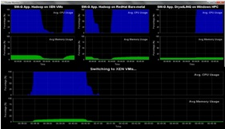
Monitoring Infrastructure
Monitoring Interface
Pub/Sub Broker Network
Virtual/Physical Clusters
Summarizer
xCAT Infrastructure
Switcher
iDataplex Bare-metal Nodes
(32 nodes)

Slide 17
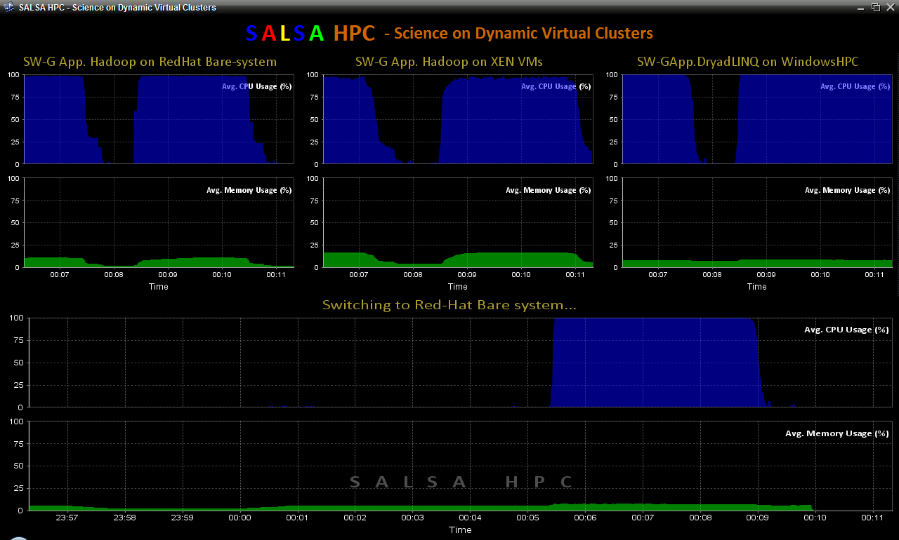
SALSA HPC Dynamic Virtual Clusters

Slide 18
Collaborators in SALSA Project
Microsoft Research
Technology Collaboration
Azure (Clouds)
Dennis Gannon
Roger Barga
Dryad (Parallel Runtime)
Christophe Poulain
CCR (Threading)
George Chrysanthakopoulos
DSS (Services)
Henrik Frystyk Nielsen
Indiana University
SALSA Technology Team
Geoffrey Fox
Judy Qiu
Scott Beason
Jaliya Ekanayake
Thilina Gunarathne
Thilina Gunarathne
Jong Youl Choi
Yang Ruan
Seung-Hee Bae
Hui Li
Saliya Ekanayake
Applications
Bioinformatics, CGB
Haixu Tang, Mina Rho,
Peter Cherbas, Qunfeng Dong
IU Medical School
Gilbert Liu
Demographics (Polis Center)
Neil Devadasan
Cheminformatics
David Wild, Qian Zhu
Physics
CMS group at Caltech (Julian Bunn)
Community Grids Lab
and UITS RT – PTI

Slide 19
Cluster Configurations
Feature | GCB-K18 @ MSR | iDataplex @ IU | Tempest @ IU
CPU | Intel Xeon CPU L5420 2.50GHz | Intel Xeon CPU L5420 2.50GHz | Intel Xeon CPU E7450 2.40GHz
# CPU /# Cores per node | 2 / 8 | 2 / 8 | 4 / 24
Memory | 16 GB | 32GB | 48GB
# Disks | 2 | 1 | 2
Network | Giga bit Ethernet | Giga bit Ethernet | Giga bit Ethernet / 20 Gbps Infiniband
Operating System | Windows Server Enterprise - 64 bit | Red Hat Enterprise Linux Server -64 bit | Windows Server Enterprise - 64 bit
# Nodes Used | 32 | 32 | 32
Total CPU Cores Used | 256 | 256 | 768
DryadLINQ
Hadoop/ Dryad / MPI
DryadLINQ / MPI

Slide 20
Science Cloud (Dynamic Virtual Cluster) Architecture
Smith Waterman Dissimilarities, CAP-3 Gene Assembly, PhyloD Using DryadLINQ, High Energy Physics, Clustering, Multidimensional Scaling, Generative Topological Mapping
Applications
Runtimes
Apache Hadoop / MapReduce++ / MPI
Microsoft DryadLINQ / MPI
Linux Bare-system
Linux Virtual Machines
Windows Server 2008 HPC
Bare-system
Windows Server 2008 HPC
Infrastructure software
Xen Virtualization
Xen Virtualization
xCAT Infrastructure
Hardware
iDataplex Bare-metal Nodes
Dynamic Virtual Cluster provisioning via xCAT
Supports both stateful and stateless OS images

Slide 21






MapReduce “File/Data Repository” Parallelism
Map = (data parallel) computation reading and writing data
Reduce = Collective/Consolidation phase e.g. forming multiple global sums as in histogram
Instruments
Iterative MapReduce
Map Map Map Map
Reduce Reduce Reduce
Communication
Reduce
Portals
/Users
Disks
Map₁
Map₂
Map₃

Slide 22
Cloud Computing: Infrastructure and Runtimes
Cloud infrastructure: outsourcing of servers, computing, data, file space, utility computing, etc.
  Handled through Web services that control virtual machine lifecycles.
Cloud runtimes: tools (for using clouds) to do data-parallel computations.
  Apache Hadoop, Google MapReduce, Microsoft Dryad, and others
  Designed for information retrieval but are excellent for a wide range of science data analysis applications
  Can also do much traditional parallel computing for data-mining if extended to support iterative operations
  Not usually on Virtual Machines

Slide 23
Application Classes
Old classification of Parallel software/hardware
in terms of 5 (becoming 6) “Application architecture” Structures)
1 | Synchronous | Lockstep Operation as in SIMD architectures
2 | Loosely Synchronous | Iterative Compute-Communication stages with independent compute (map) operations for each CPU. Heart of most MPI jobs | MPP
3 | Asynchronous | Compute Chess; Combinatorial Search often supported by dynamic threads | MPP
4 | Pleasingly Parallel | Each component independent – in 1988, Fox estimated at 20% of total number of applications | Grids
5 | Metaproblems | Coarse grain (asynchronous) combinations of classes 1)-4). The preserve of workflow. | Grids
6 | MapReduce++ | It describes file(database) to file(database) operations which has subcategories including. Pleasingly Parallel Map Only Map followed by reductions Iterative “Map followed by reductions” – Extension of Current Technologies that supports much linear algebra and datamining | Clouds
Notes:
CGL-MapReduce is an example of MapReduce++ -- supports MapReduce model with iteration (data stays in memory and communication via streams not files)

Slide 24
Applications & Different Interconnection Patterns
Map Only | Classic MapReduce | Iterative Reductions MapReduce++ | Loosely Synchronous
CAP3 Analysis Document conversion (PDF -> HTML) Brute force searches in cryptography Parametric sweeps | High Energy Physics (HEP) Histograms SWG gene alignment Distributed search Distributed sorting Information retrieval | Expectation maximization algorithms Clustering Linear Algebra | Many MPI scientific applications utilizing wide variety of communication constructs including local interactions
- CAP3 Gene Assembly - PolarGrid Matlab data analysis | - Information Retrieval - HEP Data Analysis - Calculation of Pairwise Distances for ALU Sequences | Kmeans Deterministic Annealing Clustering - Multidimensional Scaling MDS | - Solving Differential Equations and - particle dynamics with short range forces
Input
iterations
Input
Input
map
map
map
Pij
reduce
Output
reduce
Domain of MapReduce and Iterative Extensions
MPI

Slide 25
Some Life Sciences Applications
EST (Expressed Sequence Tag) sequence assembly program using DNA sequence assembly program software CAP3.
Metagenomics and Alu repetition alignment using Smith Waterman dissimilarity computations followed by MPI applications for Clustering and MDS (Multi Dimensional Scaling) for dimension reduction before visualization
Correlating Childhood obesity with environmental factors by combining medical records with Geographical Information data with over 100 attributes using correlation computation, MDS and genetic algorithms for choosing optimal environmental factors.
Mapping the 26 million entries in PubChem into two or three dimensions to aid selection of related chemicals with convenient Google Earth like Browser. This uses either hierarchical MDS (which cannot be applied directly as O(N²)) or GTM (Generative Topographic Mapping).

Slide 26
Alu and Sequencing Workflow
Data is a collection of N sequences – 100’s of characters long
  These cannot be thought of as vectors because there are missing characters
  “Multiple Sequence Alignment” (creating vectors of characters) doesn’t seem to work if N larger than O(100)
Can calculate N² dissimilarities (distances) between sequences (all pairs)
Find families by clustering (much better methods than Kmeans). As no vectors, use vector free O(N²) methods
Map to 3D for visualization using Multidimensional Scaling MDS – also O(N²)
N = 50,000 runs in 10 hours (all above) on 768 cores
Our collaborators just gave us 170,000 sequences and want to look at 1.5 million – will develop new algorithms!
MapReduce++ will do all steps as MDS, Clustering just need MPI Broadcast/Reduce

Slide 27
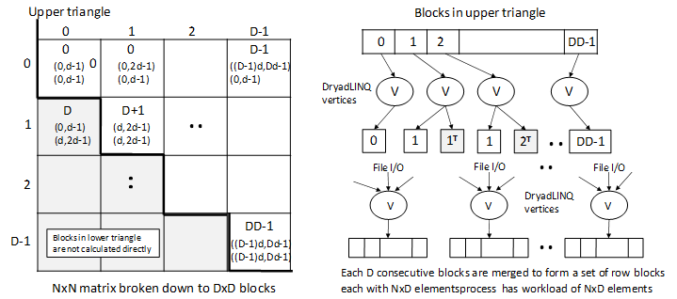
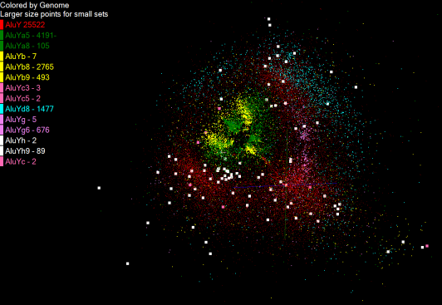
Pairwise Distances – ALU Sequences
125 million distances
4 hours & 46 minutes
Calculate pairwise distances for a collection of genes (used for clustering, MDS)
O(N^2) problem
“Doubly Data Parallel” at Dryad Stage
Performance close to MPI
Performed on 768 cores (Tempest Cluster)
Processes work better than threads when used inside vertices
100% utilization vs. 70%
Notes:
1~180 lines without threading in DryadLINQ, with threading, it is about 400 lines
MPI ~500 lines
The Alu clustering problem [27] is one of the most challenging problems for sequencing clustering because Alus represent the largest repeat families in human genome. There are about 1 million copies of Alu sequences in human genome, in which most insertions can be found in other primates and only a small fraction (~ 7000) are human-specific. This indicates that the classification of Alu repeats can be deduced solely from the 1 million human Alu elements. Notable, Alu clustering can be viewed as a classical case study for the capacity of computational infrastructures because it is not only of great intrinsic biological interests, but also a problem of a scale that will remain as the upper limit of many other clustering problem in bioinformatics for the next few years, e.g. the automated protein family classification for a few millions of proteins predicted from large metagenomics projects. In our work here we examine Alu samples of 35339 and 50,000 sequences.

Slide 28

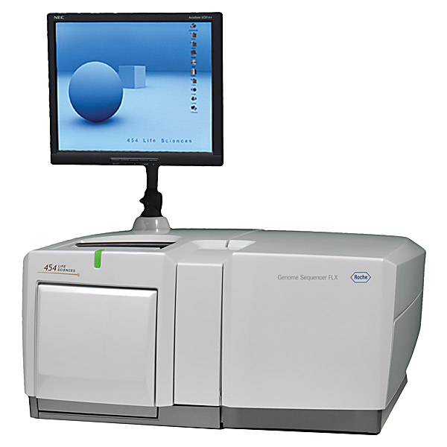
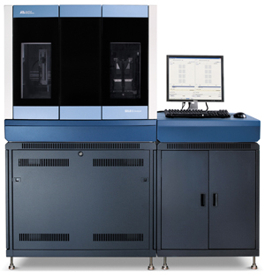

DNA Sequencing Pipeline
Illumina/Solexa Roche/454 Life Sciences Applied Biosystems/SOLiD
Internet
~300 million base pairs per day leading to
~3000 sequences per day per instrument
? 500 instruments at ~0.5M$ each
Read Alignment
Pairwise
clustering
Form block
Pairings
Sequence
alignment
Dissimilarity
Matrix
N(N-1)/2 values
Visualization
Plotviz
FASTA File
N Sequences
Blocking
MPI
MDS
MapReduce

Slide 29
Hadoop/Dryad Model
Block Arrangement in Dryad
and Hadoop
Execution Model in Dryad
and Hadoop
Need to generate a single file with full NxN distance matrix

Slide 30


Slide 31


Slide 32
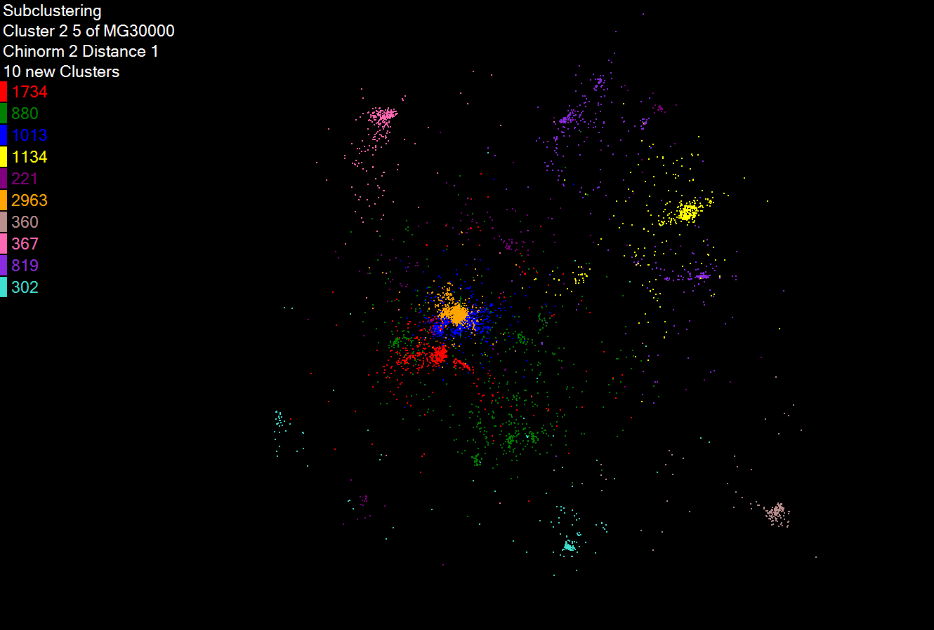
Hierarchical Subclustering

Slide 33
Pairwise Clustering
30,000 Points on Tempest

Slide 34
Dryad versus MPI for Smith Waterman
Flat is perfect scaling

Slide 35
Hadoop/Dryad Comparison
Inhomogeneous Data I
Inhomogeneity of data does not have a significant effect when the sequence lengths are randomly distributed
Dryad with Windows HPCS compared to Hadoop with Linux RHEL on Idataplex (32 nodes)
Notes:
10k data size

Slide 36
Hadoop/Dryad Comparison
Inhomogeneous Data II
This shows the natural load balancing of Hadoop MR dynamic task assignment using a global pipe line in contrast to the DryadLinq static assignment
Dryad with Windows HPCS compared to Hadoop with Linux RHEL on Idataplex (32 nodes)
Notes:
10k data size

Slide 37
Hadoop VM Performance Degradation
Perf. Degradation = (T_{vm} – T_{baremetal})/T_{baremetal}
15.3% Degradation at largest data set size

Slide 38
MapReduce++ (CGL-MapReduce)
Pub/Sub Broker Network
Map Worker
M
Worker Nodes
R
Reduce Worker
D
D
MR
Driver
User
Program
D
MRDeamon
M
M
M
M
R
R
R
R
Communication
Data Split
File System
Streaming based communication
Intermediate results are directly transferred from the map tasks to the reduce tasks – eliminates local files
Cacheable map/reduce tasks - Static data remains in memory
Combine phase to combine reductions
User Program is the composer of MapReduce computations
Extends the MapReduce model to iterative computations
Allow runtime to be invoked from MPI (later)

Slide 39


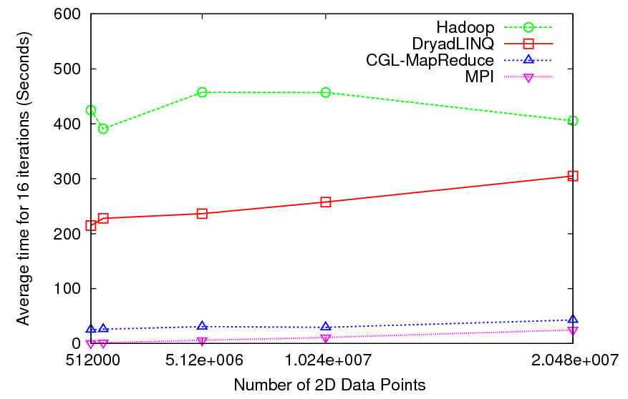
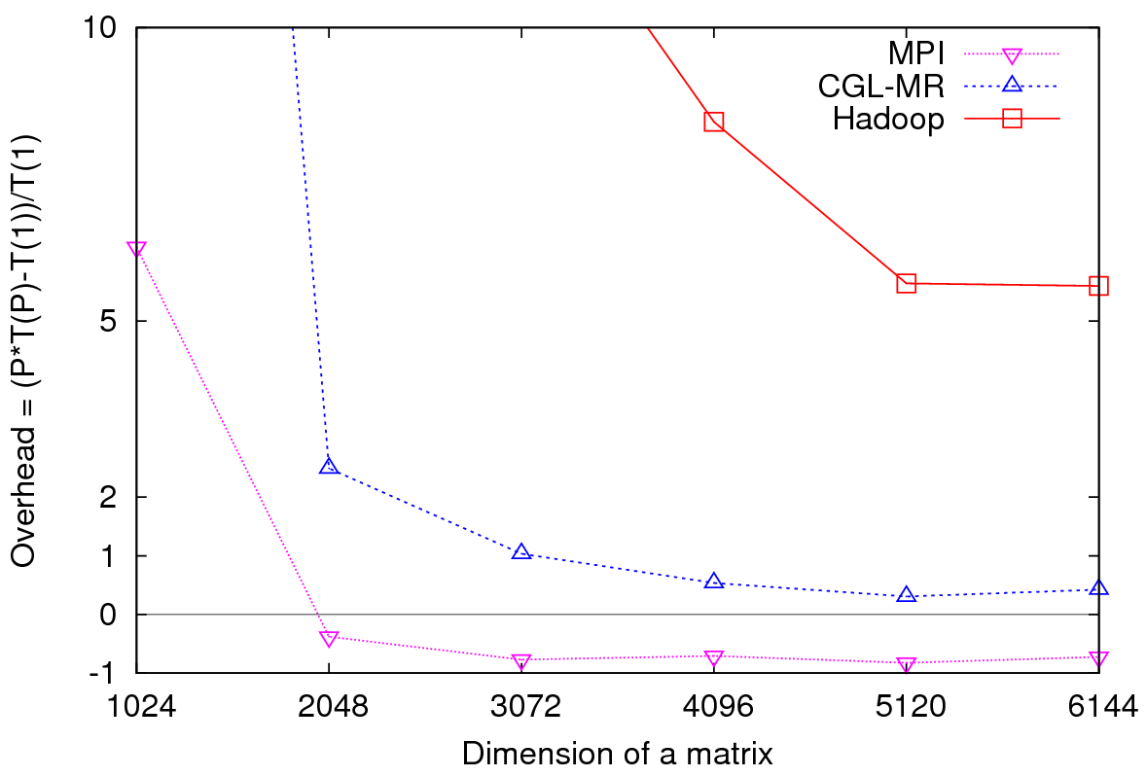
Iterative Computations
K-means
Matrix Multiplication
Performance of K-Means
Parallel Overhead Matrix Multiplication

Slide 40
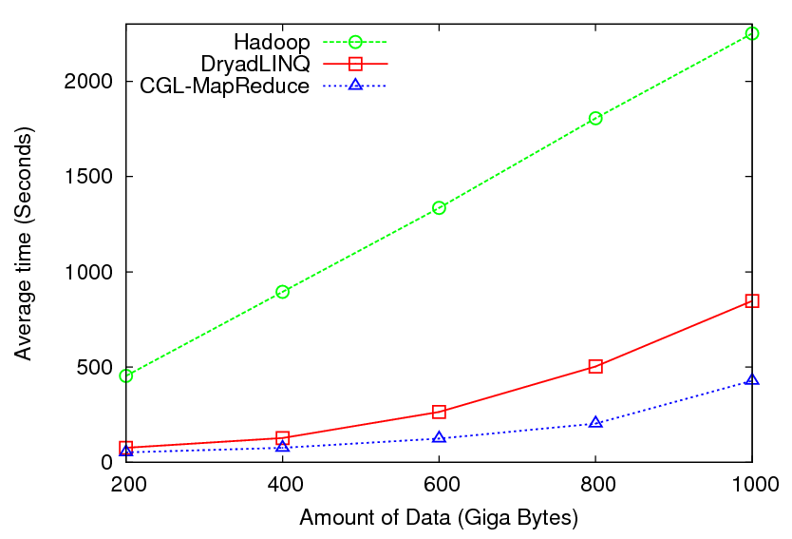

High Energy Physics Data Analysis
Histogramming of events from a large (up to 1TB) data set
Data analysis requires ROOT framework (ROOT Interpreted Scripts)
Performance depends on disk access speeds
Hadoop implementation uses a shared parallel file system (Lustre)
  ROOT scripts cannot access data from HDFS
  On demand data movement has significant overhead
Dryad stores data in local disks
  Better performance

Slide 41

Reduce Phase of Particle Physics
“Find the Higgs” using Dryad
Higgs in Monte Carlo
Combine Histograms produced by separate Root “Maps” (of event data to partial histograms) into a single Histogram delivered to Client

Slide 42
High Performance
Dimension Reduction and Visualization
Need is pervasive
  Large and high dimensional data are everywhere: biology, physics, Internet, …
  Visualization can help data analysis
Visualization with high performance
  Map high-dimensional data into low dimensions.
  Need high performance for processing large data
  Developing high performance visualization algorithms: MDS(Multi-dimensional Scaling), GTM(Generative Topographic Mapping), DA-MDS(Deterministic Annealing MDS), DA-GTM(Deterministic Annealing GTM), …
Notes:
MDS (Multi-dimensional Scaling)
GTM (Generative Topographic Mapping)
DA-MDS(Deterministic Annealing MDS)
DA-GTM(Deterministic Annealing GTM)

Slide 43
Analysis of 26 Million PubChem Entries
26 million PubChem compounds with 166 features
  Drug discovery
  Bioassay
3D visualization for data exploration/mining
  Mapping by O(N²) MDS(Multi-dimensional Scaling) and
  O(N) (but needs vectors) GTM(Generative Topographic Mapping)
  Interactive visualization tool PlotViz
  Discover hidden structures

Slide 44
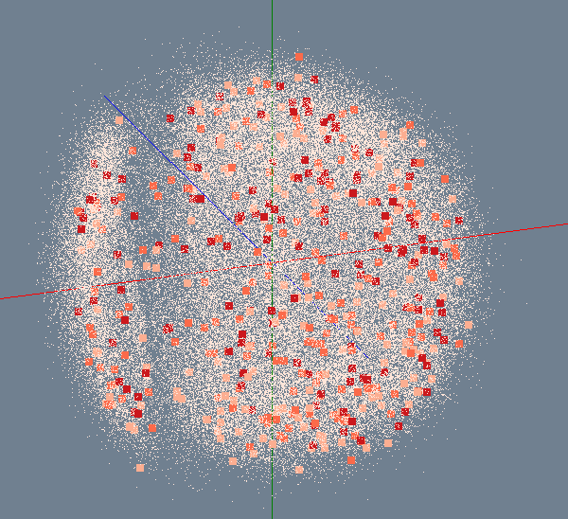
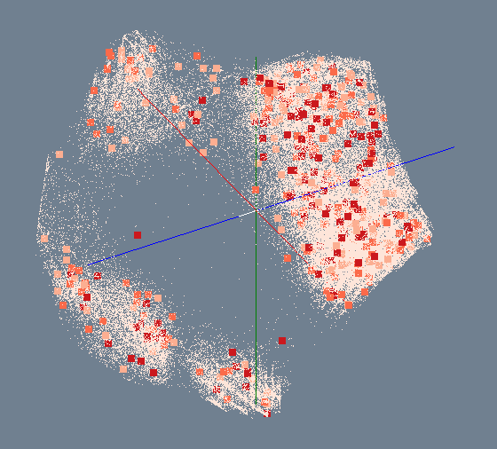
MDS/GTM for 100K PubChem
Number of Activity Results
> 300
200 ~ 300
100 ~ 200
< 100
MDS
GTM

Slide 45
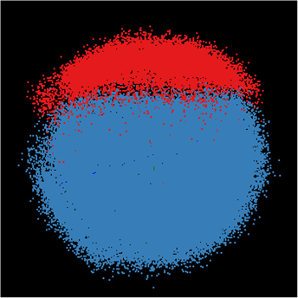
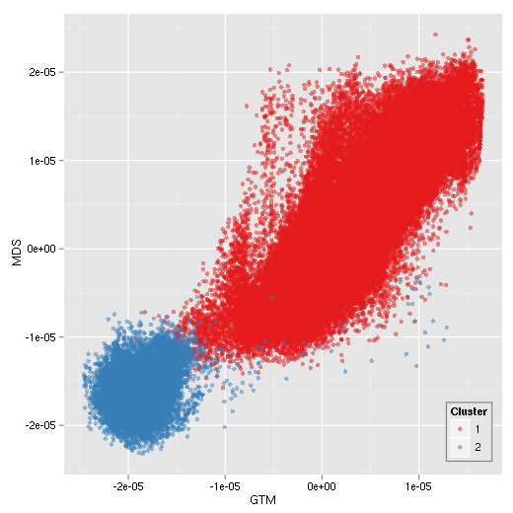
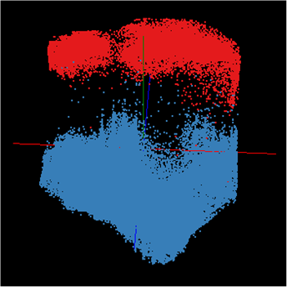
Correlation between MDS/GTM
MDS
GTM
Canonical Correlation between MDS & GTM
Notes:
Colors represent k-mean (k=2) results. Correlation is measured between MDS and GTM by using Canonical Correlation Analysis (CCA) and it shows high-correlation between them.

Slide 46
Summary: Key Features of our Approach
FutureGrid allows easy Windows v Linux with and without VM comparison
MapReduce works in loosely coupled problems but not in many datamining applications
Intend to implement range of biology applications with MapReduce++
Initially we will make key capabilities available as services that we eventually implement on virtual clusters (clouds) to address very large problems
  Basic Pairwise dissimilarity calculations
  R (done already by us and others)
  MDS in various forms
  Vector and Pairwise Deterministic annealing clustering
Point viewer (Plotviz) either as download (to Windows!) or as a Web service
Note much of our code written in C# (high performance managed code) and runs on Microsoft HPCS 2008 (with Dryad extensions)
  Hadoop code written in Java

Slide 47
Cloud Related Technology Research
MapReduce
  Hadoop
  Hadoop on Virtual Machines (private cloud)
  Dryad (Microsoft) on Windows HPCS
MapReduce++ generalization to efficiently support iterative “maps” as in clustering, MDS …
Azure Microsoft cloud
FutureGrid dynamic virtual clusters switching between VM, “Baremetal”, Windows/Linux …

Slide 48


Slide 49
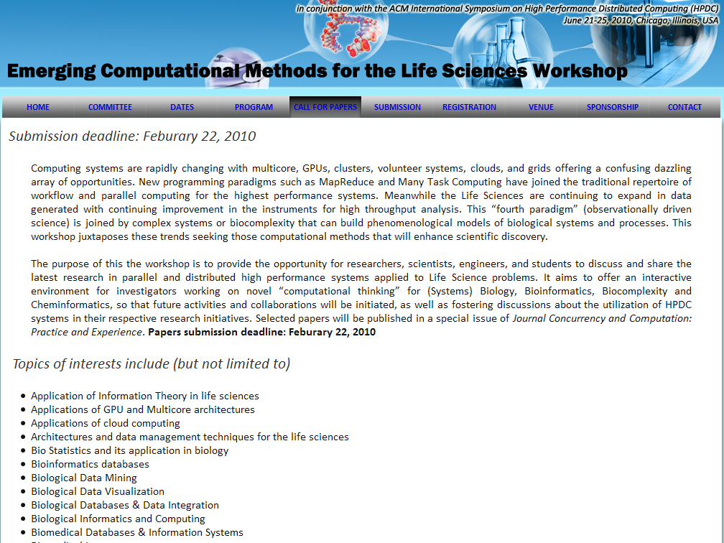
With HPDC

Slide 50
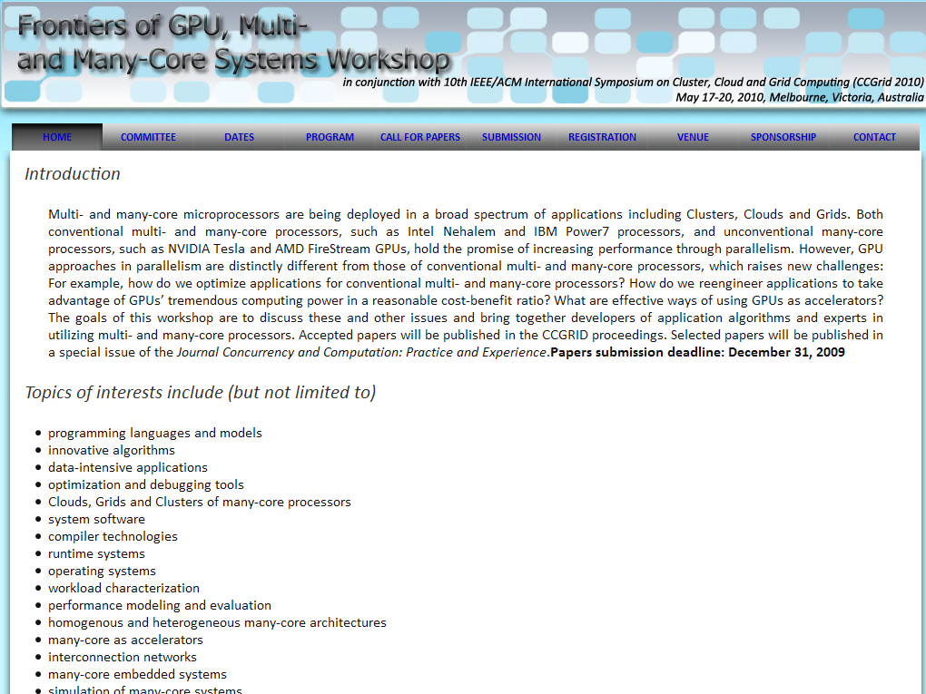
With CCGrid

