Slide 1
Applying Twister to Scientific Applications
CloudCom 2010
Indianapolis, Indiana, USA
Nov 30 – Dec 3, 2010

Slide 2
Introduction
Twister MapReduce Framework
In last paper Twister: A Runtime for Iterative MapReduce (J. Ekanayake, et.al. 2010), we showed that many scientific problems such as Kmeans, PageRank, can be solved in efficient way by Twister.
What’s next…
Notes:
Have Twister information here

Slide 3
The Focus of This Paper
The demands of new parallel algorithms and distributed computing technologies which can efficiently solve data-intensive and computing-intensive scientific problems keep growing.
Here we focus on extending the applicability of Twister to more kinds of scientific problems.

Slide 4
Outline
Twister MapReduce Framework
Iterative workflow
Architecture
Twister applications
Twister non-iterative applications
Twister iterative applications

Slide 5
Twister Iterative Workflow
Configure once and run many times
Static data
Fault tolerance

Slide 6
Twister Architecture
The client
Publish/subscribe message broker
Daemons
Twister File Tool

Slide 7
Twister Non-iterative Applications
“Map and then Reduce”
Word Count
Smith Waterman Gotoh(SW-G) distance
“Map only”
Binary invoking method
Many modern stand-alone scientific programs are complex and updated frequently with new features.
Rewriting the parallel version of such a standalone program may require too much effort to keep pace with required new features.
Twister BLAST
Twister MDS Interpolation
Twister GTM Interpolation

Slide 8
Twister BLAST
BLAST software
Other parallel BLAST applications
Twister BLAST

Slide 9
BLAST Software
BLAST+ vs. BLAST
BLAST+ is recommended by NCBI
Computing-intensive
100% CPU usage
Memory usage is based on the size of input query and the number of hits
multi-thread mode vs. multi-process mode
Performance occasionally drops down
Less memory usage

Slide 10
Parallel BLAST Applications
MPI BLAST
Rewrites original BLAST, links with NCBI library and MPI library
Query partition and database segmentation
Uses less memory
No fault tolerance solution
Cloud BLAST
Based on Hadoop
Binary invoking
Only query partition, database encapsulated into images
Azure BLAST
Build on Azure platform directly
Only query partition

Slide 11
Twister BLAST
A parallel BLAST application which is supported by Twister
Uses the state-of-the-art binary invoking parallelism.
Utilize stand-alone BLAST software since it is highly optimized
Brings scalability and simplicity to program and database maintenance.

Slide 12
Database Management
In normal cluster
Replicated to all the nodes, in order to support BLAST binary execution
Compressed before replication
Transported through Twister File Tool
In cloud
Encapsulated into the image

Slide 13
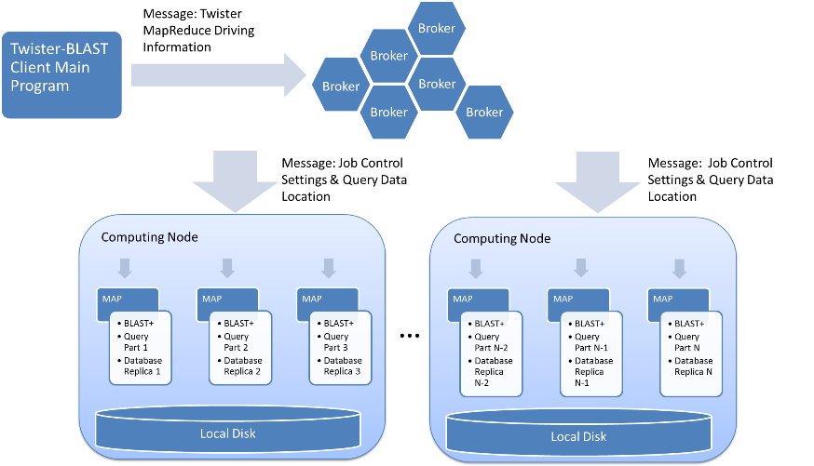
Twister-BLAST Architecture

Slide 14
Twister MDS Interpolation
MDS (Multidimensional scaling) Algorithm
If it is computed directly, its time complexity is $O(N^{2})$ level
MDS Interpolation is an out-of-sample problem.
The remaining out-of-sample data can be learned from previous samples.
The time complexity of MDS interpolation is $O\left(KM\right)$
Where K is the number of sample points and M is the number of out-of-sample points.
Notes:
N=K+M

Slide 15
Parallelization
The implementation is vector-based
The raw dataset is read instead of the Euclidean distance matrix to save the disk space.
The sampled data size is 100k, pre-processed by original MDS program.
“Map only”
Data are processed by methods which encapsulate the MDS interpolation algorithm in each map task.
The out of sample data points are only depends on the sampled data.
Notes:
6 TB ? 8? Matrix could be rectangular

Slide 16
Twister GTM Interpolation
GTM (Generative Topographic Mapping)
GTM Interpolation first performs normal GTM on samples.
The normal GTM will give features of the whole dataset
The out of sample data points will processed based on the sampled data points’ result.
Since the out-of-sample data are not involved in the computing intensive learning process, GTM Interpolation can be very fast.

Slide 17
Parallelization
“Map only”
Split the raw data file from the out-of-sample data file.
Each partition will have a mapper created to process that chunk.
Twister will invoke GTM Interpolation on each chunk to process the data.

Slide 18
Twister Iterative Application
Twister MDS
MDS (Multidimensional scaling)
The pairwise Euclidean distance within the target dimension of each pair is approximated to the corresponding original proximity value through a non-linear optimization algorithm.
Stress function
The objective function needs minimized.
SMACOF (Scaling by Majorizing a Complicated Function)
Iterative Majorization to minimize Stress function

Slide 19
Parallelization through Twister
Data distribution
Original distance matrix is partitioned into chunks by rows , and distributed to all compute nodes
Configure once and run many times
Data chunks are configured to Map tasks in one to one mapping and then held in memory and used throughout the subsequent iterations
Three MapReduce jobs are configured and reused in each iteration
Data transmission
runMapReduceBCast method (Broadcasting data to Map tasks)
Combine method (collect the result back to client)

Slide 20
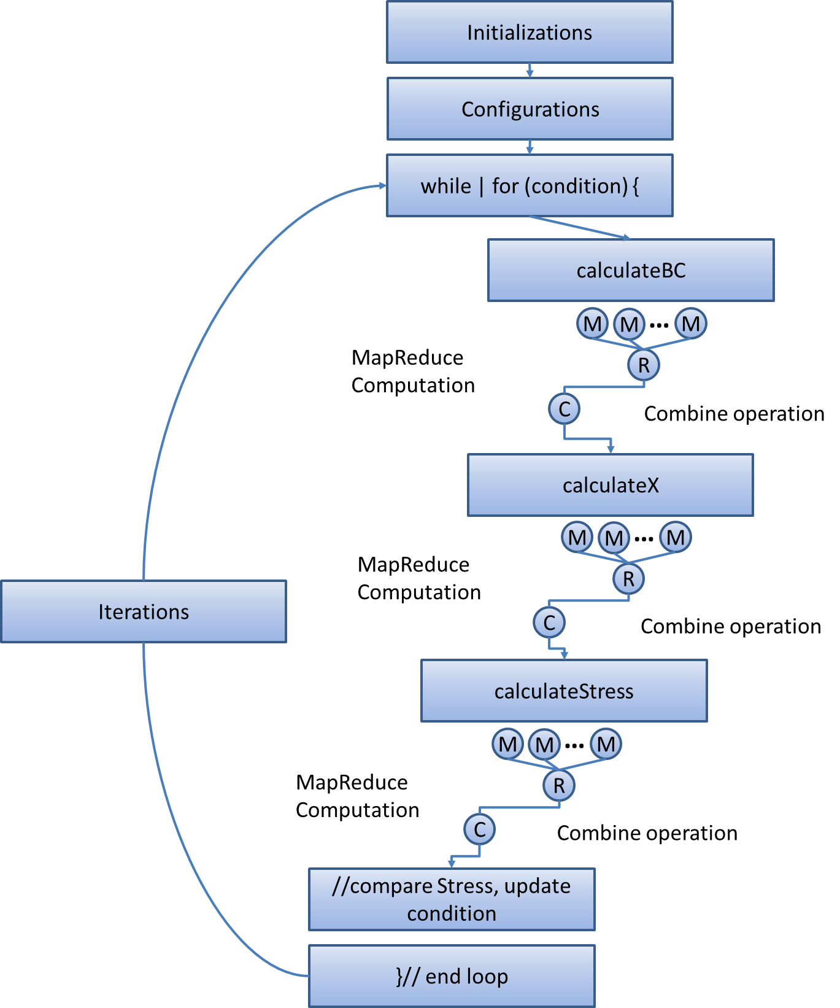
Workflow Chart

Slide 21
Performance
Parallel efficiency drops greatly when the number of cores exceeds a certain value.
The cost of data broadcasting increases as the number of cores grows.
Through using more than one broker can ease this problem, we show Twister is limited by the availability of messaging middleware.

Slide 22
Improvement
In the latest code…
Twister can automatically use direct TCP channels to transfer large intermediate data items (brokers are used to send a unique_id, then the receiving end download data via TCP) .
For smaller (<1KB) data items it uses message brokers.
With this improvement, a better performance was achieved for the matrix multiplication.
This work is still in progress…

Slide 23
Conclusion
New implementations extend the scope of existing applications using Twister.
With iterative MapReduce functions, data partitioning, caching, and reusable configuration, Twister can solve problems in a flexible and efficient fashion.

Slide 24
Conclusion cont’d
Twister’s performance largely depends on the performance of the specific messaging middleware adopted.
An interesting research issue of balancing the requirement of employing an iterative algorithm with the capability of the messaging middleware.
Twister scripts can simulate some functions of distributed file systems but needs further optimization.
In future work, we will integrate Twister with a customized messaging middleware and a distributed file system.

Slide 25
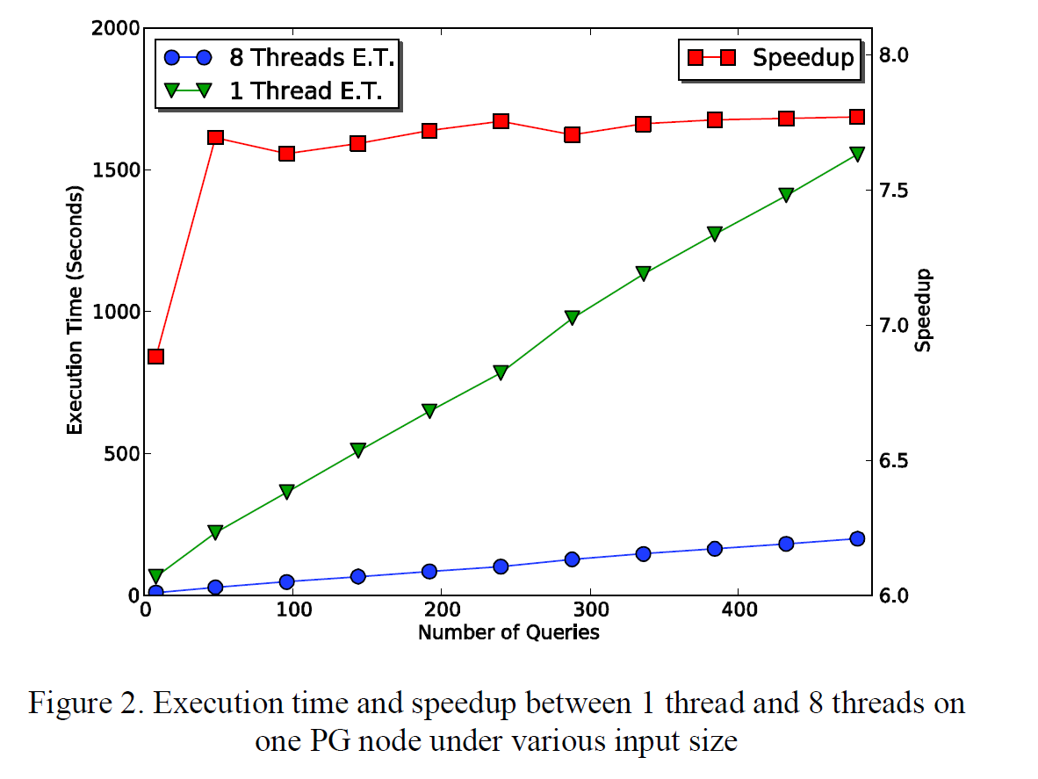
BLAST Performance on IU PolarGrid Node

Slide 26
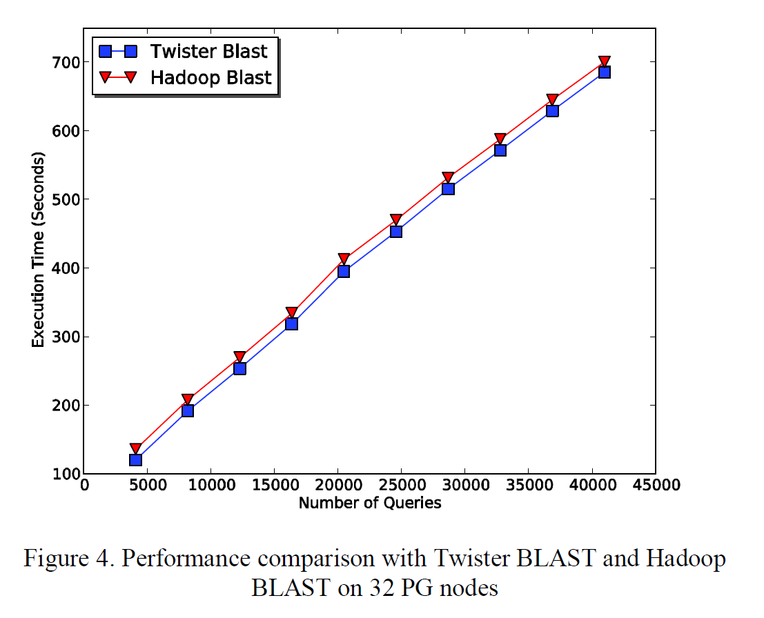
Twister-BLAST vs. Hadoop-BLAST Performance Test

Slide 27
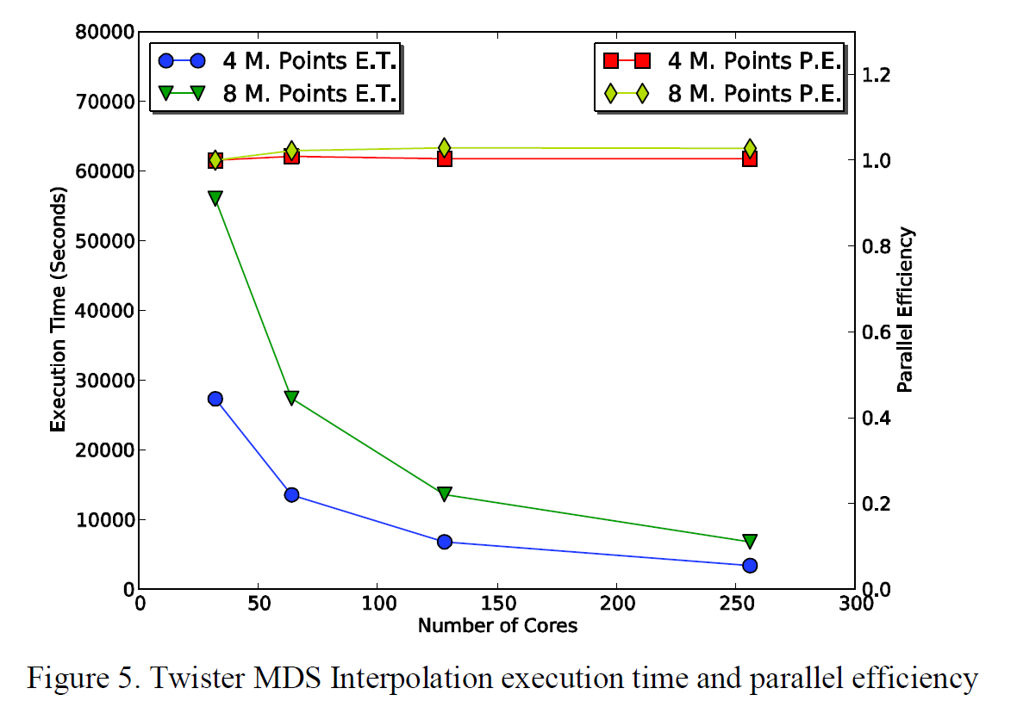
Twister MDS Interpolation Performance Test

Slide 28
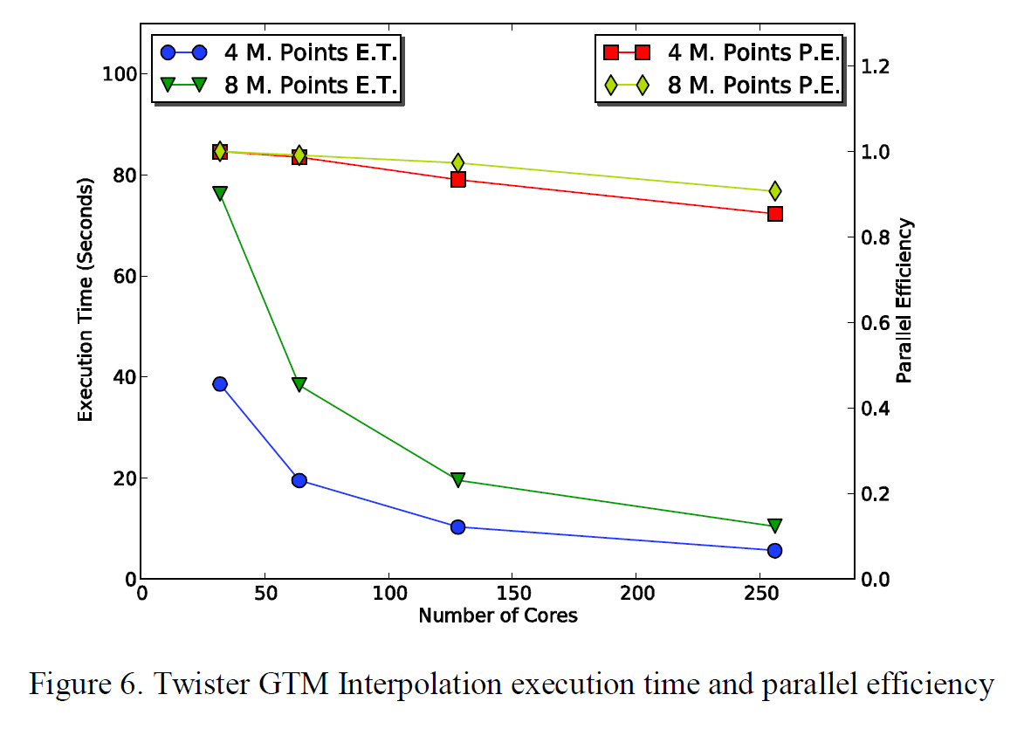
Twister GTM Interpolation Performance Test

Slide 29
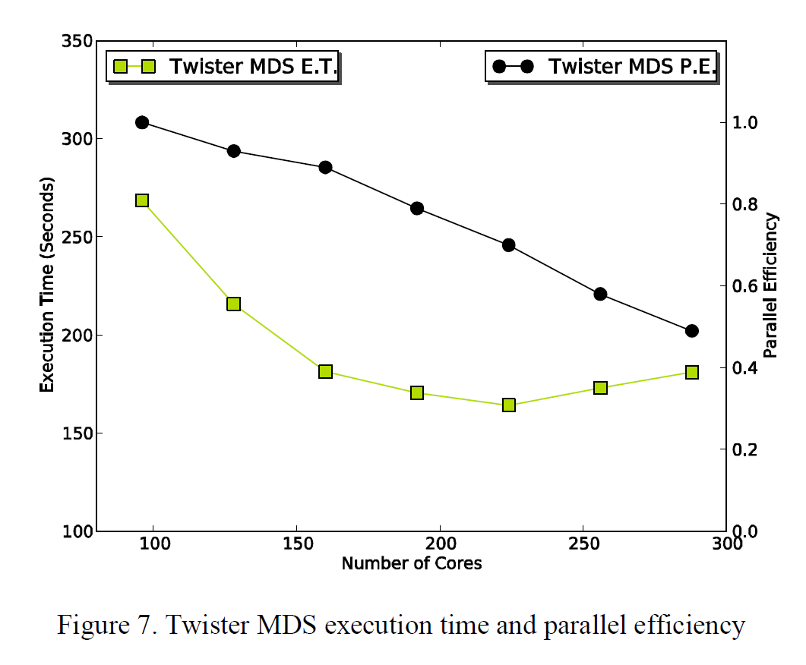
Twister MDS Performance Test
In performance test, a Twister environment with one ActiveMQ message broker was established, and Twister MDS was run with 100 iterations.
A metagenomics dataset comprised of 30000 data points with nearly 1 billion pair-wise distances to 3-D in 100 iterations

