Slide 1
Cloudmesh a Gentle Overview
Gregor von Laszewski
Sep. 2014
laszewski@gmail.com

Slide 2
Cloudmesh Plan: Isolated Networking
LAN
  Supported through IaaS on 1GE, 10GE+, Infiniband
WAN
  Expose available network resources are exposed as a first-class entity
  Allow users to specify their requirements and obtain the best available configurations.
  Make use of SDN-enabled networks using OpenFlow whenever possible
  Create virtual networks over the Internet2 Advanced Layer2 Service (AL2S) including early end-to-end SDN capabilities between
  Result => Network traffic within these networks can be isolated from other experiments, or controlled by experimental, network-aware software.

Slide 3
Cloudmesh: Accounting
Project based accounting
Federated data sources
Demonstrated integrated accounting with XSEDE resources on FutureGrid
Close interaction with XD TAS project, would allow integration of cloudmetrics into XDMoD. Bridges HPC and Cloud systems
Supports multiple cloud metric frameworks (we demonstrated in FutureGrid (OpenStack, Eucalyptus, Nimbus integration)

Slide 4
Big Data Cyberinfrastructure Stack
Just examples
PaaS
IaaS
BMaaS
SaaS
NaaS
Mahout
Hadoop
OpenStack
OpenFlow
Cobbler

Slide 5
Cloudmesh: Integrated Access Interfaces
(Horizontal Integration)
GUI
Shell
API
REST
IPython

Slide 6
Cloudmesh: Abstract Interfaces
(Vertical Integration)
Just examples
PaaS
IaaS
BMaaS
SaaS
NaaS
Mahout
Hadoop
OpenStack
OpenFlow
Cobbler
Abstract
Interfaces

Slide 7
Is there just one cloud?
There are hundreds of offerings
Can we provide a federate access to some of them?

Slide 8
What should be part of Cloudmesh?
Lessons from Futuregrid with over
2444 Registered users
~400 Projects

Slide 9
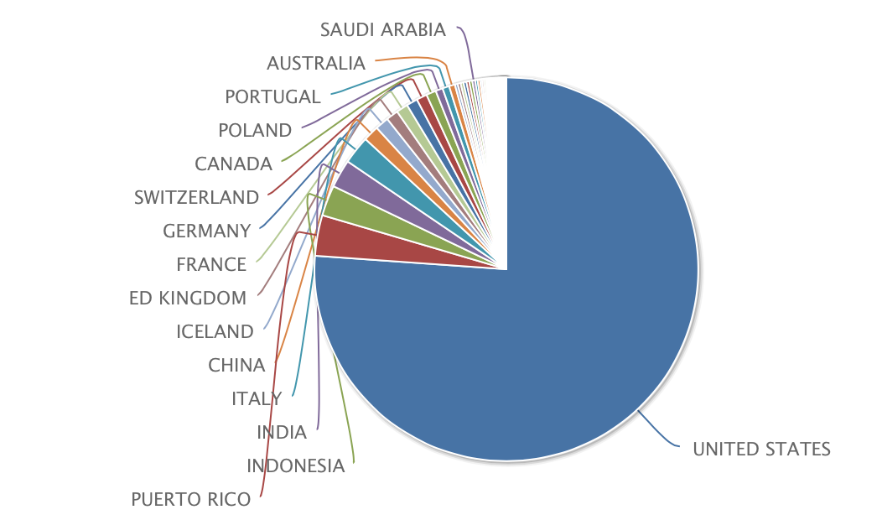
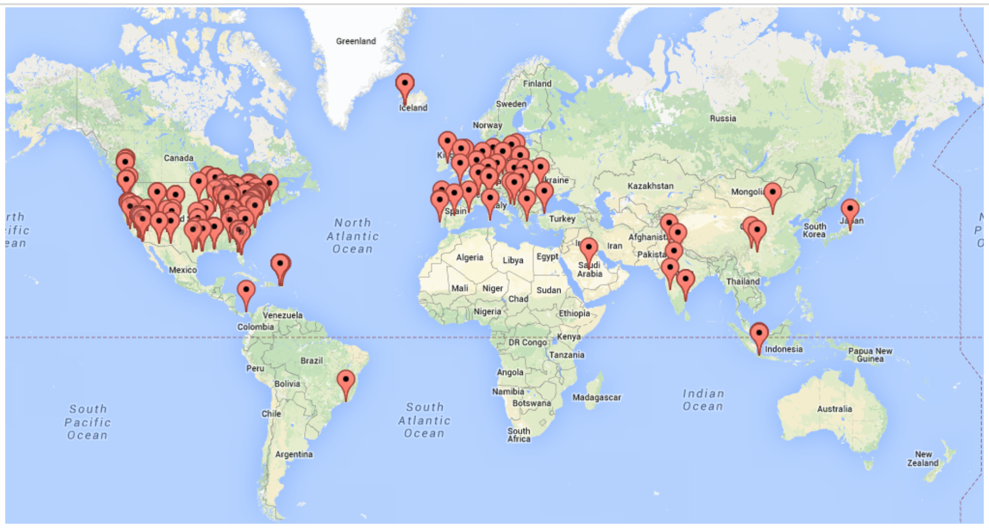
Where are our users?
Canada
USA

Slide 10
What keywords are used at the project application?

Slide 11
What words are used in the titles of the project?

Slide 12
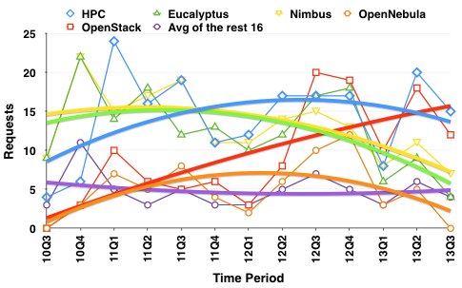
Which specific service requests are popular?
OpenStack
HPC
Eucalyptus
Nimbus

Slide 13
IaaS request popularity by year

Slide 14
Which disciplines over he last two years?

Slide 15
How many users are in a project?

Slide 16
Towards a SDDSaaS Toolkit:
Cloudmesh
Gregor von Laszewski
Geoffrey Fox
SDDSaaS = Software Defined Distributed System as a Service

Slide 17
Introduction
Cloud computing has become an integral factor for managing infrastructure by research organizations and industry.
  Public clouds: Amazon, Microsoft, Google, Rackspace, HP, and others.
  Private clouds: set up by internal Information Technology (IT) departments and made available as part of the general IT infrastructure, including my own clouds
  HPC Clouds: Non hypervisor or high performance hypervisor based systems managed like clouds
Can we leverage all of them?
How to deal with the frequent changing technologies?
  Minimal changes to users that only want to run an application!
Use “Software Defined Infrastructure” and “Software Defined Applications”

Slide 18
CloudMesh Architecture
Tightly integrated software infrastructure toolkit to deliver
  a software-defined distributed system encompassing virtualized and bare-metal infrastructure, networks, application, systems and platform software with a unifying goal of providing SDDSaaS.
This system is termed Cloudmesh to symbolize:
  The creation of a tightly integrated mesh of services targeting multiple IaaS frameworks
  The ability to federate a number of resources from academia and industry. This includes existing FutureSystems infrastructure, Amazon Web Services, Azure, HP Cloud, Karlsruhe using several IaaS frameworks
  The creation of an environment in which it becomes easier to experiment with platforms and software services while assisting with their deployment.
  The exposure of information to guide the efficient utilization of resources.
Cloudmesh exposes both hypervisor-based and bare-metal provisioning to users.
Access through command line, command shell, API, and Web interfaces.

Slide 19
Background - FutureGrid
Some requirements originate from FutureGrid.
  A high performance and grid testbed that allowed scientists to collaboratively develop and test innovative approaches to parallel, grid, and cloud computing.
  Users can deploy their own hardware and software configurations on a public/private cloud, and run their experiments.
  Provides an advanced framework to manage user and project affiliation and propagates this information to a variety of subsystems constituting the FutureGrid service infrastructure. This includes operational services to deal with authentication, authorization and accounting.
Important features of FutureGrid:
  Metric framework that allows us to create usage reports from all of our IaaS frameworks. Developed from systems aimed at XSEDE
  Repeatable experiments can be created with a number of tools including Cloudmesh. Provisioning of services and images can be conducted by Rain.
  Multiple IaaS frameworks including OpenStack, Eucalyptus, and Nimbus.
  Mixed operation model. a standard production cloud that operates on-demand, but also a set of cloud instances that can be reserved for a particular project.
FutureGrid coming to an end but preserve SDDSaaS tools as Cloudmesh

Slide 20
Functionality Requirements
Provide virtual machine and bare-metal management in a multi-cloud environment with very different policies and including
  Expandable resources,
  External clouds from research partners,
  Public clouds,
  My own cloud
Provide multi-cloud services and deployments controlled by users & provider
Enable raining of
  Operating systems (bare-metal provisioning),
  Services
  Platforms
  IaaS
Deploy and give access to Monitoring infrastructure across a multi-cloud environment
Support management of reproducible experiments

Slide 21
RAIN: provision OS – Services - Platforms
Templates
&
Services
Virtual Cluster
Virtual Machine
Hadoop
OS Image
Resources
Other

Slide 22
Cloudmesh Functionality
Virtual Machine
Management
  IaaS Abstraction
Provisioning Management
  Rain
  Cloud Shifting
  Cloud Bursting
Experiment
Management
  Shell
  IPython
Information Services
  CloudMetrics
Accounting
  Internal
  External
Cloudmesh
User On-Ramp
Amazon, Azure, FutureGrid, XSEDE, ExoGeni, Other Science Clouds
Notes:
Due to its integrated services Cloudmesh provides the ability to be an onramp for other clouds.
It provides information services to various system level sensors to give access to sensor and utilization data. Internally, it can be used to optimize the system usage.
The provisioning experience from FutureGrid has taught us that we need to provide
the creation of new clouds (rain)
the repartitioning of resources between services (cloud shifting)
and the integration of external cloud resources in case of over provisioning (cloud bursting)
As we deal with many IaaS frameworks, we need an abstraction layer on top of the IaaS framework.
Experiment management is conducted with workflows controlled in shells, Python/iPython, as well as systems such as OpenStack's Heat.
Accounting is supported through additional services such as user management and charge rate management.
Not all features are yet implemented. Figure shows the main functionality that we target at this time to implement.

Slide 23
Usability Requirements
Provide multiple interfaces including
  Command line tool and command shell
  Web portal and RESTful services
  Python API
Deliver a toolkit that is
  Open source
  Extensible
  Easily deployable
  Documented

Slide 24
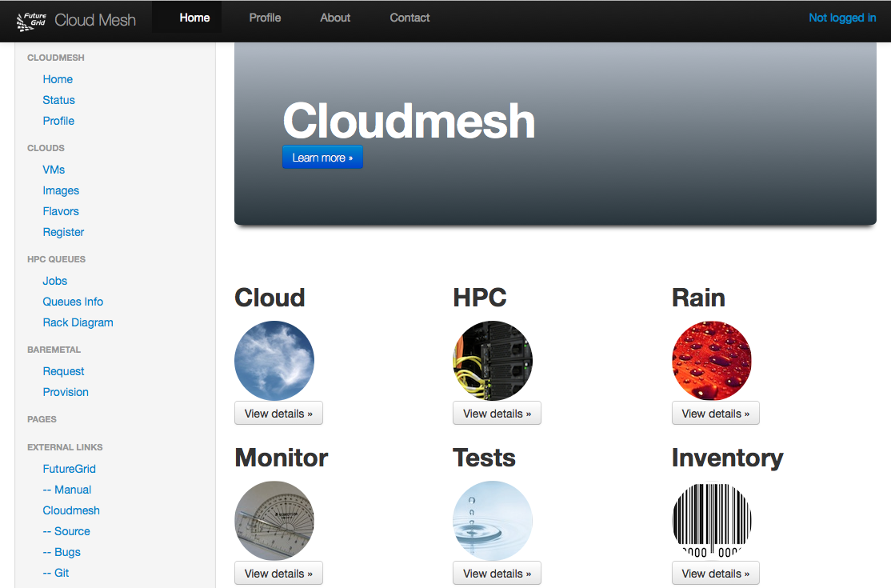
Cloudmesh User Interface
Notes:
A starting window allows to chose from the different functionality

Slide 25
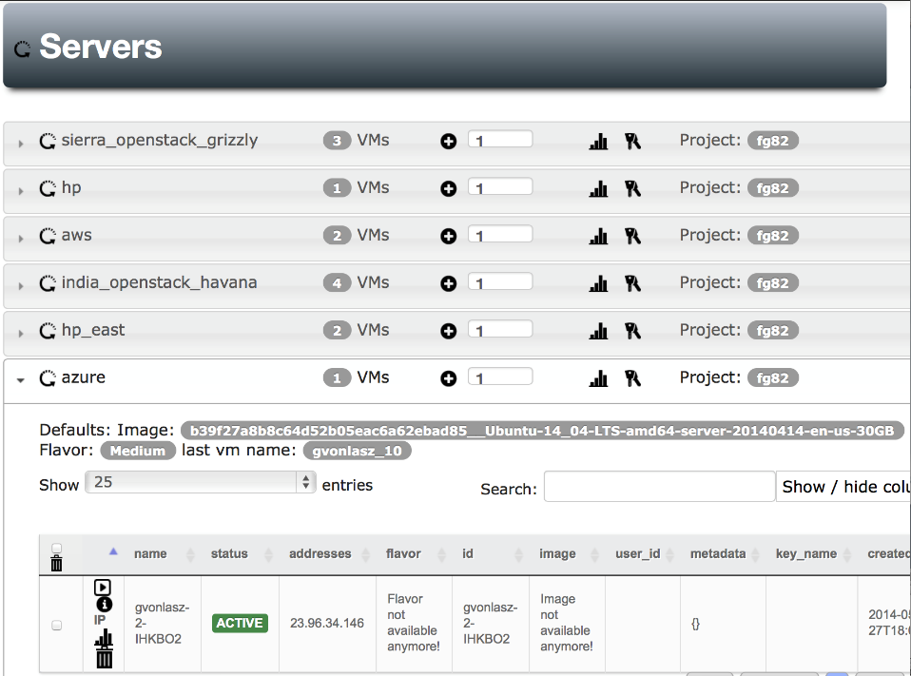
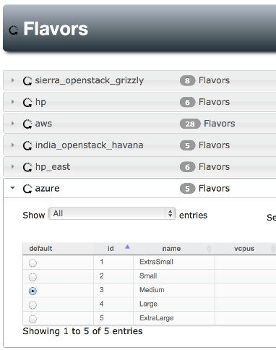
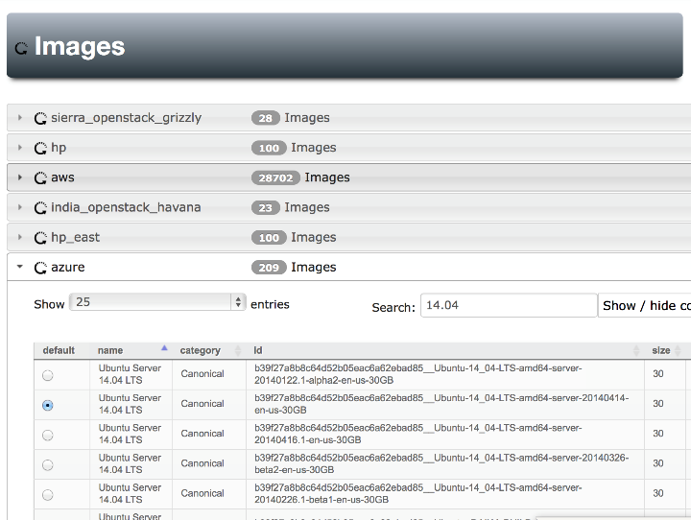
Notes:
Yes Azure is also there, Our gui can easily handle searching for images , we can set defaults for each cloud (images & flavors), pressing the + button will give us a new server with the specified defaults

Slide 26
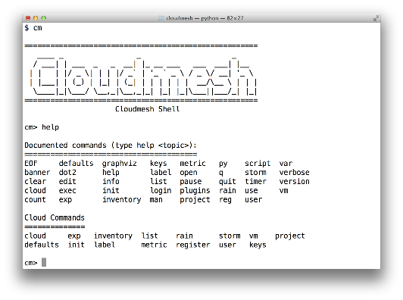
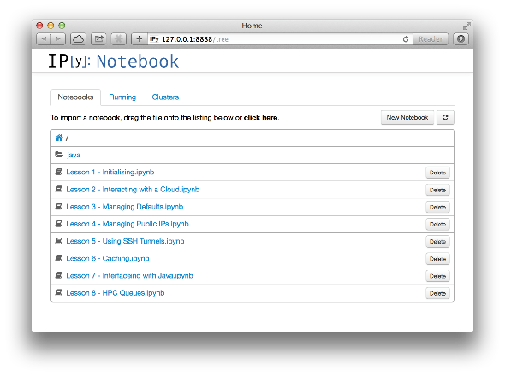
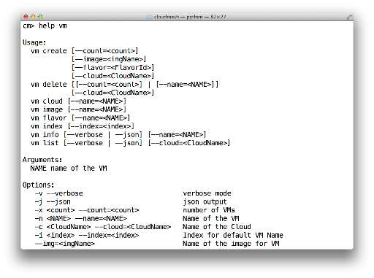
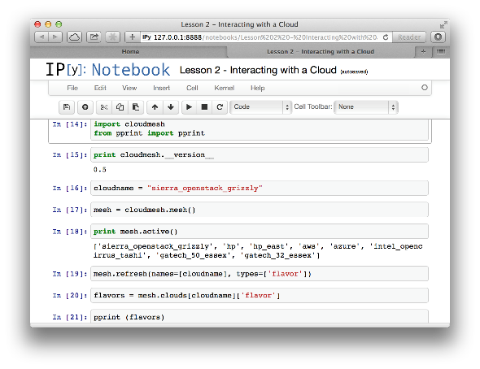
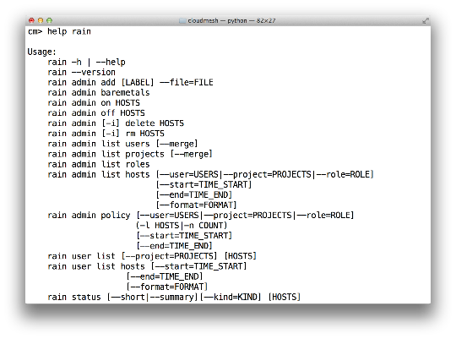
Cloudmesh Shell & bash & IPython
Notes:
Cloudmesh provides more than shell commands it has an integrated shell

Slide 27
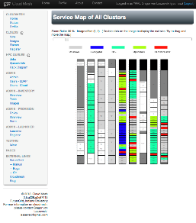
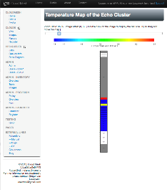
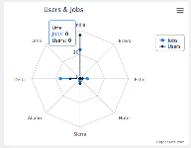
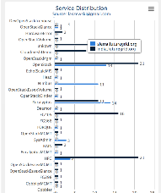
Monitoring and Metrics Interface
Service Monitoring
Energy/Temperature Monitoring
Monitoring of Provisioning
Integration with other Tools
  Nagios, Ganglia, Inca, FG Metrics
  Accounting metrics
Notes:
Naturally we want to monitor

Slide 28
Cloudmesh Definitions I
Project: The research activity to be supported by Cloudmesh. A project has roles and users assigned. The roles imply which types of SDDS can be used by users in the project
  FutureGrid has some roles but need to expand
  This definition supported by FutureSystems portal
User: Project participants
  Users have individual authorization roles and roles inherited from projects with which they are involved
  Users are assigned to projects by project lead
  Public projects can be joined by any Cloudmesh user
Experiment: The activity unit for Cloudmesh
SDDS: Software Defined Distributed System
SDDSL: Specification Language for SDDS; essentially exists from various sources

Slide 29
Cloudmesh Definitions II
Infrastructure: Clusters: Computers, Storage, Network with some reason to be treated as one: Infrastructure has
  Type as in different Amazon Instance Types
  Management Structure
  Provisioning rules for administrators
  Usage rules for users of particular roles
  A current state
  A time interval ranging from transient to a longer term persistence and including a scheduled start time
    Note storage could often need to be persistent
Virtual Infrastructure: Dynamically defined Slices of Infrastructure
Federated Virtual Infrastructure is a Software Defined Distributed System SDDS assigned to a Cloudmesh user for an Experiment in a Project

Slide 30
SDDS Software Defined Distributed Systems
Cloudmesh builds infrastructure as SDDS consisting of one or more virtual clusters or slices with extensive built-in monitoring
These slices are instantiated on infrastructures with various owners
Controlled by roles/rules of Project, User, infrastructure
User in Project
Python or REST API
Request
Execution in Project
One needs general hypervisor and bare-metal slices to support FG research
The experiment management system is intended to integrates ISI Precip, FG Cloudmesh and tools latter invokes
Enables reproducibility in experiments.
Repository
SDDSL
Results
Request
SDDS
CMMon
CMPlan
User Roles
CMExec
Infrastructure (Cluster, Storage, Network, CPS)
Select
Plan
Requested SDDS as federated Virtual Infrastructures
CMProv
#1Virtual infra.
Instance Type
Current State
Management Structure
Provisioning Rules
Usage Rules (depends on user roles)
Linux
Image and Template Library
#2 Virtual infra.
#3Virtual infra.
Windows
Linux
#4 Virtual infra.
User role and infrastructure rule dependent security checks
Mac OS X

Slide 31
Cloudmesh Definitions III
Cloudmesh Image: The software that is loaded on an Infrastructure to provision it.
  For nodes, image is loaded on bare metal or a hypervisor
  Images created as described below
Cloudmesh Image Template: An abstract specification of an Image used to define an implementation that is valid across multiple Infrastructures: three steps
  Templates as a set of one or more scripts/XML specifications
  Generic or base images that can be modified on general devops principles.
  Host specific Images
FutureGrid has a prototype Image and Template Library
  Note templates are preferred model as template description is what we mean by Software defined Systems
  However one may only have an image in some cases and also provisioning speed is improved by taking templates and pre-generating images for particular infrastructures

Slide 32
Cloudmesh Definitions IV
Cloudmesh Matchmaker CMPlan chooses appropriate Infrastructures that can be used by CMProv to satisfy a user requested SDDS (not implemented)
CloudMesh Provisioner CMProv takes a user request in SDDSL and a chosen Infrastructure and provisions the infrastructure in accordance with user roles, Infrastructures current state, management usage and provisioning rules and generates requested virtual infrastructure
  CMProv uses appropriate Cloudmesh Images and Templates and capabilities of Cloudmesh depend on availability of appropriate images/templates
CMExec produces the users’ requested SDDS as a federation of Virtual Infrastructures created by CMProv
CMMon sets up monitoring and experiment management infrastructure (incomplete)

Slide 33
CloudMesh Administrative View of SDDS aaS
CM-BMPaaS (Bare Metal Provisioning aaS) is a systems view and allows Cloudmesh to dynamically generate anything and assign it as permitted by user role and resource policy
  FutureGrid machines India, Bravo, Delta, Sierra, Foxtrot are like this
  Note this only implies user level bare metal access if given user is authorized and this is done on a per machine basis
  It does imply dynamic retargeting of nodes to typically safe modes of operation (approved machine images) such as switching back and forth between OpenStack, OpenNebula, HPC on Bare metal, Hadoop etc.
CM-HPaaS (Hypervisor based Provisioning aaS) allows Cloudmesh to generate "anything" on the hypervisor allowed for a particular user
  Platform determined by images available to user
  Amazon, Azure, HPCloud, Google Compute Engine
CM-PaaS (Platform as a Service) makes available an essentially fixed Platform with configuration differences
  XSEDE with MPI HPC nodes could be like this as is Google App Engine and Amazon HPC Cluster. Echo at IU (ScaleMP) is like this
  In such a case a system administrator can statically change base system but the dynamic provisioner cannot

Slide 34
Cloudmesh User View of SDDS aaS
Note we always consider virtual clusters or slices with nodes that may or may not have hypervisors
BM-IaaS: Bare Metal (root access) Infrastructure as a service with variants e.g. can change firmware or not
H-IaaS: Hypervisor based Infrastructure (Machine) as a Service. User provided a collection of hypervisors to build system on.
  Classic Commercial cloud view
PSaaS Physical or Platformed System as a Service where user provided a configured image on either Bare Metal or a Hypervisor
  User could request a deployment of Apache Storm and Kafka to control a set of devices (e.g. smartphones)

Slide 35
Cloudmesh Infrastructure Types
Nucleus Infrastructure:
  Persistent Cloudmesh Infrastructure with defined provisioning rules and characteristics and managed by CloudMesh
Federated Infrastructure:
  Outside infrastructure that can be used by special arrangement such as commercial clouds or XSEDE
  Typically persistent and often batch scheduled
  CloudMesh can use within prescribed provisioning rules and users restricted to those with permitted access; interoperable templates allow common images to nucleus
Contributed Infrastructure
  Outside contributions to a particular Cloudmesh project managed by Cloudmesh in this project
  Typically strong user role restrictions – users must belong to a particular project
  Can implement a Planetlab like environment by contributing hardware that can be generally used with bare-metal provisioning

Slide 36
Architecture
Cloudmesh Management Framework for monitoring and operations, user and project management, experiment planning and deployment of services needed by an experiment
Provisioning and execution environments to be deployed on resources to (or interfaced with) enable experiment management.
Resources.

Slide 37
Building Blocks of Cloudmesh
Includes convenient abstractions: over external systems/standards
  Flexible and allows adaptation if IaaS is different or changes
  Allows integration of various IaaS and baremetal frameworks
Uses internally:
  Cobbler
  Communicates to OpenStack directly via REST
  Uses libcloud for EC2 clouds
  OpenPBS (to access HPC)
  Chef
IaaS: Supported IaaS include Openstack (including tools like Heat), AWS EC2, Eucalyptus, Azure, any EC2 cloud
XSEDE Integration: We could integrate with Xsede user management
  (demonstrated successfully via Amie through Futuregrid)
Using Slurm, OCCI, Chef, (Ansible), (Puppet), AMPQ, RabbitMQ, Celery
Could leverage
  Razor, Juju, Xcat (original FG Rain used this), Foreman, for bare metal via Cloudmesh
  abstraction

Slide 38
Details on Cloudmesh Functionality
Due to its integrated services Cloudmesh provides the ability to be an onramp for other clouds.
It provides information services to various system level sensors to give access to sensor and utilization data. Internally, it can be used to optimize the system usage.
The provisioning experience from FutureGrid has taught us that we need to provide
  the creation of new clouds (rain)
  the repartitioning of resources between services (cloud shifting)
  and the integration of external cloud resources in case of over provisioning (cloud bursting)
As we deal with many IaaS frameworks, we need an abstraction layer on top of the IaaS framework.
Experiment management is conducted with workflows controlled in shells, Python/iPython, as well as systems such as OpenStack's Heat.
Accounting is supported through additional services such as user management and charge rate management.
Not all features are yet implemented. Figure shows the main functionality that we target at this time to implement.

Slide 39
User and Project Management
FutureGrid user and project services simplify the application processes needed to obtain user accounts and projects.
We have demonstrated in FutureGrid the ability to create accounts in a very short time, including vetting projects and users – allowing fast turn-around times for the majority of FutureGrid projects with an initial startup allocation.
  We also have shown that we can integrate with other services on user management such as XSEDE, we also have access to the technical team that integrated OSG into XSEDE and the XSEDE TAS project
Cloudmesh re-uses this infrastructure and also allows users to manage proxy accounts to federate to other IaaS services to provide an easy interface to integrate them.

Slide 40
Experiment Planning - Future
Imagine a shopping cart which will allow checking out of predefined repeatable experiment templates.
  Cost is associated with an experiment making
  Clearing house of images
  Clearing house of complex deployments.
  Integrated accounting framework allowing a usage cost model
  The cost model will be based not only on number of core hours used, but also the capabilities of the resource, the time, and special support it takes to set up the experiment. We will expand upon the metrics framework of FutureGrid that allows measuring of VM and HPC usage and associate this with cost models. Benchmarks will be used to normalize the charge models.

Slide 41
Cloudmesh Provisioning and Execution
Bare-metal Provisioning
  Originally developed a provisioning framework in FutureGrid based on xCAT and Moab. (Rain)
  Due to limitations and significant changes between versions we replaced it with a framework that allows the utilization of different bare-metal provisioners.
  At this time we have provided an interface for cobbler and are also targeting an interface to OpenStack Ironic.
Virtual Machine Provisioning
  An abstraction layer to allow the integration of virtual machine management APIs based on the native IaaS service protocols. This helps in exposing features that are otherwise not accessible when quasi protocol standards such as EC2 are used on non-AWS IaaS frameworks. It also prevents limitaions that exist in current implementations, such as libcloud to use OpenStack.
Network Provisioning (Future)
  Utilize networks offering various levels of control, from standard IP connectivity to completely configurable SDNs as novel cloud architectures will almost certainly leverage NaaS and SDN alongside system software and middleware. FutureGrid resources will make use of SDN using OpenFlow whenever possible though the same level of networking control will not be available in every location.

Slide 42
Provisioning – Cont’d
Storage Provisioning (Future)
  Bare-metal provisioning allows storage provisioning and making it available to users
Platform, IaaS, and Federated Provisioning (Current & Future)
  Integration of Cloudmesh shell scripting, and the utilization of DevOps frameworks such as Chef or Puppet.
Resource Shifting (Current & Future)
  We demonstrated via Rain the shift of resources allocations between services such as HPC and OpenStack or Eucalyptus.
  Developing intuitive user interfaces as part of Cloudmesh that assist administrators and users through role and project based authentication to move resources from one service to another.

Slide 43
Cloudmesh Resource Shifting
2
1

Slide 44
Resource Federation
We successfully federated resources from
  Azure
  Any EC2 cloud
  AWS,
  HP cloud
  Karlsruhe Institute of Technology Cloud
  Former FutureGrid clouds (four clouds)
    Various versions of OpenStack and Eucalyptus.
    It would be possible to federate with other clouds that run other infrastructure such as Tashi or Nimbus.
    Integration with OpenNebula is desirable due to strong EU importance

Slide 45
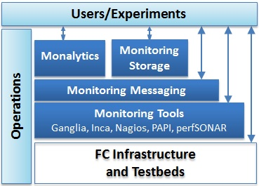
CMMon Monitoring Components of CloudMesh
Leverage best practices and expertise from projects including FutureGrid and XSEDE now and with GENI possible in future
Provide transparency of the infrastructure and deep, pervasive instrumentation capabilities (bare metal up to application level)
  Commercial cloud monitoring focuses on load monitoring (app auto-scaling)
Available to user experiments through the proposed shopping cart interface
Easily configurable and extensible
Other Aspects
  Benchmarks
  Security Monitoring
  Energy Monitoring
Cloudmesh

Slide 46
Monitoring and Accounting
Cloudmesh must be able to access empirical data about the properties and performance of the underlying infrastructure beyond what is available from commercial cloud environments. The component of Cloudmesh accomplishing this is called Cloud Metrics.
We developed a federated cloud metric service that aggregates the information from distributed clusters and a variety of heterogeneous IaaS services, such as OpenStack, Eucalyptus, and Nimbus. The main components of Cloudmesh Metrics enable
  (a) the measurement of the resource allocation across several IaaS platforms
  (b) the generation of data in regards to utilization
  (c) the comparison of data via definable metrics to mine the usage statistics
  (d) the display of the information through a convenient user interface
  (e) the availability of a simple command line interface and shell language, and
  (f) the automatic creation of resource reports in printed format for arbitrary time periods.

Slide 47
Type of Monitoring | Tools Used | Types of experiments
Physical host monitoring | Ganglia | Performance evaluation of domain science applications.
Energy monitoring | IPMI | Power/thermally driven data center & scheduling algorithms, consolidation, and mobile experiments.
Network monitoring | perfSONAR, Periscope | Network monitoring is essential for experiments from HPC, in which messaging patterns and fabric contention are significant to performance, to distributed computing in data movement is a key cost.
IaaS monitoring | Synaps, Stackwatch, | Auto-scaling experiments.
Low-level IaaS monitoring | Libvirt, libpcap | Experiments that are performance or energy oriented
Application performance monitoring | PAP/PAPI-V | Application performance analysis, including comparisons between virtual and bare-metal performance, as well as “steal-time,” i.e., the time that's used by other VMs in the cloud which might be included in "my" per-process timing results
Integrated monitoring with analytics | Monalytics | Scalable distributed behavior monitoring, debugging, anomaly detection in large-scale multi-tier, multi-runtime applications
Operational infrastructure monitoring | Inca, IU metrics and accounting, Nagios | Adaptive application simulation experiments driven by real-world trace data (e.g., service uptime, usage).

Slide 48
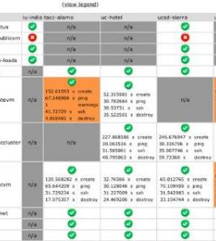
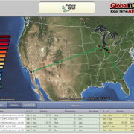
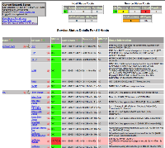
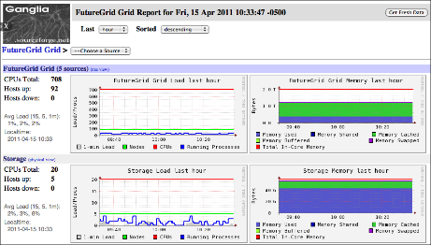
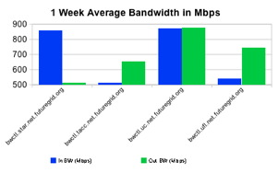
Operations Monitoring

Slide 49
Cloudmesh Status
First version of Cloudmesh released with a focus on the development of three of its components. This includes
  virtual machine management in multi-clouds
  cloud metrics in multi-clouds
  and bare-metal provisioning.
Cloudmesh has been successfully used in FutureGrid. A GUI and a Cloudmesh shell is available for easy usage by users.
  It has been used by users while deploying it on their local machines
  it also has been demonstrated as a hosted service.
A RESTful interface to the management functionality is under development.
Cloudmesh is an open source project. It uses python and Javascript.
  WE ARE OPEN, CONTACT laszewski@gmail.com TO JOIN

Slide 50
Conclusions - FutureGrid
FutureGrid has 400 project
Dominantly used for Cloud related research
Lots of educational projects
Lots do research in CS (in contrast to typical SC Centers)
Life Science …
OpenStack is now most requested IaaS
We have shown feasibility of bare metal provisioning conducted by authorized users
We have pioneered the concept of cloud shifting/resource shifting between HPC and cloud services

Slide 51
Conclusions - SDDSaaS
Cloudmesh – A toolkit for SDDSaaS
  allows to access to multiple clouds through convenient interfaces: command line, a command shell, REST, Web GUI
  is under active development and has shown its viability for accessing more than EC2 based clouds. Native interfaces to OpenStack, Azure, AWS, as well as any EC2 compatible cloud have been delivered and virtual machine management enabled.
  provides a sophisticated interface to bare metal provisioning capabilities that not only can be used by administrators, but also by authorized users. A role based authorization service makes this possible.
Cloudmesh Metrics
  a multi-cloud metrics framework that leverages information from various IaaS frameworks.
Future enhancements will include network and storage provisioning
PLEASE JOIN CLOUDMESH DEVELOPMENT ….

