Slide 1
Cloudmesh: Software Defined Distributed Systems as a Service SDDSaaS
Workshop on the Development of a Next-Generation, Interoperable,
Federated Network Cyberinfrastructure
Washington DC
October 1 2014
Geoffrey Fox, Gregor von Laszewski
gcf@indiana.edu
http://www.infomall.org
School of Informatics and Computing
Digital Science Center
Indiana University Bloomington

Slide 2
Origins and Future of Cloudmesh
Past: Needed to move back and forth between Bare Metal and different VM managers in FutureGrid using emerging DevOps ideas like Chef and templated (software defined) image libraries
  Address many different changing tools with abstractions
Integrate new metrics in form consistent with XSEDE at execution (user) and job summary levels
Current Focus/Futures: Preserves and builds on user/project
/experiment/provisioning/metrics structure of FutureGrid
Now linking of system definition and system execution steps in a common Python environment while future additions could include Software Defined Networking (as described in previous talks)
  System execution classically called orchestration or workflow i.e. our view of SDDS includes infrastructure and software including multiple workflow steps
Now used to support laboratories for online classes in data science and for several large scale data analytics research, education and standards projects including RDA (Research Data Alliance) & NIST Public Working Group in Big Data
Open source http://cloudmesh.github.io/

Slide 3
FutureGrid
IaaS request popularity by year

Slide 4
Instantiate/Test NIST Big Data Reference Architecture http://bigdatawg.nist.gov/V1_output_docs.php
Strong Industry Participation
Standardize Interfaces
INFORMATION VALUE CHAIN
System Orchestrator
Big Data Application Provider
Analytics
Data Provider
Curation
Visualization
Data Consumer
DATA
DATA
SW
Collection
Access
SW
DATA
SW
K E Y :
Big Data Framework Provider
Processing Frameworks (analytic tools, etc.)
IT VALUE CHAIN
Horizontally Scalable
Service Use
Vertically Scalable
Security & Privacy
DATA
Platforms (databases, etc.)
Management
Horizontally Scalable
Data Flow
Vertically Scalable
Infrastructures
SW
Horizontally Scalable (VM clusters)
Vertically Scalable
Analytics Tools Transfer
Physical and Virtual Resources (networking, computing, etc.)

Slide 5
Challenge!
Manage environment offering these different software components

Slide 6
Cloudmesh: from IaaS(NaaS) to Workflow (Orchestration)
(IaaS Orchestration)
Virtual Cluster
Heat
Python
Components
chef
apt-get/yum
Infrastructure
VMs, Networks,
Baremetal
(SaaS Orchestration)
Workflow
IPython
Pegasus etc.
Data
Images
HPC-ABDS Software components defined in Chef. Python (Cloudmesh) controls deployment (virtual cluster) and execution (workflow)

Slide 7
Cloudmesh and SDDSaaS Stack for HPC-ABDS
One Chef recipe per IU CS Masters Student ….
Data Distributed and Streaming …
Just examples from 150 components
IPython, Pegasus, Kepler, FlumeJava, Tez, Cascading
Orchestration
Mahout, MLlib, R
SaaS
HPC-ABDS at 4 levels
Hadoop, Giraph, Storm
PaaS
IaaS
OpenStack, Bare metal
NaaS
OpenFlow
BMaaS
Cobbler
Abstract
Interfaces removes tool dependency

Slide 8
Summer REU uses Cloudmesh as launcher

Slide 9
CloudMesh Architecture
Cloudmesh is a SDDSaaS toolkit to support
  A software-defined distributed system encompassing virtualized and bare-metal infrastructure, networks, application, systems and platform software with a unifying goal of providing Computing as a Service.
  The creation of a tightly integrated mesh of services targeting multiple IaaS frameworks
  The ability to federate a number of resources from academia and industry. This includes existing FutureSystems infrastructure, Amazon Web Services, Azure, HP Cloud, Karlsruhe using several IaaS frameworks
  The creation of an environment in which it becomes easier to experiment with platforms and software services while assisting with their deployment and execution.
  The exposure of information to guide the efficient utilization of resources. (Monitoring)
  Support reproducible computing environments
  IPython-based workflow as an interoperable onramp
Cloudmesh exposes both hypervisor-based and bare-metal provisioning to users and administrators
Access through command line, API, and Web interfaces.

Slide 10
Cloudmesh Functionality
Virtual Machine
Management
  IaaS Abstraction
Provisioning Management
  Rain
  Cloud Shifting
  Cloud Bursting
Experiment
Management
  Shell
  IPython
Information Services
  CloudMetrics
Accounting
  Internal
  External
Cloudmesh
User On-Ramp
Amazon, Azure, FutureSystems, Comet, XSEDE, ExoGeni, Other Science Clouds
Notes:
Due to its integrated services Cloudmesh provides the ability to be an onramp for other clouds.
It provides information services to various system level sensors to give access to sensor and utilization data. Internally, it can be used to optimize the system usage.
The provisioning experience from FutureGrid has taught us that we need to provide
the creation of new clouds (rain)
the repartitioning of resources between services (cloud shifting)
and the integration of external cloud resources in case of over provisioning (cloud bursting)
As we deal with many IaaS frameworks, we need an abstraction layer on top of the IaaS framework.
Experiment management is conducted with workflows controlled in shells, Python/iPython, as well as systems such as OpenStack's Heat.
Accounting is supported through additional services such as user management and charge rate management.
Not all features are yet implemented. Figure shows the main functionality that we target at this time to implement.

Slide 11
Building Blocks of Cloudmesh
Uses internally Libcloud and Cobbler
Celery Task/Query manager (AMQP - RabbitMQ)
MongoDB
Accesses via abstractions external systems/standards
OpenPBS, Chef
OpenStack (including tools like Heat), AWS EC2, Eucalyptus, Azure
Xsede user management (Amie) via Futuregrid
Implementing Docker, Slurm, OCCI, Ansible, Puppet
Evaluating Razor, Juju, Xcat (Original Rain used this), Foreman

Slide 12
SDDS Software Defined Distributed Systems
Cloudmesh builds infrastructure as SDDS consisting of one or more virtual clusters or slices with extensive built-in monitoring
These slices are instantiated on infrastructures with various owners
Controlled by roles/rules of Project, User, infrastructure
One needs general hypervisor and bare-metal slices to support research
Gives an experiment management system that enables reproducibility in science output.
User in Project
Request
Execution in Project
Python or REST API
Repository
SDDSL
Results
Request
SDDS
CMMon
CMPlan
User Roles
CMExec
Infrastructure (Cluster, Storage, Network, CPS)
Select
Plan
Requested SDDS as federated Virtual Infrastructures
CMProv
#1Virtual infra.
Instance Type
Current State
Management Structure
Provisioning Rules
Usage Rules (depends on user roles)
Linux
Image and Template Library
#2 Virtual infra.
#3Virtual infra.
Windows
Linux
#4 Virtual infra.
User role and infrastructure rule dependent security checks
Mac OS X

Slide 13
What is SDDSL?
There is an active OASIS standard activity TOSCA (Topology and Orchestration Specification for Cloud Applications)
But this is similar to mash-ups or workflow (Taverna, Kepler, Pegasus, Swift ..) and we know that workflow itself is very successful but workflow standards are not
  OASIS WS-BPEL (Business Process Execution Language) didn’t catch on
As basic tools (Cloudmesh) use Python and Python is a popular scripting language for workflow, we suggest that Python could be SDDSL
  IPython Notebooks are natural log of execution provenance
  Explosion of new Commercial (Google Cloud Dataflow) and Apache (Tez, Crunch) Orchestration tools …..

Slide 14
Cloudmesh as an On-Ramp
As an On-Ramp, CloudMesh deploys recipes on multiple platforms so you can test in one place and do production on others
Its multi-host support implies it is effective at distributed systems
It will support traditional workflow functions such as
  Specification of an execution dataflow
  Customization of Recipe
  Specification of program parameters
Workflow quite well explored in Python https://wiki.openstack.org/wiki/NovaOrchestration/WorkflowEngines
IPython notebook preserves provenance of activity

Slide 15
Cloudmesh: Integrated Access Interfaces
(Horizontal Integration)
GUI
Shell
API
REST
IPython

Slide 16
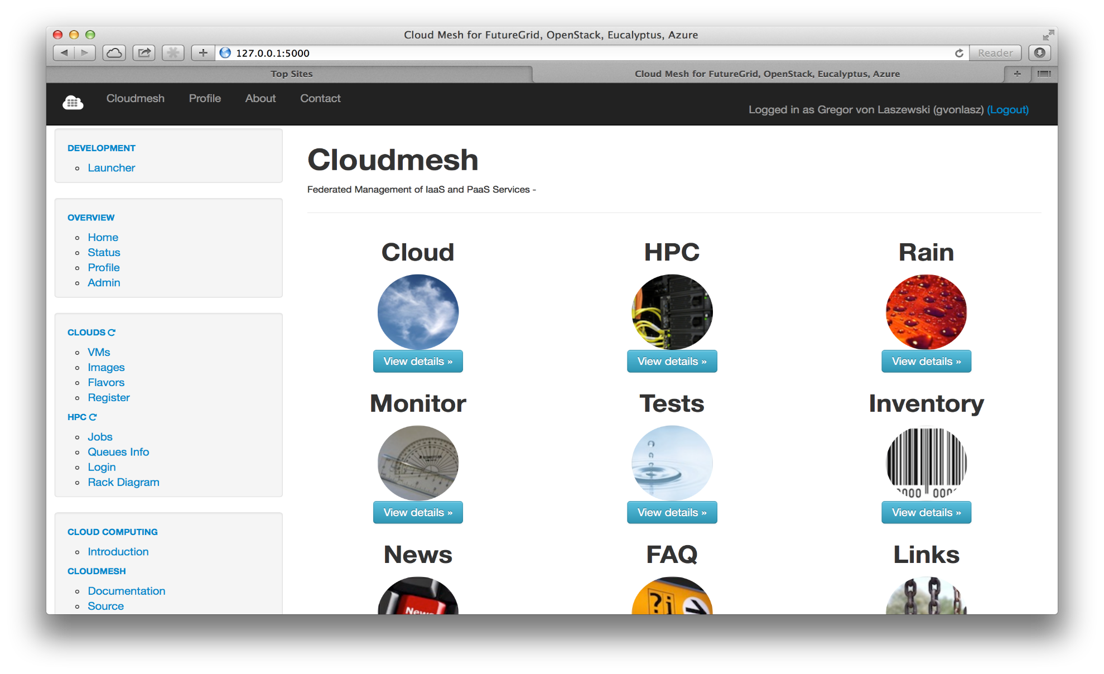
… after login you get to a start page

Slide 17
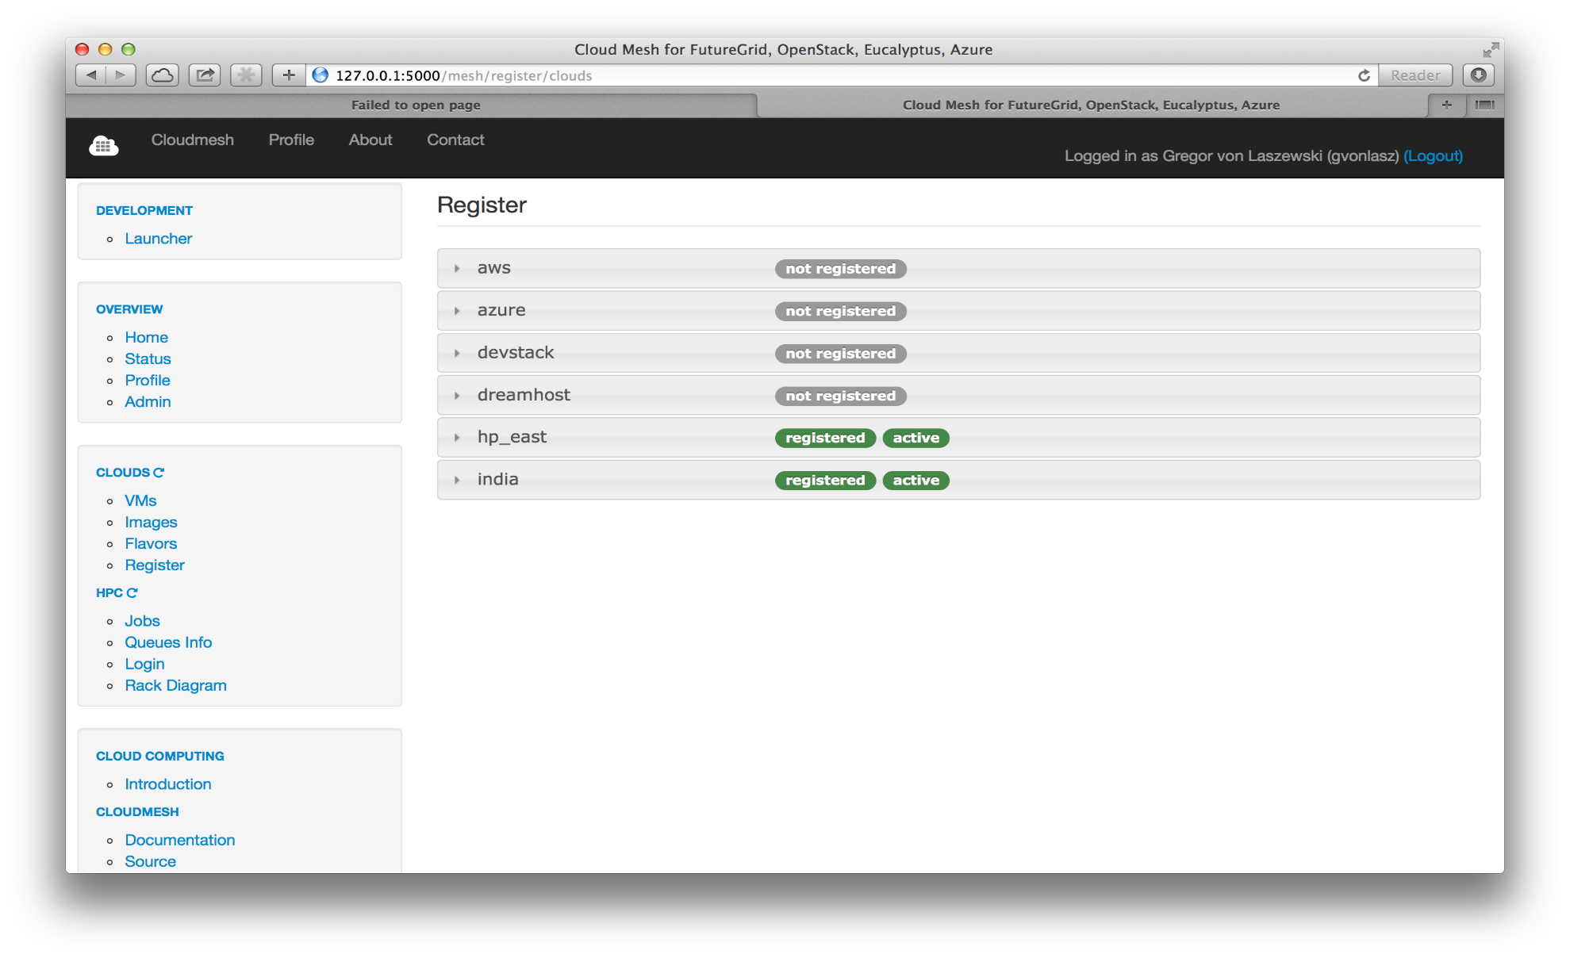
… Register clouds
Multiple clouds are registered

Slide 18
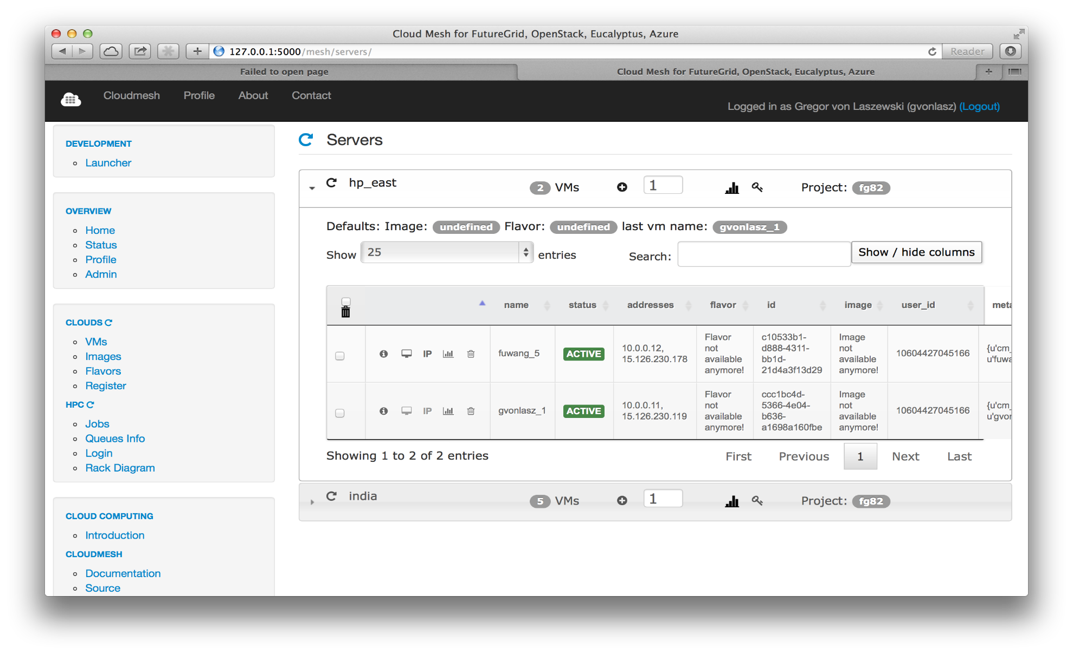
… Work with VMs
Search
VMs
Panel with VM Table (HP)

Slide 19
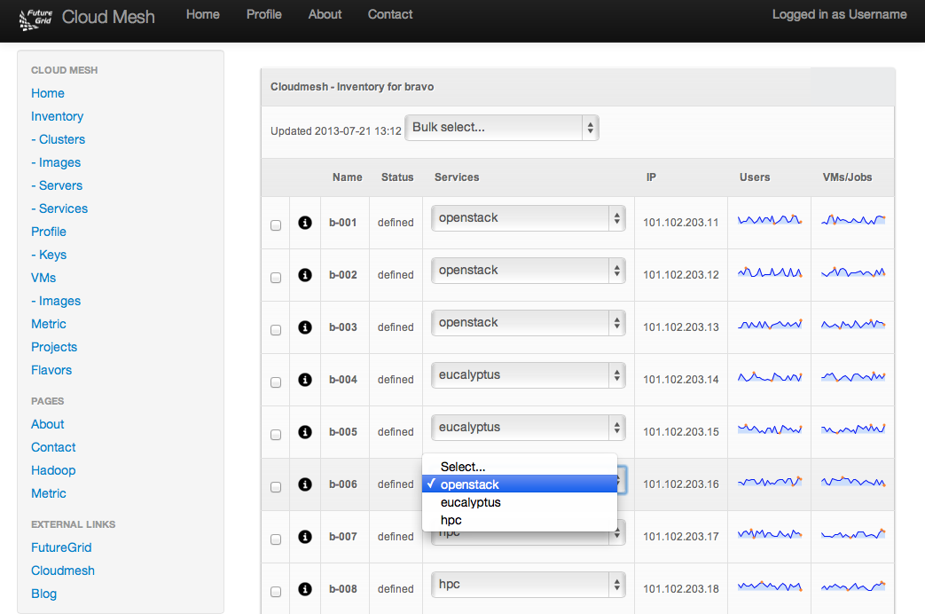
… baremetal provisioner

Slide 20
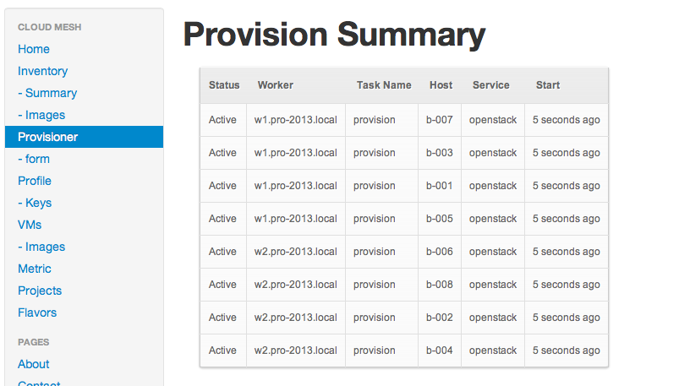
Provisioning OpenStack
View the parallel provisioning tasks execution from AMPQ

Slide 21
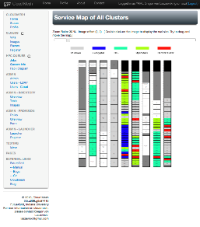
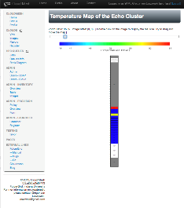
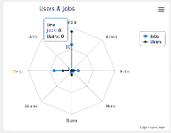
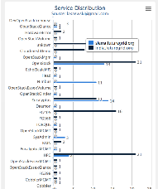
Monitoring and Metrics Interface
Service Monitoring
Energy/Temperature Monitoring
Monitoring of Provisioning
Integration with other Tools
  Nagios, Ganglia, Inca, FG Metrics
  Accounting metrics
Notes:
Naturally we want to monitor

Slide 22
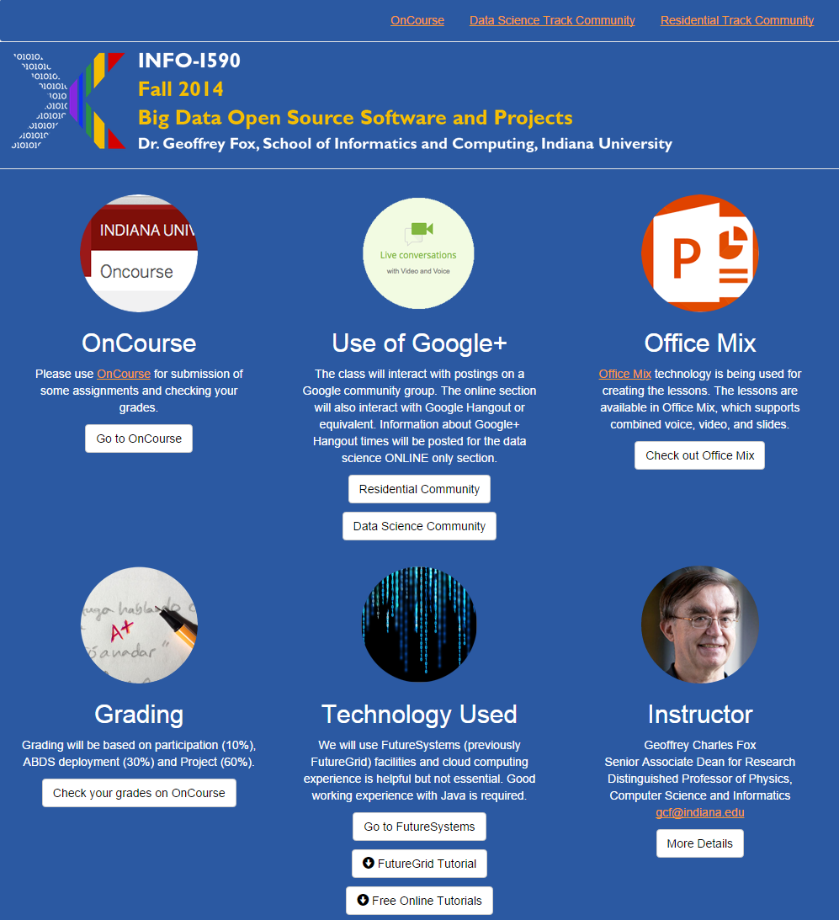
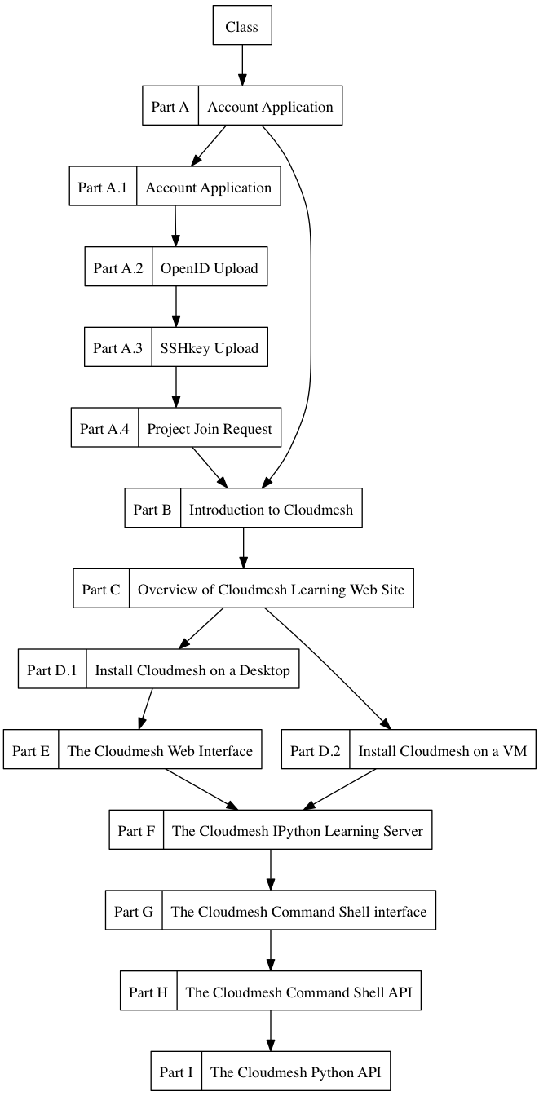
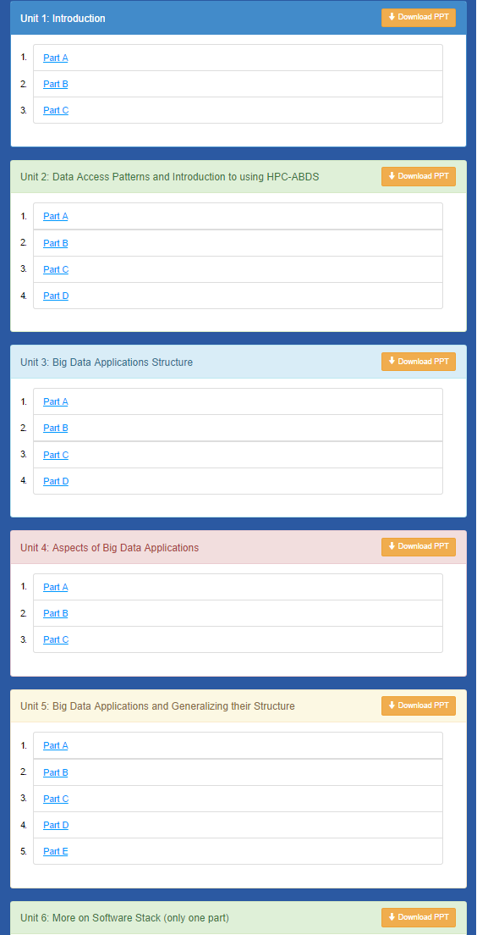
Cloudmesh MOOC Videos

Slide 23
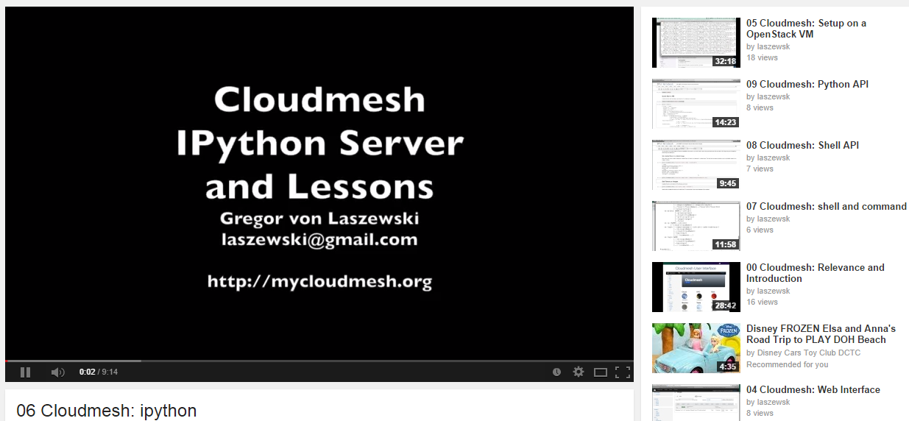
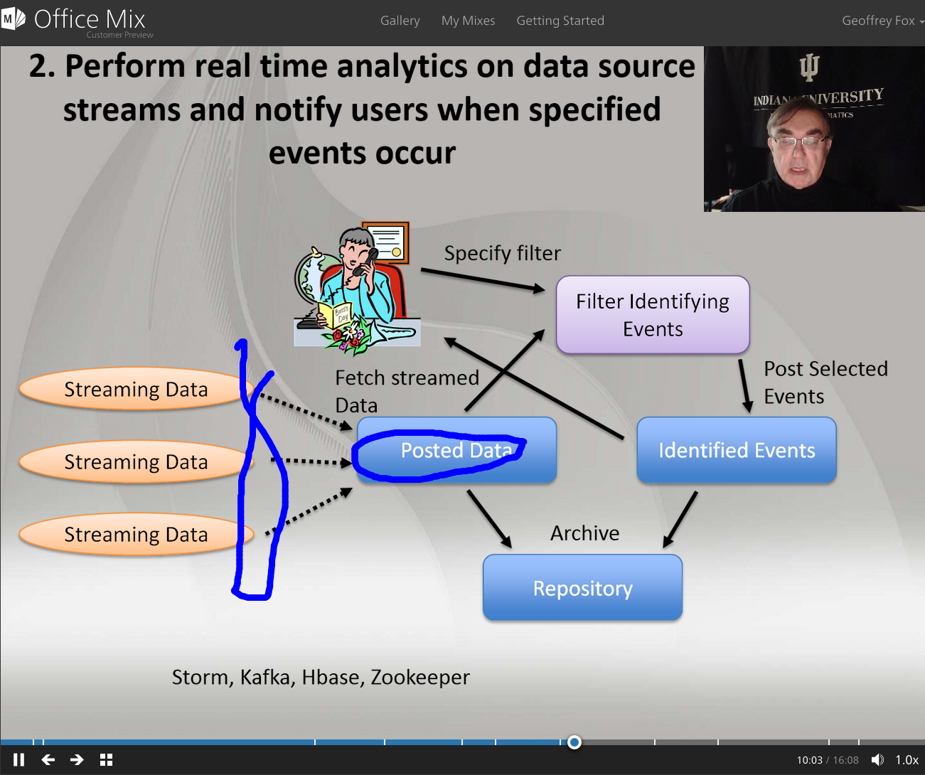
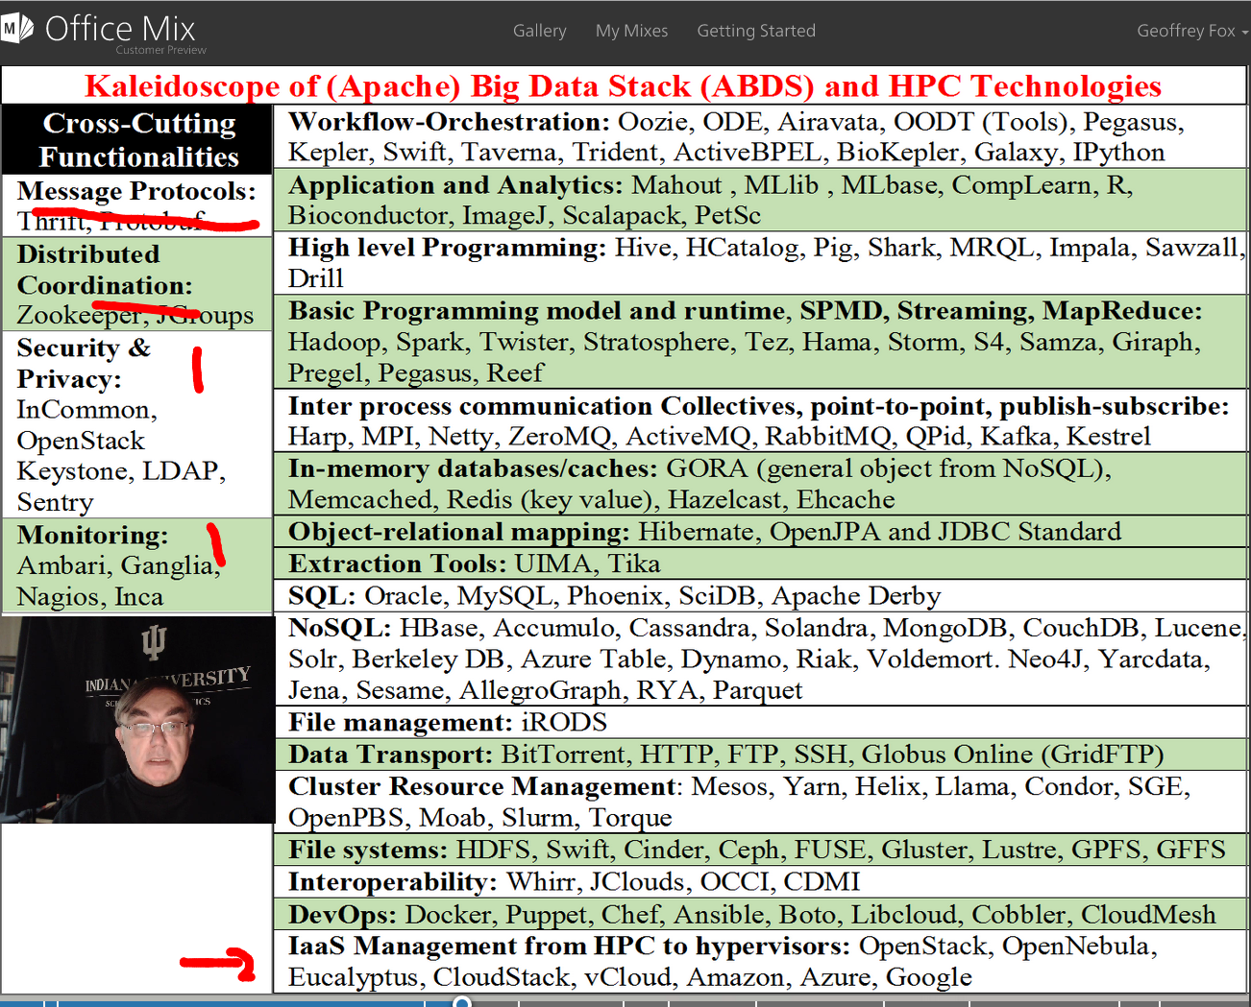

Slide 24
Software-Defined Distributed
System (SDDS) as a Service includes
FutureGrid used
SDDS-aaS Tools
Provisioning
Image Management
IaaS Interoperability
NaaS, IaaS tools
Expt management
Dynamic IaaS NaaS
DevOps
Dynamic Orchestration and Dataflow
Software
(Application
Or Usage) SaaS
Use HPC-ABDS
Class Usages e.g. run GPU & multicore
Applications
Control Robot
CloudMesh is a SDDSaaS tool that uses Dynamic Provisioning and Image Management to provide custom environments for general target systems
Involves (1) creating,
(2) deploying, and
(3) provisioning
of one or more images in a set of machines on demand http://mycloudmesh.org/
Cloud e.g. MapReduce
HPC e.g. PETSc, SAGA
Computer Science e.g. Compiler tools, Sensor nets, Monitors
Platform
PaaS
Infra
structure
IaaS
Software Defined Computing (virtual Clusters)
Hypervisor, Bare Metal
Operating System
Network
NaaS
Software Defined Networks
OpenFlow GENI

Slide 25
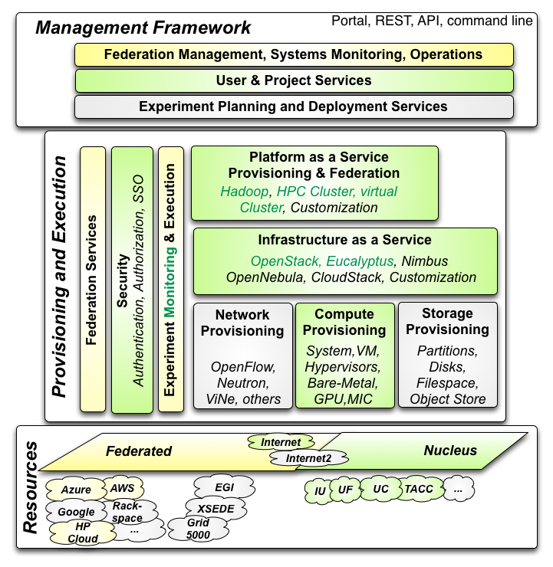

Cloudmesh Architecture
Cloudmesh Management Framework for monitoring and operations, user and project management, experiment planning and deployment of services needed by an experiment
Provisioning and execution environments to be deployed on resources to (or interfaced with) enable experiment management.
Resources.
FutureSystems, SDSC Comet, IU Juliet

Slide 26
CloudMesh Administrative View of SDDS aaS
CM-BMPaaS (Bare Metal Provisioning aaS) is a systems view and allows Cloudmesh to dynamically generate anything and assign it as permitted by user role and resource policy
  FutureGrid machines India, Bravo, Delta, Sierra, Foxtrot are like this
  Note this only implies user level bare metal access if given user is authorized and this is done on a per machine basis
  It does imply dynamic retargeting of nodes to typically safe modes of operation (approved machine images) such as switching back and forth between OpenStack, OpenNebula, HPC on Bare metal, Hadoop etc.
CM-HPaaS (Hypervisor based Provisioning aaS) allows Cloudmesh to generate "anything" on the hypervisor allowed for a particular user
  Platform determined by images available to user
  Amazon, Azure, HPCloud, Google Compute Engine
CM-PaaS (Platform as a Service) makes available an essentially fixed Platform with configuration differences
  XSEDE with MPI HPC nodes could be like this as is Google App Engine and Amazon HPC Cluster. Echo at IU (ScaleMP) is like this
  In such a case a system administrator can statically change base system but the dynamic provisioner cannot

Slide 27
CloudMesh User View of SDDS aaS
Note we always consider virtual clusters or slices with nodes that may or may not have hypervisors
Well defined user and project management assigning roles
BM-IaaS: Bare Metal (root access) Infrastructure as a service with variants e.g. can change firmware or not
H-IaaS: Hypervisor based Infrastructure (Machine) as a Service. User provided a collection of hypervisors to build system on.
  Classic Commercial cloud view
PSaaS Physical or Platformed System as a Service where user provided a configured image on either Bare Metal or a Hypervisor
  User could request a deployment of Apache Storm and Kafka to control a set of devices (e.g. smartphones)

Slide 28
Cloudmesh Components I
Cobbler: Python based provisioning of bare-metal or hypervisor-based systems
Apache Libcloud: Python library for interacting with many of the popular cloud service providers using a unified API. (One Interface To Rule Them All)
Celery is an asynchronous task queue/job queue environment based on RabbitMQ or equivalent and written in Python
OpenStack Heat is a Python orchestration engine for common cloud environments managing the entire lifecycle of infrastructure and applications.
Docker (written in Go) is a tool to package an application and its dependencies in a virtual Linux container
OCCI is an Open Grid Forum cloud instance standard
Slurm is an open source C based job scheduler from HPC community with similar functionalities to OpenPBS

Slide 29
Cloudmesh Components II
Chef Ansible Puppet Salt are system configuration managers. Scripts are used to define system
Razor cloud bare metal provisioning from EMC/puppet
Juju from Ubuntu orchestrates services and their provisioning defined by charms across multiple clouds
Xcat (Originally we used this) is a rather specialized (IBM) dynamic provisioning system
Foreman written in Ruby/Javascript is an open source project that helps system administrators manage servers throughout their lifecycle, from provisioning and configuration to orchestration and monitoring. Builds on Puppet or Chef

Slide 30
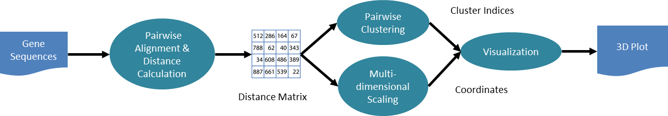
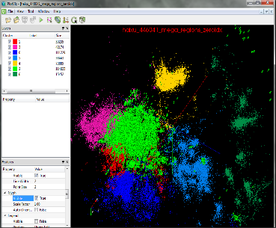
Genomic Sequence Analysis Automation
Application Functions
Cloudmesh
Workflow/
Experiment
Management
Cloudmesh
Provisioning
Workflow Functions:
File Transfer
PBS Job submission
Dynamic script creation
Submission history
storage/retrieval
Cluster A
Cluster B
History Trace of job submissions
Cluster C
Cluster D
Provisioning of either: baremetal, IaaS, existing HPC cluster

Slide 31
Background - FutureGrid
Some requirements originate from FutureGrid.
  A high performance and grid testbed that allowed scientists to collaboratively develop and test innovative approaches to parallel, grid, and cloud computing.
  Users can deploy their own hardware and software configurations on a public/private cloud, and run their experiments.
  Provides an advanced framework to manage user and project affiliation and propagates this information to a variety of subsystems constituting the FutureGrid service infrastructure. This includes operational services to deal with authentication, authorization and accounting.
Important features of FutureGrid:
  Metric framework that allows us to create usage reports from all of our IaaS frameworks. Developed from systems aimed at XSEDE
  Repeatable experiments can be created with a number of tools including Cloudmesh. Provisioning of services and images can be conducted by Rain.
  Multiple IaaS frameworks including OpenStack, Eucalyptus, and Nimbus.
  Mixed operation model. a standard production cloud that operates on-demand, but also a set of cloud instances that can be reserved for a particular project.
FutureGrid coming to an end but preserve SDDSaaS tools as Cloudmesh

Slide 32
Functionality Requirements
Provide virtual machine and bare-metal management in a multi-cloud environment with very different policies and including
  Expandable resources,
  External clouds from research partners,
  Public clouds,
  My own cloud
Provide multi-cloud services and deployments controlled by users & provider
Enable raining of
  Operating systems (bare-metal provisioning),
  Services
  Platforms
  IaaS
Deploy and give access to Monitoring infrastructure across a multi-cloud environment
Support management of reproducible experiments

Slide 33
Cloudmesh Provisioning and Execution
Bare-metal Provisioning
  Originally developed a provisioning framework in FutureGrid based on xCAT and Moab. (Rain)
  Due to limitations and significant changes between versions we replaced it with a framework that allows the utilization of different bare-metal provisioners.
  At this time we have provided an interface for cobbler and are also targeting an interface to OpenStack Ironic.
Virtual Machine Provisioning
  An abstraction layer to allow the integration of virtual machine management APIs based on the native IaaS service protocols. This helps in exposing features that are otherwise not accessible when quasi protocol standards such as EC2 are used on non-AWS IaaS frameworks. It also prevents limitaions that exist in current implementations, such as libcloud to use OpenStack.
Network Provisioning (Future)
  Utilize networks offering various levels of control, from standard IP connectivity to completely configurable SDNs as novel cloud architectures will almost certainly leverage NaaS and SDN alongside system software and middleware. FutureGrid resources will make use of SDN using OpenFlow whenever possible though the same level of networking control will not be available in every location.

Slide 34
Cloudmesh Provisioning – Continued
Storage Provisioning (Future)
  Bare-metal provisioning allows storage provisioning and making it available to users
Platform, IaaS, and Federated Provisioning (Current & Future)
  Integration of Cloudmesh shell scripting, and the utilization of DevOps frameworks such as Chef or Puppet.
Resource Shifting (Current & Future)
  We demonstrated via Rain the shift of resources allocations between services such as HPC and OpenStack or Eucalyptus.
  Developing intuitive user interfaces as part of Cloudmesh that assist administrators and users through role and project based authentication to move resources from one service to another.

Slide 35
Cloudmesh Resource Shifting
2
1

Slide 36
Resource Federation
We successfully federated resources from
  Azure
  Any EC2 cloud
  AWS,
  HP cloud
  Karlsruhe Institute of Technology Cloud
  Former FutureGrid clouds (four clouds)
    Various versions of OpenStack and Eucalyptus.
    It would be possible to federate with other clouds that run other infrastructure such as Tashi.
    Integration with OpenNebula is desirable due to strong EU importance

