Slide 1
Cloud Computing for Geophysics: Virtualization of Infrastructure
AOGS, Singapore, August 11-14, 2009
Geoffrey Fox^{1,2} and Marlon Pierce¹
gcf@indiana.edu www.infomall.org/salsa
http://grids.ucs.indiana.edu/ptliupages/
¹Community Grids Laboratory, Pervasive Technology Institute
²School of Informatics Indiana University

Slide 2
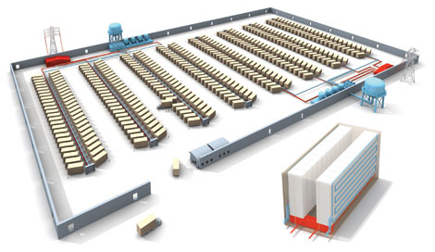
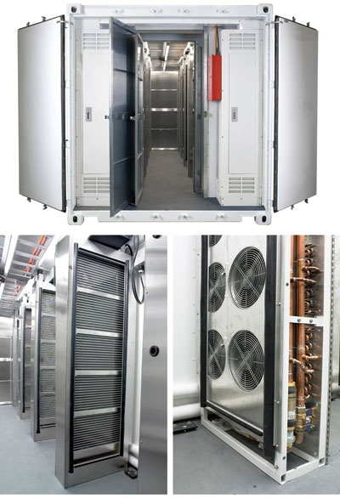
Clouds as Cost Effective Data Centers
Exploit the Internet by allowing one to build giant data centers with 100,000’s of computers; ~ 200-1000 to a shipping container
“Microsoft will cram between 150 and 220 shipping containers filled with data center gear into a new 500,000 square foot Chicago facility. This move marks the most significant, public use of the shipping container systems popularized by the likes of Sun Microsystems and Rackable Systems to date.”

Slide 3
Cloud Computing: Infrastructure and Runtimes
Cloud infrastructure: outsourcing of servers, computing, data, file space, etc.
Handled through Web services that control virtual machine (Xen, VMWare, OpenVZ,…) lifecycles.
Compare to Grid interfaces such as Globus, Unicore, etc.
Cloud runtimes:: tools for using clouds to do data-parallel computations.
Apache Hadoop, Google MapReduce, Microsoft Dryad, and others
Designed for information retrieval but are excellent for a wide range of machine learning and data-centric science applications.
Example: Apache Mahout for machine learning.

Slide 4
Commercial Cloud Software
Cloud/ Service | Amazon | Microsoft Azure | Google (and Apache)
Data | S3, EBS, SimpleDB | Blob, Table, SQL Services | GFS, BigTable
Computing | EC2, Elastic Map Reduce (runs Hadoop) | Compute Service | MapReduce (not public, but Hadoop)
Service Hosting | EC2 with load balancing. | Web Hosting Service | AppEngine/AppDrop
Boldfaced names have open source versions

Slide 5
Open Architecture Clouds
Amazon, Google, Microsoft, et al., don’t tell you how to build a cloud.
Proprietary knowledge
Indiana University and others want to document this publically.
What is the right way to build and run a cloud?
It is more than just running software.
What is the minimum-sized organization to run a cloud?
Department? University? University Consortium? Outsource it all?
Analogous issues in government, industry, and enterprise.

Slide 6
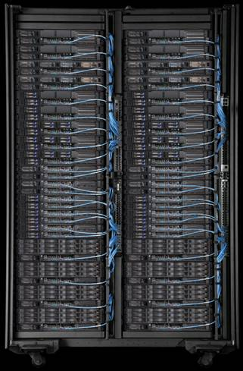
IU’s Cloud Testbed Host
Hardware:
IBM iDataplex = 84 nodes
32 nodes for Eucalyptus
32 nodes for Nimbus
20 nodes for test and/or reserve capacity
2 dedicated head nodes
Nodes specs:
2 x Intel L5420 Xeon 2.50 (4 cores/cpu)
32 gigabytes memory
160 gigabytes local hard drive
Gigabit network
No support in Xen for Infiniband or Myrinet (10 Gbps)
Part of IU’s Research Computing Infrastructure
Hopefully will grow soon.
Tempest is a similar machine that supports both Linux and Windows Server 2008

Slide 7
Cloud Runtimes
What science can you do on a cloud?

Slide 8
Data-File Parallelism and Clouds
Now that you have a cloud, you may want to do large scale processing with it.
Classic problems are to perform the same (sequential) algorithm on fragments of extremely large data sets.
Cloud runtime engines manage these replicated algorithms in the cloud.
Can be chained together in pipelines (Hadoop) or DAGs (Dryad).
Runtimes manage problems like failure control.
We are exploring both scientific applications and classic parallel algorithms (clustering, matrix multiplication) using Clouds and cloud runtimes.

Slide 9
MapReduce implemented
by Hadoop
H
map(key, value)
reduce(key, list<value>)
Y
n
Y
U
U
S
4n
S
Example: Word Histogram
Start with a set of words
Each map task counts number of occurrences in each data partition
Reduce phase adds these counts
M
4n
M
D
n
D
X
n
X
Dryad supports general dataflow
U
N
U
N

Slide 10
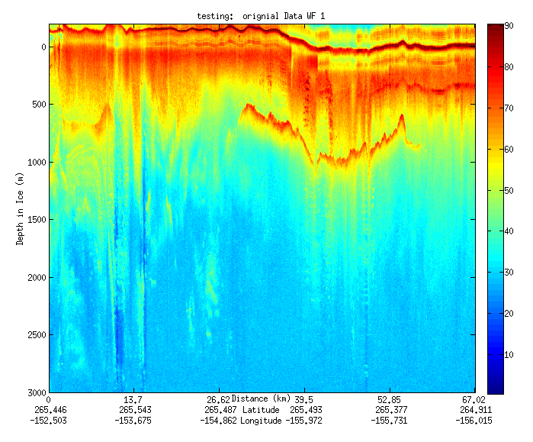
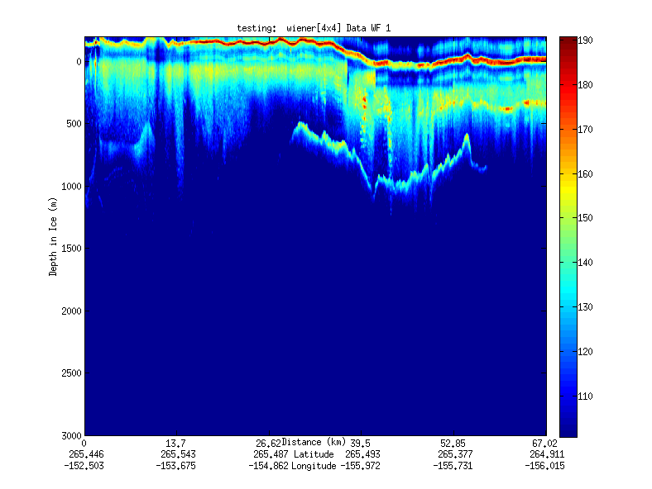
Geospatial Examples
Image processing and mining
Ex: SAR Images from Polar Grid project (J. Wang)
Apply to 20 TB of data
Flood modeling
Chaining flood models over a geographic area.
Parameter fits and inversion problems.
Earthquake modeling equivalents
GPS processing: real time and archival.
Robert Granat, JPL
Filter

Slide 11
Alternative Elastic Block Store Components
Volume Server
Virtual Machine Manager (Xen Dom 0)
VBD
Xen Dom U
ISCSI
Volume Delegate
Xen Delegate
Create Volume, Export Volume, Create Snapshot,
etc.
Import Volume, Attach Device, Detach Device, etc.
VBS Web Service
There’s more than one way to build Elastic Block Store. We need to find the best way to do this.
VBS Client

Slide 12
More Information
See publications at http://grids.ucs.indiana.edu/ptliupages/publications
Examples
Geoffrey Fox, Seung-Hee Bae, Jaliya Ekanayake, Xiaohong Qiu, and Huapeng Yuan Parallel Data Mining from Multicore to Cloudy Grids
Jaliya Ekanayake, Geoffrey Fox High Performance Parallel Computing with Clouds and Cloud Technologies
Sangmi Lee Pallickara, Marlon Pierce, Qunfeng Dong, and ChinHua Kong,Enabling Large Scale Scientific Computations for Expressed Sequence Tag Sequencing over Grid and Cloud Computing Clusters
See also http://pti.iu.edu/ and http://pti.iu.edu/cgl

