Slide 1

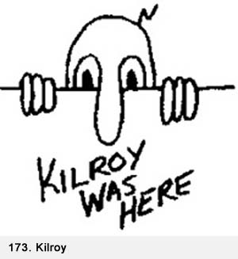
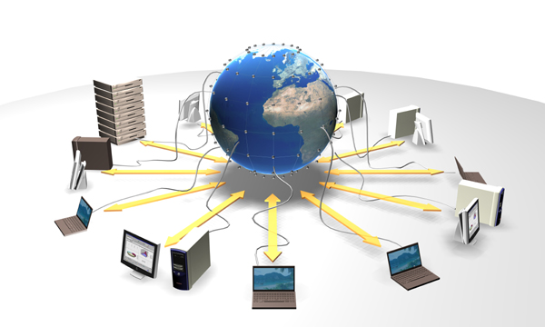
Cloudy Thoughts
Ian Foster
Grid

Slide 2
Is “Cloud” a New Concept?
“Computation may someday be organized as a public utility” – John McCarthy, 1960
  Project Mac
“By linking digital processors, storage systems and software on a global scale, grid technology is poised to transform computing from an individual and corporate activity into a general utility” – Scientific American, 2003
  Globus, TeraGrid, OSG, EGEE, … (& caBIG, ESG, …)
Infinite on-demand computing & storage to anyone with > $0.10 [where ∞ ≤ 100]
  Primarily a business model innovation (?)
[Search: “Ian Foster cloud” for further thoughts]

Slide 3
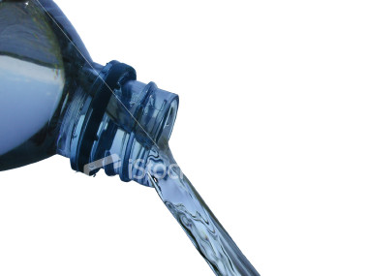

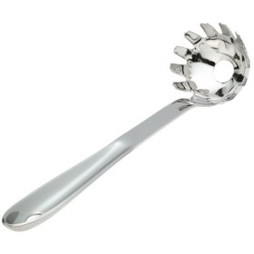
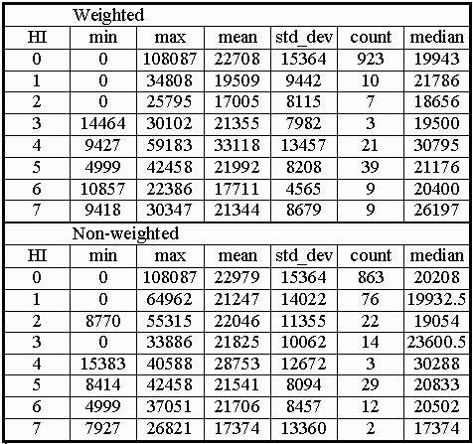
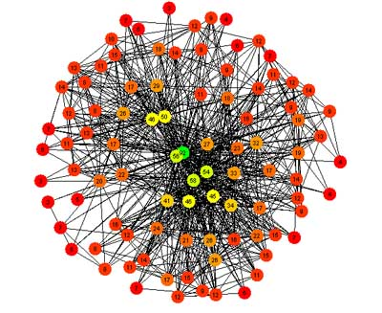


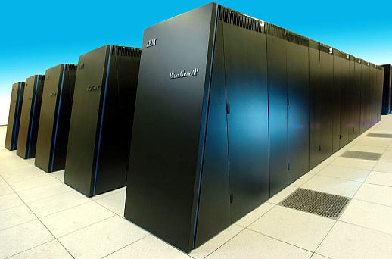
An Open Analytics Environment
(or “Data Cauldron”)
Programs
& rules in
Data
in
Results
out
“No limits”
Storage
Computing
Format
Program
Allowing for
Versioning
Provenance
Collaboration
Annotation
Notes:
The challenges of large and complex data:
Marshalling sufficient storage & computing resources
Too often limited by “what is possible”

Slide 4
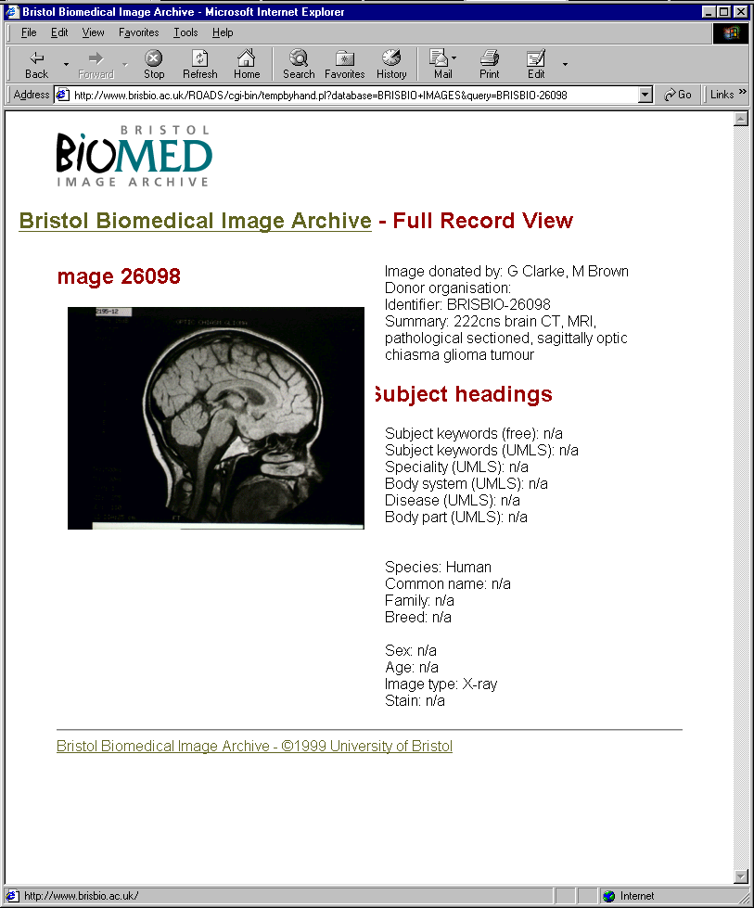
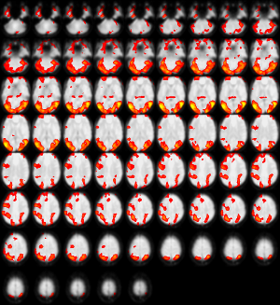

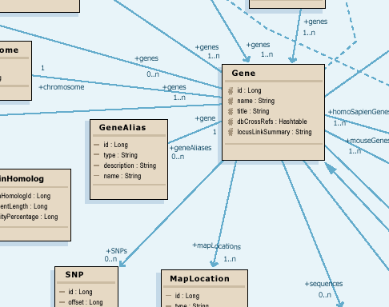
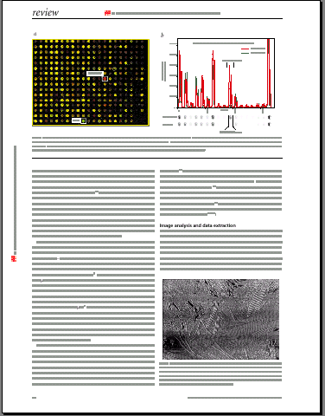

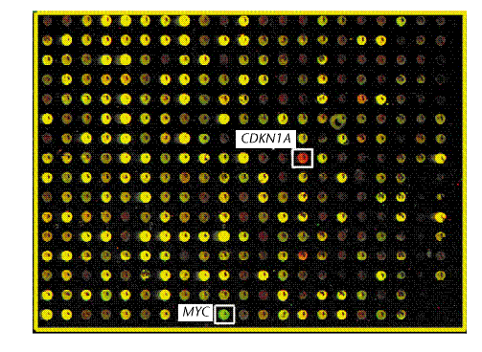
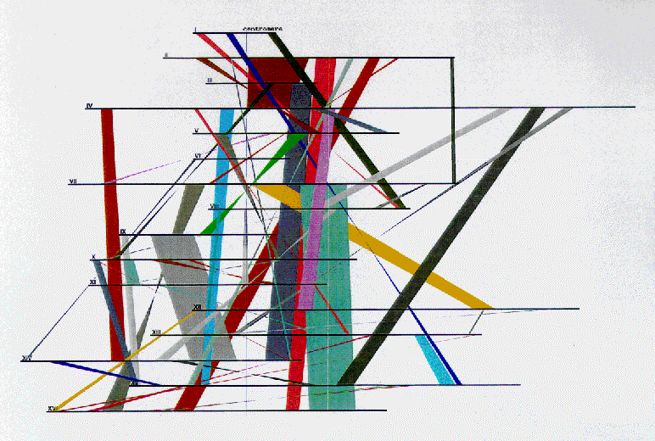
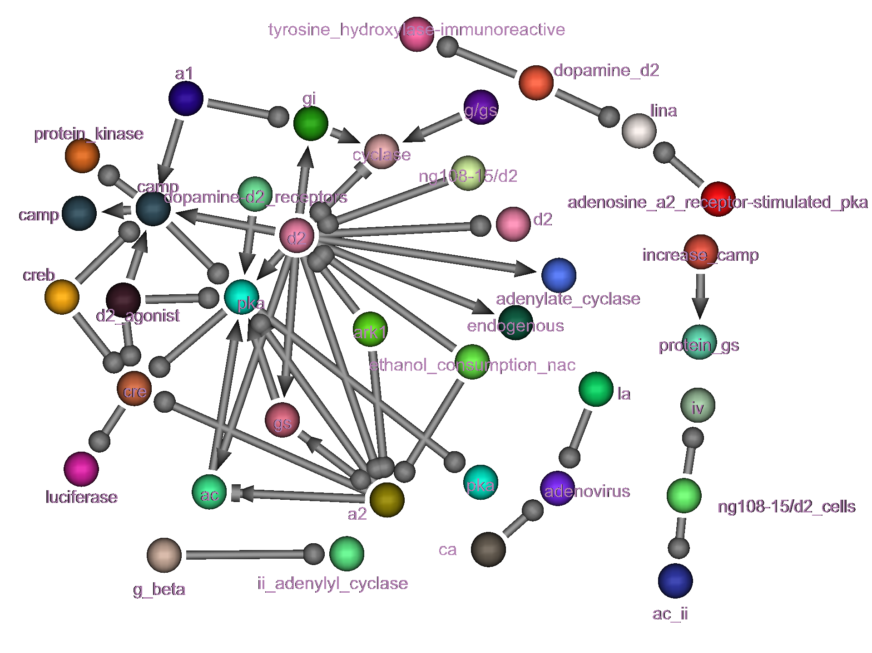
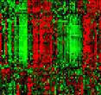
What Goes In (1)
Notes:
Experimental data
Scientific literature
Opinions
Simulation data
Tags
Hypothesized linkages
Structured and unstructured
Programs

Slide 5
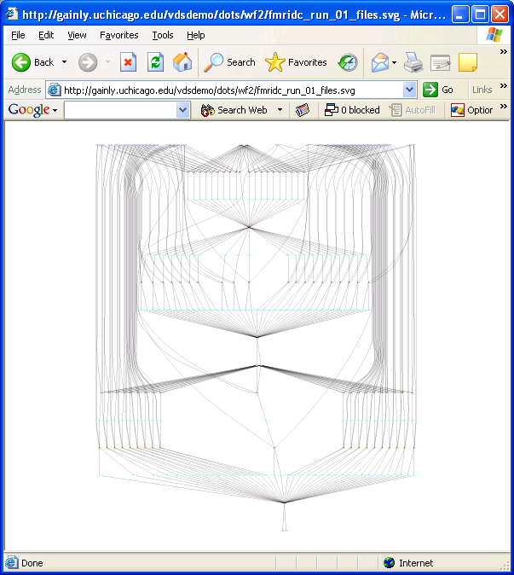
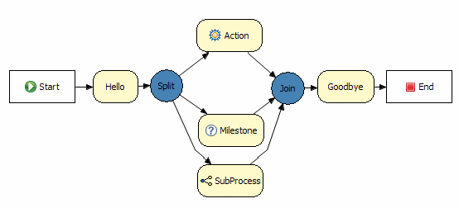
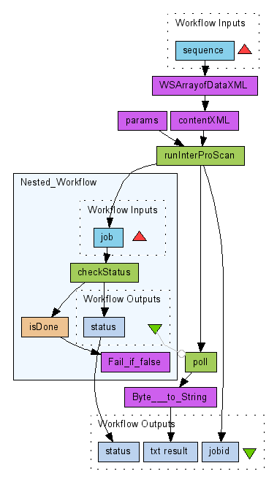
What Goes In (2)
Rules
Parallel programs
Swift
MapReduce
Workflows
R
MatLab
Dryad
SQL
Octave
BPEL
SCFL
Notes:
Programs, workflows, stored procedures
Service definitions

Slide 6
How it Cooks
Virtualization
  Run any program, store any data
Indexing
  Automated maintenance
Provisioning
  Policy-driven allocation of resources to competing demands
Notes:
What happens
-- programs get run, data gets indexed, etc., etc.
-- stored procedures are executed
-- etc. etc.

Slide 7
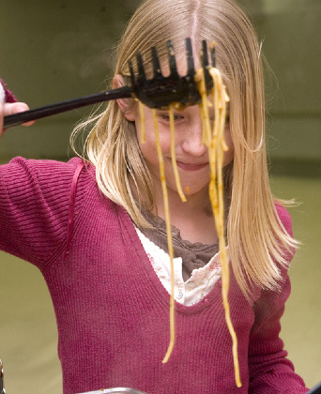
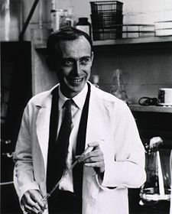
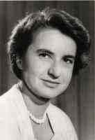
What Comes Out
Virtual Data Schema
Data
Data
Notes:
What comes out?
-- Data
-- Triggers
-- Provenance

Slide 8
Analysis as (Collaborative) Process
Transform
Annotate
Search
Add to
Tag
Visualize
Discover
Extend
Group
Share
Notes:
The challenges of large and complex data:
Marshalling sufficient storage & computing resources
Too often limited by “what is possible”

Slide 9
