Slide 1
Seattle: We Know About Clouds!
Dan Reed
reed@microsoft.com
Multicore and Scalable Computing Strategist
Managing Director, Data Center Futures

Slide 2
Cloud Questions To Ponder
What are the building blocks?
Packages, computing, storage
What should be centralized or distributed?
Hardware, data, operations
What are the control and specification models?
Declarative, PID, …
What are the service APIs?
Level, features and capabilities
What are the SLAs?
Reliability, performance, provenance, sustainability
Services and data hosted atop managed infrastructure

Slide 3
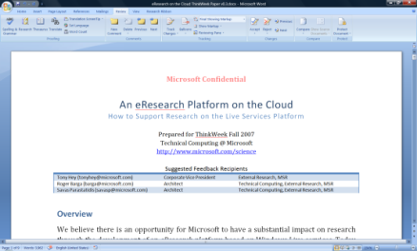
TeraGrid As a Peta-Cloud
Insights and Integration
Visualization and analysis services
Scholarly communications
Domain-specific services
Search
books
citations
Blogs & social networking
Reference management
Instant messaging
Project management
Identity
Mail
Notification
Document store
Storage/data services
The Microsoft Technical Computing mission to reduce time to scientific insights is exemplified by the June 13, 2007 release of a set of four free software tools designed to advance AIDS vaccine research. The code for the tools is available now via CodePlex, an online portal created by Microsoft in 2006 to foster collaborative software development projects and host shared source code. Microsoft researchers hope that the tools will help the worldwide scientific community take new strides toward an AIDS vaccine. See more.
Knowledge management
Compute
Services and
Virtualization
Knowledge discovery
Source: Tony Hey

Slide 4
Trusting the Clouds
“But it was all right, everything was all right, the struggle was finished. He had won the victory over himself. He loved Big Brother.”
George Orwell
We already do trust the clouds …
and it’s not a big deal
Enterprise services hosted internally
Business processes
Scientific data management and computing
Software as a service
Microsoft, Google, salesforce.com, …

Slide 5
Interoperability? Yes and No
Mashups will continue
Innovation drives new capabilities
VM sharing
Depends on level
Universal APIs are doubtful but possible
Multi-level service differentiation

Slide 6
The Killer App
Let’s get this out of the way …
It’s definitely not science, much as we’d like
Because we are too small a market
It might be business …
Hosted Software as a Service (SaaS)
But it’s probably consumer related …
And hasn’t been invented yet
One possibility is the mobile infosphere
Physical
Virtual

Slide 7
© 2008 Microsoft Corporation. All rights reserved. Microsoft, Windows, Windows Vista and other product names are or may be registered trademarks and/or trademarks in the U.S. and/or other countries.
The information herein is for informational purposes only and represents the current view of Microsoft Corporation as of the date of this presentation. Because Microsoft must respond to changing market conditions, it should not be interpreted to be a commitment on the part of Microsoft, and Microsoft cannot guarantee the accuracy of any information provided after the date of this presentation. MICROSOFT MAKES NO WARRANTIES, EXPRESS, IMPLIED OR STATUTORY, AS TO THE INFORMATION IN THIS PRESENTATION.

