Slide 1
Clouds
Ball Aerospace
March 23 2011
Geoffrey Fox
gcf@indiana.edu
http://www.infomall.org http://www.futuregrid.org
Director, Digital Science Center, Pervasive Technology Institute
Associate Dean for Research and Graduate Studies, School of Informatics and Computing
Indiana University Bloomington

Slide 2
Important Trends
Data Deluge in all fields of science
Multicore implies parallel computing important again
Performance from extra cores – not extra clock speed
GPU enhanced systems can give big power boost
Clouds – new commercially supported data center model replacing compute grids (and your general purpose computer center)
Light weight clients: Sensors, Smartphones and tablets accessing and supported by backend services in cloud
Commercial efforts moving much faster than academia in both innovation and deployment

Slide 3
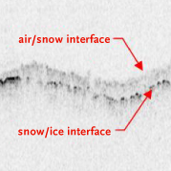
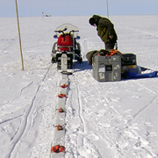
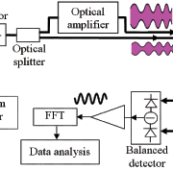
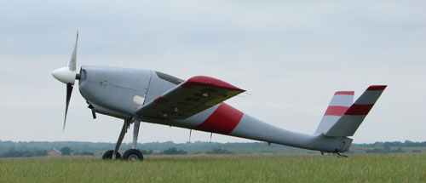
Sensors as a Service Cell phones are important sensor
Sensors as a Service
Sensor Processing as a Service (MapReduce)

Slide 4
Grids MPI and Clouds
Grids are useful for managing distributed systems
Pioneered service model for Science
Developed importance of Workflow
Performance issues – communication latency – intrinsic to distributed systems
Can never run large differential equation based simulations or datamining
Clouds can execute any job class that was good for Grids plus
More attractive due to platform plus elastic on-demand model
MapReduce easier to use than MPI for appropriate parallel jobs
Currently have performance limitations due to poor affinity (locality) for compute-compute (MPI) and Compute-data
These limitations are not “inevitable” and should gradually improve as in July 13 2010 Amazon Cluster announcement
Will probably never be best for most sophisticated parallel differential equation based simulations
Classic Supercomputers (MPI Engines) run communication demanding differential equation based simulations
MapReduce and Clouds replaces MPI for other problems
Much more data processed today by MapReduce than MPI (Industry Informational Retrieval ~50 Petabytes per day)

Slide 5
Fault Tolerance and MapReduce
MPI does “maps” followed by “communication” including “reduce” but does this iteratively
There must (for most communication patterns of interest) be a strict synchronization at end of each communication phase
Thus if a process fails then everything grinds to a halt
In MapReduce, all Map processes and all reduce processes are independent and stateless and read and write to disks
As 1 or 2 (reduce+map) iterations, no difficult synchronization issues
Thus failures can easily be recovered by rerunning process without other jobs hanging around waiting
Re-examine MPI fault tolerance in light of MapReduce
Twister will interpolate between MPI and MapReduce

Slide 6
Important Platform Capability MapReduce
Data Partitions
Map(Key, Value)
A hash function maps the results of the map tasks to reduce tasks
Reduce(Key, List<Value>)
Reduce Outputs
Implementations (Hadoop – Java; Dryad – Windows) support:
Splitting of data
Passing the output of map functions to reduce functions
Sorting the inputs to the reduce function based on the intermediate keys
Quality of service

Slide 7
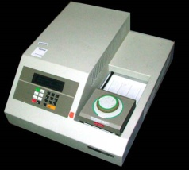
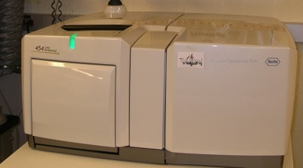
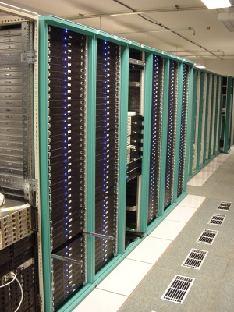
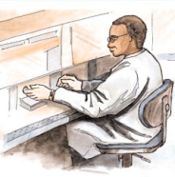
MapReduce “File/Data Repository” Parallelism
Map = (data parallel) computation reading and writing data
Reduce = Collective/Consolidation phase e.g. forming multiple global sums as in histogram
Instruments
Iterative MapReduce
Map Map Map Map
Reduce Reduce Reduce
Communication
Reduce
Portals /Users
Disks
Map₁
Map₂
Map₃

Slide 8
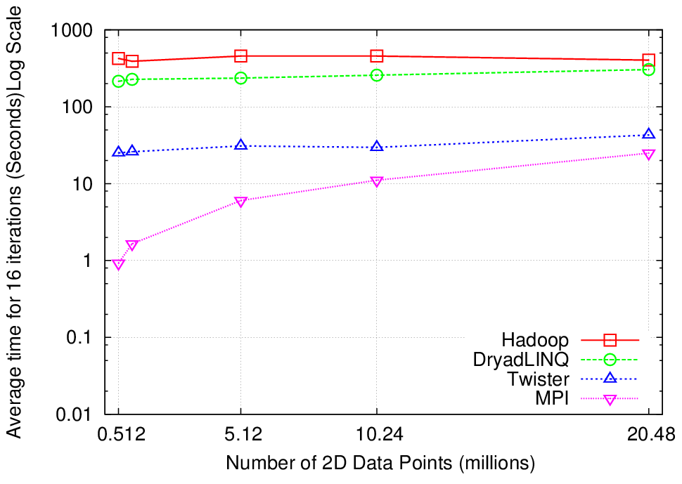
K-Means Clustering
Compute the distance to each data point from each cluster center and assign points to cluster centers
map
map
Time for 20 iterations
reduce
Compute new cluster
centers
User program
Compute new cluster centers
Iteratively refining operation
Typical MapReduce runtimes incur extremely high overheads
New maps/reducers/vertices in every iteration
File system based communication
Long running tasks and faster communication in Twister enables it to perform close to MPI

Slide 9
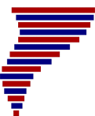
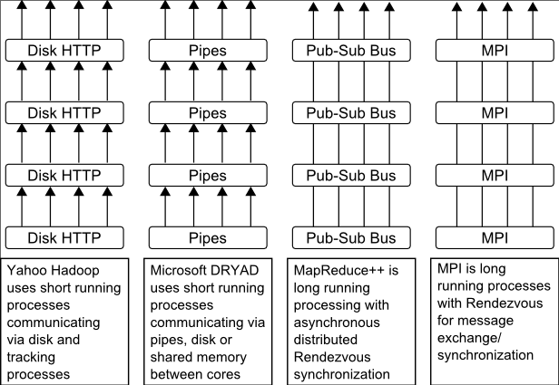
Twister
Pub/Sub Broker Network
Map Worker
M
Worker Nodes
R
Reduce Worker
Streaming based communication
Intermediate results are directly transferred from the map tasks to the reduce tasks – eliminates local files
Cacheable map/reduce tasks
Static data remains in memory
Combine phase to combine reductions
User Program is the composer of MapReduce computations
Extends the MapReduce model to iterative computations
D
D
MR
Driver
User
Program
M
M
M
M
D
MRDeamon
R
R
R
R
Data Read/Write
Communication
Data Split
File System
Iterate
Static
data
Configure()
User Program
Map(Key, Value)
δ flow
Reduce (Key, List<Value>)
Combine (Key, List<Value>)
Different synchronization and intercommunication mechanisms used by the parallel runtimes
Close()

Slide 10
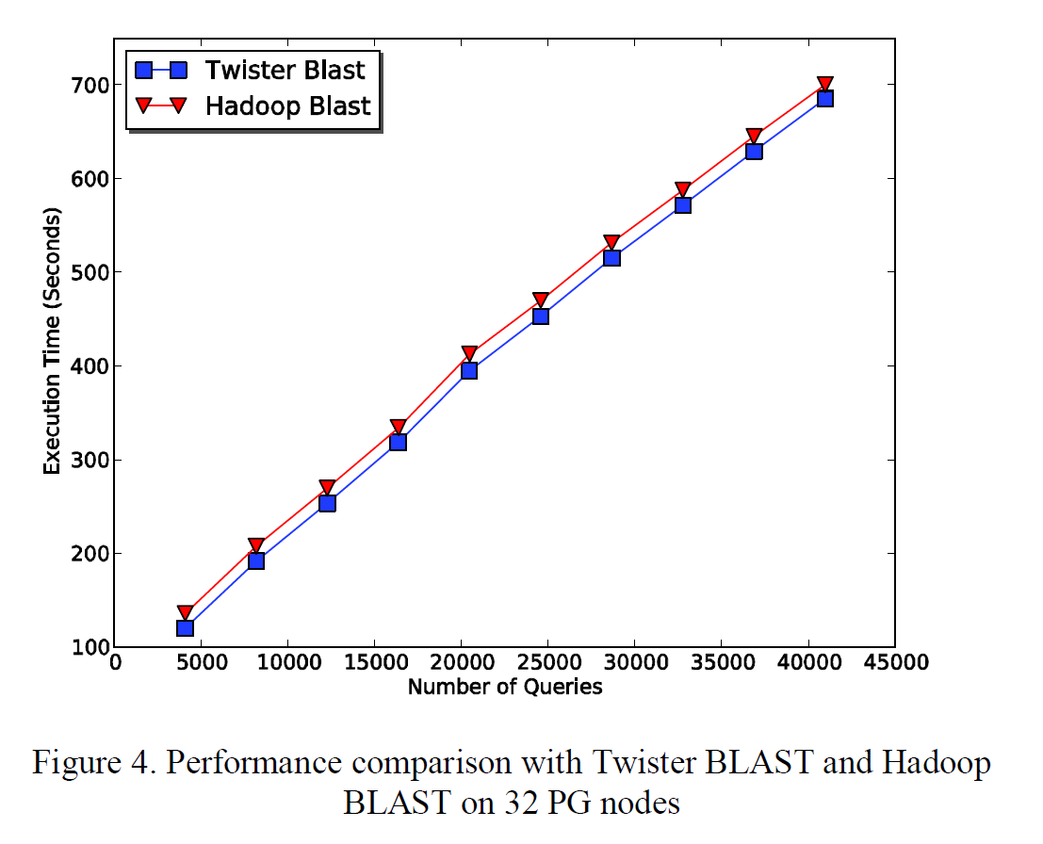
Twister-BLAST vs. Hadoop-BLAST Performance

Slide 11
Overhead OpenMPI v Twister negative overhead due to cache

Slide 12
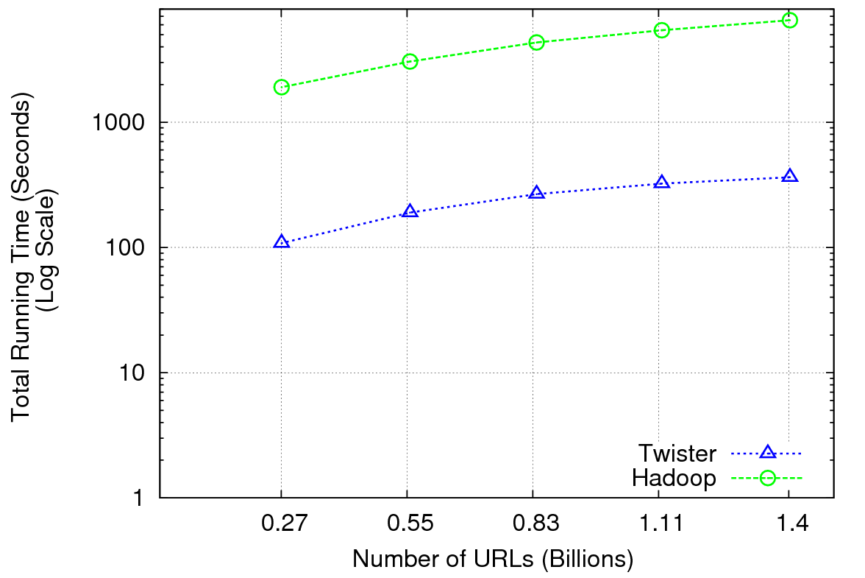
Performance of Pagerank using ClueWeb Data (Time for 20 iterations) using 32 nodes (256 CPU cores) of Crevasse

Slide 13
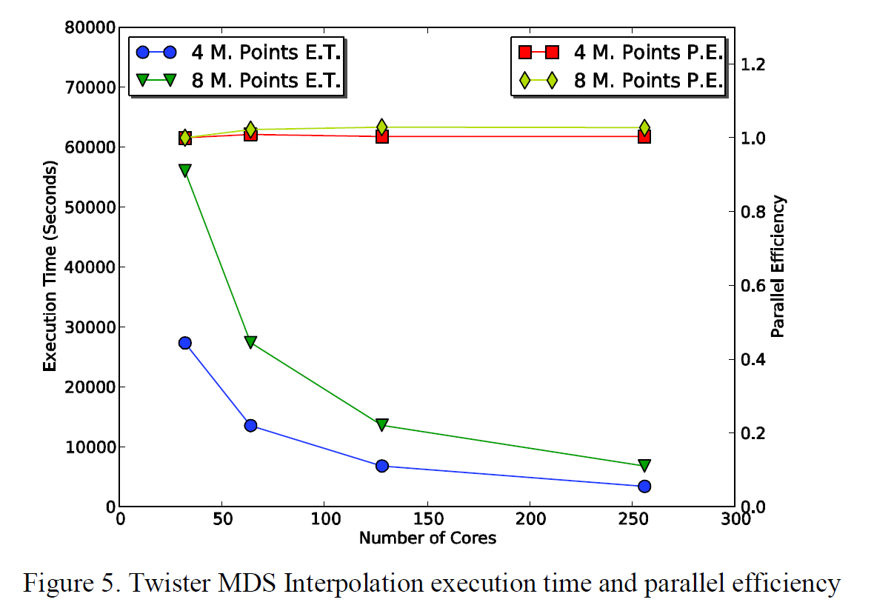
Twister MDS Interpolation Performance Test

Slide 14
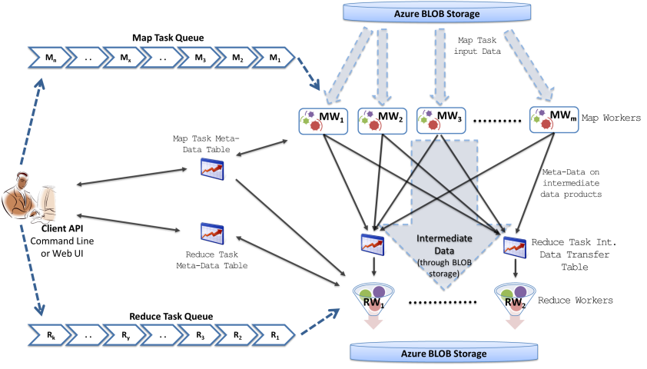
MapReduceRoles4Azure
Will have prototype Twister4Azure by May 2011
Notes:
Dealing with eventual consitency…

Slide 15
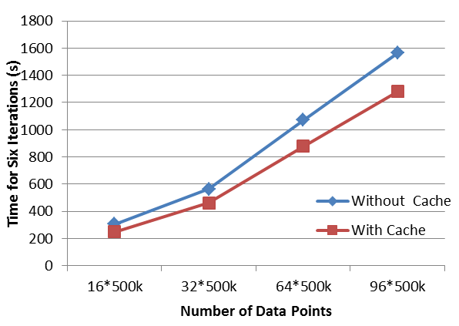
Twister for Azure
Scheduling Queue
Worker Role
Job Bulleting Board
Map Workers
Map 1
Map 2
Map n
MapID | ……. | Status
Reduce Workers
Red 1
Red 2
Red n
In Memory Data Cache
Map Task Table
MapID | ……. | Status
Task Monitoring
Role Monitoring

Slide 16
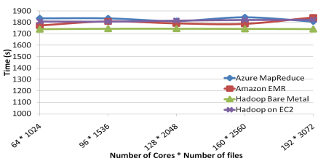
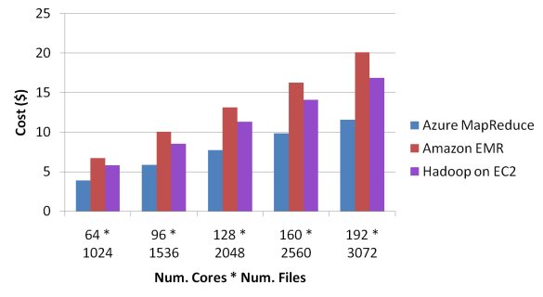
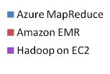
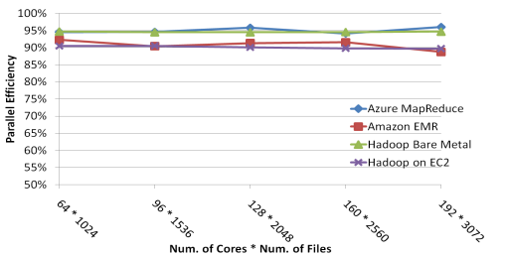
Sequence Assembly Performance

