Slide 1
Cyberinfrastructure
Geoffrey Fox
Indiana University

Slide 2
Data Analysis Cyberinfrastructure I
CReSIS is part of big data revolution – will reach petabyte of data
Cyberinfrastructure covers field and off line data processing and analysis toolkit
Design and support of field expeditions; investigation of GPU and other optimizations to improve performance per power/weight
Perform L1B data analysis on PolarGrid Systems with KU

Slide 3
Data Analysis Cyberinfrastructure II
Develop geospatial analysis tools allowing access to and comparison with existing data
  Including 2D and 3D (large screen) visualization of flight paths and their intersection
Develop innovative image processing algorithm to automate layer determination from radar data
  Refining with KU and adding to toolkit
Many REU students involved in Cyberinfrastructure research and offering summer schools to students and faculty from ADMI

Slide 4
Data Analysis Cyberinfrastructure
Field Cyberinfrastructure
PolarGrid Geospatial Data Service
3D Visualization Service
Automatic Layer Determination
Cloudy View of Computing Workshop and Summer REU
GPU and Optimized Computing

Slide 5
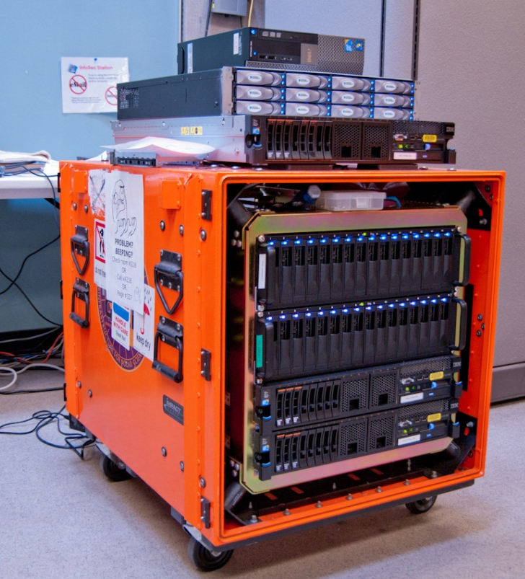
Field Cyberinfrastructure
Field cyberinfrastructure consisted of field servers to process data in real-time and storage arrays to back up data collected during each mission.
The spring 2011 Twin Otter field mission which concluded in May 2011 collected 13.4 TB of data.
The November 2011-January 2012 field missions collected 26.7 TB of data.
Initial analysis in first 24 hours allowing mission replanning is followed by detailed runs on PolarGrid facilities with disks transferred from field
Processing and storage equipment at McMurdo

Slide 6
PolarGrid Geospatial Data
26 million L2 records pointing to KU FTP sites for original L1B data
The flight path data are stored as two types of spatial objects: line and point in both the original (longitude, latitude) coordinates and the proper local projections for high-latitude region.
Geospatial data can be accessed through on-line data browser, Matlab, GIS software, Google Earth and other software which supports OGC (Open Geospatial Consortium) standards.
Raw data in ESRI shapefile, Spatialite, and PostgreSQL database are also available.

Slide 7
GIS Server Software Release
Supports expeditions and science analysis
First version released on Jan 8, 2012 (http://polargrid.org/polargrid/software-release)
On-line data browser demo is accessible at http://gf2.ucs.indiana.edu
All the flight path data are packed into GIS server for standalone operation.
GIS server is built on Ubuntu virtual machine (http://www.ubuntu.com/) with very low memory requirement; it can be carried on a USB drive.
We have successfully deployed the GIS server on Amazon EC2 cloud service with the minor updates on configuration, FutureGrid support is under development.

Slide 8
Components of GIS Server
GeoServer (http://geoserver.org) provides core GIS capabilities, and publishes data using the OGC standards
PostGreSQL (http://www.postgresql.org/) provides the data storage for GeoServer and direct geospatial database support through spatial SQL. (can use Spatialite)
Geoprocessing tools include Python scripts to import/output the flight path data in various formats.

Slide 9
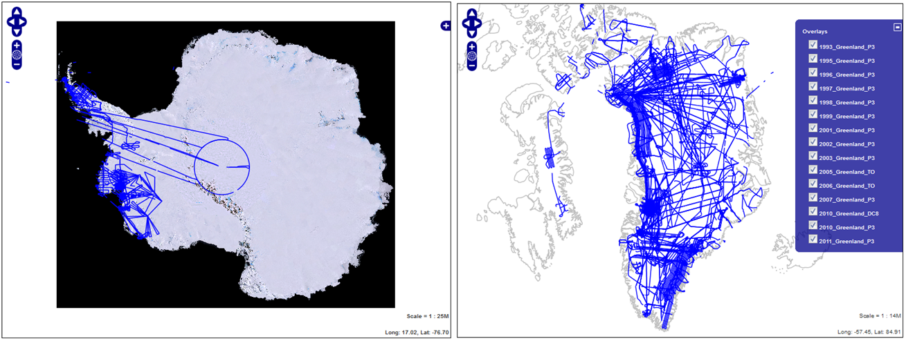
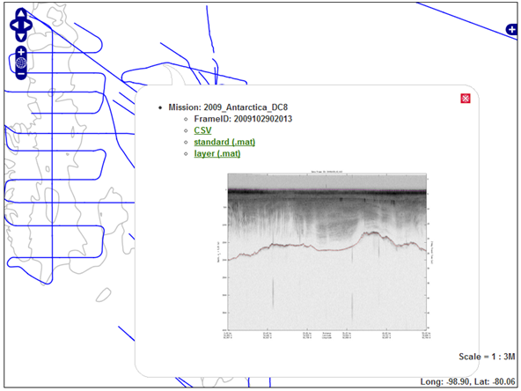
On-line Data Browser
Pure JavaScript application, highly customizable, easy to embedded in any website.
Provides direct data download links.

Slide 10
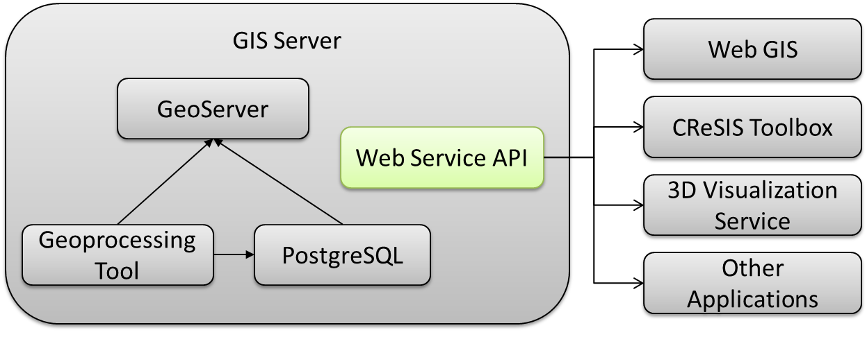
GIS Server New Development
Web Service API for the uniform GIS server access across different applications.
Hide complex GIS operation syntax from application developers.

Slide 11
Web Service API
Basic syntax: http://server/gistool?[service]&[dataset]&[operation]&[parameters]
Multiple output formats: csv, JSON, XML
Support on-line Web 2.0 application and Matlab application with the same API set.
Integration of CReSIS picker tool with Web Service API is under development.

Slide 12
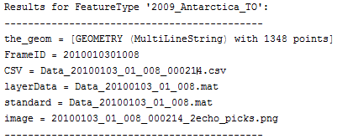
Web Service API Examples
Generate image overview: http://gisvm/gistool?data=2009_Antarctica_TO&format=png
Overview on the specific region by defined bounding box: bbox=-1483656,-514320,-1326158,-405480
Render overview with different style: styles=startend
Feature query, return flight path info if user clicked the image on x=400, y=300

Slide 13
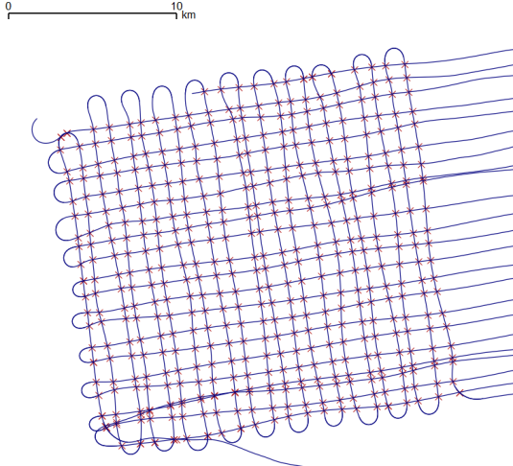
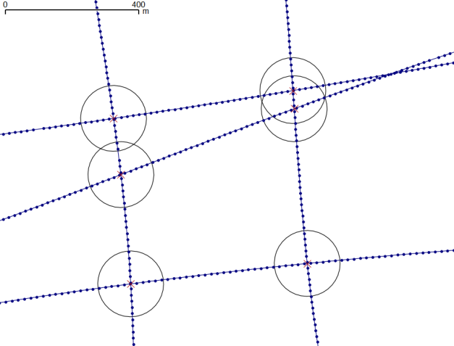
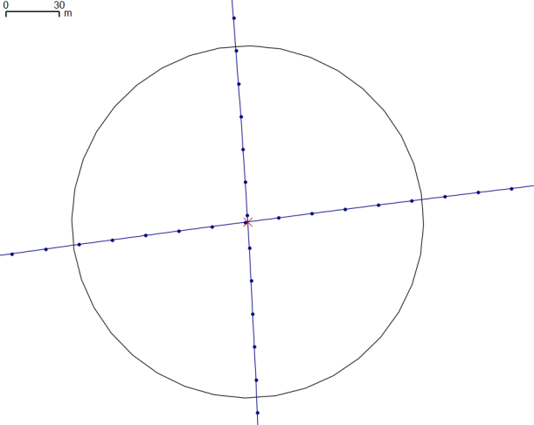
Web Service: Spatial Operation
Select data by location, region
Flight path intersection, Clip etc.
Nearest neighborhood search to path or point

Slide 14
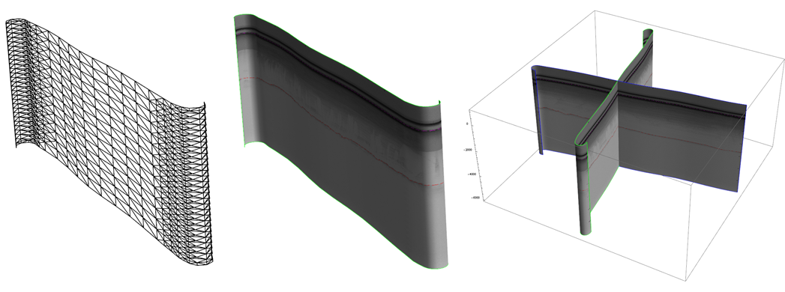
3D Visualizations
3D flight path model: a spline surface is constructed from flight path, and its radar image is used as the texture mapping.
Data are pulled from GIS server.
Expect to work with Denmark

Slide 15
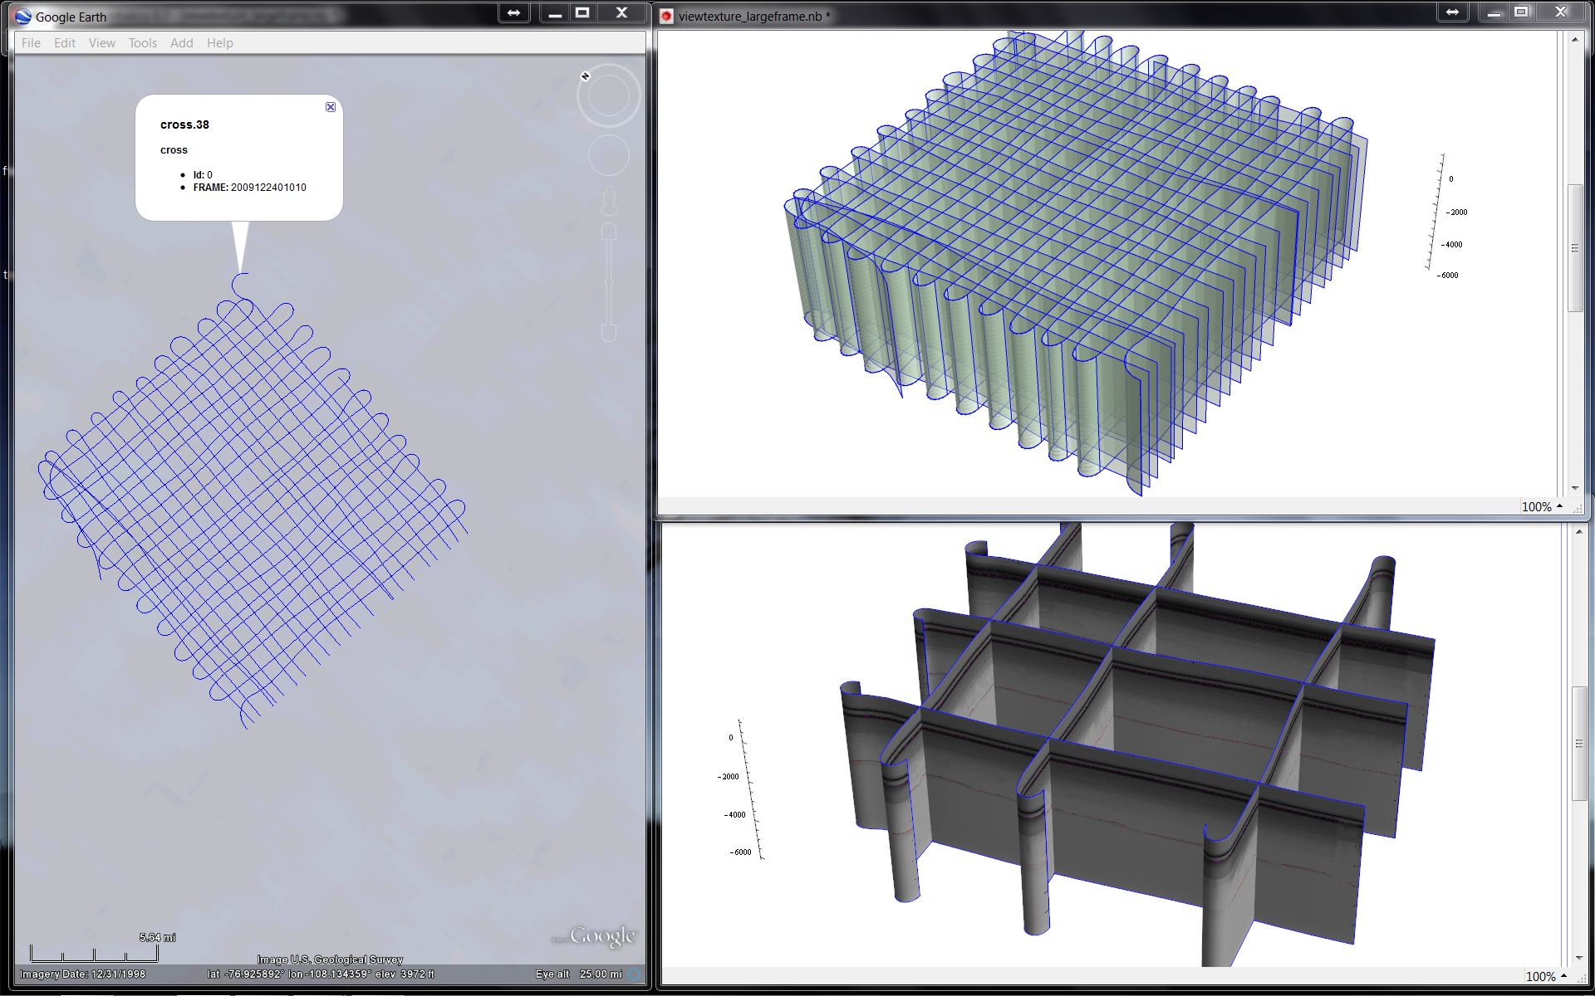
3D Visualizations

Slide 16
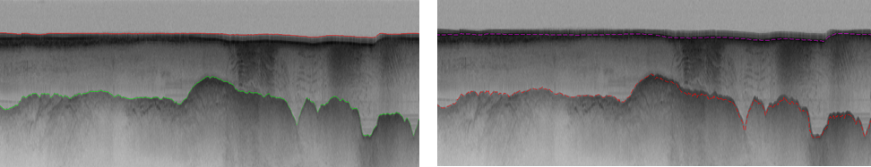
Automatic Layer Determination
Developed by David Crandall (on the faculty at Indiana University).
Hidden Markov Method based Layer Finding Algorithm.
A prototype tool was delivered to CReSIS; integrating into Geospatial data service
Automatic multiple layer tracing is under development.
Results from automatic layer finding algorithm (left) for glacier bed compared with current manual method (right)

Slide 17
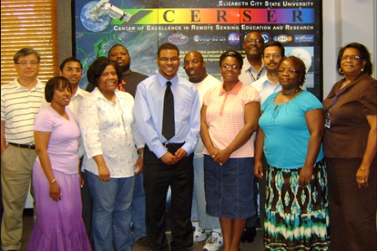
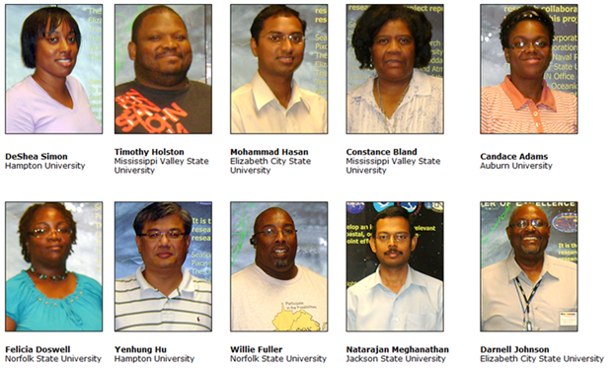
Cloudy View of Computing Workshop and Summer REU
A MapReduce bootcamp held from June 6-10 2011 at ECSU and used FutureGrid, taught by Jerome Mitchell (PhD. student), 10 HBCU faculty and students attended.
Follow up with ADMI participations at Science Cloud 2012 Summer School
Nine ADMI (including ECSU) HBCU undergraduates spent the 2010 summer at Indiana University in the summer REU program and 11 completed their 2011 summer research at Indiana University.

Slide 18
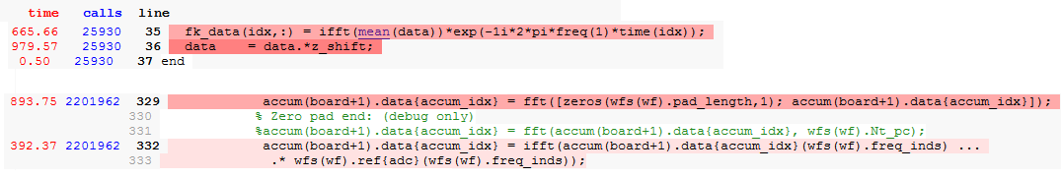
Improving Field Performance per power and weight
FFT and matrix operation are generally good for GPU accelerations.
Using FutureGrid’s GPU cloud
Evaluating I/O architecture and identifying parts of CReSIS toolbox suitable for GPU

Slide 19
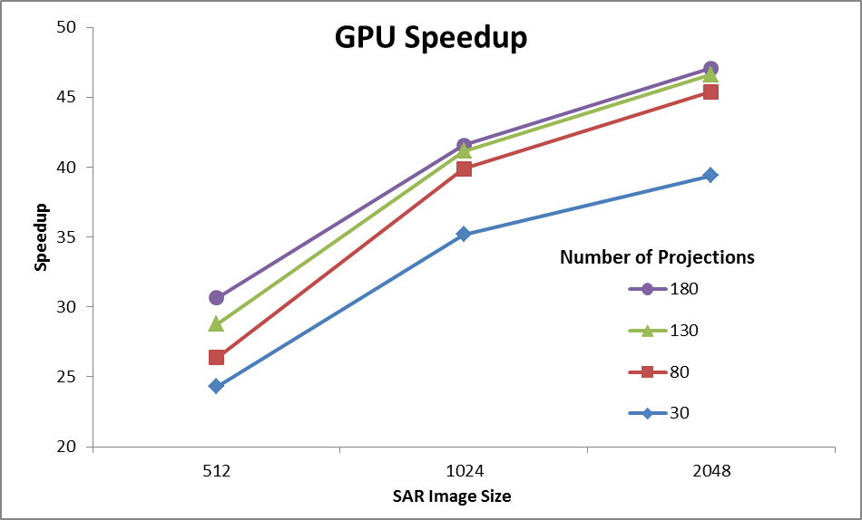
Early GPU Results
GPU computing part is written in C/C++ with the support of CUDA math library, and integrated with CReSIS toolbox through Maltab MEX interface
GPU performance speedup against CPU (single core usage) on back-projection algorithm

Slide 20


