Slide 1
DACIDR A Deterministic Annealing Clustering and Interpolative Dimension Reduction Method
Yang Ruan
PhD Candidate
Salsahpc Group
Community Grid Lab
Indiana University

Slide 2
Overview
Solve Taxonomy independent analysis problem for millions of data with a high accuracy solution.
Introduction to DACIDR
All-pair sequence alignment
Pairwise Clustering and Multidimensional Scaling
Interpolation
Visualization
SSP-Tree
Experiments

Slide 3
DACIDR Flow Chart
16S rRNA Data
Sample Set
Out-sample Set
All-Pair Sequence Alignment
Pairwise Clustering
Dissimilarity Matrix
Multidimensional Scaling
Sample Clustering Result
Heuristic Interpolation
Further Analysis
Target Dimension Result
Visualization

Slide 4
All-Pair Sequence Analysis
Input: FASTA File
Output: Dissimilarity Matrix
Use Smith Waterman alignment to perform local sequence alignment to determine similar regions between two nucleotide or protein sequences.
Use percentage identity as similarity measurement.
-
ACATCCTTAACAA - - ATTGC-ATC - AGT - CTA
$n_{ij}^{′}$=17
$δ_{ij}=1−\frac{n_{ij}^{′}}{n_{ij}}$ = 0.47
ACATCCTTAGC - - GAATT - - TATGAT - CACCA
$n_{ij}$=32

Slide 5
DACIDR Flow Chart
16S rRNA Data
Sample Set
Out-sample Set
All-Pair Sequence Alignment
Pairwise Clustering
Dissimilarity Matrix
Multidimensional Scaling
Sample Clustering Result
Heuristic Interpolation
Further Analysis
Target Dimension Result
Visualization

Slide 6
DA Pairwise Clustering
Input: Dissimilarity Matrix
Output: Clustering result
Deterministic Annealing clustering is a robust clustering method.
Temperature corresponds to pairwise distance scale and one starts at high temperature with all sequences in same cluster. As temperature is lowered one looks at finer distance scale and additional clusters are automatically detected.
No heuristic input is needed.

Slide 7
Multidimensional Scaling
Input: Dissimilarity Matrix
Output: Visualization Result (in 3D)
MDS is a set of techniques used in dimension reduction.
Scaling by Majorizing a Complicated Function (SMACOF) is a fast EM method for distributed computing.
DA introduce temperature into SMACOF which can eliminates the local optima problem.

Slide 8
DACIDR Flow Chart
16S rRNA Data
Sample Set
Out-sample Set
All-Pair Sequence Alignment
Pairwise Clustering
Dissimilarity Matrix
Multidimensional Scaling
Sample Clustering Result
Heuristic Interpolation
Further Analysis
Target Dimension Result
Visualization

Slide 9
Interpolation
Input: Sample Set Result/Out-sample Set FASTA File
Output: Full Set Result.
SMACOF uses O(N²) memory, which could be a limitation for million-scale dataset
MI-MDS finds k nearest neighbor (k-NN) points in the sample set for sequences in the out-sample set. Then use this k points to determine the out-sample dimension reduction result.
It doesn’t need O(N²) memory and can be pleasingly parallelized.

Slide 10
DACIDR Flow Chart
16S rRNA Data
Sample Set
Out-sample Set
All-Pair Sequence Alignment
Pairwise Clustering
Dissimilarity Matrix
Multidimensional Scaling
Sample Clustering Result
Heuristic Interpolation
Further Analysis
Target Dimension Result
Visualization

Slide 11
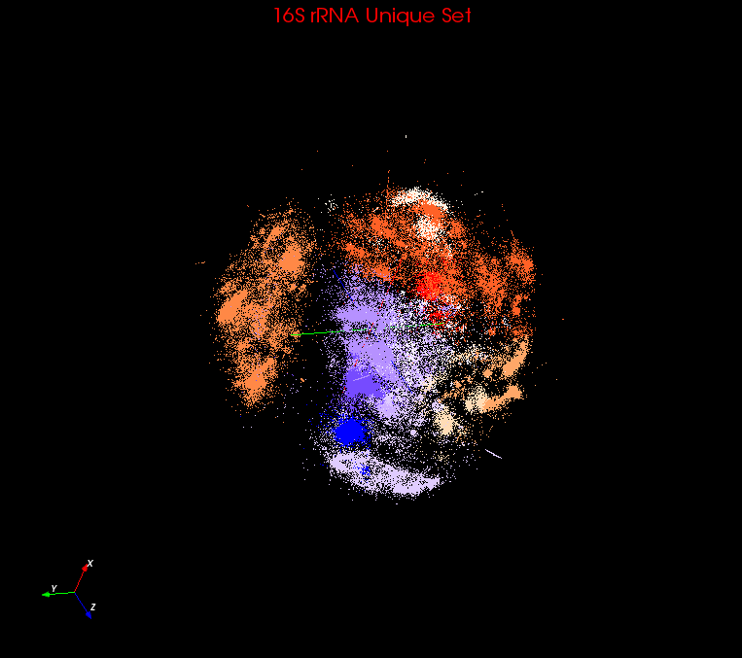
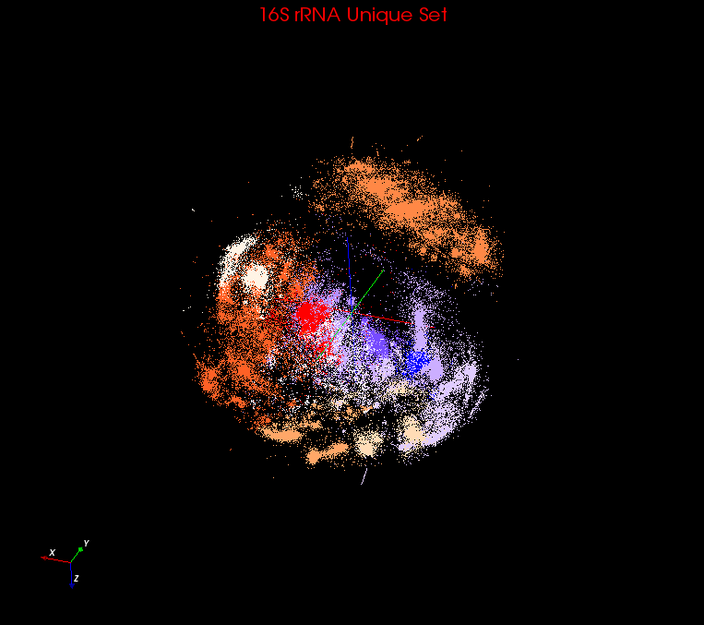
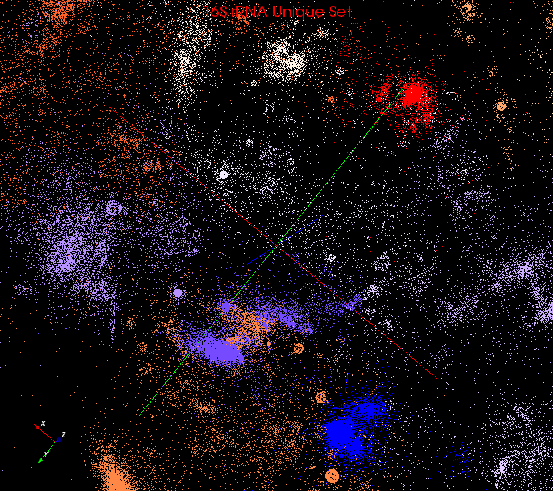
Visualization
Used PlotViz3 to visualize the 3D plot generated in previous step.
It can show the sequence name, highlight interesting points, even remotely connect to HPC cluster and do dimension reduction and streaming back result.
Rotate
Zoom in

Slide 12
SSP-Tree
Sample Sequence Partition Tree is a method inspired by Barnes-Hut Tree used in astrophysics simulations.
SSP-Tree is an octree to partition the sample sequence space in 3D.
i₀
i₁
e₄
e₅
i₂
E
F
e₀
e₁
e₂
e₃
e₆
e₇
A
B
C
D
G
H
a
An example for SSP-Tree in 2D with 8 points

Slide 13
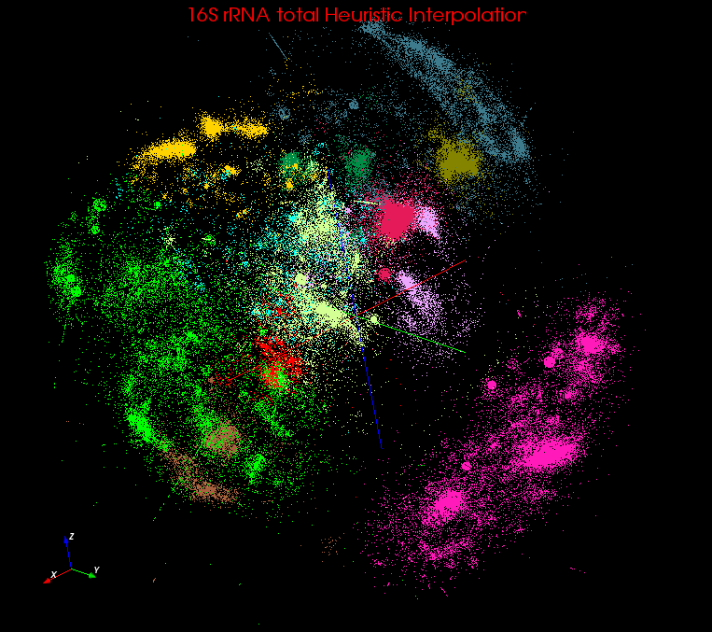
Heuristic Interpolation
MI-MDS has to compare every out-sample point to every sample point to find k-NN points
HI-MDS compare with each center point of each tree node, and searches k-NN points from top to bottom
HE-MDS directly search nearest terminal node and find k-NN points within that node or its nearest nodes.
Computation complexity
MI-MDS: O(NM)
HI-MDS: O(NlogM)
HE-MDS: O(N(N_{T} + M_{T}))
3D plot after HE-MI

Slide 14
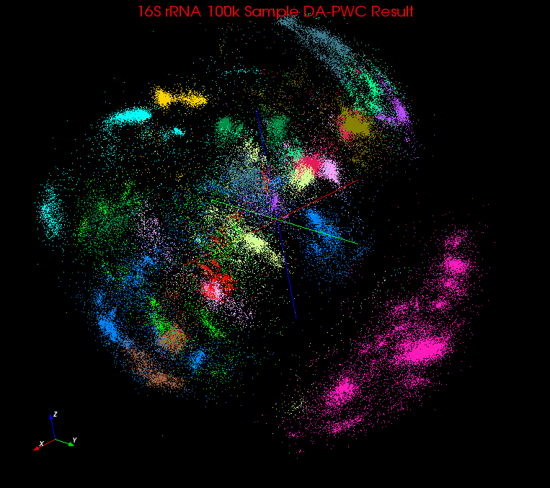
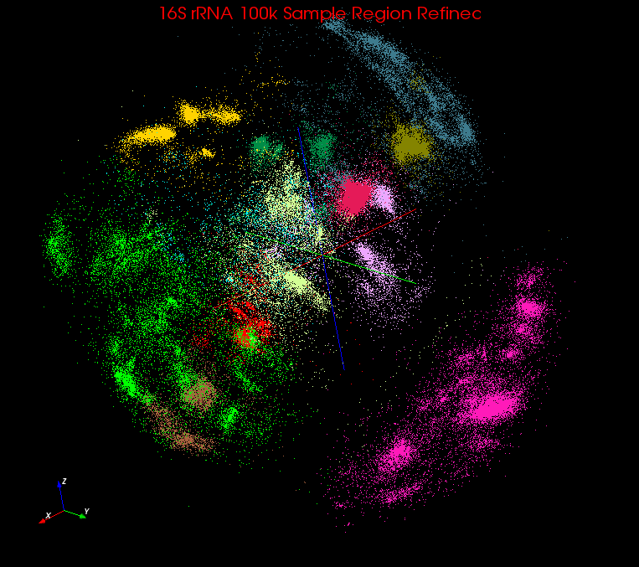
Region Refinement
Before
Terminal nodes can be divided into:
V: Inter-galactic void
U: Undecided node
G: Decided node
Take H(t) to determine if a terminal node t should be assigned to V
Take a fraction function F(t) to determine if a terminal node t should be assigned to G.
Update center points of each terminal node t at the end of each iteration.
After

Slide 15
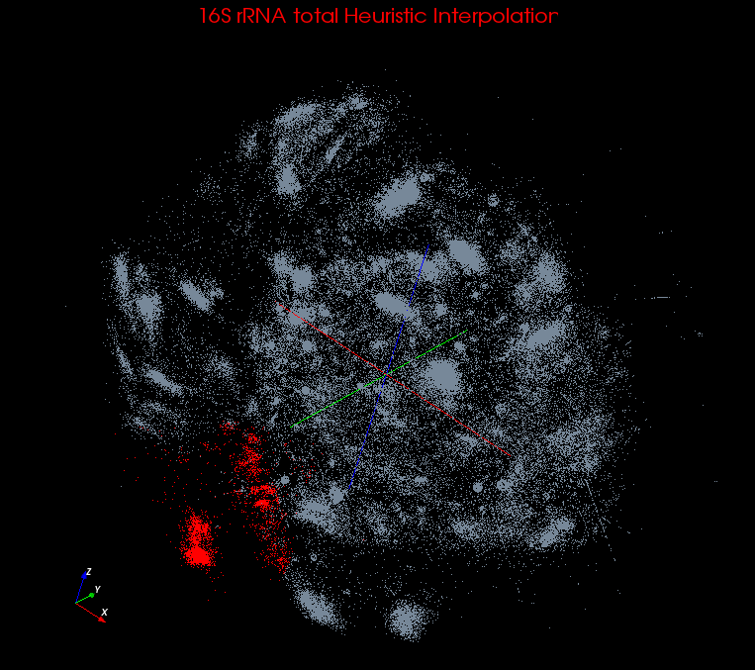
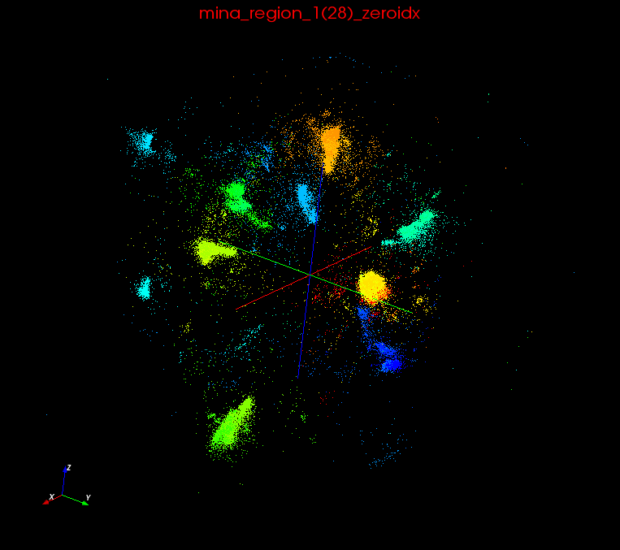
Recursive Clustering
DACIDR create an initial clustering result W = {w₁, w₂, w₃, … w_{r}}.
Possible Interesting Structures inside each mega region.
w₁ -> W₁’ = {w1₁’, w1₂’, w1₃’, …, w1_{r1}’};
w₂ -> W₂’ = {w2₁’, w2₂’, w2₃’, …, w2_{r2}’};
w₃ -> W₃’ = {w3₁’, w3₂’, w3₃’, …, w3_{r3}’};
…
w_{r} -> W_{r}’ = {wr₁’, wr₂’, wr₃’, …, wr_{rr}’};
Mega Region 1
Recursive Clustering

Slide 16
Experiments
Clustering and Visualization
Input Data: 1.1 million 16S rRNA data
Environment: 32 nodes (768 cores) of Tempest and 100 nodes (800 cores) of PolarGrid.
SW vs NW
PWC vs UCLUST/CDHIT
HE-MI vs MI-MDS/HI-MI

Slide 17
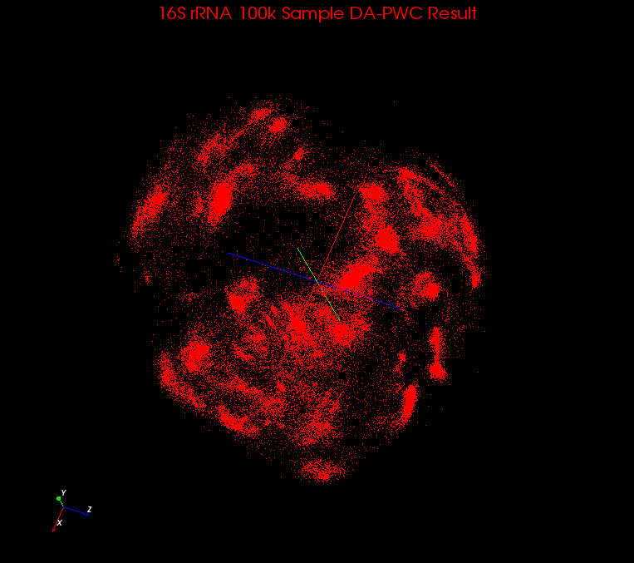
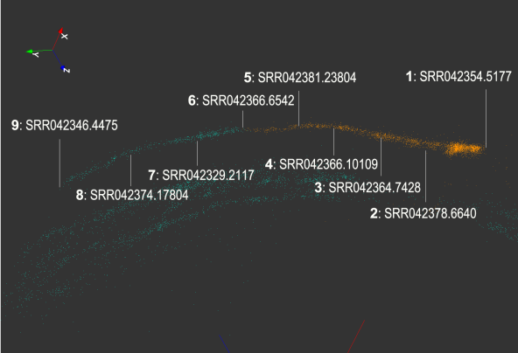
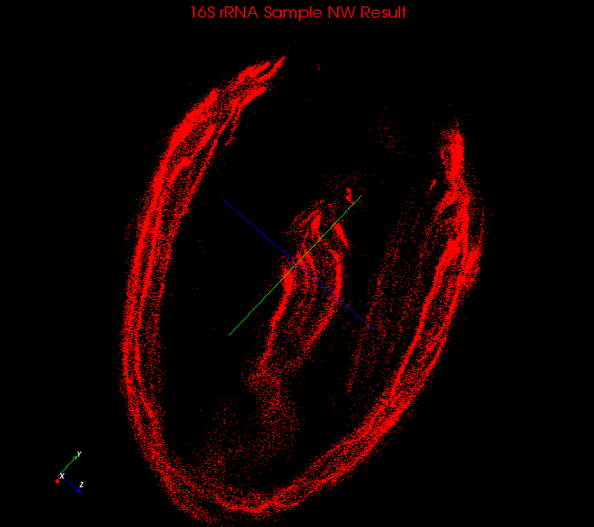
SW vs NW
SW
Smith Waterman performs local alignment while Needleman Wunsch performs global alignment.
Global alignment suffers problem from various lengths in this dataset
NW

Slide 18
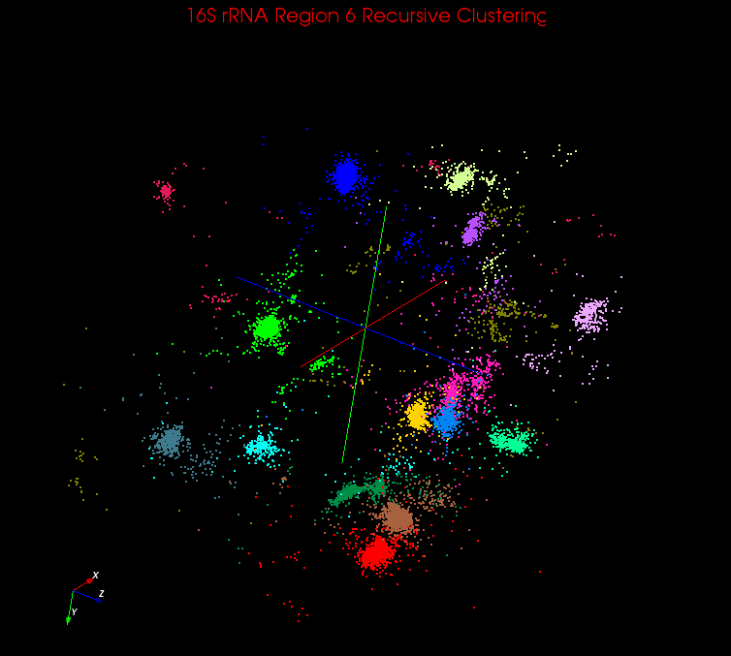
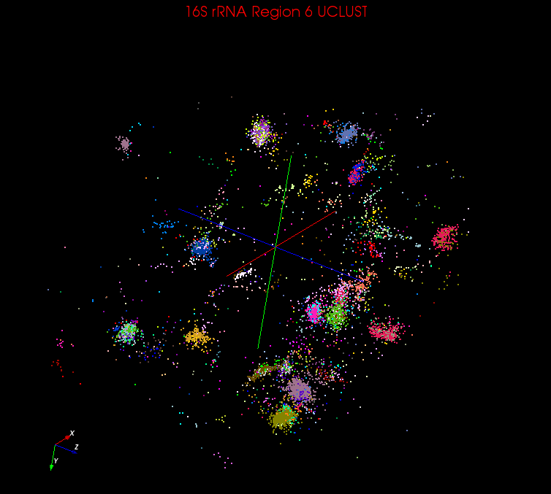
PWC vs UCLUST/CDHIT
PWC
PWC shows much more robust result than UCLUST and CDHIT
PWC has a high correlation with visualized clusters while UCLUST/CDHIT shows a worse result
UCLUST
 | PWC | UCLUST |  |  |  |  | CDHIT
Hard-cutoff Threshold | -- | 0.75 | 0.85 | 0.9 | 0.95 | 0.97 | 0.9 | 0.95 | 0.97
Number of A-clusters (number of clusters contains only one sequence) | 16 | 6 | 23 | 71(10) | 288(77) | 618(208) | 134(16) | 375(95) | 619(206)
Number of clusters uniquely identified | 16 | 2 | 9 | 8 | 9 | 4 | 3 | 2 | 1
Number of shared A-clusters | 0 | 4 | 2 | 1 | 0 | 0 | 0 | 0 | 0
Number of A-clusters in one V-cluster | 0 | 0 | 12 | 62(10) | 279(77) | 614(208) | 131(16) | 373(95) | 618(206)

Slide 19
HE-MI vs MI-MDS/HI-MI
Input set: 100k subset from 1.1 million data
Environment: 32 nodes (256 cores) from PolarGrid
Compared time and normalized stress value:
$$σ\left(X\right)=\sum_{i<j≤N}{\frac{1}{\sum_{i<j}{δ_{ij}}}}{(d_{ij}(X)−δ_{ij})}^{2}$$

Slide 20
Conclusion
By using SSP-Tree inside DACIDR, we sucessfully clustered and visualized 1.1 million 16S rRNA data
Distance measurement is important in clustering and visualization as SW and NW will give quite different answers when sequence lengths varies.
DA-PWC performs much better than UCLUST/CDHIT
HE-MI has a slight higher stress value than MI-MDS, but is almost 100 times faster than the latter one, which makes it suitable for massive scale dataset.

Slide 21
Futurework
We are experimenting using different techniques choosing reference set from the clustering result we have.
To do further study about the taxonomy-independent clustering result we have, phylogenetic tree are generated with some sequences selected from known samples.
Visualized phylogenetic tree in 3D to help biologist better understand it.

Slide 22
Questions?

