Slide 1
Training Data Scientists
DELSA Workshop DW4
May 17 2013 Washington DC
Geoffrey Fox
gcf@indiana.edu
Informatics, Computing and Physics
Digital Science Center, Pervasive Technology Institute
Indiana University Bloomington

Slide 2
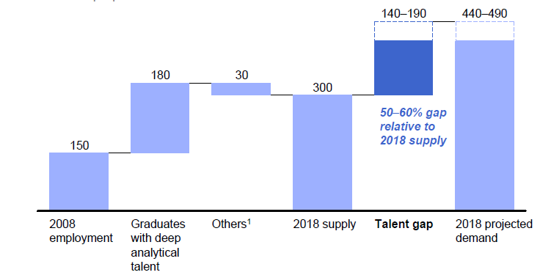
McKinsey Institute on Big Data Jobs
There will be a shortage of talent necessary for organizations to take advantage of big data. By 2018, the United States alone could face a shortage of 140,000 to 190,000 people with deep analytical skills as well as 1.5 million managers and analysts with the know-how to use the analysis of big data to make effective decisions.

Slide 3
Data Science Education
Broad Range of Topics from Policy to curation to applications and algorithms, programming models, data systems, statistics, and broad range of CS subjects such as Clouds, Programming, HCI,
Plenty of Jobs and broader range of possibilities than computational science but similar cosmic issues
What type of degree (Certificate, minor, track, “real” degree)
What implementation (department, interdisciplinary group supporting education and research program)

Slide 4
Massive Open Online Courses (MOOC)
MOOC’s are very “hot” these days with Udacity and Coursera as start-ups; perhaps over 100,000 participants
Relevant to Data Science as this is a new field with few courses at most universities
Typical model is collection of short prerecorded segments (talking head over PowerPoint) of length ~10 minutes
These “lesson objects” can be viewed as “songs”
Google Course Builder (python open source) builds customizable MOOC’s as “playlists” of “songs”
Tells you to capture all material as “lesson objects”
DELSA builds a repository of its “songs”; used in many ways – tutorials, classes …

Slide 5
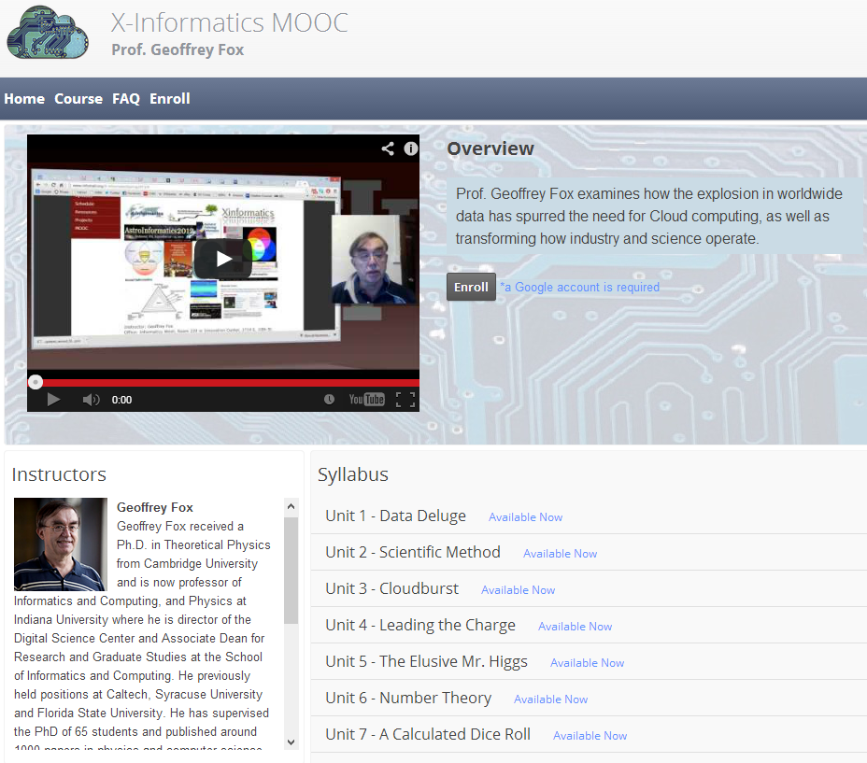

Slide 6
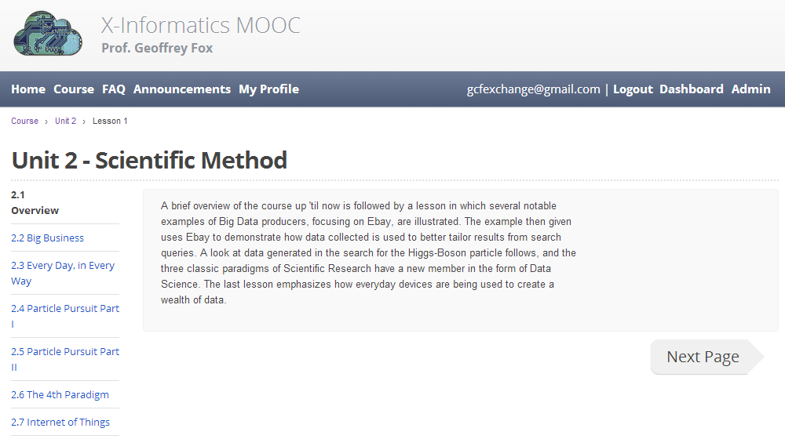
Seven ~10 minutes lesson objects in this lecture
IU wants us to close caption if use in real course

Slide 7
MOOC’s for Traditional Lectures
We can take MOOC lessons and view them as a “lesson object” that we can share between different teachers
i.e. as a way of teaching typical sized classes but with less effort as shared material
Start with what’s in repository;
pick and choose;
Add custom material of individual teachers
The ~15 minute Video over PowerPoint of MOOC’s easy to re-use
Defining how to support computing labs with FutureGrid or appliances + Virtual Box
Qiu will offer Cloud MOOC module to HBCU’s
Building MOOC Tutorial
https://docs.google.com/document/d/1n4dPIdvHNcNMEnak6cKKZGLSulQxeo40HeAOdGy-05M/edit

Slide 8
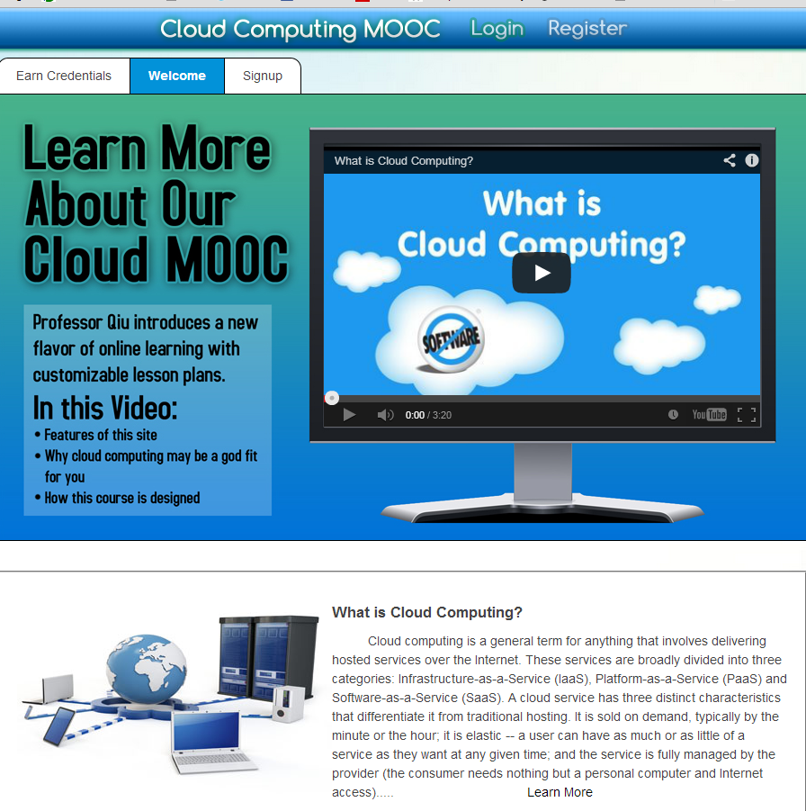
Can of course build many different interfaces
Songs stored on YouTube
Songs prepared with Adobe Presenter on Laptop

