Slide 1
Large Scale DNA Sequence Analysis and Biomedical Computing using
MapReduce, MPI and Threading
Workshop on Enabling Data-Intensive Computing: from Systems to Applications
July 30-31, 2009, Pittsburgh
Judy Qiu
xqiu@indiana.edu www.infomall.org/salsa
Community Grids Laboratory,
Digital Science Center
Indiana University

Slide 2
Collaboration in SALSA Project
Microsoft Research
Technology Collaboration
Dryad
Roger Barga
Christophe Poulain
CCR (Threading)
George Chrysanthakopoulos
DSS
Henrik Frystyk Nielsen
Indiana University
SALSA Team
Geoffrey Fox
Xiaohong Qiu
Scott Beason
Jaliya Ekanayake
Thilina Gunarathne
Thilina Gunarathne
Jong Youl Choi
Yang Ruan
Seung-Hee Bae
Others
Application Collaboration
Bioinformatics, CGB
Haiku Tang, Mina Rho,
Peter Cherbas, Qunfeng Dong
IU Medical School
Gilbert Liu
Demographics (GIS)
Neil Devadasan
Cheminformatics
Rajarshi Guha (NIH), David Wild
Physics
CMS group at Caltech (Julian Bunn)
Community Grids Lab
and UITS RT – PTI

Slide 3
Data Intensive (Science) Applications
1) Data starts on some disk/sensor/instrument
  It needs to be partitioned; often partitioning natural from source of data
2) One runs a filter of some sort extracting data of interest and (re)formatting it
  Pleasingly parallel with often “millions” of jobs
  Communication latencies can be many milliseconds and can involve disks
3) Using same (or map to a new) decomposition, one runs a parallel application that could require iterative steps between communicating processes or could be pleasing parallel
  Communication latencies may be at most some microseconds and involves shared memory or high speed networks
Workflow links 1) 2) 3) with multiple instances of 2) 3)
  Pipeline or more complex graphs
Filters are “Maps” or “Reductions” in MapReduce language

Slide 4






“File/Data Repository” Parallelism
Instruments
Map = (data parallel) computation reading and writing data
Reduce = Collective/Consolidation phase e.g. forming multiple global sums as in histogram
Communication via Messages/Files
Portals
/Users
Disks
Map₁
Map₂
Map₃
Reduce
Computers/Disks

Slide 5
Data Analysis Examples
LHC Particle Physics analysis: File parallel over events
  Filter1: Process raw event data into “events with physics parameters”
  Filter2: Process physics into histograms using ROOT or equivalent
  Reduce2: Add together separate histogram counts
  Filter 3: Visualize
Bioinformatics - Gene Families: Data parallel over sequences
  Filter1: Calculate similarities (distances) between sequences
  Filter2: Align Sequences (if needed)
  Filter3: Cluster to find families and/or other statistical tools
  Filter 4: Apply Dimension Reduction to 3D
  Filter5: Visualize

Slide 6
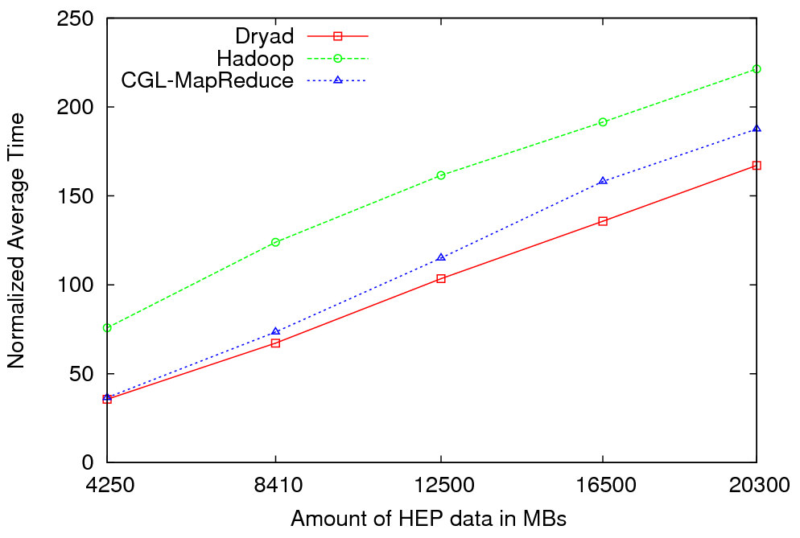

Particle Physics (LHC) Data Analysis
MapReduce for LHC data analysis
LHC data analysis, execution time vs. the volume of data (fixed compute resources)
Root running in distributed fashion allowing analysis to access distributed data

Slide 7

Reduce Phase of Particle Physics
“Find the Higgs” using Dryad
Combine Histograms produced by separate Root “Maps” (of event data to partial histograms) into a single Histogram delivered to Client

Slide 8
Notes on Performance
Speed up = T(1)/T(P) = ε (efficiency ) P
  with P processors
Overhead f = (PT(P)/T(1)-1) = (1/ε -1)
is linear in overheads and usually best way to record results if overhead small
For MPI communication f ∝ ratio of data communicated to calculation complexity = n^{-0.5} for matrix multiplication where n (grain size) matrix elements per node
MPI Communication Overheads decrease in size as problem sizes n increase (edge over area rule)
Dataflow communicates all data – Overhead does not decrease
Scaled Speed up: keep grain size n fixed as P increases
Conventional Speed up: keep Problem size fixed n ∝ 1/P
VMs and Windows Threads have runtime fluctuation /synchronization overheads

Slide 9
Gene Sequencing Application
This is first filter in Alu Gene Sequence study – find Smith Waterman dissimilarities between genes
Essentially embarrassingly parallel
Note MPI faster than threading
All 35,229 sequences require 624,404,791 pairwise distances = 2.5 hours with some optimization
This includes calculation and needed I/O to redistribute data)
Parallel Overhead =
(Number of Processes/Speedup) - 1
Two data
set sizes

Slide 10
Some Other File Parallel Examples from Indiana University Biology Dept.
EST (Expressed Sequence Tag) Assembly: 2 million mRNA sequences generates 540000 files taking 15 hours on 400 TeraGrid nodes (CAP3 run dominates)
MultiParanoid/InParanoid gene sequence clustering: 476 core years just for Prokaryotes
Population Genomics: (Lynch) Looking at all pairs separated by up to 1000 nucleotides
Sequence-based transcriptome profiling: (Cherbas, Innes) MAQ, SOAP
Systems Microbiology (Brun) BLAST, InterProScan
Metagenomics (Fortenberry, Nelson) Pairwise alignment of 7243 16s sequence data took 12 hours on TeraGrid
All can use Dryad

Slide 11
CAP3 Results
Results obtained using using two clusters running at IU and Microsoft. Each cluster has 32 nodes and so each node has 8 cores. There is a total of 256 cores.
Cap3 is a sequence assembly program that operates on a collection of gene sequence files which produce several output files.
In parallel implementations, the input files are processed concurrently and the outputs are saved in a predefined location.
As a comparison, we have implemented this application using Hadoop, CGL-MapReduce (enhanced Hadoop) and Dryad.

Slide 12
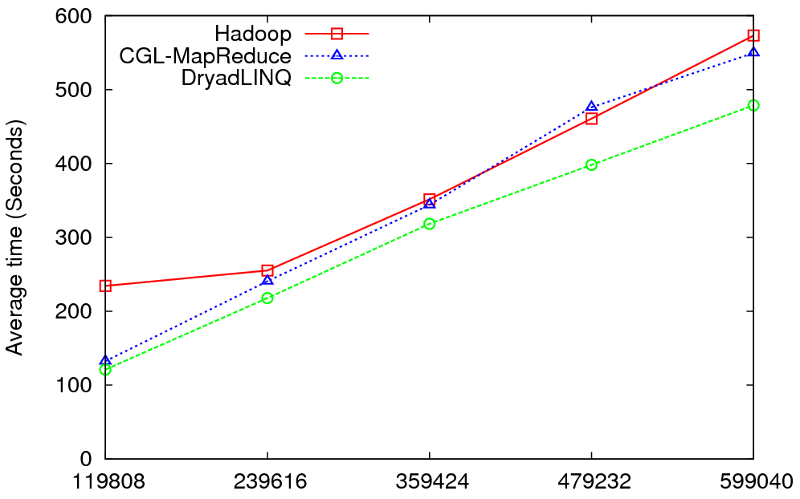
CAP3 Results
Number of CAP3 Files

Slide 13
Data Intensive Architecture
Instruments
User Data
Files
Files
Files
Visualization
User Portal
Knowledge
Discovery
Users
Files
Files
Files
Initial
Processing
Higher Level
Processing
Such as R
PCA, Clustering
Correlations …
Maybe MPI
Prepare for
Viz
MDS

Slide 14
Why Gather/ Scatter Operation Important
There is a famous factor of 2 in many O(N²) parallel algorithms
We initially calculate in parallel Distance(i,j) between points (sequences) i and j.
  Done in parallel over all processor nodes for say i < j
However later parallel algorithms may want specific Distance(i,j) in specific machines
Our MDS and PWClustering algorithms require each of N processes has 1/N of sequences and for this subset {i} Distance({i},j) for ALL j. i.e. wants both Distance(i,j) and Distance(j,i) stored (in different processors/disk)
The different distributions of Distance(i,j) across processes is in MPI called a scatter or gather operation. This time is included in previous SW timings and is about half total time
  We did NOT get good performance here from either MPI (it should be a seconds on Petabit/sec Infiniband switch) or Dryad
  We will make needed primitives precise and greatly improve performance here

Slide 15
High Performance Robust Algorithms
We suggest that the data deluge will demand more robust algorithms in many areas and these algorithms will be highly I/O and compute intensive
Clustering N= 200,000 sequences using deterministic annealing will require around 750 cores and this need scales like N²
NSF Track 1 – Blue Waters in 2011 – could be saturated by 5,000,000 point clustering

Slide 16
High end Multi Dimension scaling MDS
Given dissimilarities D(i,j), find the best set of vectors x_{i} in d (any number) dimensions minimizing
Σ_{i,j} weight(i,j) (D(i,j) – |x_{i} – x_{j}|^{n})² (*)
Weight chosen to refelect importance of point or perhaps a desire (Sammon’s method) to fit smaller distance more than larger ones
n is typically 1 (Euclidean distance) but 2 also useful
Normal approach is Expectation Maximation and we are exploring adding deterministic annealing to improve robustness
Currently mainly note (*) is “just” γ² and one can use very reliable nonlinear optimizers
  We have good results with Levenberg–Marquardt approach to γ² solution (adding suitable multiple of unit matrix to nonlinear second derivative matrix). However EM also works well
We have some novel features
  Fully parallel over unknowns x_{i}
  Allow “incremental use”; fixing MDS from a subset of data and adding new points
  Allow general d, n and weight(i,j)
  Can optimally align different versions of MDS (e.g. different choices of weight(i,j) to allow precise comparisons
Feeds directly to powerful Point Visualizer

Slide 17
Deterministic Annealing Clustering
Clustering methods like Kmeans very sensitive to false minima but some 20 years ago an EM (Expectation Maximization) method using annealing (deterministic NOT Monte Carlo) developed by Ken Rose (UCSB), Fox and others
Annealing is in distance resolution – Temperature T looks at distance scales of order T^{0.5}.
Method automatically splits clusters where instability detected
Highly efficient parallel algorithm
Points are assigned probabilities for belonging to a particular cluster
Original work based in a vector space e.g. cluster has a vector as its center
Major advance 10 years ago in Germany showed how one could use vector free approach – just the distances D(i,j) at cost of O(N²) complexity.
We have extended this and implemented in threading and/or MPI
We will release this as a service later this year followed by vector version
  Gene Sequence applications naturally fit vector free approach.

Slide 18
Key Features of our Approach
Initially we will make key capabilities available as services that we eventually be implemented on virtual clusters (clouds) to address very large problems
  Basic Pairwise dissimilarity calculations
  R (done already by us and others)
  MDS in various forms
  Vector and Pairwise Deterministic annealing clustering
Point viewer (Plotviz) either as download (to Windows!) or as a Web service
Note all our code written in C# (high performance managed code) and runs on Microsoft HPCS 2008 (with Dryad extensions)

Slide 19
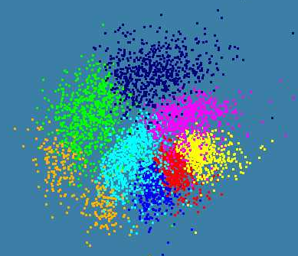
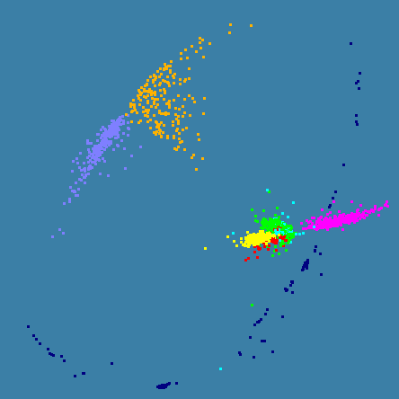
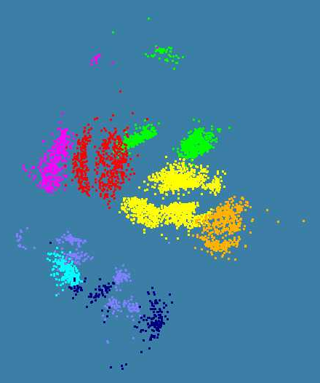
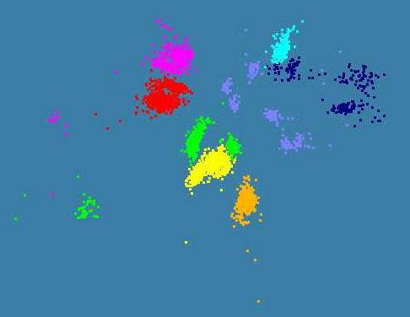
Various Alu Sequence Results showing Clustering and
MDS
4500 Points : Pairwise Aligned
3000 Points : Clustal MSA
Kimura2 Distance
4500 Points : Clustal MSA
Map distances to 4D Sphere before MDS

Slide 20
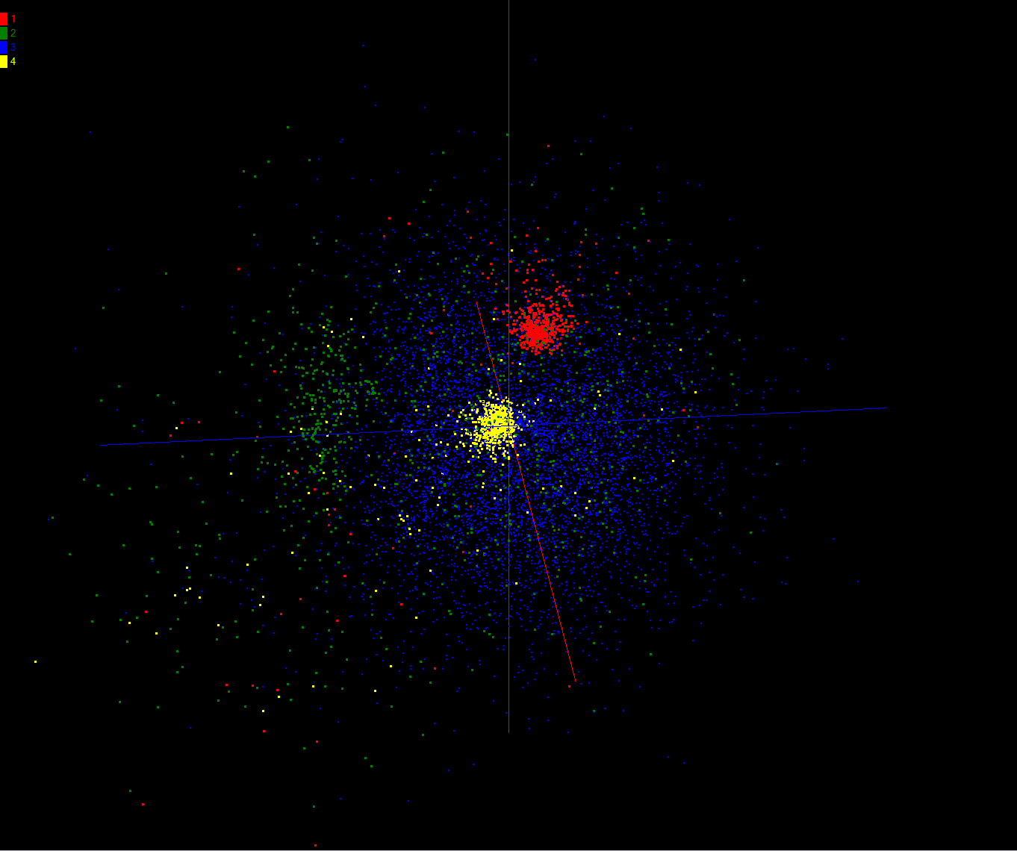
Pairwise Clustering of 35229 Sequences
Initial Clustering of 35229 Sequences showing first four clusters identified with different colors
The Pairwise clustering using MDS on same sample to display results. It used all 768 cores from Tempest Windows cluster
Further work will improve clustering. Investigate sensitivity to alignment (Smith Waterman) and give performance details

Slide 21
PWDA Parallel Pairwise data clustering
by Deterministic Annealing run on 24 core computer
Parallel
Overhead
Intra-node
MPI
Inter-node
MPI
Threading
Parallel Pattern (Thread X Process X Node)

Slide 22
Parallel Pairwise Clustering PWDA
Speedup Tests on eight 16-core Systems (6 Clusters, 10,000 Patient Records)
Threading with Short Lived CCR Threads
Parallel Overhead
Parallel Patterns (# Thread /process) x (# MPI process /node) x (# node)

Slide 23
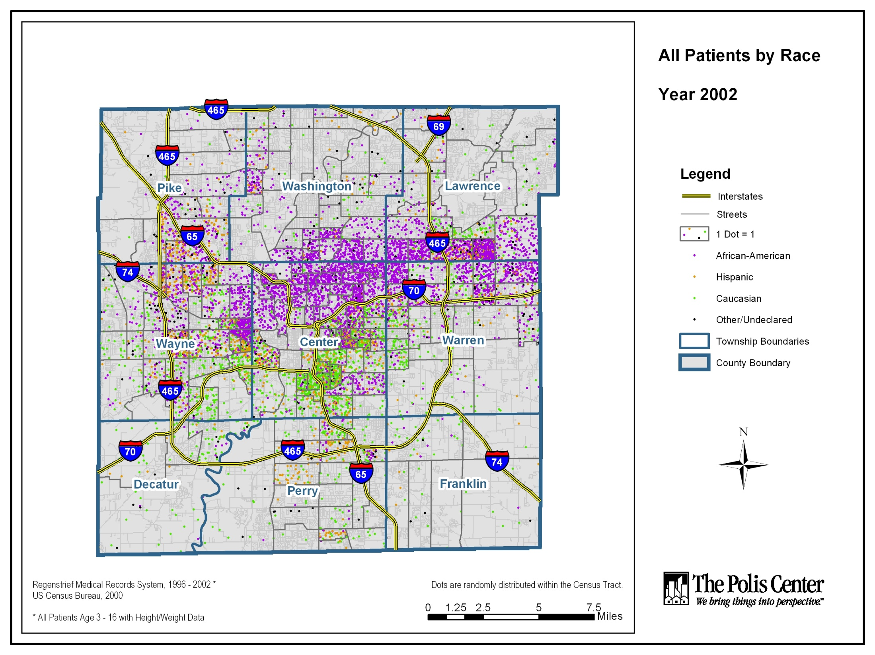

Slide 24
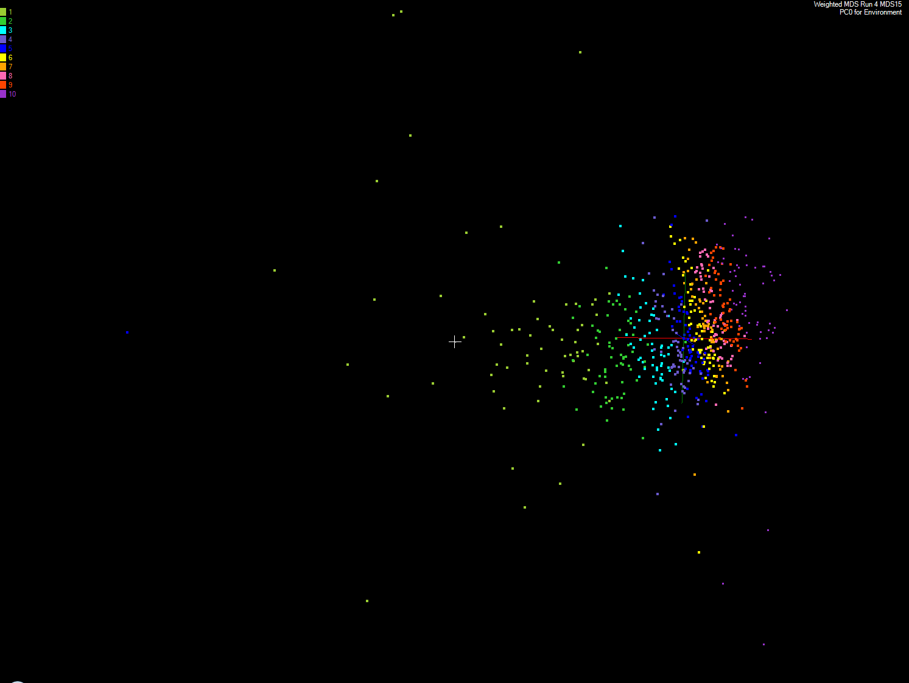
MDS and Primary PCA Vector
MDS of 635 Census Blocks with 97 Environmental Properties
Shows expected Correlation with Principal Component – color varies from greenish to reddish as projection of leading eigenvector changes value
Ten color bins used

Slide 25
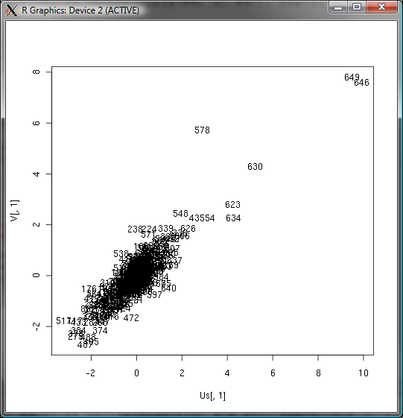
Canonical Correlation
Choose vectors a and b such that the random variables U = a^{T}.X and V = b^{T}.Y maximize the correlation
ρ= cor(a^{T}.X, b^{T}.Y).
X Environmental Data
Y Patient Data
Use R to calculate ρ = 0.76

Slide 26
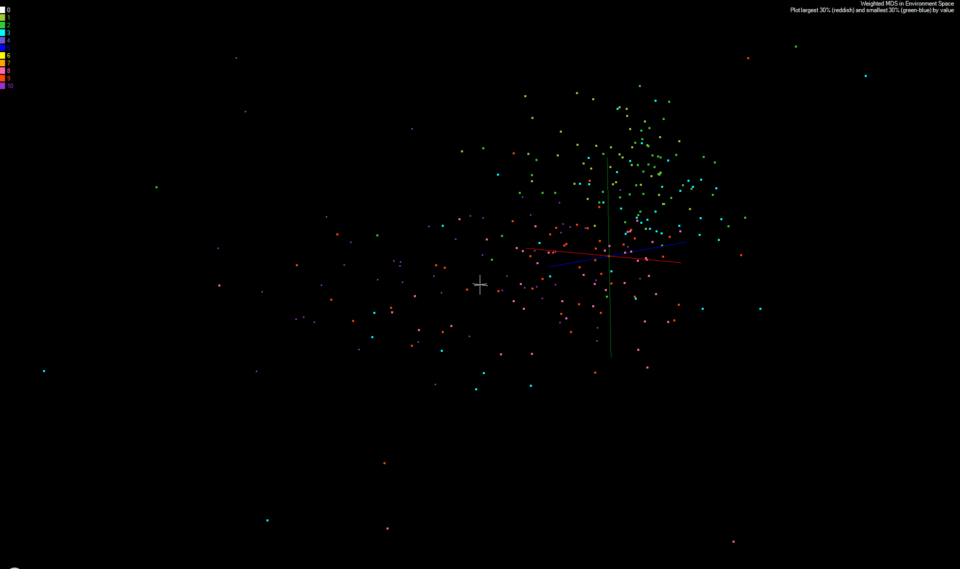
MDS and Canonical Correlation
Projection of First Canonical Coefficient between Environment and Patient Data onto Environmental MDS
Keep smallest 30% (green-blue) and top 30% (red-orchid) in numerical value
Remove small values < 5% mean in absolute value

Slide 27
References
K. Rose, "Deterministic Annealing for Clustering, Compression, Classification, Regression, and Related Optimization Problems," Proceedings of the IEEE, vol. 80, pp. 2210-2239, November 1998
T Hofmann, JM Buhmann Pairwise data clustering by deterministic annealing, IEEE Transactions on Pattern Analysis and Machine Intelligence 19, pp1-13 1997
Hansjörg Klock and Joachim M. Buhmann Data visualization by multidimensional scaling: a deterministic annealing approach Pattern Recognition Volume 33, Issue 4, April 2000, Pages 651-669
Granat, R. A., Regularized Deterministic Annealing EM for Hidden Markov Models, Ph.D. Thesis, University of California, Los Angeles, 2004. We use for Earthquake prediction
Geoffrey Fox, Seung-Hee Bae, Jaliya Ekanayake, Xiaohong Qiu, and Huapeng Yuan, Parallel Data Mining from Multicore to Cloudy Grids, Proceedings of HPC 2008 High Performance Computing and Grids Workshop, Cetraro Italy, July 3 2008
Project website: www.infomall.org/salsa

