Slide 1
Digital Science Center
February 12, 2010, Bloomington
Geoffrey Fox
Judy Qiu
gcf@indiana.edu www.infomall.org
School of Informatics and Computing
and Community Grids Laboratory,
Digital Science Center
Pervasive Technology Institute
Indiana University

Slide 2
PTI Activities in Digital Science Center
Community Grids Laboratory led by Fox
Gregor von Lazewski: FutureGrid architect, GreenIT
Marlon Pierce: Grids, Services, Portals including Earthquake Science, Chemistry and Polar Science applications
Judy Qiu: Multicore and Data Intensive Computing (Cyberinfrastructure) including Biology and Cheminformatics applications
Open Software Laboratory led by Andrew Lumsdaine
Software like MPI, Scientific Computing Environments
Parallel Graph Algorithms
Complex Networks and Systems led by Alex Vespignani
Very successful H1N1 spread simulations run on Big Red
Can be extended to other epidemics and to “critical infrastructure” simulations such as transportation

Slide 3
FutureGrid
September 10, 2009 Press Release
BLOOMINGTON, Ind. -- The future of scientific computing will be developed with the leadership of Indiana University and nine national and international partners as part of a $15 million project largely supported by a $10.1 million grant from the National Science Foundation (NSF). The award will be used to establish FutureGrid—one of only two experimental systems (other one is GPU enhanced cluster) in the NSF Track 2 program that funds the most powerful, next-generation scientific supercomputers in the nation.
http://uitspress.iu.edu/news/page/normal/11841.html

Slide 4
FutureGrid
FutureGrid is part of TeraGrid – NSF’s national network of supercomputers – and is aimed at providing a distributed testbed of ~9 clusters for both application and computer scientists exploring
Clouds
Grids
Multicore and architecture diversity
Testbed enabled by virtual machine technology including virtual network
Dedicated network connects allowing experiments to be isolated
Modest number of cores (5000) but will be relatively large as a Science Cloud

Slide 5
Add 768 core Windows Server at IU and Network Fault Generator

Slide 6
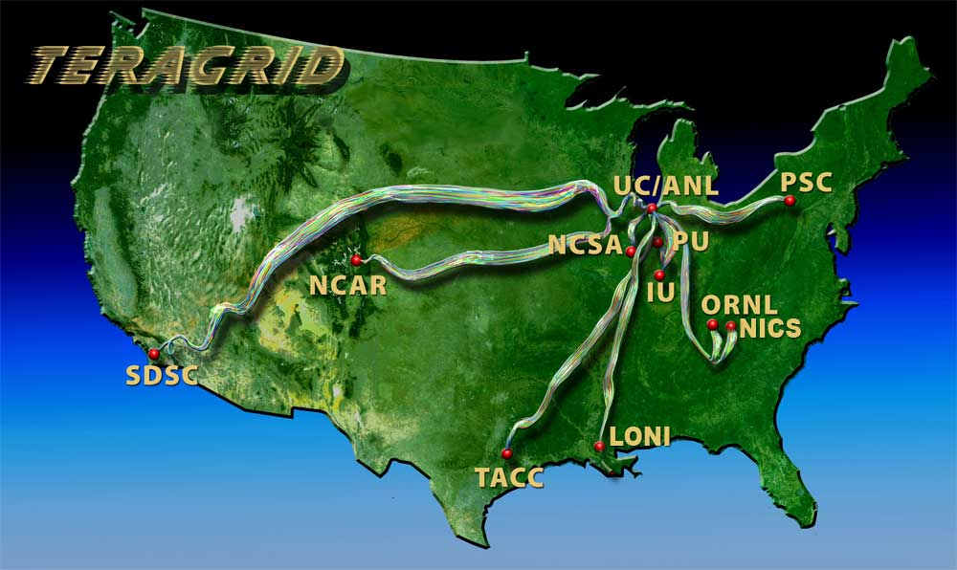
Indiana University is already part of base TeraGrid through Big Red and services

Slide 8
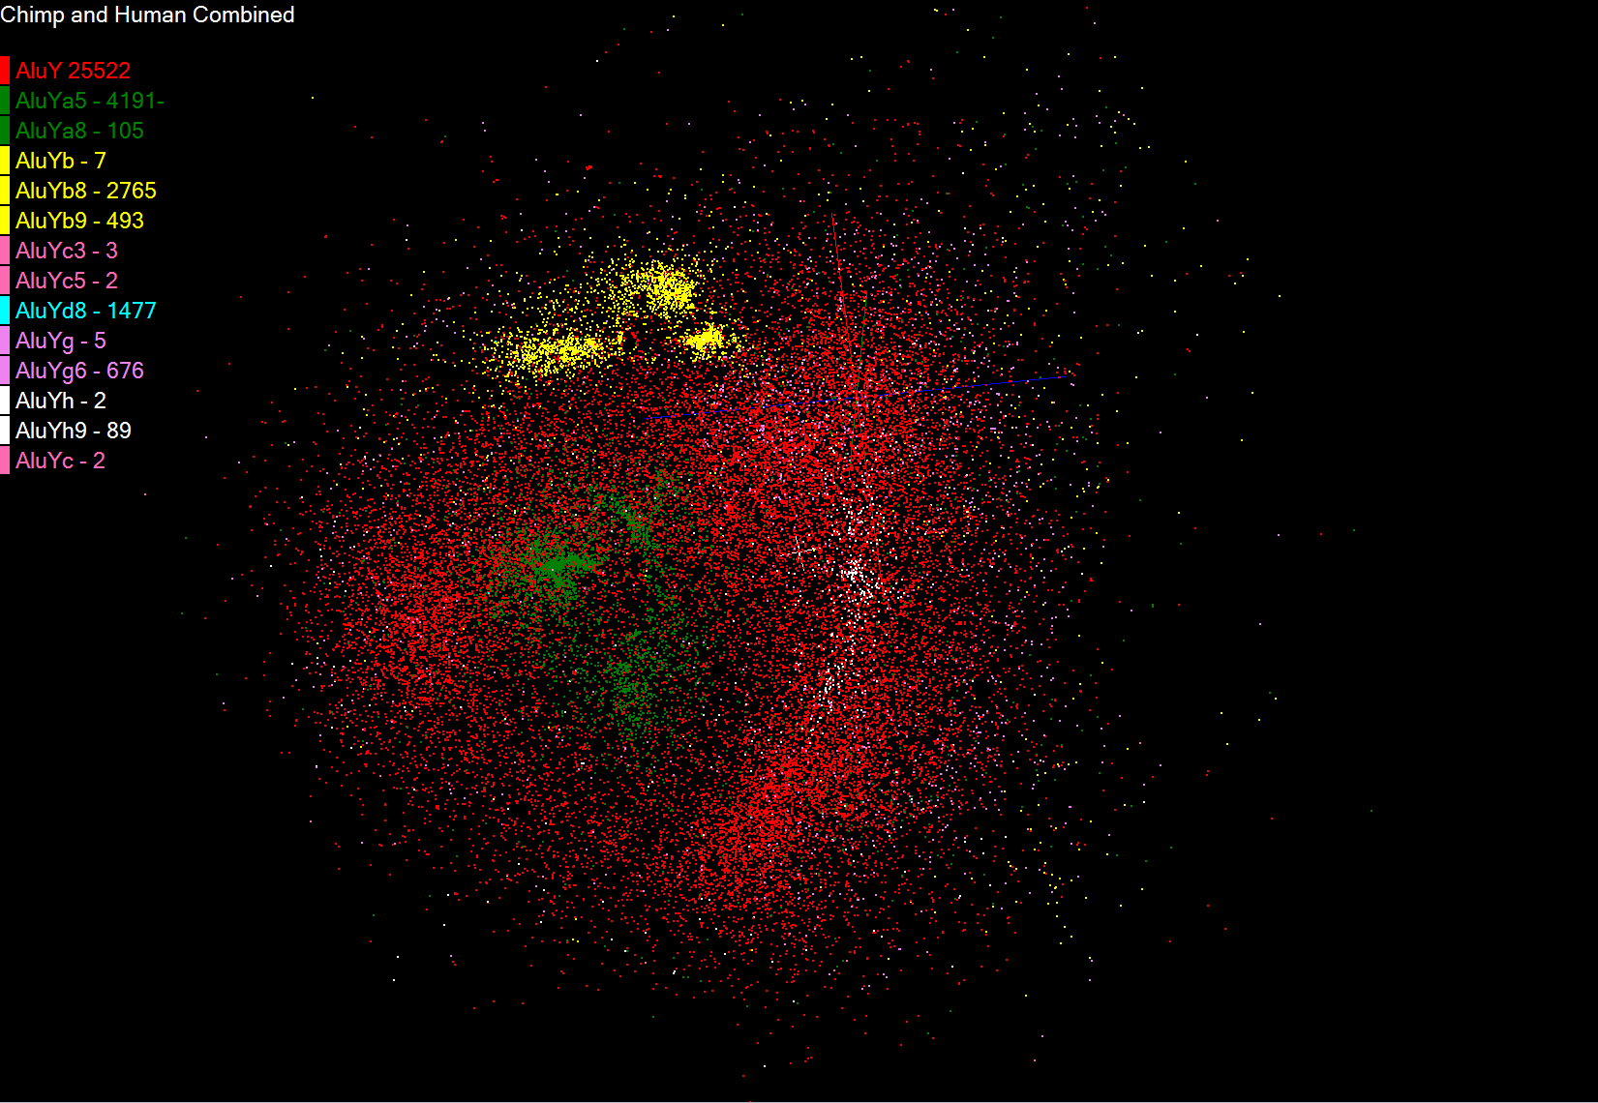
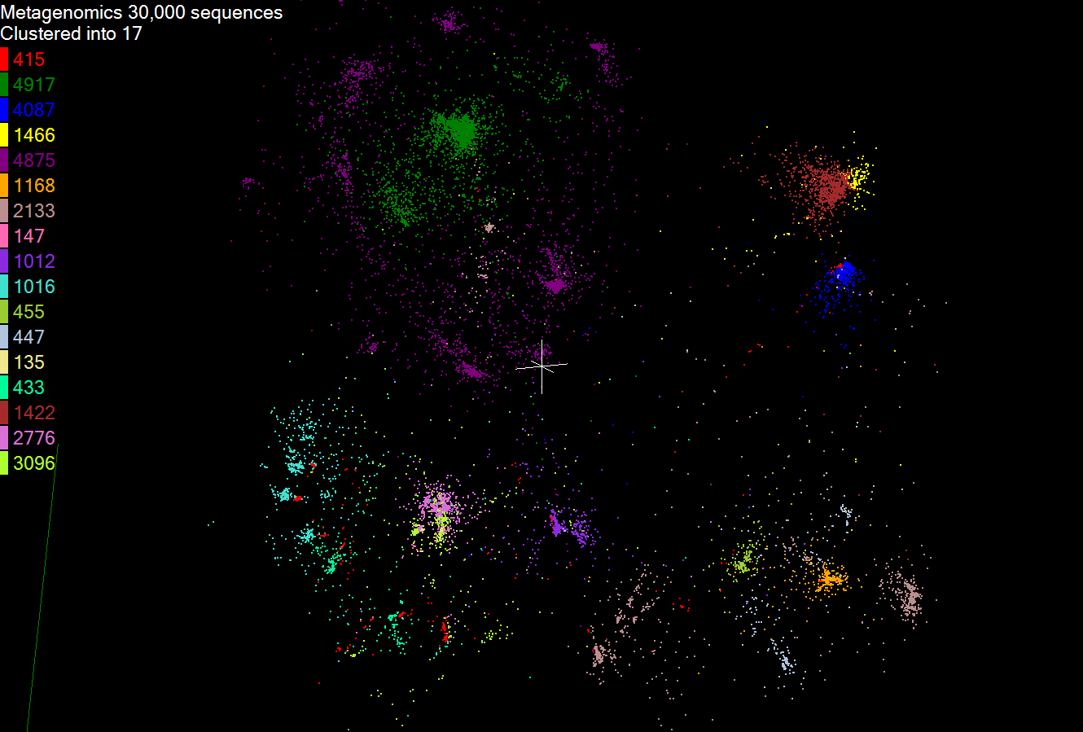
Biology MDS and Clustering Results
Alu Families
This visualizes results of Alu repeats from Chimpanzee and Human Genomes. Young families (green, yellow) are seen as tight clusters. This is projection of MDS dimension reduction to 3D of 35399 repeats – each with about 400 base pairs
Metagenomics
This visualizes results of dimension reduction to 3D of 30000 gene sequences from an environmental sample. The many different genes are classified by clustering algorithm and visualized by MDS dimension reduction

Slide 9
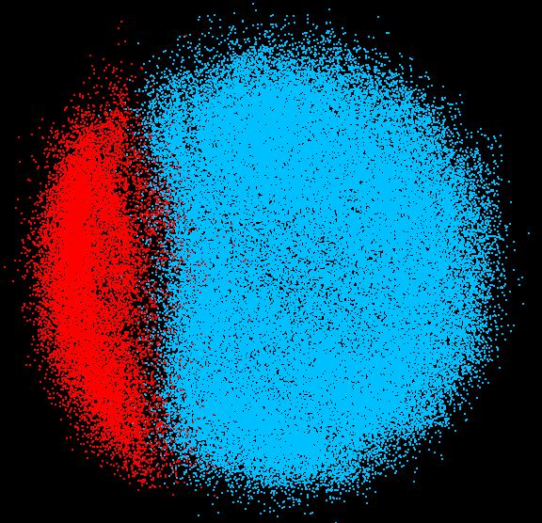
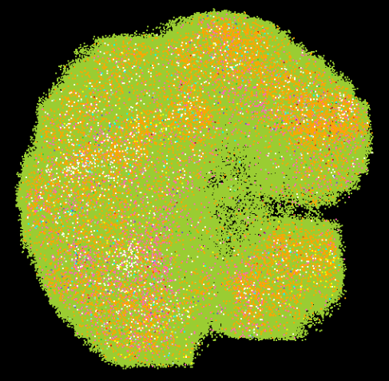
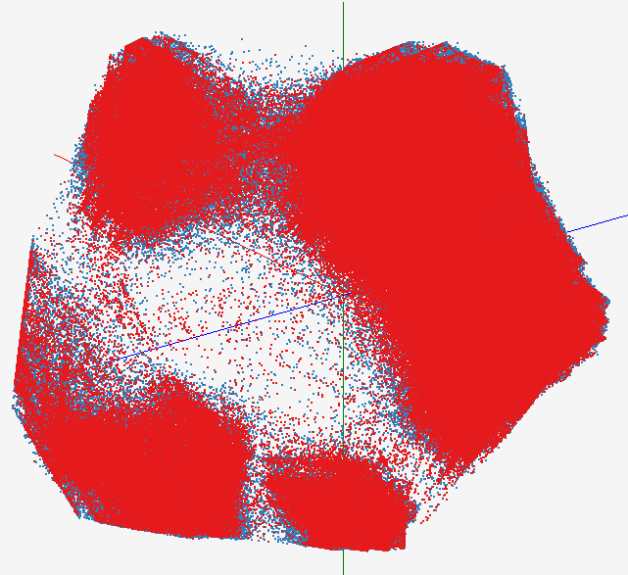
High Performance Data Visualization
Developed parallel MDS and GTM algorithm to visualize large and high-dimensional data
Processed 0.1 million PubChem data having 166 dimensions
Parallel interpolation can process up to 2M PubChem points
GTM with interpolation for 2M PubChem data
2M PubChem data is plotted in 3D with GTM interpolation approach. Red points are 100k sampled data and blue points are 4M interpolated points.
MDS for 100k PubChem data
100k PubChem data having 166 dimensions are visualized in 3D space. Colors represent 2 clusters separated by their structural proximity.
GTM for 930k genes and diseases
Genes (green color) and diseases (others) are plotted in 3D space, aiming at finding cause-and-effect relationships.
[3] PubChem project, http://pubchem.ncbi.nlm.nih.gov/

Slide 10
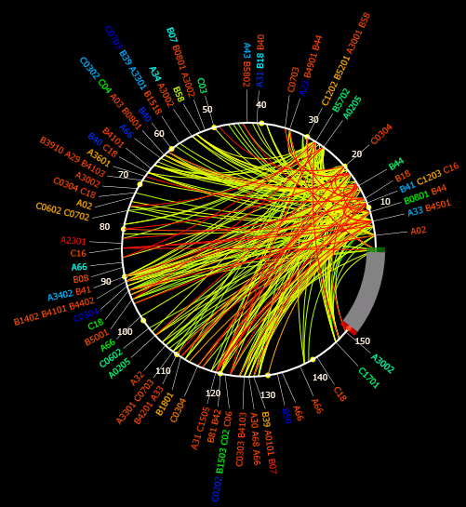
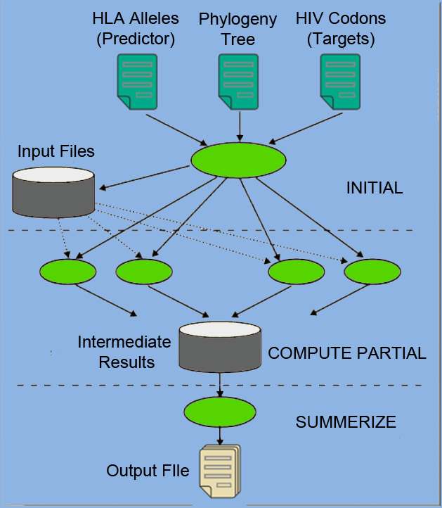
Applications using Dryad & DryadLINQ (2)
PhyloD [2] project from Microsoft Research
Output of PhyloD shows the associations
Derive associations between HLA alleles and HIV codons and between codons themselves
Scalability of DryadLINQ PhyloD Application
[5] Microsoft Computational Biology Web Tools, http://research.microsoft.com/en-us/um/redmond/projects/MSCompBio/

Slide 11
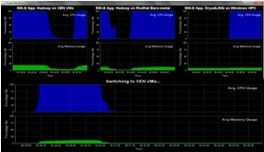
Dynamic Virtual Clusters
Dynamic Cluster Architecture
Monitoring & Control Infrastructure
Monitoring Infrastructure
Monitoring Interface
Pub/Sub Broker Network
SW-G Using Hadoop
SW-G Using Hadoop
SW-G Using DryadLINQ
Linux
Bare-system
Linux on Xen
Windows Server 2008 Bare-system
Virtual/Physical Clusters
Summarizer
XCAT Infrastructure
XCAT Infrastructure
Switcher
iDataplex Bare-metal Nodes
(32 nodes)
iDataplex Bare-metal Nodes
Switchable clusters on the same hardware (~5 minutes between different OS such as Linux+Xen to Windows+HPCS)
Support for virtual clusters
SW-G : Smith Waterman Gotoh Dissimilarity Computation as an pleasingly parallel problem suitable for MapReduce style applications

Slide 12
SALSA HPC Dynamic Virtual Clusters Demo
At top, these 3 clusters are switching applications on fixed environment. Takes ~30 Seconds.
At bottom, this cluster is switching between Environments – Linux; Linux +Xen; Windows + HPCS. Takes about ~7 minutes.
It demonstrates the concept of Science on Clouds using a FutureGrid cluster.

